Slide 1
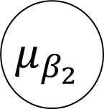

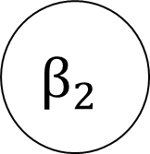


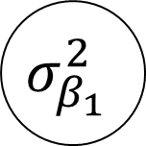
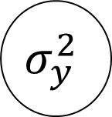
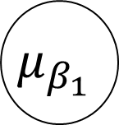

$$μ_{β_{1}}$$
$$X$$
$$β_{1}$$
$$σ_{β_{1}}^{2}$$
y
$$σ_{y}^{2}$$
$$μ_{β_{2}}$$
$$β_{2}$$
$$σ_{β_{2}}^{2}$$
$$n_{j}$$
J

Slide 2
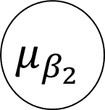

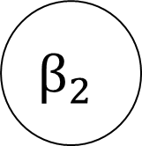
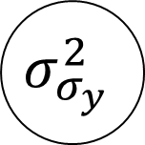




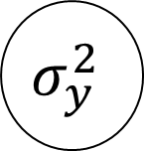
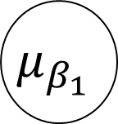

$$μ_{β_{1}}$$
$$X$$
$$β_{1}$$
$$μ_{σ_{y}}$$
$$σ_{β_{1}}^{2}$$
y
$$σ_{y}^{2}$$
$$μ_{β_{2}}$$
$$σ_{σ_{y}}^{2}$$
$$β_{2}$$
$$σ_{β_{2}}^{2}$$
J
$$n_{j}$$

