Slide 1
Designing Neural Network Architectures Using Reinforcement Learning
Presented by: Andrew Low
CS 294 | 2/23/2019

Slide 2
Outline
Problem
Background
Reformulating the Problem
Key Results
Improvements and Limitations
Discussion and Impact
3
5
9
14
17
18

Slide 3
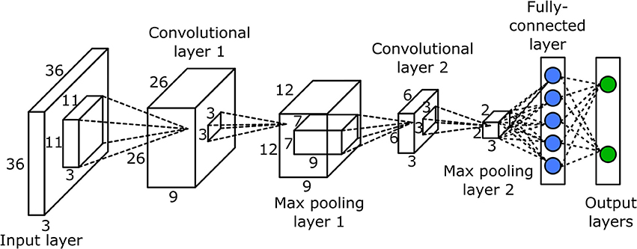
Context
Neural Networks are powerful and increasingly popular
Many different network architectures exist - without a clear winner
Architecture depends on the domain

Slide 4
Problem
Convolutional neural network architecture design today
Large search space
Most novel architectures are hand-designed, motivated by theoretical insights and experimental intuition of experts
Slow and expensive!
How to efficiently find optimal neural net architectures?

Slide 5
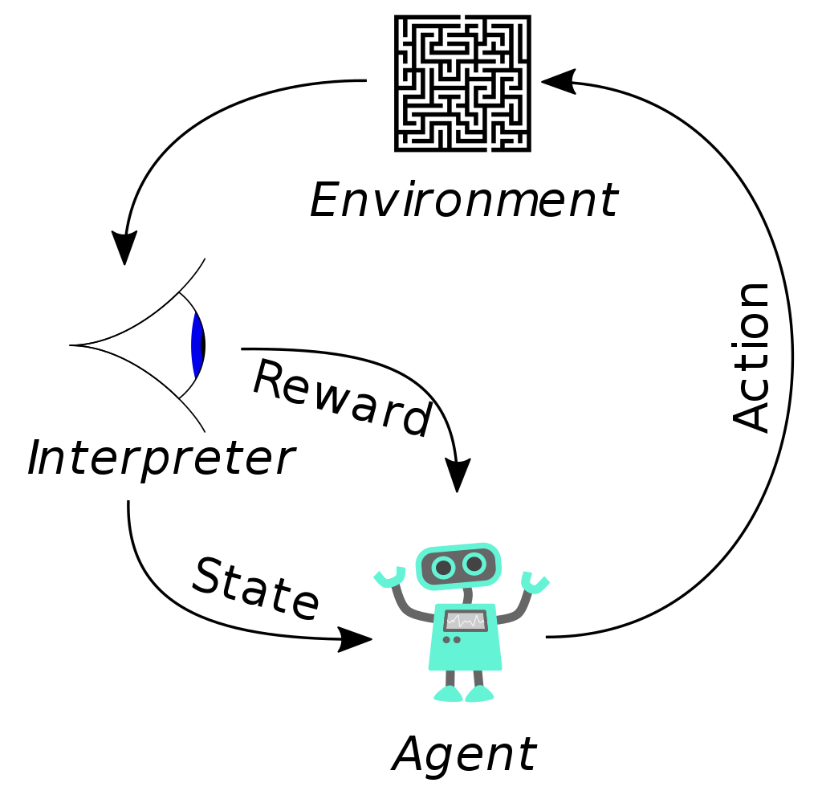
Background - Reinforcement Learning Recap
State space S, action space U, and reward distribution R.
Rewards may be delayed and/or sparse - require a sequence of correct actions
Goal: Find the optimal policy that maximizes our expected reward (Find optimal path on a MDP with a finite horizon)

Slide 6

Background - Q Learning
Difficult to know the actual value function, so we approximate the value function using Q values
Model free and Off-policy
As the agent explores the state and action spaces, it learns about its environment and retains that knowledge via Q values
Notes:
Each (state, action) tuple is associated with its own Q-value
Image Credits: CS188 https://inst.eecs.berkeley.edu/~cs188/sp19/assets/slides/lecture7.pdf

Slide 7
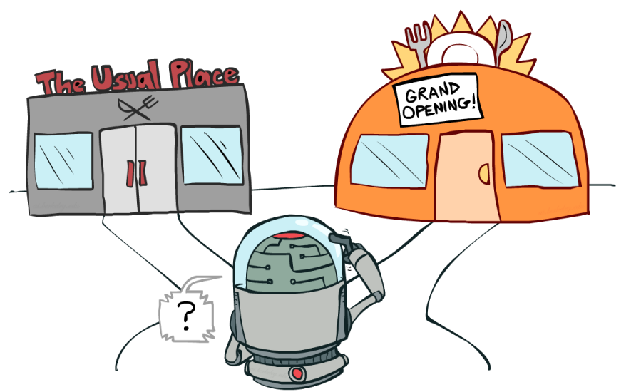
Background - Exploration and Exploitation
Exploration: when an agent tries new actions and states to learn about its environment
Exploitation: when an agent utilizes what it knows to take the best path possible
Too much exploration -> slow convergence
Too much exploitation -> converge to local optima
ε-learning: Higher ε means more exploration
Notes:
Image Credits: CS188 https://inst.eecs.berkeley.edu/~cs188/sp19/assets/slides/lecture7.pdf

Slide 8
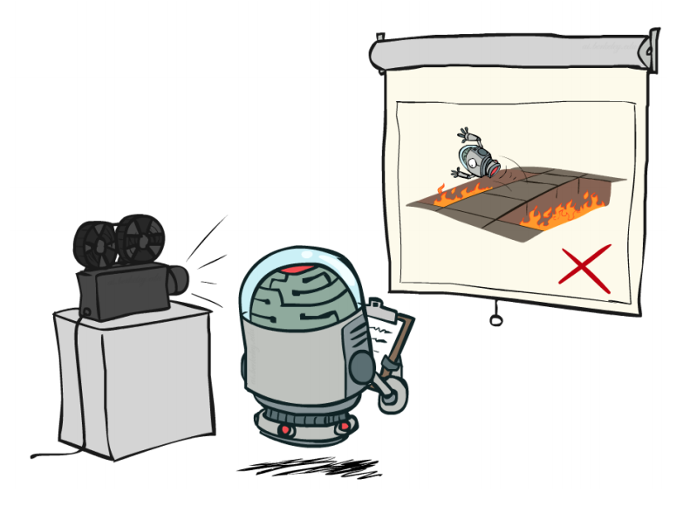
Background - Experience Replay
Generating data for reinforcement learning can be costly - and many RL algorithms require lots of data
We store each (state, action, reward, new state) in a database
Can then ‘replay’ past experiences by randomly sampling from the database
Notes:
Enables efficient reuse of past experiences, which is useful since Q-learning updates often don’t converge quickly
Image Credits: CS188 https://inst.eecs.berkeley.edu/~cs188/sp19/assets/slides/lecture7.pdf

Slide 9
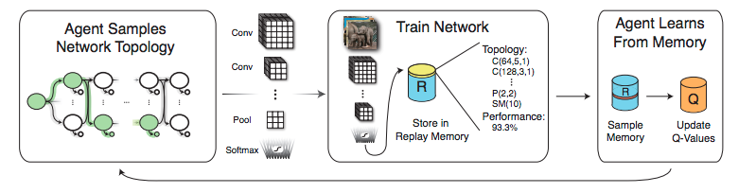
Reformulating the Problem
The key innovation is to reformulate the network architecture search as a reinforcement learning task!
State space: all possible neural net architectures
Action space: choosing new layers (conv, FC, pool) to put in the network
Reward function: the validation accuracy of the complete model

Slide 10
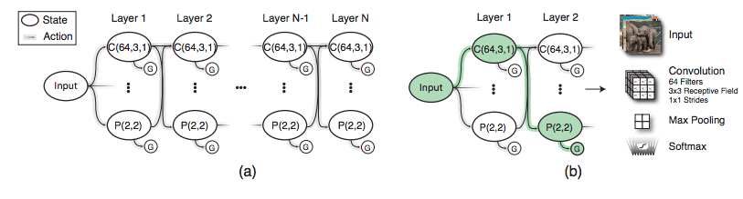
Reformulating the Problem
Key Assumption - a well-performing layer in one network will also perform well in a different network
State space - Neural net architectures that can be built using the following layer types: Convolution, Pooling, Fully Connected, Global Average Pooling, and ReLU
Termination states are GAP and Softmax

Slide 11
Reformulating the Problem
Action Space - the set of possible layers we can put at the next level.
The authors place restrictions on the action space for tractability
Maximum network depth
Representation size
Layer order
Consecutive Pooling layers
Transitioning to FC layers
Number of FC layers

Slide 12
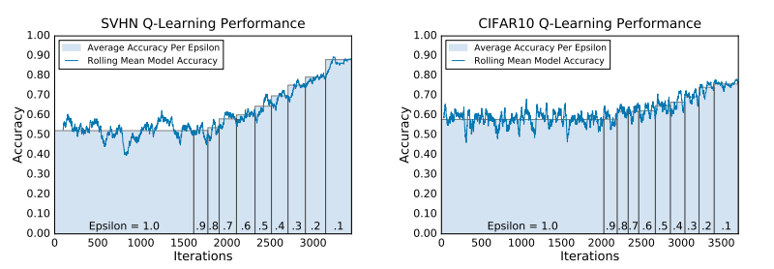
Experimental Setup
Models were trained with the Adam optimizer
Top ten models were selected and fine tuned further
3 Datasets:
MNIST
CIFAR 10
SVHN

Slide 13
Experimental Setup - Details
Each model trained with Adam optimizer
Q-learning rate alpha = 0.01
Epsilon transitions from 1 -> 0.1
Utilizes experience replay to save time
β1 = 0.9, β2 = 0.999, ε = 10−8
Batch size: 128, Learning rate = 0.001

Slide 14
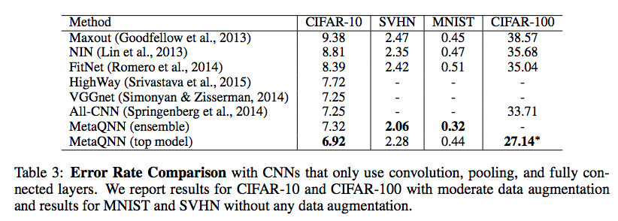
Key Results
MetaQNN models outperformed CNNs that only used the same layer types

Slide 15
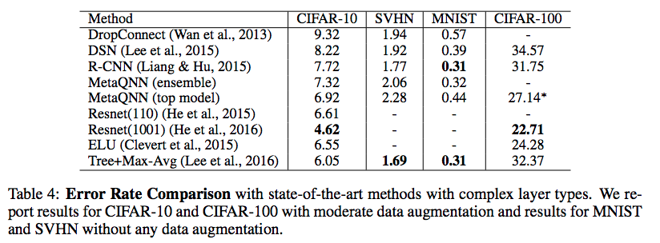
Key Results
MetaQNN models performed worse than but still at a ‘competitive’ level compared to than state-of-the-art models that utilize more complex layers and training methods.

Slide 16
Key Results
MetaQNN models outperformed other automated network design protocols
Error rates (%)
 | CIFAR-10 | MNIST
MetaQNN | 6.92 | 0.32
Bergstra | 21.2
Verbancsics |  | 7.9

Slide 17
Limitations and Improvements
Limitations
Hyperparameter optimization
Is CNN architecture the limiting factor in model accuracy? Or simply an optimization?
Improvements
Complex layer types
More fine-grained state-action space

Slide 18
Impact and Discussion
MetaQNN provides an automated solution for CNN architecture
Saves research time while pinpointing more optimal solutions
Largely an optimization - future progress will likely come from different areas
Discussion
How useful is this program today, given that state-of-the-art models all utilize complex layer types and specialized training techniques?
As it exists, is MetaQNN useful to non-experts?
Are there any other areas that can be reformulated as RL tasks?
Would MetaQNN have been able to re-invent recent architecture breakthroughs?

