Slide 1
Matchbox
fire it up
An aesthetically pleasing way to kill a couple of minutes, get out of your head, and stay the onset of dementia.

Slide 2
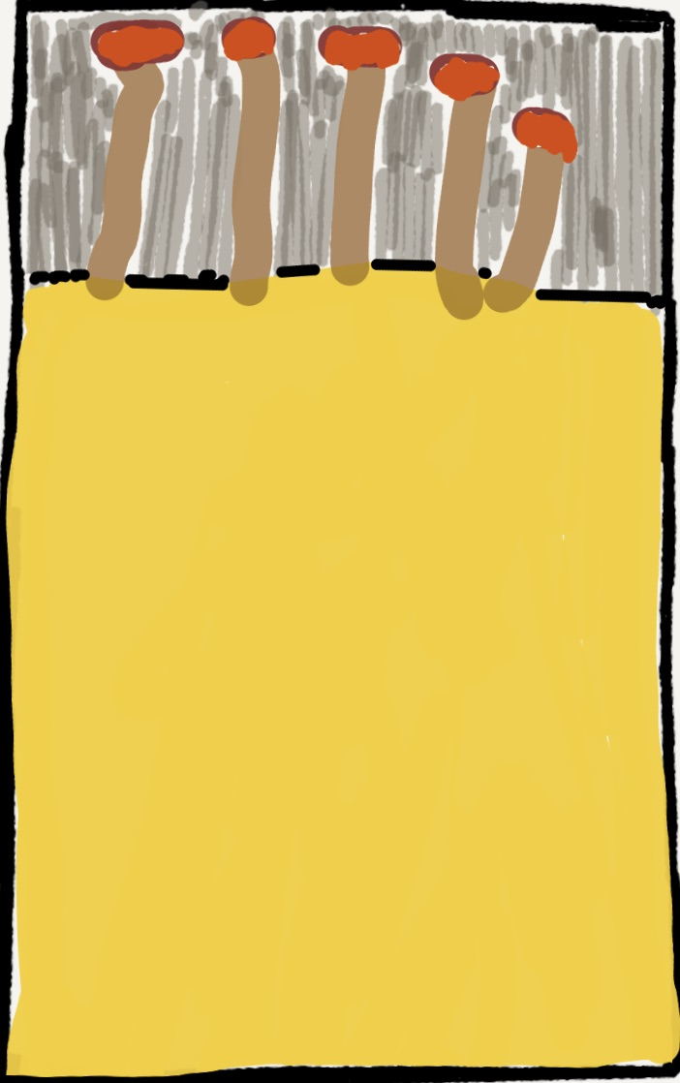
Meet the Matchbox Team

Slide 3

Ricardo Barcenas
Full-stack JavaScript Developer who thrives in a collaborative environment
Enjoys team sports (watching and playing . . . except baseball, it's really boring to watch)
Fluent in Spanish

Slide 4

Nathan rhead cox
Software developer with a background in international education and travel
Professionally fluent in Russian, working toward the same in JavaScript

Slide 5

simon panek
Full-stack JavaScript developer
Extensive experience in business and product development
Enjoys an intellectually challenging and diverse workplace
Seeking a position as a developer

Slide 6


Documentation: Technologies used
HTML, CSS, and JavaScript
The React Framework (via the create-react-app library)
React’s Redux library for state management

Slide 7
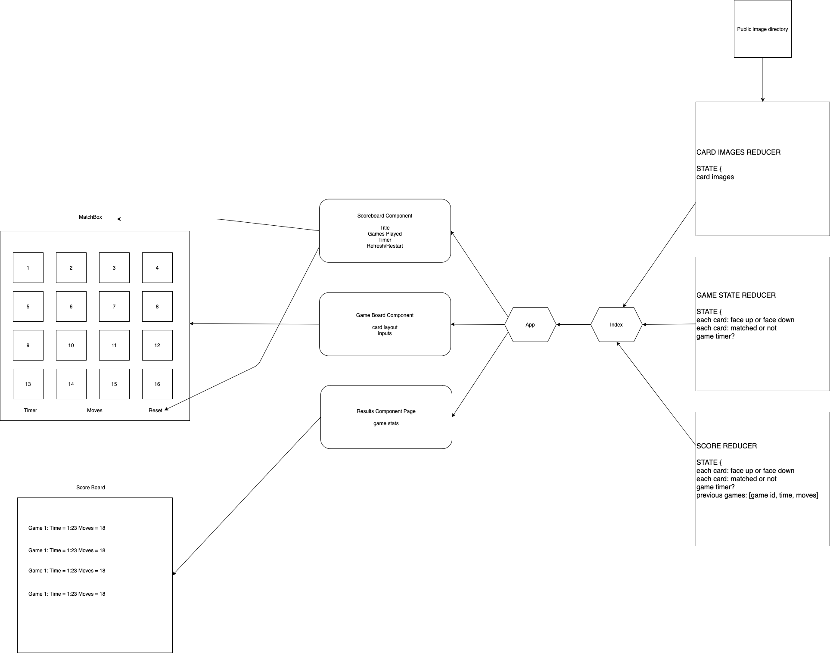
Documentation: UML

Slide 8
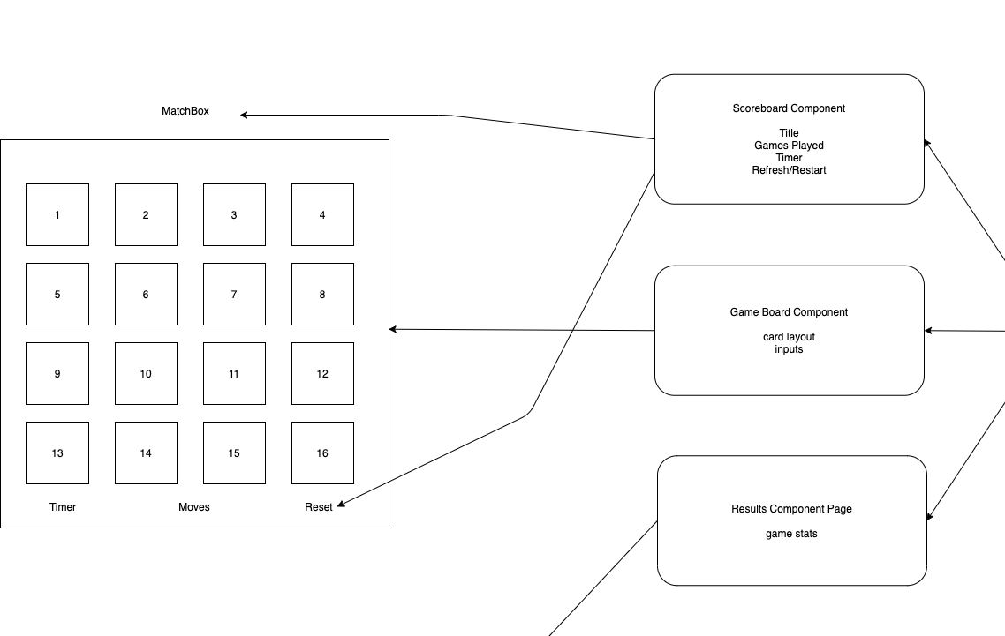
Documentation: UML

Slide 9
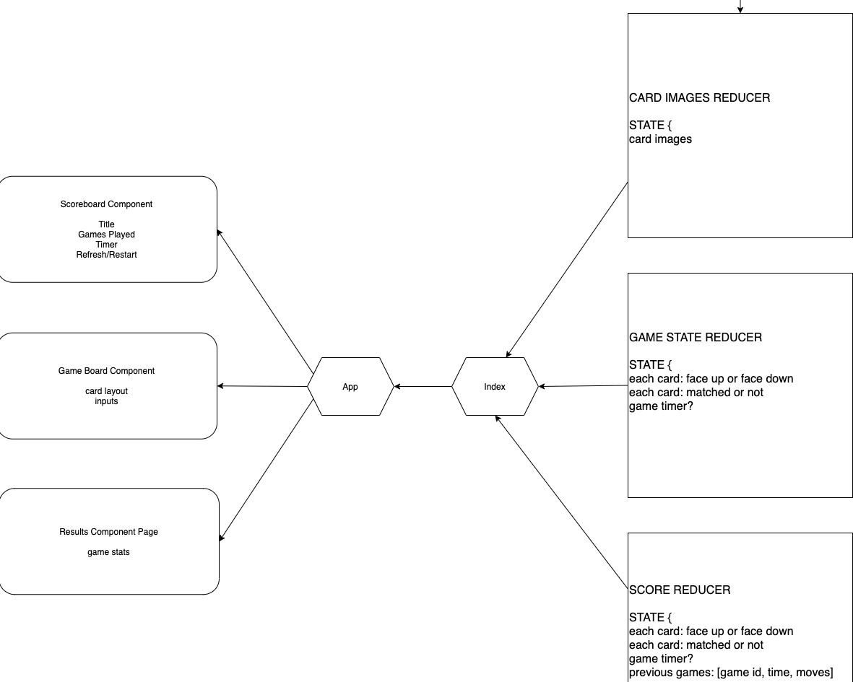
Documentation: UML

Slide 10
Matchbox
DEMO

Slide 11


Slide 12





(Imagine a 4x4 grid)
Moves: 6
Time: 0:37
Refresh

Slide 13

Features
Card flip animation
Move counter
Timer
Refresh gameboard
Recent games history
Matching logic
Favicon (by Sasha)

Slide 14
Redux State
gameboard:
{ currentBoard [empty array] card: { object }, startTime, endTime, gameMoves, gameNumber }
card:
{ id, pathToImage, faceup (Boolean), matched (Boolean) }
timer:
{ timerOn (Boolean), timerStart, timerEnd }

Slide 15
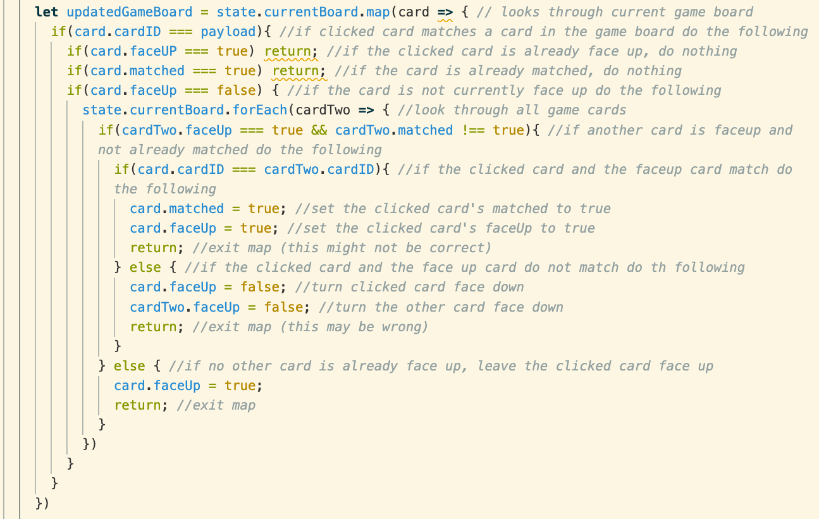
Challenges - Game logic - Displaying and mapping images in react - Timer - time constraints

Slide 16
Questions?

