Slide 1
תכנות מונחה עצמים תרגול 01
מייל : simon.pikalov@msmail.ariel.ac.il
נכתב ע"י : סמיון פיקלוב

Slide 2
נושאים להיום
בקצרה על הקורס .
יישור קו.
מושג האובייקט המחלקה .
שיטות ת הרשאות .
וירושה.
ממשקים
עבודה עם קבצים .
איך מתחילים את המטלה.

Slide 3
כמה מילים על הקורס:
מה אתם מקבלים מהקורס הזה?
אחד ההבדלים בין מתכנת לבין מישהו שיודע לכתוב קוד זה העקרונות שאתם תלמדו כאן.
אחד מהנושאים הנפוצים ביותר הנשאלים ברעיונות עבודה.
תיק עבודות ב גיט שלכם.
למה מצפים ממכם?
יושר.(תהיה בדיקת העתקות)
להשקיע במטלות.
להבין את התאוריה של מה שאתם עושים.
ללמוד לחפש מידע.
איפה ניתן לראות את החומרים של ההרצאה והתרגול ואיך עושים את זה ?
כל הקודים נמצאים ב github
קישור

Slide 4

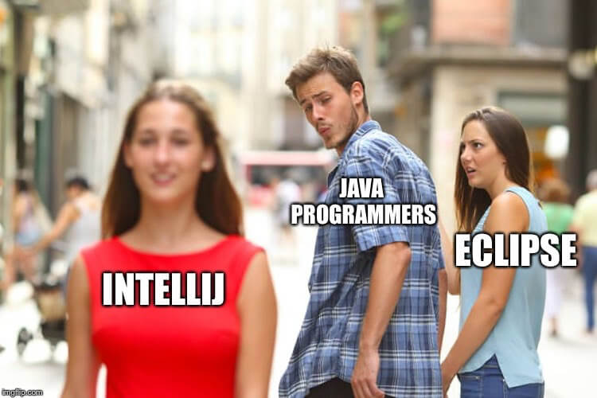


Slide 5
Google is your best friend from now !
How to syso in intellij ????
Answer

Slide 6
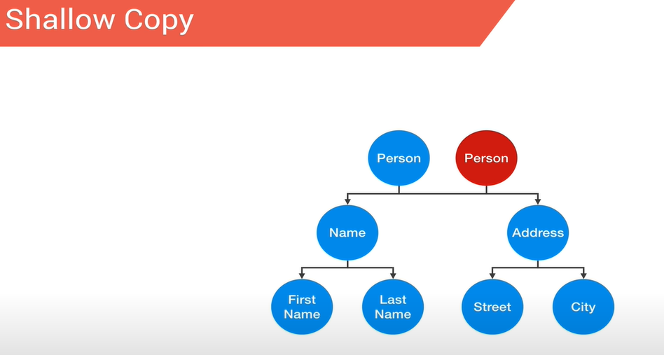
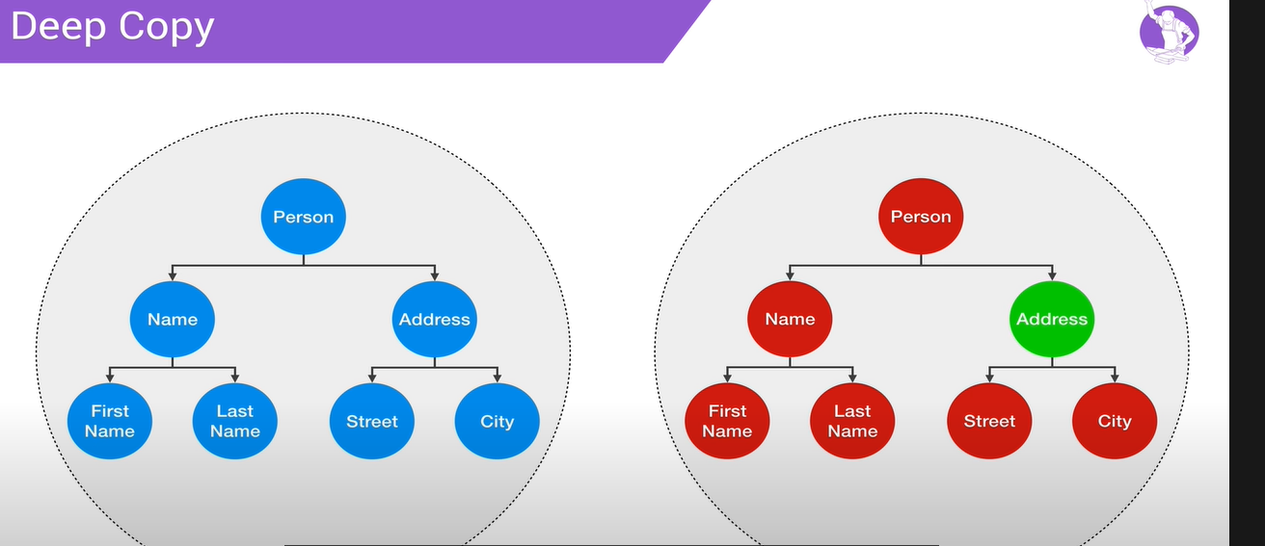
יישור קו העתקה עמוקה (deep copy)
https://www.youtube.com/watch?v=QaCYMgyprtc

Slide 7
יישור קו המושג גנרי
תכנות גנרי - הוא סגנון פיתוח תוכנה בו אלגוריתמים נכתבים במונחים של טיפוסים שיוגדרו בהמשך, וסוג הטיפוס יוגדר על פי הצורך ואז יתבצע שימוש באלגוריתם עבור הטיפוס המסוים שנקבע.
(ויקיפדיה)
דוגמא למחלקה גנרית שכולכם מכירים :
ArrayList<String> cars = new ArrayList<String>(); // Create an ArrayList object

Slide 8
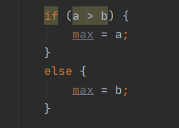

Shorten if
The value of a variable often depends on whether a particular boolean expression is or is not true and on nothing else.
For instance one common operation is setting the value of a variable to the maximum of two quantities. In Java you might write
Setting a single variable to one of two states based on a single condition is such a common use of if-else that a shortcut has been devised for it
, the conditional operator, ?:. Using the conditional operator you can rewrite the above example in a single line like this:

Slide 9
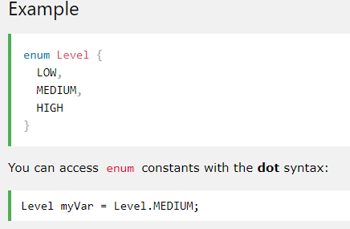
Enum
An enum is a special "class" that represents a group of constants (unchangeable variables, like final variables).
To create an enum, use the enum keyword (instead of class or interface), and separate the constants with a comma. Note that they should be in uppercase letters:
Example

Slide 10
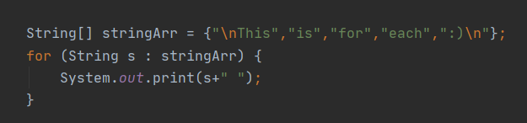

for each
Out:

Slide 11
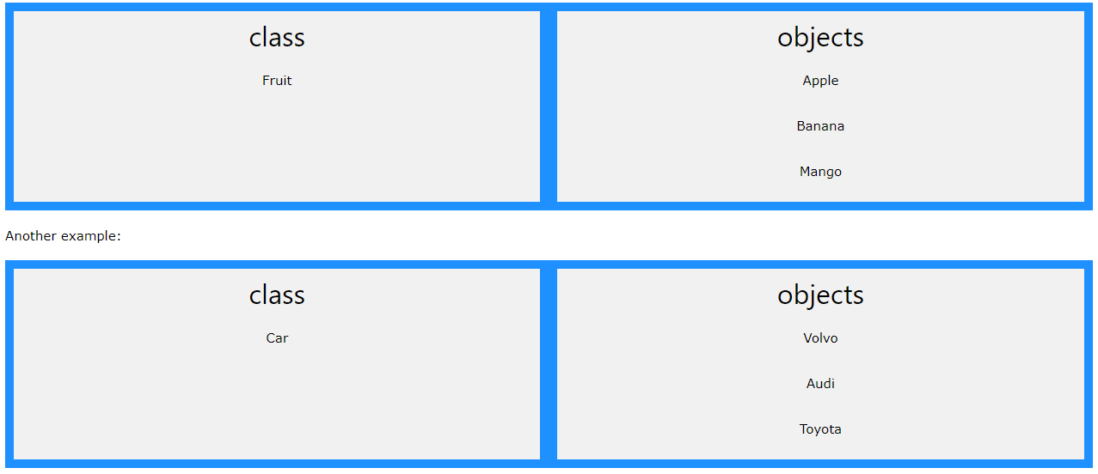
Classes
Java - What are Classes and Objects?
Classes and objects are the two main aspects of object-oriented programming.
Look at the following illustration to see the difference between class and objects:

Slide 12
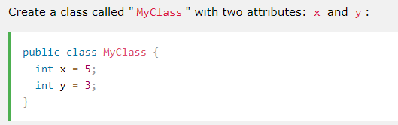
Classes Constructors
Create a Class
To create a class, use the keyword class:

Slide 13
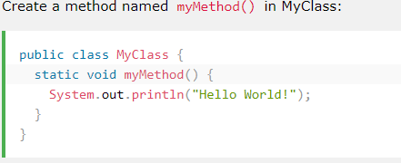
Classes methods
Java class methods:

Slide 14
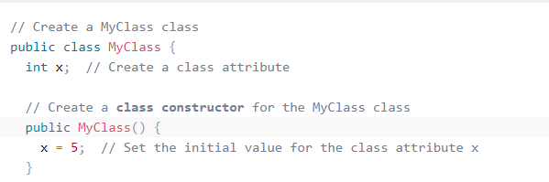
Classes constructor
A constructor in Java is a special method that is used to initialize objects. The constructor is called when an object of a class is created. It can be used to set initial values for object attributes:

Slide 15
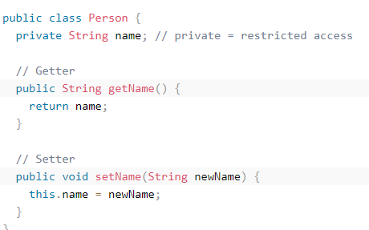
Classes Encapsulation
The meaning of Encapsulation, is to make sure that "sensitive" data is hidden from users. To achieve this, you must:
declare class variables/attributes as private
provide public get and set methods to access and update the value of a private variable

Slide 16
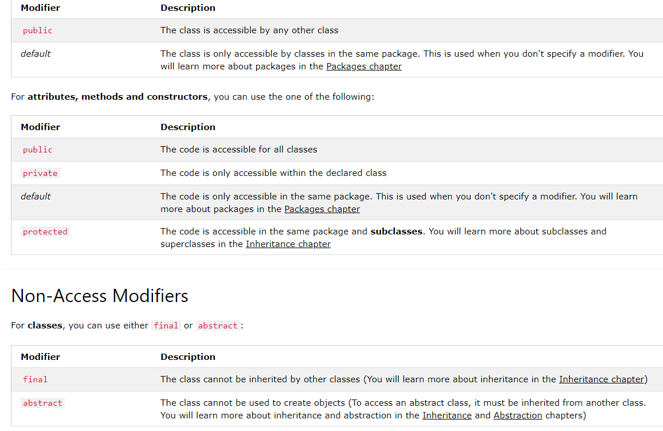
Classes Modifier

Slide 17
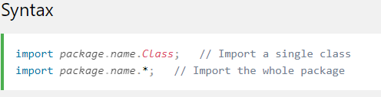
Classes Packages & API
Java Packages & API
A package in Java is used to group related classes. Think of it as a folder in a file directory. We use packages to avoid name conflicts, and to write a better maintainable code. Packages are divided into two categories:
Built-in Packages (packages from the Java API)
User-defined Packages (create your own packages)

Slide 18
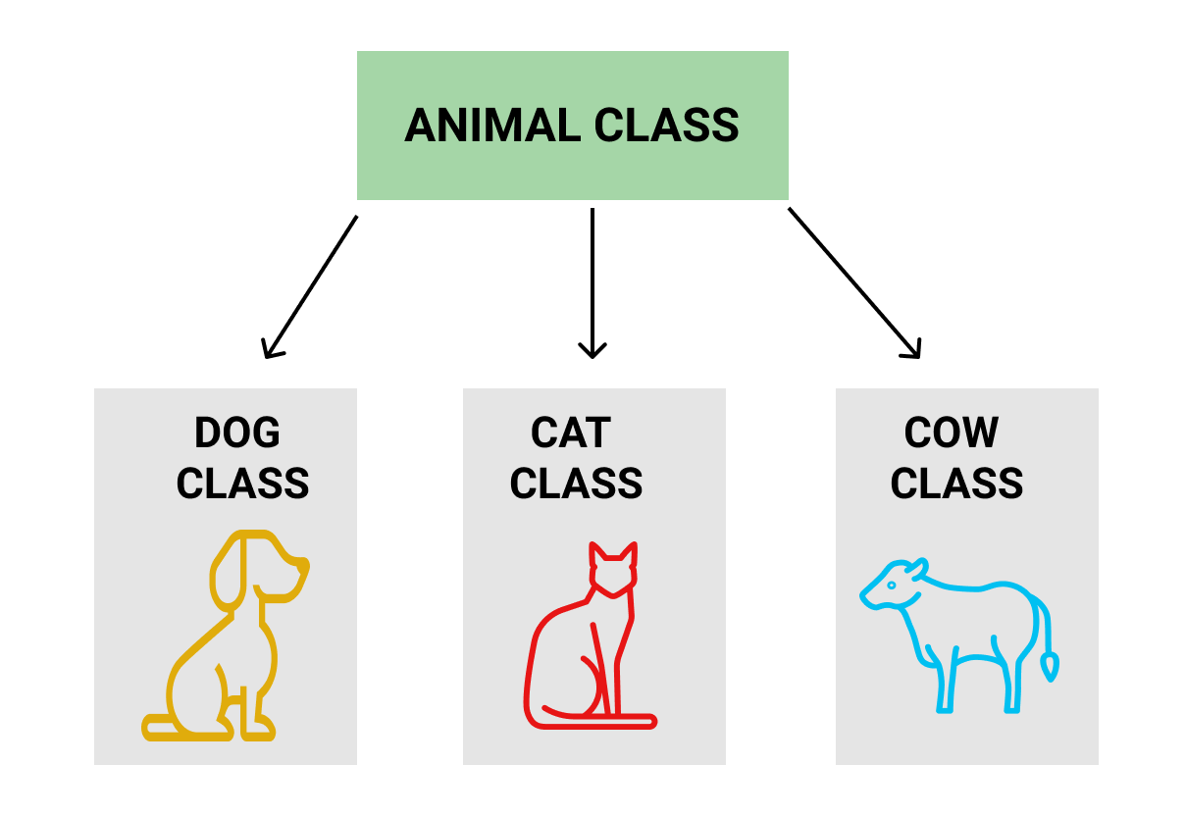
Java Inheritance (Subclass and Superclass)
subclass (child) - the class that inherits from another class
superclass (parent) - the class being inherited from

Slide 19
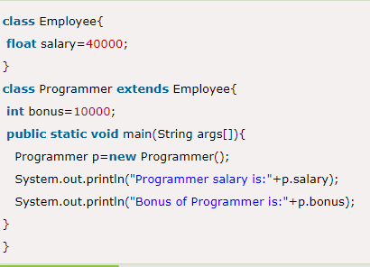

Inheritance
In Java, it is possible to inherit attributes and methods from one class to another. We group the "inheritance concept" into two categories:
subclass (child) - the class that inherits from another class
superclass (parent) - the class being inherited from
To inherit from a class, use the extends keyword.
class Subclass-name extends Superclass-name
{
//methods and fields
}
}

Slide 20
Polymorphism
Java Polymorphism
Polymorphism means "many forms", and it occurs when we have many classes that are related to each other by inheritance.
Like we specified in the previous chapter; Inheritance lets us inherit attributes and methods from another class. Polymorphism uses those methods to perform different tasks. This allows us to perform a single action in different ways.

Slide 21
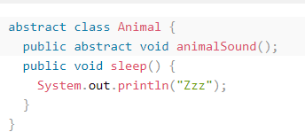

Abstraction
Abstract Classes and Methods
Data abstraction is the process of hiding certain details and showing only essential information to the user.
Abstraction can be achieved with either abstract classes or interfaces (which you will learn more about in the next chapter).
The abstract :
keyword is a non-access modifier, used for classes and methods
Abstract class: is a restricted class that cannot be used to create objects (to access it, it must be inherited from another class).
Abstract method: can only be used in an abstract class, and it does not have a body. The body is provided by the subclass (inherited from).
An abstract class can have both abstract and regular methods:

Slide 22
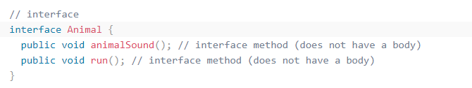
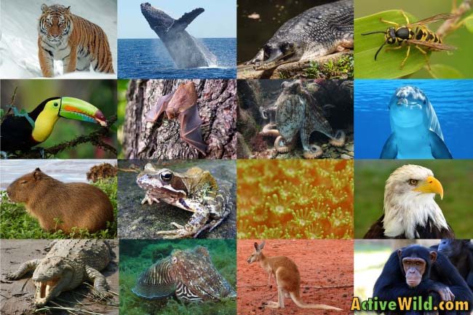

Interfaces
Interfaces
Another way to achieve abstraction in Java, is with interfaces.
An interface is a completely "abstract class" that is used to group related methods with empty bodies:

Slide 23
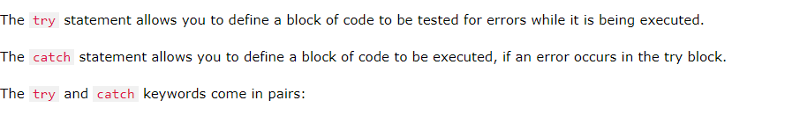

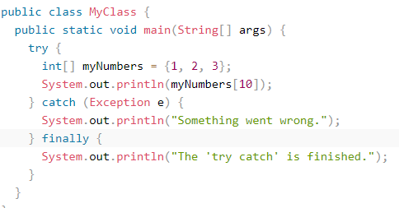
Exceptions
When executing Java code, different errors can occur: coding errors made by the programmer, errors due to wrong input, or other unforeseeable things.
When an error occurs, Java will normally stop and generate an error message. The technical term for this is: Java will throw an exception (throw an error).

Slide 24
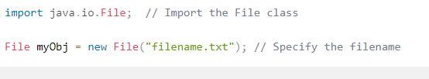
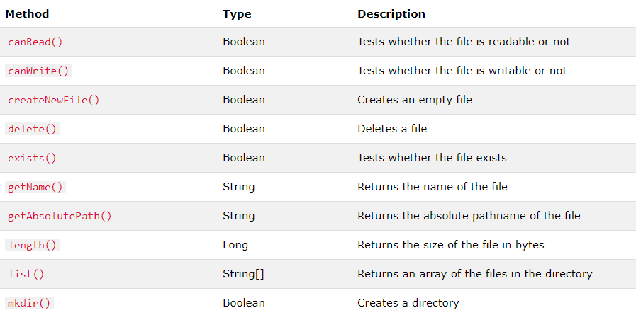
Java Files
The File class from the java.io package, allows us to work with files.
To use the File class, create an object of the class, and specify the filename or directory name:

Slide 25
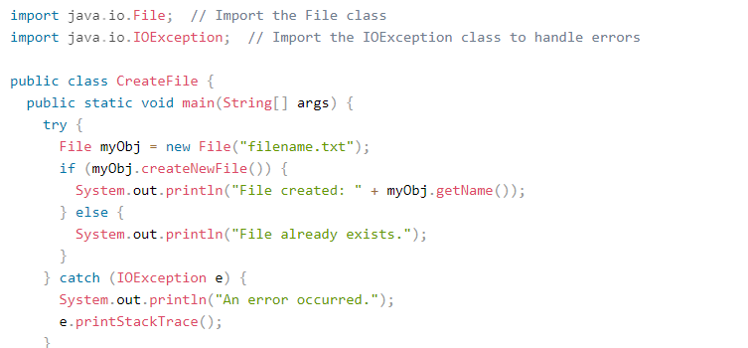

Create a File
To create a file in Java, you can use the createNewFile() method. This method returns a boolean value: true if the file was successfully created, and false if the file already exists. Note that the method is enclosed in a try...catch block. This is necessary because it throws an IOException if an error occurs (if the file cannot be created for some reason):
To create a file in a specific directory (requires permission), specify the path of the file and use double backslashes to escape the "\" character (for Windows). On Mac and Linux you can just write the path, like: /Users/name/filename.txt

Slide 26
Exceptions
When executing Java code, different errors can occur: coding errors made by the programmer, errors due to wrong input, or other unforeseeable things.
When an error occurs, Java will normally stop and generate an error message. The technical term for this is: Java will throw an exception (throw an error).

Slide 27
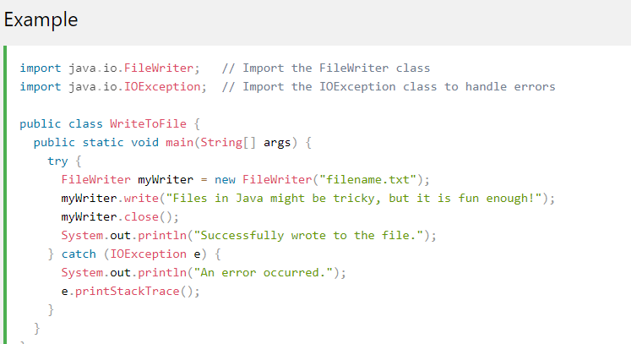
Write To a File
In the following example, we use the FileWriter class together with its write() method to write some text to the file we created in the example above. Note that when you are done writing to the file, you should close it with the close() method:

Slide 28
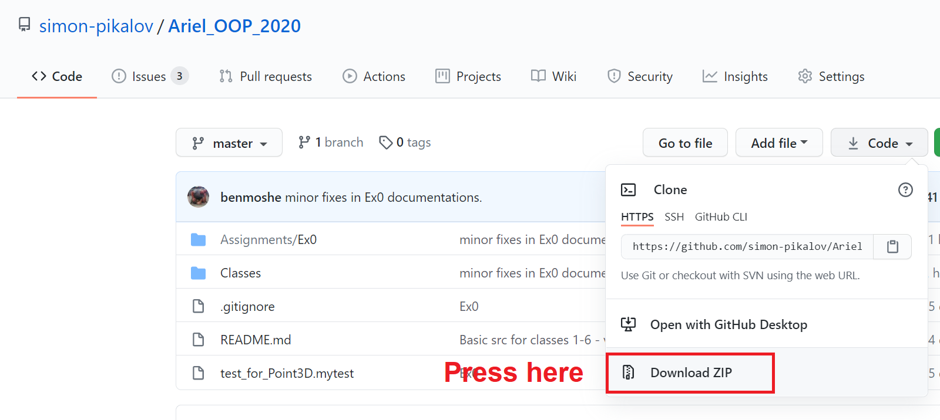
Ex0
Go Here :
https://github.com/simon-pikalov/Ariel_OOP_2020/

Slide 29


Slide 30
מקורות
https://www.w3schools.com/java/
ויקיפדיה

