Slide 1
תכנות מונחה עצמים תרגול 3
מייל : simon.pikalov@msmail.ariel.ac.il
נכתב ע"י : סמיון פיקלוב

Slide 2
נושאים להיום
Java I/O
Lambda expressions .
Equals and Hash Code
Junit 5.
.Inner Classes

Slide 3
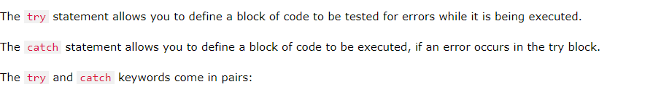

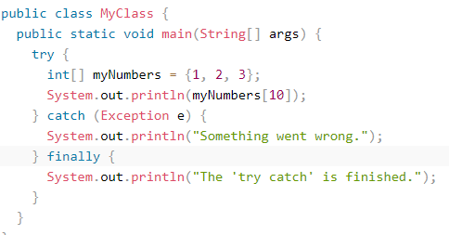
Exceptions
When executing Java code, different errors can occur: coding errors made by the programmer, errors due to wrong input, or other unforeseeable things.
When an error occurs, Java will normally stop and generate an error message. The technical term for this is: Java will throw an exception (throw an error).

Slide 4
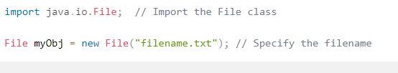
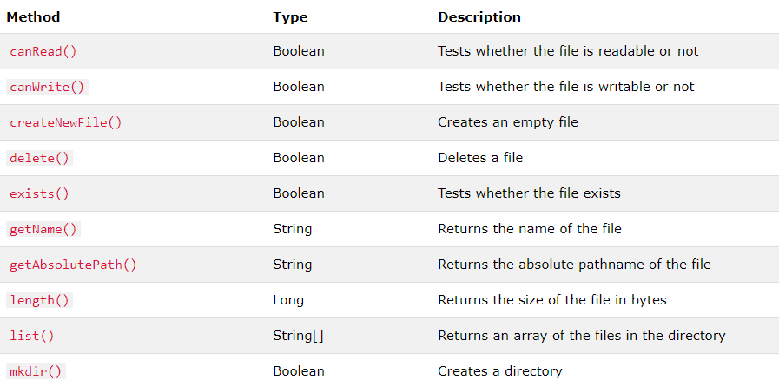
Java Files
The File class from the java.io package, allows us to work with files.
To use the File class, create an object of the class, and specify the filename or directory name:

Slide 5
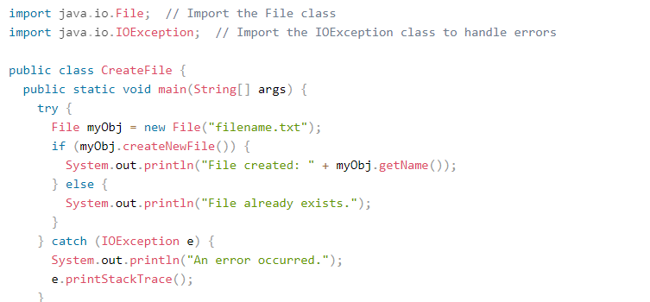

Create a File
To create a file in Java, you can use the createNewFile() method. This method returns a boolean value: true if the file was successfully created, and false if the file already exists. Note that the method is enclosed in a try...catch block. This is necessary because it throws an IOException if an error occurs (if the file cannot be created for some reason):
To create a file in a specific directory (requires permission), specify the path of the file and use double backslashes to escape the "\" character (for Windows). On Mac and Linux you can just write the path, like: /Users/name/filename.txt

Slide 6
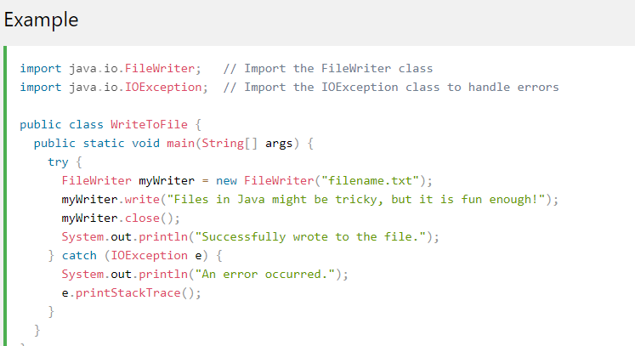
Write To a File
In the following example, we use the FileWriter class together with its write() method to write some text to the file we created in the example above. Note that when you are done writing to the file, you should close it with the close() method:

Slide 7
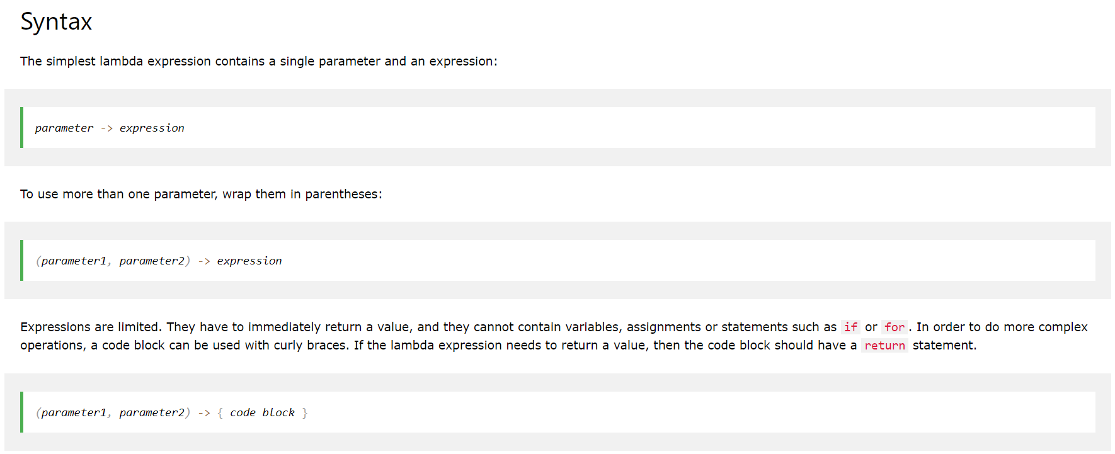
Lambda
A lambda expression is a short block of code which takes in parameters and returns a value. Lambda expressions are similar to methods, but they do not need a name and they can be implemented right in the body of a method.
Video Tutorial.

Slide 8
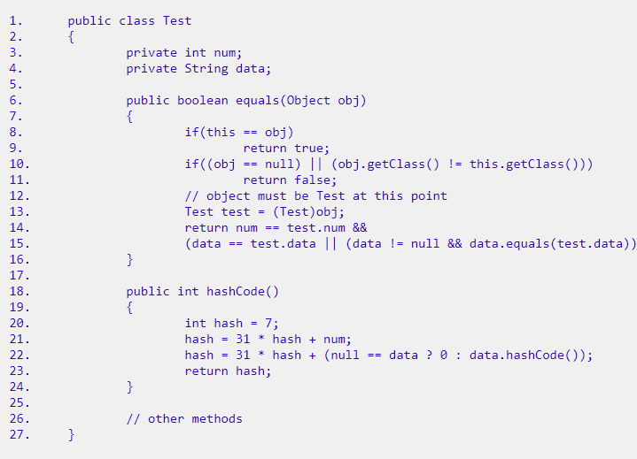
Equals and Hash Code
public boolean equals(Object obj)
This method checks if some other object passed to it as an argument is equal to the object on which this method is invoked. The default implementation of this method in Object class simply checks if two object references x and y refer to the same object. i.e. It checks if x == y. This particular comparison is also known as "shallow comparison". However, the classes providing their own implementations of the equals method are supposed to perform a "deep comparison"; by actually comparing the relevant data members. Since Object class has no data members that define its state, it simply performs shallow comparison.
public int hashCode()
This method returns the hash code value for the object on which this method is invoked. This method returns the hash code value as an integer and is supported for the benefit of hashing based collection classes such as Hashtable, HashMap, HashSet etc. This method must be overridden in every class that overrides the equals method.

Slide 9
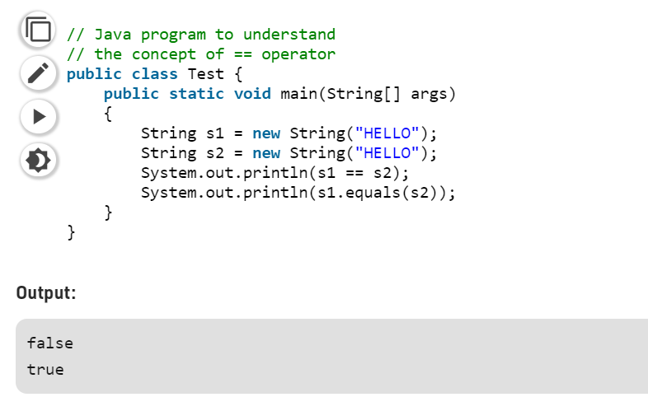
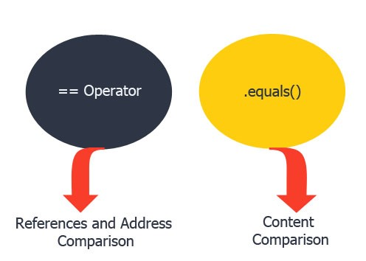
difference between == and equals() method in Java
In general both equals() and “==” operator in Java are used to compare objects to check equality but here are some of the differences between the two:
Main difference between .equals() method and == operator is that one is method and other is operator.
We can use == operators for reference comparison (address comparison) and .equals() method for content comparison. In simple words, == checks if both objects point to the same memory location whereas .equals() evaluates to the comparison of values in the objects.
If a class does not override the equals method, then by default it uses equals(Object o) method of the closest parent class that has overridden this method. See this for detail

Slide 10

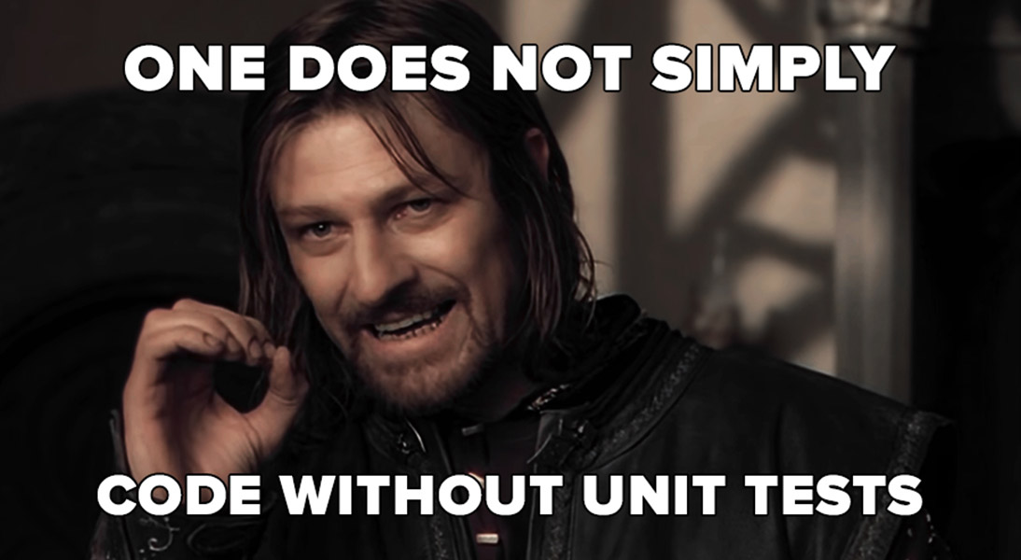
Junit 5

Slide 11

Junit 5
Fast — it gotta run fast, otherwise it would completely miss a valuable characteristic of a unit test against an ordinary test.
Independent — it shouldn’t depend of the results of another test or involve other unit — a unit test is meant to test only one unit.
Repeatable — it gotta return the same result every time it runs, once you say that a certain class with certain inputs should return certain outputs: it will need to respect these rules forever.
Self-Validating — it gotta be totally automated and with clear results (PASS or FAIL).
Timely — it's gotta be planned.

Slide 12
Junit 5
JUnit is one of the most popular unit-testing frameworks in the Java ecosystem. The JUnit 5 version contains a number of exciting innovations, with the goal to support new features in Java 8 and above, as well as enabling many different styles of testing.
@Test - Denotes that a method is a test method. Unlike JUnit 4’s @Test annotation, this annotation does not declare any attributes, since test extensions in JUnit Jupiter operate based on their own dedicated annotations. Such methods are inherited unless they are overridden.
@DisplayName – defines custom display name for a test class or a test method
@BeforeEach – denotes that the annotated method will be executed before each test method
@AfterAll – Denotes that the annotated method should be executed after all @Test
@Disabled – it is used to disable a test class or method
@AfterEach - Denotes that the annotated method should be executed after each @Test.

Slide 13

Junit 5
JUnit-5-assertion Link

Slide 14
Junit 5
@BeforeAll static void setup() {@BeforeAll annotation needs to be static, otherwise the code will not compile. System.out.println("@BeforeAll - executes once before all test methods in this class"); } @BeforeEach void init() { System.out.println("@BeforeEach - executes before each test method in this class"); }

Slide 15
Junit 5
@DisplayName("Single test successful") @Test void testSingleSuccessTest() { System.out.println("Success"); } @Test @Disabled("Not implemented yet") void testShowSomething() { }

Slide 16
Junit 5
@AfterEach void tearDown() { System.out.println("@AfterEach - executed after each test method."); } @AfterAll static void done() {//@AfterAll needs also to be a static method. System.out.println("@AfterAll - executed after all test methods."); }

Slide 17
Junit 5
@Test void assrtTrue() { assertTrue(10>-1); } @Test void assrtTrueMessege() { assertTrue(-10>-1,"why this didnt work ? "); } @Test void groupAssertions() { int[] numbers = {0, 1, 2, 3, 4}; assertAll("numbers", () -> assertEquals(numbers[0], 1), () -> assertEquals(numbers[3], 3), () -> assertEquals(numbers[4], 1) ); }
assertAll() - report any failed assertions within the group with a MultipleFailuresError:

Slide 18
Junit 5
Assumptions are used to run tests only if certain conditions are met. This is typically used for external conditions that are required for the test to run properly, but which are not directly related to whatever is being tested.
You can declare an assumption with assumeTrue(), assumeFalse(), and assumingThat().
@Test void trueAssumption() { assumeTrue(5 > 1); assertEquals(5 + 2, 7); } @Test void falseAssumption() { assumeFalse(5 < 1); assertEquals(5 + 2, 7); }

Slide 19
Junit 5
There are two ways of exception testing in JUnit 5. Both of them can be implemented by using assertThrows() method:
@Test void assertThrowsException() { String str = null; assertThrows(Exception.class, () -> { Integer.valueOf(str); }); }

Slide 20
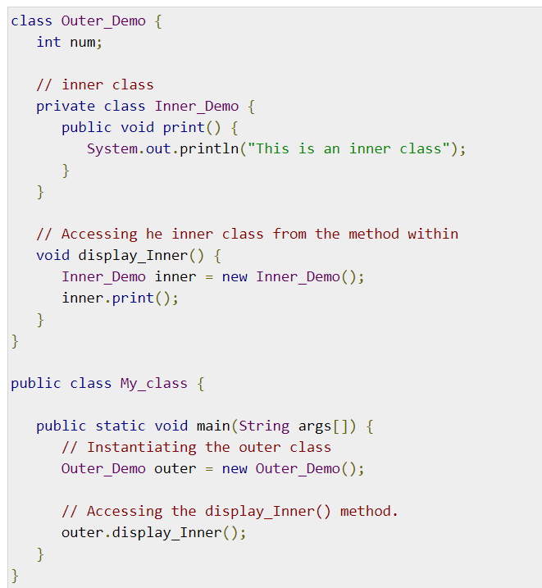
Inner Class
Creating an inner class is quite simple. You just need to write a class within a class. Unlike a class, an inner class can be private and once you declare an inner class private, it cannot be accessed from an object outside the class.

Slide 21
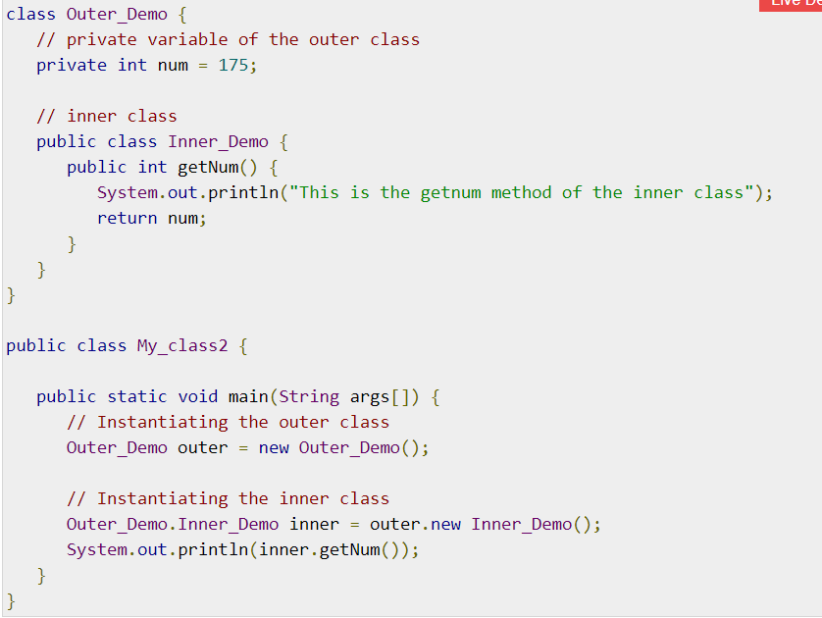
Inner Class
Accessing the Private Members
inner classes are also used to access the private members of a class. Suppose, a class is having private members to access them. Write an inner class in it, return the private members from a method within the inner class.
say, getValue(), and finally from another class (from which you want to access the private members) call the getValue() method of the inner class.
To instantiate the inner class, initially you have to instantiate the outer class. Thereafter, using the object of the outer class, following is the way in which you can instantiate the inner class.

Slide 22


Slide 23
מקורות
https://www.w3schools.com/java/
Edureka
Geeks for geeks
baeldung
https://medium.com/mackmobile/swift-unit-testing-ff6655748e15
https://blog.jetbrains.com/idea/2020/09/writing-tests-with-junit-5/

