Slide 1
תכנות מונחה עצמים תרגול 4
מייל : simon.pikalov@msmail.ariel.ac.il
נכתב ע"י : סמיון פיקלוב

Slide 2
נושאים להיום
git
github
readme.md.
Serialization.

Slide 3
Theory

Slide 4
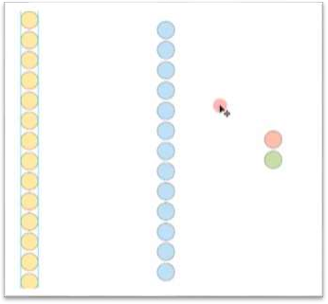
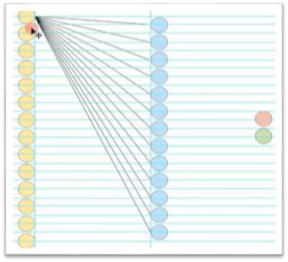
Git - Version Control System
◆ Version control is a system that records changes to a file or set of files over time so that you can recall specific versions later.
Design 1
Design 2

Slide 5
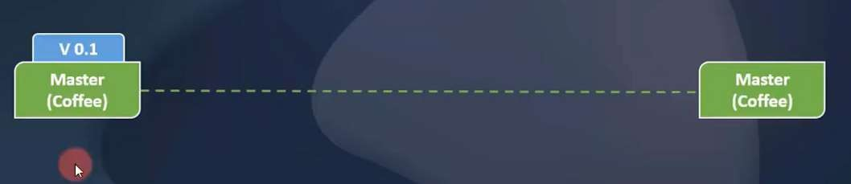

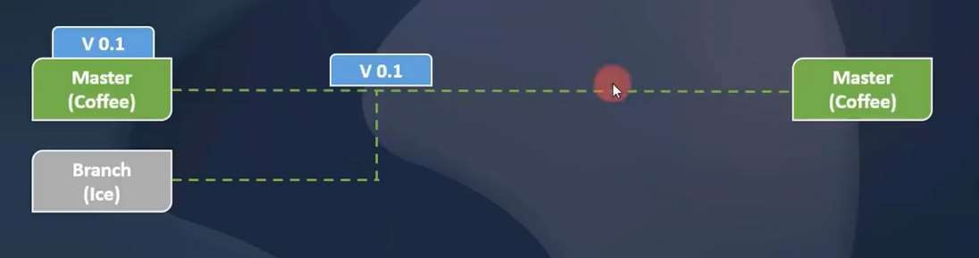

Branch
Master Branch
Branch 1

Slide 6
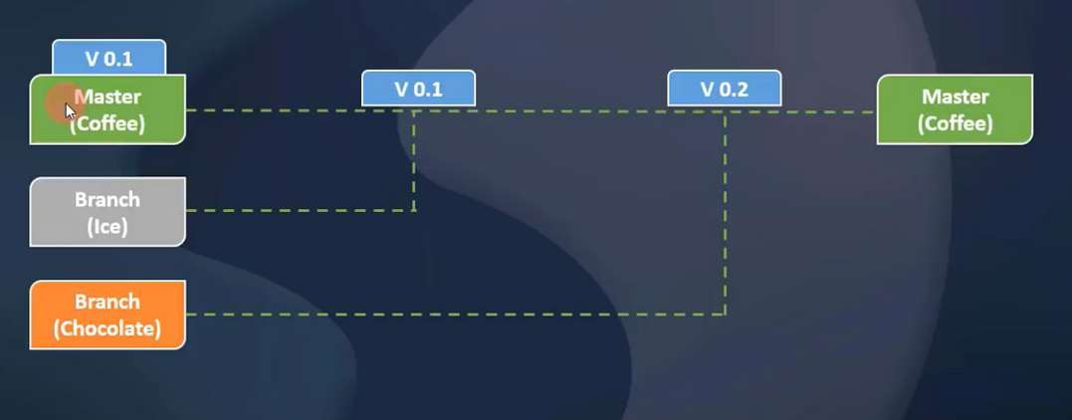
Branch
Contd..

Slide 7
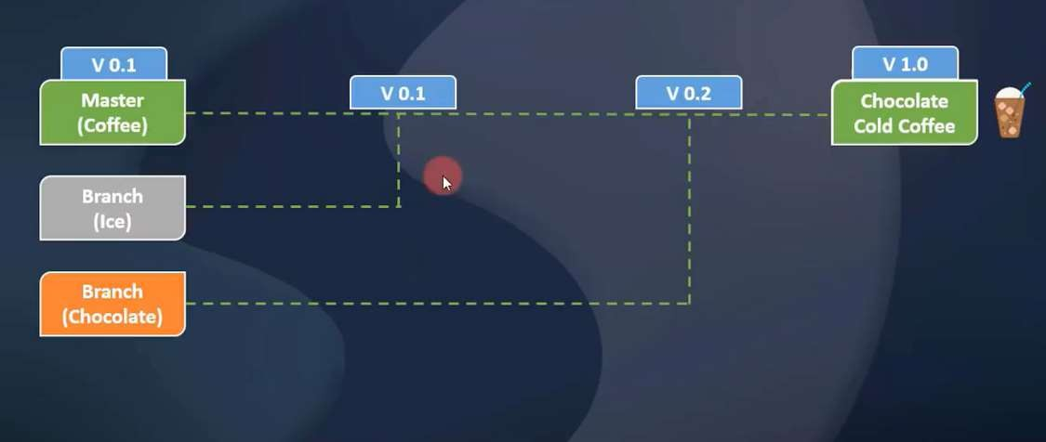
Contd..
Branch

Slide 8
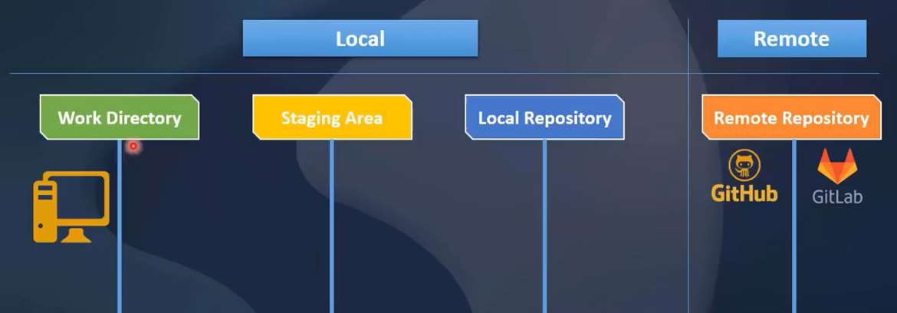
Repository

Slide 9
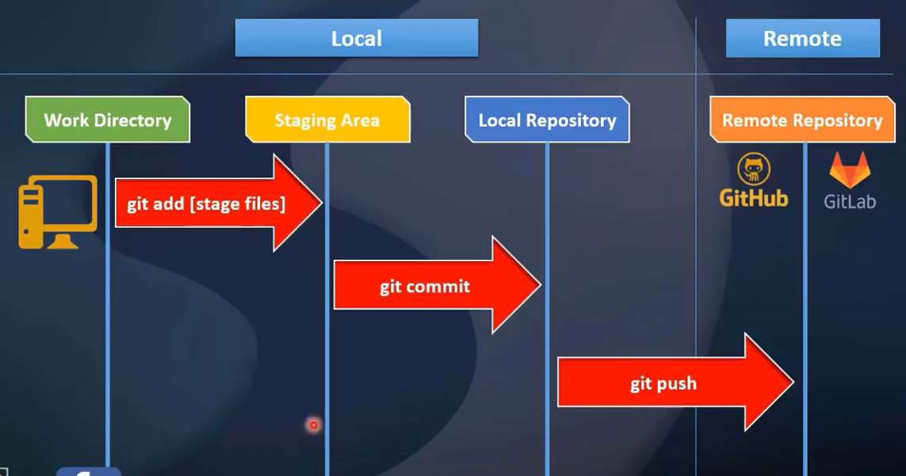
Contd..
Repository

Slide 10
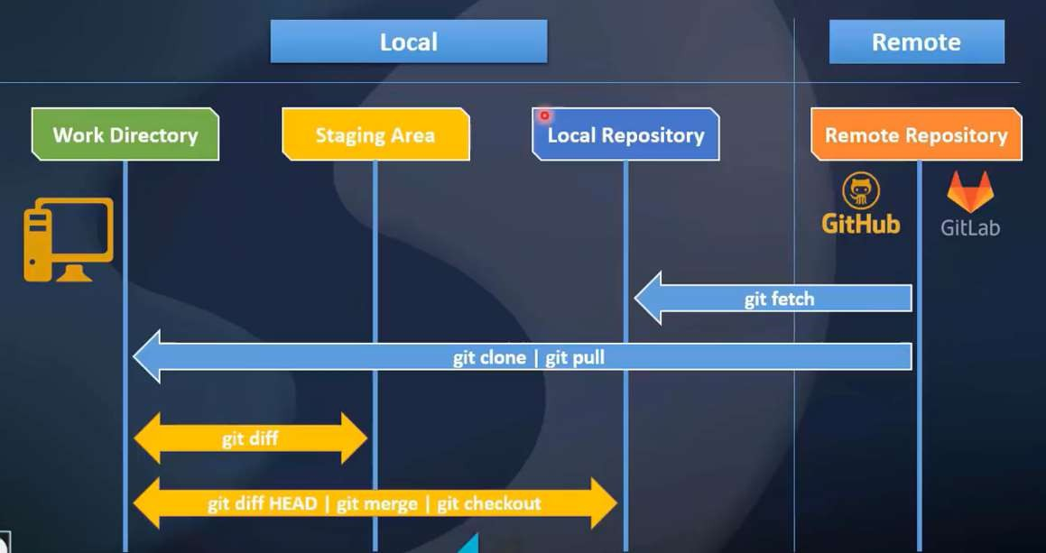
Contd..
Repository

Slide 11
Practical

Slide 12
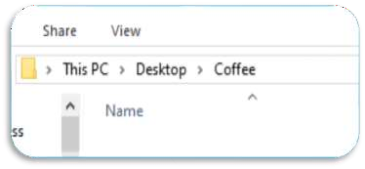
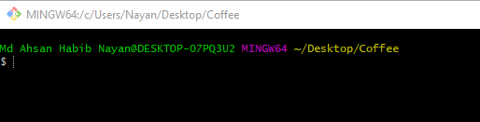
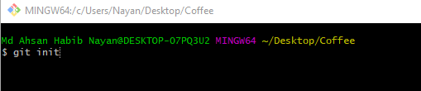
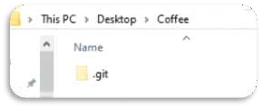
Initialization
◆ Create a folder in any directory. For example, I created a folder
named “Coffee” in my desktop.
◆ Then open Git Bash here.
◆ Then type “git init” for initialization.
◆ Now you can see “.git” folder in you “Coffee” directory.

Slide 13
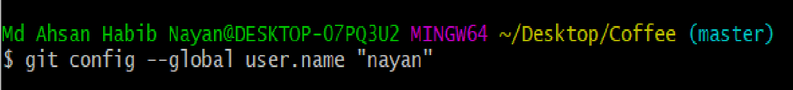

Configuration
◆ To set username globally:
git config --global user.name “nayan”
◆ To set email globally:
git config --global user.email “habib@cse.green.edu.bd”
◆ To set username and email locally: git config user.name “nayan”
git config user.email “habib@cse.green.edu.bd”
◆ Now type “git config --list” to show your configuration.

Slide 14
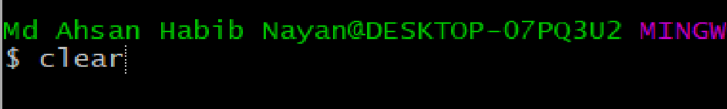
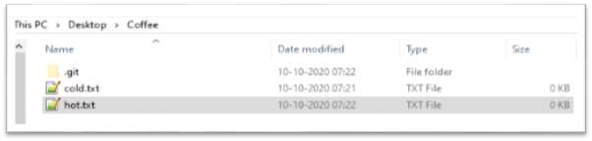

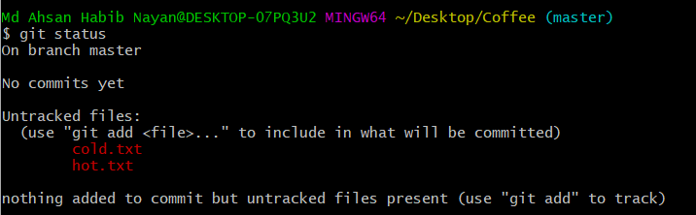
Commands
◆ To clear your screen just type: clear
◆ Let’s create two files in “Coffee” dir.
◆ cold.txt
◆ hot.txt
◆ Now type:
git status

Slide 15
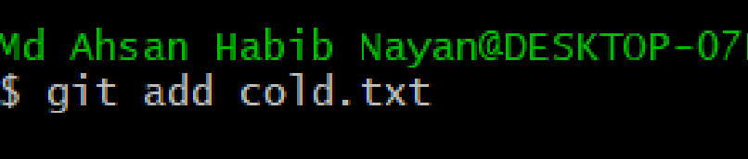

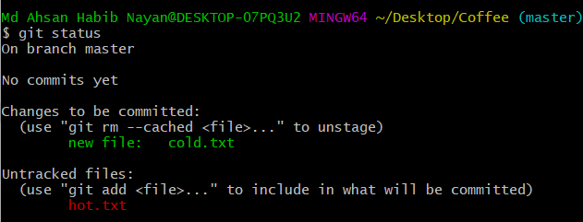
Commands
◆ Let’s use add command: git add cold.txt
◆ Now type:
git status

Slide 16
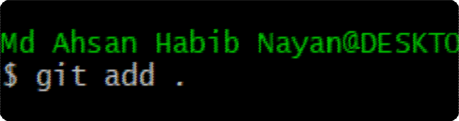

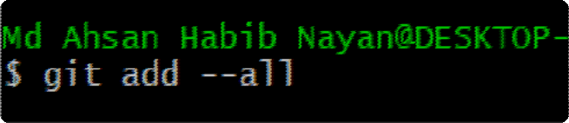


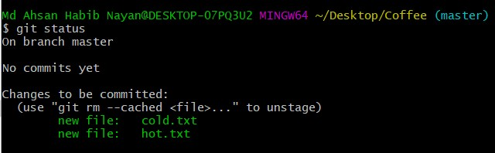
Commands
◆ Add all files using single command: git add --all or
git add .
◆ Now type:
git status

Slide 17
Commit

Slide 18
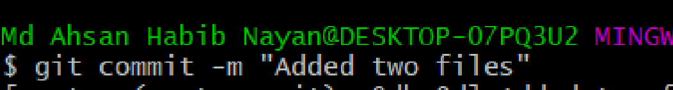



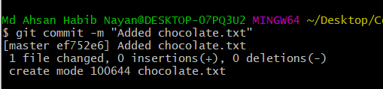
Commit
◆ Staging area to Local repo:
git commit –m “Added two files”
◆ Now type:
git status
◆ Let’s commit again:
◆ First create a file “chocolate.txt” in “Coffee”.
◆ Now add this file.
◆ Then commit.

Slide 19

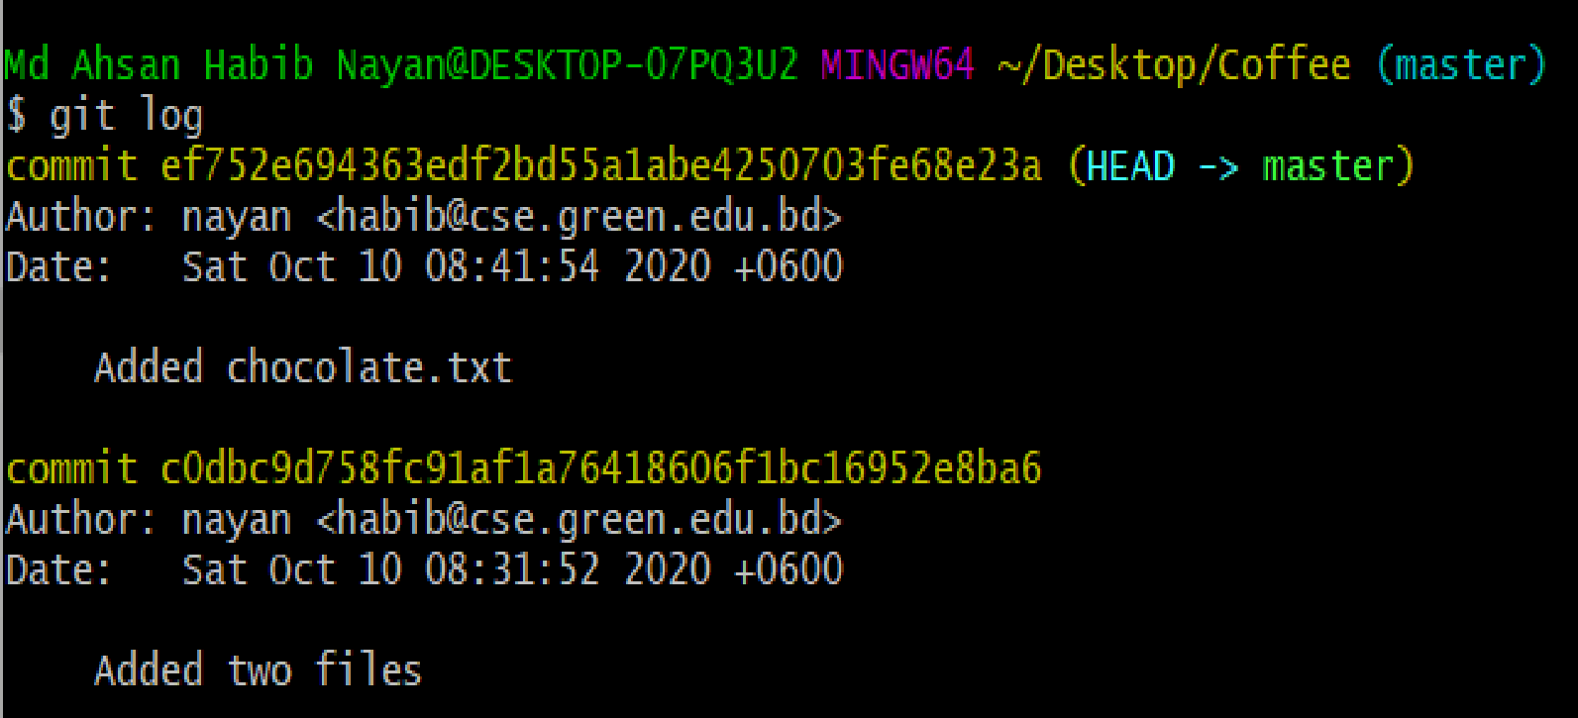

Commit
◆ To show our commit: git log
◆ Another way [Simple]: git log --oneline

Slide 20
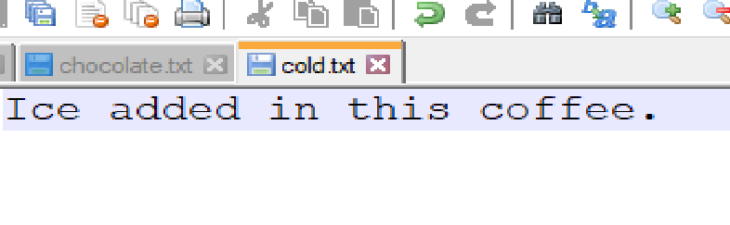
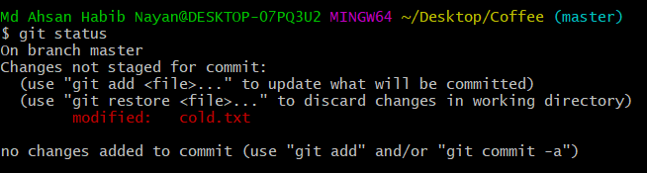

Commit
◆ Let’s write something in cold.txt file.
◆ Now type:
git status
◆ Let’s commit again:
◆ Add the changed file [cold.txt].
◆ Then commit.
◆ Now use git log command to show commits.

Slide 21
Checkout

Slide 22


Checkout
◆ Let’s we need to go back our previous version of cold.txt.
◆ Can we do that?
◆ Yes, It’s simple. Just use checkout command.
◆ To do this.
◆ First log the commits.
◆ Then use checkout using commit id.
◆ You can see that you cold.txt file got empty again.
◆ Note: we are not in master branch now.

Slide 23


Checkout
◆ Let’s use git log again. You can see there are only two
commits exist.
◆ Can you switch one of the commit-ids ?
◆ Have a try ☺
◆ Let’s back to our master branch.

Slide 24
Diff

Slide 25
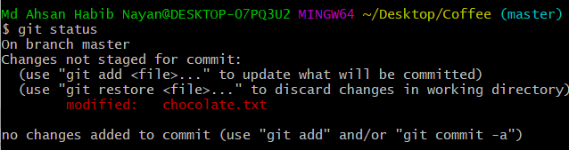
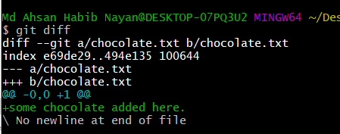
Diff
◆ Let’s compare two files. We have to use git diff command.
◆ To do this.
◆ First add some text in chocolate.txt.
◆ You can use git status to show if chocolate.txt changes or not.
◆ Then use git diff comman.
◆ You can see the changes.
◆ Note: git diff always works between latest changes.

Slide 26
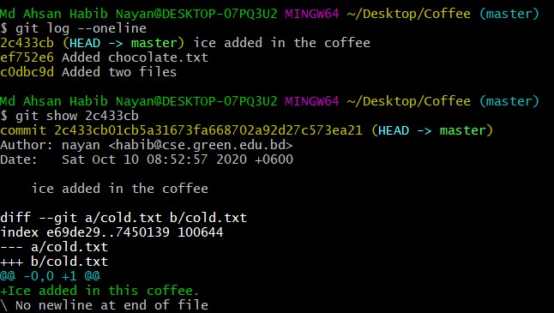
Diff
◆ To show changes at a particular commit you can use git
show with commit-id.

Slide 27
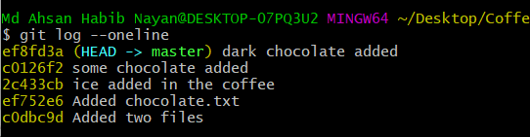
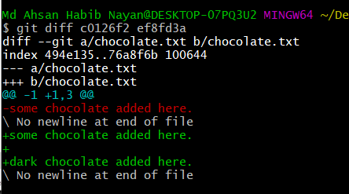
Diff
◆ We haven’t add the updated chocolate.txt file yet. Just
add this file. Then commit it.
◆ Now we again added some text in chocolate.txt file. Then add and commit it.
◆ Using git log you can see like this.
◆ Now we want to show differences between two chocolate.txt files [previous and current].
◆ To do use use git diff with two commit-ids. git diff id1 id2

Slide 28
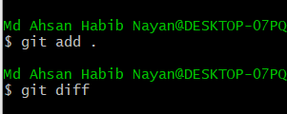
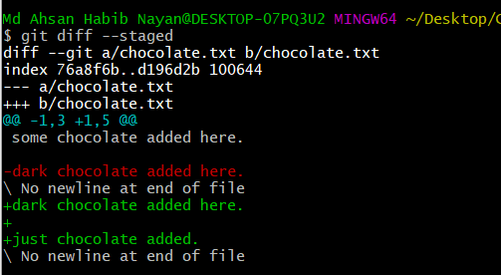
Diff
◆ What if we want to see the differences in the staged
section ie. Afer adding and before commit.
◆ Use: git diff --staged
◆ To do this:
◆ Update chocolate.txt again. Use git diff to show changes.
◆ Now use git add command. If you want to show changes now and use git diff command it shows nothing.
◆ To show changes use: Git diff --staged

Slide 29
Remove

Slide 30
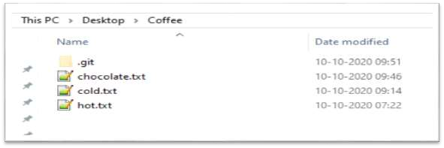


Remove file
◆ How can we delete a file?
◆ If you delete from “Coffee” directory then it is removed from current stage [not all commits].
◆ What if we want to delete permanently ie. delete a file from all commits ?
◆ We have to use: git rm file_name
◆ It deletes the file from all commits.
◆ If we run git status then we can see that the hot.txt file is in staged section. If we want to delete from staged section then we have to use: git reset HEAD hot.txt. Now again run git status command to see the chages.

Slide 31
Let’s Store/Push the files into Remote Repository!!

Slide 32
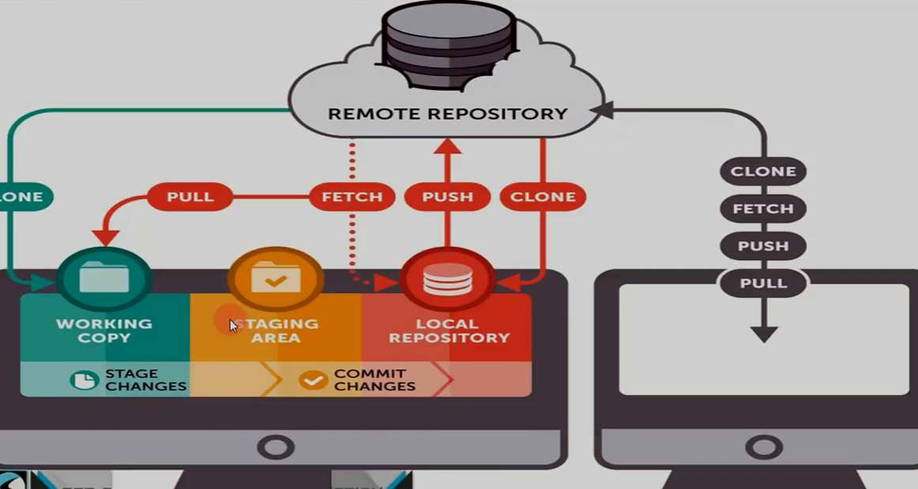
Full System Pictorial View

Slide 33
Push
◆ How can we push the files into Remote Repo?
◆ To do this:
◆ We need to have a github account.
◆ Now let’s create a Repository.
◆ Then follow some steps.
◆ Copy the remote repo link and run in the Bash Terminal.
◆ Use push command.
◆ Now refresh your repo.
◆ Let’s see graphically.

Slide 34
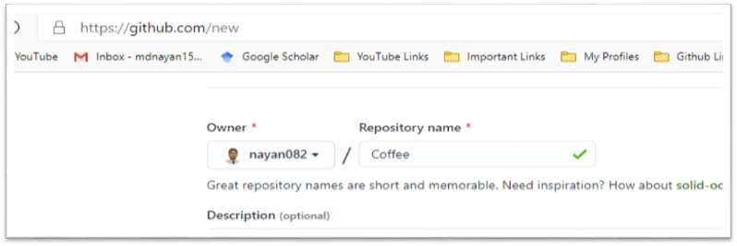
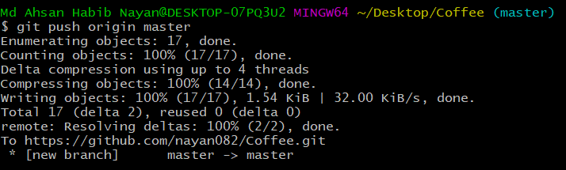
Push
◆ First, create a repository.
◆ Then copy the link (remote repo) and run.
◆ Now run push command. git push origin master or git push –u origin master

Slide 35
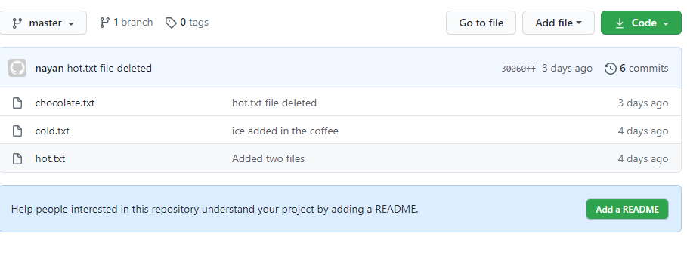
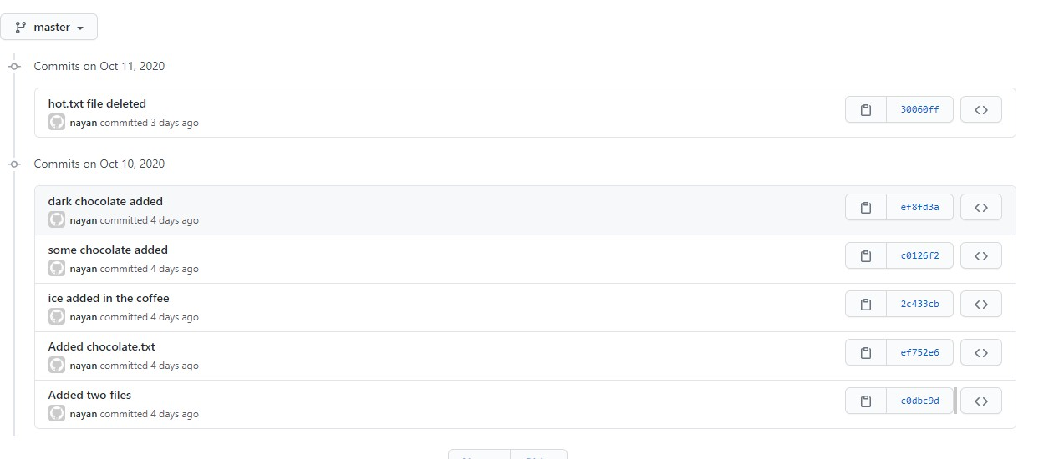
Repository
◆ We can see here all commits
we have done.
◆ And we can go back any stage of those commits.

Slide 36
Download/Clone from Remote Repository!!

Slide 37

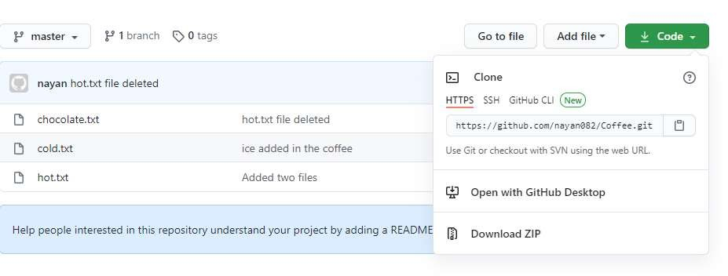
Clone
◆ How can we download/clone the projects into Remote Repo?
◆ To do this:
◆ We can download as a zip or
◆ We can clone the repo.

Slide 38
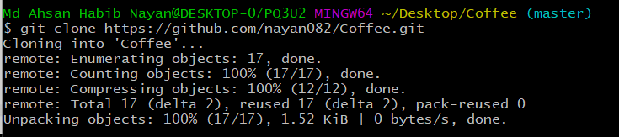
Clone
◆ To clone the repository copy the project link and run the command: git clone repo_link
◆ The folder named with the repository name.
◆ If you want to assign a different name use: git clone repo_link new_name

Slide 39
Fetch

Slide 40

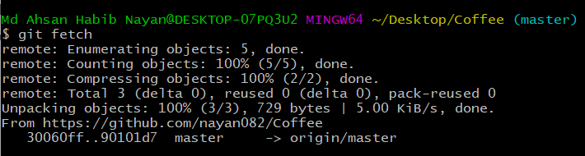
Fetch
◆ First, let’s change cold.txt file (add a line into cold.txt) and make a commit (from remote repo).
◆ To fetch the repository we use:
git fetch

Slide 41
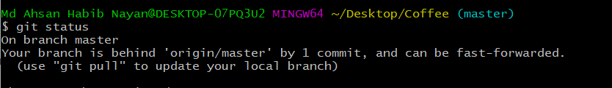
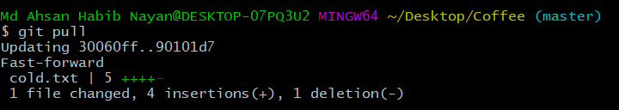
Fetch
◆ Now run git status to see the commit.
◆ Now let’s check the cold.txt file. Can you see any update ?
◆ No. Our machine only know that something changes. And they suggest us
to use git pull command.!!
◆ Now use: git pull. Now check the cold.txt file.

Slide 42
Branch

Slide 43

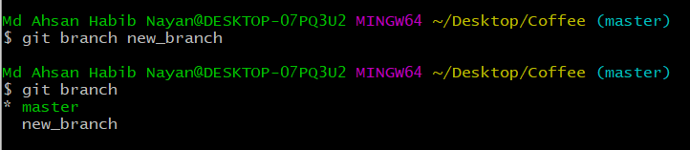
Branch
◆ To create a branch we use: git branch branch_name
◆ To check how many branch we have: git branch
◆ * Sign represent the current branch.

Slide 44

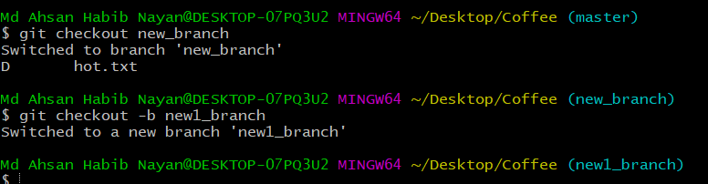
Branch
◆ To switch a branch we use:
git checkout branch_name
◆ We can create and switch at a time to the branch using: git checkout -b branch_name

Slide 45
Branch
◆ Now we are in “new1_branch”. Anything changes in the Coffee repository, the changes will be happen in the new1_branch not affects other branches(master, new_branch).
◆ Let’s create a file in the current branch (new1_branch) and use git add and commit command.
◆ If you switch to master branch, you can see the changes in the Coffee repo.

Slide 46

Conflicts generally arise when two people have changed the same lines in a file, or if one developer deleted a file while another developer was modifying it. In these cases, Git cannot automatically determine what is correct. Conflicts only affect the developer conducting the merge, the rest of the team is unaware of the conflict. Git will mark the file as being conflicted and halt the merging process. It is then the developers' responsibility to resolve the conflict.
Conflicts

Slide 47
Merge

Slide 48
Merge
◆ If you want to merge/add all the changes in the master branch. You can run:
git merge new1_branch
◆ By running this you can see the changes happen to the master branch.

Slide 49

Delete a Branch
◆ If you want to delete a branch. You can run: git branch -d branch_name

Slide 50
GitIgnore

Slide 51
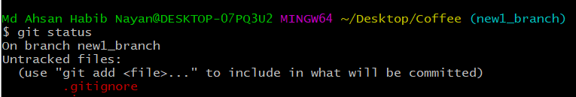
Git Ignore
◆ If you want some files do not need to be commit or add we can make a list of them into “.gitignore” file.
◆ Let’s first create a file which should be ignored (ex: no_need.txt).
◆ Now we need to create “.gitignore” file and write no_need.txt inside it. Now run git status, you can see that the no_need.txt file not be tracked.

Slide 52
Readme.md

Slide 53

Markdown
Markdown is a way to style text on the web. You control the display of the document; formatting words as bold or italic, adding images, and creating lists are just a few of the things we can do with Markdown. Mostly, Markdown is just regular text with a few non-alphabetic characters thrown in, like # or *.
https://www.markdownguide.org/basic-syntax/

Slide 54
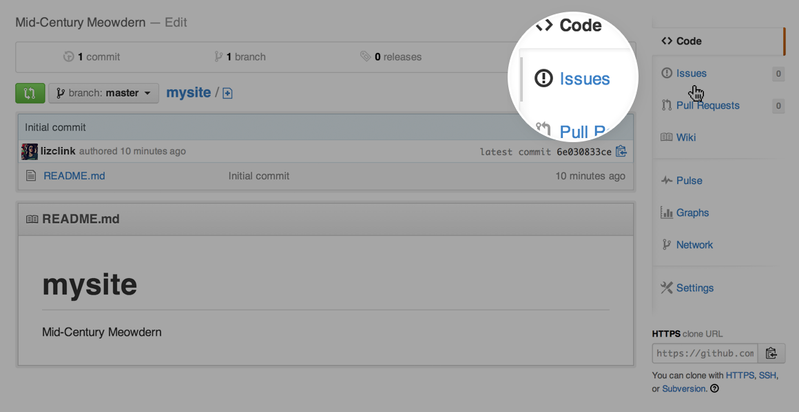
Issues
Issues are a great way to keep track of tasks, enhancements, and bugs for your projects. They’re kind of like email—except they can be shared and discussed with the rest of your team. Most software projects have a bug tracker of some kind. GitHub’s tracker is called Issues, and has its own section in every repository.

Slide 55
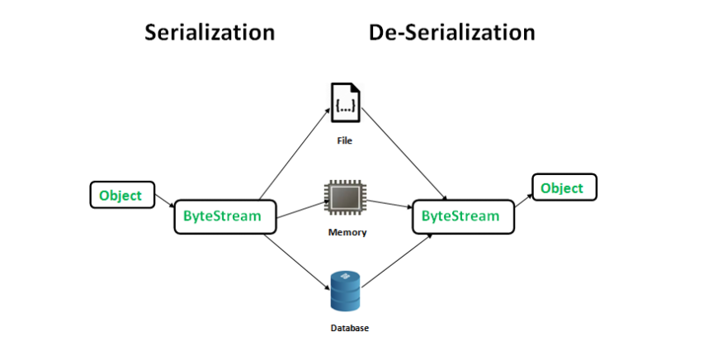
Serialization and Deserialization
Serialization is a mechanism of converting the state of an object into a byte stream. Deserialization is the reverse process where the byte stream is used to recreate the actual Java object in memory. This mechanism is used to persist the object.

Slide 56
Serialization and Deserialization
class Demo implements java.io.Serializable { public int a; public String b; // Default constructor public Demo(int a, String b) { this.a = a; this.b = b; } } class Test { public static void main(String[] args) { Demo object = new Demo(1, "geeksforgeeks"); String filename = "file.ser"; // Serialization try { //Saving of object in a file FileOutputStream file = new FileOutputStream(filename); ObjectOutputStream out = new ObjectOutputStream(file); // Method for serialization of object out.writeObject(object); out.close(); file.close(); System.out.println("Object has been serialized"); } catch(IOException ex) { System.out.println("IOException is caught"); }
}
}

Slide 57
מקורות
Md. Ahsan Habib Email: habib@cse.green.edu.bd Cell: 01515626136.
https://www.java8net.com/2020/03/serialize-hashmap-in-java.html

