Slide 1
תכנות מונחה עצמים תרגול 7
מייל : simon.pikalov@msmail.ariel.ac.il
נכתב ע"י : סמיון פיקלוב

Slide 2
נושאים להיום
Multithreading cont.
Java Gui

Slide 3

Java - Multithreading

Slide 4
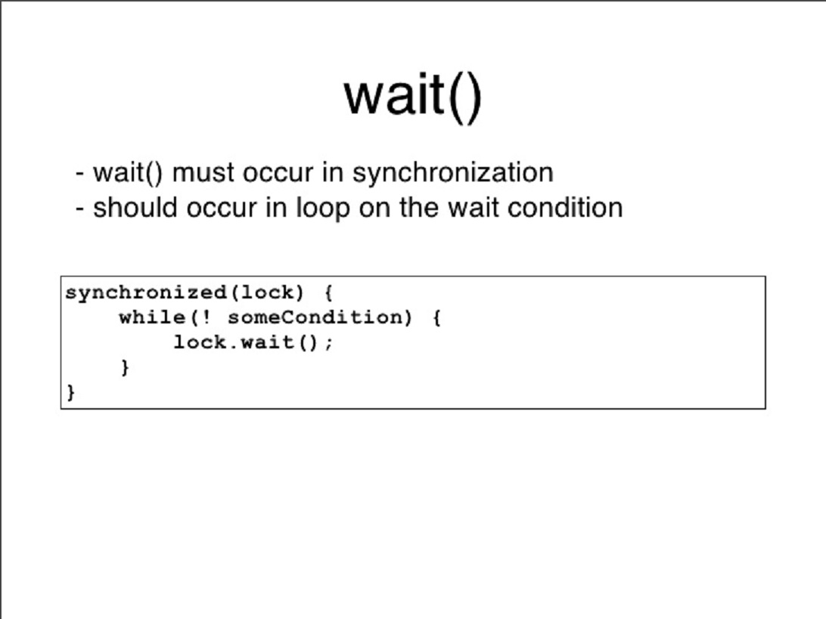
wait
wait()
The wait() method causes the current thread to wait indefinitely until another thread either invokes notify() for this object or notifyAll().
wait(long timeout)
Using this method, we can specify a timeout after which thread will be woken up automatically. A thread can be woken up before reaching the timeout using notify() or notifyAll().
Note that calling wait(0) is the same as calling wait().

Slide 5
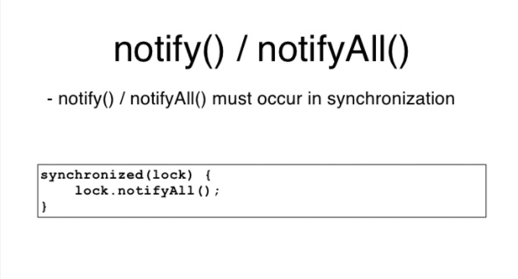
notify
notify() and notifyAll()
The notify() method is used for waking up threads that are waiting for an access to this object's monitor.
There are two ways of notifying waiting threads:
notify()
For all threads waiting on this object's monitor (by using any one of the wait() method), the method notify() notifies any one of them to wake up arbitrarily. The choice of exactly which thread to wake is non-deterministic and depends upon the implementation.
Since notify() wakes up a single random thread it can be used to implement mutually exclusive locking where threads are doing similar tasks, but in most cases, it would be more viable to implement notifyAll().
notifyAll()
This method simply wakes all threads that are waiting on this object's monitor.
The awakened threads will complete in the usual manner – like any other thread.
But before we allow their execution to continue, always define a quick check for the condition required to proceed with the thread – because there may be some situations where the thread got woken up without receiving a notification (this scenario is discussed later in an example).

Slide 6
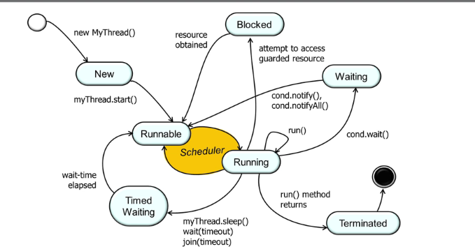
Java - Multithreading
Java is a multi-threaded programming language which means we can develop multi-threaded program using Java. A multi-threaded program contains two or more parts that can run concurrently and each part can handle a different task at the same time making optimal use of the available resources specially when your computer has multiple CPUs.
By definition, multitasking is when multiple processes share common processing resources such as a CPU. Multi-threading extends the idea of multitasking into applications where you can subdivide specific operations within a single application into individual threads. Each of the threads can run in parallel. The OS divides processing time not only among different applications, but also among each thread within an application.
Multi-threading enables you to write in a way where multiple activities can proceed concurrently in the same program.

Slide 7
Java Concurrency Utilities - java.util.concurrent
Java 5 added a new Java package to the Java platform, the java.util.concurrent package. This package contains a set of classes that makes it easier to develop concurrent (multithreaded) applications in Java. Before this package was added, you would have to program your utility classes yourself.
Java BlockingQueue
Java ArrayBlockingQueue
Java DelayQueue
Java LinkedBlockingQueue
Java PriorityBlockingQueue
Java SynchronousQueue
Java BlockingDeque
Java LinkedBlockingDeque
Java ConcurrentMap
Java ConcurrentNavigableMap
Java CountDownLatch
Java CyclicBarrier
Java Exchanger
Java Semaphore
Java ExecutorService
Java Callable
Java Future
Java ThreadPoolExecutor
Java ScheduledExecutorService
Java ForkJoinPool
Java Lock
Java ReadWriteLock
Java AtomicInteger
Java AtomicLong
Java AtomicReference
Java AtomicStampedReference
Java AtomicIntegerArray
Java AtomicLongArray
Java AtomicReferenceArray

Slide 8

Dynamic Thread sleep
Thread.sleep causes the current thread to suspend execution for a specified period. This is an efficient means of making processor time available to the other threads of an application or other applications that might be running on a computer system. The Thread sleep time may variate to achieve more dynamic system.

Slide 9
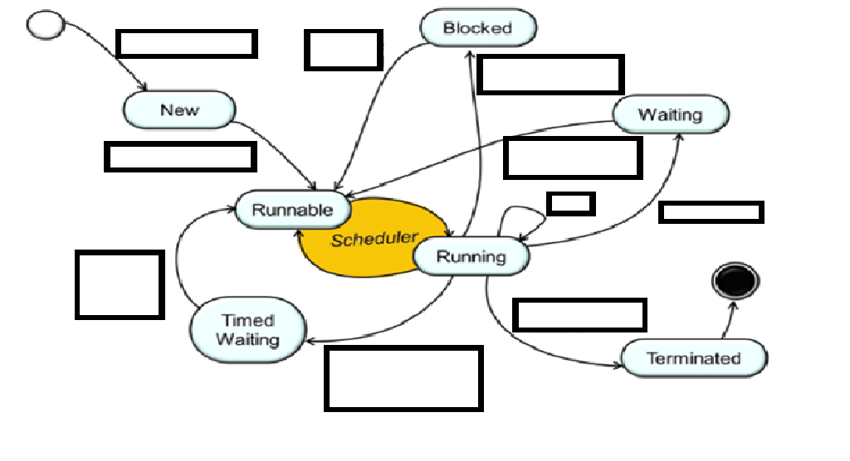








Fill this to see if you understood

Slide 10

Java gui

Slide 11
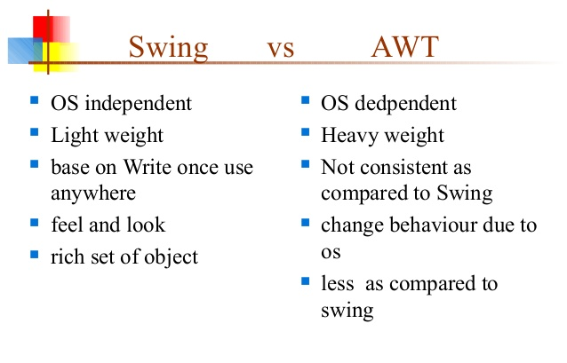
AWT vs. Swing
Each ION Java component is shipped in two forms, one built on AWT classes, the other on Swing classes. This section discusses the difference between AWT and Swing, the advantages and disadvantages of each, and how to distinguish between the ION AWT classes and the ION Swing classes.
AWT and Swing are both part of a group of Java class libraries called the Java Foundation Classes (JFC). The Abstract Windowing Toolkit (AWT) is the original GUI toolkit shipped with the Java Development Kit (JDK). The AWT provides a basic set of graphical interface components similar to those available with HTML forms. Swing is the latest GUI toolkit, and provides a richer set of interface components than the AWT. In addition, Swing components offer the following advantages over AWT components:
The behavior and appearance of Swing components is consistent across platforms, whereas AWT components will differ from platform to platform
Swing components can be given their own "look and feel"
Swing uses a more efficient event model than AWT; therefore, Swing components can run more quickly than their AWT counterparts

Slide 12
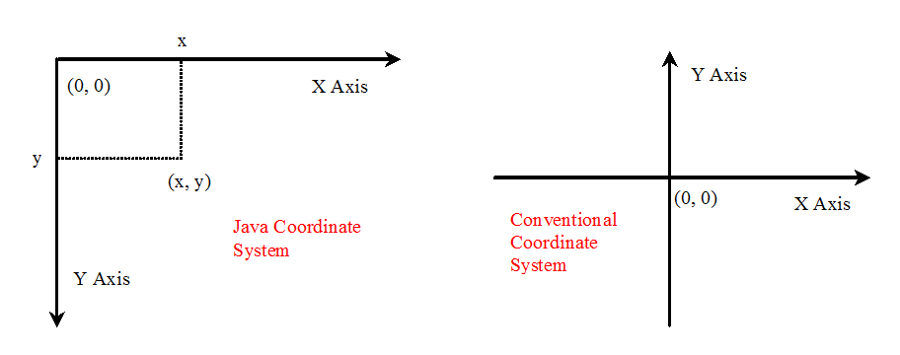
Java Coordinate System
To paint, you need to know where to paint.
the origin (0, 0) at the upper-left corner of the component

Slide 13
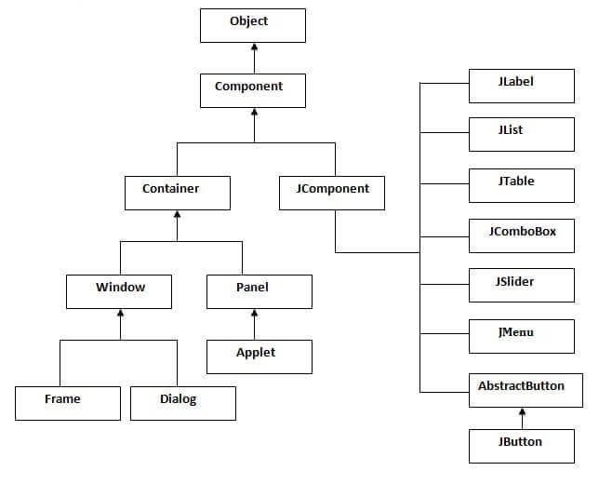
Hierarchy of Java Swing classes
The hierarchy of java swing API is given below.

Slide 14
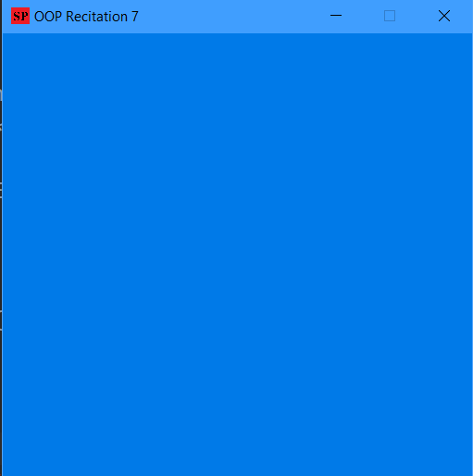
JFrame
The javax.swing.JFrame class is a type of container which inherits the java.awt.Frame class. JFrame works like the main window where components like labels, buttons, textfields are added to create a GUI.

Slide 15
JLabel
The object of JLabel class is a component for placing text in a container. It is used to display a single line of read only text. The text can be changed by an application but a user cannot edit it directly. It inherits JComponent class.
Constructor | Description
JLabel() | Creates a JLabel instance with no image and with an empty string for the title.
JLabel(String s) | Creates a JLabel instance with the specified text.
JLabel(Icon i) | Creates a JLabel instance with the specified image.
JLabel(String s, Icon i, int horizontalAlignment) | Creates a JLabel instance with the specified text, image, and horizontal alignment.
Methods | Description
String getText() | t returns the text string that a label displays.
void setText(String text) | It defines the single line of text this component will display.
void setHorizontalAlignment(int alignment) | It sets the alignment of the label's contents along the X axis.
Icon getIcon() | It returns the graphic image that the label displays.
int getHorizontalAlignment() | It returns the alignment of the label's contents along the X axis.

Slide 16
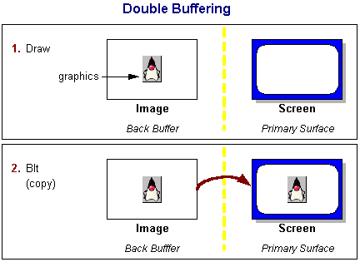
Double Buffering
Suppose you had to draw an entire picture on the screen, pixel by pixel or line by line. If you were to draw such a thing directly to the screen (using, say, Graphics.drawLine), you would probably notice with much disappointment that it takes a bit of time. You will probably even notice visible artifacts of how your picture is drawn. Rather than watching things being drawn in this fashion and at this pace, most programmers use a technique called double-buffering.
The traditional notion of double-buffering in Java applications is fairly straightforward: create an offscreen image, draw to that image using the image's graphics object, then, in one step, call drawImage using the target window's graphics object and the offscreen image. You may have already noticed that Swing uses this technique in many of its components, usually enabled by default, using the setDoubleBuffered method.

Slide 17
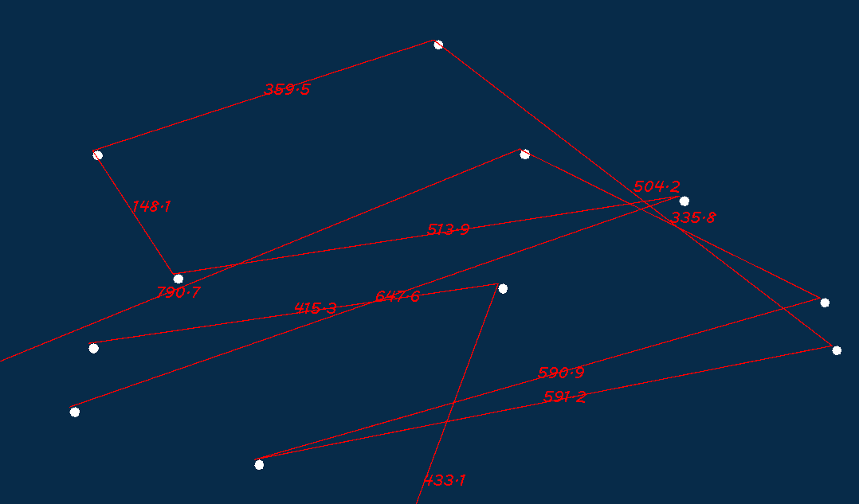
JPanel
The JPanel is a simplest container class. It provides space in which an application can attach any other component. It inherits the JComponents class.
It doesn't have title bar.
JPanel() | It is used to create a new JPanel with a double buffer and a flow layout.

Slide 18
Scale
* * @param data denote some data to be scaled * @param r_min the minimum of the range of your data * @param r_max the maximum of the range of your data * @param t_min the minimum of the range of your desired target scaling * @param t_max the maximum of the range of your desired target scaling * @return */ private double scale(double data, double r_min, double r_max, double t_min, double t_max) { double res = ((data - r_min) / (r_max-r_min)) * (t_max - t_min) + t_min; return res; }

Slide 19
Sources
https://www.geeksforgeeks.org/daemon-thread-java/?ref=lbp
http://tutorials.jenkov.com/java-util-concurrent/index.html

