Slide 1
תכנות מונחה עצמים תרגול 9
מייל : simon.pikalov@msmail.ariel.ac.il
נכתב ע"י : סמיון פיקלוב

Slide 2
נושאים להיום
Python

Slide 3
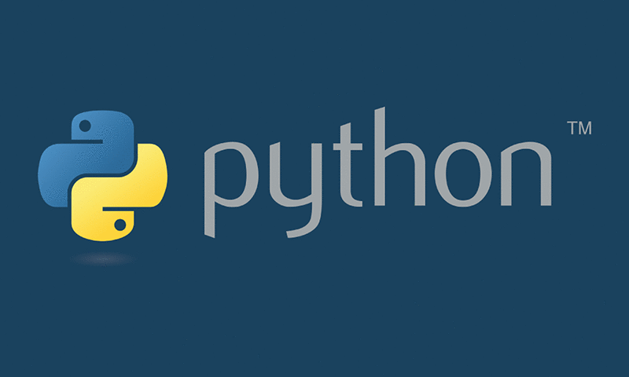
python

Slide 4
Interpreted language
An interpreted language is a type of programming language for which most of its implementations execute instructions directly and freely, without previously compiling a program into machine-language instructions. The interpreter executes the program directly, translating each statement into a sequence of one or more subroutines, and then into another language (often machine code).
Advantages
Interpreting a language gives implementations some additional flexibility over compiled implementations. Features that are often easier to implement in interpreters than in compilers include:
platform independence (Java's byte code, for example)
reflection and reflective use of the evaluator (e.g. a first-order eval function)
dynamic typing
smaller executable program size (since implementations have flexibility to choose the instruction code)
dynamic scoping
Furthermore, source code can be read and copied, giving users more freedom.
Disadvantages of interpreted languages are:
Without static type-checking, which is usually performed by a compiler, programs can be less reliable,[citation needed] because type checking eliminates a class of programming errors (though type-checking of the code can be done by using additional stand-alone tools. See TypeScript for instance)
Interpreters can be susceptible to Code injection attacks.
Slower execution compared to direct native machine code execution on the host CPU. A technique used to improve performance is just-in-time compilation which converts frequently executed sequences of interpreted instruction to host machine code. JIT is most often combined with compilation to byte-code as in Java.
Source code can be read and copied (e.g. JavaScript in web pages), or more easily reverse engineered through reflection in applications where intellectual property has a commercial advantage. In some cases, obfuscation is used as a partial defense against this.

Slide 5
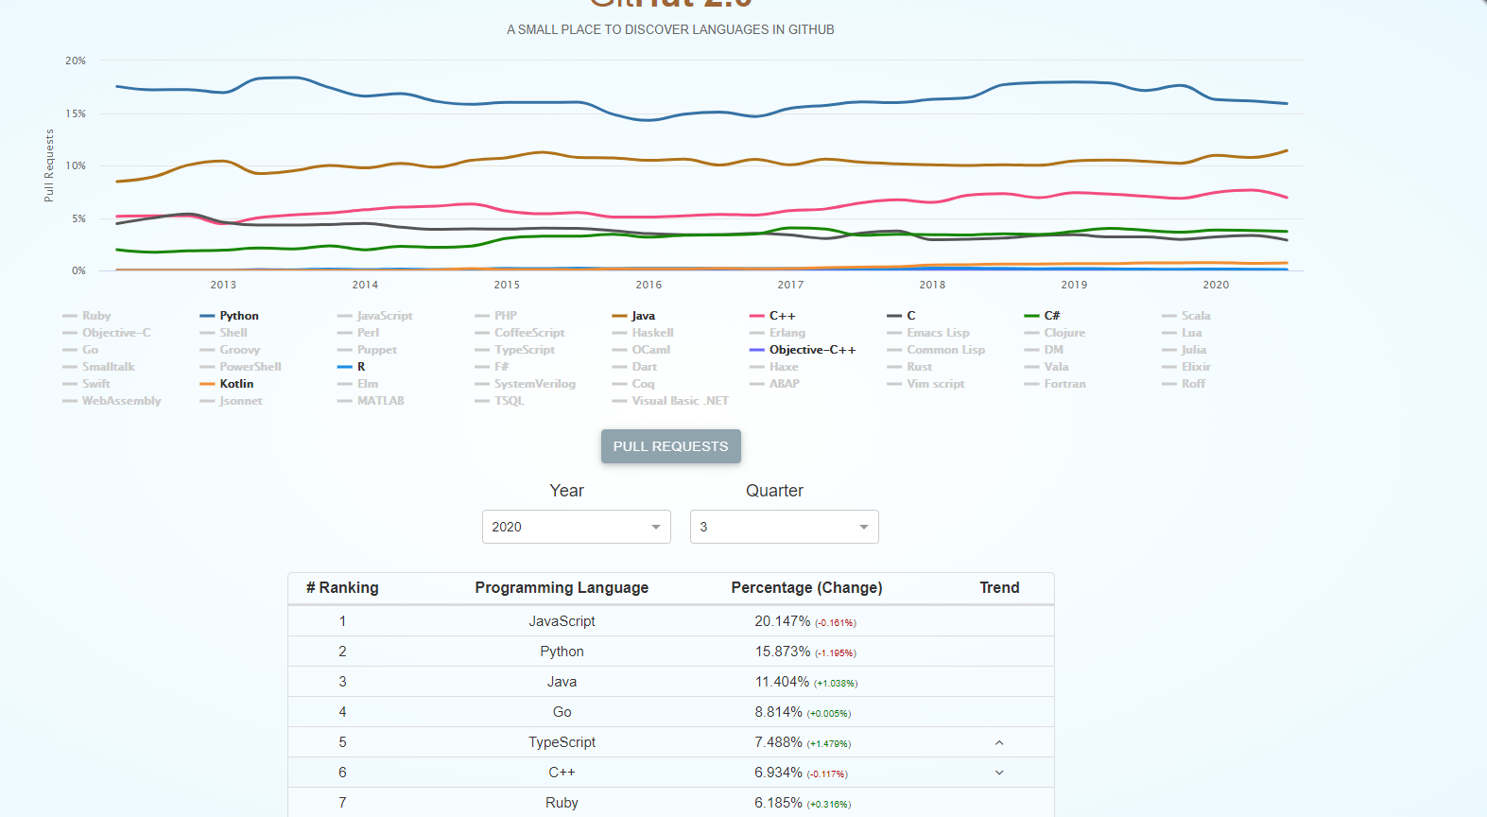
Why Python?
Python works on different platforms (Windows, Mac, Linux, Raspberry Pi, etc).
Python has a simple syntax similar to the English language.
Python has syntax that allows developers to write programs with fewer lines than some other programming languages.
Python runs on an interpreter system, meaning that code can be executed as soon as it is written. This means that prototyping can be very quick.
Python can be treated in a procedural way, an object-oriented way or a functional way.

Slide 6
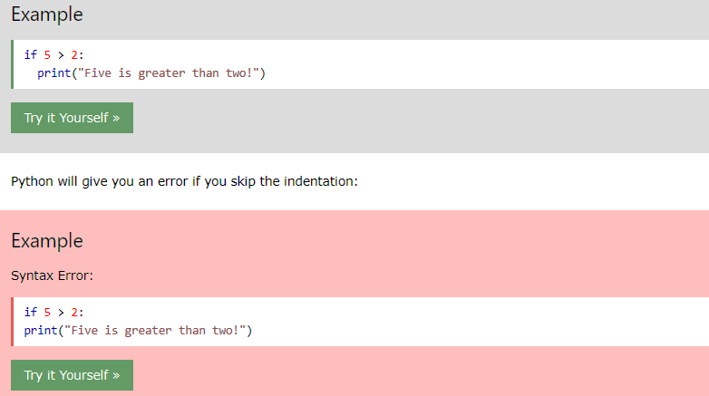
Python Indentation
Indentation refers to the spaces at the beginning of a code line.
Where in other programming languages the indentation in code is for readability only, the indentation in Python is very important.
Python uses indentation to indicate a block of code.

Slide 7
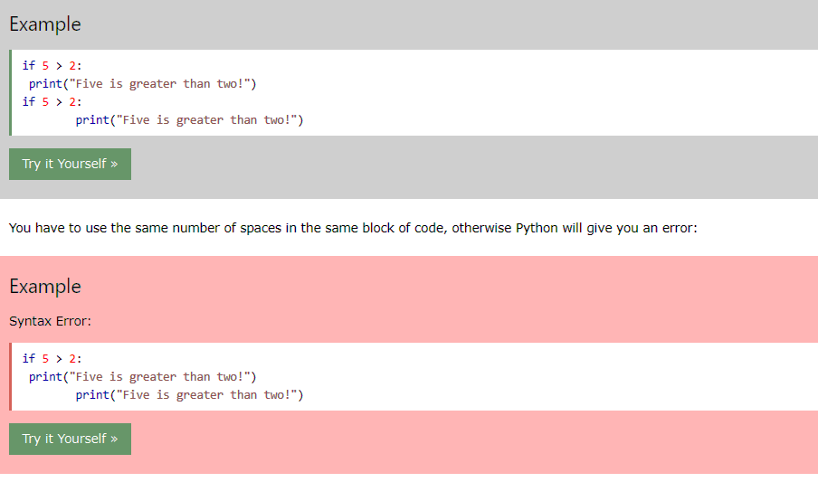
Python Indentation cont
Indentation refers to the spaces at the beginning of a code line.
Where in other programming languages the indentation in code is for readability only, the indentation in Python is very important.
Python uses indentation to indicate a block of code.

Slide 8
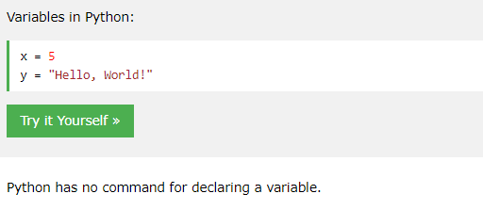
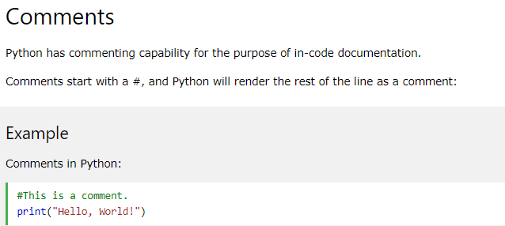
Python syntax basics
In Python, variables are created when you assign a value to it

Slide 9
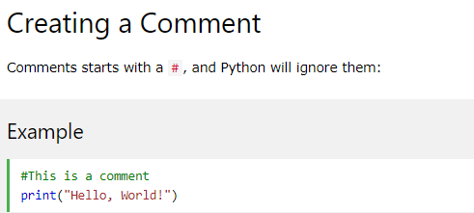
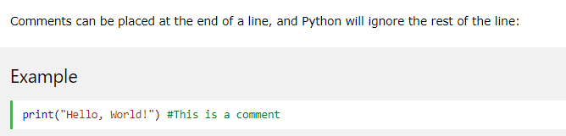
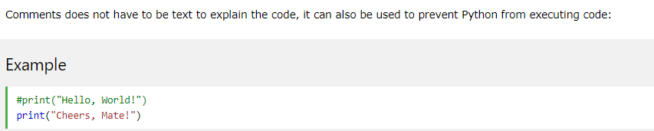
Python Comments
Comments can be used to explain Python code.
Comments can be used to make the code more readable.
Comments can be used to prevent execution when testing code.

Slide 10
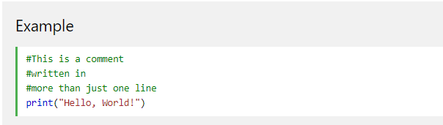
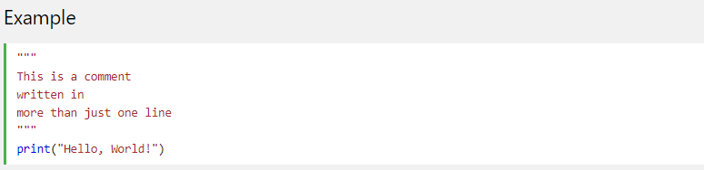
Multi Line Comments
First way for a Multi Line Comments
Second way for a Multi Line Comments

Slide 11
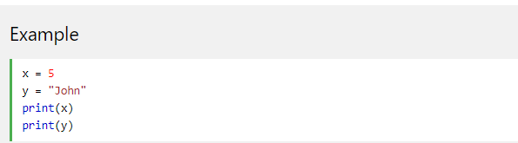

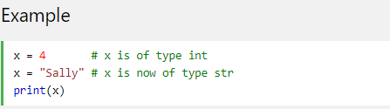
Python Variables
Creating Variables
Python has no command for declaring a variable.
A variable is created the moment you first assign a value to it.
Variables do not need to be declared with any particular type, and can even change type after they have been set.

Slide 12
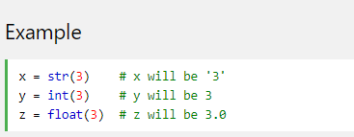
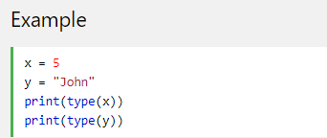
Python Variables
If you want to specify the data type of a variable, this can be done with casting.
Get the Type
You can get the data type of a variable with the type() function.

Slide 13
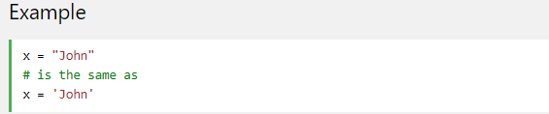
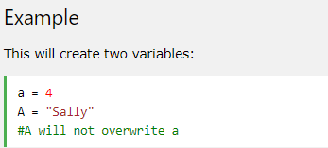
Python Variables
Single or Double Quotes? (Same as java)
String variables can be declared either by using single or double quotes:
Case-Sensitive (Same as java)
Variable names are case-sensitive.

Slide 14
Python Variables
Creating Variables
Python has no command for declaring a variable.
A variable is created the moment you first assign a value to it.
Variables do not need to be declared with any particular type, and can even change type after they have been set.

Slide 15
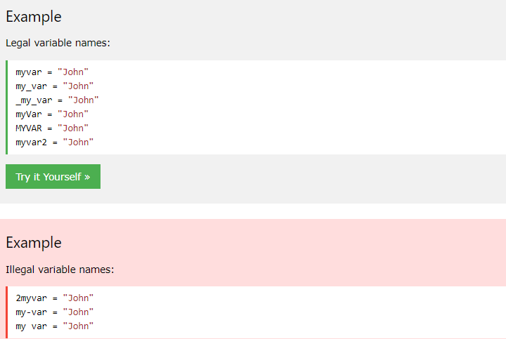
Python - Variable Names
A variable can have a short name (like x and y) or a more descriptive name (age, carname, total_volume). Rules for Python variables:
A variable name must start with a letter or the underscore character
A variable name cannot start with a number
A variable name can only contain alpha-numeric characters and underscores (A-z, 0-9, and _ )
Variable names are case-sensitive (age, Age and AGE are three different variables)

Slide 16
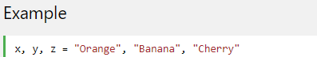
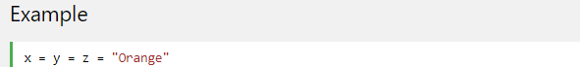
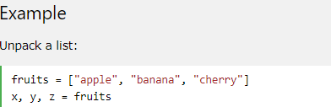
Python Variables - Assign Multiple Values
Many Values to Multiple Variables
Python allows you to assign values to multiple variables in one line:
One Value to Multiple Variables
And you can assign the same value to multiple variables in one line:
Unpack a Collection
If you have a collection of values in a list, tuple etc. Python allows you extract the values into variables. This is called unpacking.

Slide 17
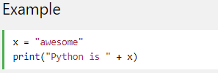

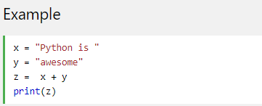

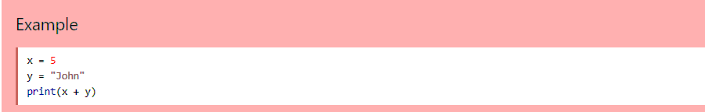
Output Variables
The Python print statement is often used to output variables.
To combine both text and a variable, Python uses the + character:
You can also use the + character to add a variable to another variable:
If you try to combine a string and a number, Python will give you an error:

Slide 18
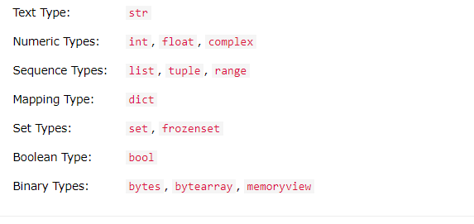
Python Data Types
Built-in Data Types
In programming, data type is an important concept.
Variables can store data of different types, and different types can do different things.
Python has the following data types built-in by default, in these categories:

Slide 19
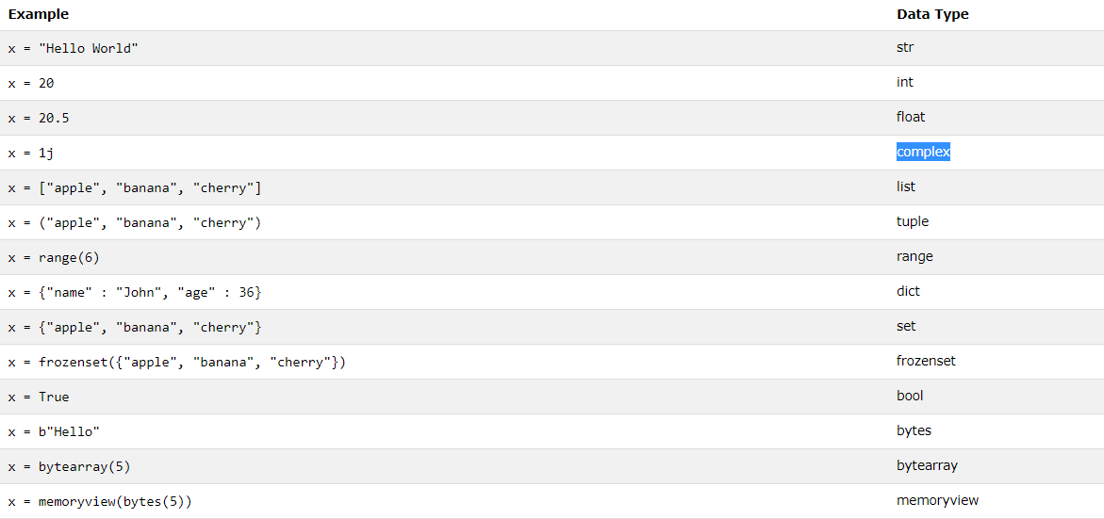
Python Data Types Cont.
In Python, the data type is set when you assign a value to a variable:

Slide 20

Random Number
Random Number
Python does not have a random() function to make a random number, but Python has a built-in module called random that can be used to make random numbers:
Example
Import the random module, and display a random number between 1 and 9:

Slide 21
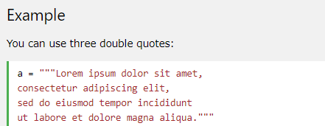
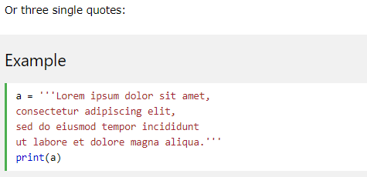
Multiline Strings
You can assign a multiline string to a variable by using three quotes:

Slide 22
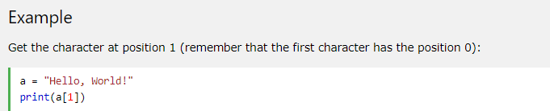

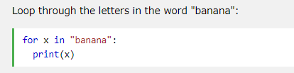
Strings are Arrays
Like many other popular programming languages, strings in Python are arrays of bytes representing unicode characters.
However, Python does not have a character data type, a single character is simply a string with a length of 1.
Square brackets can be used to access elements of the string.
Looping Through a String
Since strings are arrays, we can loop through the characters in a string, with a for loop.

Slide 23
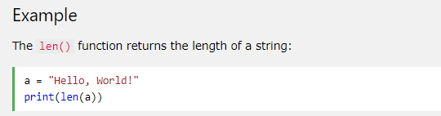
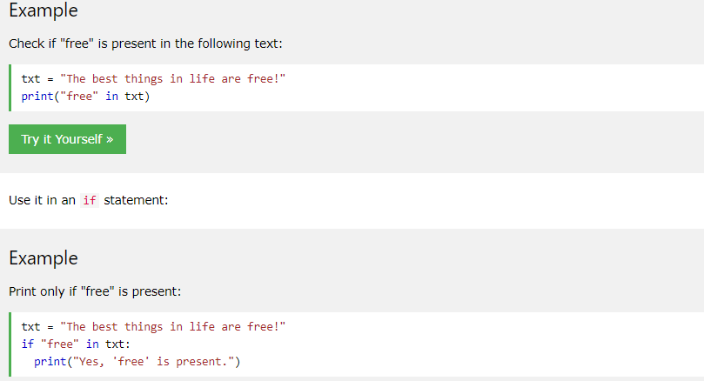


Strings are Arrays
String Length
To get the length of a string, use the len() function.
Check String
To check if a certain phrase or character is present in a string, we can use the keyword in.

Slide 24
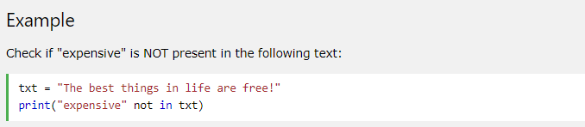
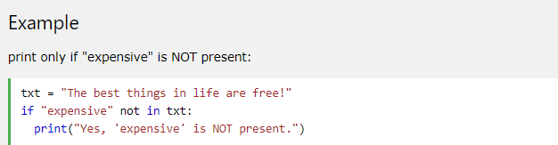
Strings are Arrays
Check if NOT
To check if a certain phrase or character is NOT present in a string, we can use the keyword not in.

Slide 25
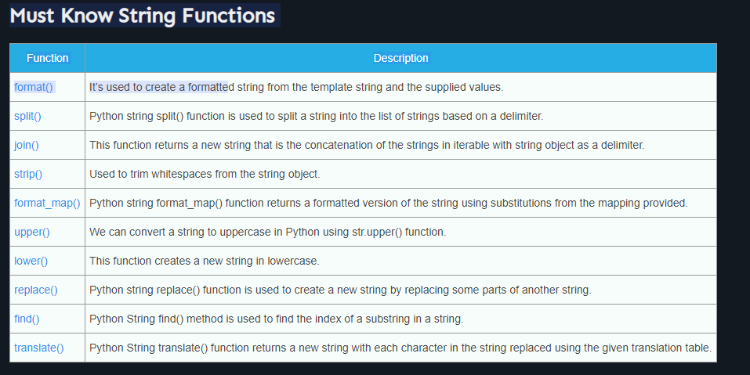
Strings

Slide 26
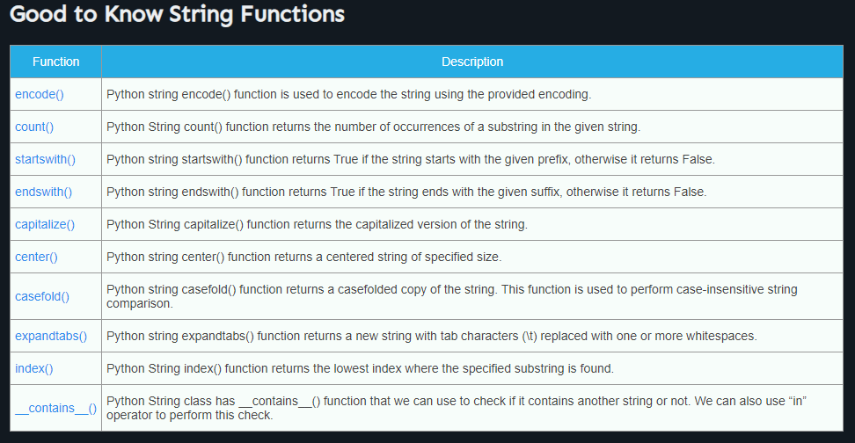
Strings

Slide 27
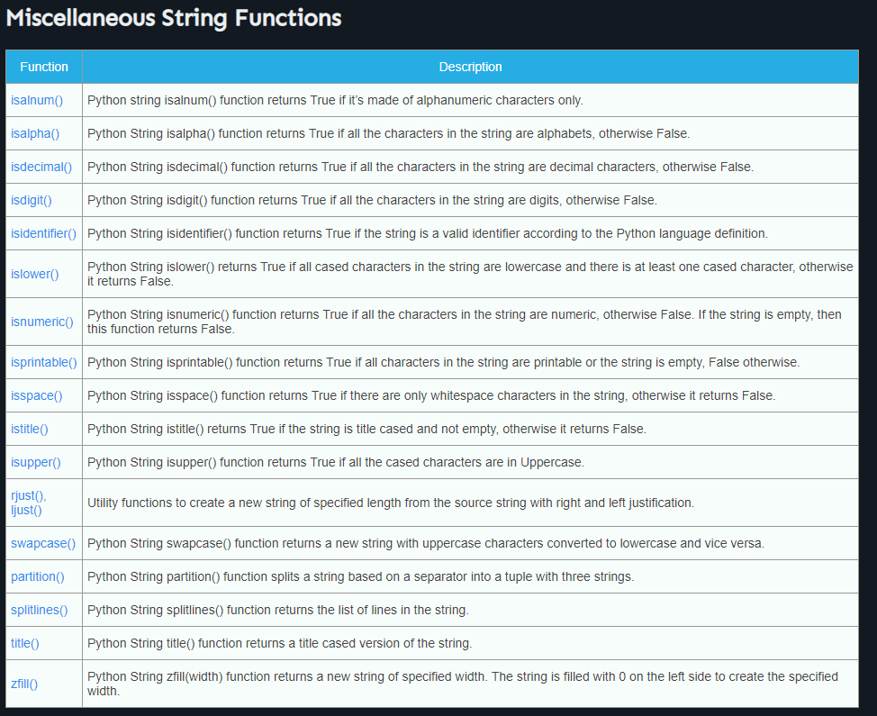
Strings

Slide 28
Strings

Slide 29
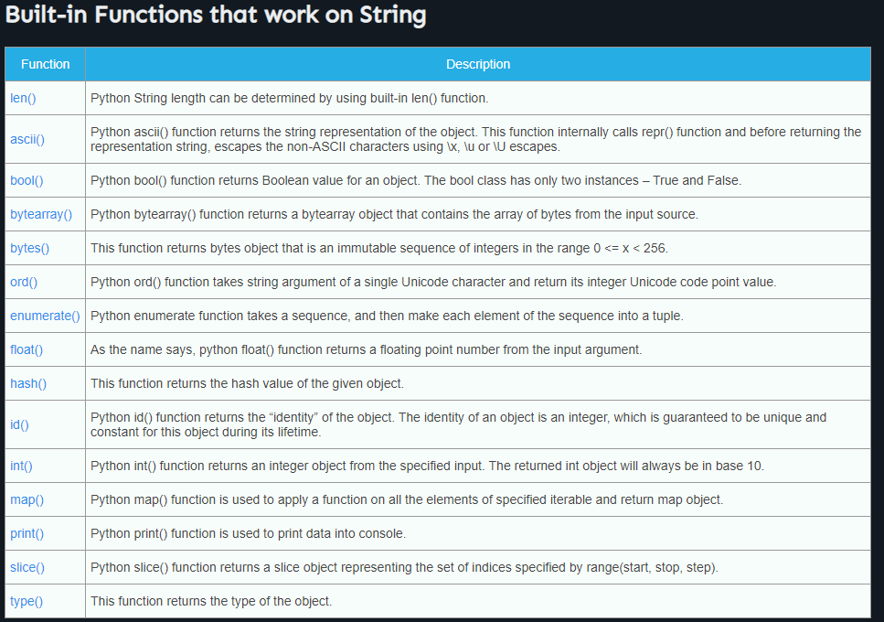
Strings

Slide 30
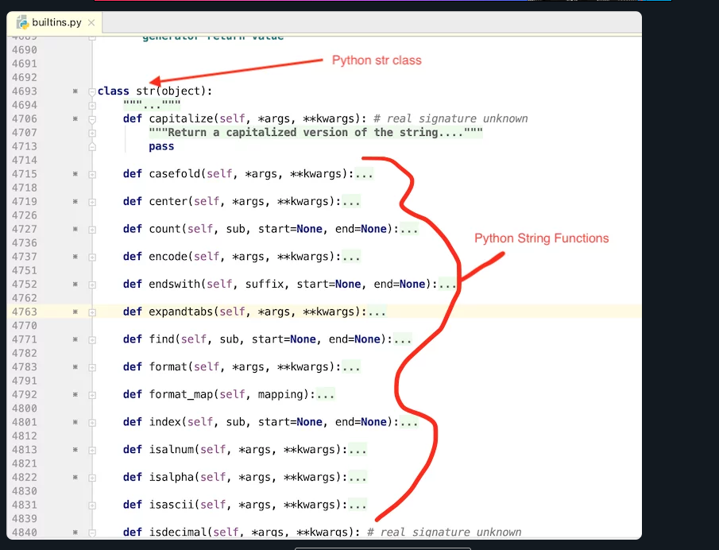
Do I Need to remember all of them ???

Slide 31
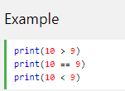

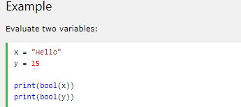

Python Booleans
Booleans represent one of two values: True or False.
Boolean Values
In programming you often need to know if an expression is True or False.
You can evaluate any expression in Python, and get one of two answers, True or False.
When you compare two values, the expression is evaluated and Python returns the Boolean answer:
Evaluate Values and Variables
The bool() function allows you to evaluate any value, and give you True or False in return,

Slide 32
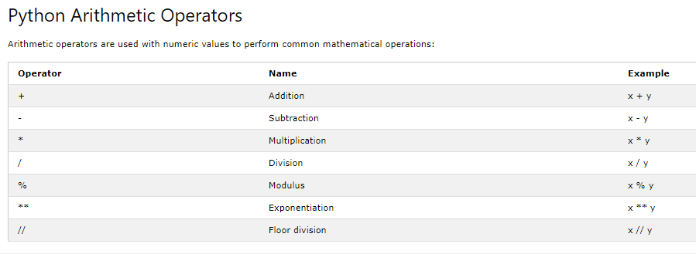
Python Operators
Python Operators
Operators are used to perform operations on variables and values.
In the example below, we use the + operator to add together two values:

Slide 33
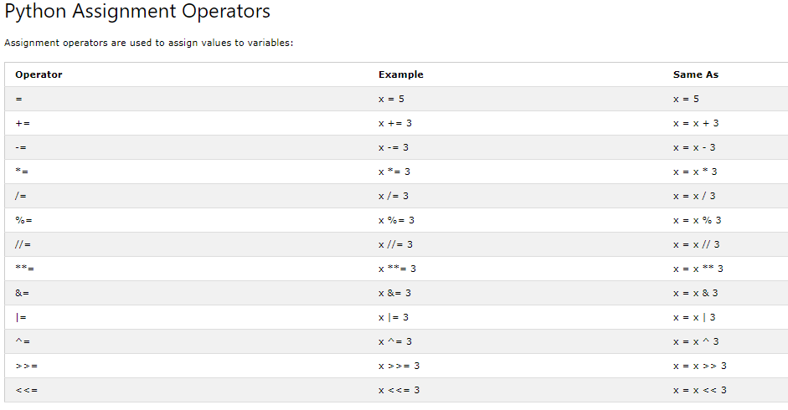
Python Operators

Slide 34
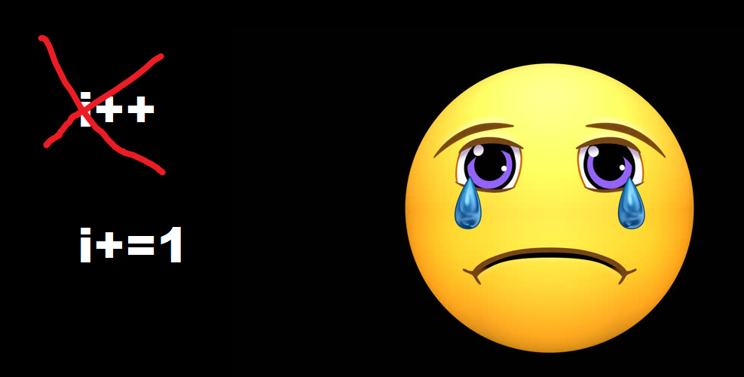
Python Operators

Slide 35
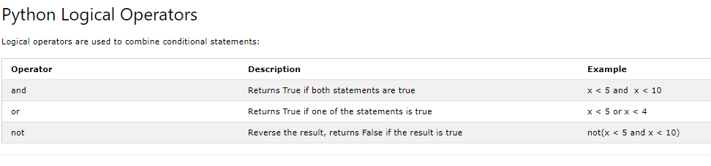
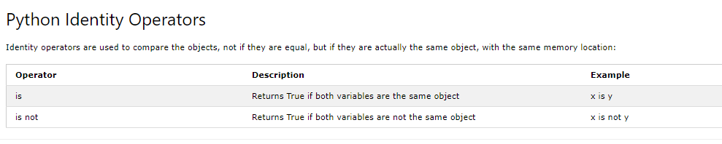
Python Operators

Slide 36
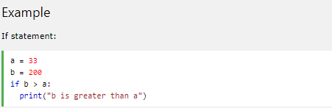
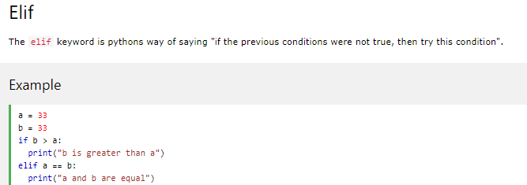
Python If ... Else
If statement:
Python relies on indentation (whitespace at the beginning of a line) to define scope in the code. Java programming language use curly-brackets for this purpose.

Slide 37


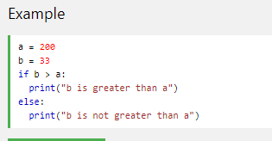

Python If ... Else
If statement:
Python relies on indentation (whitespace at the beginning of a line) to define scope in the code. Java programming language use curly-brackets for this purpose.

Slide 38
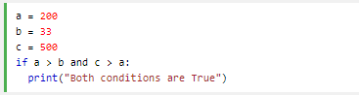



Python If ... Else
And
The and keyword is a logical operator, and is used to combine conditional statements:
Or
The or keyword is a logical operator, and is used to combine conditional statements:

Slide 39


Python If ... Else
Nested If
You can have if statements inside if statements, this is called nested if statements.
The pass Statement
if statements cannot be empty, but if you for some reason have an if statement with no content, put in the pass statement to avoid getting an error.

Slide 40


Short Hand If
If you have only one statement to execute, you can put it on the same line as the if statement.
Short Hand If ... Else
If you have only one statement to execute, one for if, and one for else, you can put it all on the same line:

Slide 41


Python While Loops
The while Loop
With the while loop we can execute a set of statements as long as a condition is true.
The while Loop
With the while loop we can execute a set of statements as long as a condition is true.

Slide 42


Python While Loops
The continue Statement
With the continue statement we can stop the current iteration, and continue with the next:
while-loop-else-clause, which is unique to Python. The else-block is only executed if the while-loop is exhausted.

Slide 43

Python Lists
List
Lists are used to store multiple items in a single variable.
Lists are one of 4 built-in data types in Python used to store collections of data, the other 3 are Tuple, Set, and Dictionary, all with different qualities and usage.
Lists are created using square brackets:
List items are ordered, changeable, and allow duplicate values.
List items are indexed, the first item has index [0], the second item has index [1] etc.\
Ordered
When we say that lists are ordered, it means that the items have a defined order, and that order will not change.
If you add new items to a list, the new items will be placed at the end of the list.
Note: There are some list methods that will change the order, but in general: the order of the items will not change.
Changeable
The list is changeable, meaning that we can change, add, and remove items in a list after it has been created.
Allow Duplicates
Since lists are indexed, lists can have items with the same value.

Slide 44




Python Lists
The list() Constructor
It is also possible to use the list() constructor when creating a new list.

Slide 45



Python - Access List Items
Access Items
List items are indexed and you can access them by referring to the index number:
Negative Indexing
Negative indexing means start from the end
-1 refers to the last item, -2 refers to the second last item etc.
Negative Indexing
Negative indexing means start from the end
-1 refers to the last item, -2 refers to the second last item etc.

Slide 46
Python - Access List Items
Access Items
List items are indexed and you can access them by referring to the index number:
Negative Indexing
Negative indexing means start from the end
-1 refers to the last item, -2 refers to the second last item etc.
Negative Indexing
Negative indexing means start from the end
-1 refers to the last item, -2 refers to the second last item etc.
Note: The search will start at index 2 (included) and end at index 5 (not included).

Slide 47



Python - Access List Items
Example
This example returns the items from the beginning to, but NOT included, "kiwi":
Check if Item Exists
To determine if a specified item is present in a list use the in keyword:

Slide 48


Modifying elements in a list
Example
This example returns the items from the beginning to, but NOT included, "kiwi":

Slide 49

Modifying elements in a list
Example
This example returns the items from the beginning to, but NOT included, "kiwi":

Slide 50



Removing elements from a list
The remove() method removes the specified item.
The remove() method removes the specified item.

Slide 51



Removing elements from a list
If you do not specify the index, the pop() method removes the last item.
Remove the first item
The clear() method empties the list.
The list still remains, but it has no content.

Slide 52




Join Two Lists
There are several ways to join, or concatenate, two or more lists in Python.
One of the easiest ways are by using the + operator.
Use the extend() method to add list2 at the end of list1:

Slide 53

List Methods
Python has a set of built-in methods that you can use on lists.

Slide 54
List Methods
Python has a set of built-in methods that you can use on lists.

Slide 55

List Methods Complexity

Slide 56


Python Tuples
Tuples are used to store multiple items in a single variable.
A tuple is a collection which is ordered and unchangeable.
Tuples are written with round brackets.
Tuple items are ordered, unchangeable, and allow duplicate values.
Tuple items are indexed, the first item has index [0], the second item has index [1] etc.
Ordered
When we say that tuples are ordered, it means that the items have a defined order, and that order will not change.
Unchangeable
Tuples are unchangeable, meaning that we cannot change, add or remove items after the tuple has been created.
Allow Duplicates
Since tuple are indexed, tuples can have items with the same value:

Slide 57




Python Tuples
To determine how many items a tuple has, use the len() function:
Access Tuple Items
You can access tuple items by referring to the index number, inside square brackets:

Slide 58

Python Tuples
To determine how many items a tuple has, use the len() function:
Access Tuple Items
You can access tuple items by referring to the index number, inside square brackets:

Slide 59

Change Tuple Values
Once a tuple is created, you cannot change its values. Tuples are unchangeable, or immutable as it also is called.
Tuples are unchangeable, so you cannot remove items from it

Slide 60


Python - Unpack Tuples
Unpacking a Tuple
When we create a tuple, we normally assign values to it. This is called "packing" a tuple:
Unpacking a Tuple
When we create a tuple, we normally assign values to it. This is called "packing" a tuple:

Slide 61



Tuples
To join two or more tuples you can use the + operator
If you want to multiply the content of a tuple a given number of times, you can use the * operator:

Slide 62



Python Dictionaries
Dictionaries are used to store data values in key:value pairs.
A dictionary is a collection which is unordered, changeable and does not allow duplicates.
Dictionaries are written with curly brackets, and have keys and values:
Dictionary Items
Dictionary items are unordered, changeable, and does not allow duplicates.
Dictionary items are presented in key:value pairs, and can be referred to by using the key name.

Slide 63


Python Dictionaries
Unordered
When we say that dictionaries are unordered, it means that the items does not have a defined order, you cannot refer to an item by using an index.
Changeable
Dictionaries are changeable, meaning that we can change, add or remove items after the dictionary has been created.
Duplicates Not Allowed
Dictionaries cannot have two items with the same key:

Slide 64


Python Dictionaries
Dictionary Length
To determine how many items a dictionary has, use the len() function:
Dictionary Length
To determine how many items a dictionary has, use the len() function:

Slide 65



Access Dictionary Items
You can access the items of a dictionary by referring to its key name, inside square brackets:
You can access the items of a dictionary by referring to its key name, inside square brackets:
The keys() method will return a list of all the keys in the dictionary.

Slide 66


Access Dictionary Items
The list of the keys is a view of the dictionary, meaning that any changes done to the dictionary will be reflected in the keys list.

Slide 67



Access Dictionary Items
Get Values
The values() method will return a list of all the values in the dictionary.
The items() method will return each item in a dictionary, as tuples in a list.

Slide 68





Loop Through a Dictionary
You can loop through a dictionary by using a for loop.
When looping through a dictionary, the return value are the keys of the dictionary, but there are methods to return the values as well.

Slide 69

Dictionary Methods Complexity

Slide 70

python data structures

Slide 71




Python For Loops
A for loop is used for iterating over a sequence (that is either a list, a tuple, a dictionary, a set, or a string).
This is less like the for keyword in other programming languages, and works more like an iterator method as found in other object-orientated programming languages.
With the for loop we can execute a set of statements, once for each item in a list, tuple, set etc.

Slide 72


Python For Loops
With the break statement we can stop the loop before it has looped through all the items:
With the continue statement we can stop the current iteration of the loop, and continue with the next:

Slide 73






Python For Loops The range() Function
To loop through a set of code a specified number of times, we can use the range() function,
The range() function returns a sequence of numbers, starting from 0 by default, and increments by 1 (by default), and ends at a specified number.
To loop through a set of code a specified number of times, we can use the range() function,
The range() function returns a sequence of numbers, starting from 0 by default, and increments by 1 (by default), and ends at a specified number.
The range() function defaults to increment the sequence by 1, however it is possible to specify
the increment value by adding a third parameter: range(2, 30, 3):

Slide 74


Python For Loops
A nested loop is a loop inside a loop.
The "inner loop" will be executed one time for each iteration of the "outer loop":
The pass Statement
for loops cannot be empty, but if you for some reason have a for loop with no content, put in the pass statement to avoid getting an error.

Slide 75



Python Functions
n Python a function is defined using the def keyword:
To call a function, use the function name followed by parenthesis:
Information can be passed into functions as arguments.
Arguments are specified after the function name, inside the parentheses. You can add as many arguments as you want, just separate them with a comma.
The following example has a function with one argument (fname). When the function is called, we pass along a first name, which is used inside the function to print the full name:

Slide 76
Python Functions
n Python a function is defined using the def keyword:
To call a function, use the function name followed by parenthesis:
Information can be passed into functions as arguments.
Arguments are specified after the function name, inside the parentheses. You can add as many arguments as you want, just separate them with a comma.
The following example has a function with one argument (fname). When the function is called, we pass along a first name, which is used inside the function to print the full name:

Slide 77


Python Functions
By default, a function must be called with the correct number of arguments. Meaning that if your function expects 2 arguments, you have to call the function with 2 arguments, not more, and not less.
Keyword Arguments
You can also send arguments with the key = value syntax.
This way the order of the arguments does not matter.

Slide 78


Python Functions
Default Parameter Value
The following example shows how to use a default parameter value.
If we call the function without argument, it uses the default value:
You can send any data types of argument to a function (string, number, list, dictionary etc.), and it will be treated as the same data type inside the function.
E.g. if you send a List as an argument, it will still be a List when it reaches the function:

Slide 79

Python Functions
Return Values
To let a function return a value, use the return statement:
The pass Statement
function definitions cannot be empty, but if you for some reason have a function definition with no content, put in the pass statement to avoid getting an error.

Slide 80



Python - Global Variables
Global Variables
Variables that are created outside of a function (as in all of the examples above) are known as global variables.
Global variables can be used by everyone, both inside of functions and outside.
If you create a variable with the same name inside a function, this variable will be local, and can only be used inside the function. The global variable with the same name will remain as it was, global and with the original value.

Slide 81




Python - Global Variables Cont.
The global Keyword
Normally, when you create a variable inside a function, that variable is local, and can only be used inside that function.
To create a global variable inside a function, you can use the global keyword.
Also, use the global keyword if you want to change a global variable inside a function.

Slide 82






Python String Formatting
To make sure a string will display as expected, we can format the result with the format() method.
The format() method allows you to format selected parts of a string.
Sometimes there are parts of a text that you do not control, maybe they come from a database, or user input?
To control such values, add placeholders (curly brackets {}) in the text, and run the values through the format() method:
You can add parameters inside the curly brackets to specify how to convert the value:
If you want to use more values, just add more values to the format() method:

Slide 83



Python Try Except
The try block lets you test a block of code for errors.
The except block lets you handle the error.
The finally block lets you execute code, regardless of the result of the try- and except blocks.
You can define as many exception blocks as you want, e.g. if you want to execute a special block of code for a special kind of error:

Slide 84



Python Try Except
The finally block, if specified, will be executed regardless if the try block raises an error or not.
This can be useful to close objects and clean up resources:

Slide 85


Raise an exception
As a Python developer you can choose to throw an exception if a condition occurs.
To throw (or raise) an exception, use the raise keyword
The raise keyword is used to raise an exception.
You can define what kind of error to raise, and the text to print to the user.

Slide 86


catch all exceptions
Notice the normal from here.

Slide 87

Python User Input
Python 3.6 uses the input() method.

Slide 88
Sources
https://www2.slideshare.net/LiliaSfaxi/software-engineering-chp4-design-patterns
https://www.journaldev.com/1377/java-singleton-design-pattern-best-practices-examples

