Slide 1
תכנות מונחה עצמים תרגול 11
מייל : simon.pikalov@msmail.ariel.ac.il
נכתב ע"י : סמיון פיקלוב

Slide 2
נושאים להיום
abstract classes
Python JSON
Matplotlib basics
Python threads

Slide 3
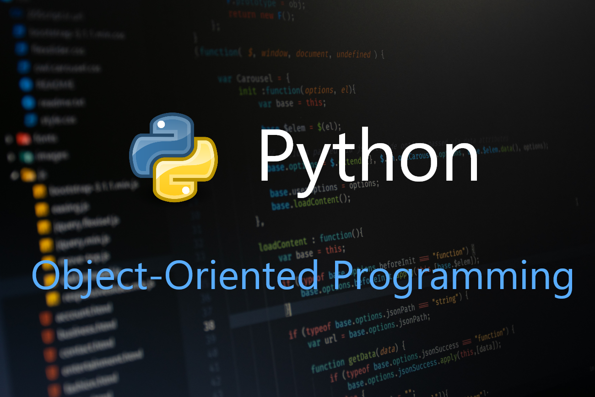
Python

Slide 4
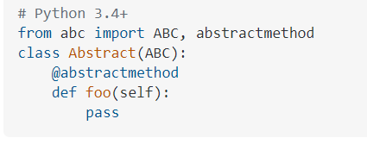
Abstract Classes in Python
An abstract class can be considered as a blueprint for other classes. It allows you to create a set of methods that must be created within any child classes built from the abstract class. A class which contains one or more abstract methods is called an abstract class. An abstract method is a method that has a declaration but does not have an implementation. While we are designing large functional units we use an abstract class. When we want to provide a common interface for different implementations of a component, we use an abstract class.
How Abstract Base classes work :
By default, Python does not provide abstract classes. Python comes with a module which provides the base for defining Abstract Base classes(ABC) and that module name is ABC. ABC works by decorating methods of the base class as abstract and then registering concrete classes as implementations of the abstract base. A method becomes abstract when decorated with the keyword @abstractmethod. For Example –

Slide 5
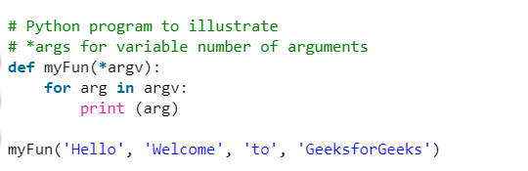

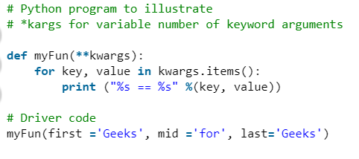
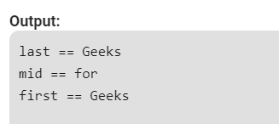
*args and **kwargs in Python
In Python, we can pass a variable number of arguments to a function using special symbols. There are two special symbols:
1.)*args (Non-Keyword Arguments)
2.)**kwargs (Keyword Arguments)
https://www.geeksforgeeks.org/args-kwargs-python/

Slide 6
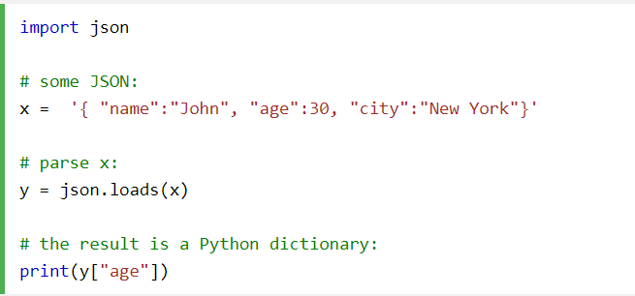
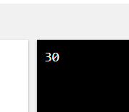
JSON in Python Convert from JSON to Python
Python has a built-in package called json, which can be used to work with JSON data.

Slide 7
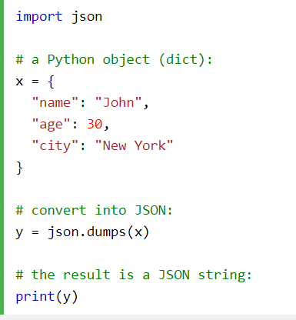
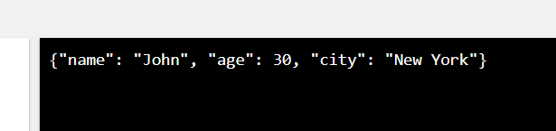
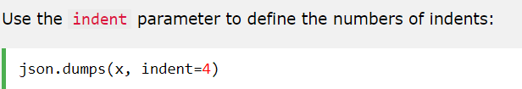
JSON in Python to JSON
If you have a Python object, you can convert it into a JSON string by using the json.dumps() method.
Format the Result
The example above prints a JSON string, but it is not very easy to read, with no indentations and line breaks.
The json.dumps() method has parameters to make it easier to read the result:

Slide 8
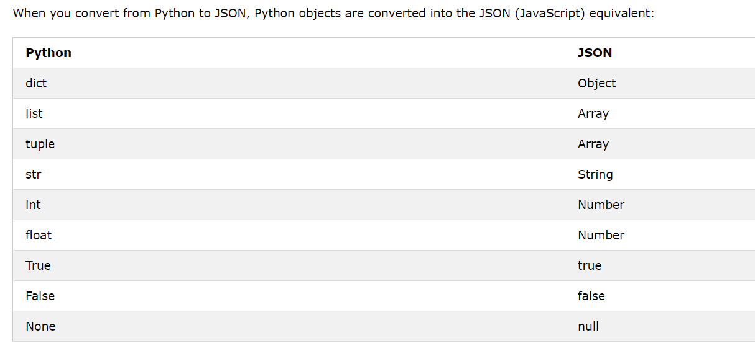
JSON in Python

Slide 9
Concurrency in Python
One of the most frequently asked questions from beginning Python programmers when they explore multithreaded code for optimisation of CPU-bound code is "Why does my program run slower when I use multiple threads?".
The expectation is that on a multi-core machine a multithreaded code should make use of these extra cores and thus increase overall performance. Unfortunately the internals of the main Python interpreter, CPython, negate the possibility of true multi-threading due to a process known as the Global Interpreter Lock (GIL).
The GIL is necessary because the Python interpreter is not thread safe. This means that there is a globally enforced lock when trying to safely access Python objects from within threads. At any one time only a single thread can acquire a lock for a Python object or C API. The interpreter will reacquire this lock for every 100 bytecodes of Python instructions and around (potentially) blocking I/O operations. Because of this lock CPU-bound code will see no gain in performance when using the Threading library, but it will likely gain performance increases if the Multiprocessing library is used.

Slide 10
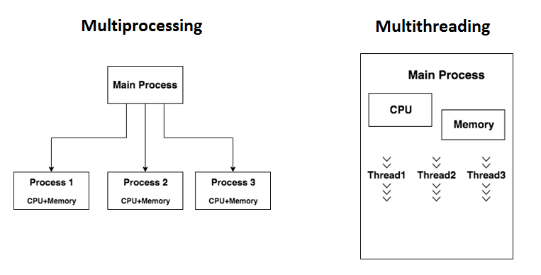
python threads vs processes

Slide 11

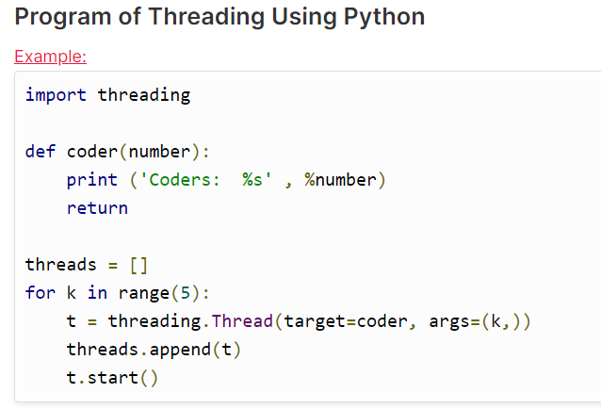
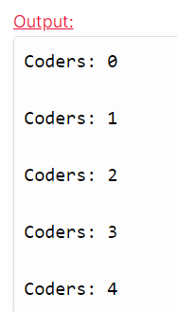
Create a thread
It is achievable to execute functions in a separate thread using a module Thread. For doing this, programmers can use the function - thread.start_new_thread().

Slide 12
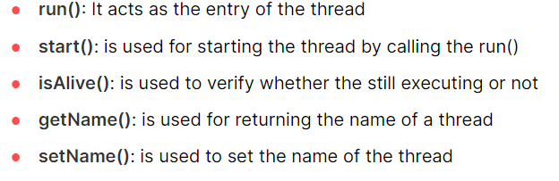
Thread methodes
The threading module, as described earlier, has a Thread class that is used for implementing threads, and that class also contains some predefined methods used by programmers in multi-threaded programming.

Slide 13
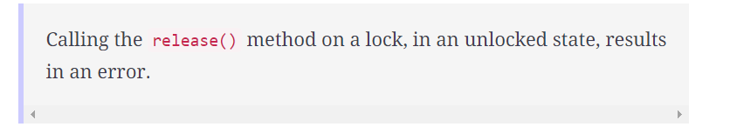
Thread SYNC
Race condition is a significant problem in concurrent programming. The condition occurs when one thread tries to modify a shared resource at the same time that another thread is modifying that resource – t​his leads to garbled output, which is why threads need to be synchronized.
The threading module of Python includes locks as a synchronization tool. A lock has two states:
locked
unlocked
A lock can be locked using the acquire() method. Once a thread has acquired the lock, all subsequent attempts to acquire the lock are blocked until it is released. The lock can be released using the release() method.

Slide 14
Sources
https://www.geeksforgeeks.org/args-kwargs-python/

