Slide 1


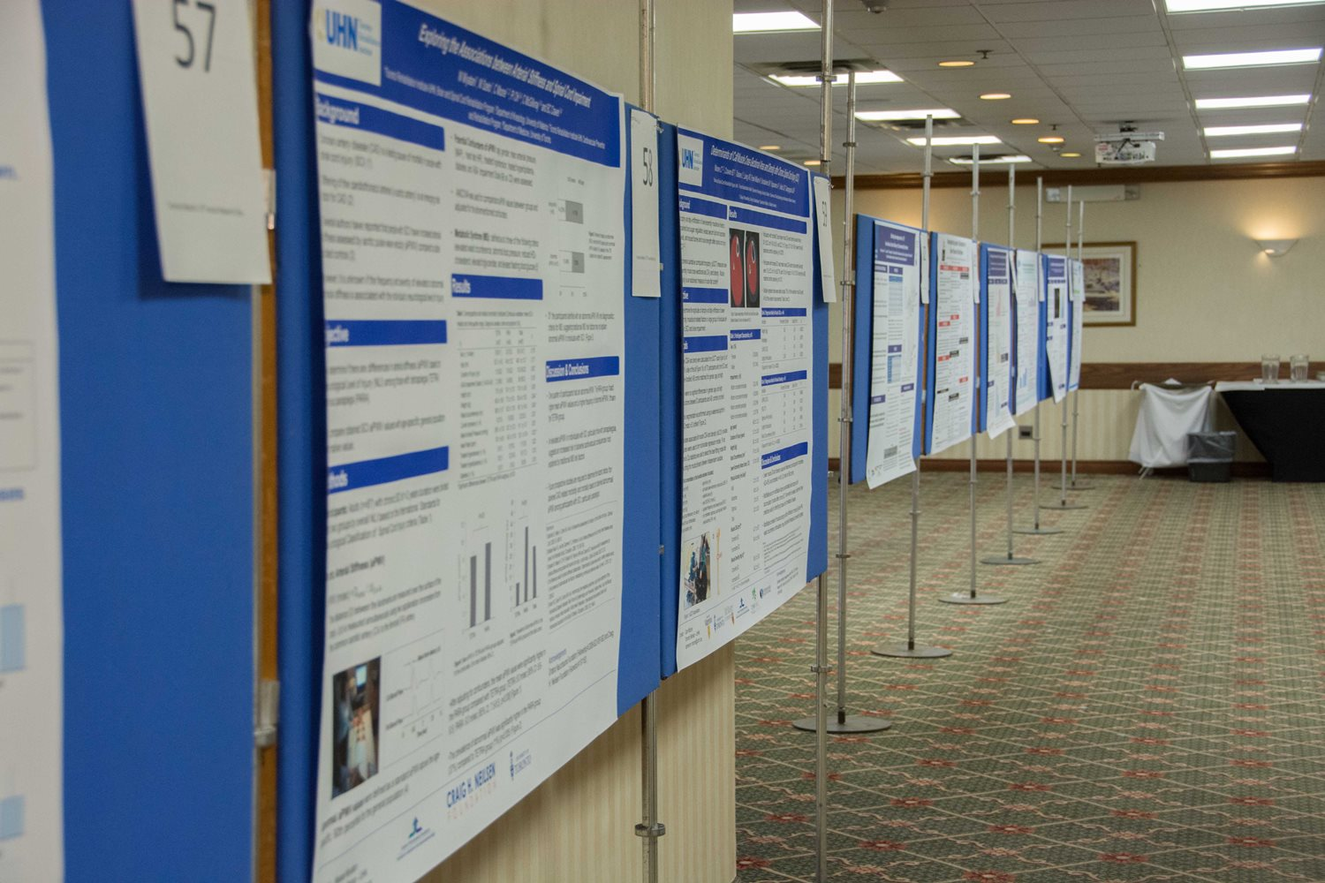
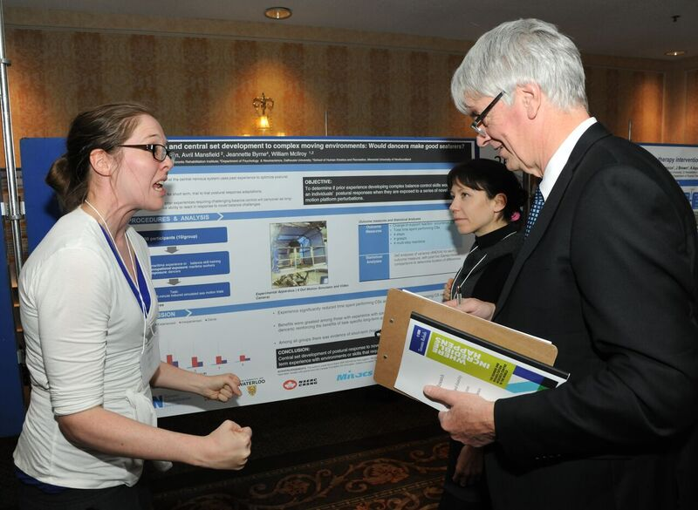
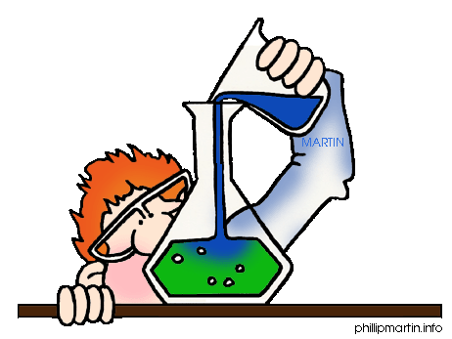

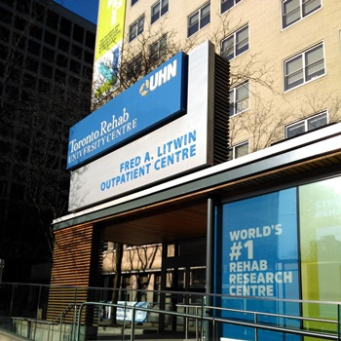
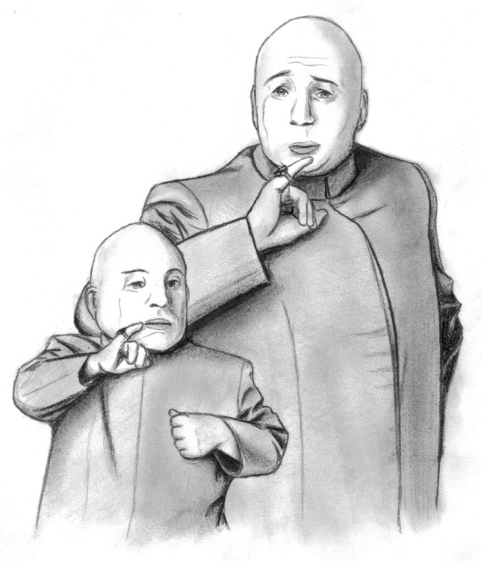
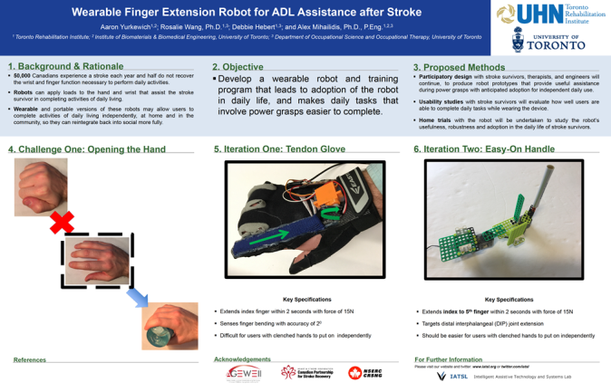
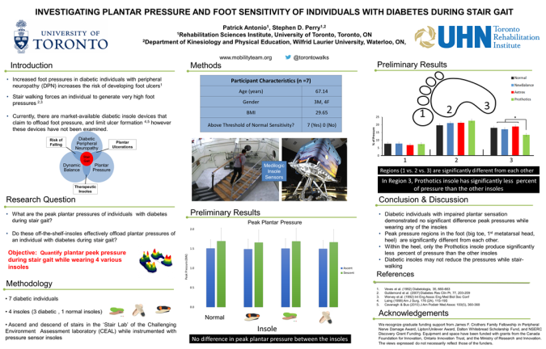
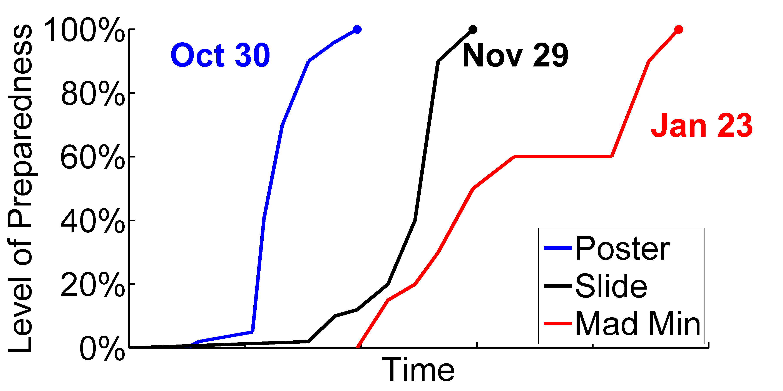









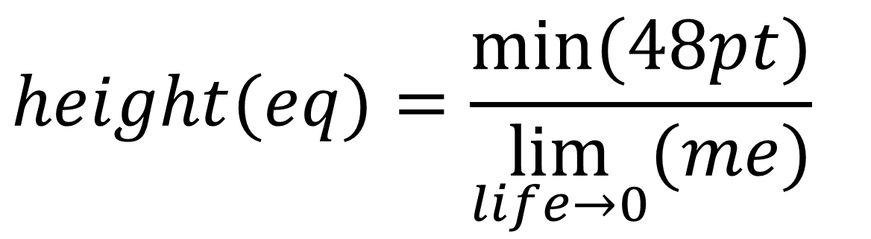
Designing a 2019 Toronto Rehab Poster (90 pt)
Noah Jackson¹, Milos Popovic^{1,2} (72pt)
¹KITE - Toronto Rehabilitation Institute – University Health Network, ²Institute of Biomaterials and Biomedical Engineering, University of Toronto (36pt)
Introduction (Header) (60pt)
Methods (60pt)
Results (60pt)
This poster is a template for a Toronto Rehab Research Day poster. The purpose of a research poster is to draw people towards it, then support the story of your work. If people do not visit your poster, they will not learn about your fantastic work.
vs.
Your introduction sets the stage: Why are you motivated to do this work? What is the problem? What is the opportunity? (All body text is 48pt)
There are many options for poster format, including:
Prepare a draft of your research poster as early as you can, and have it reviewed by peers you respect. Authors on the poster should approve before it is submitted.
Methods describes what you did. In the results section, list the measurements that you made, the data that you collected, and the outcomes after doing the analysis that you described in your methods section. Leave any and all interpretation for the Discussion section.
(a)
(b)
(c)
(d)
1
2
3
4
5
6
7
8
9
Figure 1: Find a layout that works for you. You could try (a) three columns, (b) two columns, (c) six boxes of info, (d), graphics with supporting text, or something else entirely. The figure caption should not be too long. (36pt)
2016 Research Day Poster Characteristic | Count | %
Number of posters displayed | 89 | 100
Used UHN Logo properly | 50 | 56
Used correct dimensions 36” tall x 56” wide | 47 | 53
Poster review team eye test: a “good” poster | 44 | 49
Posters with “not-enough” information | 0 | 0
Would be accepted without revision in 2018 | 19 | 21
empty
text
(60pt) table
figures
Table 1: After the event, we analyzed 2016 Research Day posters while preparing to display the best ones in TRI research areas. “Good” posters allowed educated non-subject experts to view and understand the high-level project goals within about 30s. The posters receiving highest marks from judges paired a “good” poster with a professional discussion.
Objectives (60pt)
Figure 2: Good research posters find a nice balance between text, figures, tables, and empty space. Figures should be 600 dpi. (36pt)
The objective may have something to do with preventing, restoring, enabling, or optimizing. It may not. The objectives of this poster are:
Present my work at Research Day 2018
Have my poster displayed at Toronto Rehab in 2019
Describe my work from the Research Day booklet
Advertise and promote my work with a poster that translates well into a smaller version (6.5” x 10”)
$$height(eq)=\frac{min⁡(48pt)}{\lim_{life→0}{(me)}}$$
$$\sum{(eq)≤3}$$
Discussion (60pt)
These new poster guidelines represent a paradigm shift for TRI research. If you agree with this shift – great. If not, then we are asking you to please bear with us, follow our guidelines, and suspend judgement until after our 13th Research Day 2018. (48pt)
Figure 3: Trajectory of an organized trainee preparing for Research Day 2018. Test the font size on your plot axes, legends, and labels. It should be at least as big as this 36pt font.
References (max 3, 1 line each, abbrevs)
Jones, S, et al., J Short Refs, 1(1), 34-39, 2017. 36pt.
FYI, UHN RGB colours are Blue = [15 109 198] & Gold = [220 199 120]
Popovic, MP, et al., J Badass FES, 4(3), 105-114, 2018. 36 pt.
Contact:TRI-ResearchDay@uhn.ca

Helpful
University
SPONSOR
LOGOS!
600 dpi logos
Notes:
Some tips
To get a fresh blank template:
New Slide
Select the “TRI Research Day Poster” layout
You don’t have to use UHN colours, or blue, or black text, etc. But you should use colour combinations that look nice together.
You don’t have to use the template, but if you go off template you are still required to adhere to the Research Day Poster Guidelines.
If you want to match, UHN RGB Colour Codes are:
Blue: RGB = [15 109 198]
Gold: RGB = [220 199 120]
Make sure you include your (or someone’s) contact information! Email address, website, and any other mode that you want to include. How does someone find you and/or more of your work?
Include the logos or acknowledgements for sources of funding and helpful institutions. You can also include the logo for your lab.
Respect logos and use them properly! Do not change the aspect ratio. Use a high-resolution logo. If it is meant to be on a white background, then make sure it is on a white background.

Slide 2
¹KITE - Toronto Rehabilitation Institute – University Health Network, ²Institute of Biomaterials and Biomedical Engineering, University of Toronto (36pt)

