Slide 1
Long Short-Term Memory (LSTM) Demonstration
Soft Computing (SFC) project
Brno University of Technology, Faculty of Information Technology
Božetěchova 1/2, 612 66 Brno - Královo Pole
Šimon Šmída, xsmida03@stud.fit.vut.cz
11.12. 2023

Slide 2
LSTM in theory
type of Recurrent Neural Network
designed to mitigate the vanishing gradient problem
Memory cells
Gates (input, output, forget)
Application:
Natural Language Processing (NLP)
text generation
machine translation
Time Series Prediction
Task for the project = sequence prediction

Slide 3


Project Overview
Task for the LSTM
sequence prediction
next symbol in a sequence of 1s and 0s:
e.g. 1,0,1,0,1,0,1,0 … → 1,0,1,0,1,0,1,0, …
Software
Python + PyQt (numpy, matplotlib)
TensorFlow (Keras LSTM model)

Slide 4
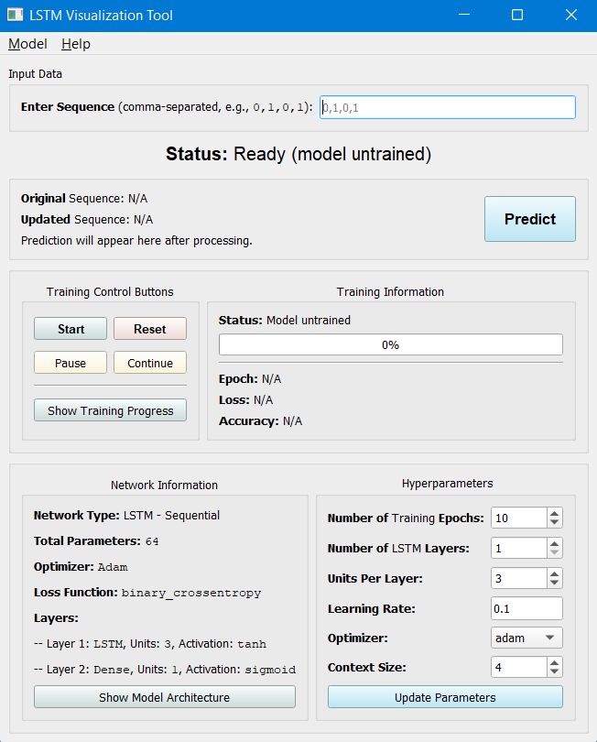
Application GUI

Slide 5
Application GUI
input sequence
output section

Slide 6
Application GUI
App status

Slide 7
Application GUI
Control Buttons
Training information

Slide 8
Application GUI
Network info
Hyperparam. setting

Slide 9
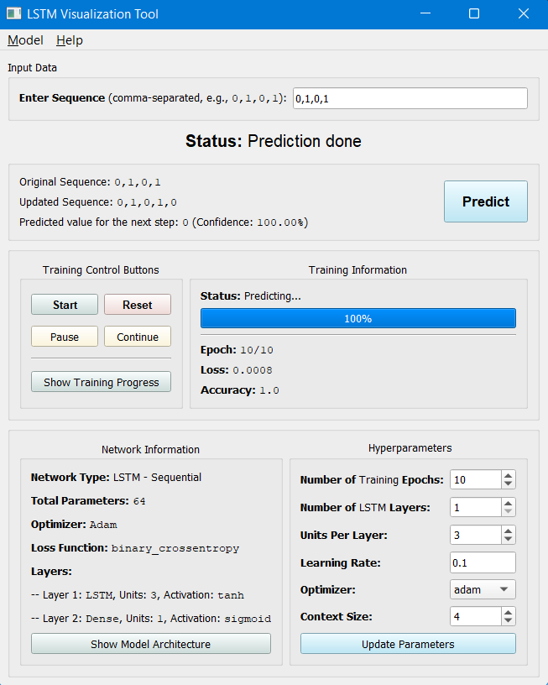
Application

Slide 10
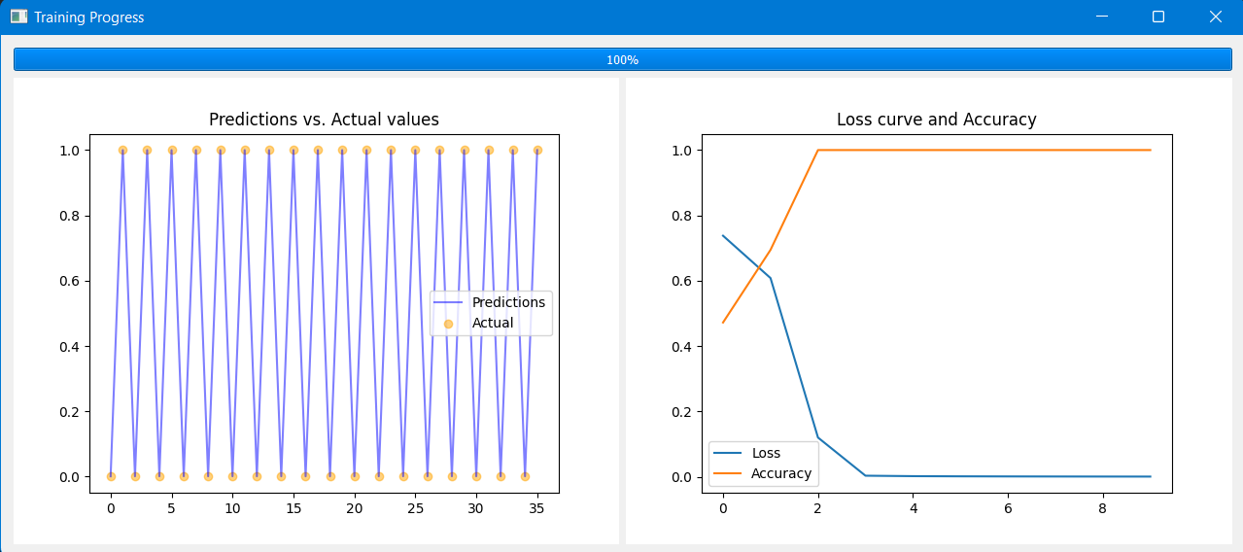
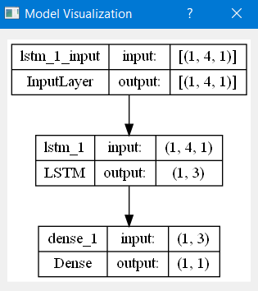
Application

