Slide 1
T1A3 - Terminal Application
Football Shootout!
A simple Ruby game by Simon Tanna

Slide 2
Why a football game?
They are fun
Football is a universal language
My favourite game franchise is the Football Manager / Championship Manager series

Slide 3
The Game

Slide 4
What should a football sim do?
It needs
Teams
Players
A coin toss
Phases of play
Goals!
Extra-time
A winner!!!
Apart from being fun…

Slide 5
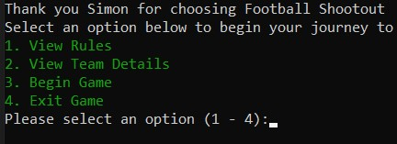
Features & Flow
User welcome and main menu
Rules
Team Information
Begin Game
Exit
Rules
Basic game information - similar to what is in the readme.
Explains what’s going to happen in-game.

Slide 6
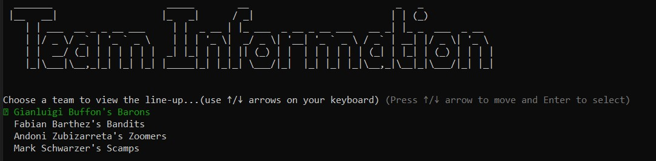
Features & Flow
Team Information
Potential opponents are listed here with randomly populated line-ups through ‘faker’ Ruby gem.
User can choose to view other teams or return to the main menu.
Error handling with rescue and retry featured in this menu.

Slide 7
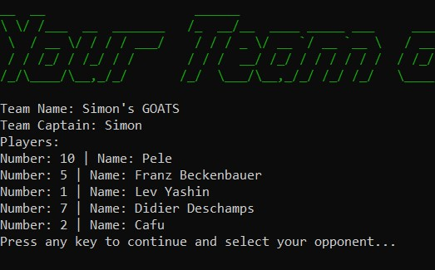
Features & Flow
Main Game (1)
Create a team of legends
The user will be asked to create a team, give them a name and select 5 legendary players.
Select opposition
Coin Toss
Who kicks off?
If the user wins the toss…
3 attacking and 2 defending phases.

Slide 8
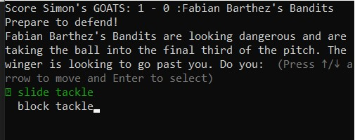
Features & Flow
Main Game (2)
If the user loses the toss
3 defending and 2 attacking phases.
In each phase there will be a choice for the user to make
In attack: Shoot or Pass
In defence: Slide Tackle or Block Tackle
If choice = true then…
In attack: GOOAAALLL!!!!
In defence: You win possession
If choice = false then…
In attack: You lose possession
In defence: Goal to your opponent

Slide 9
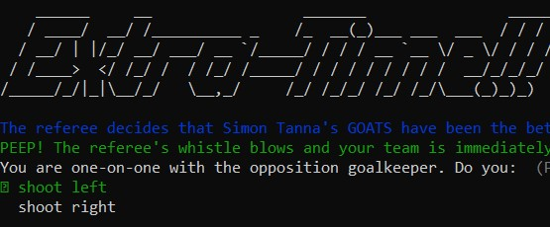
Features & Flow
Main Game (3)
If the user score = bot team score…
EXTRA-TIME!!!
The user will have one last chance to win the game and will have the option to shoot to the left or right of the goalkeeper.
If choice = true then they WIN!
If choice = false they lose…
User will have the option to return to main and create another team.

Slide 10
The Code

Slide 11
index.rb
seed.rb
game.rb
teams.rb
players.rb

Slide 12
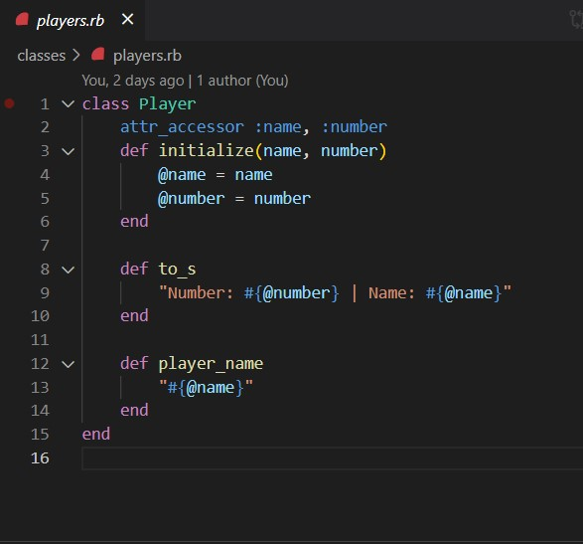
Players Class
Simple attributes :
Name and Number
To be used by the Teams class to populate “players” array.

Slide 13
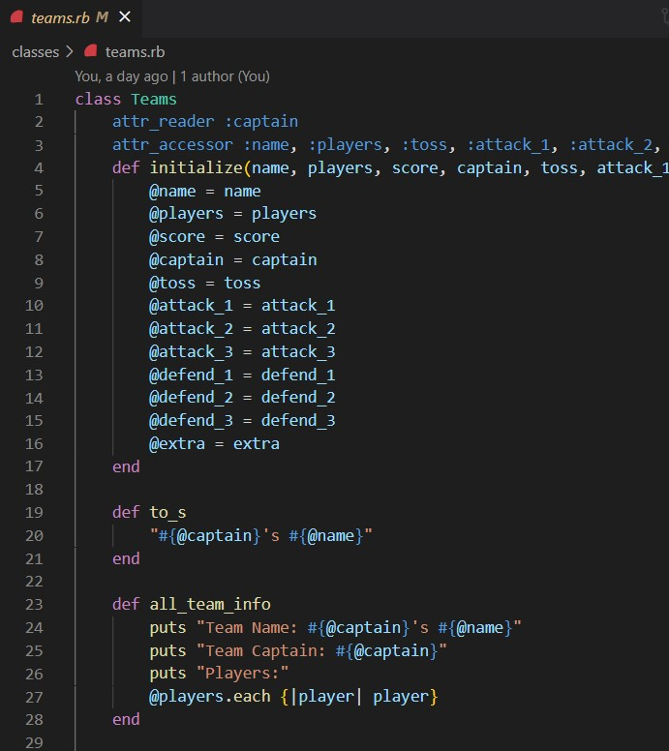
Teams Class
Attributes:
To be used in the game to determine the truthy or falsey values of game events, the coin toss result and to store the team score.
all_team_info method used in Team Information menu and pre-game.

Slide 14

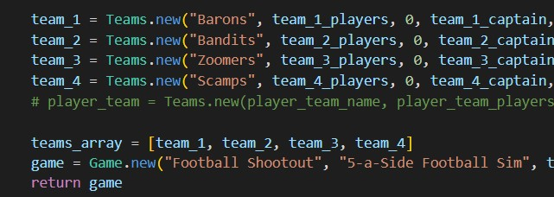
Game Class
Seed File
Used to store all teams and players
Stores all bot team information
‘Faker’ Ruby gem used to populate player names.
Teams passed into array and then into Game class for use in the index.rb

Slide 15
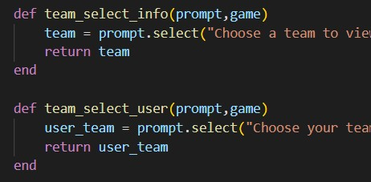
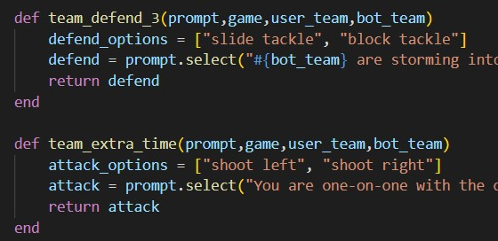
The Game (index.rb)
Methods for in-game selection options.
tty-prompt used.
Methods for game phases
User selects 1 of 2 options
The truthy/falsey value of these variables are determined when the user team is created…

Slide 16
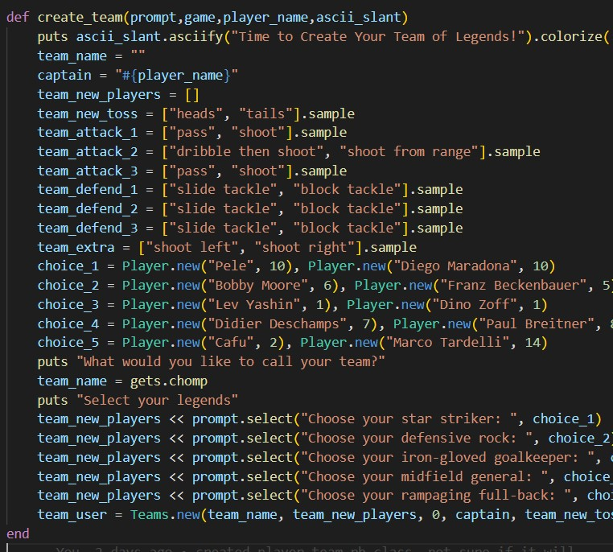
The Game (index.rb)
Team Creation
Team name, players and all in-game options are stored here.
In-game prompts variables are set by .sample method. Returns a random element

Slide 17
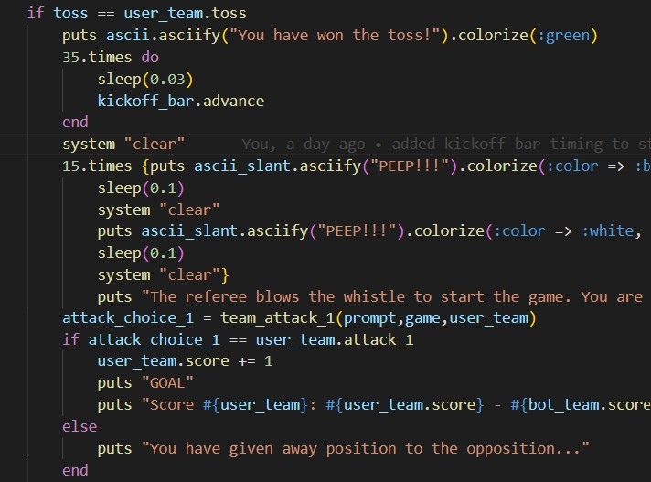
The Game (index.rb)
The Match
User input is passed into this method.
Return of score value is passed into the user or bot team variable.
Loops used:
if-else
if-elsif-else
while

Slide 18
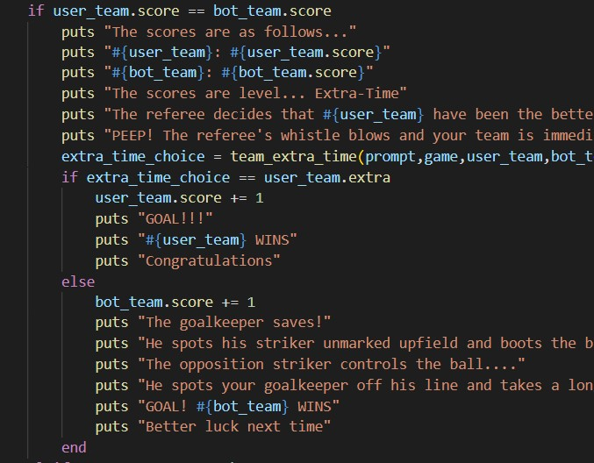
The Game (index.rb)
Extra-time
Nested if-else loop determines the winner if the scores are level after 5 phases of play.

Slide 19
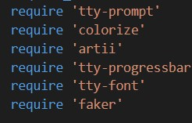
The Game (index.rb)
Gems Used

Slide 20
Build Process
Control Flow and Data Flow
Useful when stuck on elements of the code
Trello
Really really useful when trying to decide “what to do next!?!”
Ethical Issue
Using real football player names
If this game was to be released commercially, permission would be needed.
Favourite Part
The result
Building something that began as an idea through to a real and tangible thing!
Being able to create a football team of legends

Slide 21
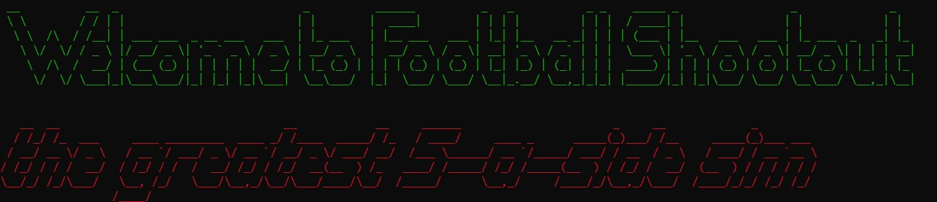
The Result

