Slide 1

Training/Validating/Testing
Zybooks 8-2

Slide 2
Types of Machine Learning Algorithms
Supervised: Trained on Labeled Data
  Example: Regression
Unsupervised: Trained on Unlabeled Data
  Example: K-Means
    Given data but no labels, K-Means can discover clusters
      Budget-Conscious Shoppers vs. High-Spending Occasional Buyers

Slide 3
Two Types of Supervised ML Algorithms
Regression: used with numerical data
Classification: used with categorical values

Slide 4
Training
Process of estimating model parameters to make a prediction
  We did this with slope and intercept parameters in linear regression

Slide 5
Validating
Experiment iteratively with hyperparameter tuning
  Learning rate (α) – controls how big a step the algorithm takes when updating weights.
  Number of epochs – how many times the model sees the full training data during learning.
  Regularization strength (λ) – controls how much the model is penalized for complexity to prevent overfitting.
  Feature selection controls what a model learns from (which variables are included)
  Optimizer choice – determines how the model updates its parameters during training.

Slide 6
Testing
Evaluates the final model on unseen data (test set) to measure true performance and generalization.

Slide 7

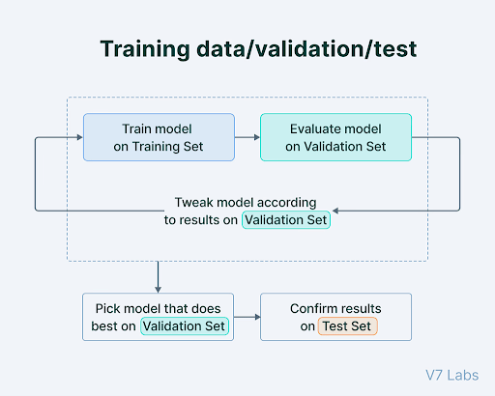
Training-Validation-Test Split
Training Data: Used to fit a model
Validation Data: Used to evaluate model performance, adjust parameters or model settings, and conduct feature selection
Test Data: Used to evaluate final model performance and compare different models.

Slide 8
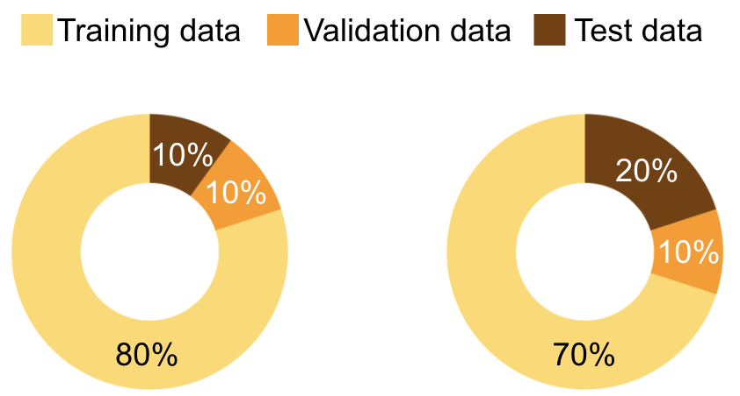
Splits

