Slide 1
Songs that just hit different
Simon Hoque, Sai Koukuntla, Lindia Tjuatja

Slide 2
Overall Goal
Identify characteristics of successful songs in each time period.

Slide 3
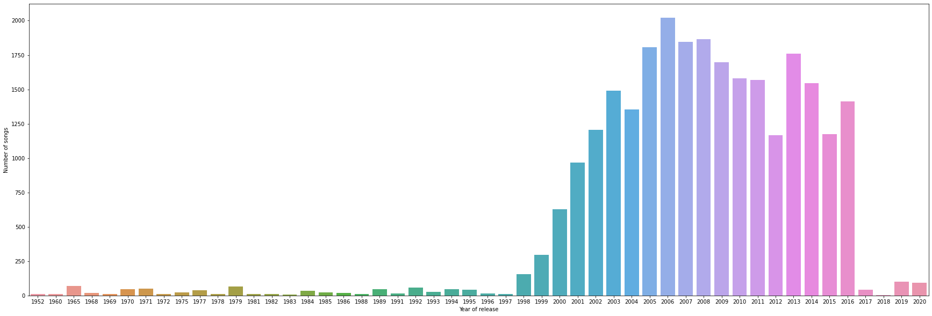
Limitations of the dataset
Missing and misrepresentative data for 2017 through 2020
Ex: 2018 only has 5 songs, all from the same obscure Portuguese album

Slide 4
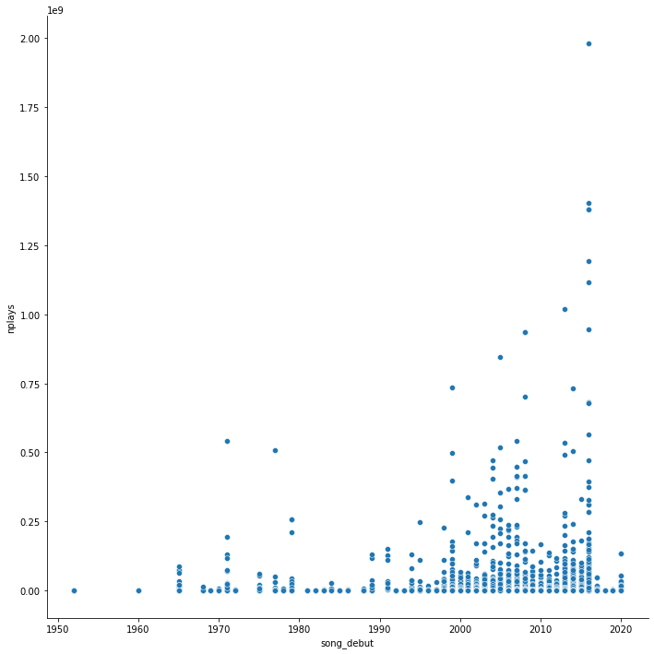
Limitations of the dataset
Much scarcer data for pre-2000s music
Spotify as a service came out in 2008
This serves as a challenge when gauging success of less recent music when using number of plays as a metric

Slide 5
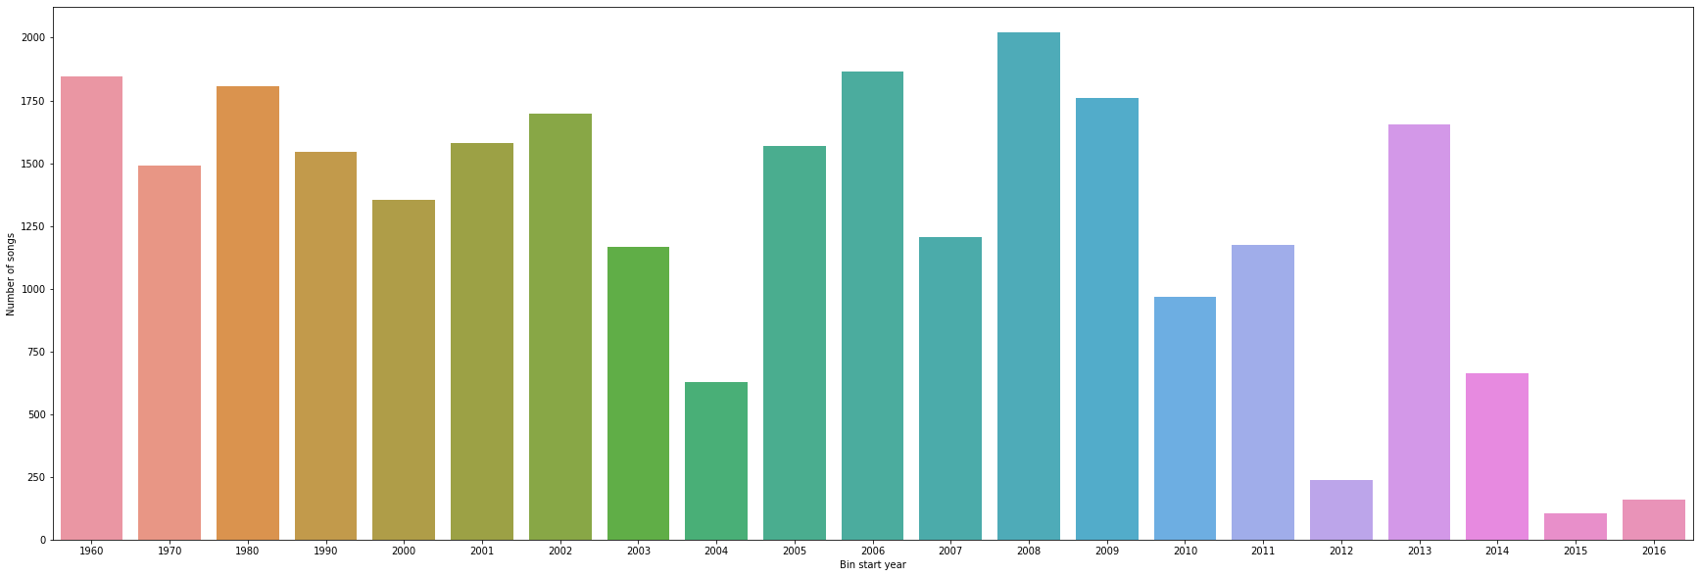
Preprocessing
Due to the drastic differences in pre-2000 vs. post-2000 counts, we decided to bin by release year non-uniformly
Pre-2000: Drop songs from 1952 (9 songs), bin by decade
Post-2000: One bin per year, but combining 2016-2020 due to lack of data

Slide 6
Feature selection
We chose to drop features that do not describe characteristics of the music itself, since we want to identify musical characteristics that create a successful song
Name, album, artist
Critic, critic rating
Review, reviewer type
Hotness

Slide 7
Defining Success
Due to the distribution of data, we decided to define success in two ways:
Number of plays - Classification
More important for songs released after 2000
Used to visualize trends of successful songs over time
A “successful” song is in the top 10 percentile of plays in its bin
Critic rating - Regression
Used as a secondary metric to confirm feature importance
Can give measure of success upon release

Slide 8
Model architecture: CatBoost
Built models to identify important features, not to predict success
Drop non-representative features (as discussed previously) and other success metrics
Pass categorical features
Beats per measure, Major/minor, Style, Tone (key), Vulgarity
Popularity classifier
Target: 1 if in top 10% of plays, 0 if not
Eval metric: AUC
Critic rating regressor
Target: Critic rating score [0,100]
Eval metric: RMSE

Slide 9
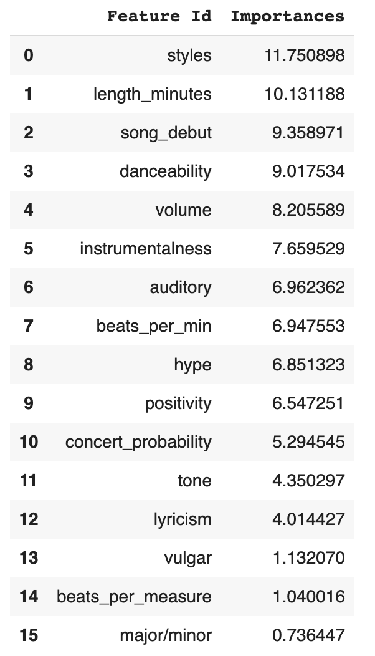
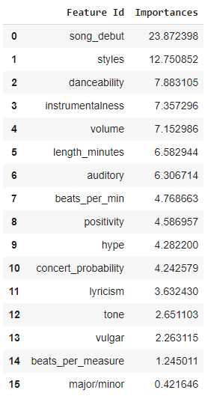
Feature importances: all data
Popularity classifier
Critic rating regressor

Slide 10
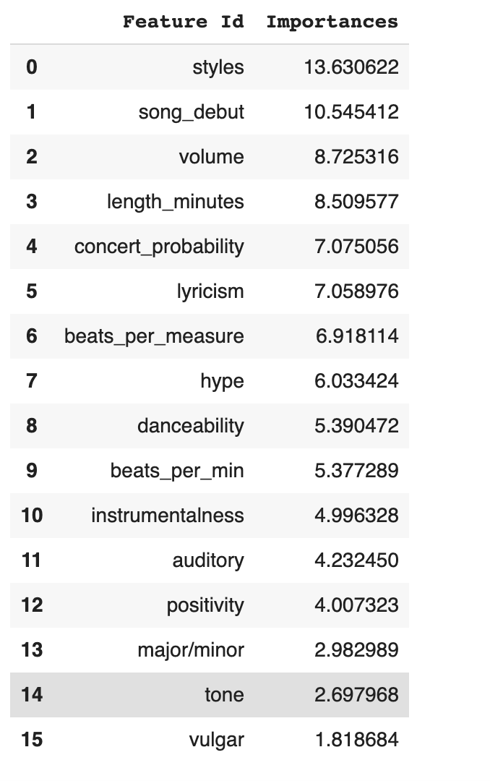
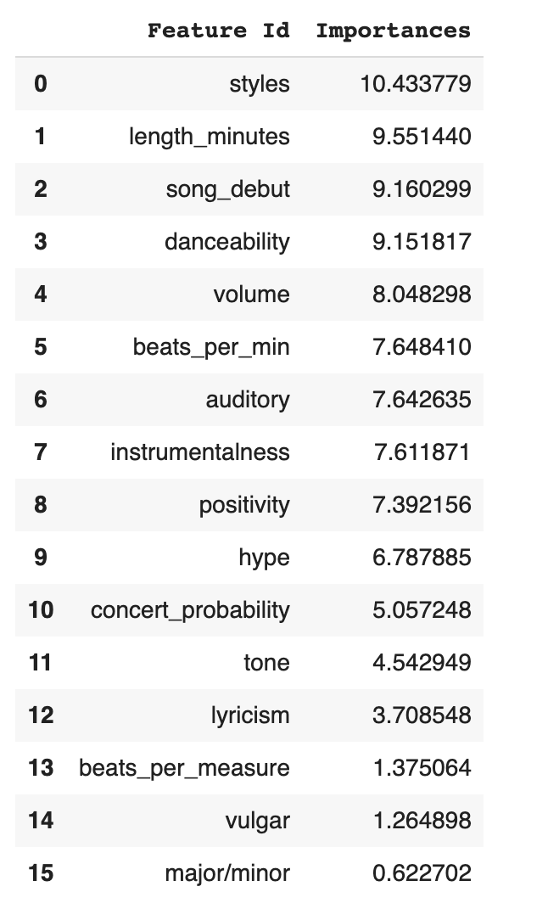
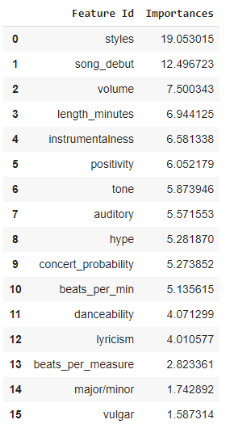
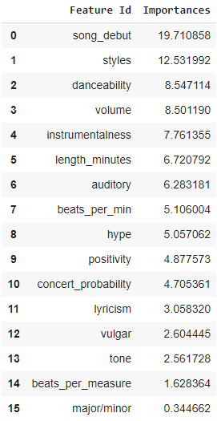
Feature importances: pre versus post-2000
Popularity classifier
Critic rating regressor

Slide 11
Takeaways from models
The two models generally agree on which features are important
Style/genre is more important pre-2000
Danceability is more important post-2000
Song debut is important, the impact of different characteristics might vary by time period
To validate this observation, we visualized trends in features over time

Slide 12
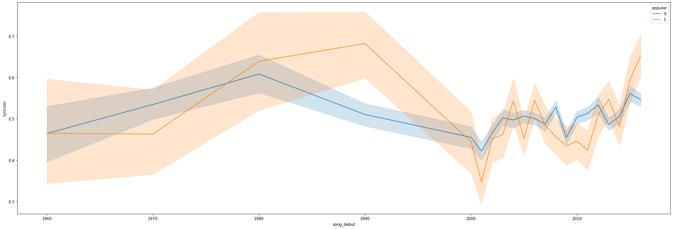
Instrumentalness over time

Slide 13
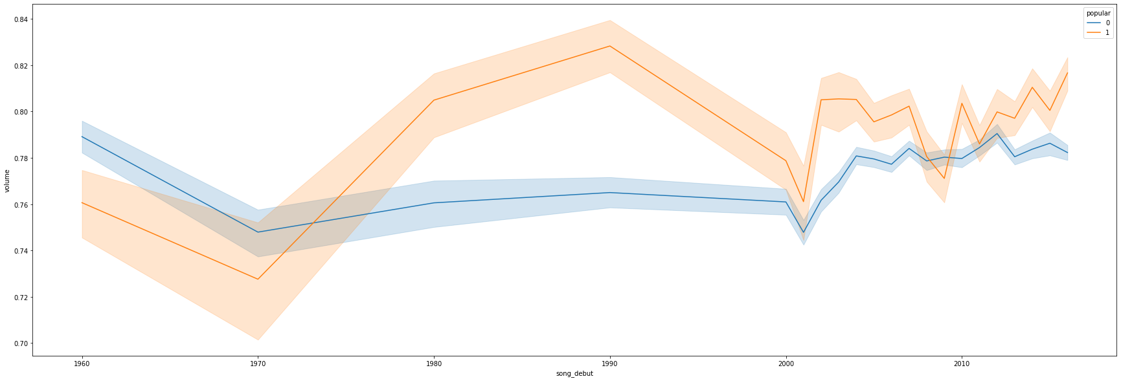
Volume over time
Notes:
We like bangers

Slide 14
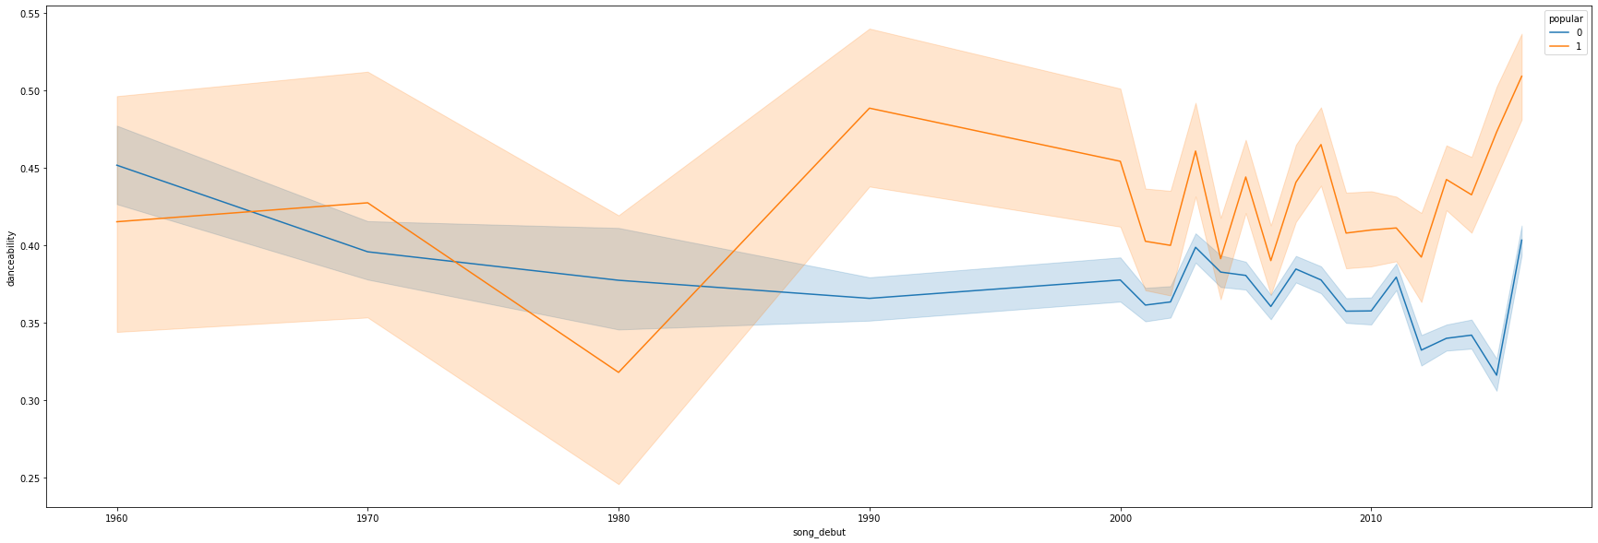
Danceability over time
Notes:
Danceability more important now

Slide 15
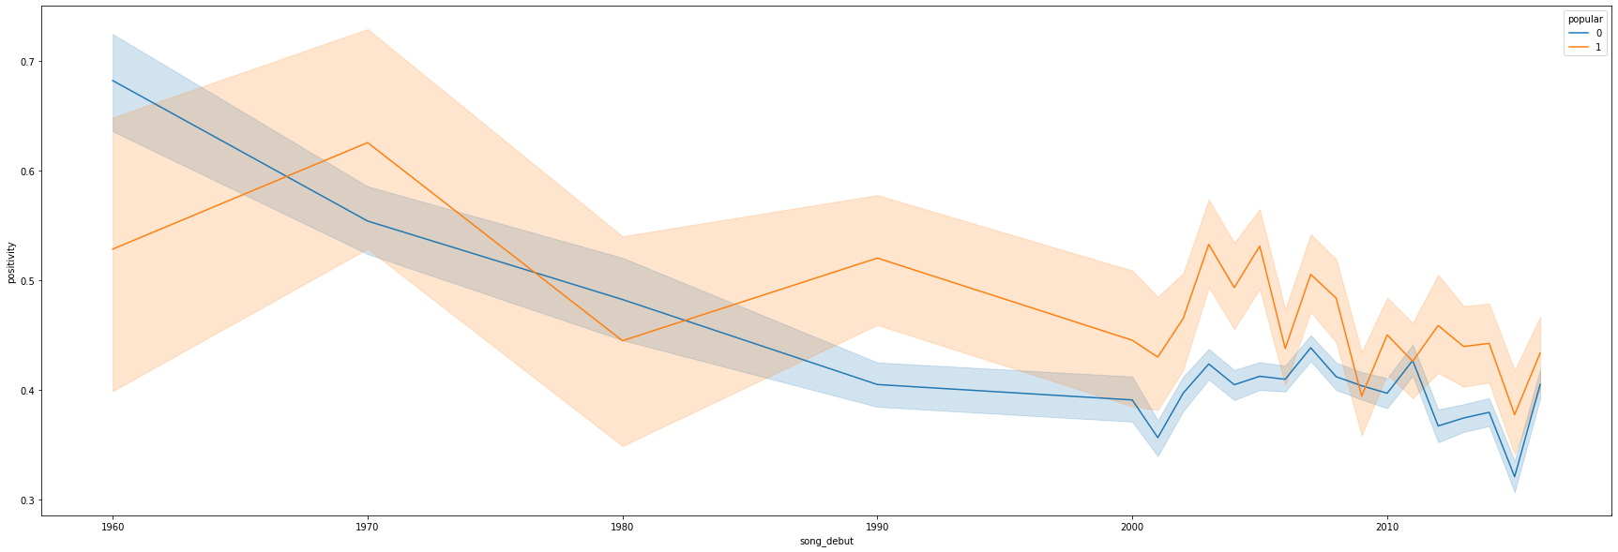
Positivity over time
Notes:
Everyone is sad now

Slide 16
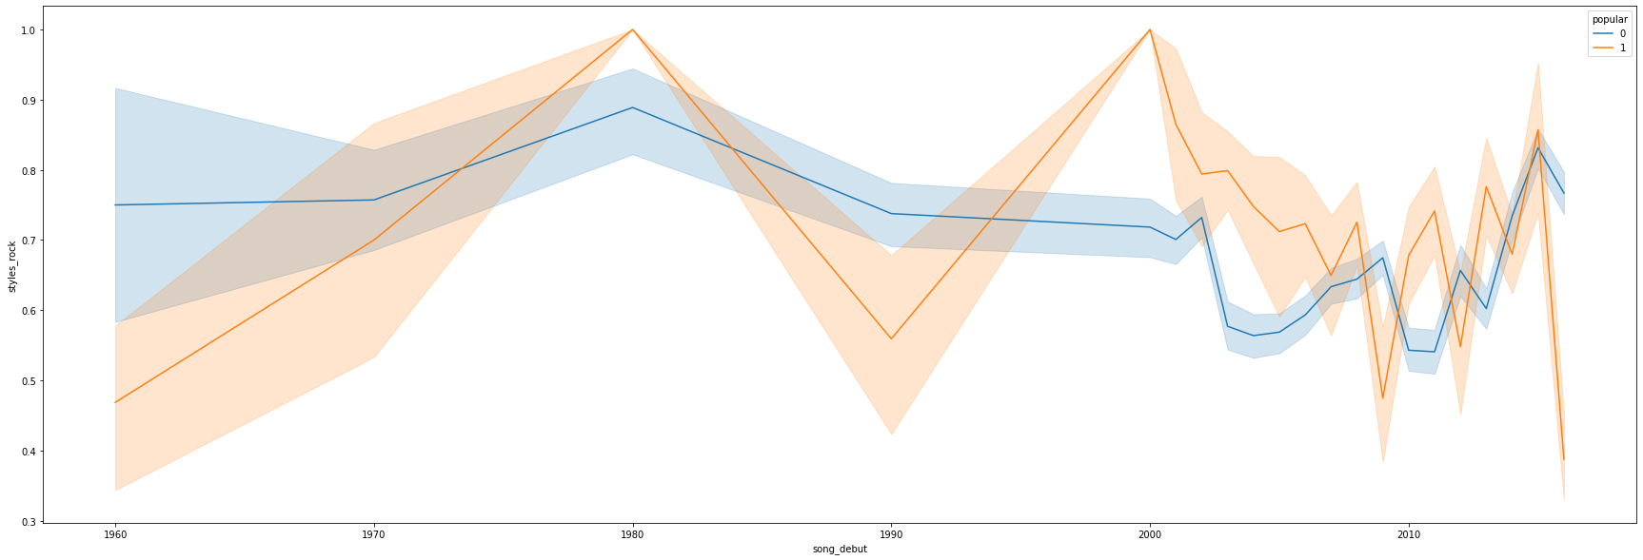
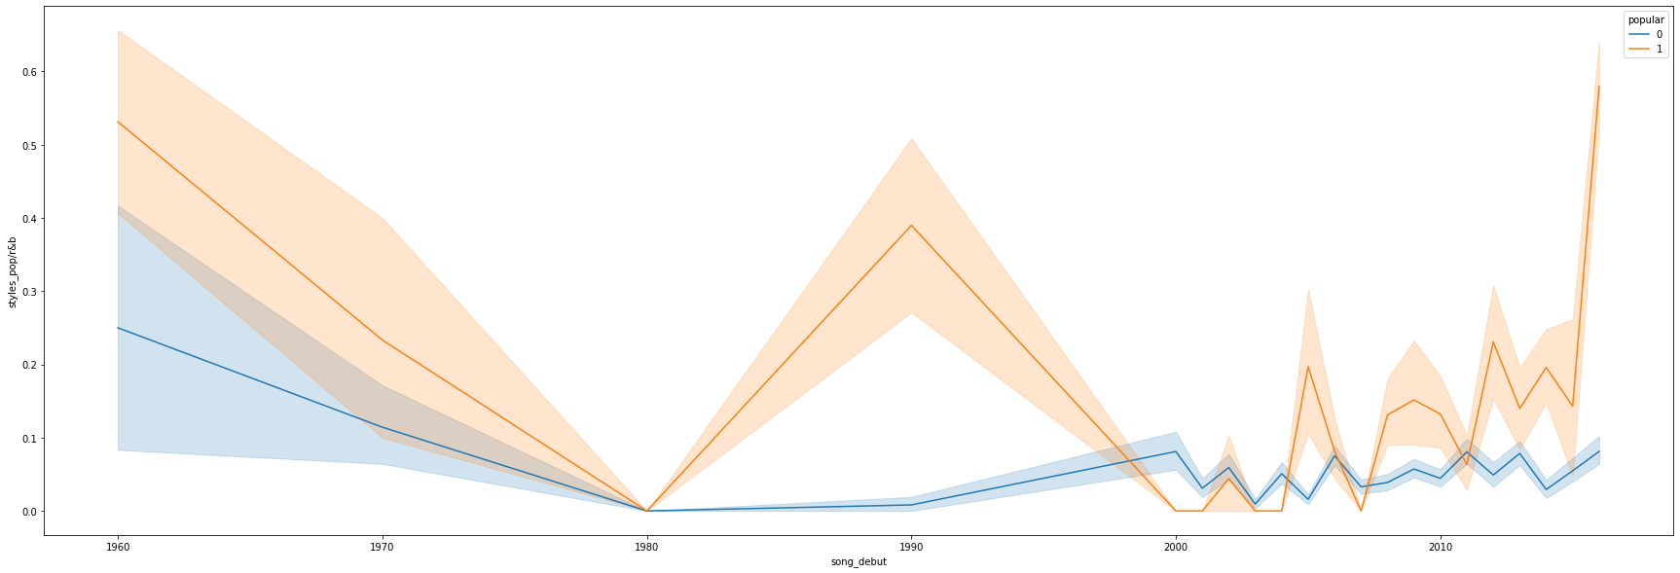
Prevalence of rock
Prevalence of pop/RnB
Notes:
-there were other trends in style but this was the most dramatic

Slide 17
Characteristics of successful songs by time period
1960s | 1970s | 1980s | 1990s | 2000s | 2010s
- Sadder - Softer | - Happier - Rock | - More instrumental - Louder - Less danceable | - Happier - More instrumental - Louder - Danceable - Pop-heavy | - Sadder - Danceable - Pop/R&B | - Sadder - Definitely not rock - Danceable - Pop/R&B
Notes:
-early music was more homogenous

Slide 18
Other possible approaches
If we had a more representative dataset, these are some things we would like to try:
Influence of “smash hits”
Do novel features of highly popular songs influence the music of the time period following their release?
One-hit-wonders
What makes a one-hit-wonder so successful, and why are some artists unable to replicate their success?
Use additional measures of success (unrelated to Spotify streaming counts/time sensitive measures of success)
Album sales, radio plays, awards

