Slide 1
VERY DEEP CONVOLUTIONAL NETWORKS FOR LARGE-SCALE IMAGE RECOGNITION
淺談VGG
Professor: Lu-Hung Chen
Presenter:Chih-Huan Wang

Slide 2
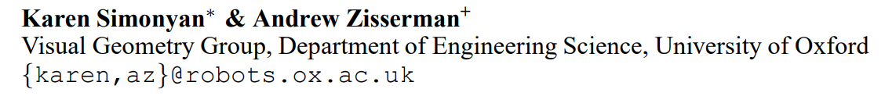
VERY DEEP CONVOLUTIONAL NETWORKS FOR LARGE-SCALE IMAGE RECOGNITION

Slide 3
Introduction
VGG
VGG是以較小kernel size 與 stride 的架構設計的CNN
以加深CNN的深度為特點，kernel size 設定為3*3
首次應用在ILSVRC-2014
ILSVRC(ImageNet Large Scale Visual Recognition Competition)
由ImageNet所舉辦的年度大規模視覺識別挑戰賽
競賽所使用的dataset來自於ImageNet
競賽中評比的Top-5 error rate分數

Slide 4
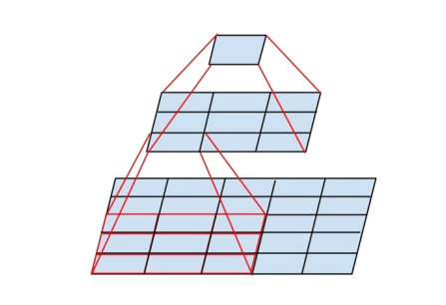
How to increase the degree of depth?
A stack of two 3×3 conv. layers (without spatial pooling in between) has an effective receptive field of 5×5.

Slide 5
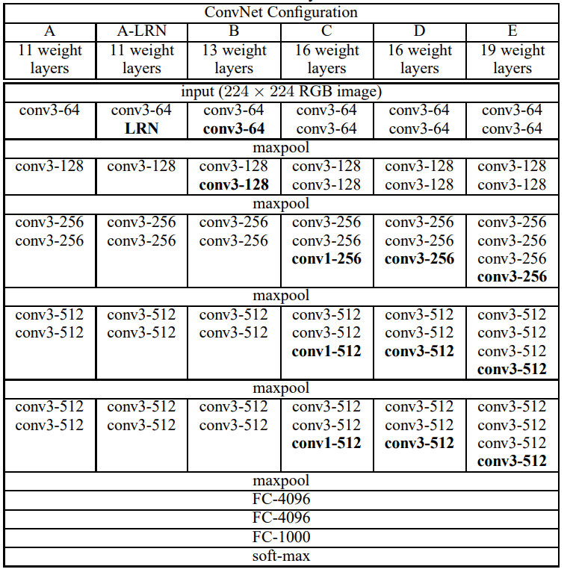
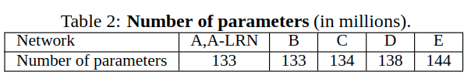
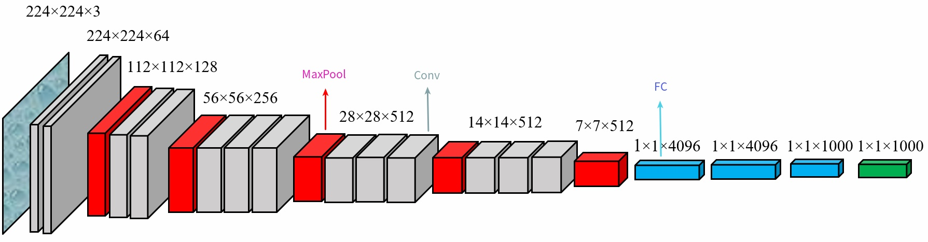
Architecture of VGG
Fixed stride 1
Padding(same)
Pool size 2

Slide 6
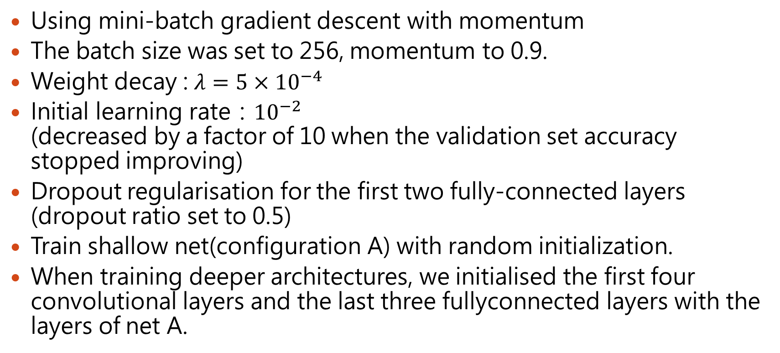
Training
Using mini-batch gradient descent with momentum
The batch size was set to 256, momentum to 0.9.
Weight decay : $λ=5×{10}^{−4}$
Initial learning rate：${10}^{−2}$ (decreased by a factor of 10 when the validation set accuracy stopped improving)
Dropout regularisation for the first two fully-connected layers (dropout ratio set to 0.5)
Train shallow net(configuration A) with random initialization.
When training deeper architectures, we initialised the first four convolutional layers and the last three fullyconnected layers with the layers of net A.

Slide 7
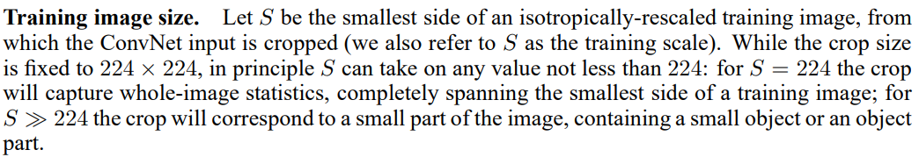
Image size

Slide 8
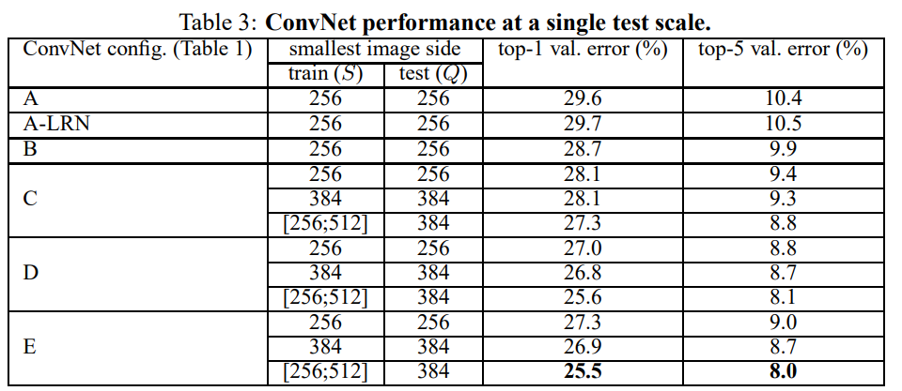
SINGLE SCALE EVALUATION
The test image size was set as follows: Q = S for fixed S.
Q = 0.5(Smin + Smax) for jittered S ∈ [Smin, Smax].

Slide 9
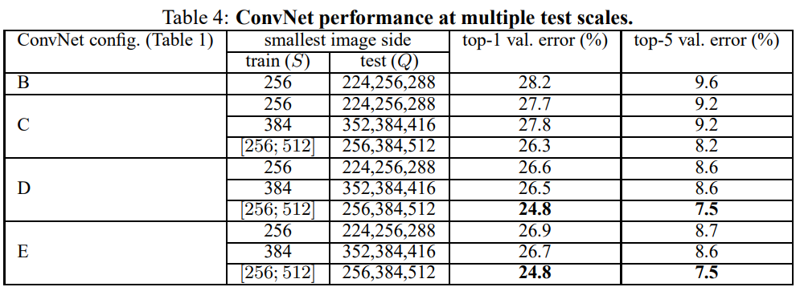
MULTI-SCALE EVALUATION
Q = {S-32,S,S+32} for fixed S.
Q = {Smin, 0.5(Smin + Smax), Smax} for jittered S ∈ [Smin, Smax].

Slide 10
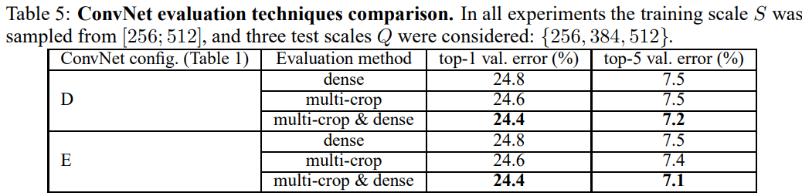
MULTI-CROP EVALUATION

Slide 11
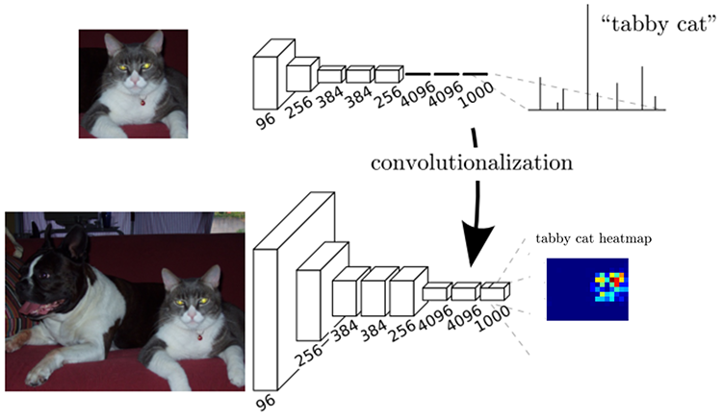
FCN vs CNN
Dense
Multi-crop

Slide 12
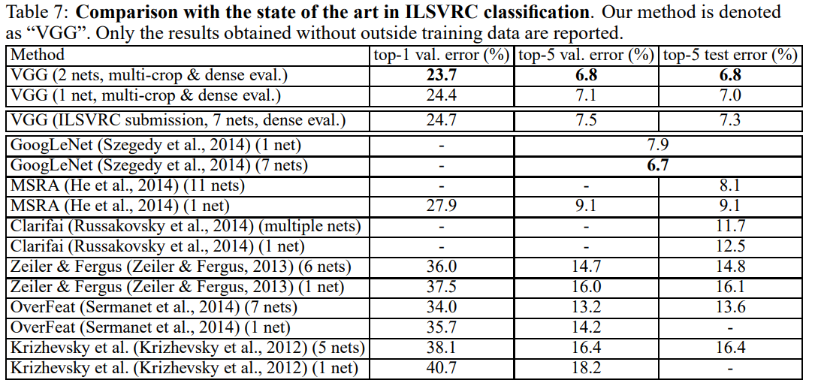
Comparison

