Slide 1
Expansion of Higher Education in Taiwan:
Impacts and Challenges
Chuing Prudence Chou (周祝瑛)
Department of Education
National Chengchi University
International Conference on Education and Training Technologies (ICETT), Taipei
Friday, August 29, 2014

Slide 2
Overview: Expansion of HE in Taiwan
Taiwan
  Country Profile
  Historical Context
  Significance
Trends
  Proliferation of HEIs
  Student enrollment
  Government spending
  Birth rate
Reasons
  Civil society
  Economic development
  Globalization
Goals
  National development
  Social and cultural expectations
  Personal development
Reforms
  Timeline
  University autonomy
  Accountability
  Competition
Success?
Unexpected Consequences
  Quality of education
  Educational opportunity
  Stratification
  Socioeconomic inequality
Challenges Today

Slide 3
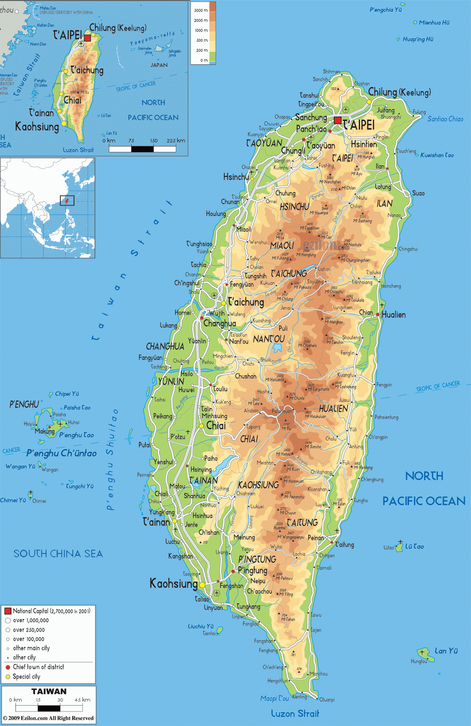
Taiwan: Country Profile
Population: 23.3 million (2013)
GDP, per capita: $20,930 (#40) (2013)
Literacy rate: 98.04% (2010)
Urbanization: 70% (2010)
Demographics:
98% Han Chinese
  84% “Benshengren” (本省人)
  15% “Waishengren” (外省人）
2% Indigenous
Sources: IMF, Ministry of the Interior, Government Information Office

Slide 4
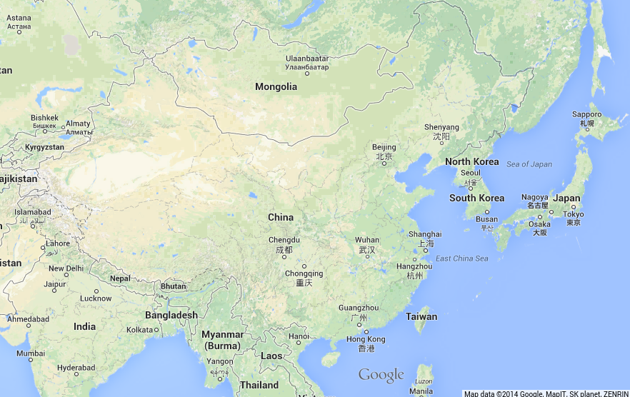

Slide 5
Taiwan: Historical Context
-1895
1895-1945
1949-1987
1987-
Qing Dynasty Era
Education primarily for elite
Japanese Colonial Era
Development of modern education system
Japanese language in schools
Republic of China, Martial Law Era
Emphasis on “Chinese” aspects of Taiwanese history and culture
Republic of China, Democratic Era
Education increasingly “Taiwanese”
Still primarily centralized

Slide 6
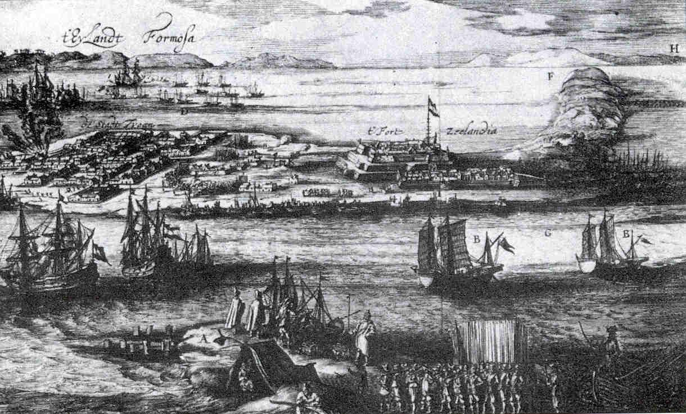
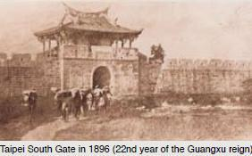
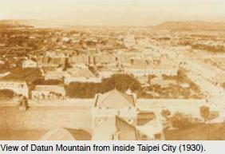
Zheng Chenggong (鄭成功) landing in Taiwan in 1662

Slide 7
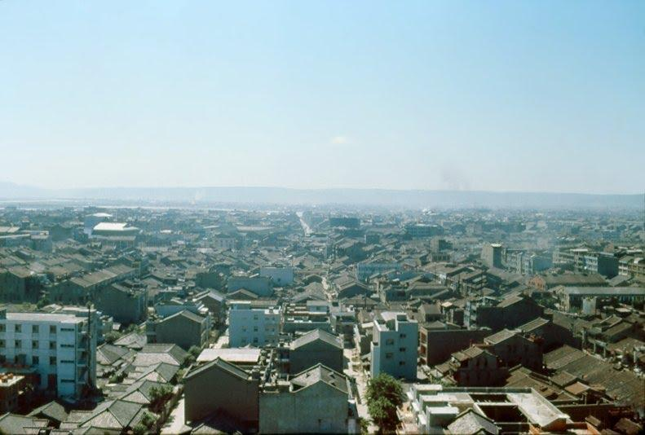
Taipei, 1960s
Source: taipics.com

Slide 8
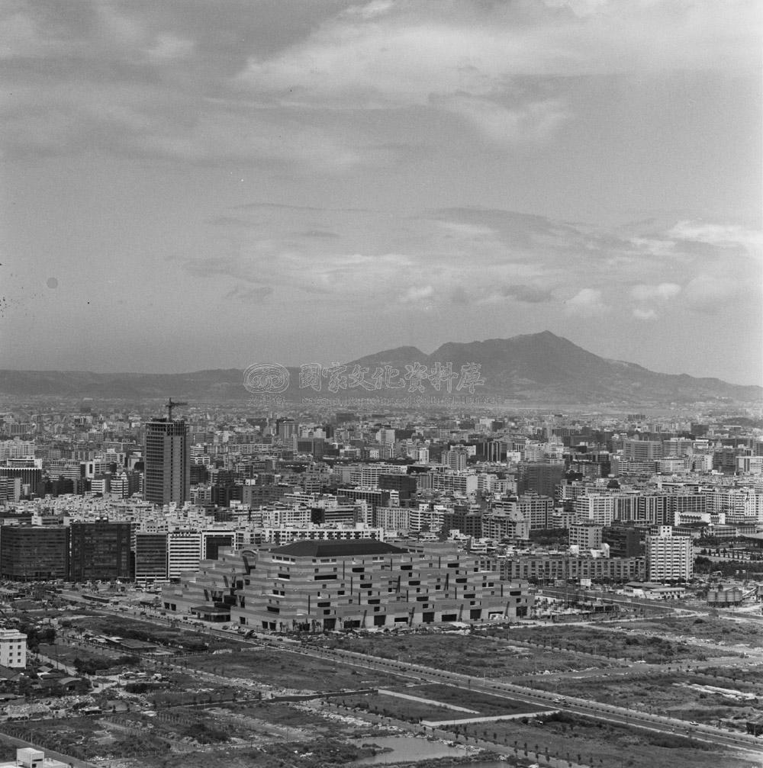
Taipei, early 1980s
Source: taipics.com

Slide 9
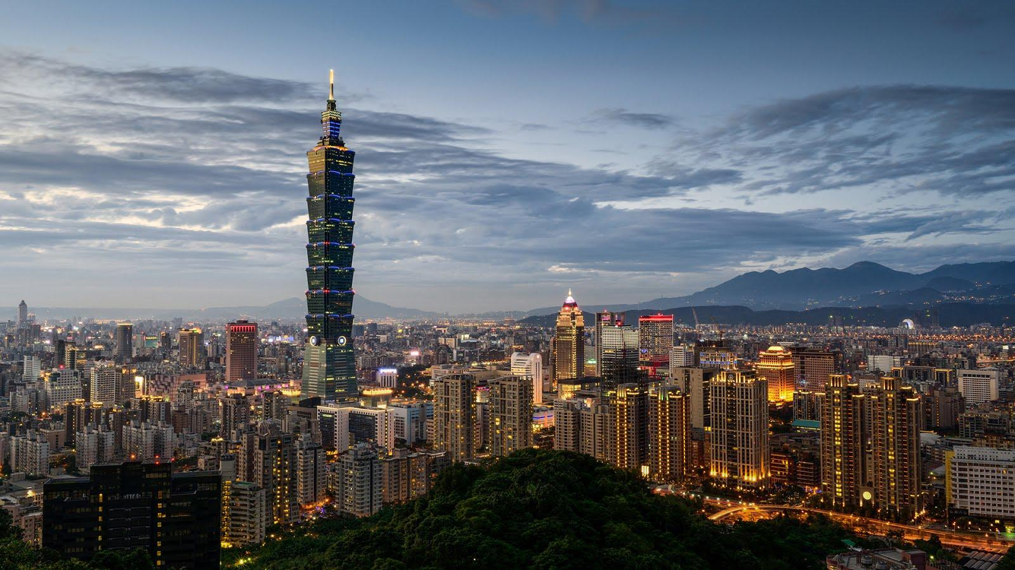
Taipei, 2010s

Slide 10
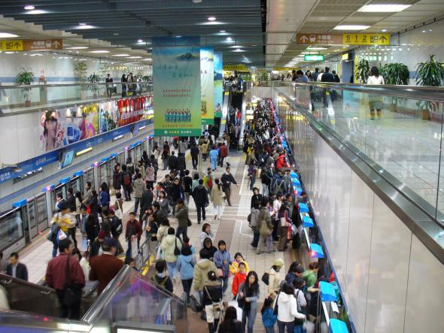
Taipei MRT, 2010s

Slide 11
EXPANSION OF HIGHER EDUCATION IN TAIWAN
Why does Taiwan’s HE matter?
Globally
High student achievement in mass higher education
Model of economic success
Example of impacts of neoliberalism and marketization on HE
New 12-year Basic Education
Locally
University expansion and upcoming closures
Declining higher education quality and youth unemployment
Increasing inequality
Impact on future of cross-strait relations

Slide 12
EXPANSION OF HIGHER EDUCATION IN TAIWAN
Trends
Proliferation of HEIs
Student enrollment
Government spending
Birth rate

Slide 13
TRENDS IN THE EXPANSION OF HIGHER EDUCATION IN TAIWAN
Proliferation of HEIs
1950
7
1986
105
(15x increase)
2012
163
(1.55x increase)

Slide 14
TRENDS IN THE EXPANSION OF HIGHER EDUCATION IN TAIWAN
Student enrollment
1950
6,665
1986
345,736
(52x increase)
2012
1,259,490
(3.6x increase)
70%
of 18–22 age cohort in HE
(#2 in world)

Slide 15
TRENDS IN THE EXPANSION OF HIGHER EDUCATION IN TAIWAN
Government spending
1980
$6,700
(200,000 NT)
per student
Today
$4,300
(130,000 NT)
per student

Slide 16
TRENDS IN THE EXPANSION OF HIGHER EDUCATION IN TAIWAN
Birth rate
199,113
total births in 2013
1.1
fertility rate in 2014
(#222/224, almost the world’s lowest)

Slide 17
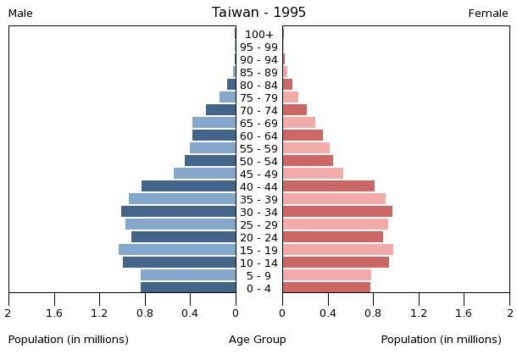
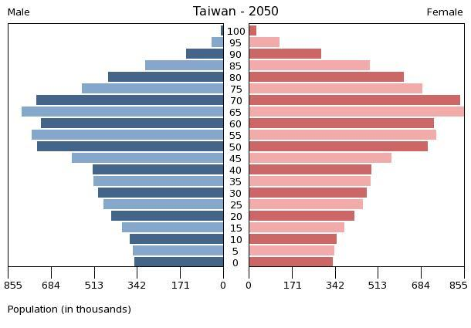
TRENDS IN THE EXPANSION OF HIGHER EDUCATION IN TAIWAN
Aging population
1995
2050

Slide 18
EXPANSION OF HIGHER EDUCATION IN TAIWAN
Reasons
Civil society
Economic development
Globalization

Slide 19
REASONS FOR THE EXPANSION OF HIGHER EDUCATION IN TAIWAN
Civil society
Lifting of martial law in 1987
Social and political activism in the 1990s
  Freedom of speech and press
  Less banking restrictions
  More competent university graduates to accommodate the emerging tech industry

Slide 20
REASONS FOR THE EXPANSION OF HIGHER EDUCATION IN TAIWAN
Economic development
Demands by companies for a highly educated workforce
Demands by parents for increasing university admissions

Slide 21
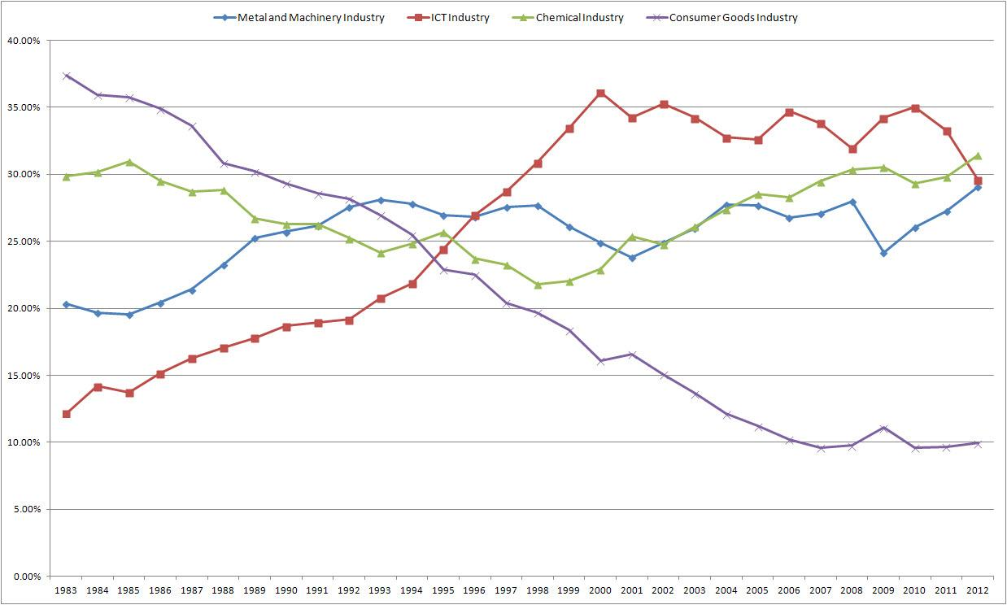
REASONS FOR THE EXPANSION OF HIGHER EDUCATION IN TAIWAN
Economic development in ICT
Increase in ICT jobs during 1990s
Decline in consumer goods manufacturing
Source: Taiwan MOEA IDB

Slide 22
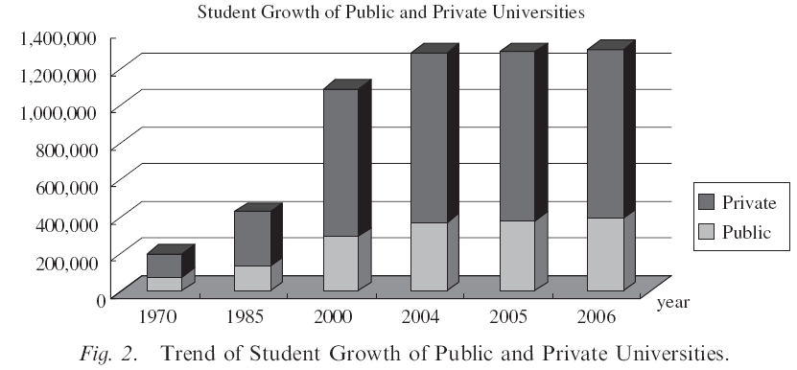
REASONS FOR THE EXPANSION OF HIGHER EDUCATION IN TAIWAN
Globalization
Economic competition
Spread of marketization, privatization, and neoliberal economic policies
Source: Taiwan MOE

Slide 23
EXPANSION OF HIGHER EDUCATION IN TAIWAN
Goals
National development
Social and cultural expectations
Personal fulfillment

Slide 24
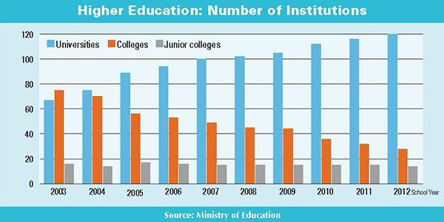
GOALS OF THE EXPANSION OF HIGHER EDUCATION IN TAIWAN
National development
Government prioritization of education as training for high-tech industry
Political election campaign promises (e.g., “one university per county”)
Upgrading of
vocational and
technological
institutes into
universities

Slide 25
GOALS OF THE EXPANSION OF HIGHER EDUCATION IN TAIWAN
Social and cultural expectations
Education highly valued traditionally
Diploma disease
Starting salaries based on level of education, not work experience

Slide 26
GOALS OF THE EXPANSION OF HIGHER EDUCATION IN TAIWAN
Personal fulfillment
High family spending on education (70-80%)
Personal obligation to become educated
Reluctance to “marry down”
Connection between education and family pride

Slide 27
EXPANSION OF HIGHER EDUCATION IN TAIWAN
Reforms
Timeline
University autonomy
Accountability
Competition

Slide 28
REFORMS IN THE EXPANSION OF HIGHER EDUCATION IN TAIWAN
Timeline
1994
1999
2003
2004
2005-10
2006
2011-16
2014
University Law
Project for Pursuing Excellence in Higher Education
University Act revised
Taiwan Assessment and Evaluation Association founded
Gender Equity Education Act
Aim for the Top University Plan, Phase 1 (“5 Year, 50 Billion”)
Higher Education Evaluation and Accreditation Council of Taiwan founded
Aim for the Top University Plan, Phase 2
Plan to Promote 12-Year Basic Education

Slide 29
REFORMS IN THE EXPANSION OF HIGHER EDUCATION IN TAIWAN
University autonomy
Institutions, administration, and professors given more autonomy
Increasing notion of “academic freedom”
Parents and students expected to become empowered consumers of higher education

Slide 30
REFORMS IN THE EXPANSION OF HIGHER EDUCATION IN TAIWAN
Accountability
Evaluation based on quantitative indicators
Funding based on assessments
Social Sciences Citation Index
Science Citation Index
Arts and Humanities Citation Index
Taiwan SSCI

Slide 31
REFORMS IN THE EXPANSION OF HIGHER EDUCATION IN TAIWAN
Competition
For…
Government funding
Students
Between…
Public and private universities
Departments
Professors

Slide 32
EXPANSION OF HIGHER EDUCATION IN TAIWAN
Success?
1996
49%
2006
96%
(among the highest in Asia)
University acceptance rates:

Slide 33
EXPANSION OF HIGHER EDUCATION IN TAIWAN
Unexpected Consequences
Quality of education
Educational opportunity
Institutional and departmental stratification
Socioeconomic inequality

Slide 34
CONSEQUENCES OF THE EXPANSION OF HIGHER EDUCATION
Quality of education
Lower admissions criteria
Less academically prepared, less motivated students
Higher graduate unemployment
Higher rate of graduates employed in field unrelated to major

Slide 35
CONSEQUENCES OF THE EXPANSION OF HIGHER EDUCATION
Educational opportunity
Widening socioeconomic gap
Public universities
  Less expensive
  Higher acceptance of wealthy and upper-middle class students
Private universities
  More expensive
  Higher acceptance of poor and working class students

Slide 36
CONSEQUENCES OF THE EXPANSION OF HIGHER EDUCATION
Stratification
Institutional: Public and private universities
Departmental: “Hard” sciences benefit more than humanities
“The rich get richer while the poor get poorer.”

Slide 37
CONSEQUENCES OF THE EXPANSION OF HIGHER EDUCATION
Socioeconomic inequality
Increasing unequal educational opportunities in SES, regions, gender, ethnic groups, elite/non-elite HEIs.
Class reproduction
Higher wealth required to receive better education (privatization)

Slide 38
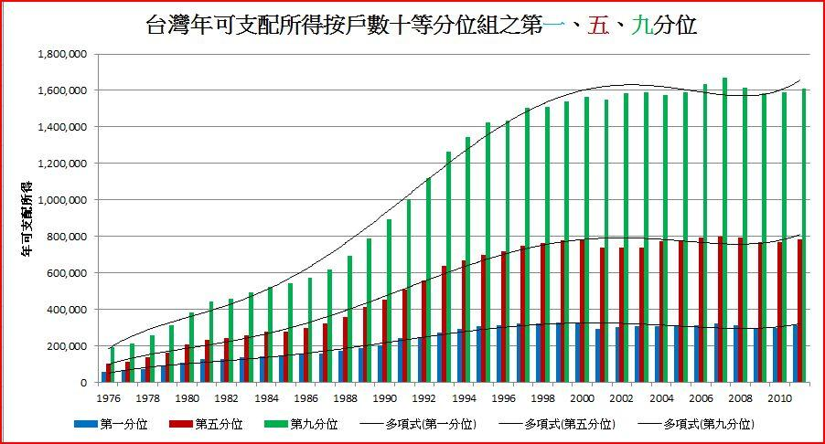
CONSEQUENCES OF THE EXPANSION OF HIGHER EDUCATION
Socioeconomic inequality
Annual Disposable Income
Top 10%
Median income
Bottom 10%

Slide 39
EXPANSION OF HIGHER EDUCATION IN TAIWAN
Challenges Today
Oversupply of university graduates seeking employment
Insufficient high school graduates to fill universities
Upcoming university closures and mergers
Internationalization
SSCI syndrome in academia

Slide 40
Lessons from Taiwan’s Higher Education Expansion
1. University expansion out of political/campaign consideration
2. Public opinion vs. professional opinion
3. Academic drift: The Peter Principle in vocational education
4. One size fits all: The SSCI syndrome
5. Cross-straitization: for peace or for survival

Slide 41
Thank you.
Questions and Comments:
Chuing Prudence Chou (周祝瑛)
National Chengchi University
iaezcpc2007@gmail.com
www3.nccu.edu.tw/~iaezcpc/en/

Slide 42

Chuing Prudence Chou
Chou, C. P.; Spangler, J. (eds.). (forthcoming). Chinese Education Models in a Global Age: Transforming Practice into Theory. Singapore: Springer, forthcoming.
Chou, C. P. (Ed) (2014). The SSCI Syndrome in Higher Education: A Local or Global Phenomenon. Netherland: Sense Publishers.
Chou, C. P.; Ching, Gregory S. (2012). Taiwan Education at the Crossroad: When Globalization Meets Localization. International and Development Education. New York: Palgrave Macmillan.
周祝瑛(2008)。台灣教育怎麼辦？臺北：心理。

