Slide 1
LCPC

Slide 2
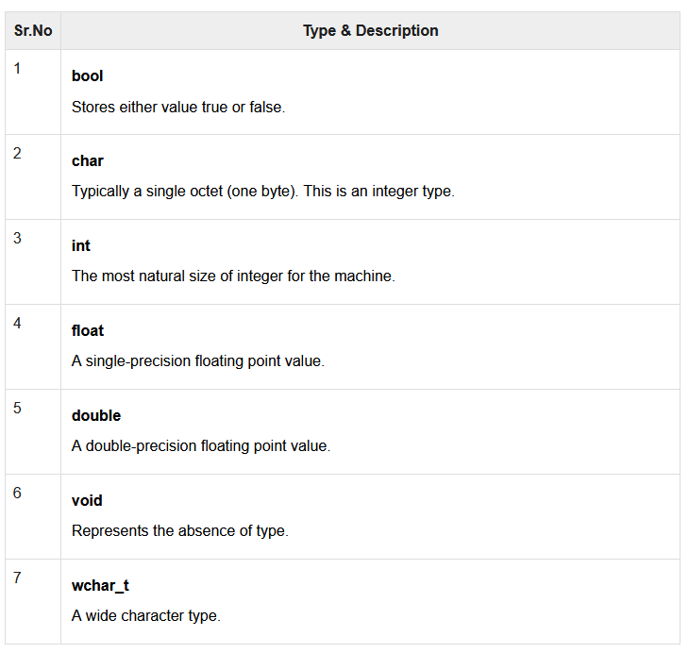
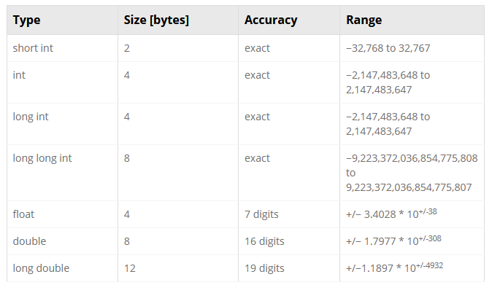
Variables

Slide 3
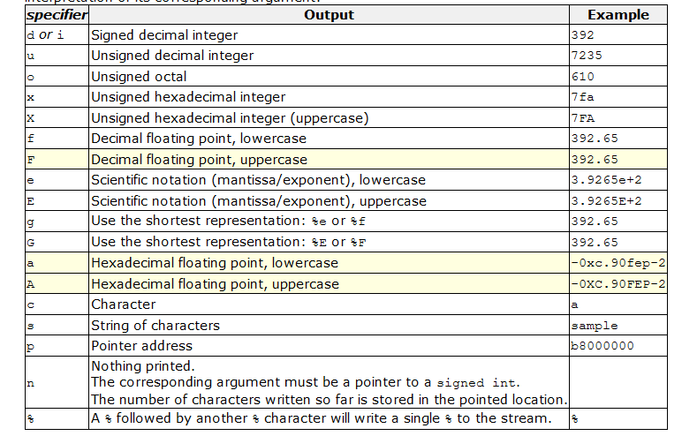
Output Format
printf("%d\n“, VARIABLE)
Display 6 values after the .
printf("%6f\n“, VARIABLE)
Example: 7.000000

Slide 4
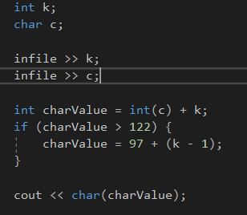
Conversion of Variables
Convert char c to int
int(c)
Convert int charvalue to char
char(charvalue)
z = 122 asci
a = 97 asci

Slide 5
What to Consider
Arrays
Loops
Variables
List
Reading from file
Output Formatting

Slide 6
How to Solve
1- Check all questions and choose what seems easy
2- Underline all important words in the problem and understand the behind meaning of the problem
3- Carefully read the input section and circle the required input requirements
Check if the input has a certain condition: 1 input line, negative value to end the code, number of test cases
4- Carefully read the output section and circle the required output requirements
5- Reading from file: spaces and enter split the variables

Slide 7


