Slide 1
A | R | R | A | Y | S

Slide 2
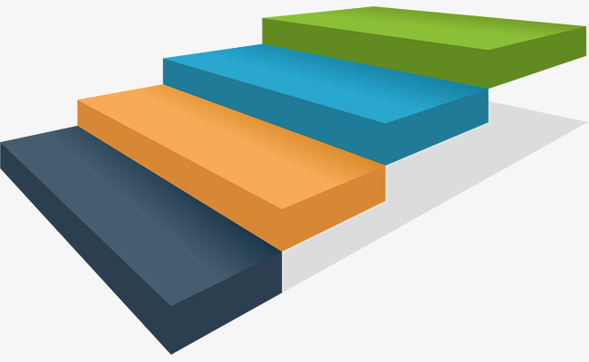
What are arrays?

Slide 3
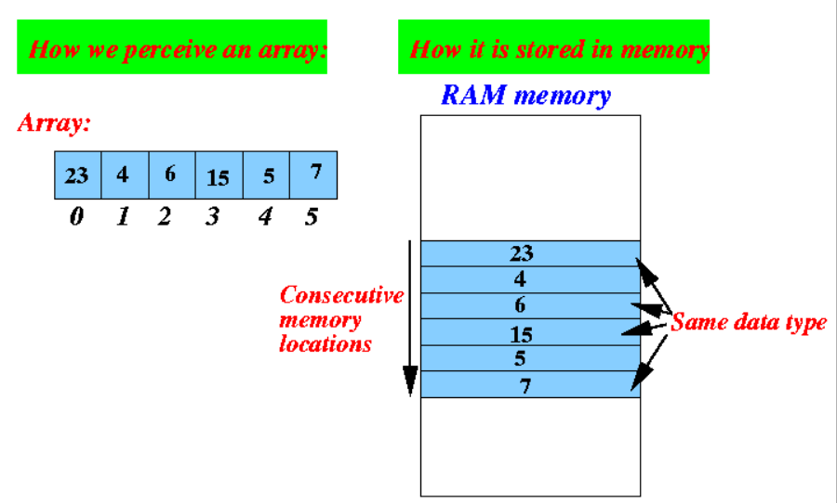
WHAT ARE ARRAYS?
Type of data structure
Collection of items stored at adjoining memory locations

Slide 4
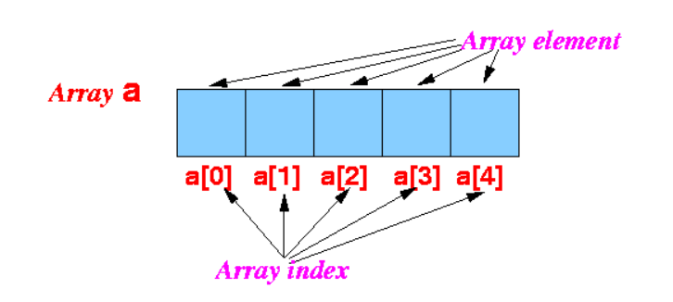
Array Components

Slide 5
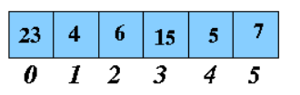
Access element
a[0] : 23
a[1] : 4
a[2] : 6
a[3] :
a[4] :
a[5] :

Slide 6
Update element
a[0] =23
a[1] = 4
a[2] = 6
a[3] =
a[4] =
a[5] =

Slide 7
Declaration C++ (static)
Array of integers containing 5 elements:
int arrayOfInts[5];
Array of integers containing 5 elements and having specific elements
int arrayOfInts[5] = {10, 20, 30, 40, 50};

Slide 8
Declaration C++ (dynamic)
Array with no defined number of elements
int* a = new int[n];

Slide 9
Applications on arrays
Add & Update Data
Search
Sort

Slide 10


