Slide 1

Version Control

Slide 2
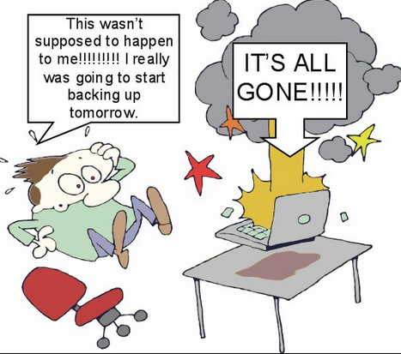

Slide 3
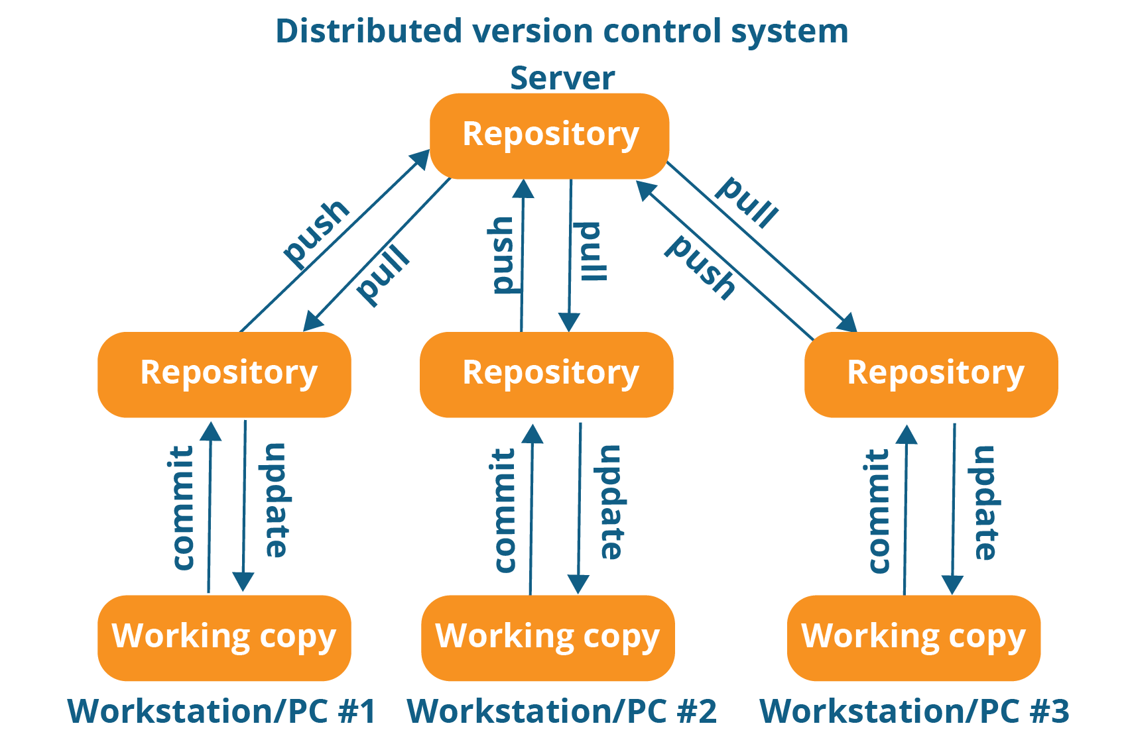

Slide 4
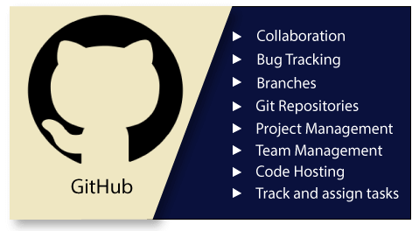
GitHub?

Slide 5
Essential components of the GitHub
Repositories
Branches
Commits
Pull Requests
Git (the version control tool GitHub is built on)

Slide 6
Commands
git add .
git commit -m "my changes"
git remote add origin add the URL of the repository
git push -u origin master
git status
git pull

Slide 7
