Slide 1
Basics

Slide 2

Variables

Slide 3
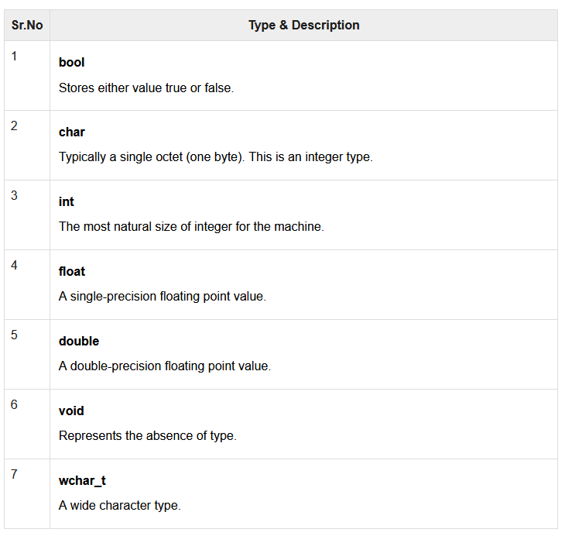
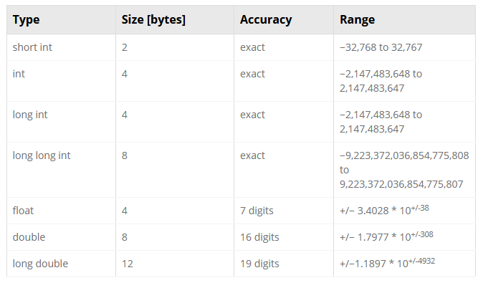

Slide 4
Input/Output
Input
Cin
Scanf
File input
Output
Cout
Printf

Slide 5
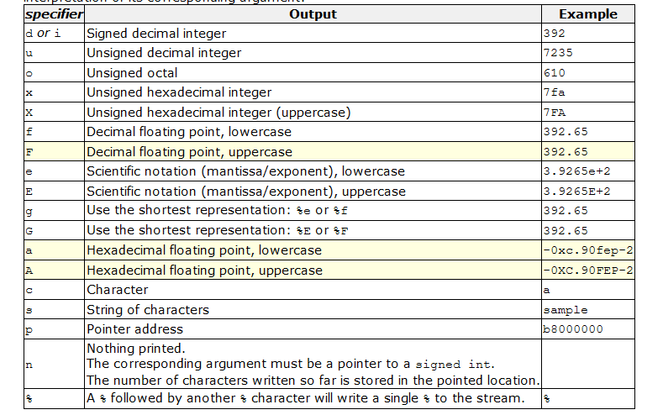
printf("%d\n“, VARIABLE)
Display 6 values after the .
printf("%6f\n“, VARIABLE)
Example: 7.000000

Slide 6

Conditions

Slide 7
Truth Tables
C1 | C2 | C1 AND C2
False | False | False
False | True | False
True | False | False
True | True | True
C1 | C2 | C1 OR C2
False | False | False
False | True | True
True | False | True
True | True | True
C1 | NOT C1
False | True
True | False

Slide 8


