Slide 1
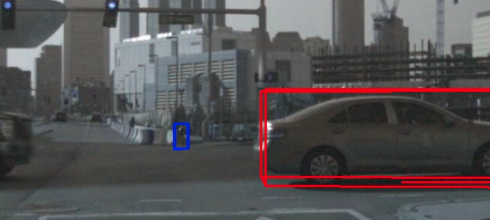
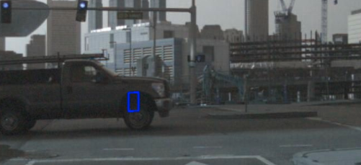
标签中存在CAM_FRONT中没有的物体！
Visibility in nuScenes :the fraction of pixels of a particular annotation that are visible over the 6 camera feeds, grouped into 4 bins.
Visibility in KITTI: 1 occluded Integer (0,1,2,3) indicating occlusion state:0 = fully visible, 1 = partly occluded, 2 = largely occluded, 3 = unknown, labeled only for image2

Slide 2
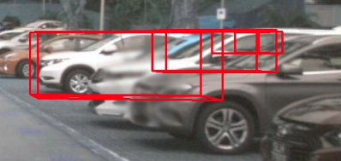
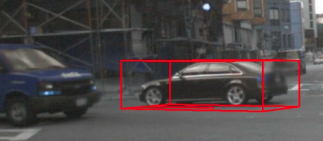
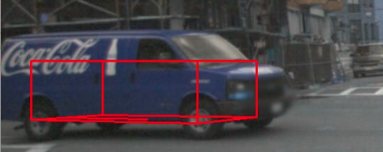
标签中存在CAM_FRONT中没有的物体！

Slide 3
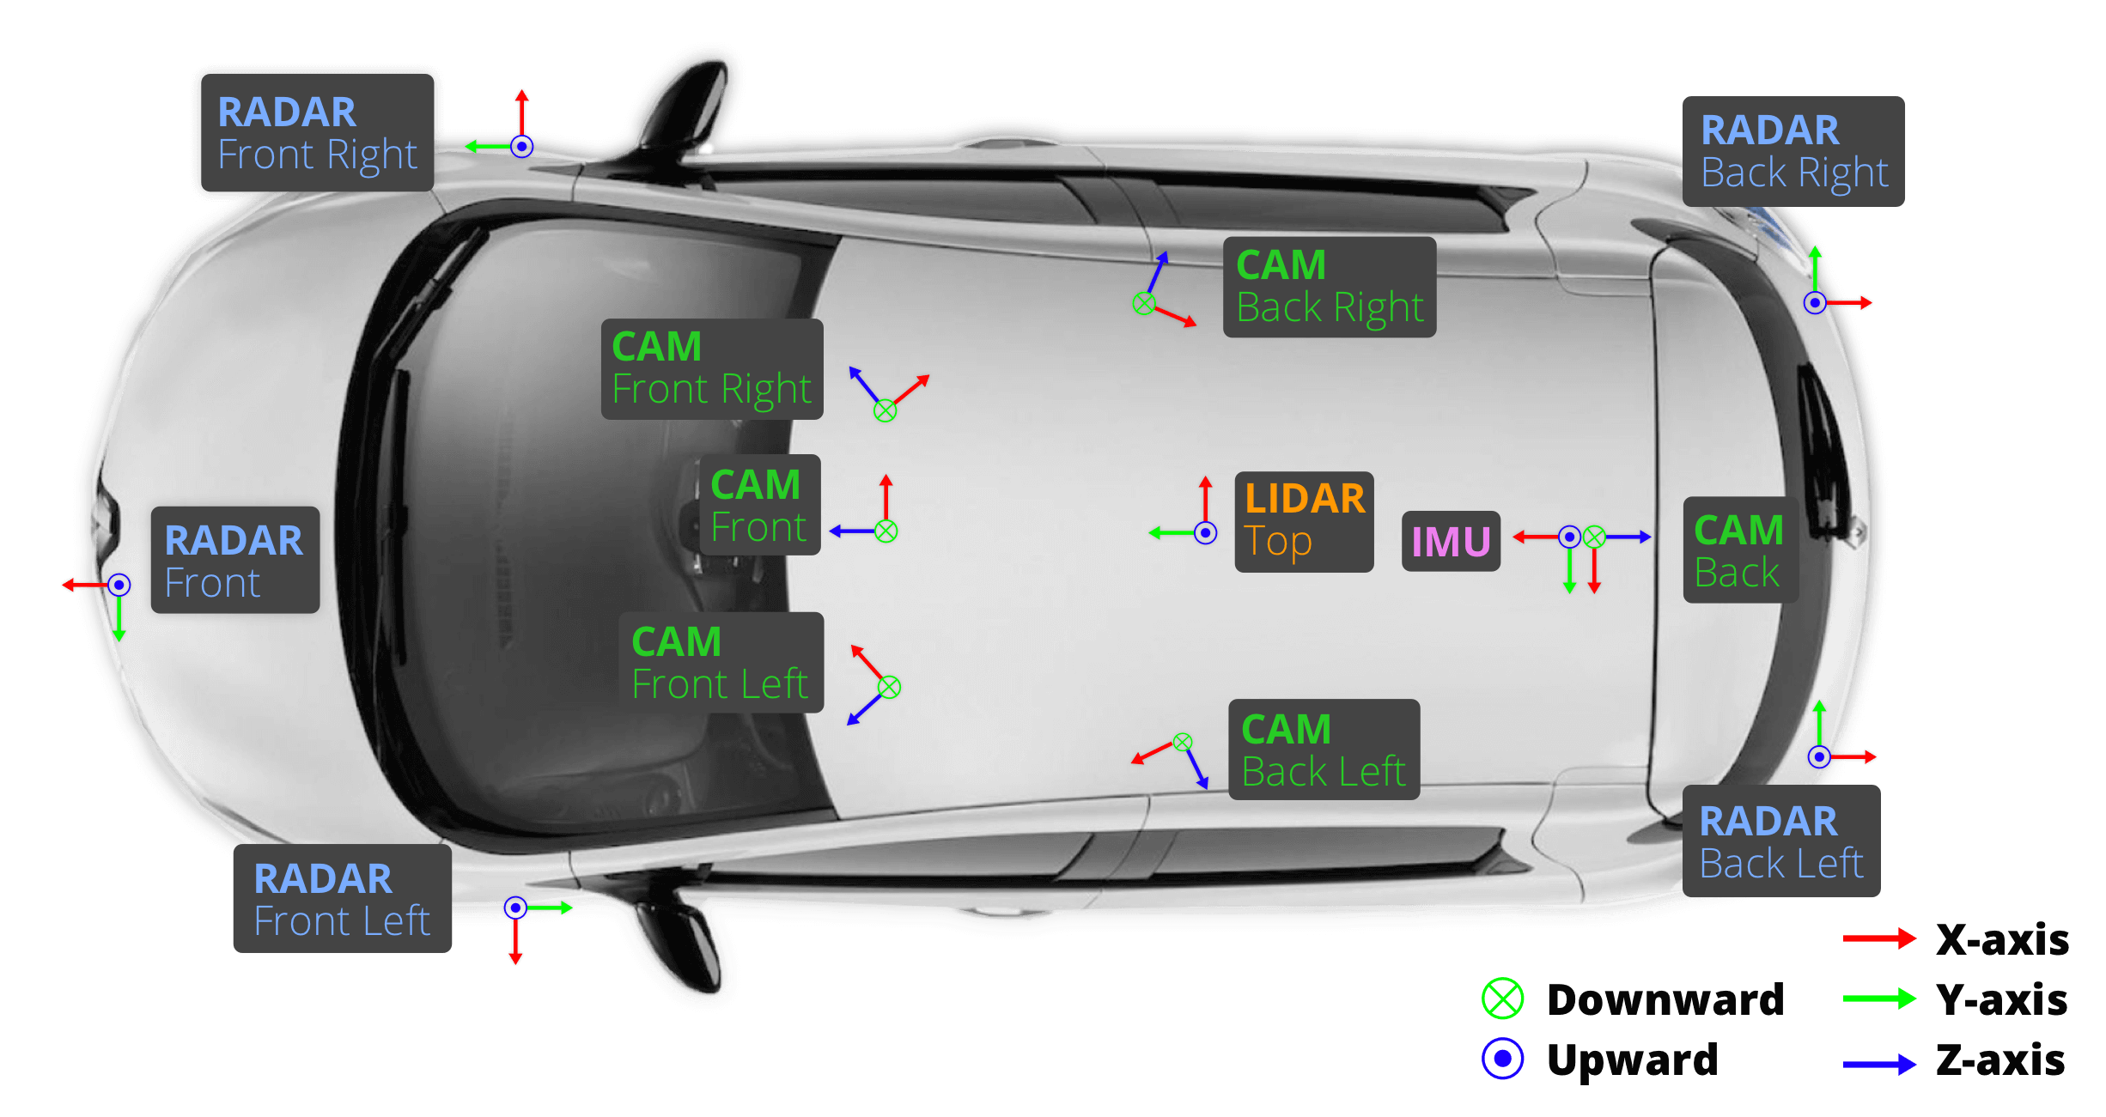
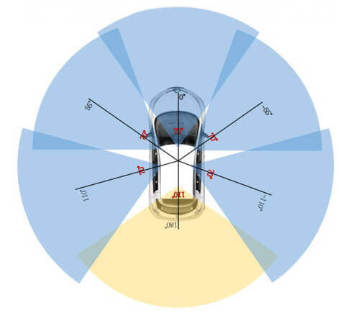

Slide 4
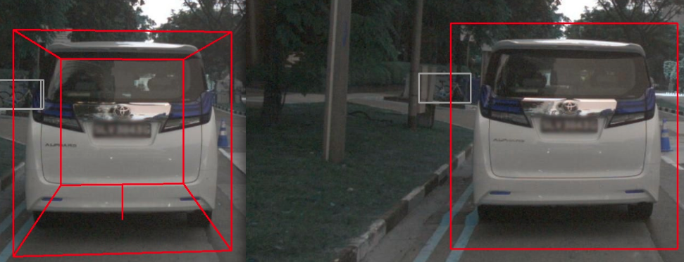
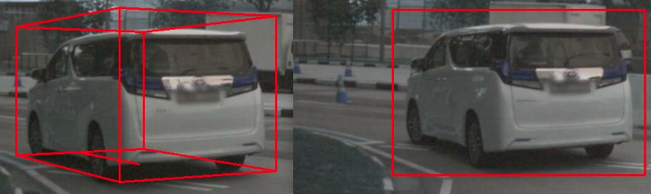
基于LIDAR_TOP的3D标签
投影到2D后不紧凑

Slide 5
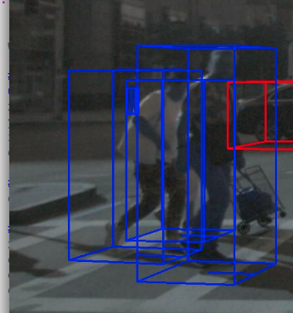
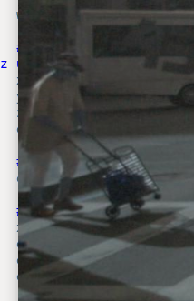
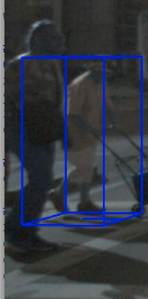
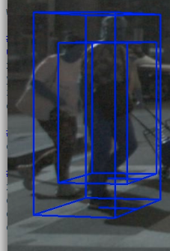
NuScenes:Max. truncation = 0？
KITTI:0~1

Slide 6
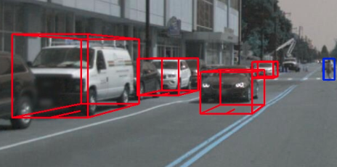
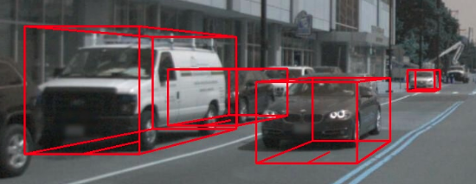
漂移？

Slide 7
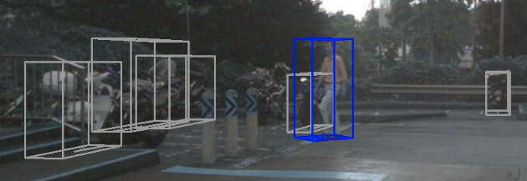
'vehicle.motorcycle': 'Cyclist',
'vehicle.bicycle': 'Cyclist',

Slide 8
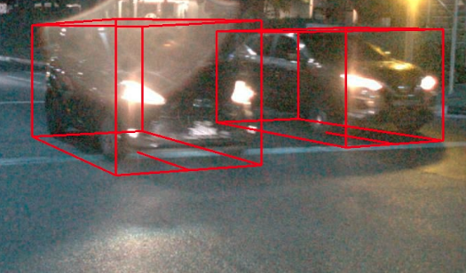
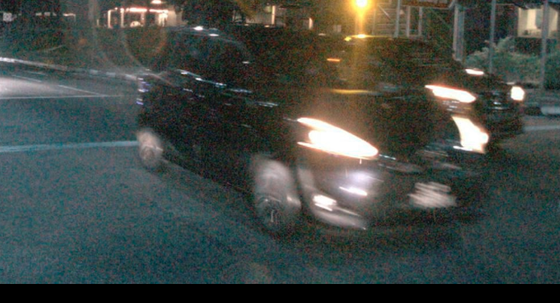
太近？

