Slide 1
MEAN

Slide 2
Express

Slide 3
The application object
app.set(name, value): This is used to set environment variables that Express will use in its configuration.
app.get(name): This is used to get environment variables that Express is using in its configuration
app.locals: This is used to send application-level variables to all rendered templates

Slide 4
The application object
app.use([path], callback)
app.VERB(path, [callback...], callback)
app.route(path).VERB([callback...], callback)

Slide 5
Middleware
morgan: This is an HTTP request logger
body-parser: This is a body-parsing middleware that is used to parse the request body.
method-override: This is a middleware that provides HTTP verb support such as PUT or DELETE
express.static: This middleware used to serve static files
cookie-parser: This is a cookie-parsing middleware that populates the req.cookiesobject
Session: This is a session middleware used to support persistent sessions

Slide 6
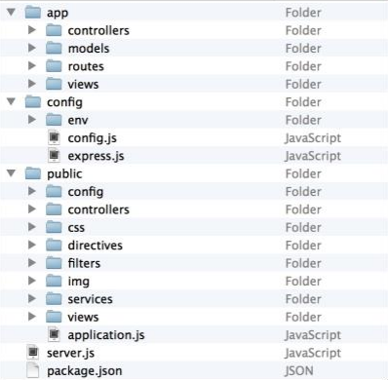
Horizontal folder structure

Slide 7
Rendering views
app.set('views', './app/views'); app.set('view engine', 'ejs');
res.render('index', { title: 'Hello World‘ })

Slide 8
Mongoose

Slide 9
Testing

Slide 10
Mocha
describe(description, callback)
it(description, callback)
before(callback): This is a hook function that is executed once before all the tests in a test suite.
beforeEach(callback): This is a hook function that is executed before each test specification in a test suite
after(callback): This is a hook function that is executed once after all the tests in a test suite are executed.
afterEach(callback): This is a hook function that is executed after each testspecification in a test-suite is executed.

Slide 11
Should.js
https://github.com/shouldjs/should.js
Example: user.should.be.an.Object.and.have.property('name', 'tj');

Slide 12
SuperTest
Dùng để test với web application
https://github.com/visionmedia/supertest
request(app).get('/user') .set('Accept', 'application/json') .expect('Content-Type', /json/) .expect(200, done);

Slide 13
Debugging with node-inspector
Use grunt-node-inspector

Slide 14
Yo generator
Install npm install -g yo npm install -g generator-meanjs
init project yo meanjs

Slide 15
Resource
http://www.bradoncode.com/tutorials/mean-stack-tutorial-part-2-server-side/

Slide 16
Async
http://www.sebastianseilund.com/nodejs-async-in-practice

Slide 17
Best Practice
Thêm return trước mỗi callback vì hàm callback không kết thúc hàm
Always Check for “error” in Callbacks
Use single quotes, unless you are writing JSON.
Use the === operator.
Keep your functions short

Slide 18
Use closures, but don't nest them.
setTimeout(function() { client.connect(afterConnect); }, 1000);
function afterConnect() { console.log('winning'); }

