Slide 1
Reproducing the real gate from the IBIS file
Simon Huang · 24 September 2026
The output stage is a static map of its own gate, so a stressed pad is right when the gate's shape is right — and the gate is the one thing an IBIS file does not record.
1 measure the map 2 show it works 3 show why our gate fails
4 the motivation 5 the method, step by step 6 where it stands
Notes:
Order matters here: every earlier version started from the method. This one starts from the measurement, because that is how the work went and it makes the method's motivation earned rather than asserted.

Slide 2
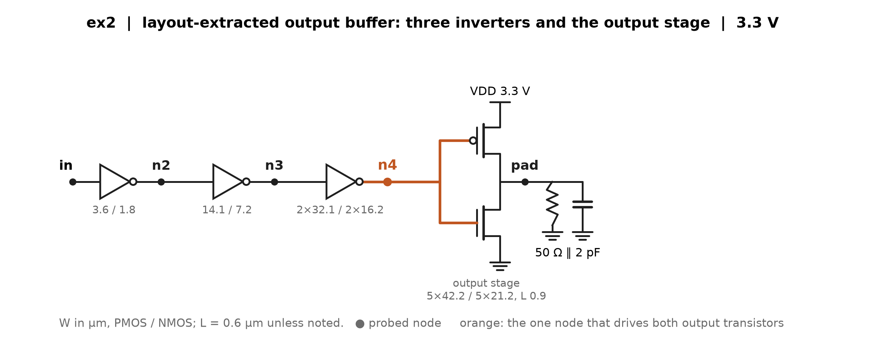
1 · We can look inside our own test chips
These are our designs, so the transistor netlist is available and every internal node can be probed. A customer using a vendor's IBIS file cannot do this — which is the whole problem, and the reason to do it once, carefully.
The node that matters is the output stage's gate — ex2's n4 below. Everything the pad does is decided there.
Notes:
ex2's predriver is three stages; n4 (orange) is the gate of the output device. Probes ran on predriver_stages_2026-09-09; the same schematics exist for io_buf and inv_chain on the 09-18 deck.

Slide 3
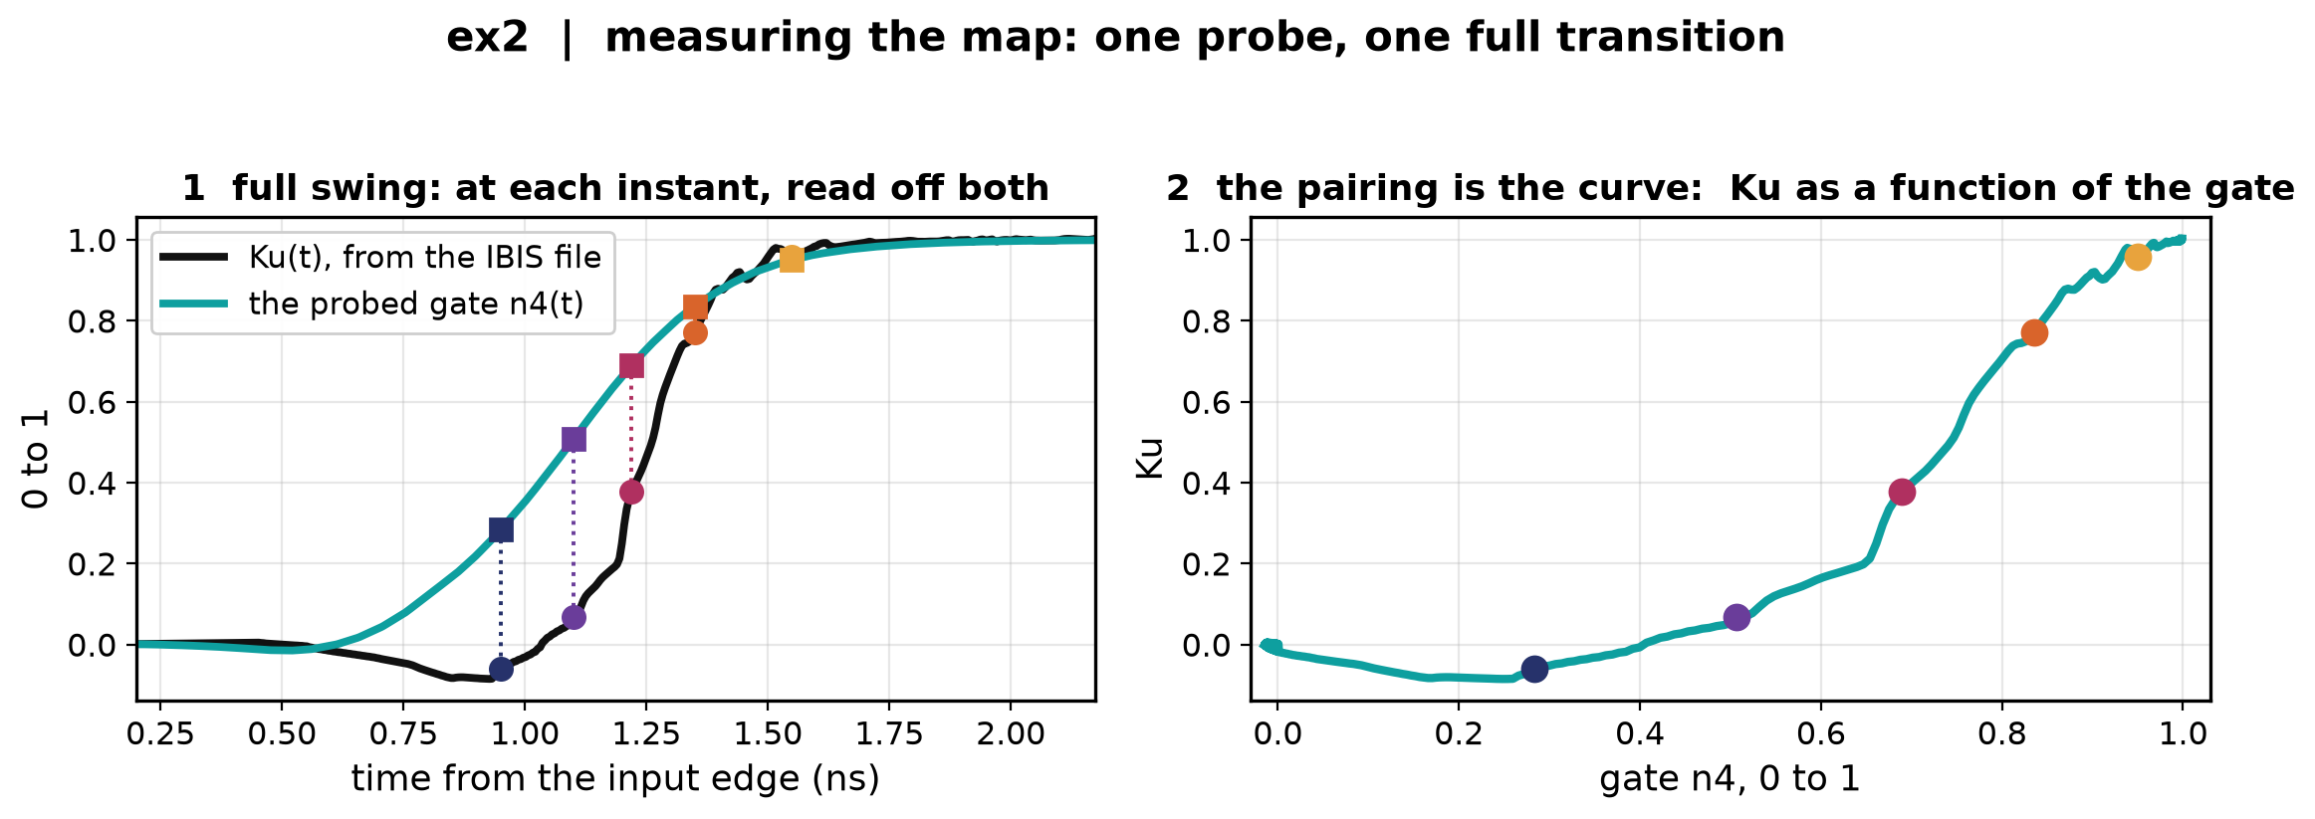
2 · Measuring the map: pair Ku(t) with the gate, instant by instant
The IBIS file gives Ku(t) on one full transition. The probe gives the gate on the same run. At each instant we have both numbers — so plot one against the other.
The pairing is the map. No fitting: it is read off a single full-swing run.
Notes:
Left: Ku(t) from the file and the probed n4(t), with five instants marked. Right: the same five instants plotted Ku against gate. This is the measured Ku-vs-gate map, and it is what the next slides drive.

Slide 4
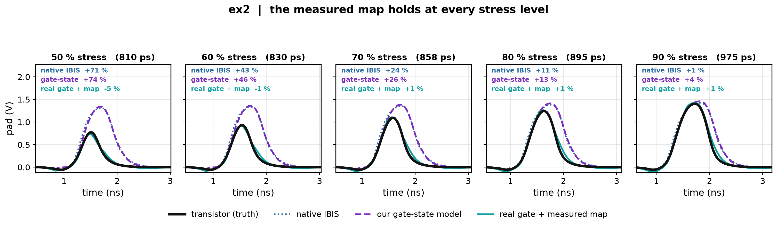
3 · Does the measured map work? ex2
Drive that measured map with the transistor's own gate; compare against the transistor at all five stress levels.
Within ±5 % at every level. Native IBIS runs +71 % at the deepest, our own gate-state model +74 %.
Notes:
Build: gate_replay_silicon_full in gate_cascade_prototype_2026-09-09 — the real gate replayed through the map measured at full swing. The same replay through the IBIS-implied map is fine on ex2 (-3…-6 %) and collapses on inv_chain (-14 to -69 %), which is why the measured map is the one shown here.

Slide 5
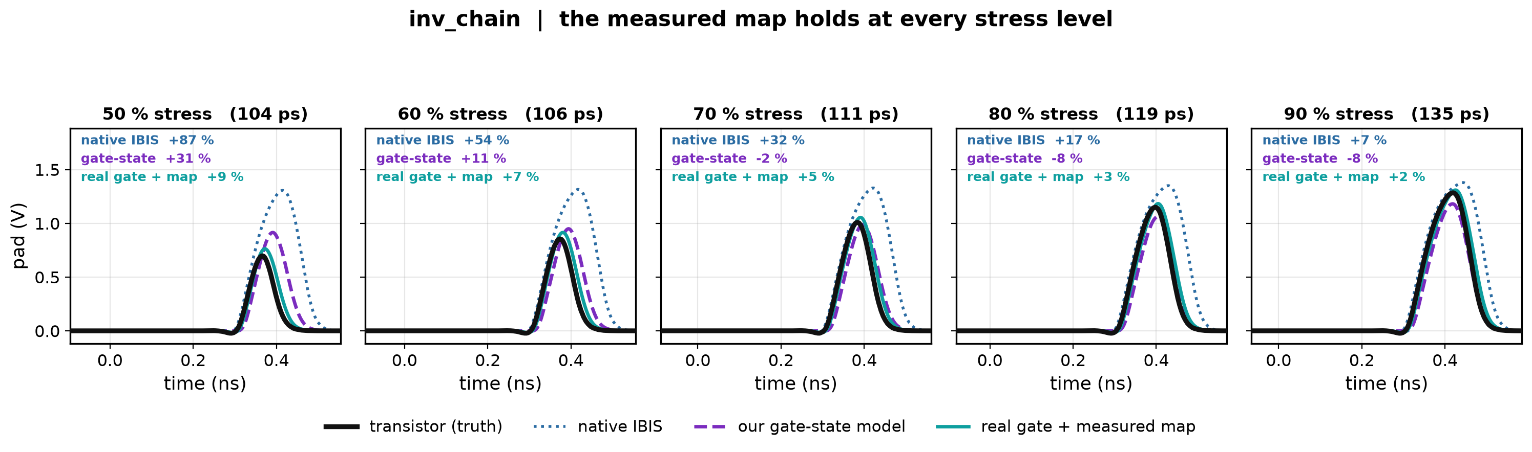
3 · Does the measured map work? inv_chain
Drive that measured map with the transistor's own gate; compare against the transistor at all five stress levels.
Within +2…+9 %, where native IBIS runs +87 %. Our gate-state model looks good at 70–90 % for the wrong reason — see the backup slide on Vinh.
Notes:
Build: gate_replay_silicon_full in gate_cascade_prototype_2026-09-09 — the real gate replayed through the map measured at full swing. The same replay through the IBIS-implied map is fine on ex2 (-3…-6 %) and collapses on inv_chain (-14 to -69 %), which is why the measured map is the one shown here.

Slide 6
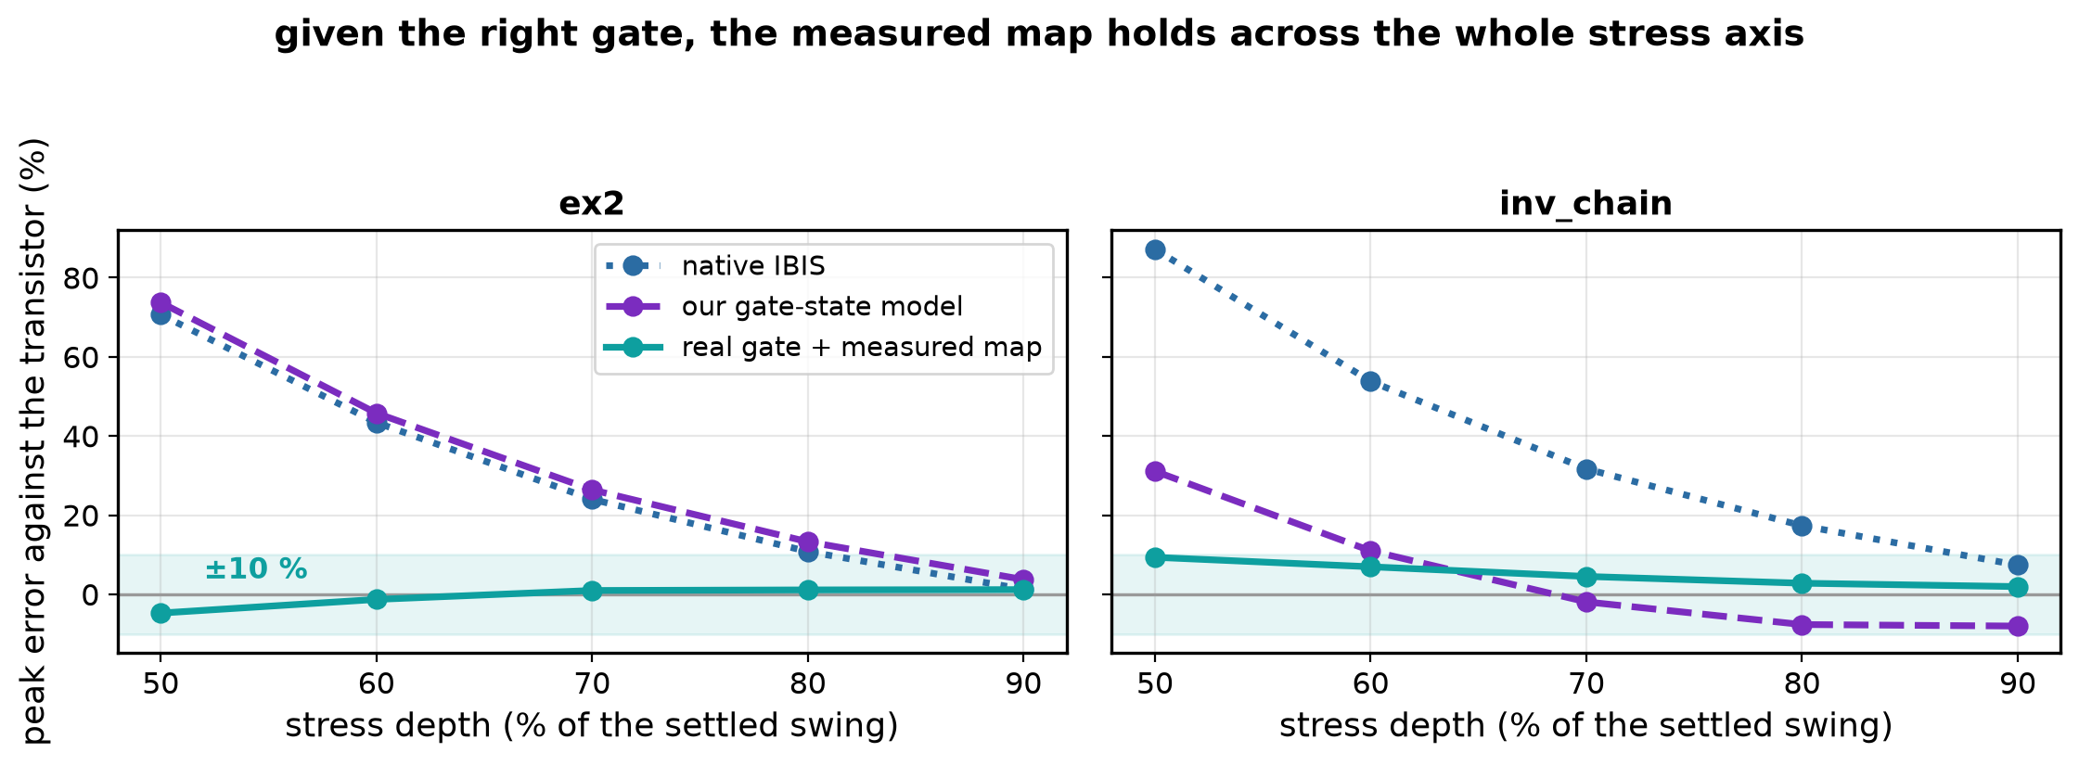
3 · So the output stage is not the problem
Given the right gate, the map reproduces the pad at every stress level, on both buffers.
The map itself is a fixed curve — it has no memory, and it does not change with the pulse. Measured hysteresis between the rising and falling branches is 0.07–0.10.
Everything that is wrong with our model is therefore in the gate.
Notes:
This is the pivot of the deck. It licenses spending the rest of the time on the gate's shape and nothing else.

Slide 7
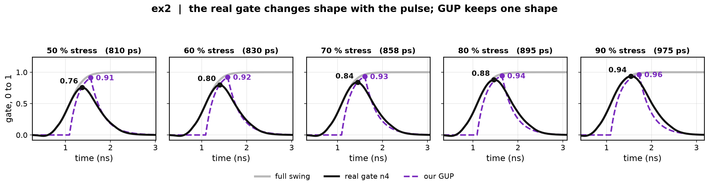
4 · Why our gate fails: the real gate changes shape, GUP does not
Our GUP is a fixed delay then an RC ramp. Truncating the input truncates that one shape.
The real gate is already moving long before GUP starts, and it turns round earlier.
Compare the two at each stress level — the mismatch grows as the pulse shortens.
Notes:
Grey: the full-swing gate. Black: the real gate under the stressed pulse. Purple: our GUP. Note that the real gate leaves zero around 0.5 ns while GUP is still flat until 1.1 ns, and that GUP's peak arrives after the real gate's.

Slide 8
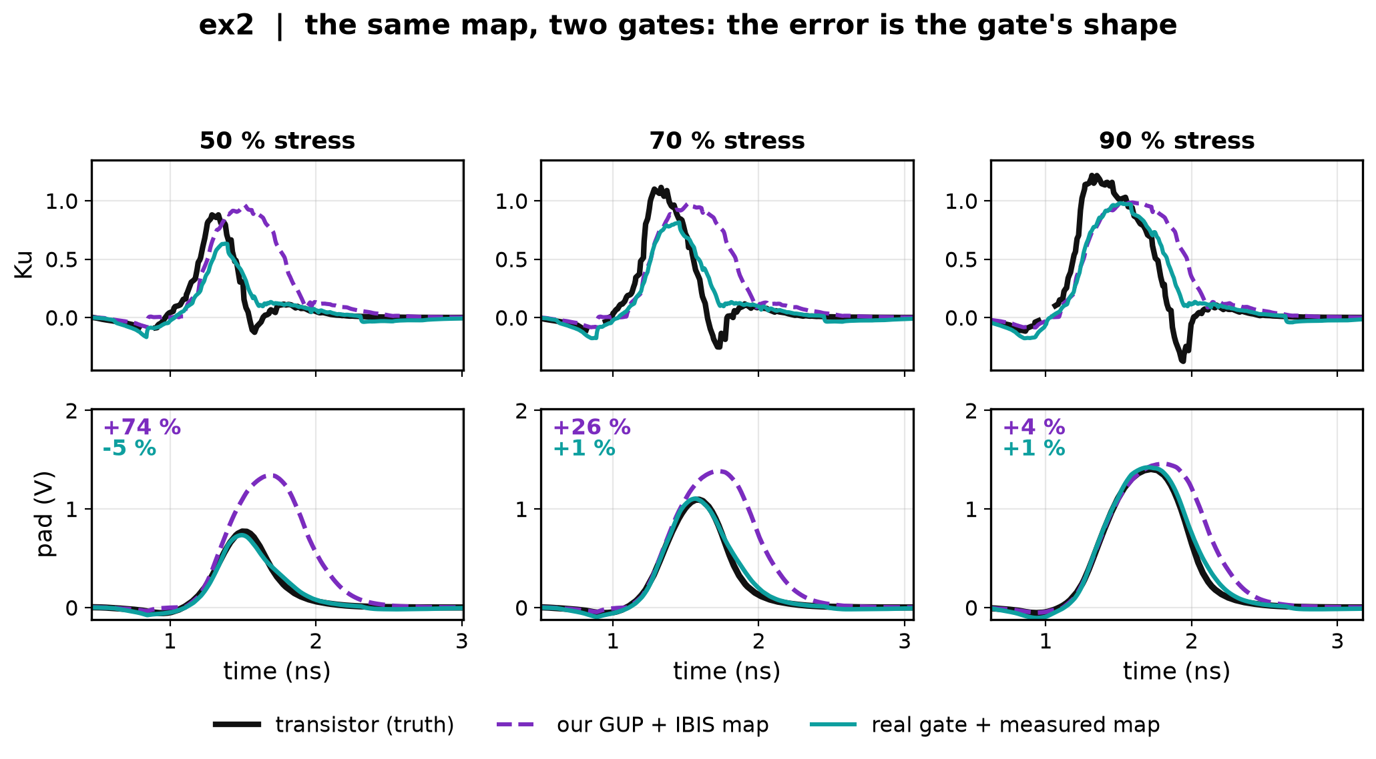
4 · What that shape difference does downstream
Same map, two gates: Ku on top, the pad below. Our peak error: +74 % at 50 % stress, +4 % at 90 %.
GUP holds Ku high after the real gate has let go, and the pad overshoot is exactly that extra area.
Notes:
This is the causal chain end to end: gate shape -> Ku -> pad. At 90 % stress the two gates nearly coincide and the error nearly vanishes, which is why the failure only shows up under stress.

Slide 9
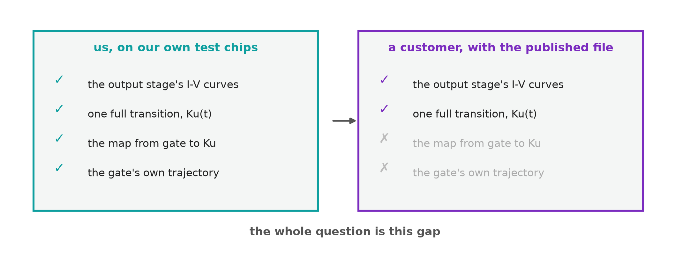
5 · So the problem is now a precise one
We know what a correct model needs: the real gate's shape, and the map.
We have both — by probing. A customer with only the vendor's IBIS file has neither.
The question for track 1: how much of that gate shape can be recovered from the IBIS file plus one measurement taken at the pad, with nothing probed inside?
Two things have to come from somewhere: how fast the gate travels, and the map's shape. The next slides are about where each one can come from.
Notes:
This is the motivation slide, and it only works because the evidence half has shown that the gate's shape is the entire error. Earlier versions of this deck asserted the motivation before showing that.

Slide 10
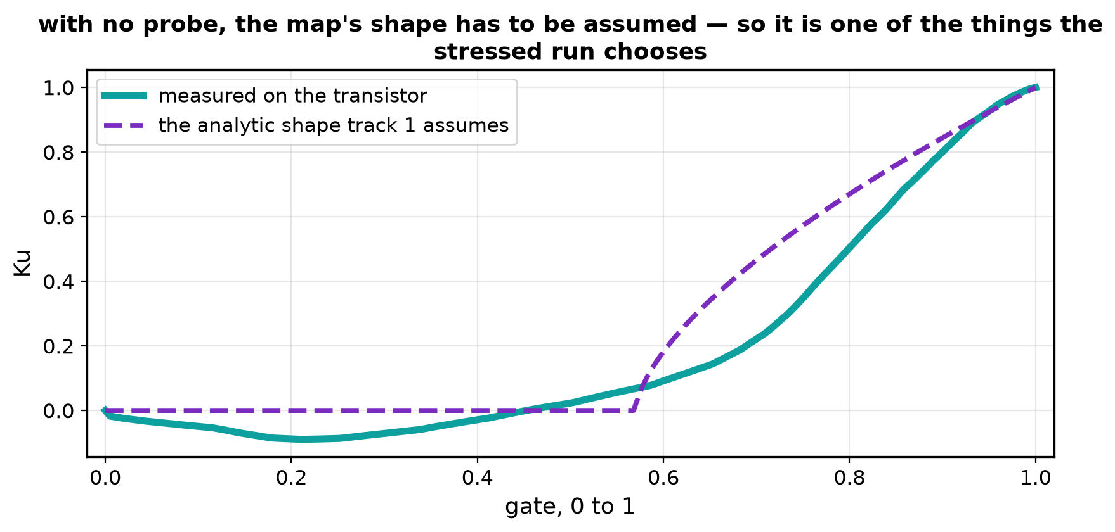
6 · What the file fixes, and what it leaves open
The file gives Ku(t) — a complete waveform, with shape at every instant. Shape is not what is missing.
What is missing is the split. Ku(t) = map(gate(t)) fixes the composition and nothing more: pick any gate trajectory and the map is forced to whatever reproduces Ku(t). Every such pair matches the file exactly.
With no probe the map cannot be measured, so its shape has to be assumed — and the assumed shape is not the measured curve.
Assume a different map and the fit hands you a different gate. That is the whole difficulty.
Notes:
An earlier cut explained where Ku(t) itself comes from - the two-fixture solve. It is now a backup slide: this audience knows it.

Slide 11
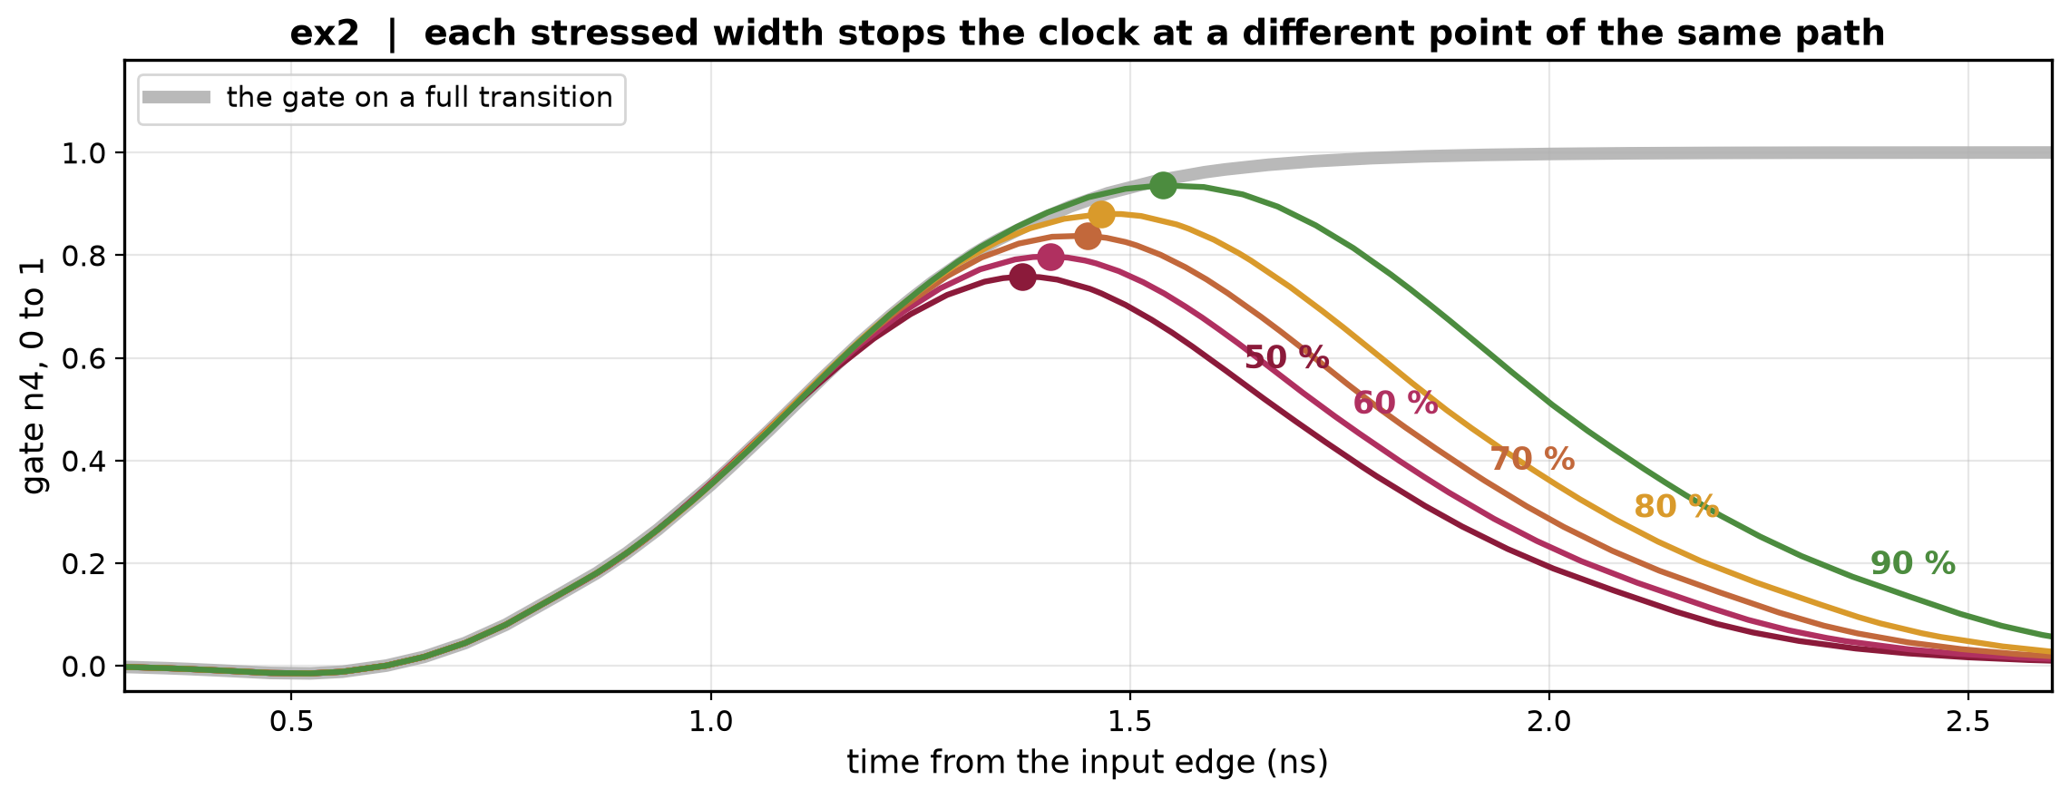
7 · One more measurement, and a stressed pulse is the one
A full transition cannot separate them. A truncated one can: the chain then produces a different gate trajectory, and where it turns round depends on how fast the gate was really travelling.
Each stressed width stops the gate at a different height on the same path — here at 0.76, 0.80, 0.84, 0.88 and 0.94.
Five stress levels are five independent tests of the split, and they cost one measurement at the pad.
Notes:
Grey is the full transition; the coloured curves follow it and peel off at different points. This is why the recipe needs exactly one extra measurement.

Slide 12
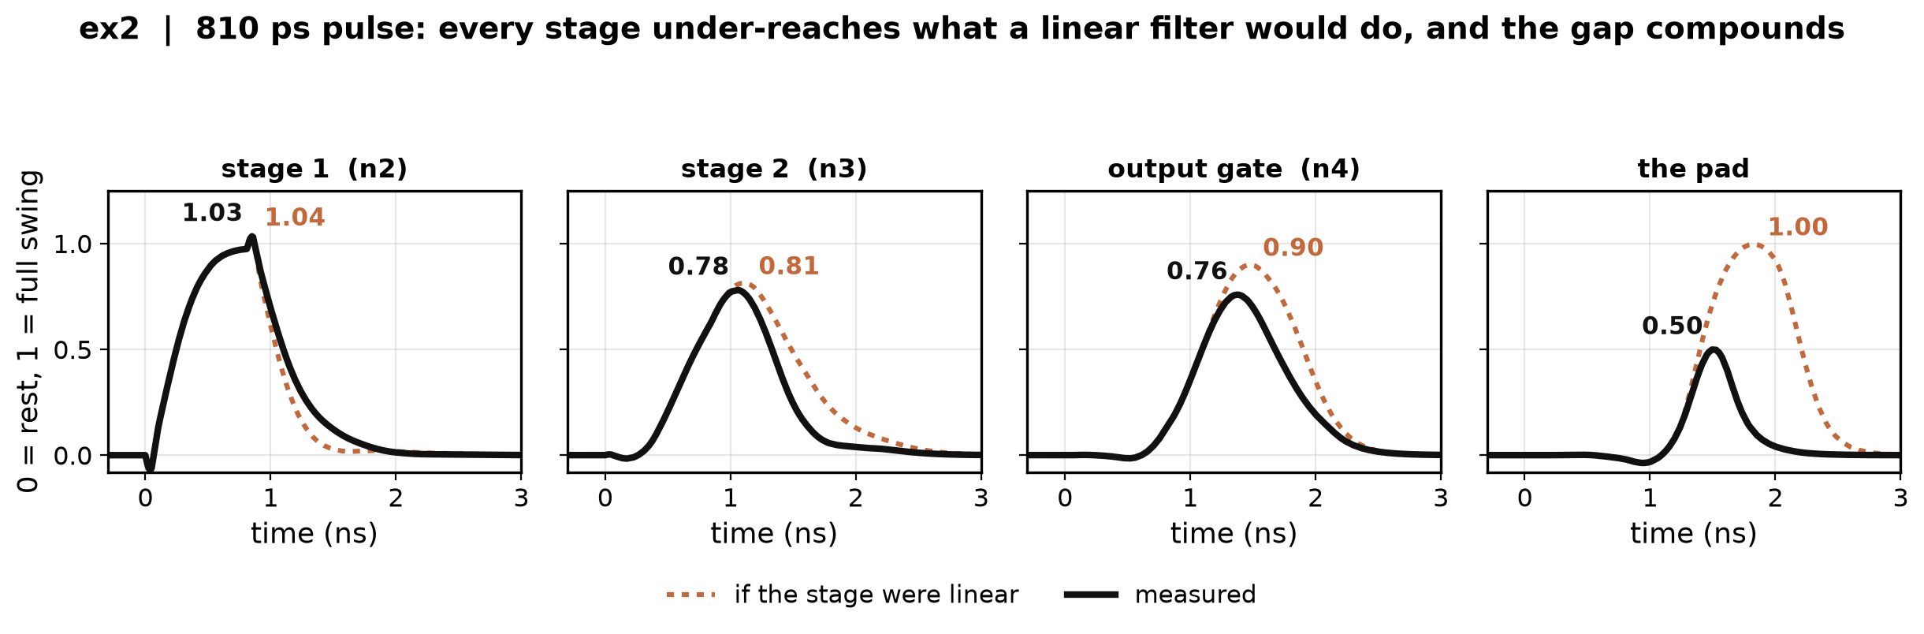
8 · But a few samples need a family of shapes to choose from
Five samples cannot pick a curve out of all possible curves. They can pick one out of a small family — so what family does this circuit actually produce?
Probe every stage under a short pulse against what a linear filter would give: its own step response, superposed.
Every stage under-reaches, and the gap compounds down the chain — at the pad the linear prediction says 1.00 where the transistor does 0.50. So the family is not linear.
Notes:
This rules out RC cascades, delay-plus-RC and superposition - which is what the shipped model is built from.

Slide 13
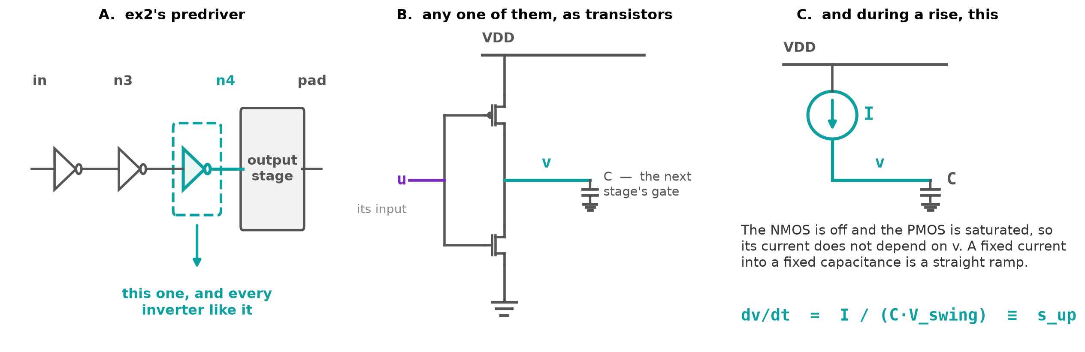
9 · What the stage law is a model of
Take one inverter out of ex2's predriver and draw it as transistors. While its output is rising the NMOS is off and the PMOS is saturated, so the current it passes does not depend on how far the output has got.
A fixed current into a fixed capacitance is a straight ramp. That ramp is the backbone of the law. The next three slides are where it, and the two things that modulate it, come from.
Notes:
A is ex2's own predriver from slide 2, with the third inverter picked out. B is that inverter as transistors, driving the next stage's gate capacitance. C is what it reduces to while the output rises: the NMOS off, the PMOS saturated, so a fixed current into a fixed capacitance. The next slide says which of the device's voltages u and v actually are.

Slide 14
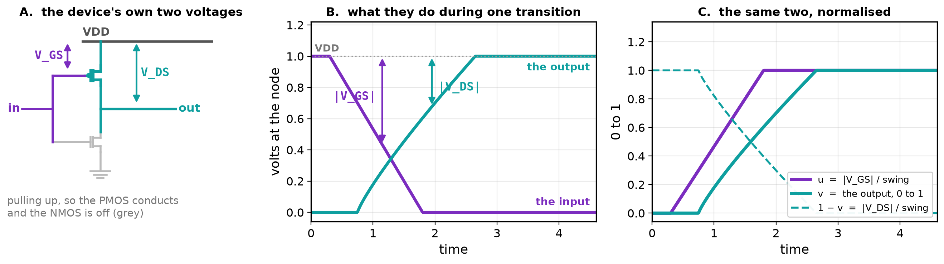
10 · The device's two voltages, in our two variables
The law is written in u and v; the physics is written in V_GS and V_DS. Same two quantities, measured down from the rail the device sits on: u = |V_GS| / swing and 1 − v = |V_DS| / swing.
u rises as the stage turns on — though this is an inverter and its input fell to do it. Normalising each stage in the direction that turns it on is the whole reason a chain of inverters reads as non-inverting.
Notes:
Without this slide the next two are unreadable: they plot 'share of full current' against u and against v, and the viewer has no way to know those are the device's own gate and drain voltages. For the PMOS pulling up, source on VDD: |V_GS| = VDD - v_in and |V_DS| = VDD - v_out.

Slide 15
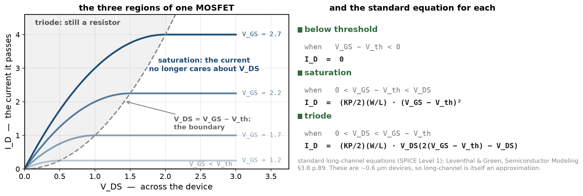
11 · What one MOSFET actually does
A transistor has three regimes. Below threshold it passes nothing. Saturated — which here means a large voltage across it — its current stops depending on that voltage, so it behaves like a current source. In triode it is a resistor again, and on these parts that is most of the travel, not a sliver near the rail.
These three regimes are what the stage law is built from — but the law is a compact stand-in for them, not a derivation of them. The next slide is where it departs, and by how much.
Notes:
Leventhal & Green, Semiconductor Modeling, section 3.8 printed page 89 (pdf 105): the SPICE Level 1 / Shichman-Hodges equations 3-23 to 3-25. Note the naming trap: a MOSFET's SATURATION region is its constant-current one, the opposite sense to a BJT. The equations beneath are the standard long-channel ones; for 0.6 um devices they are themselves an approximation, and velocity saturation extends the real constant-current region.

Slide 16
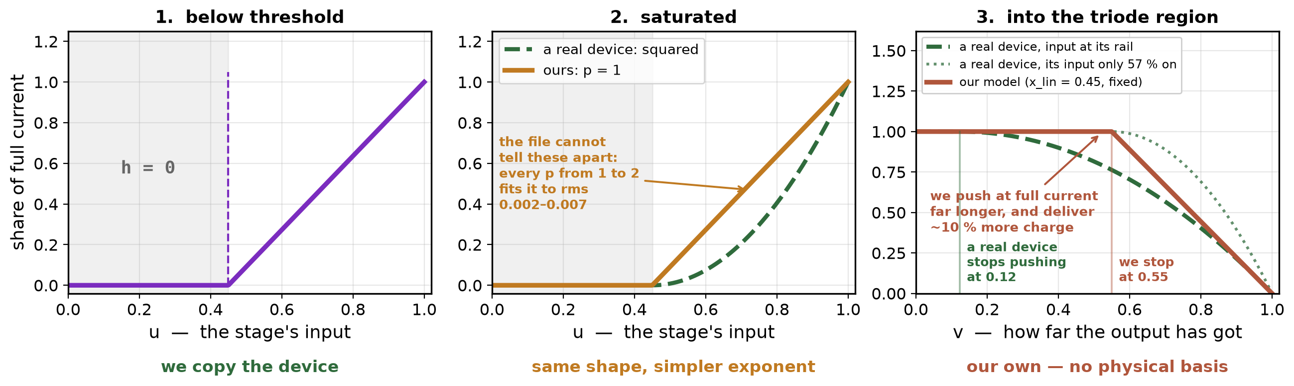
12 · What we keep of that, and what we replace
Our version of each regime, drawn on top of a real device's. Below threshold we copy it. Saturated we keep the shape and flatten the exponent from 2 to 1. Into triode we put a straight line of fixed width where the device's width changes with its input.
What x_lin really says is: our stage keeps pushing at full current for the first 55 % of its travel, where a real device gives up at 12 %. Over the travel we deliver about 10 % more charge than the device would. That is the largest approximation in the model and the first thing to distrust.
In its favour: 0.45 is where a real device's boundary sits when its input is only 57 % on — a partly-driven stage, which is exactly the stressed case.
Notes:
Why p = 1: it is not a claim about the device, it is an admission that the file cannot see p - every value from 1 to 2 fits the full-swing Ku(t) to rms 0.002-0.007. Why the straight line: it keeps the stage law solvable in one expression, and the stressed pulse turns round before the gate is deep into this region on most buffers.

Slide 17
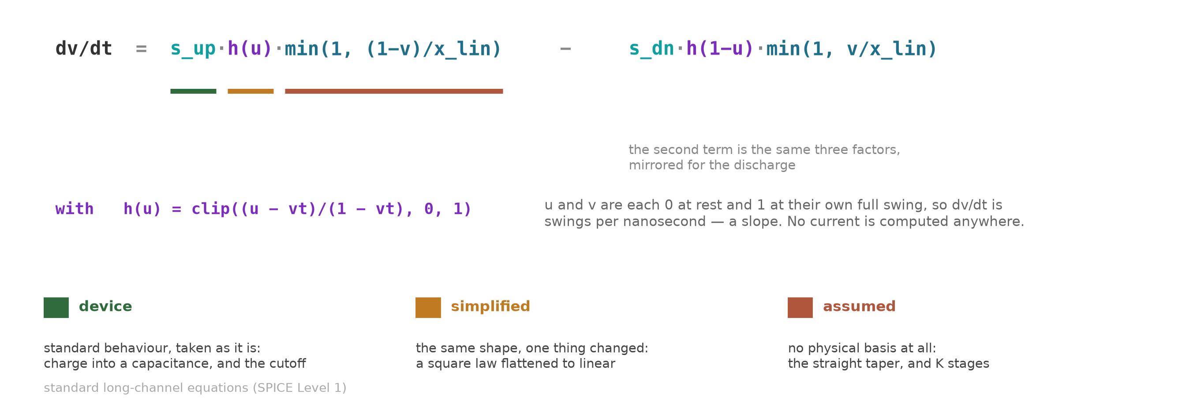
13 · The law, with where each piece came from
Read the colours: green is standard transistor behaviour taken as it is, amber is that behaviour with one thing simplified for a reason we can state, red has no physical basis at all. K stages in series is a fourth thing in the red category.
So this is a physically motivated reduced-order model, not one derived from device physics. A transistor gives us the shape to expect — a current-limited phase, then a resistive approach to the rail. It does not hand us the min(), the straight taper, the fixed x_lin or p = 1. Those are ours, and the case for them is the measured result on the next fifteen slides, not the derivation.
Notes:
The honest summary: the backbone and the threshold are standard device behaviour, the exponent is ours by necessity, the taper and the chain are ours by choice. This is the slide to stand behind if someone says the model is derived from physics - it is not, and the results do not depend on it being.

Slide 18
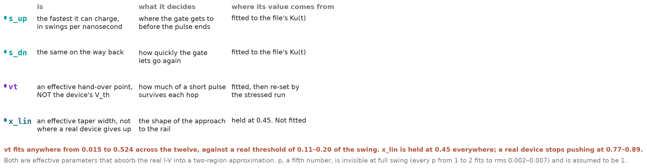
14 · The four numbers that leaves
s_up and s_dn are slopes — ex2 fits 2.59/ns, 0.39 ns to cross a stage's swing flat out. vt and x_lin are effective parameters, not device quantities: they absorb the real I-V into a two-region approximation.
Does the file not give vt? Its Vinh/Vinl are the input pin's thresholds, and the converter does use those, for our input comparator. But vt is not a threshold voltage at all — it is where one modelled stage hands over to the next, and nothing in the file describes that.
Notes:
On inv_chain the file's Vinh is 2.0 V on a 1.8 V part, which is why the converter guards it - the backup slide. p is assumed 1 because it is invisible at full swing: every p from 1 to 2 fits to rms 0.002-0.007.

Slide 19
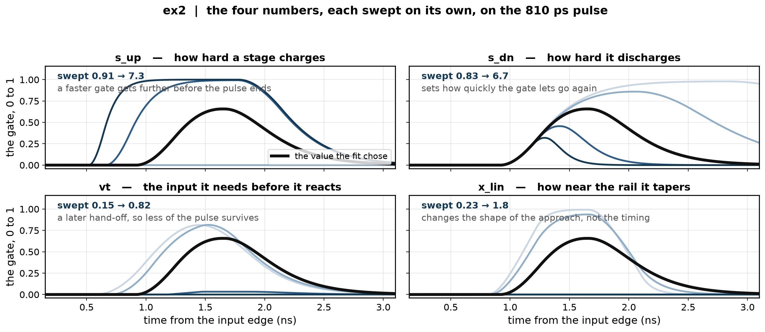
15 · What each of the four actually does
Each swept on its own about the value the fit chose, on the 810 ps pulse. The thick black trace is the fitted value.
Look at the vt panel: pushed high enough the gate never leaves the floor. In the model that is abrupt; in silicon the current falls off continuously and a short pulse degrades stage by stage until it is gone. The hard threshold is our approximation of that, not the device's behaviour.
Notes:
Simulated with the project's own stage model from the fitted values the 09-17 film exported.

Slide 20
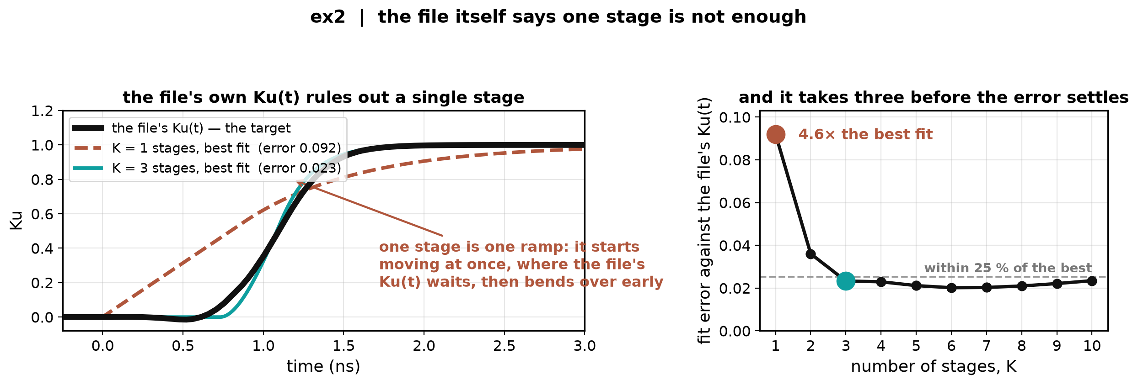
16 · Why a chain, and not one stage
Fit one stage as well as it can be fitted and it still misses the file's own Ku(t) by 4.6× the best error. One stage is one ramp: it starts the instant the input does, where the real Ku(t) waits, and then bends over too early.
The file itself rules out a single stage — no stressed data needed to see it. Three stages is where the error settles.
Notes:
est_knee fit, ex2 pull-up: K=1 rms 0.0920, K=2 0.0360, K=3 0.0233, best (K=6) 0.0202. The real predriver is a chain too - ex2's schematic showed three inverters - but this is the file saying so on its own.

Slide 21
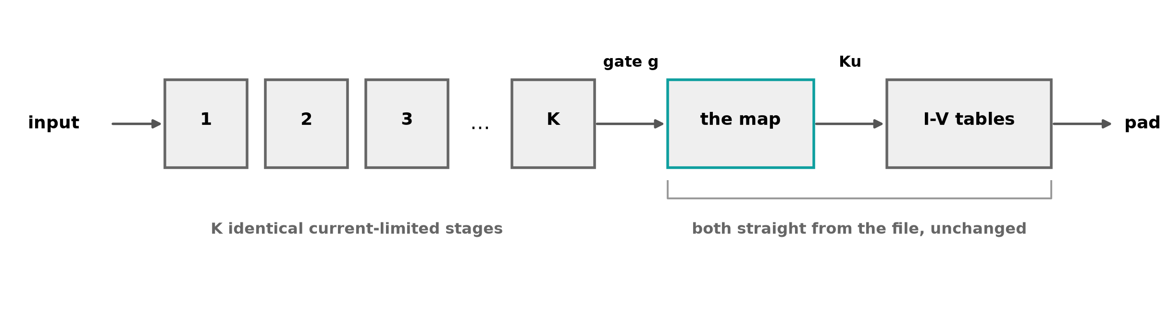
16 · So: K identical stages, then the file's own map
We cannot see how many stages a vendor's part has, so the count K is a parameter. The stages are held identical in their normalised dynamics — not in their dimensions, which a real tapered predriver deliberately varies. That is defensible when the taper ratio is roughly constant, and letting them differ makes the fit degenerate.
Everything to the right of the gate is the file's own, untouched — the map and the I-V tables. We are only building the left-hand box.
Notes:
Degenerate: a free fit splits the delay into one sluggish stage plus one quick one, reproduces the full swing slightly better, and predicts a stressed gate of 0.23 against a measured 0.76.

Slide 22
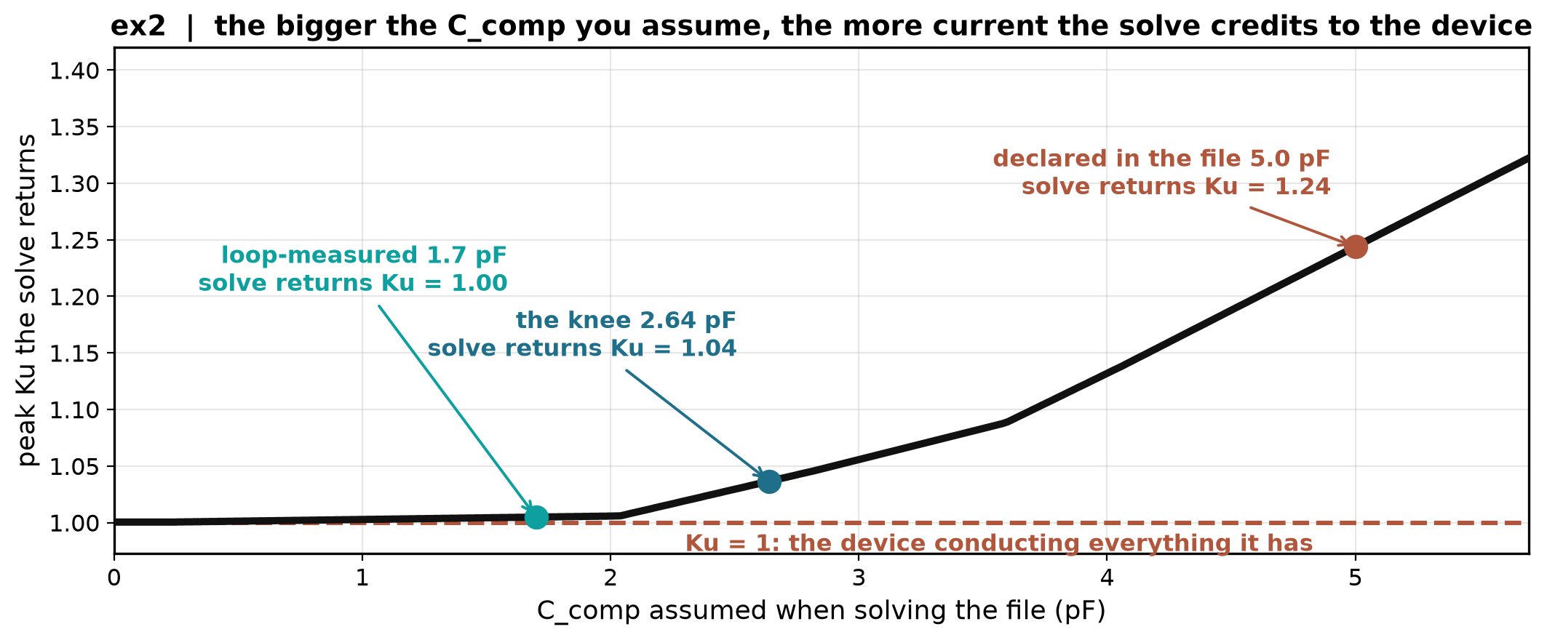
17 · Before the recipe: C_comp is an input, and this file's is wrong
C_comp is not something the method derives — it is an input the solve needs, and we assume it arrives with the file. When s2ibispy extracts it properly, it drops into this same slot and nothing downstream changes.
It still needs a validity check, because this file's declared value fails one. Ku is defined as a multiplier on the fully-on I-V table, so a solved Ku above 1 means the arithmetic is asking the device for more than it has: ex2's declared 5.0 pF implies Ku = 1.24. Treat that as a diagnostic rather than a law — extraction noise and fixture error can push it over 1 too.
Today's numbers therefore use the value at which Ku just reaches 1 — 2.64 pF here, against 1.70 measured with a probe. 55 % off, and it still works, because the stressed peak is not sharp in C_comp.
Notes:
C_comp is not a model parameter: it is a number the file's own Ku tables were solved with, so a wrong value inflates the curve everything downstream is fitted to.

Slide 23
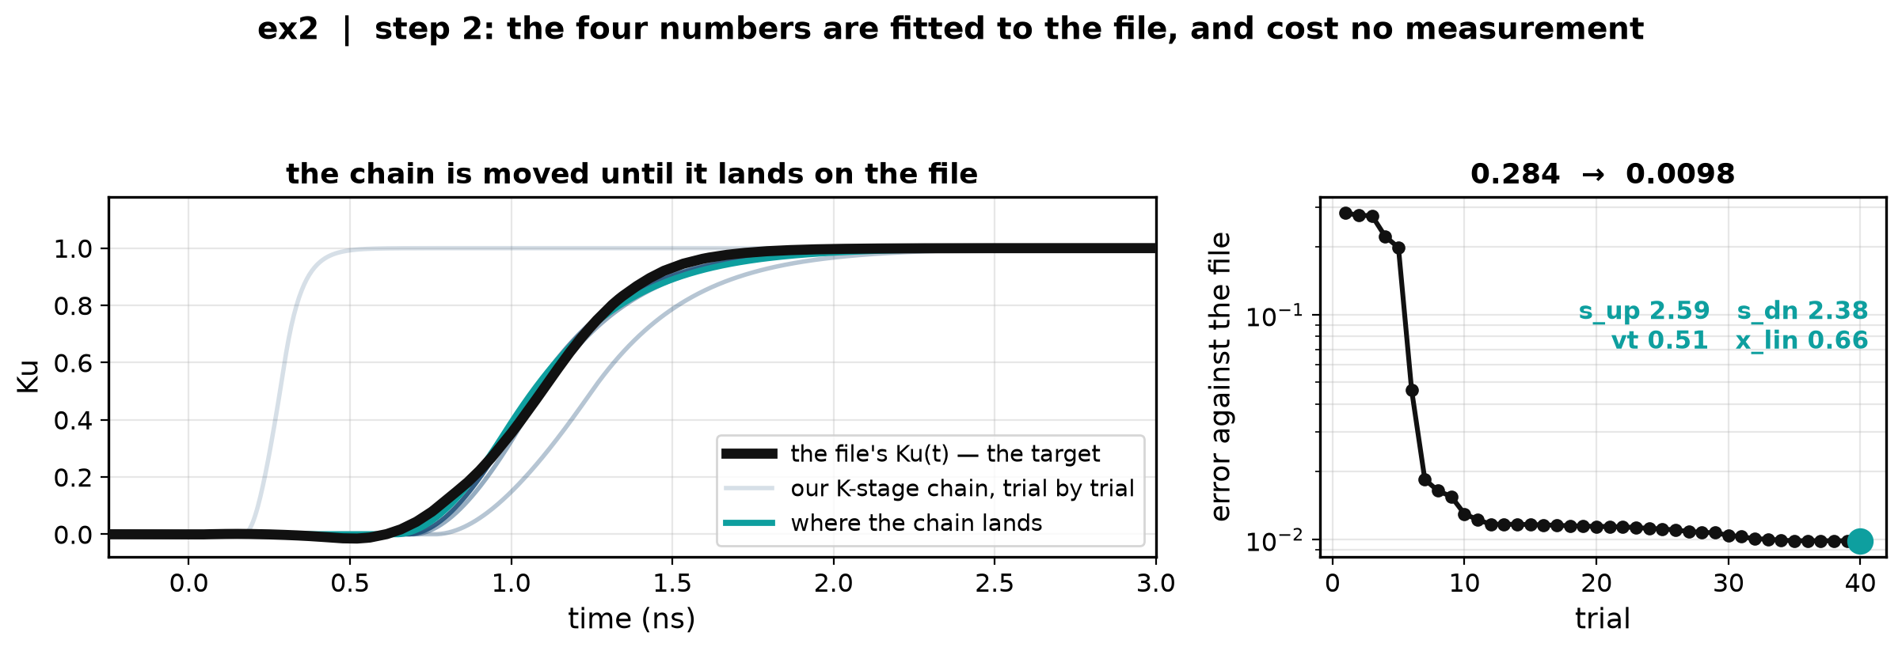
18 · Recipe step 1 of 4 — fit the four numbers to the file's Ku(t)
The chain is the K stages above, in series. Its output is a gate; put that gate through the map and it becomes a Ku. The four numbers are searched until that Ku reproduces the file's own full-swing Ku(t) — the black curve. Nelder–Mead, three restarts.
Error 0.284 down to 0.0098, landing on s_up 2.59, s_dn 2.38, vt 0.51, x_lin 0.66.
No measurement is involved: the target is a curve the file already contains.
Notes:
Every trial the optimiser actually took, exported live by the 09-17 film. What it does NOT give us is K, or the map's shape.

Slide 24
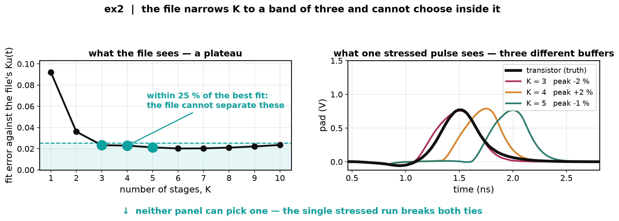
19 · Recipe step 2 of 4 — enumerate what the file cannot choose
Left: past K = 3 the fit error against the file's Ku(t) is flat. Right: the three candidates inside that band on one 810 ps pulse — same file, same fit quality, three completely different buffers.
The map's shape is under-determined the same way: 3 stage counts × 3 map shapes = nine candidates, all equally good against the file.
The file is now spent. Everything left is decided by the one stressed run.
Notes:
The three shapes are (0.50, 0.70), (0.40, 0.60) and (0.40, 0.90). Note on the right that all three already match the peak - that is the calibration, and it is why the peak cannot be what chooses.

Slide 25
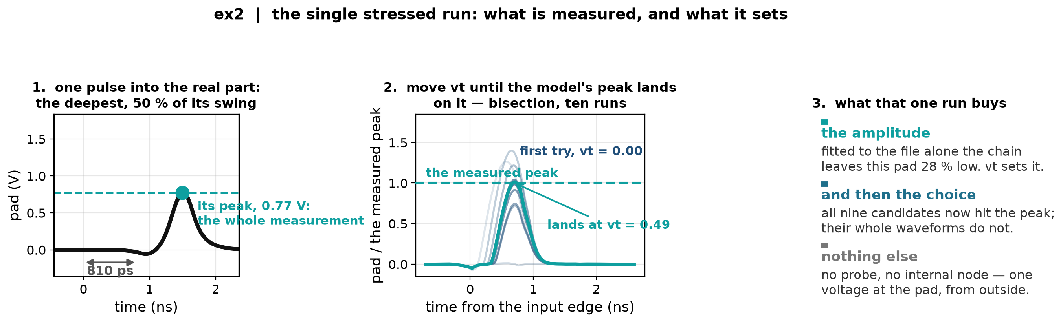
20 · Recipe step 3 of 4 — the stressed run sets the amplitude
One pulse into the real part, at the deepest rung of the ladder, and one number off it: the peak. Nothing is probed.
Why vt and not the drive rates? The rates were fitted to reproduce the full swing, and moving them breaks it. vt changes when the chain hands off, not how fast it runs.
Notes:
Every iteration the calibration actually wrote, recovered from the netlists it emitted. The vt here is the film's ex2 case; the deck's own K = 3 build lands on 0.632 from a different starting fit.

Slide 26
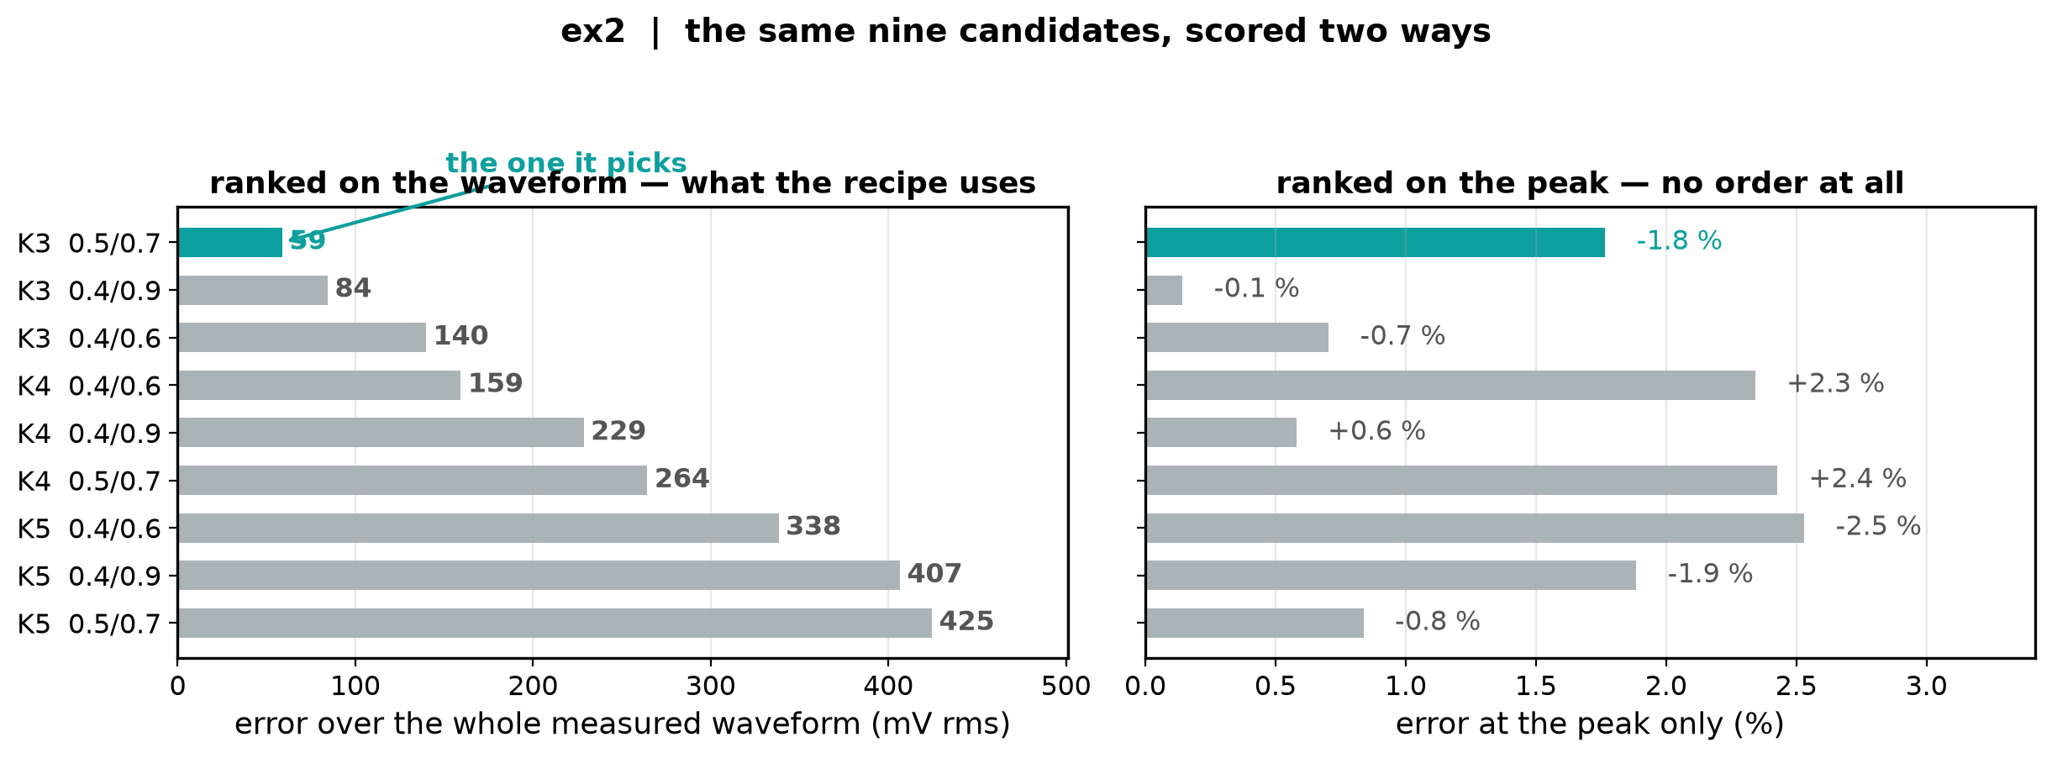
21 · Recipe step 4 of 4 — the same run picks one of the nine
All nine candidates are now calibrated, so all nine hit the measured peak — the calibration put it there. Right-hand panel: ranked on the peak every one is within 2.5 %, in no meaningful order.
Left-hand panel: score each one against the whole measured waveform instead, over the pulse and its return. Now they separate, from 59 mV to over 200.
That ranking is the choice. The recipe keeps the top row — here K = 3 with the 0.50/0.70 shape, which is also the best of the nine outright.
Notes:
Ranking on the peak instead picks a chain that arrives up to 300 ps late with four times the waveform error. The nine waveforms themselves are the backup slide.

Slide 27
22 · The recipe, end to end
Assumed as an input: C_comp, with a Ku > 1 validity check on it.
Steps 1–2, from the file alone: fit s_up, s_dn, vt, x_lin to the file's Ku(t) at each stage count in the band; that leaves nine candidates the file cannot separate.
Steps 3–4, from one stressed pad run: bisect vt until the peak matches, then pick the candidate whose whole waveform matches.
Nothing is probed. The only measurement is a pad voltage, from outside the chip.
Notes:
The same block diagram as the chain slide, with the recipe attached. This is the slide to leave up during questions.

Slide 28
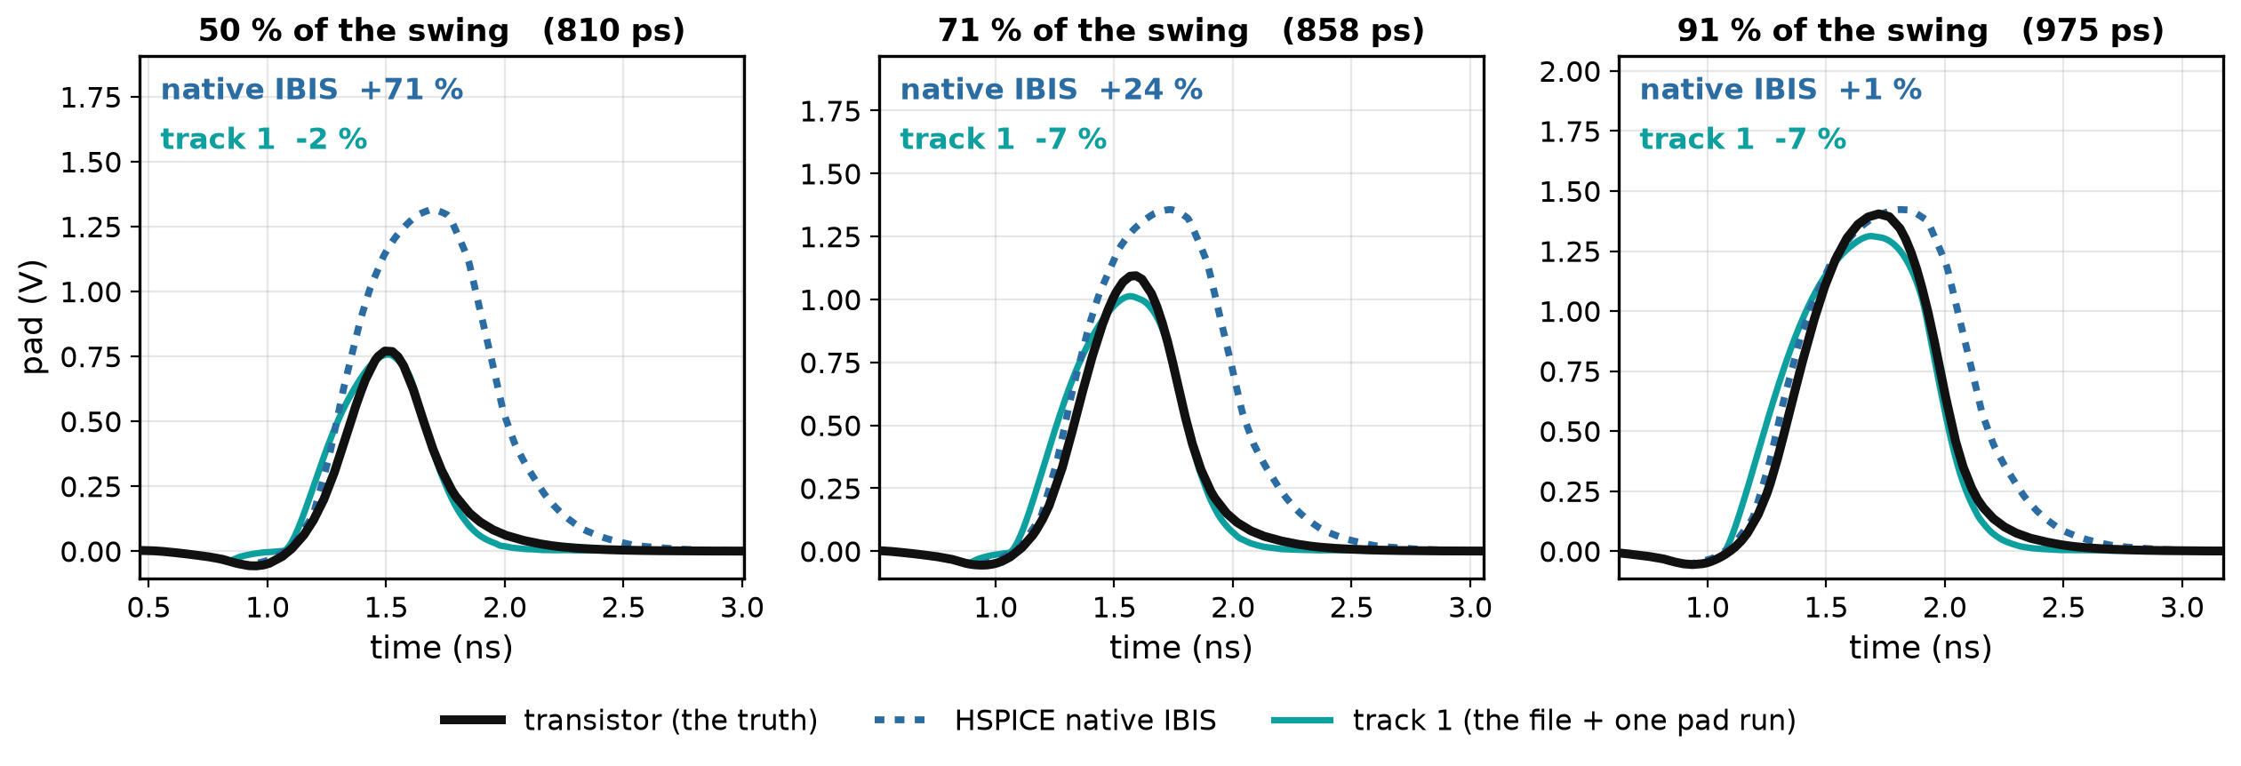
Result · ex2
Transistor in black, HSPICE native IBIS dotted, track 1 in teal. Only the 810 ps rung was measured; the other two are predictions.
Native IBIS collapses from +71 % to +1 % as the pulse lengthens. Track 1 holds −2, −7, −7 % — flat, and slightly shallow away from the rung it was calibrated on.
Notes:
Native from the delay_cmd waveform set, track 1 from the selector's pick for ex2. The calibration used the deepest rung only, so the milder two are out-of-sample.

Slide 29
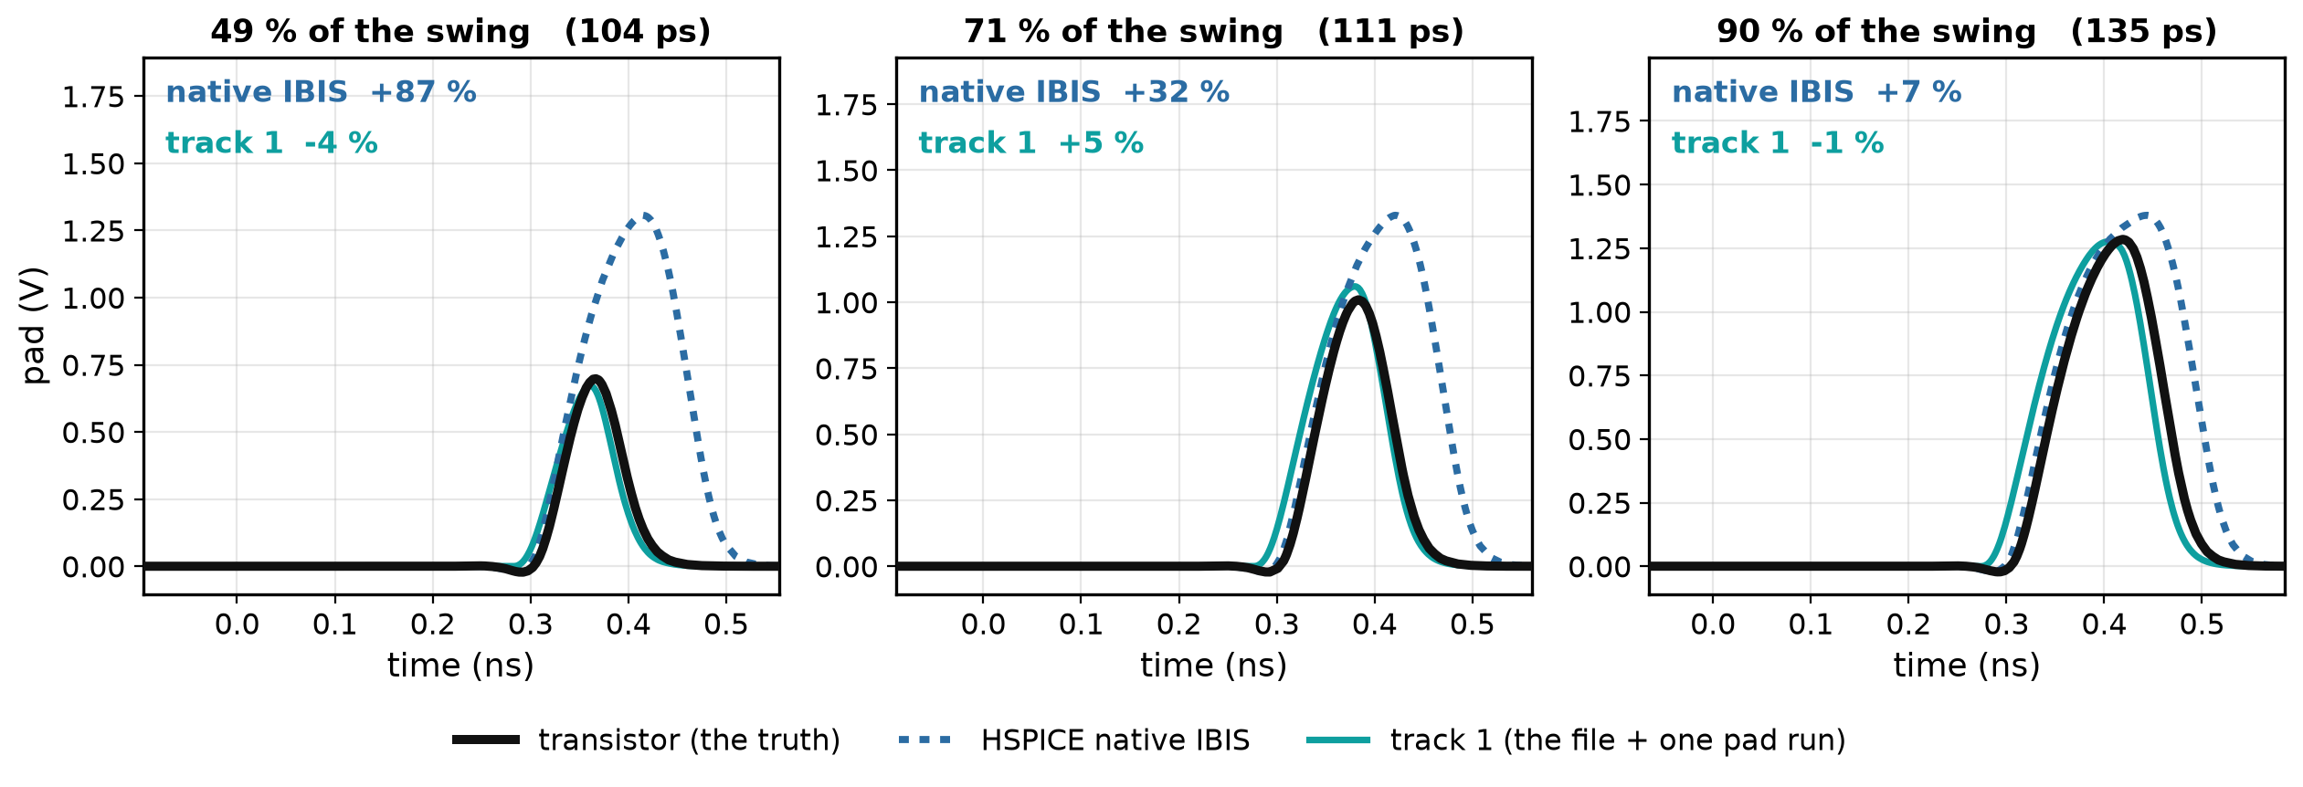
Result · inv_chain
Transistor in black, HSPICE native IBIS dotted, track 1 in teal. Only the 104 ps rung was measured; the other two are predictions.
Native IBIS runs +87 % at the deepest and +7 % at the mildest. Track 1 holds −4, +5, −1 % across the ladder.
Notes:
Native from the delay_cmd waveform set, track 1 from the selector's pick for inv_chain. The calibration used the deepest rung only, so the milder two are out-of-sample.

Slide 30
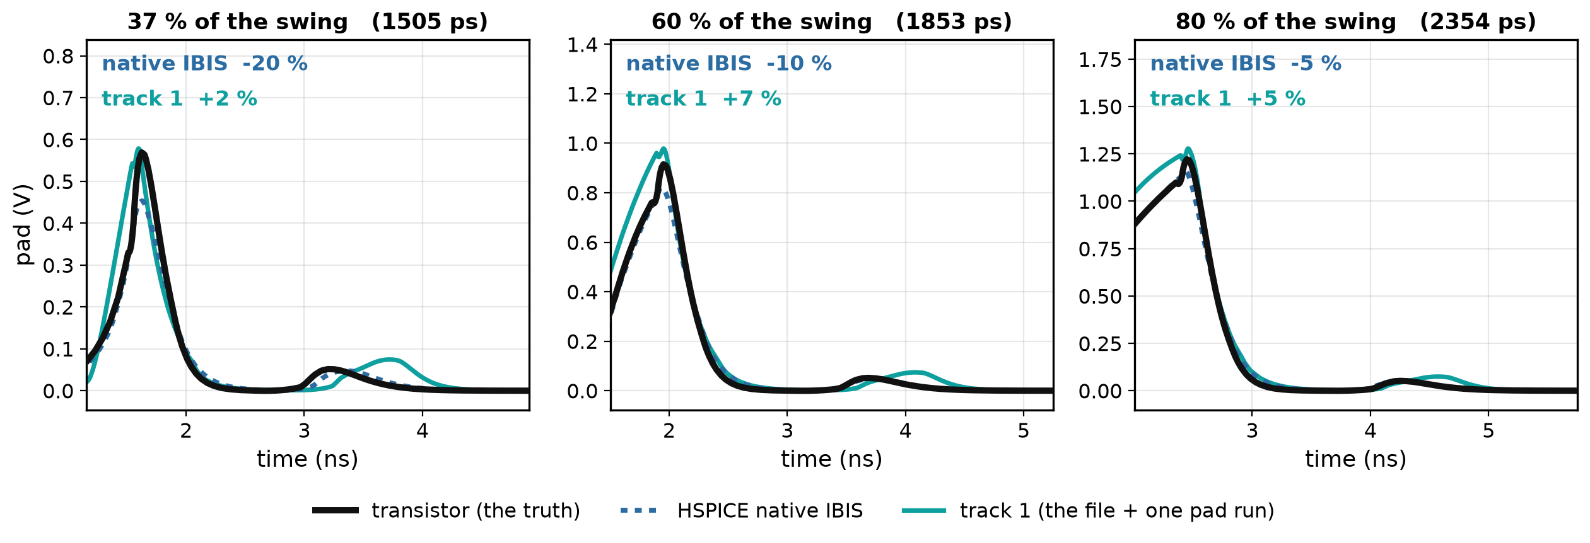
Result · io_buf
Transistor in black, HSPICE native IBIS dotted, track 1 in teal. Only the 1505 ps rung was measured; the other two are predictions.
io_buf's ladder is shallower — 37 % is as deep as its pulse goes, and native is only −20 % there. Track 1 is +2, +7, +5 %.
Notes:
Native from the delay_cmd waveform set, track 1 from the selector's pick for io_buf. The calibration used the deepest rung only, so the milder two are out-of-sample.

Slide 31
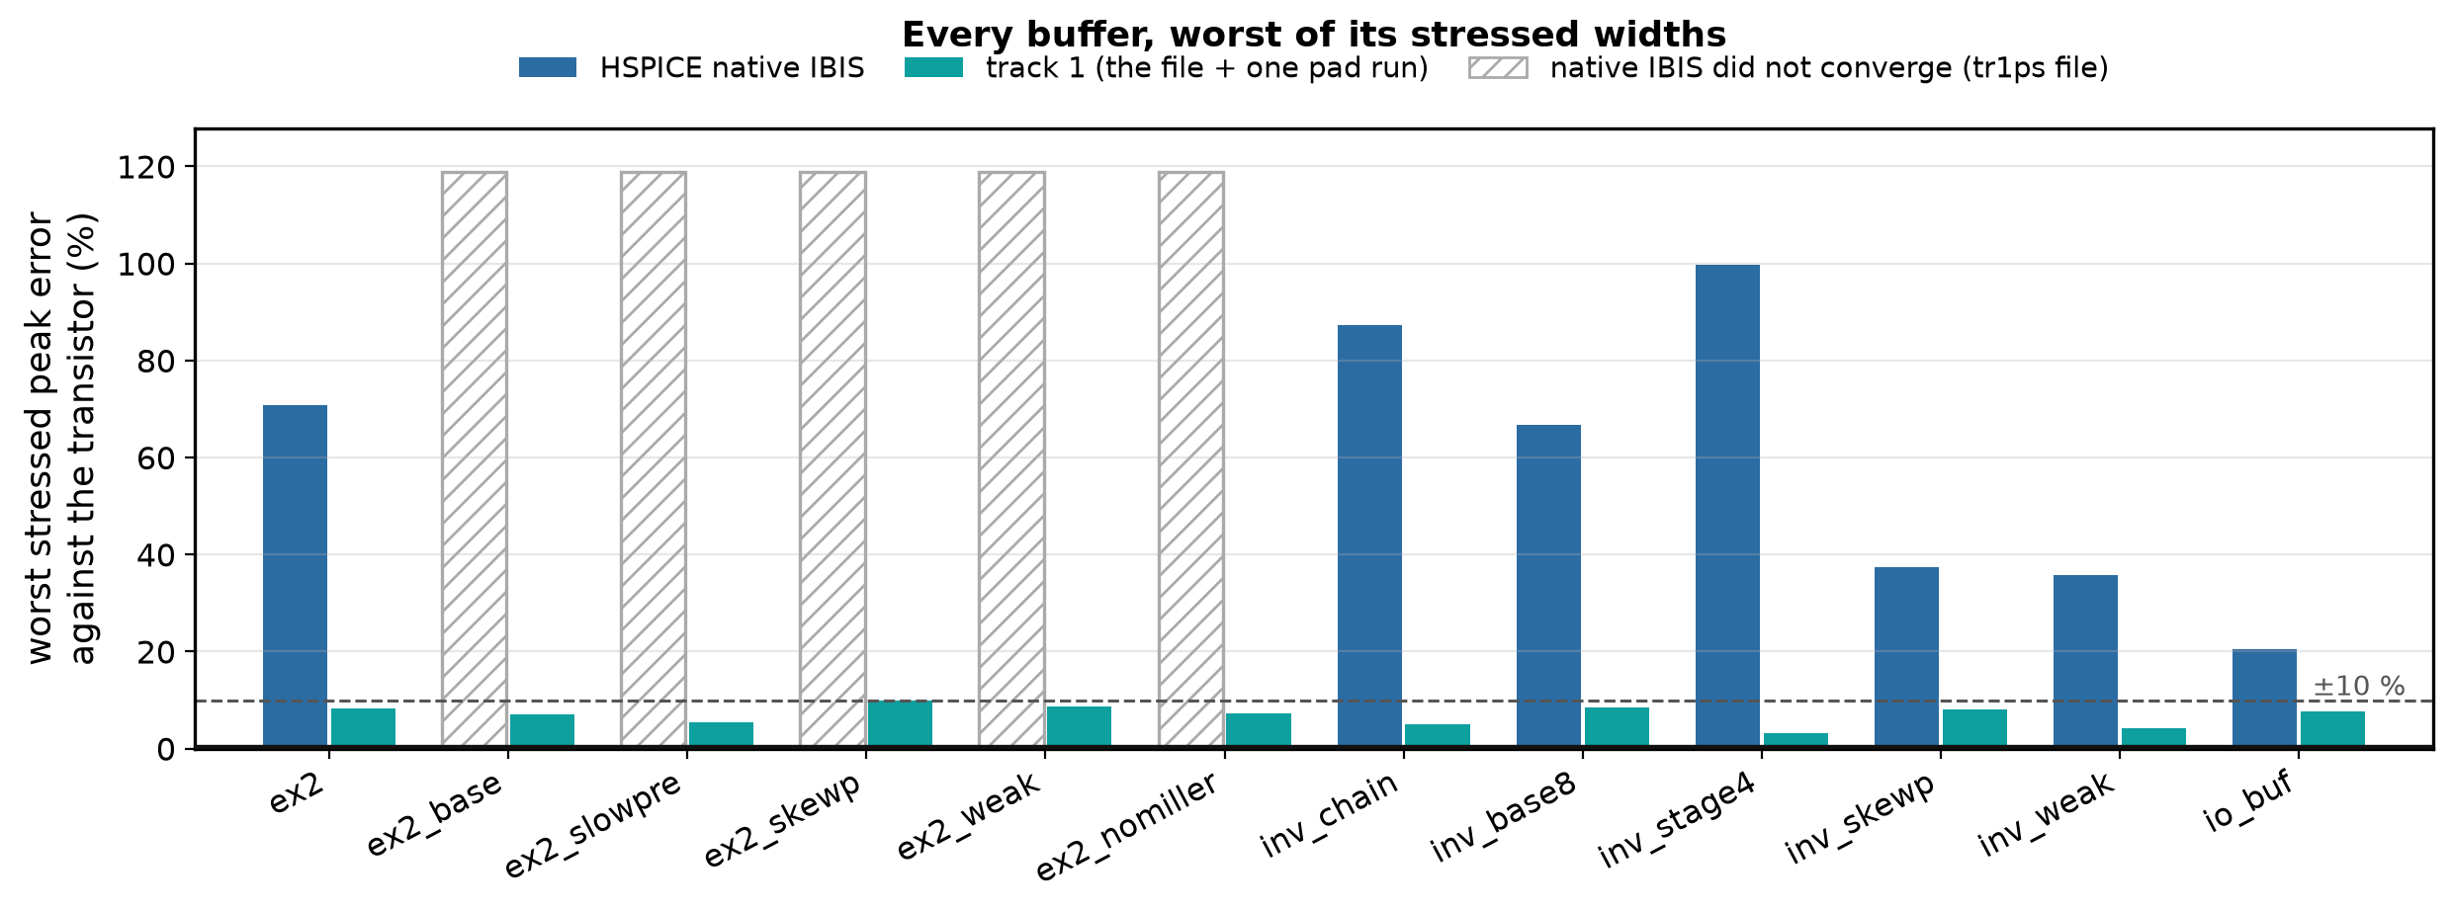
Result · every buffer, worst of its stressed widths
12 of 12 within ±10 % against the transistor; mean 6.9 %. Native IBIS, where it runs at all, is 20 % to 100 %.
Native does not converge on the five ex2 variants — HSPICE's two-waveform solver dies on their 1 ps files and reports the pulse missing at every depth, the mildest included. Those bars are hatched, not scored.
What it costs: the full transition is worse than the shipped model on 10 of 12 buffers, and a stressed pulse train is still lost on ex2 and io_buf. We are buying stressed accuracy with full-swing accuracy.
Notes:
Native from gate_cascade_prototype_2026-09-09 sweeps, track 1 from selector_from_one_run_2026-09-23. Same five widths per buffer in both. The tr1ps death is documented in docs/native_vt_waveform_modes.md.

Slide 32
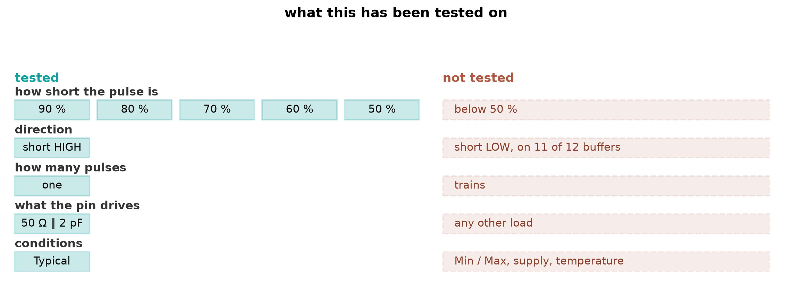
Result · what this does not cover yet
Direction. Everything here is a short HIGH pulse. Only io_buf has been run pulling down, where the model is 16–21 points too shallow — its pull-down chain never turns on at all on a short pulse.
Depth. The ladder samples 50–90 % of the travel. Below 50 % is unsampled.
Trains. One pulse at a time; a stressed train is still lost on two of three buffers.
The recipe has seen the answer key. Two of the three candidate map shapes were chosen by looking at results on these same twelve buffers. A thirteenth buffer may need a shape the grid does not contain.
Notes:
Better said than asked. The direction gap is the one that would most change the headline number.

Slide 33
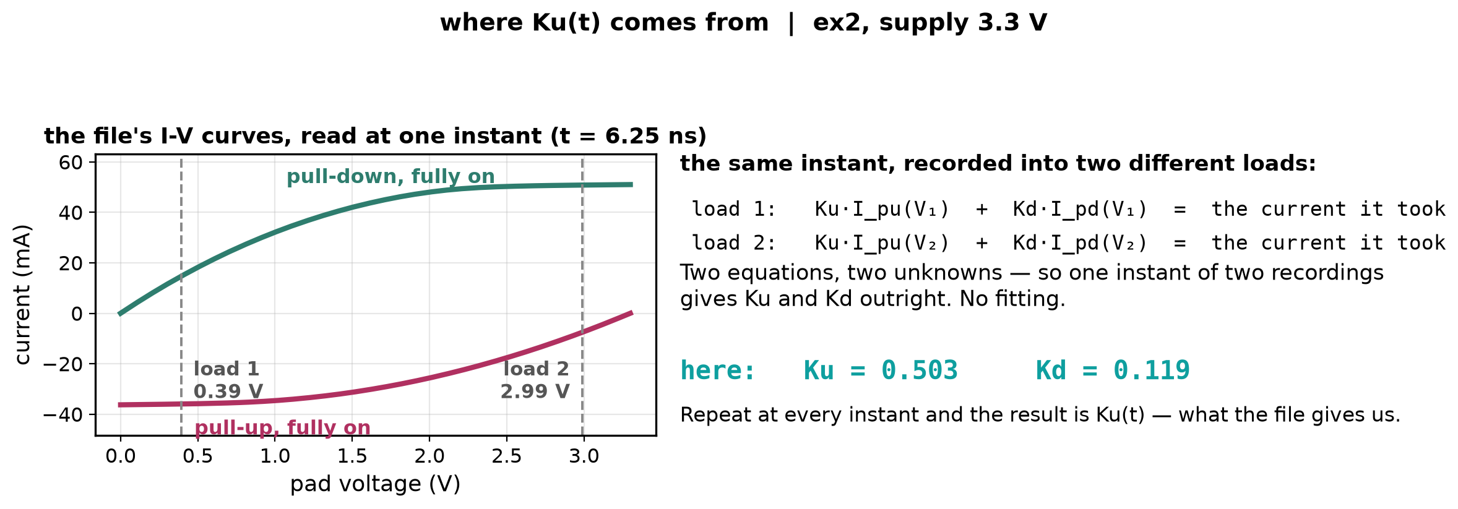
Backup · where Ku(t) comes from
The file holds the I-V curves and recordings of one transition into two different loads. At any instant the pad took some current, and both branches supplied it.
Two loads give two equations in the same two unknowns, so one instant gives Ku and Kd outright — no fitting. Every instant gives Ku(t).
Notes:
Moved out of the main line: this audience knows where Ku comes from.

Slide 34
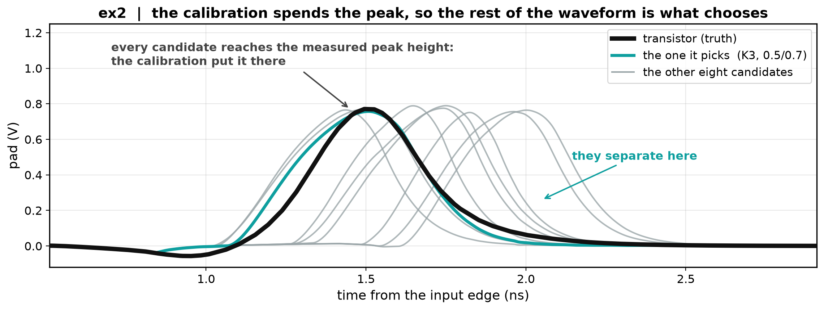
Backup · the nine candidates as waveforms
The same nine as step 5, drawn rather than ranked. Every one reaches the measured peak height — the calibration put it there — and they separate in when that peak arrives, and in the tail.
The one the recipe picks sits on the transistor.
Notes:
This was the main slide before; the ranking says the same thing more directly.

Slide 35
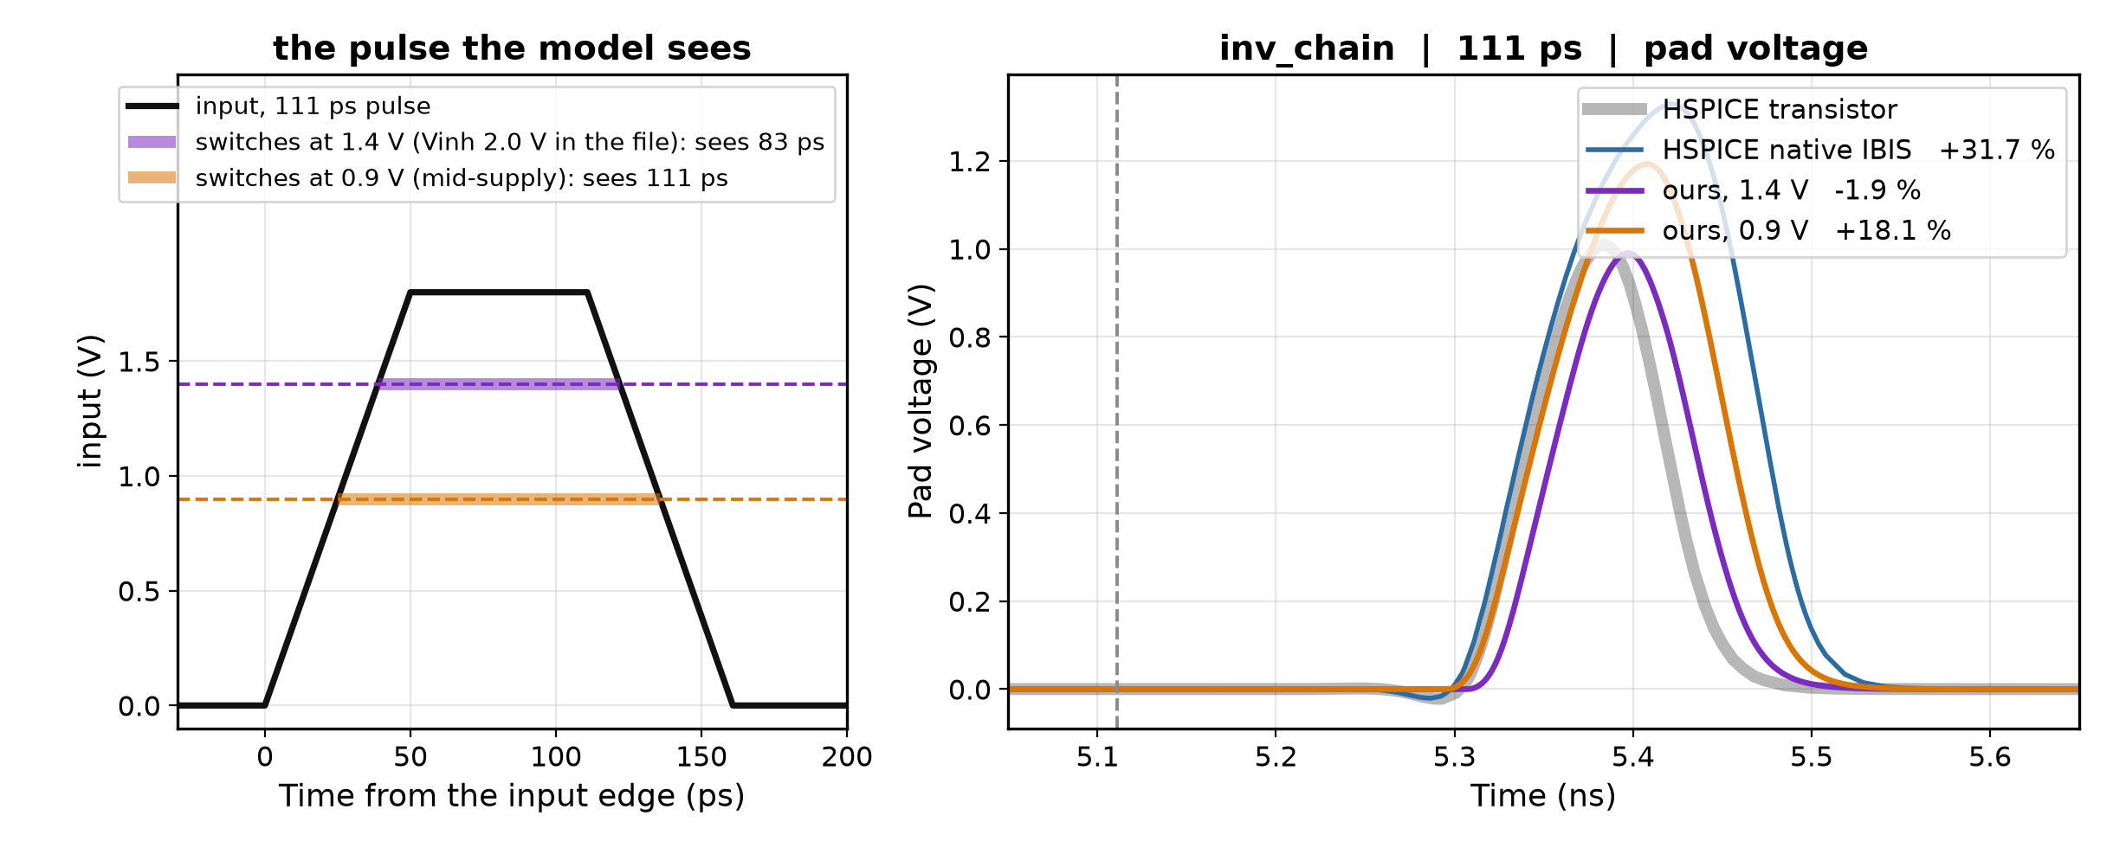
Backup · inv_chain's input threshold
inv_chain's IBIS file declares Vinh 2.0 V on a 1.8 V part, so our input comparator fires late and trims about 29 ps off every pulse.
That trim cancels most of the gate-state model's overshoot, which is why it reads −2 % at 70 % stress on the previous slides while native IBIS reads +32 %.
It is a defect that flatters us, not a result. With the threshold at mid-supply the shipped error roughly doubles.
Notes:
Carried from the 09-18 deck so the inv_chain numbers earlier are not read as a win. review_2026-09-09 item 12B has the measurement.

