Slide 1
IBIS Simulation Short Pulse Handling
Simon Hwang
Dr. Chulsoon Hwang
Dr. Zhiping Yang
9/4/2026

Slide 2
Table of contents
• Issue recap
• Delaying the input command
• RLC fixture effects on V-t waveforms and Ku/Kd
• Pybis in HSPICE vs. NgSPICE
• More SPICE buffer mockups

Slide 3
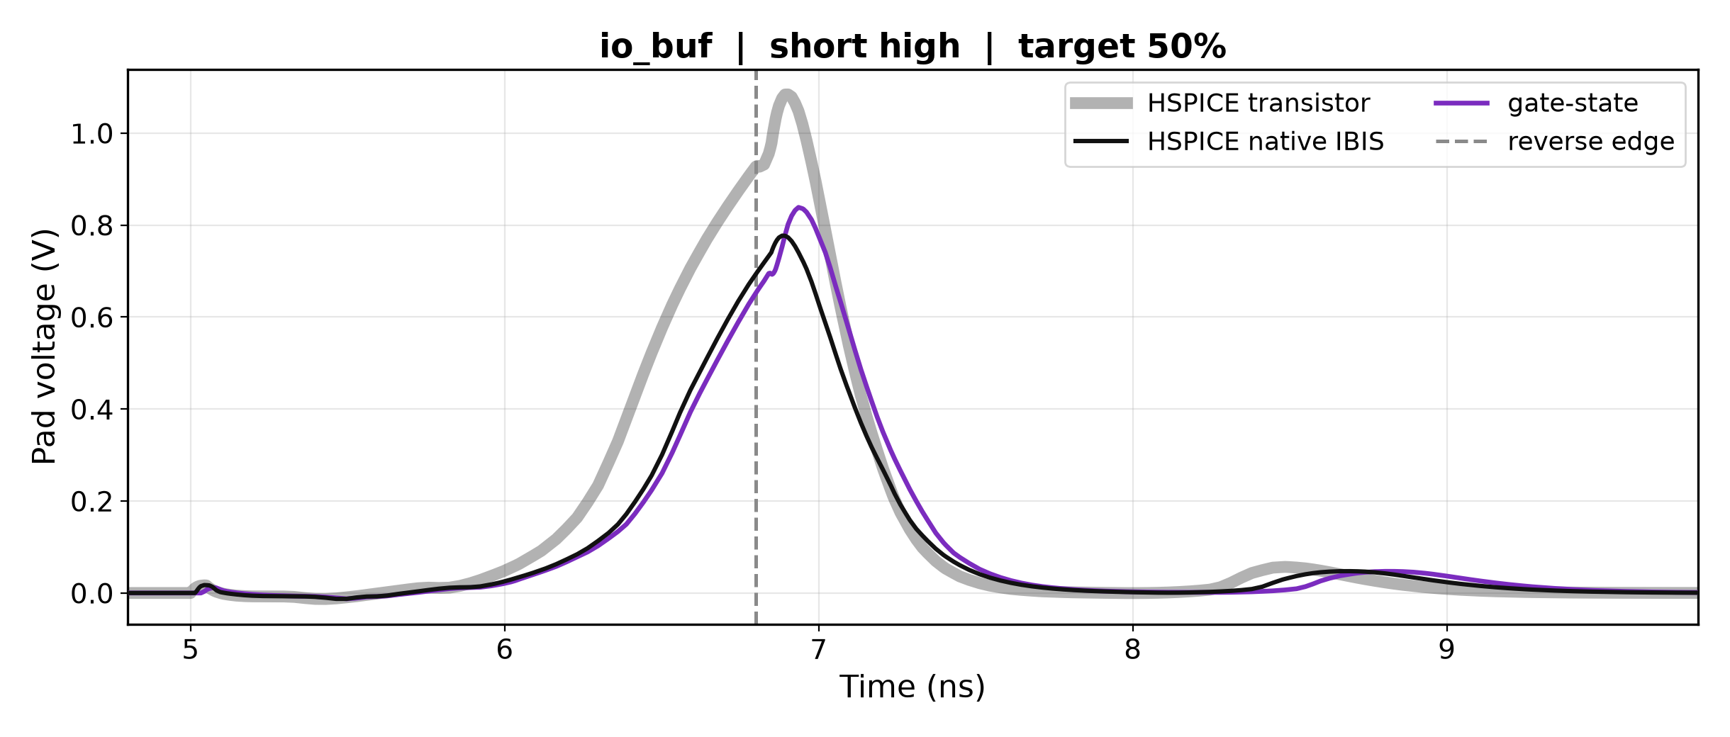
Issue recap
ISSUE RECAP
• A short pulse reverses before the pad has finished its transition.
• Both IBIS models under-shoot the peak the transistor reaches, and ours sits slightly high on the tail after the reversal.

Slide 4
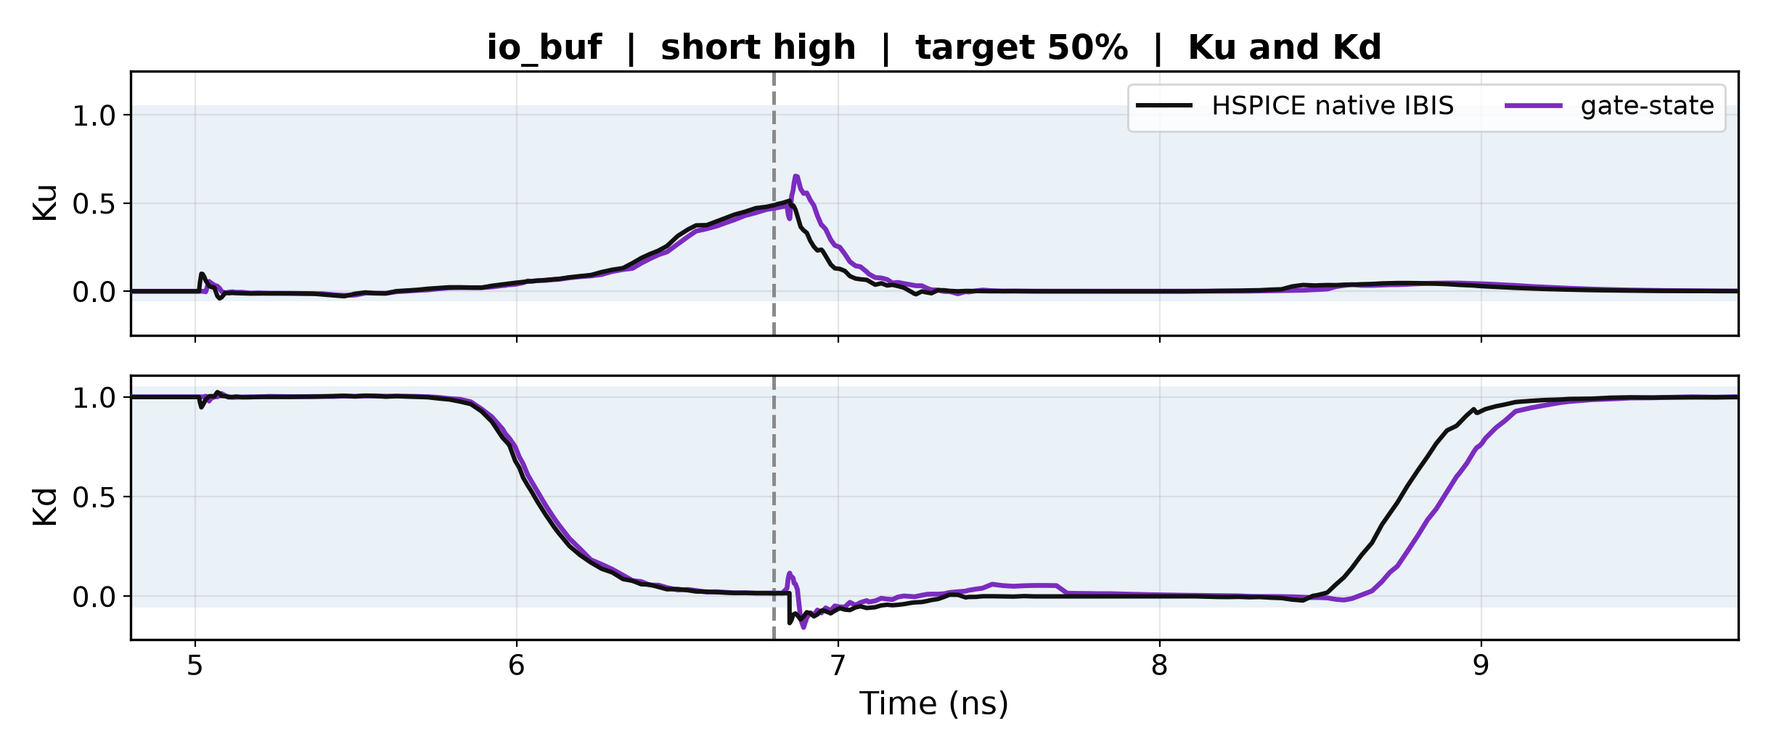
Issue recap — the coefficients
ISSUE RECAP
• Ku(t) and Kd(t) assume the transition starts from a settled state.
• When the reverse edge arrives first, they are still replayed from fully settled, and Ku does not return to zero.

Slide 5
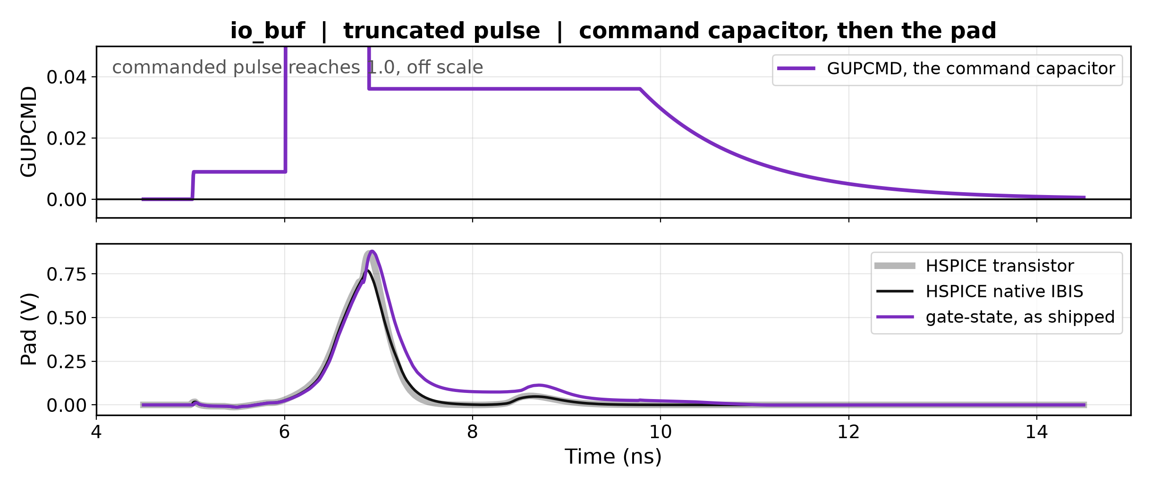
The offset: charge stranded in the command capacitor
DELAYING THE INPUT COMMAND
• GUPCMD is a capacitor across 1e15 ohm, charged once per input edge.
• A truncated pulse leaves charge in it with no resistive path out.
Notes:
The sign of the stranded charge flips with the timestep, so it is an integration error. Any fix by tuning a coefficient is a coin flip, which is why the retuned version helped on some cases and not others.

Slide 6
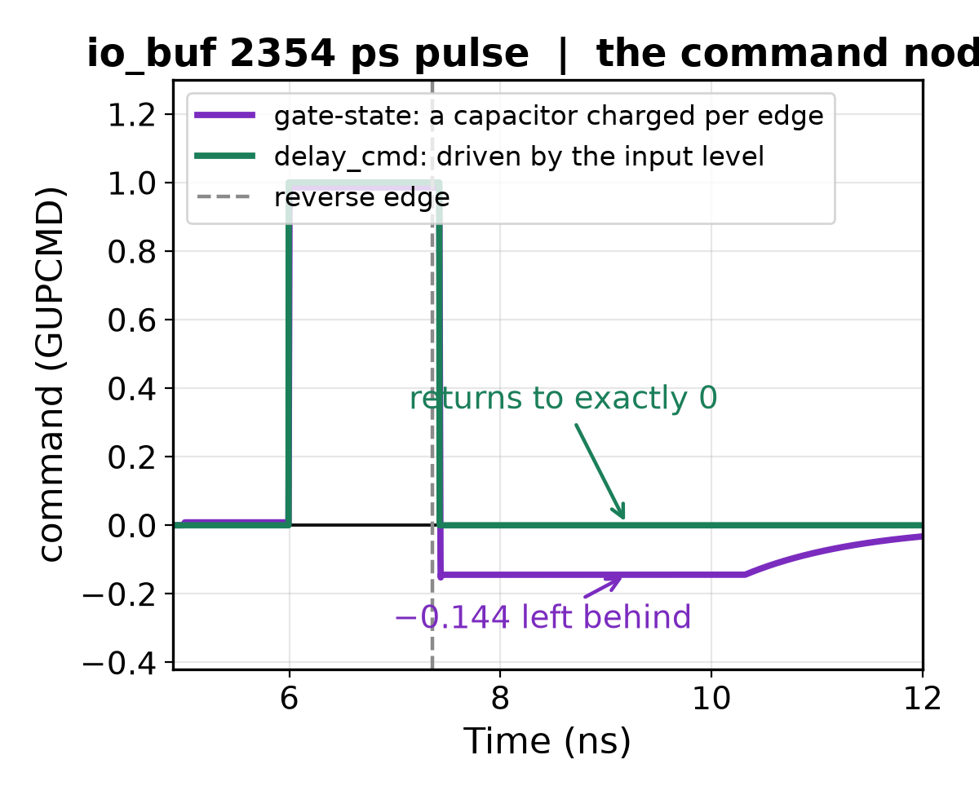
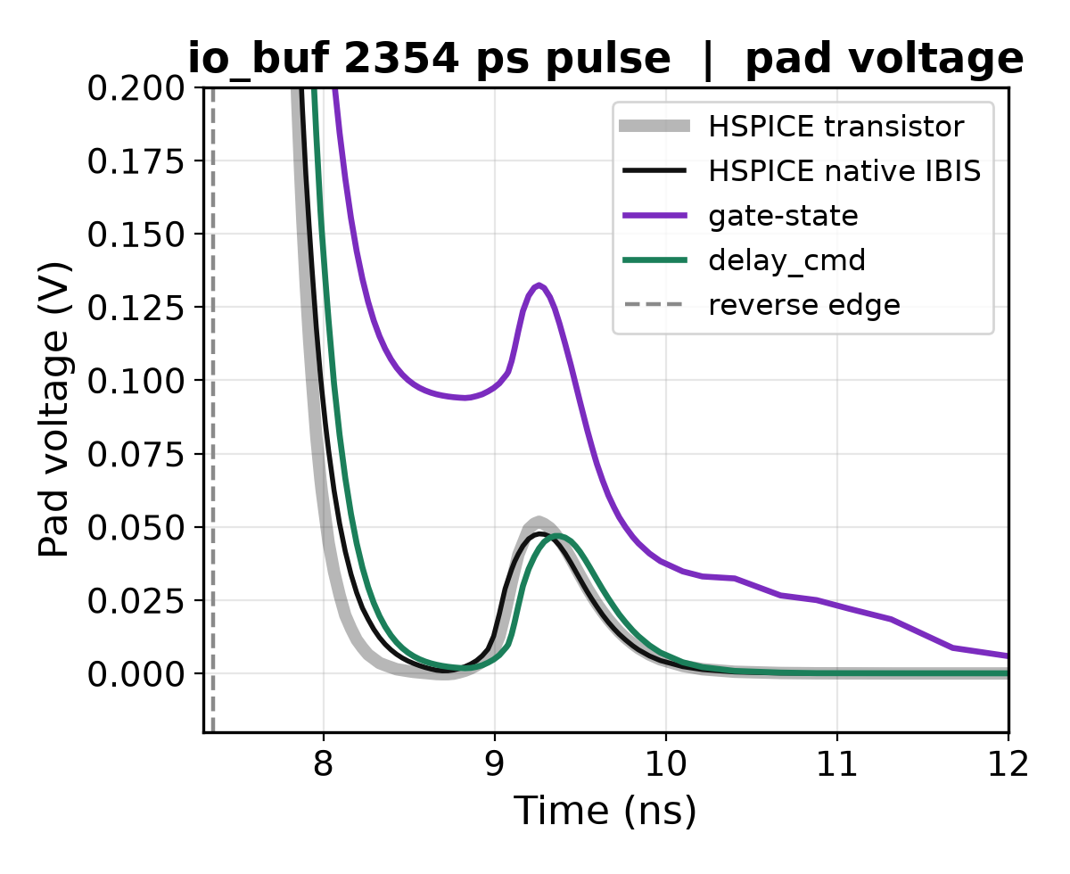
How delay_cmd works
DELAYING THE INPUT COMMAND
• gate-state: GUPCMD is a capacitor across 1e15 Ω, given a fixed packet of charge on each input edge — an integrator with no DC path.
• delay_cmd: GUPCMD is driven straight from the present input level.
Notes:
One line of the generated subcircuit separates them. gate_state: CGUPCMD across RGUPCMD 1e15 with BGUPCMDON injecting a packet per edge. delay_cmd: BGUPCMD GUPCMD 0 V = V(PUCMDLVL). On the tail after the reversal gate_state sits at -0.144 and creeps back over ~3 ns; delay_cmd is at exactly 0. On this particular bench the stranded charge is negative and the command clamp removes it before it reaches Ku, so the two pads agree to 5 mV -- the pad consequence on the right is the case where the charge is positive.

Slide 7
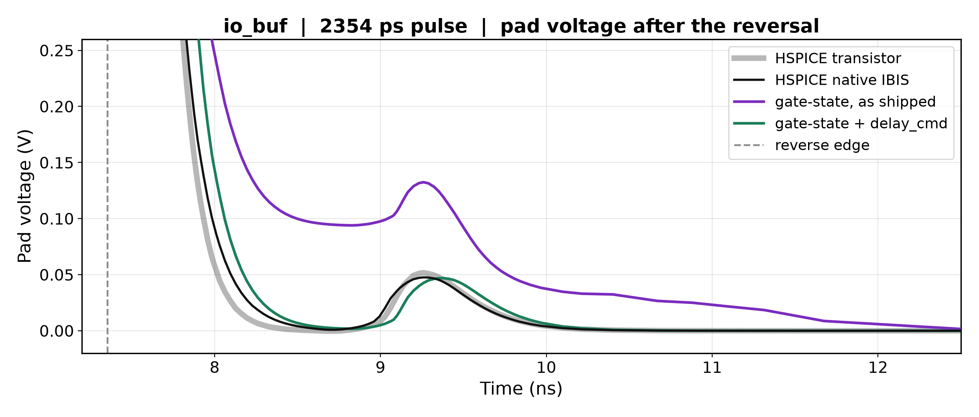
delay_cmd removes the offset
DELAYING THE INPUT COMMAND
• The command returns to exactly zero, so nothing is stranded.
• The pedestal goes from 97.9 mV to 5.2 mV, against the transistor's 2.1.
Notes:
On this case the pedestal goes from 97.9 mV to 5.2 mV against the transistor's 2.1 mV. Across all 29 matched stress cases RMSE goes from 108.6 to 92.2 mV, the only build that beats native IBIS. Caveat to state: delay_cmd has a 1.25 ns dead zone after a reversal where neither device is commanded on.

Slide 8
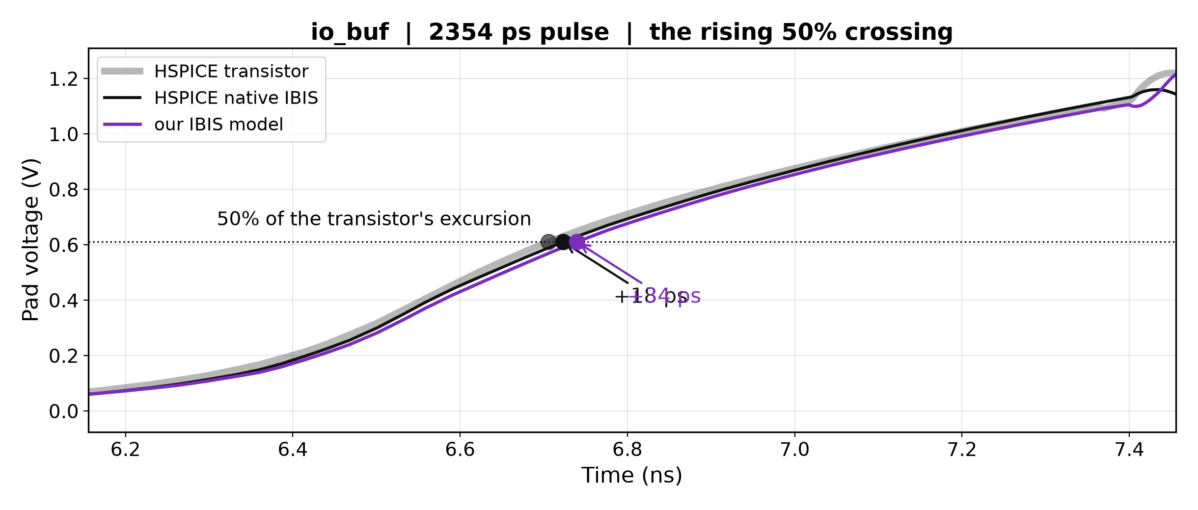
It does not fix the timing
DELAYING THE INPUT COMMAND
• delay_cmd improved the timing on 0 of 19 stress cases — so the offset and the shift are two mechanisms, not one.
• Our 50% crossing still arrives after native's: io_buf +27..+34 ps against native's +11..+18.
Notes:
The plan quotes 69-99 ps late where native is 5-26 ps early. That is not reproducible from the data on disk with a 50%-of-excursion metric. The stress matrix gives io_buf native +11..+18 against ours +27..+34; inv_chain native -6..-5 against ours +8..+12; ex2 both early with ours closer. The defect is real and device-dependent, but smaller and less one-sided than the plan states. It also grows as the pulse is truncated, on all nine buffer variants tested so far.

Slide 9
Is the difference the engine or the model?
PYBIS IN HSPICE VS. NGSPICE
• Every native-vs-ours number changes two things at once. We wrote a translator so the same model runs in both simulators.
Falling 50% crossing:
• our model in ngspice 5.3371 ns
• our model in HSPICE 5.3375 ns engine: −0.5 ps
• native IBIS in HSPICE 5.3319 ns model: +5.6 ps
The engine is not the source — provided ngspice is converged. At a 1 ps step it was an aliasing outlier that doubled the apparent lag.

Slide 10
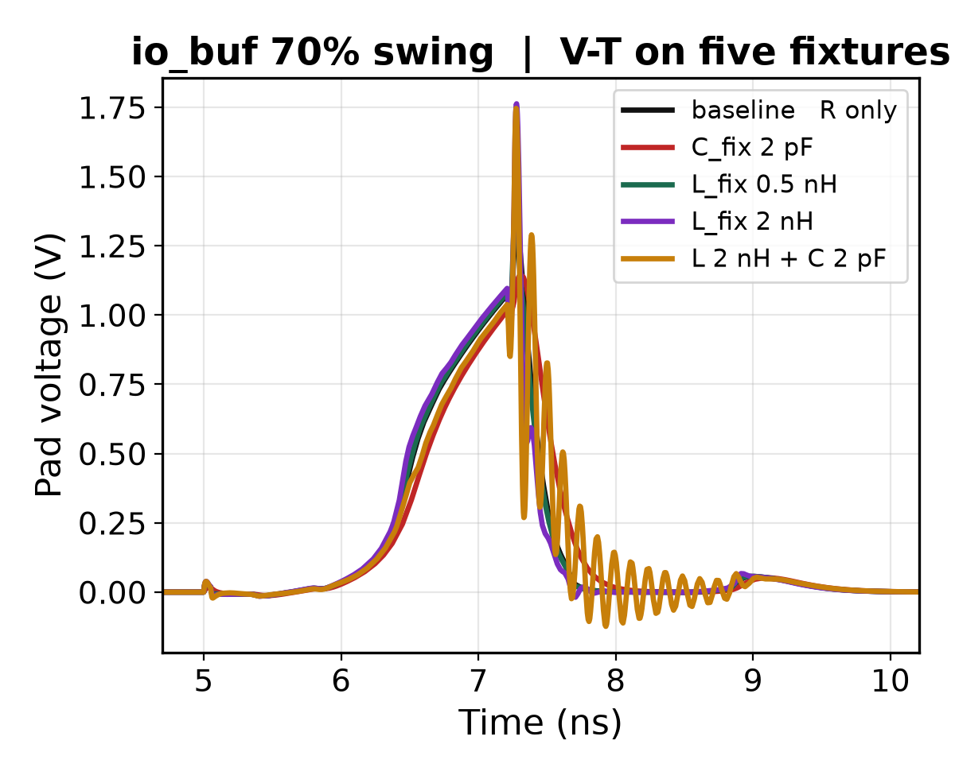
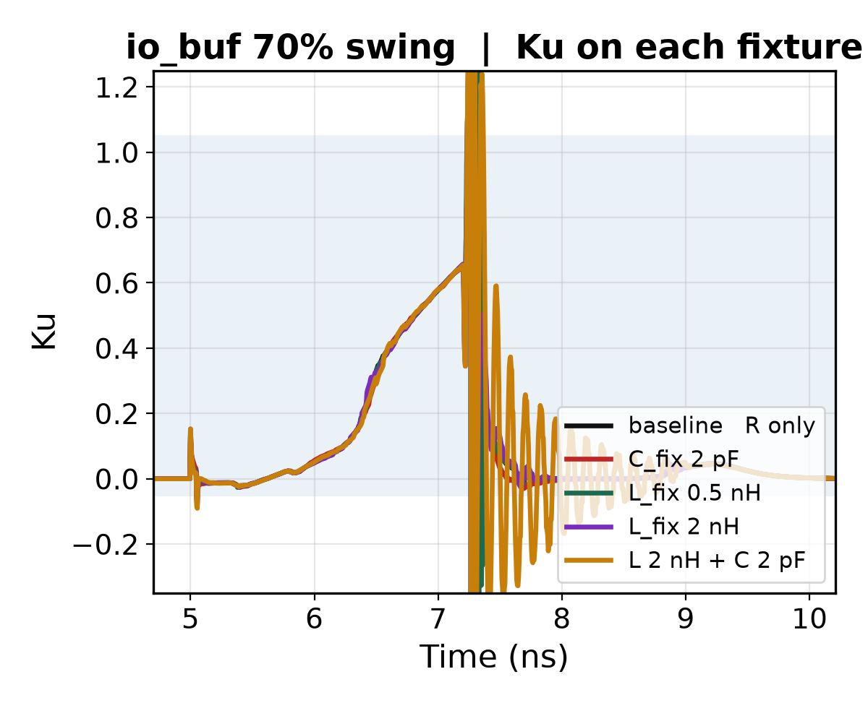
What fixtures do to the extracted Ku/Kd
RLC FIXTURE EFFECTS
• Five fixtures, Ku re-solved on each. In the quiet regions all five agree to four decimals.
• Series inductance disturbs it, and only on io_buf.
Notes:
The control reproduces the shipped solve to 2.4e-08, so the method is exact, and in the quiet regions Ku is load-independent to four decimals -- the extraction really is a device property, not a fixture artifact. Ku RMSE against the R-only baseline: io_buf C 0.011 / L0.5 0.142 / L2 0.164 / L+C 0.159; inv_chain C 0.007 / L0.5 0.004 / L2 0.007 / L+C 0.009; ex2 C 0.028 / L0.5 0.008 / L2 0.022 / L+C 0.032. Correction worth stating: the plan says added L and C are safe individually and the resonant combination is the problem. The measurement does not support that. On io_buf L alone is the worst case (0.164, peak 7.9) and L+C is no worse (0.159, peak 5.2); on the other two devices everything stays under 0.03. The real rule is that series inductance disturbs the solve, by an amount that depends on the buffer.

Slide 11
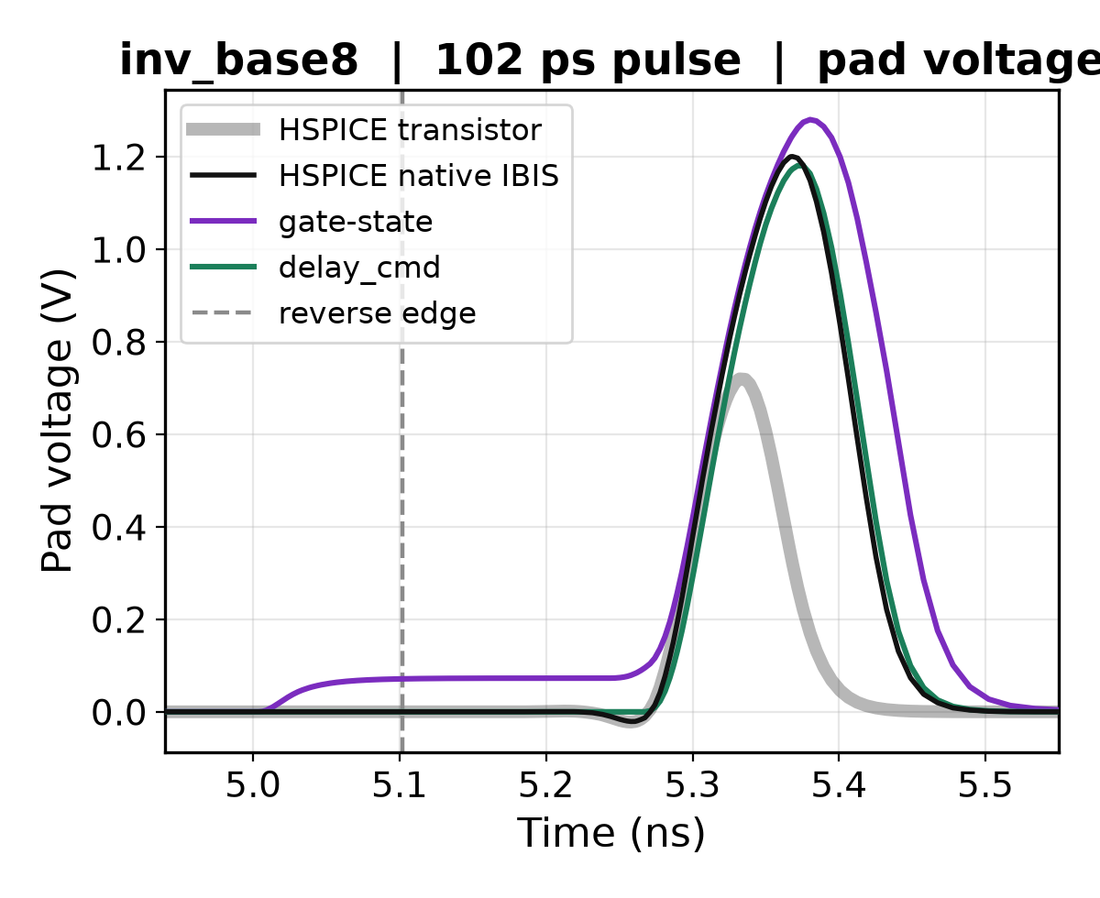
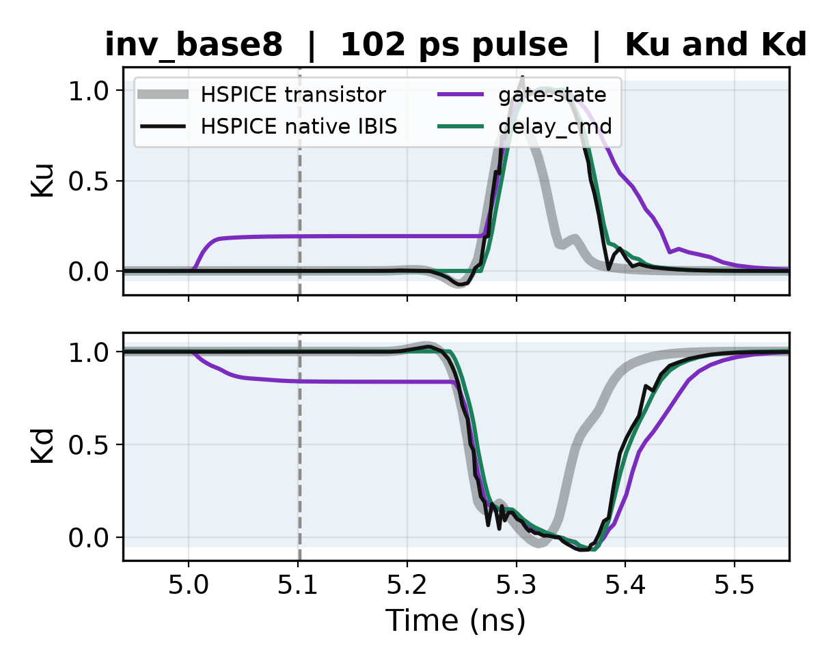
Nine new buffer variants, same stress axis
MORE SPICE BUFFER MOCKUPS
• Slower predriver, halved output devices, skewed PMOS, open-drain.
• Characterised and stressed exactly like the three base buffers.
Notes:
Ku and Kd here come from the transistor itself, by driving it into two fixtures and running the same two-equation solve the model uses. That is a ground-truth coefficient target, not native IBIS's opinion.

Slide 12
Where this leaves us
SUMMARY
Settled:
• C_comp is handled correctly
• the SPICE engine is not a confounder
• our model reproduces its own golden waveforms
• delay_cmd removes the settled offset
Open:
• the timing shift has no candidate mechanism, and grows with truncation
• the 1.25 max|Ku| cap needs replacing with a within-buffer outlier test
Notes:
Two rules worth not re-learning: any bench for this model must start with a real edge, never a held level, because it initialises pulldown-on and latches state only on an edge. And ngspice must be converged before drawing any conclusion.

