Slide 1
Continuous Gate-State Model for IBIS Ku/Kd
From handwritten RC-state derivation to runtime ngspice behavior
IBIS short-pulse study
Notes:
This deck transcribes the handwritten IBIS Ku/Kd notes into a structured explanation. The central idea is to replace elapsed-time table position with two continuous stored states: GUP for pullup drive and GDN for pulldown drive.

Slide 2

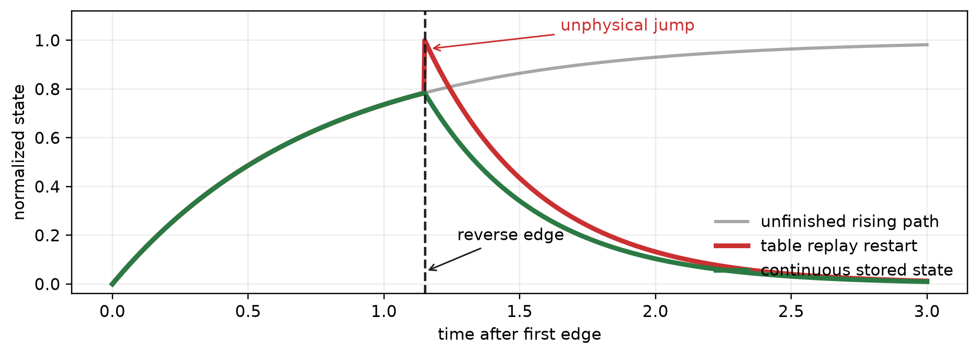
1. The original replay loses continuity at a reversal
PROBLEM
- A long pulse lets the first table finish, so restart looks acceptable.
- A short pulse reverses while Ku and Kd are still between endpoints.
- The missing quantity is a continuous memory of transition progress.
The problem is not the table values themselves; it is how transition state is carried across a new edge.
Source: handwritten notes, IBIS kukd .pdf (2026-07-22)
Notes:
The legacy model detects an edge and replays a complete Ku/Kd transition table from its beginning. If the input reverses before that table finishes, switching to the opposite table at t=0 can assign a different coefficient immediately. The red conceptual curve shows this reset. The green curve shows the behavior we want: preserve the current state and only reverse its direction of motion.

Slide 3
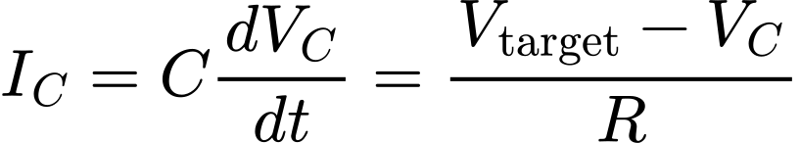
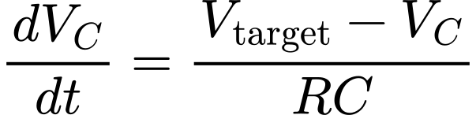
2. A capacitor voltage is a natural continuous memory
STATE
Gtarget
0 or 1
GUP or GDN
R
C stores the state
Vc,PU becomes GUP
Vc,PD becomes GDN
The solver stores capacitor charge between timesteps.
GUP and GDN are not recomputed from elapsed time; they persist as capacitor voltages.
Source: handwritten notes, IBIS kukd .pdf (2026-07-22)
Notes:
The handwritten circuit uses an RC node as memory. The target is either zero or one. The capacitor voltage cannot jump, so it records how far the transition has progressed. In the generated model this stored voltage is called GUP or GDN rather than Vc.

Slide 4
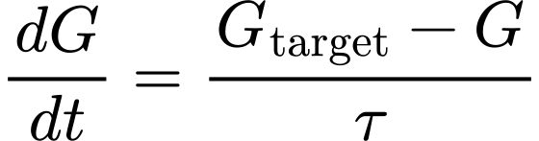

3. The state follows a first-order RC equation
EQUATION
G0 is the state already stored at the command edge
- Changing the target changes the derivative.
- Changing direction selects a different tau.
- Neither action resets G itself.
The state value is continuous; only its destination and rate change at an edge.
Source: handwritten notes, IBIS kukd .pdf (2026-07-22)
Notes:
Defining tau as RC gives the first-order state equation. The closed-form solution starts from the state value G0 present when the command changes. This initial value is why the model can reverse from the middle rather than restart at an endpoint.

Slide 5

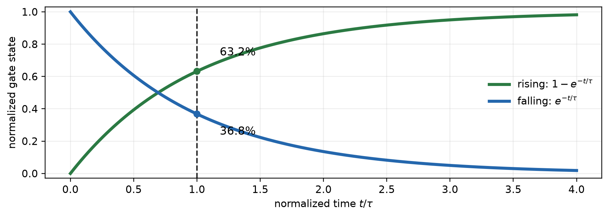


4. Tau is the characteristic transition time
CALIBRATION
Read tau from the 63.2% point of each normalized transition.
Tau is the rate parameter that reproduces each original coefficient transition.
Source: handwritten notes, IBIS kukd .pdf (2026-07-22)
Notes:
For a normalized first-order rising response, one tau reaches 63.2 percent of the total change. For a falling response, one tau leaves 36.8 percent. The handwritten derivation uses the time where the normalized original Ku/Kd transition reaches this level.

Slide 6




5. Four physical directions require four time constants
CALIBRATION
Input rises
Input falls
GUP: 0 -> 1
pullup ON
GDN: 1 -> 0
pulldown OFF
GUP: 1 -> 0
pullup OFF
GDN: 0 -> 1
pulldown ON
- Each tau comes from the corresponding original Ku/Kd transition.
- No symmetry is assumed between pullup, pulldown, rising, and falling.
- All values are derived offline from the original IBIS/pybis coefficient tables.
Direction-specific timing preserves real pullup/pulldown asymmetry.
Source: handwritten notes, IBIS kukd .pdf (2026-07-22)
Notes:
Pullup and pulldown do not have to be symmetric. An input rise turns the pullup on and turns the pulldown off. An input fall turns the pullup off and the pulldown on. Each path therefore gets its own tau, extracted from the corresponding original coefficient table.

Slide 7
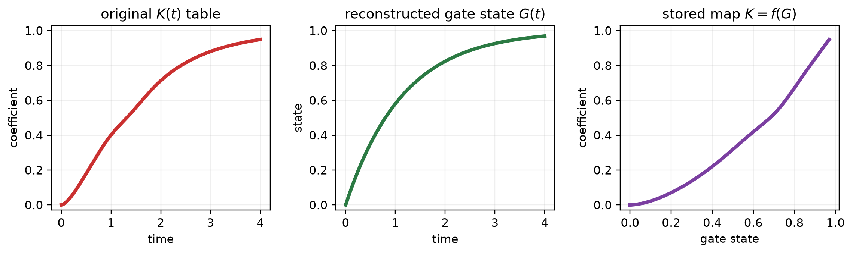


6. Offline: replace table time with gate state
MAPPING
Four original tables -> four direction-aware state maps
Ku/Kd tables are still used; they become functions of continuous state rather than elapsed time.
Source: handwritten notes, IBIS kukd .pdf (2026-07-22)
Notes:
For every sample in an original Ku or Kd table, reconstruct the gate-state value that would exist at the same time using the fitted tau. Pair that gate-state value with the original coefficient. The resulting point cloud becomes a PWL function K=f(G). The original coefficient information is preserved; only its independent variable changes from elapsed time to stored state.

Slide 8
7. Offline preparation and runtime simulation are separate
WORKFLOW
OFFLINE - model generation
Extract Ku/Kd(t)
Fit four taus
Build K=f(G)
Write .sp
RUNTIME - ngspice
Detect edge
Change targets
Integrate GUP/GDN
Evaluate Ku/Kd
Actual pulse width and interruption history exist only at runtime.
Offline fitting supplies constants and maps; runtime integration supplies the actual state history.
Source: handwritten notes, IBIS kukd .pdf (2026-07-22)
Notes:
Everything in the top row happens once while generating the pybis SPICE model: extract coefficient tables, fit four taus, build the PWL state maps, and write the netlist. During simulation, the actual pulse history drives the targets. Ngspice integrates GUP and GDN and evaluates the precomputed maps at each timestep.

Slide 9
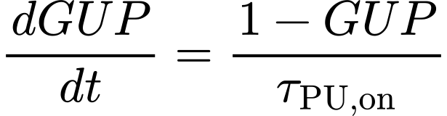
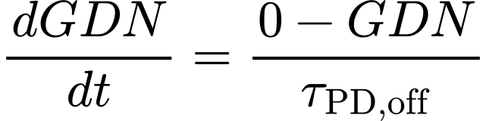
8. Runtime example: a normal rising input edge
RUNTIME
Before edge
GUP=0, GDN=1
Command targets
GUPtarget=1, GDNtarget=0
Continuous motion
GUP rises, GDN falls
For a complete transition, the new state model reconstructs the original Ku/Kd path.
Source: handwritten notes, IBIS kukd .pdf (2026-07-22)
Notes:
Starting from stable low, GUP is zero and GDN is one. A rising command eventually changes the targets to one and zero. The states then move continuously with PU-on and PD-off time constants. Ku and Kd are read from the corresponding directional maps.

Slide 10


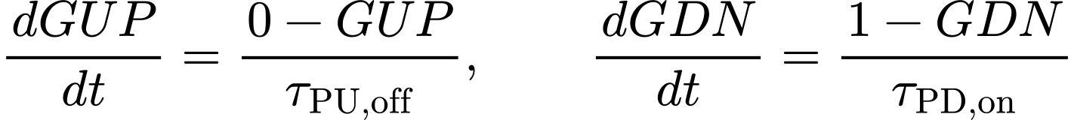
9. Runtime reversal: targets and rates switch, states do not
RUNTIME
targets flip
GUPtarget: 1 -> 0
GDNtarget: 0 -> 1
taus switch
PU on -> PU off
PD off -> PD on
integration continues
from current GUP/GDN
falling edge
A reversal changes the future trajectory, not the state already accumulated.
Source: handwritten notes, IBIS kukd .pdf (2026-07-22)
Notes:
Suppose the input falls before the rising transition settles. At the reverse edge, the targets flip and the model selects PU-off and PD-on taus. GUP and GDN themselves remain exactly at the values accumulated up to that instant. Their derivatives reverse sign, which creates a corner in slope but no jump in state. The coefficients remain continuous if the directional maps agree at the switching state.

Slide 11
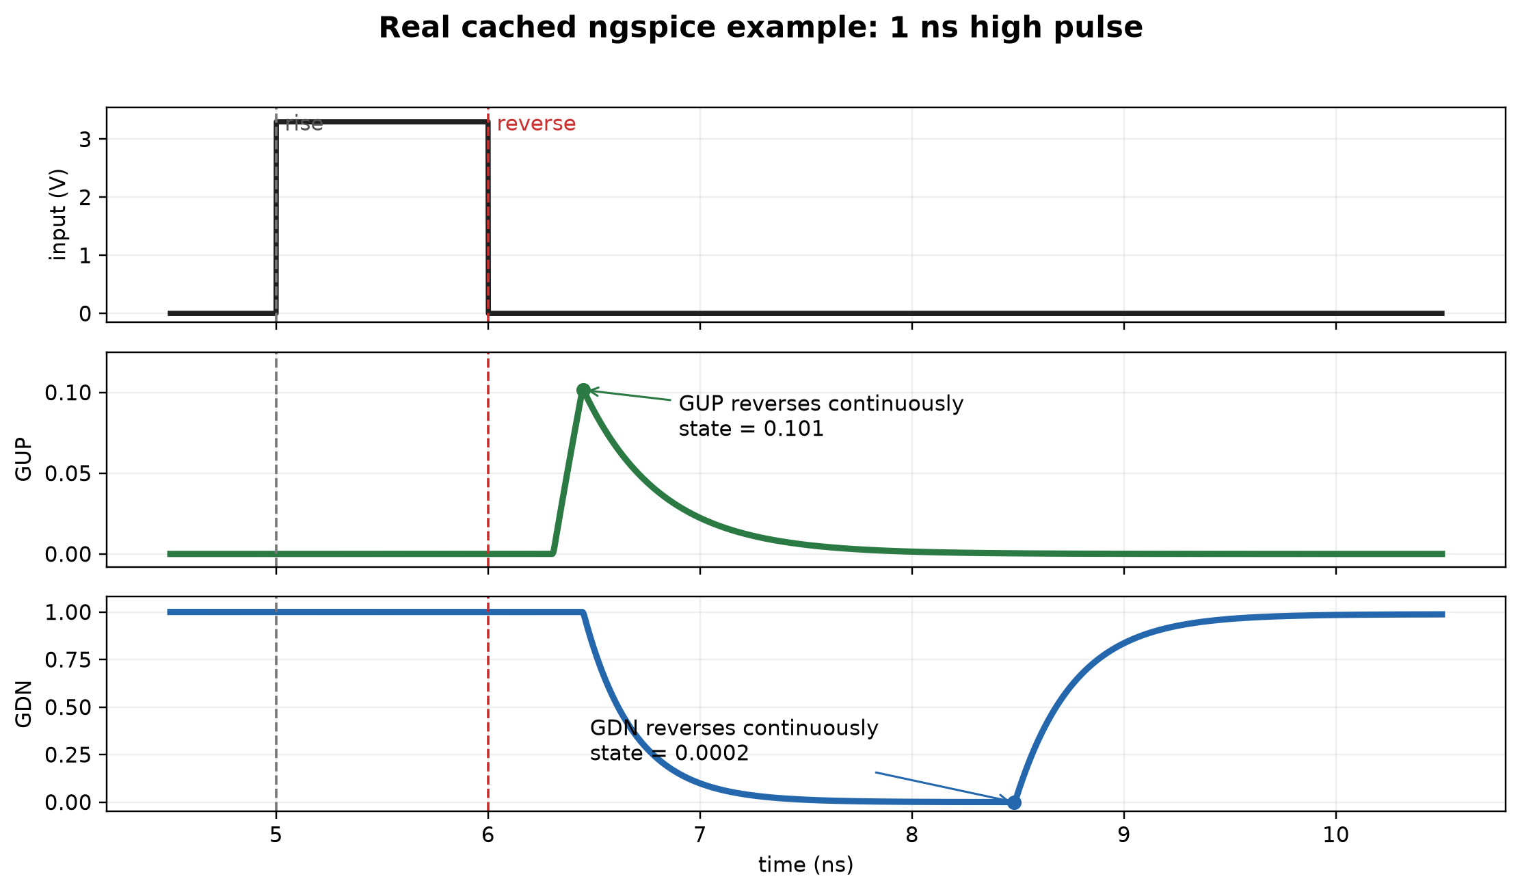
10. Real example: GUP and GDN preserve state through reversal
WAVEFORMS
The two states carry different histories and reverse independently, but neither state is reset.
Cached data: io_buf_two_state_gate_model_2026-06-30 / short_pulse_1ns_high / directional_residual
Notes:
This is cached ngspice data from the real io_buf short_pulse_1ns_high case using the two_state_directional_residual model. The input rises near 5 ns and reverses near 6 ns. GUP and GDN are actual internal capacitor voltages. Each reaches its own turning point without a vertical jump. This slide focuses only on continuity and does not introduce additional timing mechanisms beyond the handwritten derivation.

Slide 12
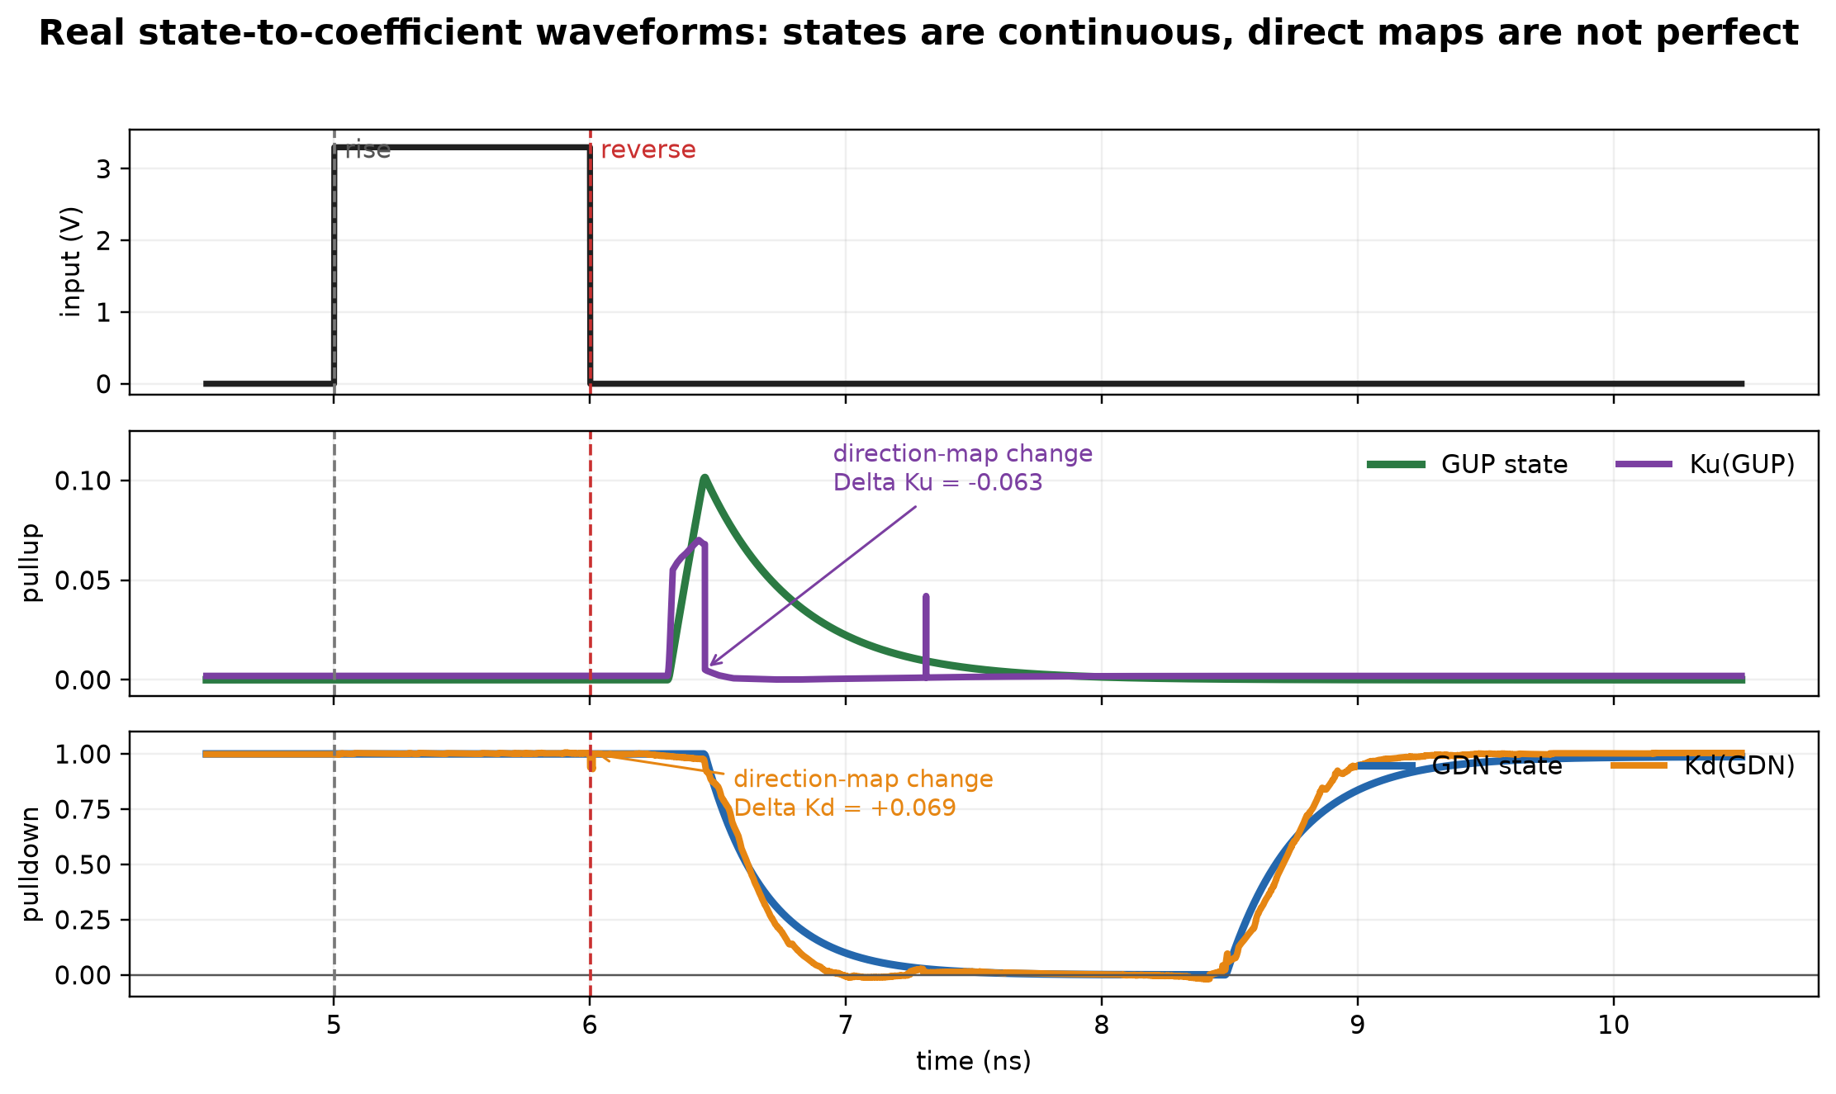
11. Real example: state continuity does not guarantee Ku/Kd continuity
WAVEFORMS
Continuous GUP/GDN solve state reset; directional-map alignment remains necessary for continuous Ku/Kd.
Underlying samples: results/ibis_kukd_handwritten_notes_deck/real_short_pulse_1ns_high_waveforms.csv
Notes:
The upper mapped waveform compares GUP with the direct pullup map output Ku(GUP). The lower waveform compares GDN with Kd(GDN). These are actual runtime signals, not analytic sketches. GUP and GDN are continuous, but selecting between directional maps creates sharp changes in the direct mapped coefficients: about -0.063 in Ku(GUP) and +0.069 in Kd(GDN) at their largest adjacent-sample changes. The final Ku/Kd state nodes smooth these changes, but this figure shows that the directional maps themselves still need alignment.

Slide 13
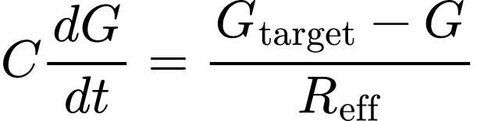
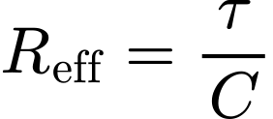
12. Ngspice stores GUP and GDN as capacitor voltages
IMPLEMENTATION
* Continuous pullup gate state
CGUP GUP 0 1p ic=0
BGUP GUP 0 I=-1p*(V(GUPTARGET)-V(GUP))/tau_selected
* Continuous pulldown gate state
CGDN GDN 0 1p ic=1
BGDN GDN 0 I=-1p*(V(GDNTARGET)-V(GDN))/tau_selected
C = 1 pF is a numerical state capacitor; tau sets the dynamics.
At each solver step: Gnew = Gold + (dG/dt) Delta t
The previous capacitor voltage is the initial condition for the next timestep and for any reversal.
Source: handwritten notes, IBIS kukd .pdf (2026-07-22)
Notes:
The capacitor is the memory element. The behavioral current source produces the first-order derivative. With a one-picofarad numerical capacitor, ngspice integrates the state at every timestep. The sign shown follows the current orientation of the generated behavioral source. R_eff is implicit because tau divided by C is the equivalent resistance.

Slide 14
13. The stored state selects Ku/Kd, which scale IBIS currents
IMPLEMENTATION
Input history
GUP / GDN
Ku / Kd maps
IBIS V-I current
B3 DIE PULLUP_REF I={V(Ku)*pwl(...)}
B4 DIE PULLDOWN_REF I={V(Kd)*pwl(...)}
The innovation is state tracking; the established IBIS coefficient-scaled V-I structure remains intact.
Source: handwritten notes, IBIS kukd .pdf (2026-07-22)
Notes:
GUP and GDN are hidden drive states, not replacements for Ku and Kd. The precomputed PWL maps convert gate state into the effective coefficients. Those coefficients retain their original IBIS role: scaling the full pullup and pulldown current-voltage tables.

Slide 15
14. What the handwritten model establishes
SUMMARY
1
Store progress
2
Fit four paths
3
Map K=f(G)
4
Integrate runtime
5
Scale IBIS V-I
Strengths
Validation still required
- Continuous mid-transition state
- No elapsed-time reset
- Preserves original coefficient tables
- Naturally handles arbitrary pulse width
- Normal Ku/Kd reconstruction
- Directional-map continuity
- Short-high and short-low coefficients
- Pad comparison against native IBIS and transistor SPICE
Continuous state solves the restart mechanism; evidence decides whether the chosen state model is sufficient.
Source: handwritten notes, IBIS kukd .pdf (2026-07-22)
Notes:
This is the complete conceptual chain in the notes. It explains how to eliminate elapsed-time restart while continuing to use the original Ku/Kd information. It does not by itself prove that one first-order state per network reproduces every interrupted transition. That must be checked against normal-table reconstruction, short pulses, and transistor-level pad behavior.

Slide 16
15. Next steps recorded in the handwritten notes
NEXT STEPS
Model scope question
Reference and circuit checks
Should GUP/GDN only track the correct Ku/Kd starting point at a mid-transition reversal?
- Investigate why the HSPICE result looks unusual.
- Sweep termination capacitance from about 1 fF to 10 pF; account for driver strength.
- Use ADS to create a transistor-level SPICE buffer.
- Talk to Jianchuan about the inverter model.
These are open questions and validation tasks, not conclusions.
The next experiment should test whether continuous state is best used as the full dynamics or only as the restart coordinate.
Transcribed from handwritten source, page 3
Notes:
This slide restores the explicit next-step list from page three of the handwritten notes. The first item asks whether the capacitor state should have a narrower role: track only the correct mid-transition starting point, then let the original coefficient tables handle the rest. The remaining items call for investigating the unusual HSPICE behavior, checking termination capacitance sensitivity over roughly 1 fF to 10 pF, creating a transistor buffer in ADS, and consulting Jianchuan about the inverter model.

Slide 17
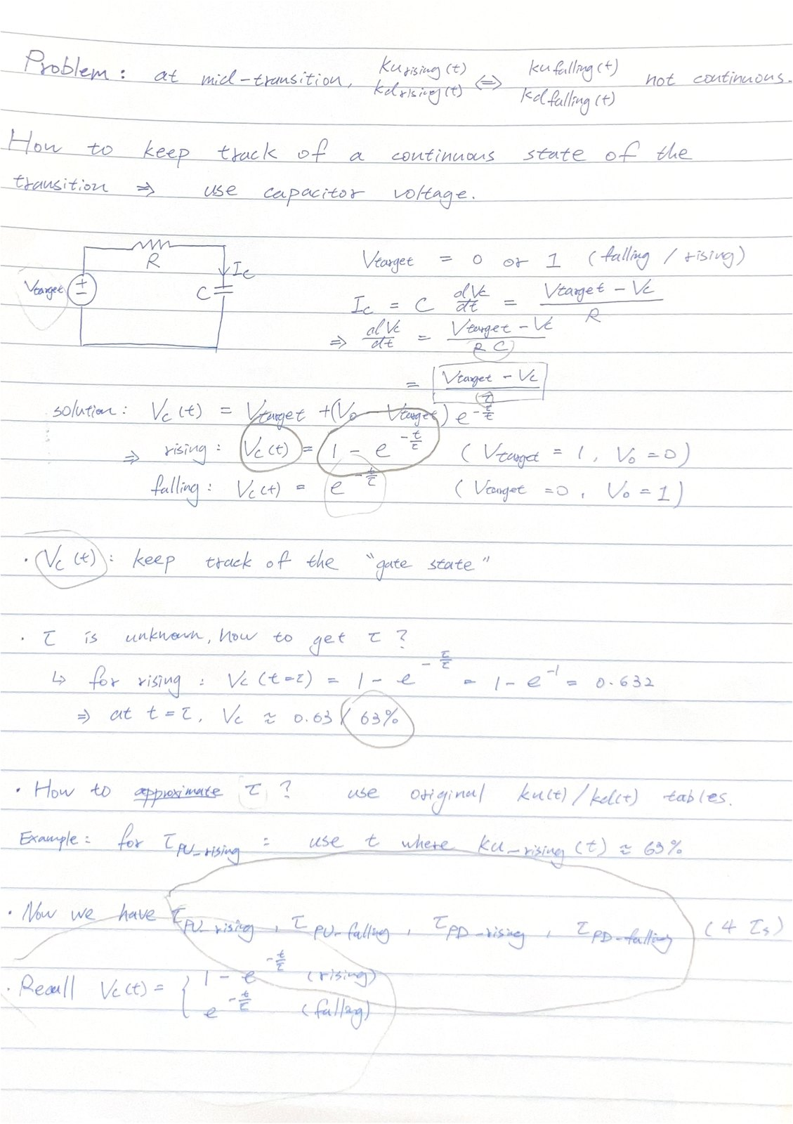
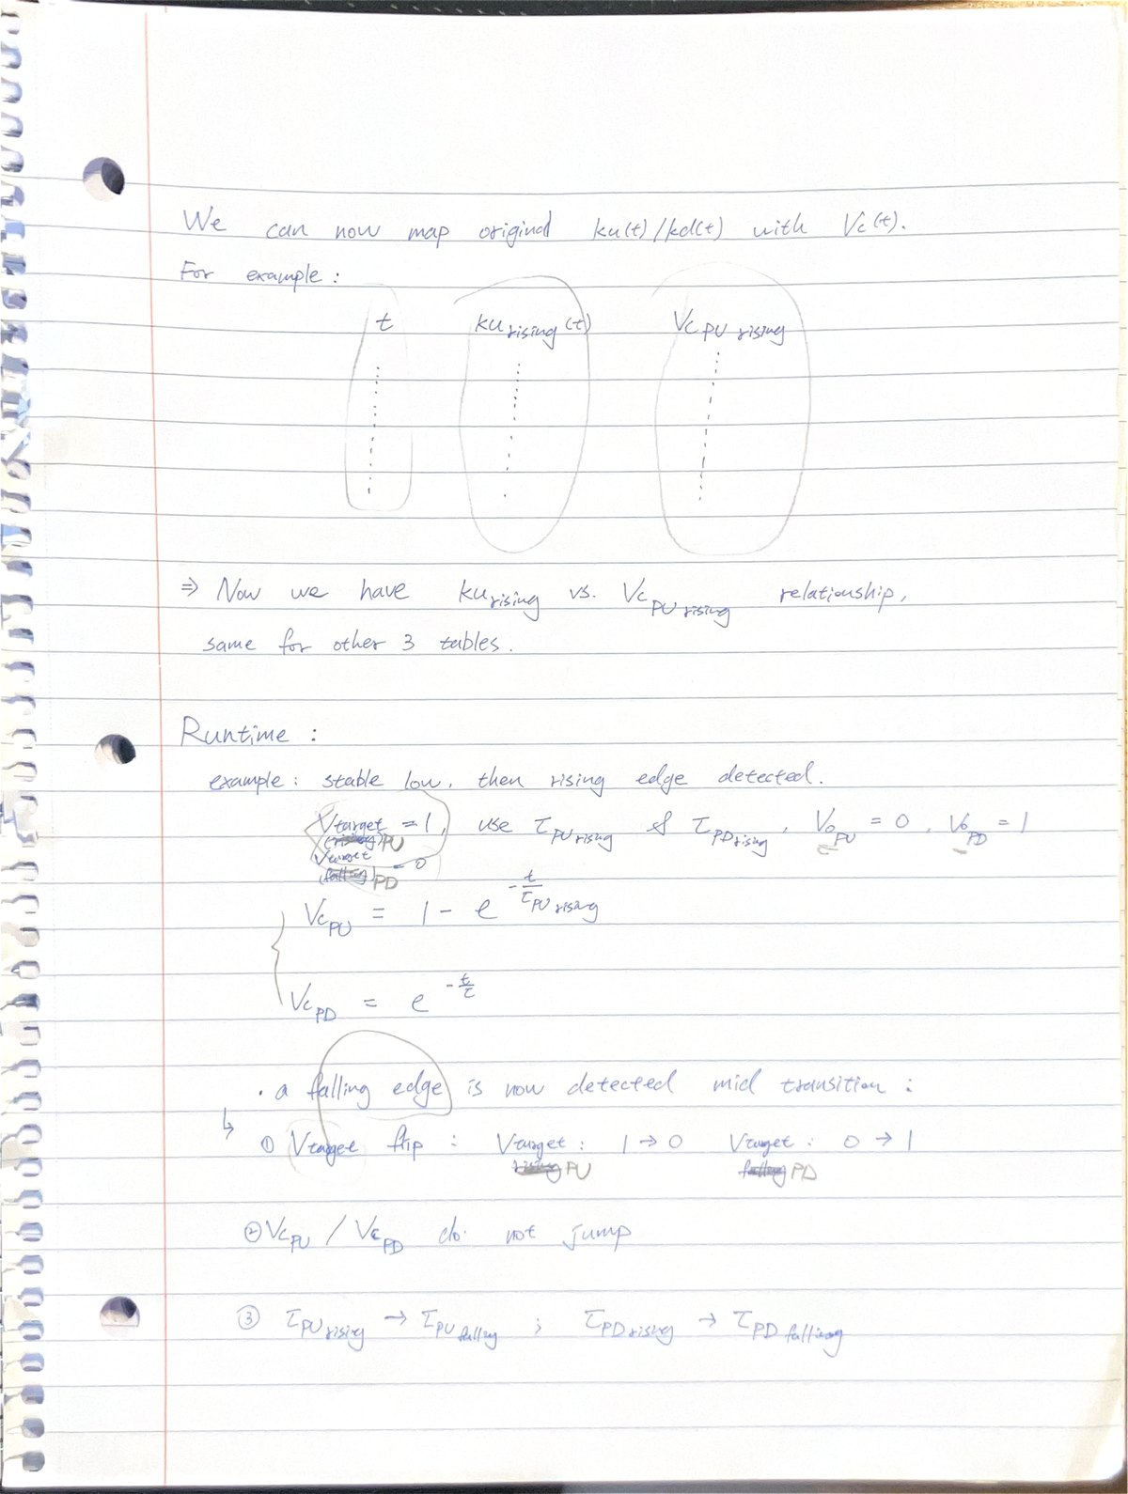
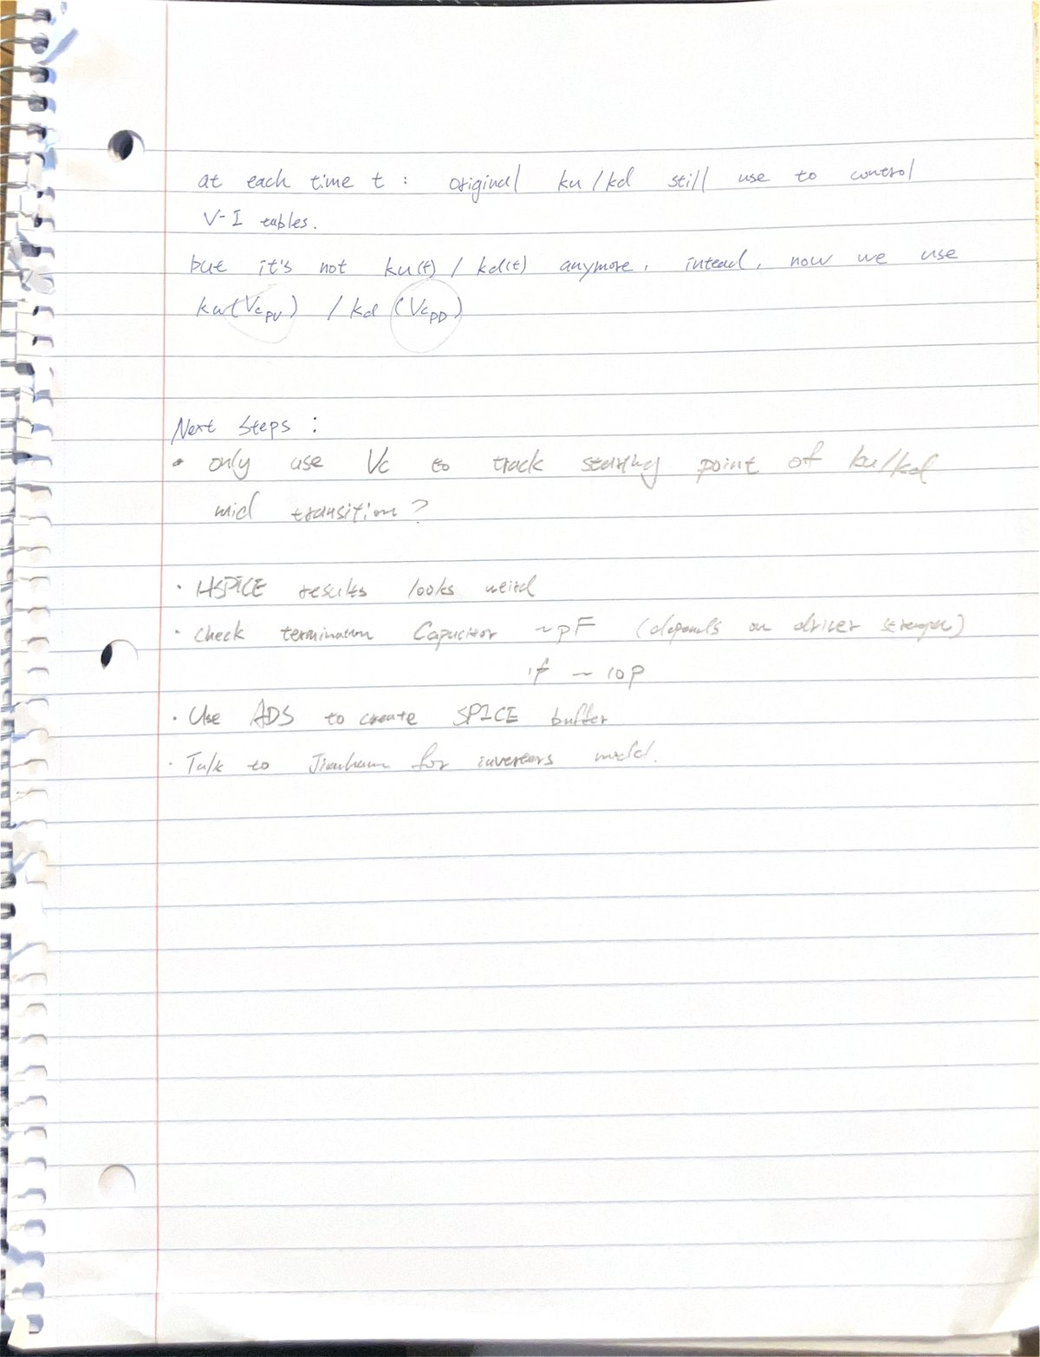
Appendix: original handwritten source
SOURCE
Page 1
Page 2
Page 3
Original PDF: \\minerfiles.mst.edu\dfs\users\sh3qm\Downloads\IBIS kukd .pdf
Notes:
These are the three original handwritten pages used for this deck. They are included so the transcription and notation can be checked directly.

