Slide 1
Reproducing the real gate from the IBIS file
Simon Huang · 24 September 2026
The story in one line: the output stage is a static map of its own gate, so a stressed pad is right when the gate's shape is right — and the gate is the thing IBIS does not record.
1 measure the map 2 show it works 3 show why our gate fails 4 reproduce the gate from the file
Notes:
Order matters here: every earlier version started from the method. This one starts from the measurement, because that is how the work went and it makes the method's motivation earned rather than asserted.

Slide 2
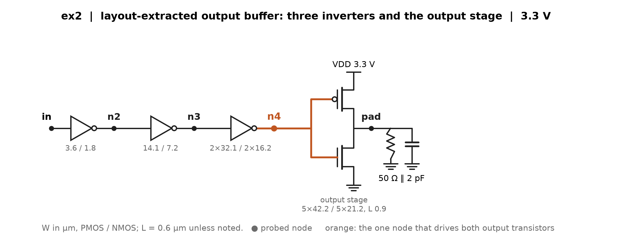
1 · We can look inside our own test chips
These are our designs, so the transistor netlist is available and every internal node can be probed. A customer using a vendor's IBIS file cannot do this — which is the whole problem, and the reason to do it once, carefully.
The node that matters is the output stage's gate — ex2's n4 below. Everything the pad does is decided there.
Notes:
ex2's predriver is three stages; n4 (orange) is the gate of the output device. Probes ran on predriver_stages_2026-09-09; the same schematics exist for io_buf and inv_chain on the 09-18 deck.

Slide 3
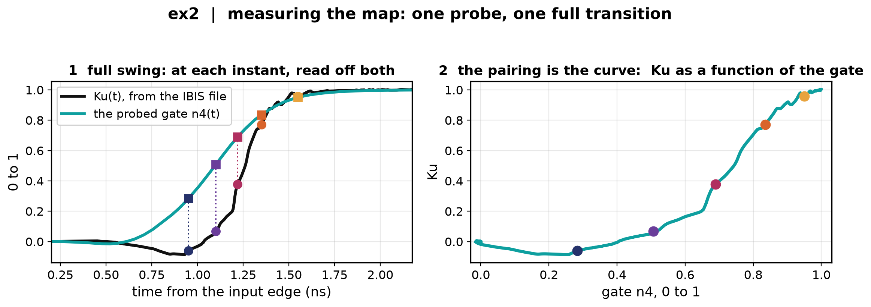
2 · Measuring the map: pair Ku(t) with the gate, instant by instant
The IBIS file gives Ku(t) on one full transition. The probe gives the gate on the same run. At each instant we have both numbers — so plot one against the other.
The pairing is the map. No fitting: it is read off a single full-swing run.
Notes:
Left: Ku(t) from the file and the probed n4(t), with five instants marked. Right: the same five instants plotted Ku against gate. This is the measured Ku-vs-gate map, and it is what the next slides drive.

Slide 4
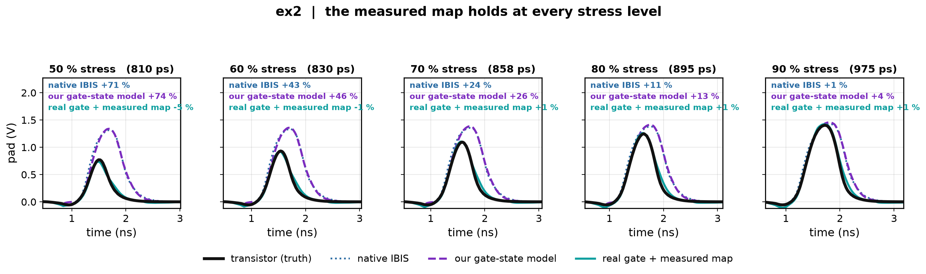
3 · Does the measured map work? ex2
Drive that measured map with the transistor's own gate, and compare the pad against the transistor at all five stress levels.
Within ±5 % at every level, where native IBIS runs +71 % at the deepest and our own gate-state model +74 %.
Notes:
Build: gate_replay_silicon_full in gate_cascade_prototype_2026-09-09 — the real gate replayed through the map measured at full swing. The same replay through the IBIS-implied map is fine on ex2 (-3…-6 %) and collapses on inv_chain (-14 to -69 %), which is why the measured map is the one shown here.

Slide 5
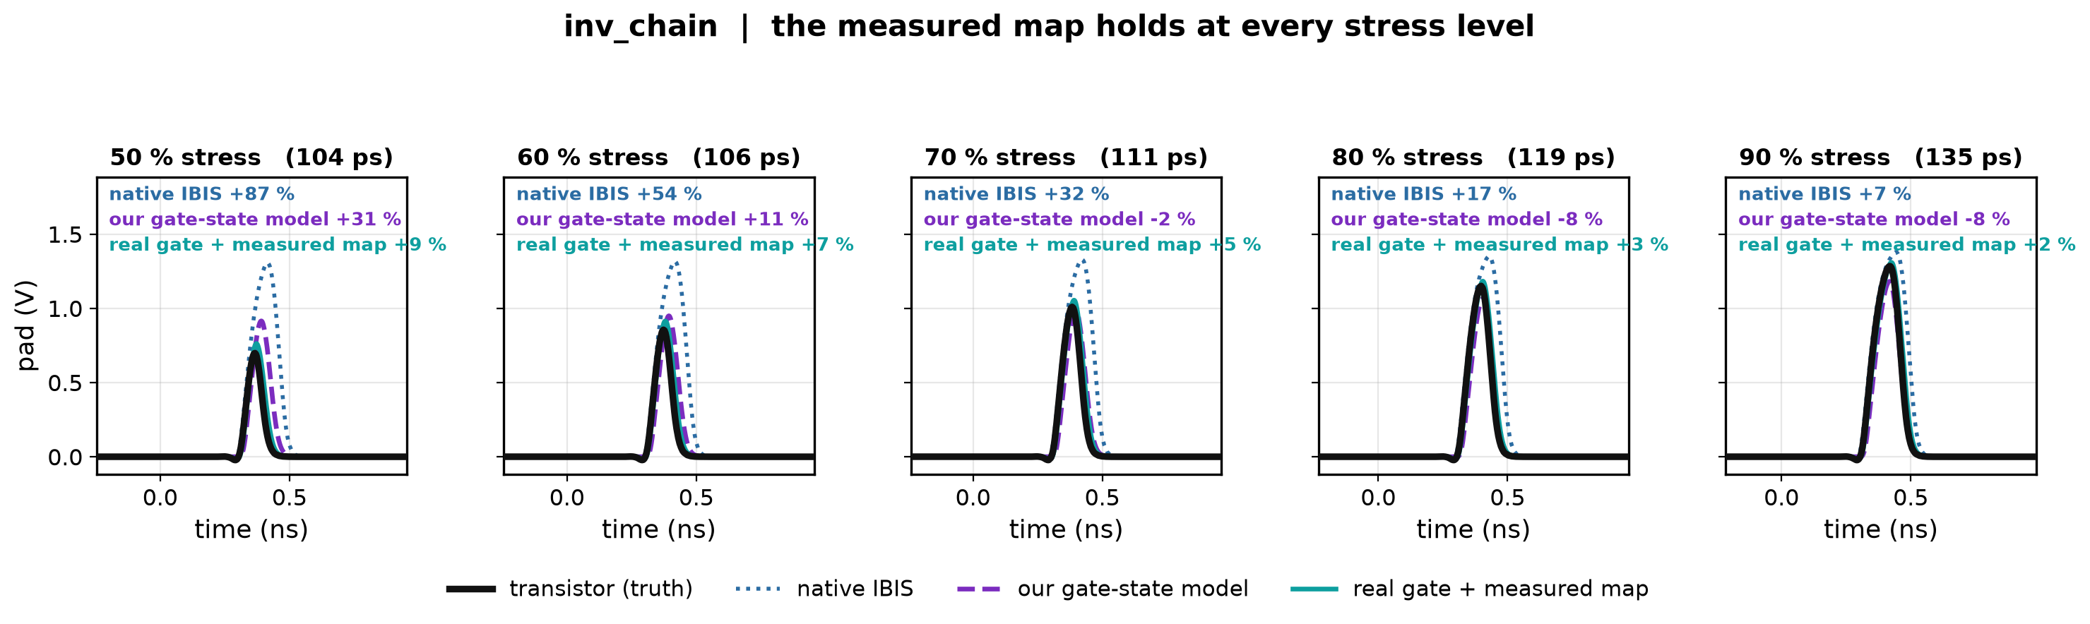
3 · Does the measured map work? inv_chain
Drive that measured map with the transistor's own gate, and compare the pad against the transistor at all five stress levels.
Within +2…+9 %, where native IBIS runs +87 % at the deepest. Our gate-state model looks good at 70–90 % for the wrong reason — see the backup slide on Vinh.
Notes:
Build: gate_replay_silicon_full in gate_cascade_prototype_2026-09-09 — the real gate replayed through the map measured at full swing. The same replay through the IBIS-implied map is fine on ex2 (-3…-6 %) and collapses on inv_chain (-14 to -69 %), which is why the measured map is the one shown here.

Slide 6
3 · So the output stage is not the problem
Given the right gate, the map reproduces the pad at every stress level, on both buffers.
The map itself is a fixed curve — it has no memory, and it does not change with the pulse. Measured hysteresis between the rising and falling branches is 0.07–0.10.
Everything that is wrong with our model is therefore in the gate.
Notes:
This is the pivot of the deck. It licenses spending the rest of the time on the gate's shape and nothing else.

Slide 7
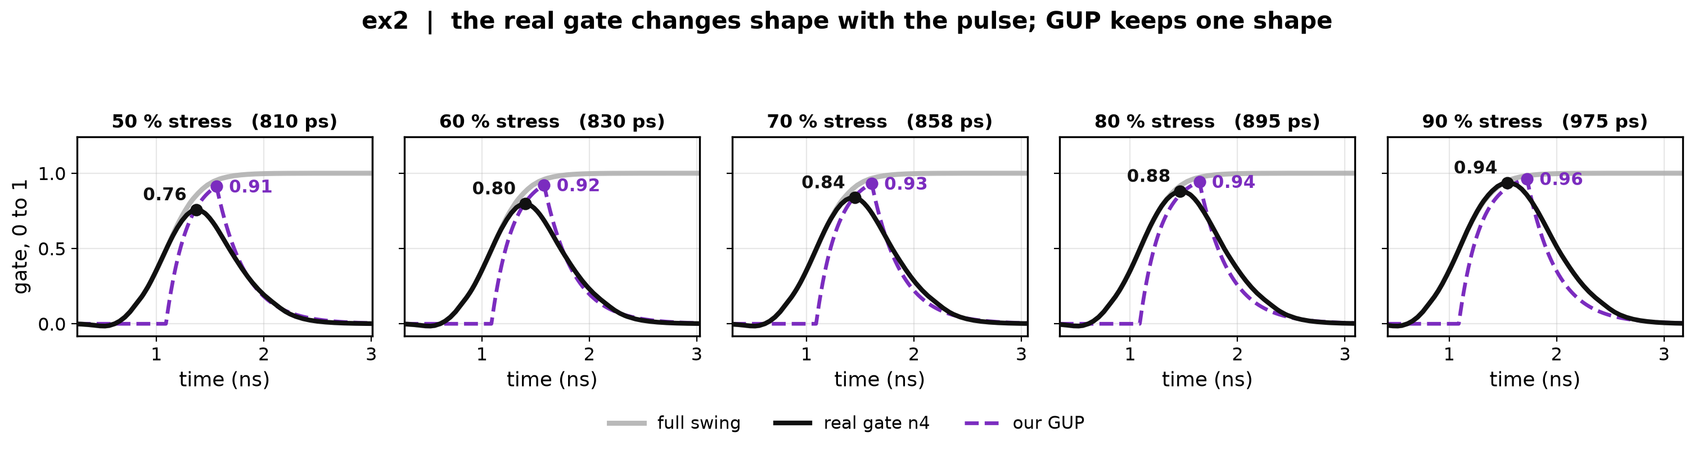
4 · Why our gate fails: the real gate changes shape, GUP does not
Our GUP is a fixed delay then an RC ramp. Truncating the input truncates that one shape.
The real gate is already moving long before GUP starts, and it turns round earlier.
Compare the two at each stress level — the mismatch grows as the pulse shortens.
Notes:
Grey: the full-swing gate. Black: the real gate under the stressed pulse. Purple: our GUP. Note that the real gate leaves zero around 0.5 ns while GUP is still flat until 1.1 ns, and that GUP's peak arrives after the real gate's.

Slide 8
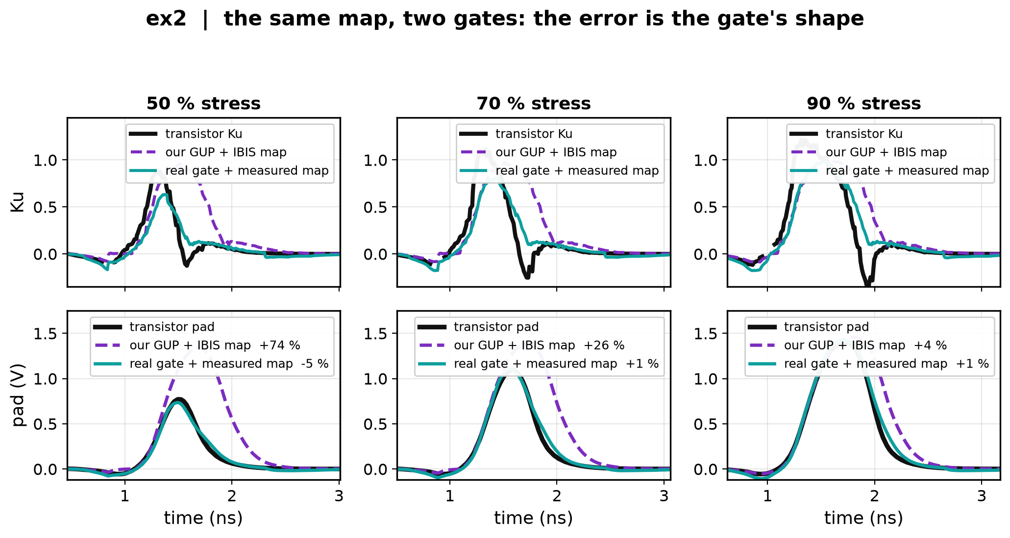
4 · What that shape difference does downstream
Same map, two gates. The top row is Ku, the bottom row the pad.
GUP holds Ku high long after the real gate has let go — and the pad overshoot is exactly that extra area. +74 % at 50 % stress, +4 % at 90 %.
Notes:
This is the causal chain end to end: gate shape -> Ku -> pad. At 90 % stress the two gates nearly coincide and the error nearly vanishes, which is why the failure only shows up under stress.

Slide 9
5 · So the problem is now a precise one
We know what a correct model needs: the real gate's shape, and the map.
We have both — by probing. A customer with only the vendor's IBIS file has neither.
The question for track 1: how much of that gate shape can be recovered from the IBIS file plus one measurement taken at the pad, with nothing probed inside?
Two things have to come from somewhere: how fast the gate travels, and the map's shape. The next slides are about where each one can come from.
Notes:
This is the motivation slide, and it only works because slides 2-4 have already shown that the gate's shape is the entire error. Earlier versions of this deck asserted the motivation before showing that.

Slide 10
6 · What the file gives, and what is missing
The file records Ku(t) on one full transition. That is a complete waveform — it has shape at every instant, not just at its ends. Shape is not what is missing.
What is missing is the split. Ku(t) = map(gate(t)) fixes the composition and nothing more: pick any gate trajectory you like, and the map is forced to be whatever reproduces Ku(t). Every such pair matches the file exactly.
A truncated pulse breaks the tie — because the chain then produces a different gate trajectory, and where it turns round depends on how fast the gate was really travelling. A fast gate is near the rail at the reversal, a slow one is only halfway, and the same static map reads different values off them.
That is why our GUP passes the full-swing check and fails under stress: it is one legal split, and not the right one.
Notes:
Slide 15 is the measured form of this - at K = 7 and K = 9 the model fits the file to the same four decimal places and predicts stressed gates running from extinguished to almost intact. Same composition, different split.

Slide 11
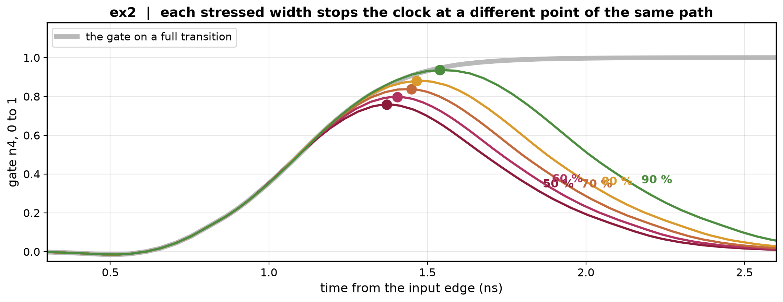
7 · One stressed pulse is the measurement that reaches the gate
Cutting the input short stops the clock partway through the gate's travel. What the pad does next depends on where the gate had got to.
Each stressed width is one sample of the interior of the same path — here the five widths stop the gate at 0.76, 0.80, 0.84, 0.88 and 0.94.
So the stress sweep is a sampling grid, not a robustness check — and one pad measurement per buffer, taken from outside the chip, is the extra input track 1 needs.
Notes:
Grey is the full transition. The five coloured curves follow it and peel off at different points. This is the justification for asking the user for one stressed pad run, and for the 50-90 percent depth ladder.

Slide 12
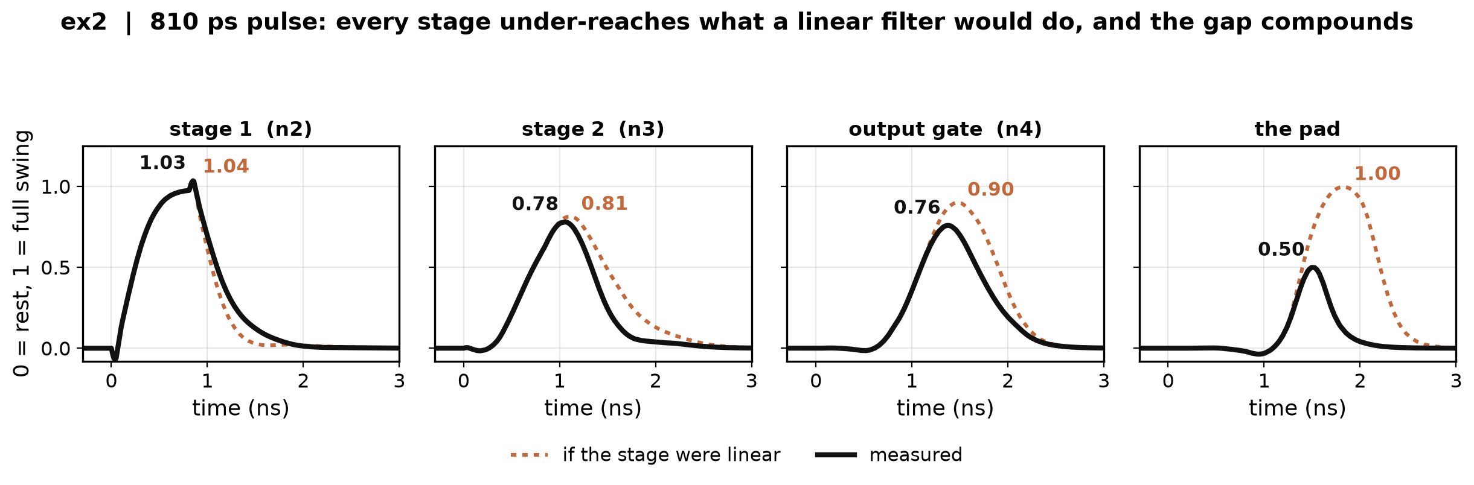
8 · What shape may the gate be? Measure a stage
A sample only helps if we know what gate shapes are possible — five samples cannot pick a curve out of all curves.
So probe every stage under a short pulse and compare with what a linear filter would give (its own step response, superposed).
Every stage under-reaches, and the gap compounds down the chain: at the pad the linear prediction says 1.00 where the transistor does 0.50.
Notes:
This rules out RC cascades, delay-plus-RC and superposition - which is what the shipped model is built from. Data: predriver_stages_2026-09-09, whose own module computes the superposition.

Slide 13
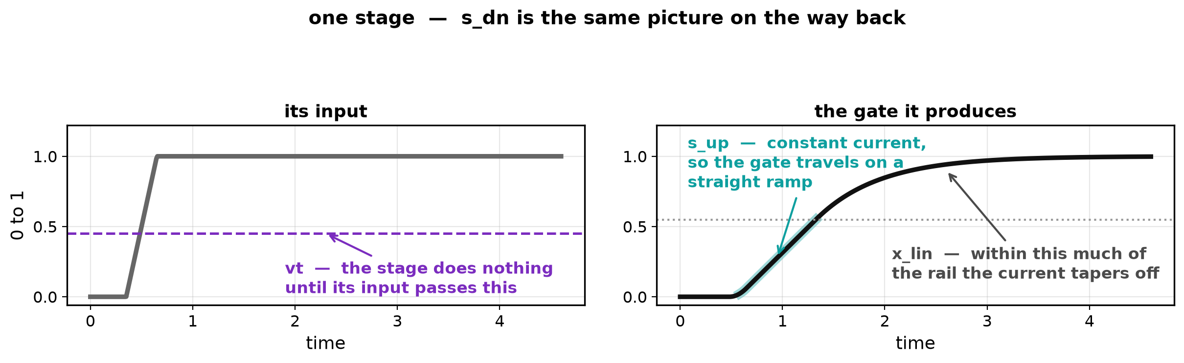
9 · The physics that explains it, and the four numbers it forces
A CMOS inverter driving a large load is a current source while its input sits at the rail — its device is in saturation — and becomes a resistor only near the destination rail, in triode. A constant current into a gate capacitance is a ramp.
That picture forces exactly four numbers per stage, and no more — named below. s_dn is the same picture on the way back.
All four are fitted to the file's own Ku(t), so they cost no measurement. (p, the drive's curvature under a partial input, is assumed: full swing cannot see it.)
Notes:
The four are not free knobs: each names something the circuit has. x_lin is pinned at 0.45 on most buffers, inside the 0.37-0.63 the real probed stages fitted. This slide answers 'what are the equations and where do the numbers come from'.

Slide 14
10 · What we build
input → K identical current-limited stages → gate g → the map → Ku → the file's own I-V tables → the pad
Each stage: dv/dt = s_up·h(u)·min(1, (1−v)/x_lin) − s_dn·h(1−u)·min(1, v/x_lin), with h(u) = clip((u − vt)/(1 − vt), 0, 1)
All K stages share one set of the four numbers — a real tapered predriver is approximately that, and letting them differ makes the fit degenerate.
Two things are still unknown: how many stages, and the shape of the map. Neither can be fitted to the file — that is what the stressed run is spent on.
Notes:
The map here is the two-parameter MOSFET-shaped curve, not the measured one: track 1 has no probe. Its shape is one of the two things the stressed run selects.

Slide 15
11 · Where every number comes from
From the file alone: C_comp — kept unless the file's own arithmetic rejects it, since Ku cannot exceed 1 and ex2's declared 5.0 pF implies 1.24 — and s_up, s_dn, vt, x_lin, fitted to the file's Ku(t).
From the one stressed pad run: the stage count K and the map's shape. The file narrows K to a band of about three and cannot choose inside it: at K = 7 and K = 9 it fits to the same four decimal places, while the gate they predict runs from extinguished to almost intact.
The run is spent twice, in order: first it sets the amplitude by moving vt, then it picks among the nine candidates (3 stage counts × 3 shapes) on the whole pad waveform.
Not on the peak — the first step has just matched the peak for every candidate, so the peak has no information left to rank them with.
Notes:
The peak point is the one that cost a night's work: ranking on the peak selects chains that turn on 155-300 ps late and hit the right height with the wrong pulse under it.

Slide 16
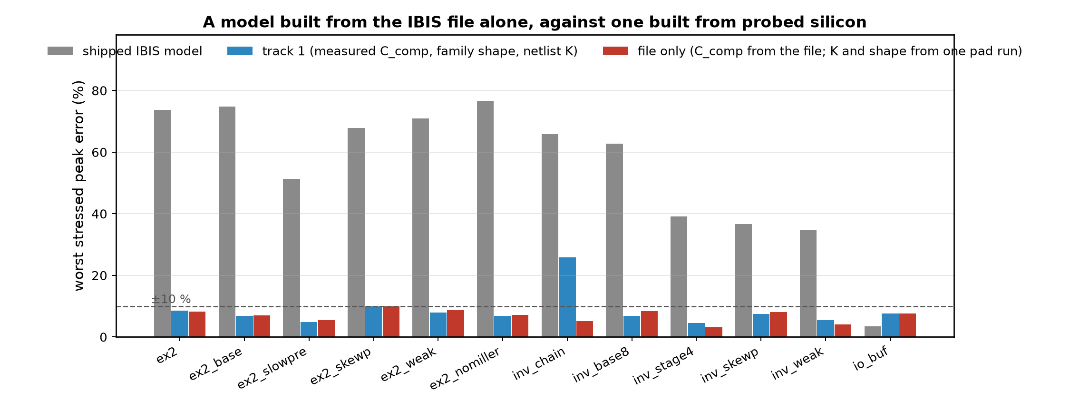
12 · Where the file-only recipe stands
12 of 12 buffers within ±10 % on the worst stressed pulse; mean 6.9 %.
On inv_chain the file-only build reaches 5.1 %, against 25.8 % for a build that uses the probed silicon — the shape choice matters more than the measurement.
What it costs: the full transition is worse than the shipped model on 10 of 12 buffers, and a stressed pulse train is still lost on ex2 and io_buf. We buy accuracy in stressed accuracy with full-swing accuracy.
Notes:
Grey is the shipped model, blue the build using probed silicon, red the file-only one. Full numbers in docs/track1_recipe.md.

Slide 17
13 · What this does not cover yet
Direction. Everything here is a short HIGH pulse. Only io_buf has been run pulling down, where the model is 16–21 points too shallow — its pull-down chain never turns on at all on a short pulse.
Depth. The ladder samples 50–90 % of the travel. Below 50 % is unsampled.
Trains. One pulse at a time; a stressed train is still lost on two of three buffers.
The recipe has seen the answer key. Two of the three candidate map shapes were chosen by looking at results on these same twelve buffers. A thirteenth buffer may need a shape the grid does not contain.
Notes:
Better said than asked. The direction gap is the one that would most change the headline number.

Slide 18
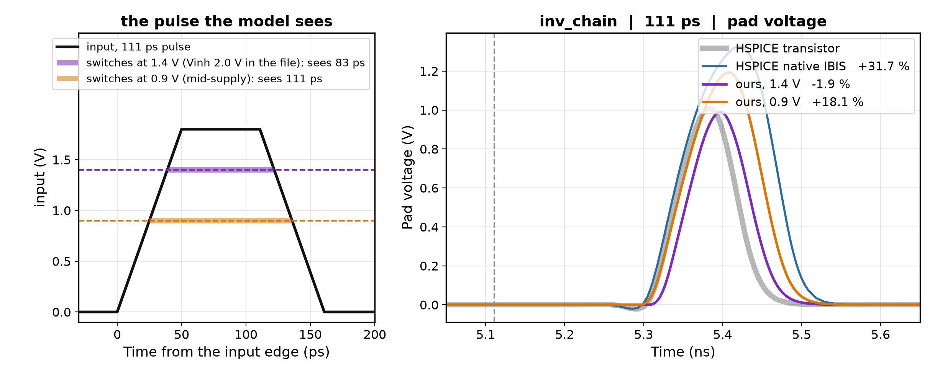
Backup · inv_chain's input threshold
inv_chain's IBIS file declares Vinh 2.0 V on a 1.8 V part, so our input comparator fires late and trims about 29 ps off every pulse.
That trim cancels most of the gate-state model's overshoot, which is why it reads −2 % at 70 % stress on the previous slides while native IBIS reads +32 %.
It is a defect that flatters us, not a result. With the threshold at mid-supply the shipped error roughly doubles.
Notes:
Carried from the 09-18 deck so the inv_chain numbers on slide 3 are not read as a win. review_2026-09-09 item 12B has the measurement.

