Slide 1
IBIS Simulation in Ngspice
Simon Hwang
Advisor: Dr. Chulsoon Hwang
Dr. Zhiping Yang
7/3/2026

Slide 2
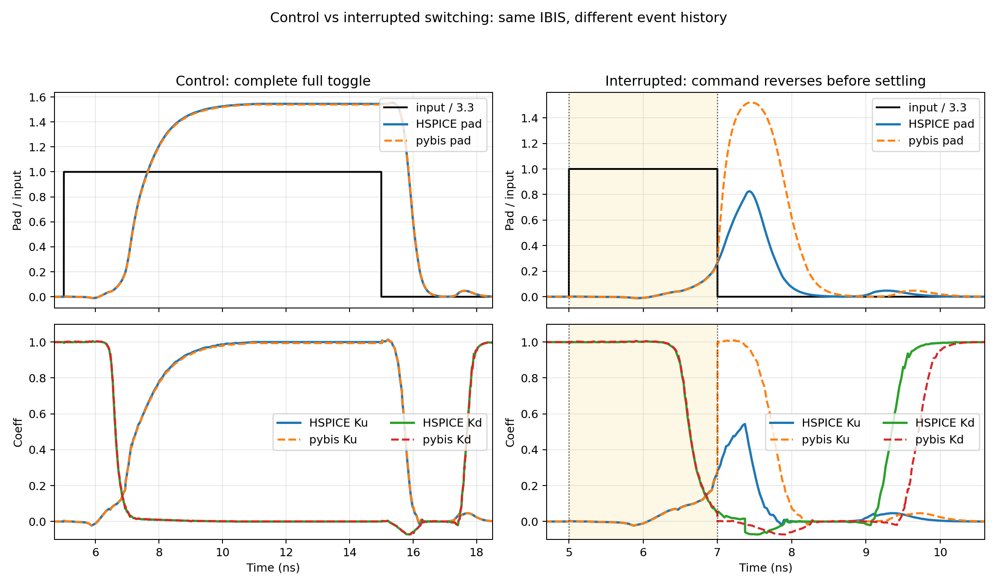
"Replay Problem" for Short Pulse
Ku replay from fully on state

Slide 3
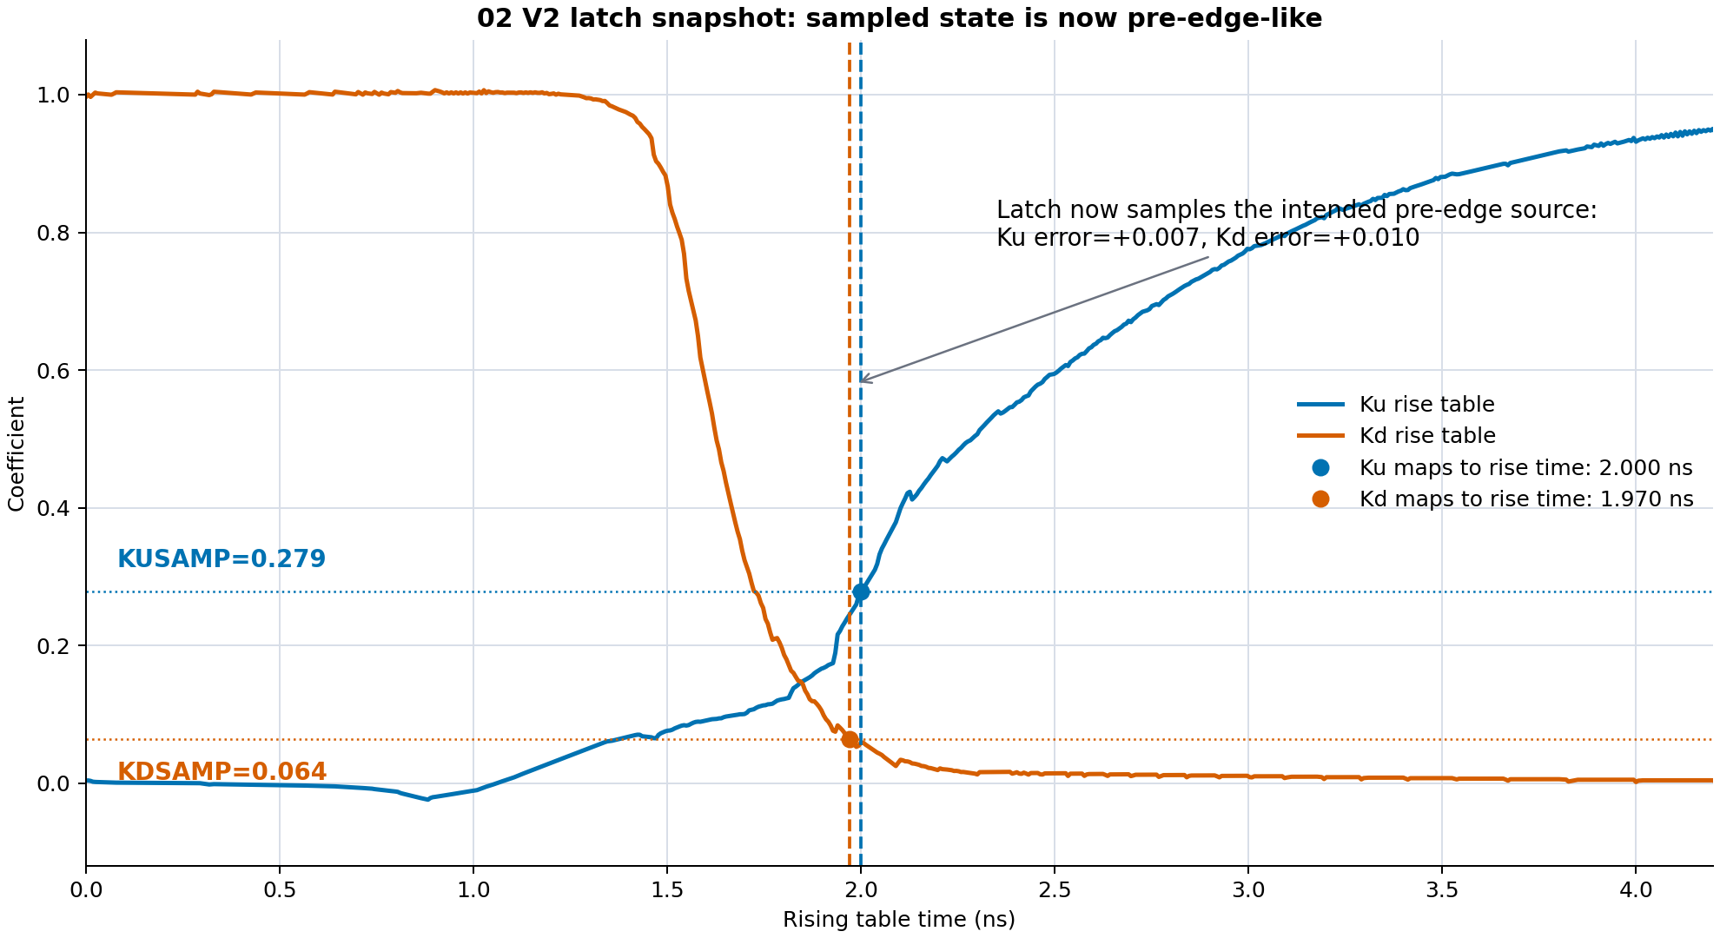
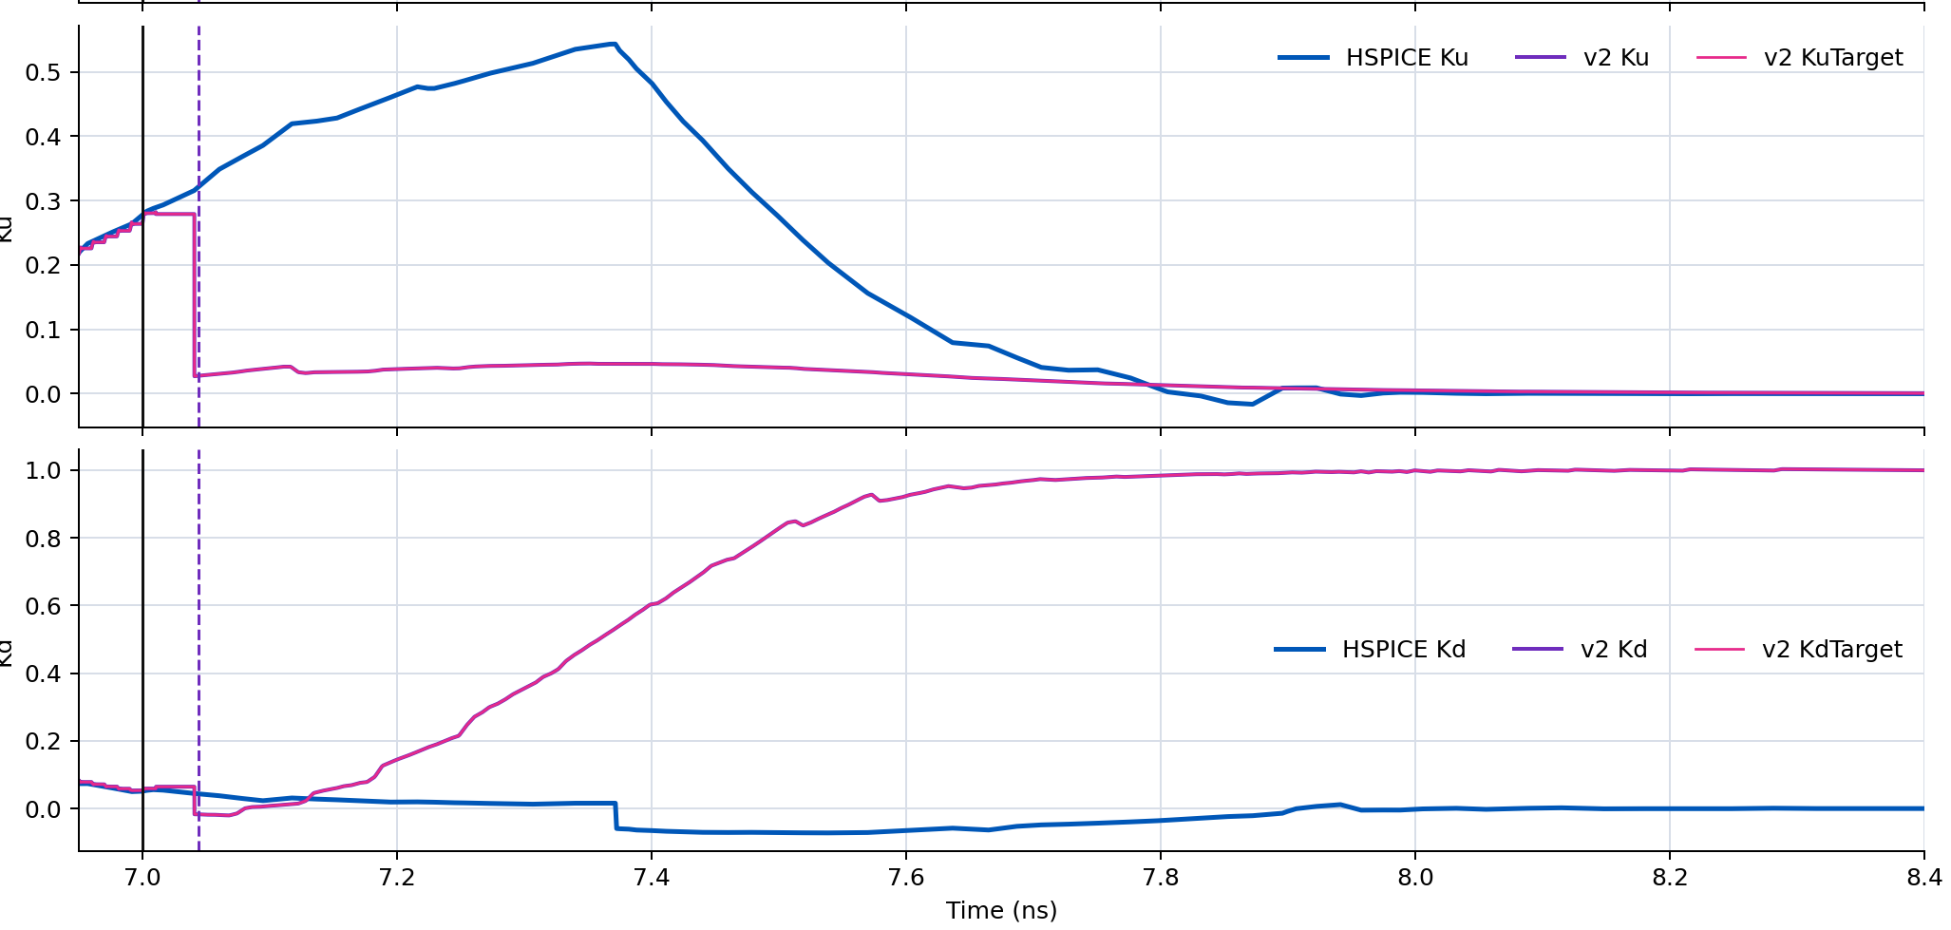
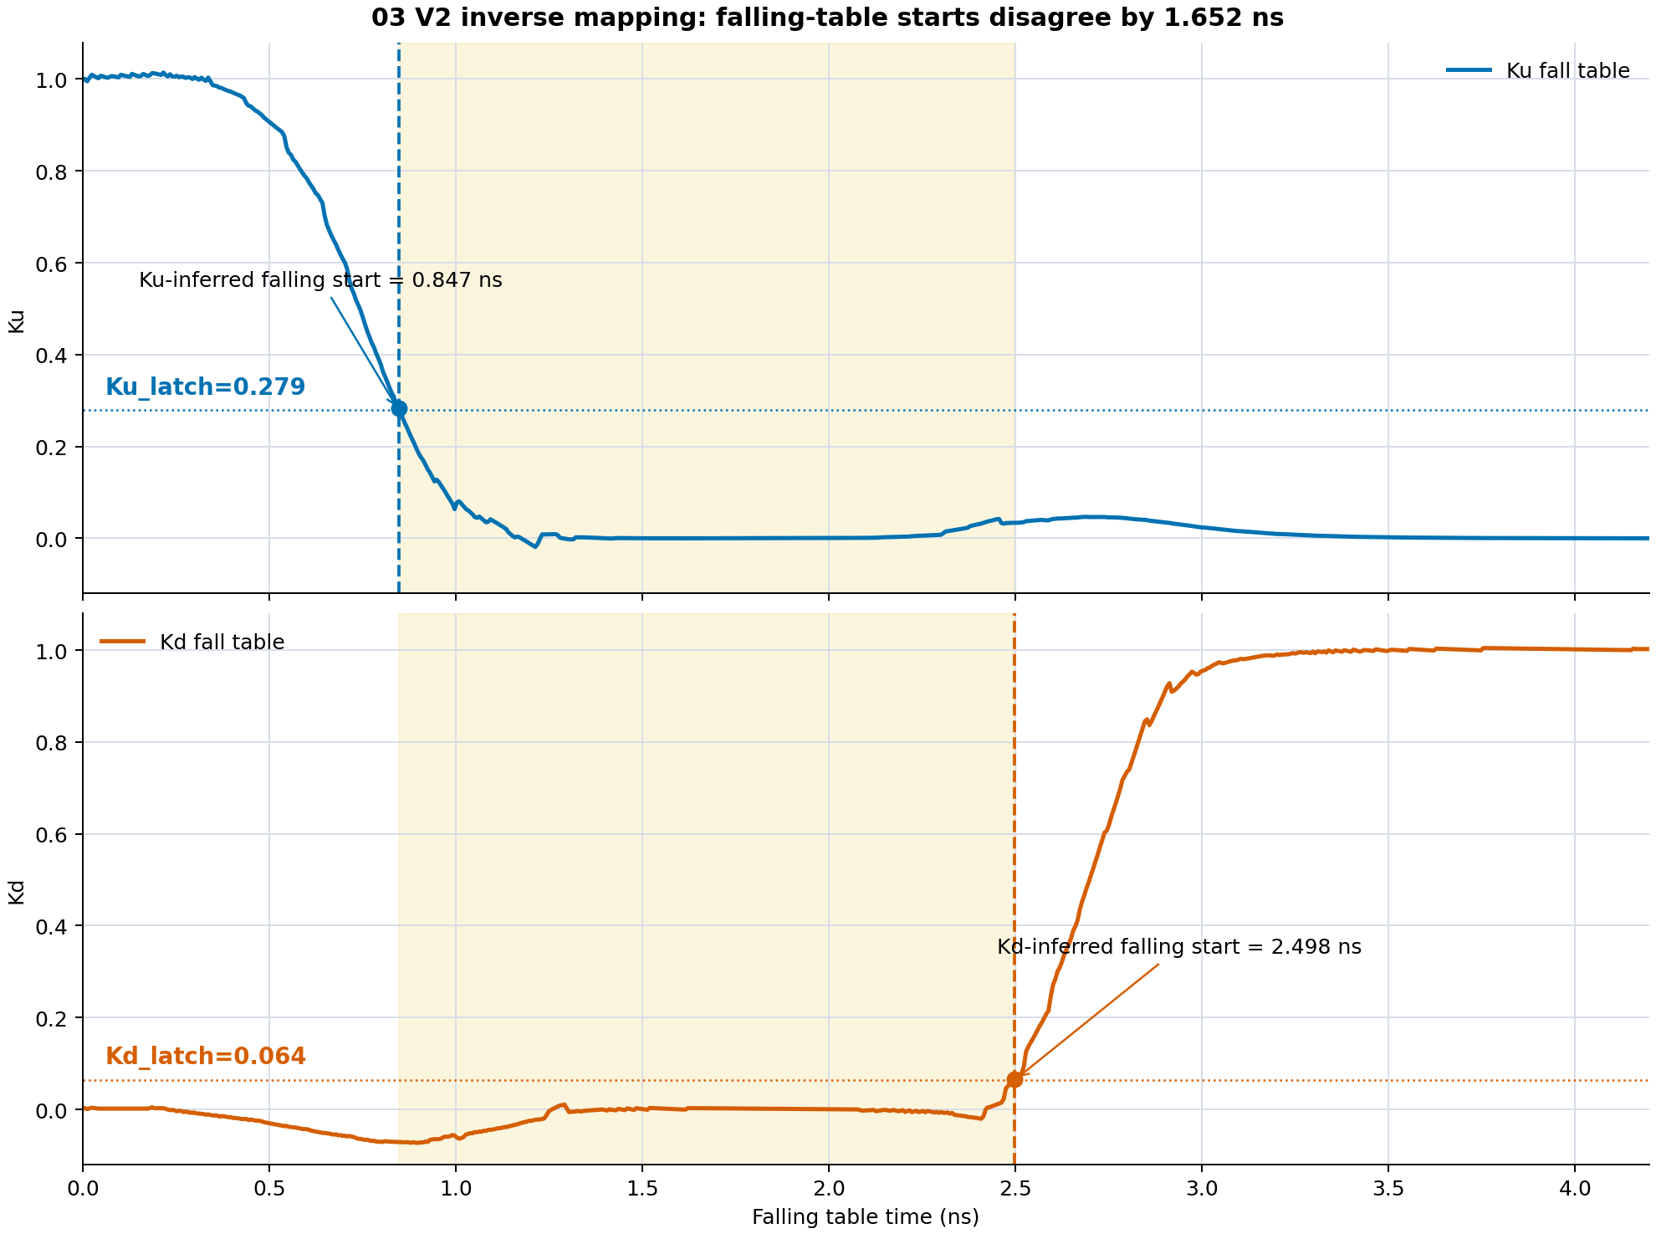
Why "Value-matched" Method Fails
Mid-transition Ku_rising/Kd_rising:
Resulting Ku_ falling/Kd_falling during simulation vs. HSPICE Ku/Kd:
Mapping to Ku_falling/Kd_falling tables:

