Slide 1
Continuous Vc Model for IBIS Ku/Kd
Strict transcription of the handwritten derivation
IBIS short-pulse study
Notes:
This version follows the handwritten terminology and sequence. Vc_PU and Vc_PD are capacitor voltages that track pullup and pulldown transition progress. No additional timing concepts are introduced.

Slide 2
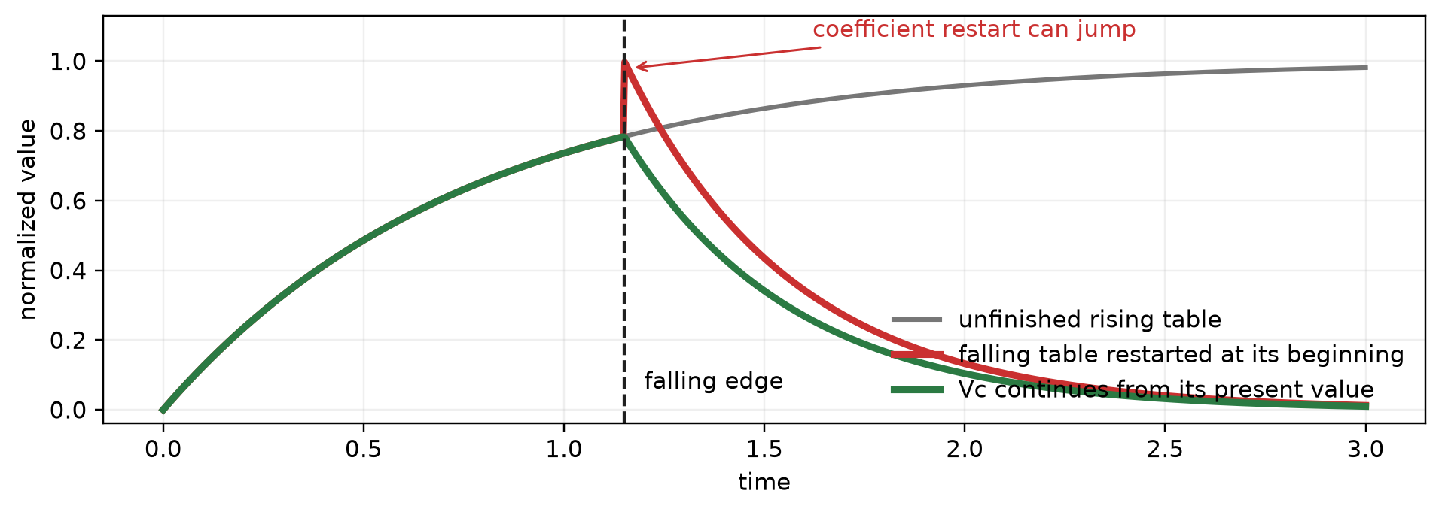
1. Problem: changing tables in the middle is not continuous
PROBLEM
- The first transition has not reached its endpoint.
- The falling tables assume their own starting condition.
- A continuous quantity is needed to remember transition progress.
The short-pulse problem is a mid-transition starting-point problem.
Source: handwritten notes, IBIS kukd .pdf (2026-07-22)
Notes:
The notes begin with the mid-transition problem. A rising edge starts Ku_rising and Kd_rising. If a falling edge arrives before they settle, restarting Ku_falling and Kd_falling at the beginning can force new coefficient values rather than continue from the values already reached.

Slide 3
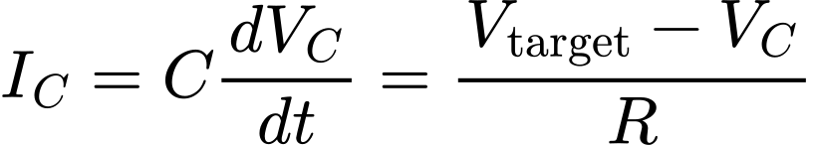
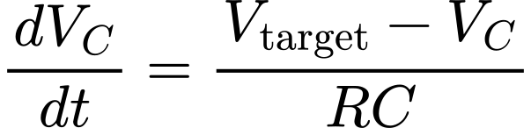
2. Use capacitor voltage Vc to keep a continuous transition state
VC
Vtarget
0 or 1
Vc
R
C stores Vc
Vc keeps the present transition position.
Vtarget = 0 or 1
The capacitor carries the previous value into the next solver timestep.
Source: handwritten notes, IBIS kukd .pdf (2026-07-22)
Notes:
The handwritten solution is to use a capacitor voltage. Capacitor voltage cannot jump instantaneously. Its present value therefore records how far the transition has progressed.

Slide 4
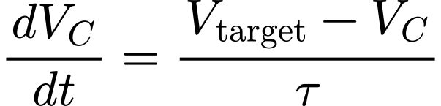

3. Solve the first-order Vc equation
EQUATION
V0 is the capacitor voltage already reached.
- Vtarget selects the destination.
- Tau selects how quickly Vc moves.
- Vc itself is not restarted.
A new input edge changes the equation parameters, not the stored Vc value.
Source: handwritten notes, IBIS kukd .pdf (2026-07-22)
Notes:
The solution starts from V0, the capacitor voltage already present when the target changes. The same equation therefore covers a full transition and a change in the middle.

Slide 5


4. Rising and falling are the two Vc solutions
EQUATION
Rising
Falling
Vtarget = 1, V0 = 0
Vtarget = 0, V0 = 1
Both equations keep Vc continuous when the target changes.
Rising moves Vc toward 1; falling moves Vc toward 0.
Source: handwritten notes, IBIS kukd .pdf (2026-07-22)
Notes:
For rising, the target is one and the initial value is zero. For falling, the target is zero and the initial value is one. These are the two normalized capacitor-voltage curves used throughout the rest of the notes.

Slide 6

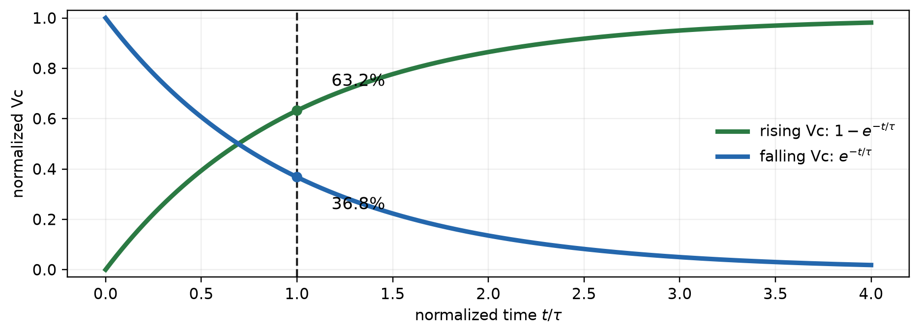
5. Obtain tau from the original Ku/Kd tables
TAU
Example: use the time where Ku_rising reaches about 63% of its total change.
Repeat for the other three tables.
The four tau values come directly from the original coefficient transitions.
Source: handwritten notes, IBIS kukd .pdf (2026-07-22)
Notes:
At one tau, a rising first-order response reaches 63.2 percent. The handwritten method therefore estimates each tau from the time at which the corresponding normalized Ku or Kd table reaches the equivalent 63-percent transition point.

Slide 7




6. The result is four tau values
TAU
Input rising
Input falling
Vc_PU: 0 -> 1
Vc_PD: 1 -> 0
Vc_PU: 1 -> 0
Vc_PD: 0 -> 1
No pullup/pulldown or rising/falling symmetry is assumed.
Each original Ku/Kd table gets its corresponding Vc transition.
Source: handwritten notes, IBIS kukd .pdf (2026-07-22)
Notes:
The notes name the four constants by pullup or pulldown and by input transition direction: PU-rising, PU-falling, PD-rising, and PD-falling.

Slide 8
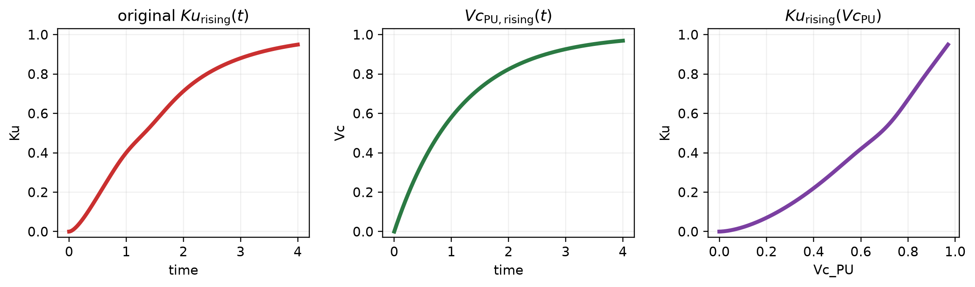
7. Map Ku(t) and Kd(t) to Vc instead of time
MAPPING
Create the same relationship for all four original tables.
The coefficient tables are retained; their lookup coordinate changes from t to Vc.
Source: handwritten notes, IBIS kukd .pdf (2026-07-22)
Notes:
The notes pair each original coefficient sample with the Vc value at the same table time. The example shown is Ku_rising versus Vc_PU_rising. Repeat the same process for Ku_falling, Kd_rising, and Kd_falling.

Slide 9


8. Before simulation, prepare four Ku/Kd versus Vc relationships
PREPARATION
Ku_rising(Vc_PU)
Ku_falling(Vc_PU)
Kd_rising(Vc_PD)
Kd_falling(Vc_PD)
At runtime, the current Vc selects the coefficient value.
Time is used during preparation; Vc is used during simulation.
Source: handwritten notes, IBIS kukd .pdf (2026-07-22)
Notes:
This slide makes explicit the result of the handwritten mapping step. There are four relationships: pullup rising and falling, plus pulldown rising and falling. These are prepared before simulation.

Slide 10


9. Runtime example: stable low, then a rising edge
RUNTIME
Stable low
Vc_PU=0
Vc_PD=1
Rising edge
Vtarget,PU=1
Vtarget,PD=0
Use
Tau_PU,rising
Tau_PD,rising
The rising edge moves both capacitor voltages using their rising-direction relationships.
Source: handwritten notes, IBIS kukd .pdf (2026-07-22)
Notes:
The handwritten runtime example begins from stable low. Vc_PU is zero and Vc_PD is one. On a rising input edge, the pullup target becomes one and the pulldown target becomes zero. The two rising-direction tau values govern the capacitor voltages.

Slide 11
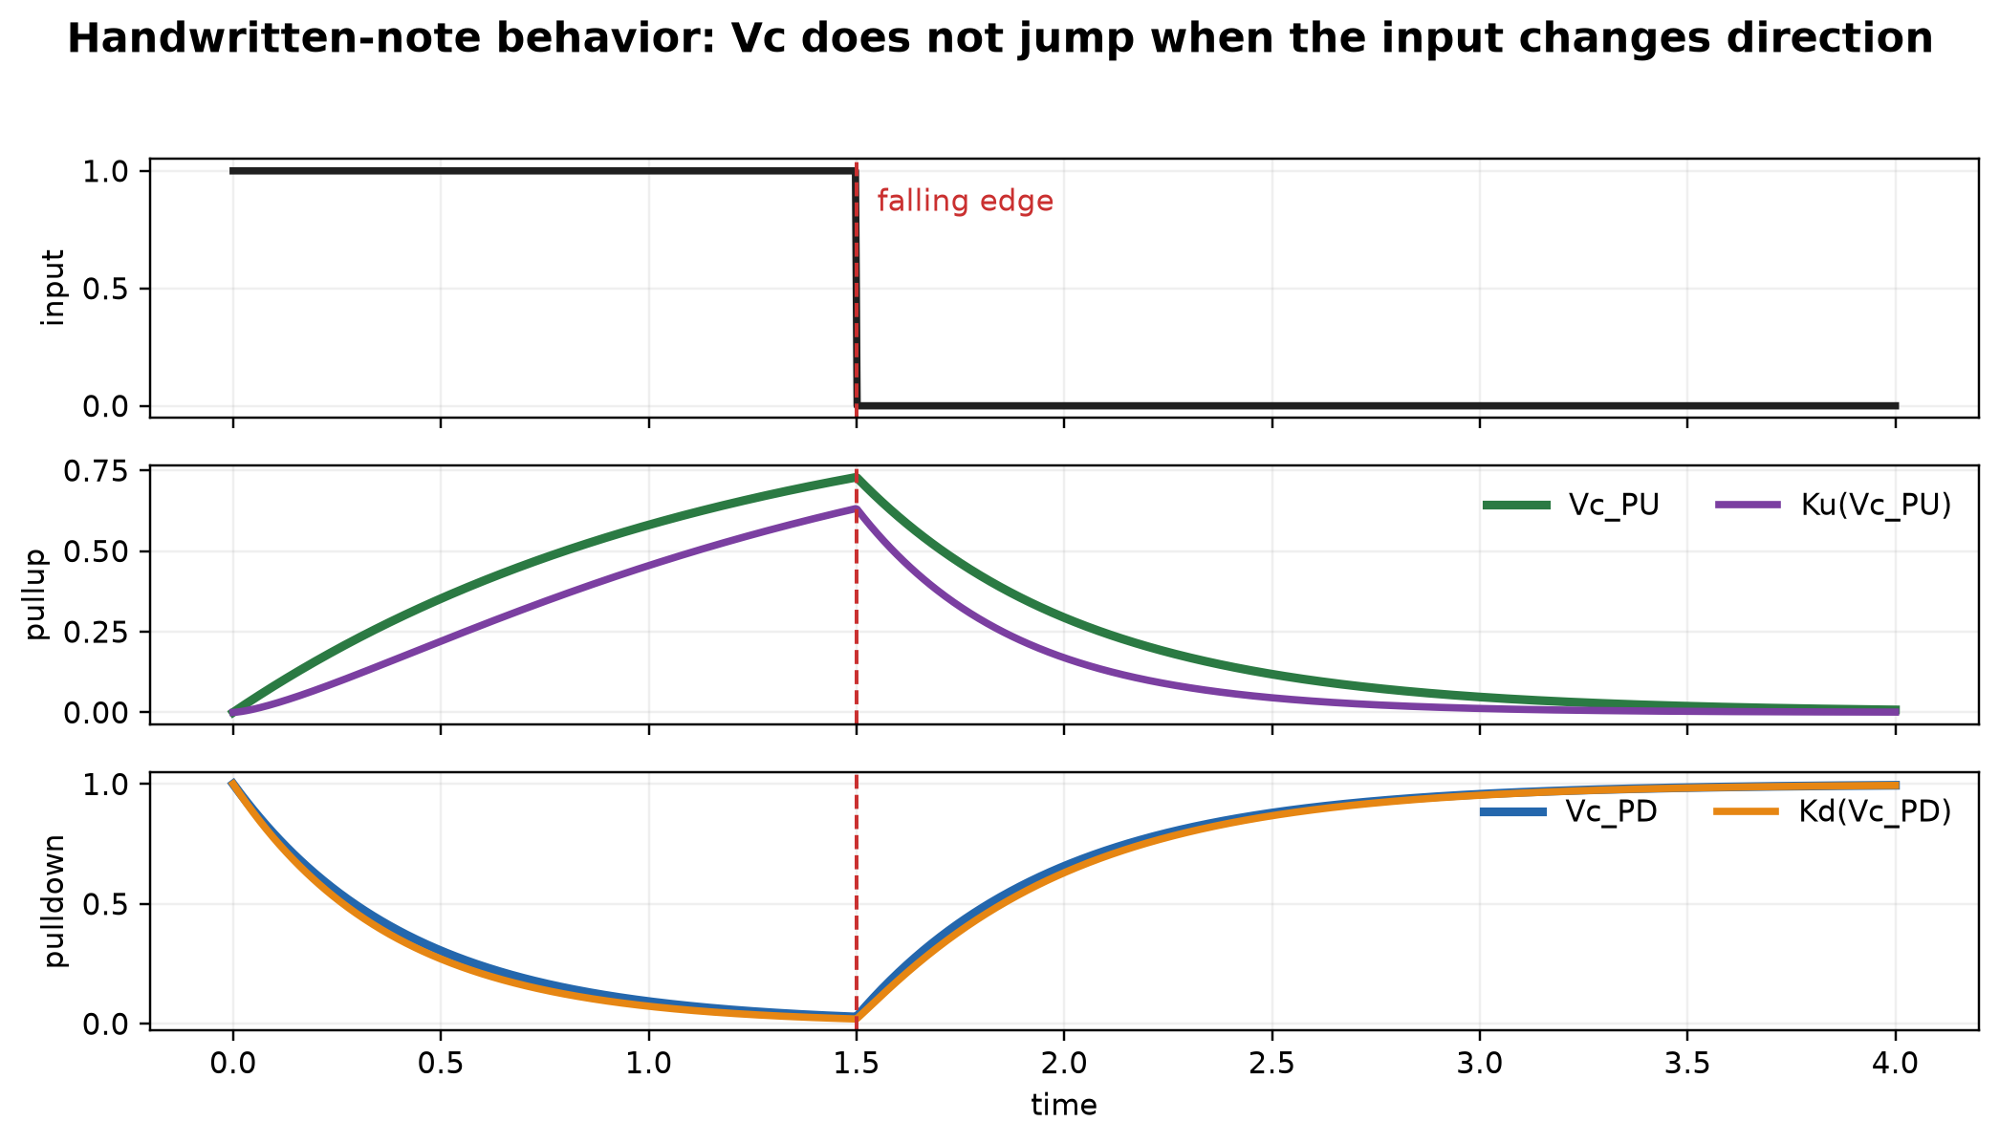
10. A falling edge arrives before the rising transition finishes
RUNTIME
Targets flip
PU: 1 -> 0
PD: 0 -> 1
Tau changes
rising -> falling
Vc_PU and Vc_PD
do not jump
The falling relationship starts from the present capacitor voltage, not from a settled endpoint.
Source: handwritten notes, IBIS kukd .pdf (2026-07-22)
Notes:
At the falling edge, the targets flip and the model changes from rising-direction tau values to falling-direction tau values. Vc_PU and Vc_PD do not jump; they continue from the values already reached. The falling Ku/Kd versus Vc relationships are then used.

Slide 12
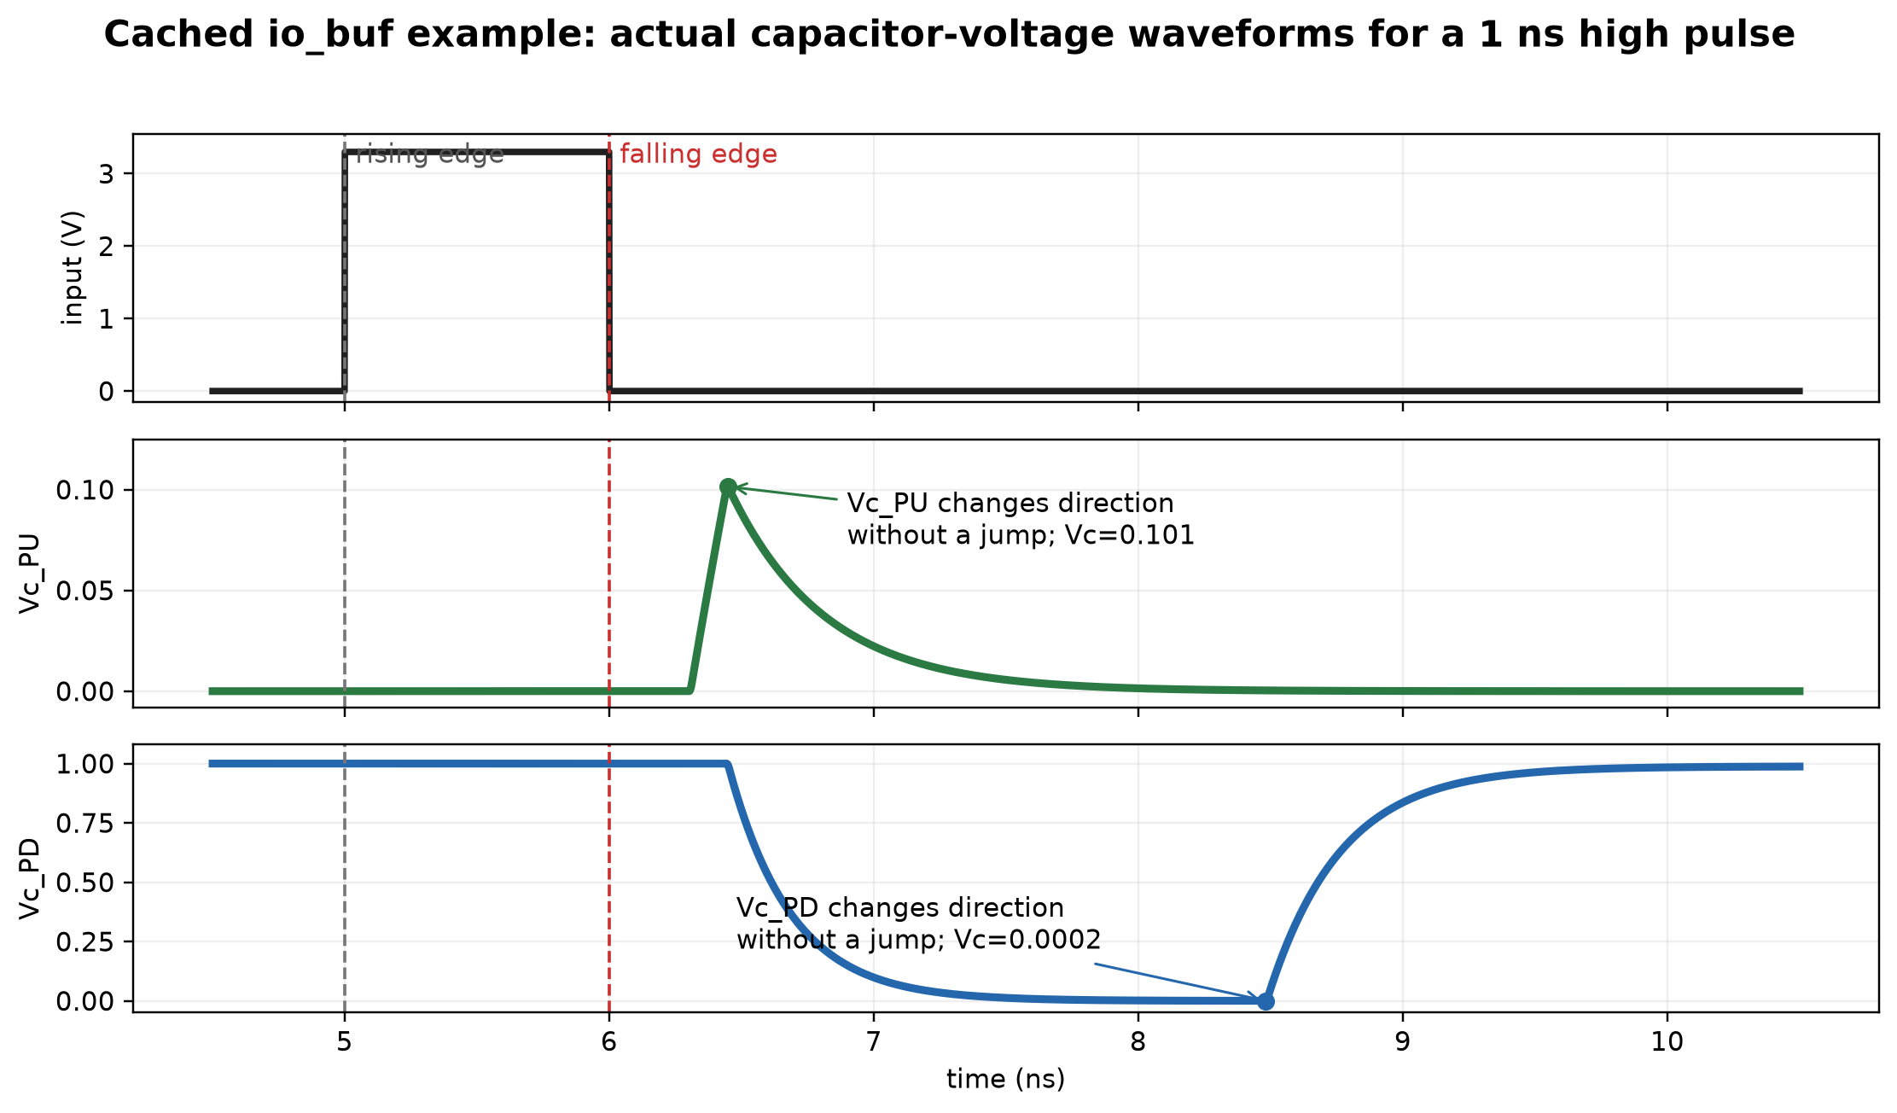
11. Cached io_buf example: actual Vc_PU and Vc_PD
WAVEFORMS
The measured capacitor voltages carry different transition histories, but neither is reset.
Cached data: io_buf short_pulse_1ns_high / two_state_directional_residual
Notes:
This slide uses cached ngspice data from the short_pulse_1ns_high case. The internal numerical capacitor voltages are relabeled in the handwritten notation as Vc_PU and Vc_PD. Both are continuous. Their measured turning points are shown without introducing another timing model.

Slide 13
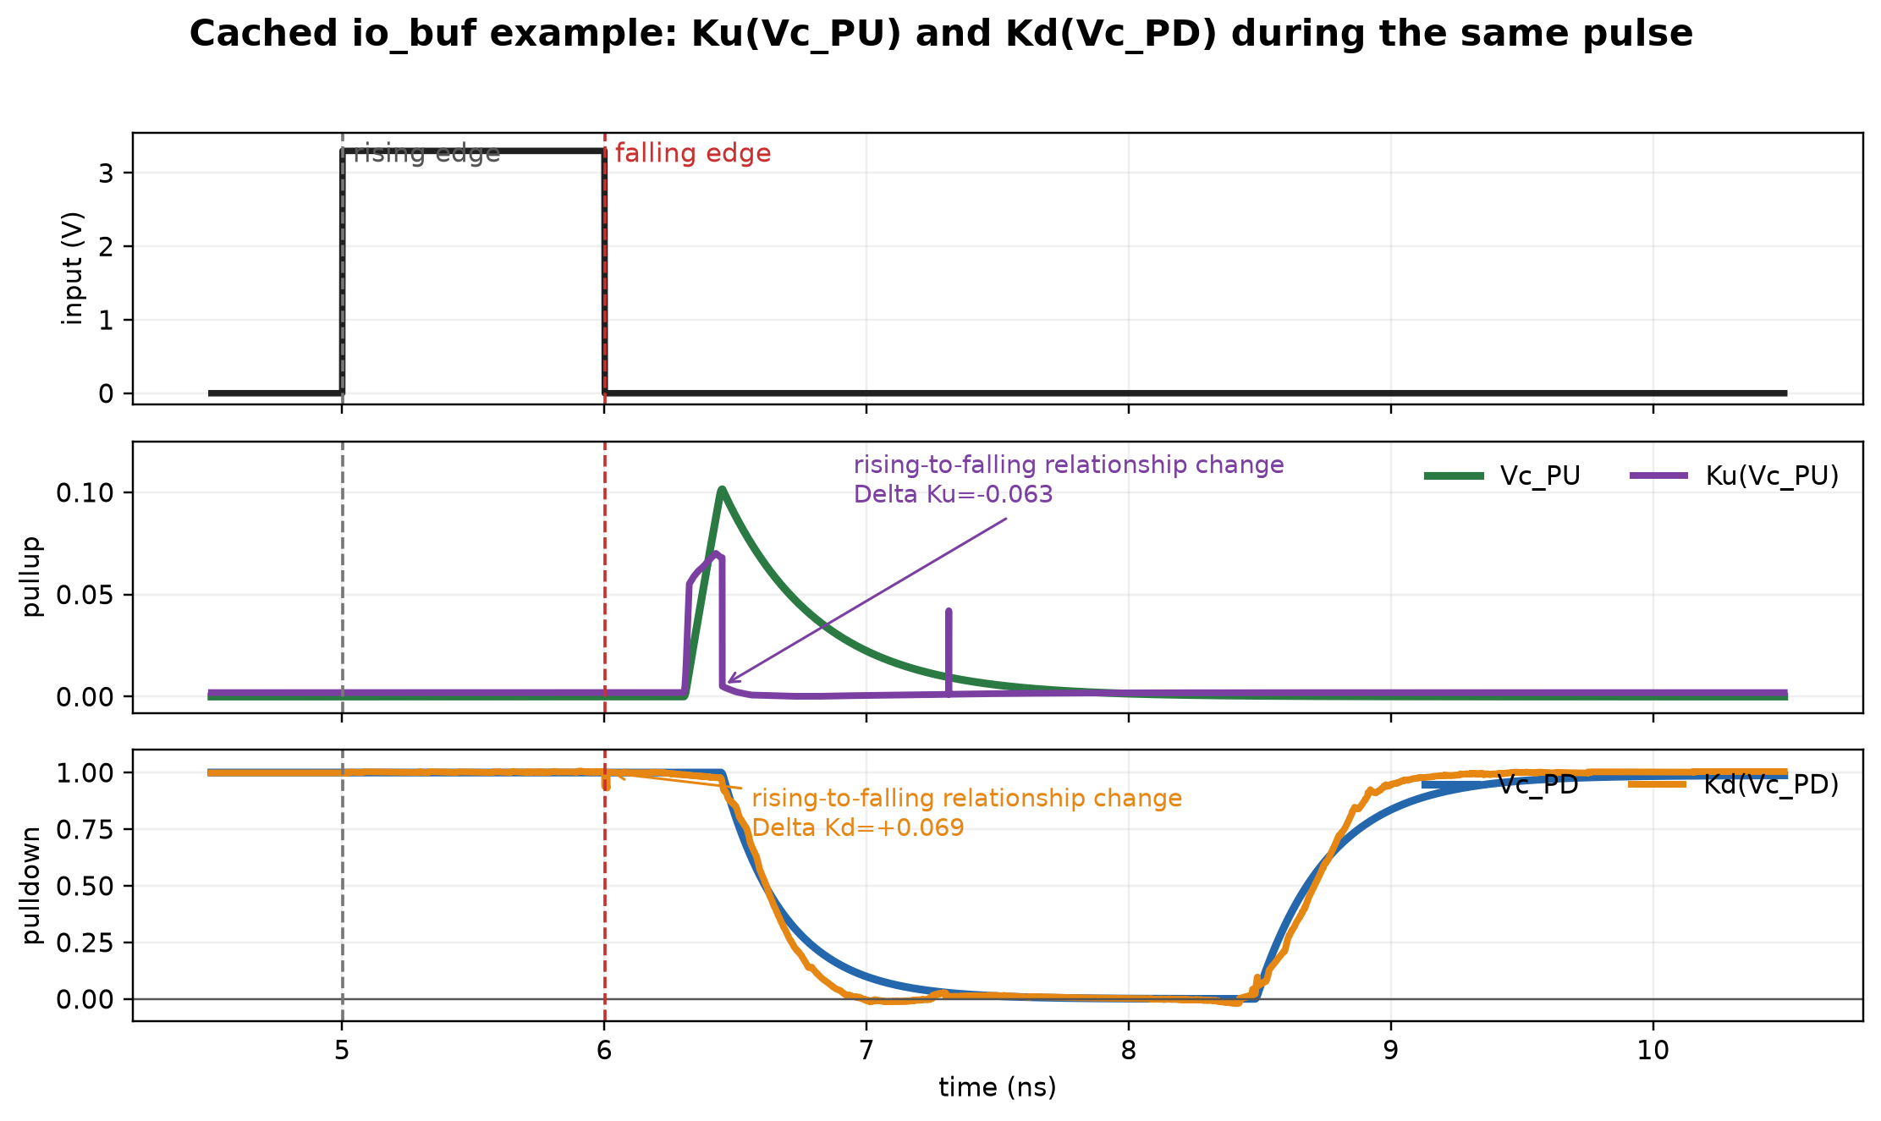
12. Cached io_buf example: Ku(Vc_PU) and Kd(Vc_PD)
WAVEFORMS
Continuous Vc fixes the starting coordinate; the rising/falling Ku/Kd relationships still need compatible values.
Underlying samples: results/ibis_kukd_handwritten_notes_deck/strict_vc_real_example_waveforms.csv
Notes:
This is the coefficient result of using the capacitor voltages as lookup coordinates. The capacitor voltages are continuous, but changing between the rising and falling relationships still produces sharp coefficient changes in the present implementation. The measured adjacent-sample changes are annotated. This directly motivates the first next-step question in the handwritten notes.

Slide 14
13. Ku(Vc_PU) and Kd(Vc_PD) still control the IBIS V-I tables
IBIS
Input history
Vc_PU / Vc_PD
Ku(Vc_PU) / Kd(Vc_PD)
IBIS V-I current
The original pullup and pulldown V-I tables are unchanged.
Only the Ku/Kd lookup coordinate changes; the IBIS current structure remains the same.
Source: handwritten notes, IBIS kukd .pdf (2026-07-22)
Notes:
The final handwritten statement is that Ku and Kd retain their normal role in the IBIS current calculation. The difference is only how their values are selected: from Vc_PU and Vc_PD rather than directly from elapsed time.

Slide 15
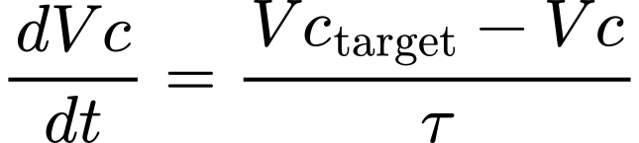
14. SPICE-equivalent realization using the handwritten Vc notation
IMPLEMENTATION
* Pullup capacitor voltage
CVCPU VCPU 0 1p ic=0
BVCPU VCPU 0 I=-1p*(V(VCPUTARGET)-V(VCPU))/tau_selected
* Pulldown capacitor voltage
CVCPD VCPD 0 1p ic=1
BVCPD VCPD 0 I=-1p*(V(VCPDTARGET)-V(VCPD))/tau_selected
CVCPU and CVCPD store the two Vc values.
The ngspice solver integrates Vc at every timestep.
Vc is stored as capacitor voltage and carried continuously through a change in direction.
Notation-matched SPICE realization of the handwritten equations
Notes:
This slide expresses the capacitor-voltage equations in SPICE syntax while retaining the handwritten Vc names. Each capacitor stores one voltage. Each behavioral current source makes that voltage approach its target according to the selected tau.

Slide 16
15. Next steps recorded in the handwritten notes
NEXT STEPS
Main model question
Reference and circuit checks
Only use Vc to track the Ku/Kd starting point when an edge arrives mid-transition?
- Investigate why the HSPICE result looks unusual.
- Check termination capacitance from about 1 fF to 10 pF; account for driver strength.
- Use ADS to create a SPICE buffer.
- Talk to Jianchuan about the inverter model.
These are open questions from the notes.
The next experiment should test Vc as a starting-point coordinate before expanding its role.
Transcribed from handwritten source, page 3
Notes:
The notes end with five next steps. First, test whether Vc should only locate the correct starting point for Ku/Kd when an edge arrives in the middle. Then investigate the unusual HSPICE result, check termination capacitance from about 1 fF to 10 pF with driver-strength dependence, create a SPICE buffer using ADS, and talk to Jianchuan about the inverter model.

Slide 17
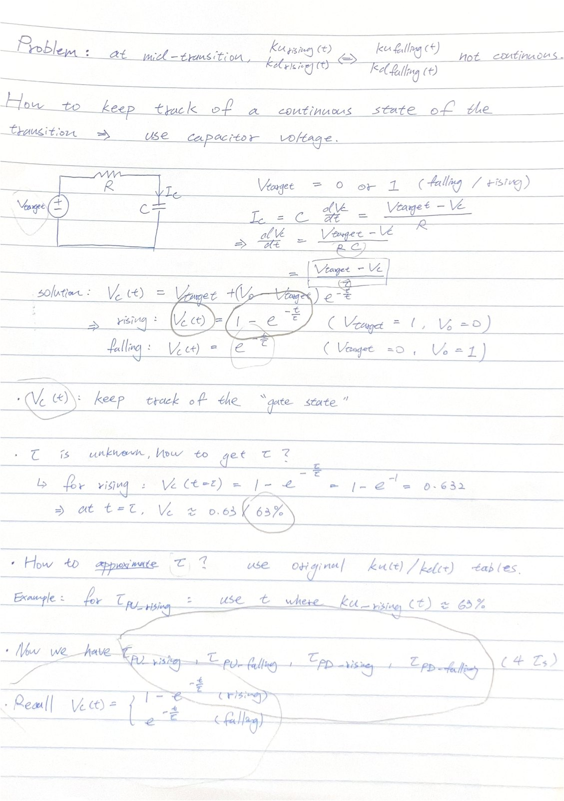
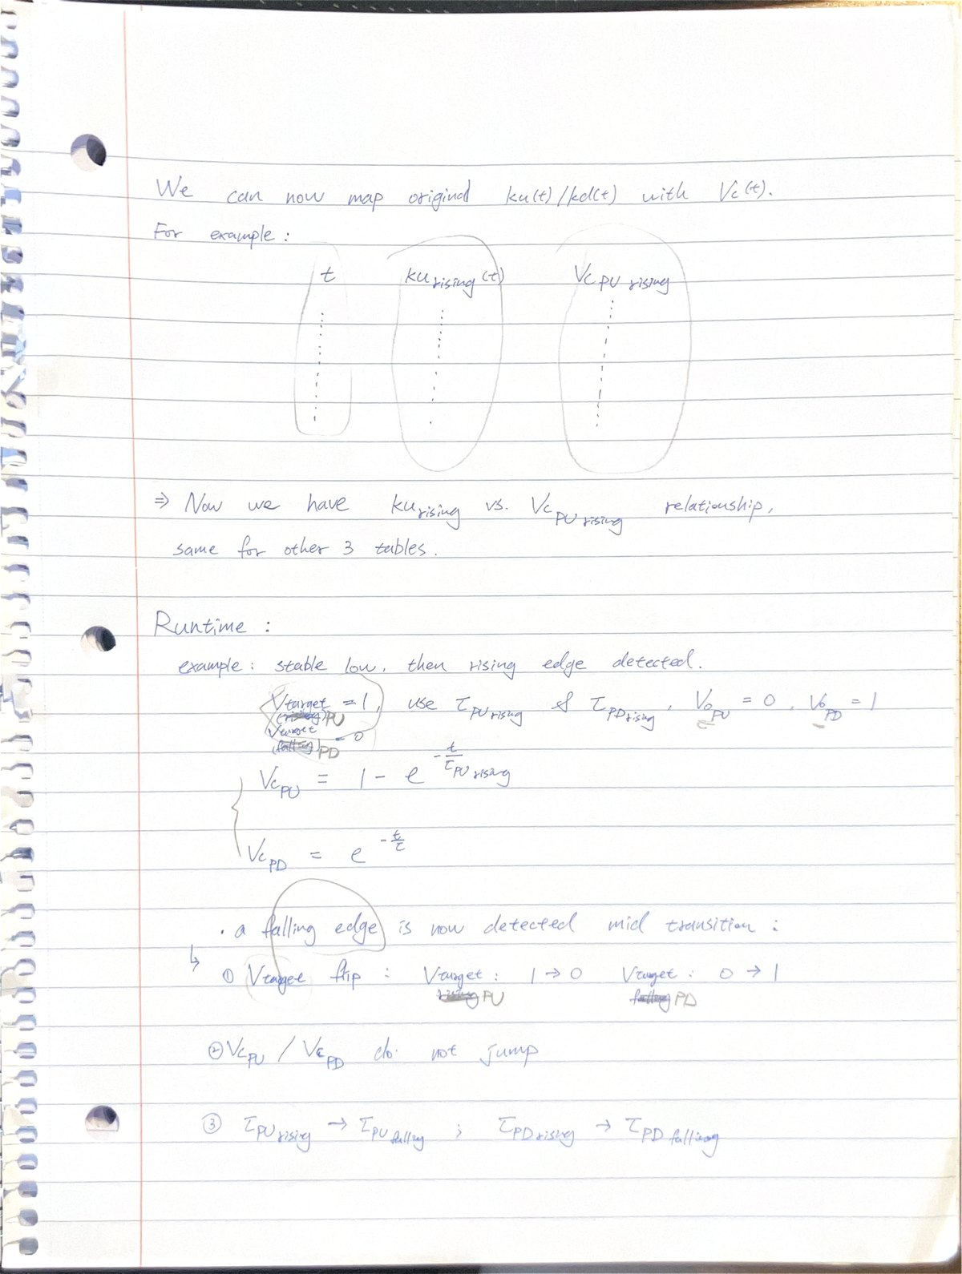
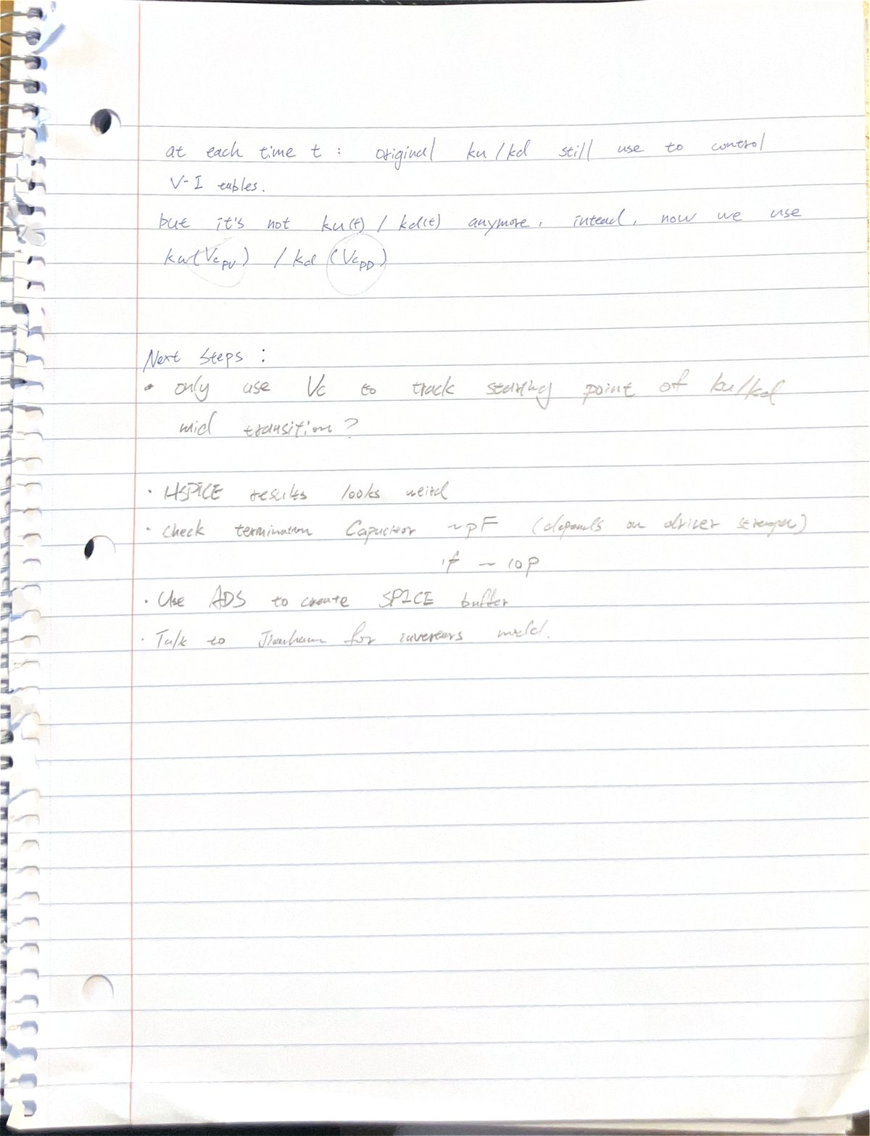
Appendix: original handwritten source
SOURCE
Page 1
Page 2
Page 3
Original PDF: \\minerfiles.mst.edu\dfs\users\sh3qm\Downloads\IBIS kukd .pdf
Notes:
These are the three handwritten pages used as the vocabulary and sequence for this strict version.

