Slide 1

Invoice-six
Enterprise Retail & Strategic Inventory System
BSc (Hons) Artificial Intelligence — Level 5 | Group Project | Group 5
The British College | University of west of England

Slide 2
OUR TEAM
Meet the Team Behind INVO6
Sachin Maharjan
Simona Kattel
Aayushma Dhakal
Scrum Master &
Backend Developer
Product Owner &
Frontend Lead
Mobile Developer &
Database Architect
Complete Finisher
Coordinator
Specialist
ID: 24036543
ID: 24030159
ID: 24030146
Abhinav Sitaula
Bardan Thapa
Pradip Yadav
IoT Engineer &
Systems Integrator
UI/UX Designer &
QA Engineer
AI/ML Engineer &
DevOps Lead
Resource Investigator
Plant
Shaper
ID: 23085179
ID: 23085198
ID: 24036544
Module: Group Project — Level 5 | Intake: September

Slide 3






WHAT WE SET OUT TO ACHIEVE
Project Objectives
Smart Billing
Inventory Intelligence
Sales Forecasting
IoT barcode scanning with real-time ESP32 + MQTT pipeline eliminating manual entry errors.
Automated stock tracking with low-stock alerts and demand-driven restocking suggestions.
Scikit-learn regression models trained on historical data with RMSE target below 15%.
AI Chatbot (RAG)
Business Analytics
Security & Access
Context-aware assistant for shopkeepers and customers via semantic embeddings & LLM API.
Real-time dashboards with WebSocket updates — sales trends, inventory and revenue insights.
JWT auth, bcrypt hashing, Email OTP 2FA, and role-based access control across all roles.

Slide 4
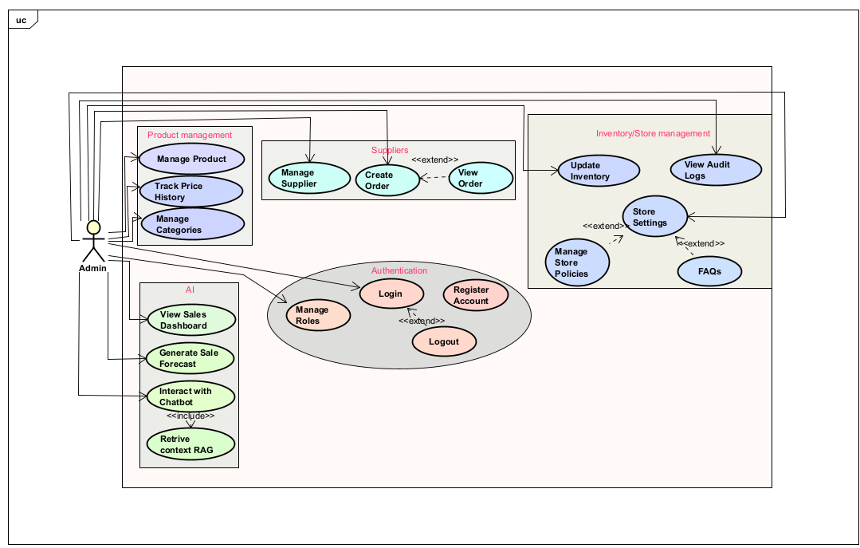
ADMIN CAPABILITIES
ADMIN
Admin Dashboard & Management
Sachin
Maharjan
Inventory Management
Full CRUD operations on products add, edit, delete, categorize stock with real-time level visibility.
Scrum Master &
Backend Developer
Analytics & Reports
Admin-facing system has inventory, analytics, reporting, user management, and backend APIs.
Sales trend charts, revenue summaries, top-selling products, and peak hour analysis via dashboard.
User & Role Management
Create and manage cashier accounts with role-based access control ensuring operational separation.
Billing & Transactions
Review all transaction records, generate invoices, and oversee billing integrity across sessions.

Slide 5
ADMIN — TECHNOLOGY STACK
How the Admin System is Built
BACKEND
DATABASE
FastAPI (Python)
MySQL
High-performance async REST API framework. Chosen for speed, automatic OpenAPI docs, and native Python AI integration.
Relational schema with indexed tables for Users, Products, Transactions, Inventory, and Audit Logs ensuring ACID compliance.
AUTHENTICATION
REAL-TIME
JWT + bcrypt + OTP
WebSocket
Stateless tokens with bcrypt password hashing and Email OTP two-factor authentication for shopkeeper logins.
Pushes live dashboard updates to admin clients without polling — instant inventory and transaction visibility.
FRONTEND
ANALYTICS AI
React.js
Scikit-learn
Component-based web dashboard with Tailwind styling, chart visualizations, and responsive admin UI.
Supervised regression for sales forecasting trained on historical transactions, targeting sub-15% RMSE error.

Slide 6
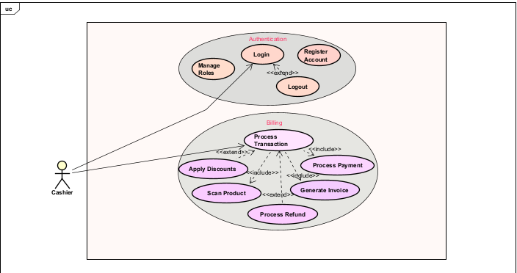
CASHIER CAPABILITIES
CASHIER
Smart Billing & IoT Integration
Aayushma
Dhakal
Barcode Scanning Workflow
ESP32 + barcode scanner captures product codes and publishes via MQTT to backend — instant billing trigger.
Mobile Developer &
Database Architect
Real-Time Inventory Update
Each successful scan deducts stock automatically, keeping inventory synchronized across the system.
Cashier does billing workflow, IoT scanner integration, database schema, and mobile-backend communication.
Invoice Generation
Automatic receipt creation per transaction with product details, quantities, prices, and timestamps.
Product Lookup & Handling
Cashier can search, add, and verify products manually when the scanner workflow requires override.

Slide 7
CASHIER — TECHNOLOGY STACK
IoT Billing Pipeline
BARCODE
SCANNER
ESP32
MICROCONTROLLER
MQTT
PROTOCOL
FastAPI
BACKEND
MySQL
DATABASE
›
›
›
›
IOT HARDWARE
COMMUNICATION
ESP32 + Barcode Scanner
MQTT Protocol
ESP32 microcontroller reads 1D/QR barcodes and sends data over Wi-Fi — cost-effective hardware at ~NPR 5,500 total.
Lightweight publish-subscribe protocol ideal for IoT. Delivers scan events reliably with minimal network overhead.
BACKEND
DATABASE
FastAPI MQTT Subscriber
MySQL — Relational Schema
Backend subscribes to MQTT topics and processes each scan event — updating billing session and inventory in real-time.
Transactions, TransactionItems, Inventory tables maintain consistency with foreign key constraints and indexed queries.
SECURITY
FRONTEND
Static Device ID + TLS
React.js Cashier View
Each ESP32 device has a dedicated MQTT username/password with a static device ID embedded in every payload.
Responsive cashier interface displays live scan results, current bill, and allows manual product additions.

Slide 8
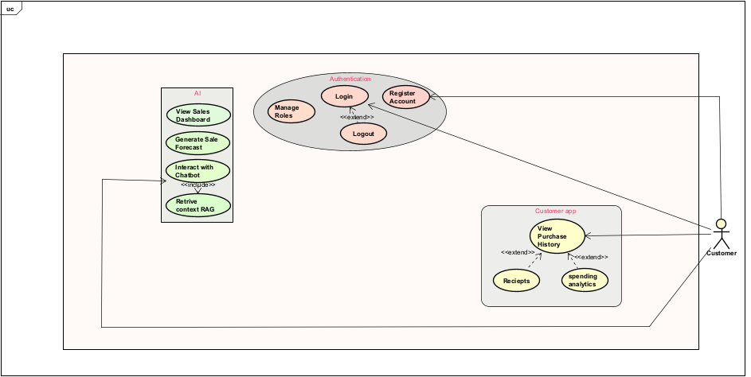
CUSTOMER CAPABILITIES
CUSTOMER
Customer Mobile Experience
Bardan
Thapa
Secure Registration & Login
Customers register and authenticate on the mobile app with secure credentials and purchase history access.
UI/UX Designer &
QA Engineer
Purchase History & Receipts
customer-facing mobile experience has AI chatbot, offers and deals , analytics , purchase history, and QA.
Digital receipts and full purchase history visible per session — replacing paper-based records.
Spending Analytics
Visual spending summaries and category breakdowns give customers insight into their buying habits.
AI Assistant (RAG Chatbot)
Context-aware chatbot answers queries about products, store info, and recommendations using LLM + embeddings.

Slide 9
CUSTOMER — TECHNOLOGY STACK
Mobile App & AI Intelligence
MOBILE FRONTEND
AUTHENTICATION
React Native
JWT + bcrypt
Cross-platform mobile app (iOS & Android) sharing a unified codebase — consistent UX with native performance.
Customers log in with hashed credentials and receive a JWT token for session management across mobile requests.
AI CHATBOT
EMBEDDING MODEL
RAG + LLM API
Sentence Transformers
Retrieval-Augmented Generation chatbot converts store data into vector embeddings (FAISS) for semantic search.
Pre-trained sentence embedding models encode product descriptions and FAQs into vector space for context retrieval.
BACKEND API
AI MICROSERVICE
FastAPI REST Endpoints
Python + FAISS
Mobile app communicates via REST to the FastAPI backend for auth, purchase history, analytics, and chatbot queries.
Containerized Python microservice handles all AI tasks (forecasting, RAG, embeddings) isolated from core backend.

Slide 10
PROJECT MANAGEMENT
The Journey of Building INVO6
Phase 1 — Initiation
Project Title Approval
Group 5 proposed "Enterprise Retail & Strategic Inventory System" — approved by The British College.
Risk Register
Risks identified: Hardware failure, data security, schedule overrun, integration issues — all with mitigation plans.
Team Contract
Agreed team norms, communication protocols, conflict resolution, and contribution expectations.
Project Charter
Defined scope, objectives, roles, budget (~NPR 6,000 hardware), and 12-week delivery timeline

Slide 11
PROJECT MANAGEMENT
Phase 2 — Planning
Skill Audit
Each member mapped technical skills — identifying strengths and gaps to allocate responsibilities optimally.
Belbin Team Analysis
Roles mapped: Coordinator · Plant · Shaper · Specialist · Resource Investigator · Complete Finisher.
Requirement Catalogue
Structured functional requirements across 8 categories: Inventory · Billing · AI · IoT · Auth · Customer · Admin · Non-functional.
Collaboration Tools
Jira— Sprint Tracking
Trello — Task Boards
Discord — Team Communication
GitHub — Version Control
Figma — UI Design

Slide 12
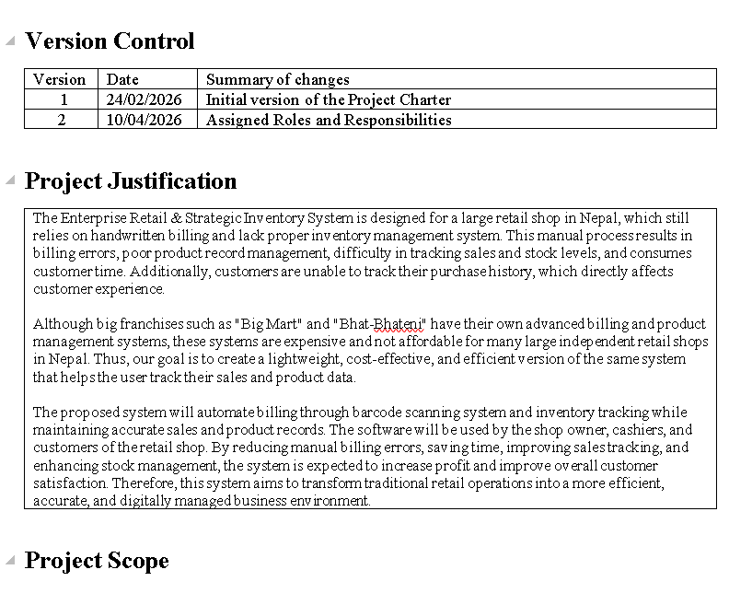
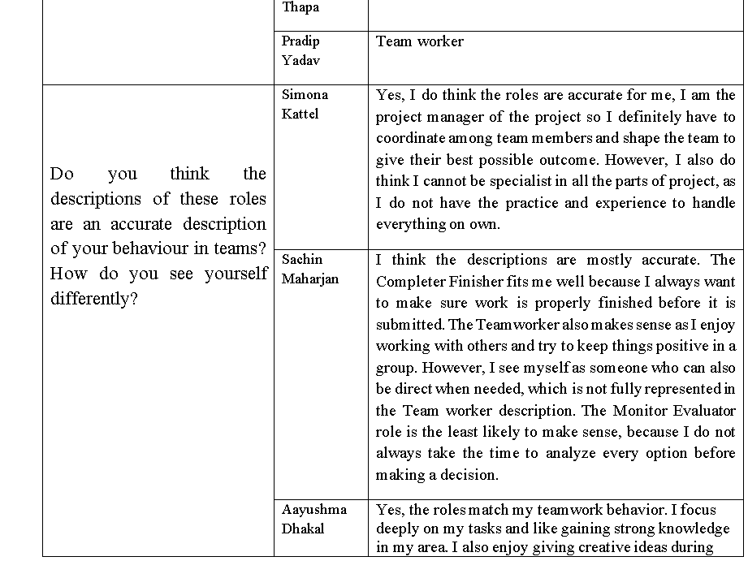
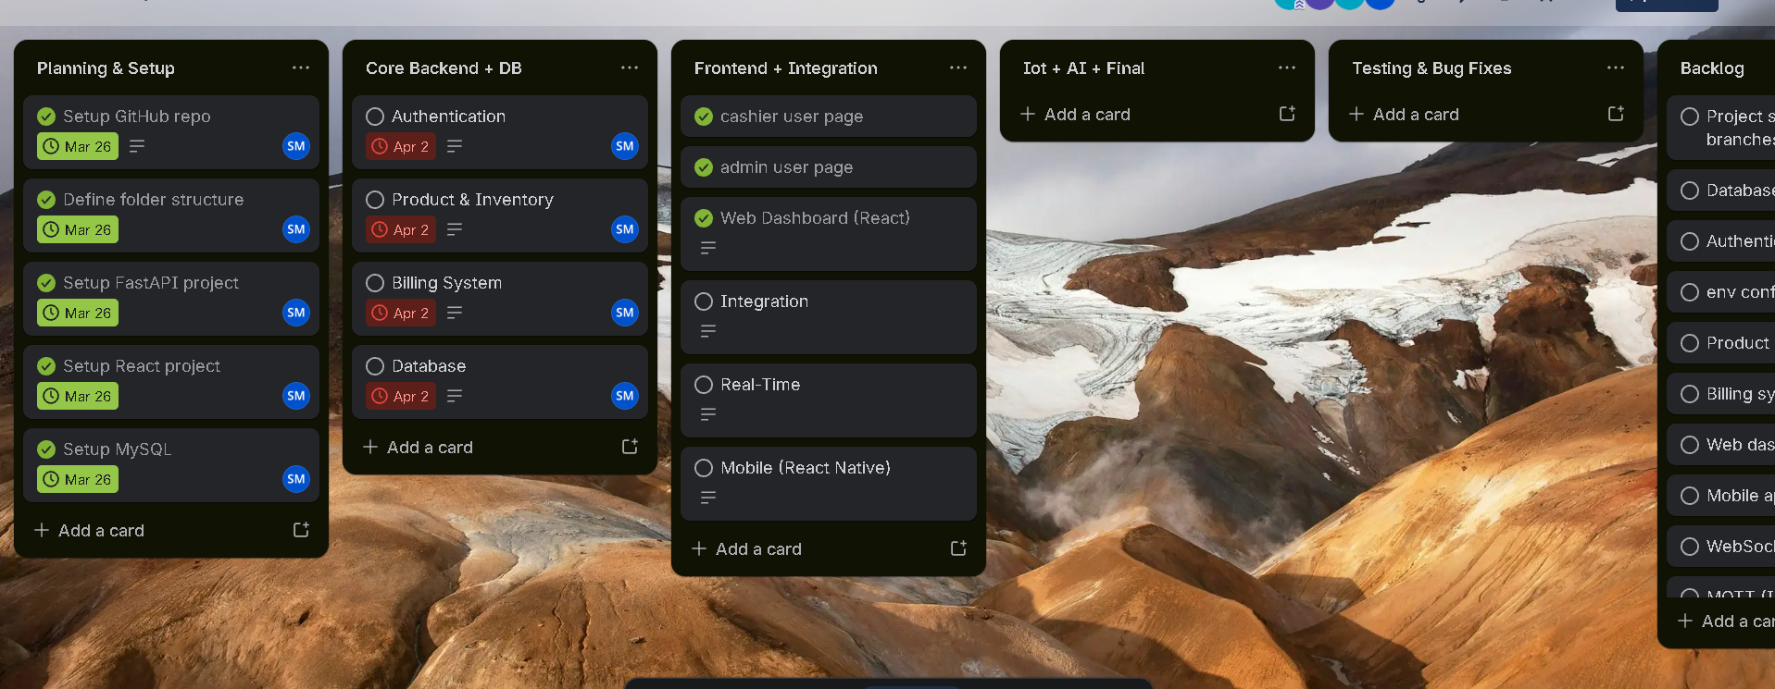
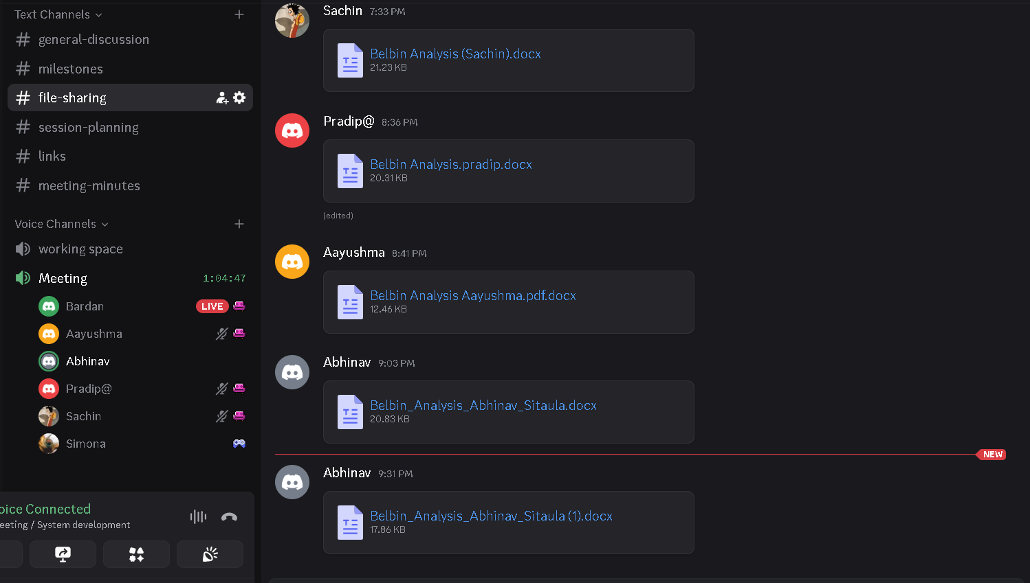
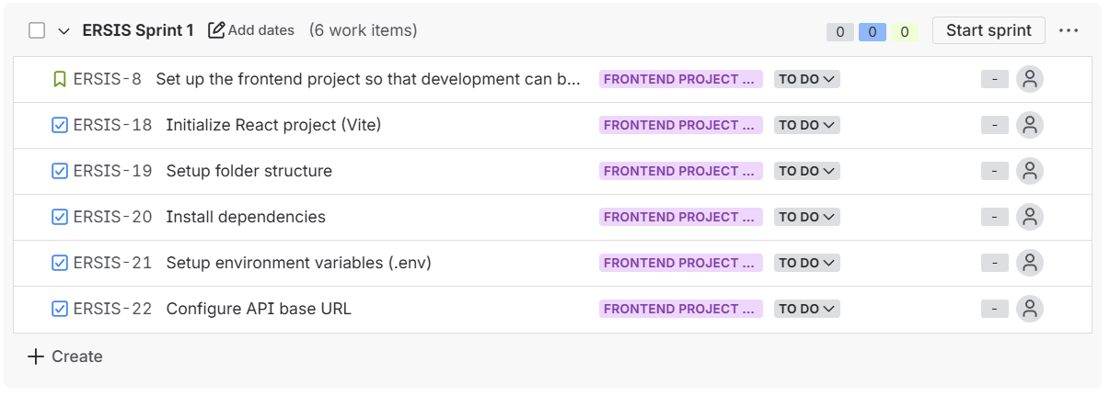
Evidence of Initiation and Planning phase

Slide 13
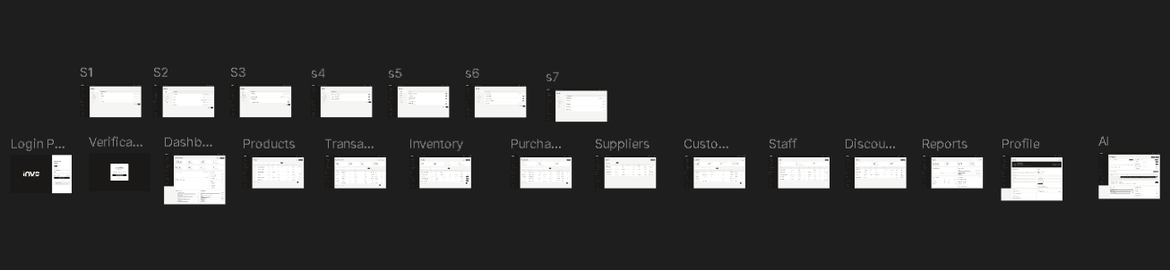
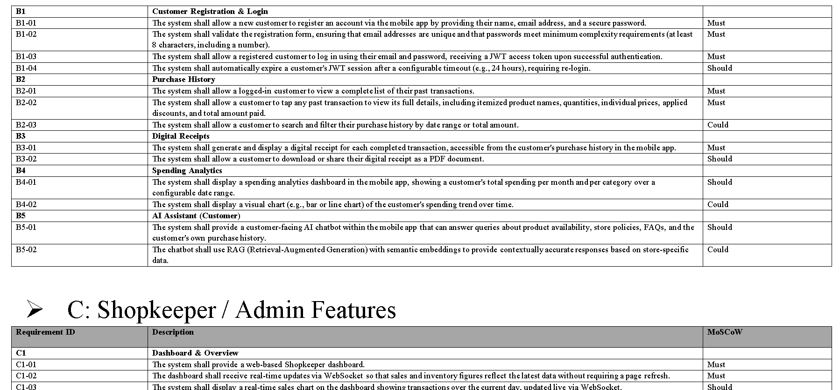
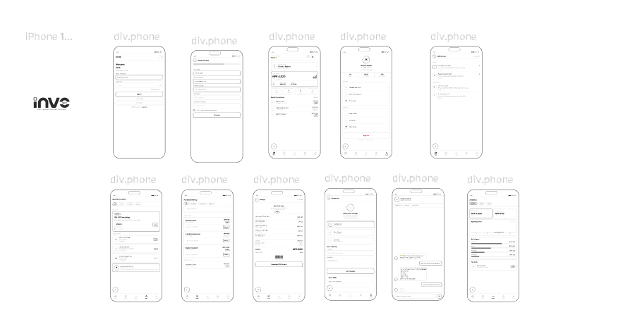
EXECUTING PHASE DIAGRAMS
Wireframes & Requirement catalogue
UI Wireframes (Figma)
Requirement catalogue
Admin Dashboard · Cashier Billing · Customer Mobile — designed in Figma before development.
functional and non-functional requirements across 8 categories: Product & Inventory Management, Customer Features, Admin Features, Billing , IoT Integration, Authentication & Security, and Store Administration.
[ Insert Wireframes Here ]
[ Insert Use Case Diagram Here ]

Slide 14
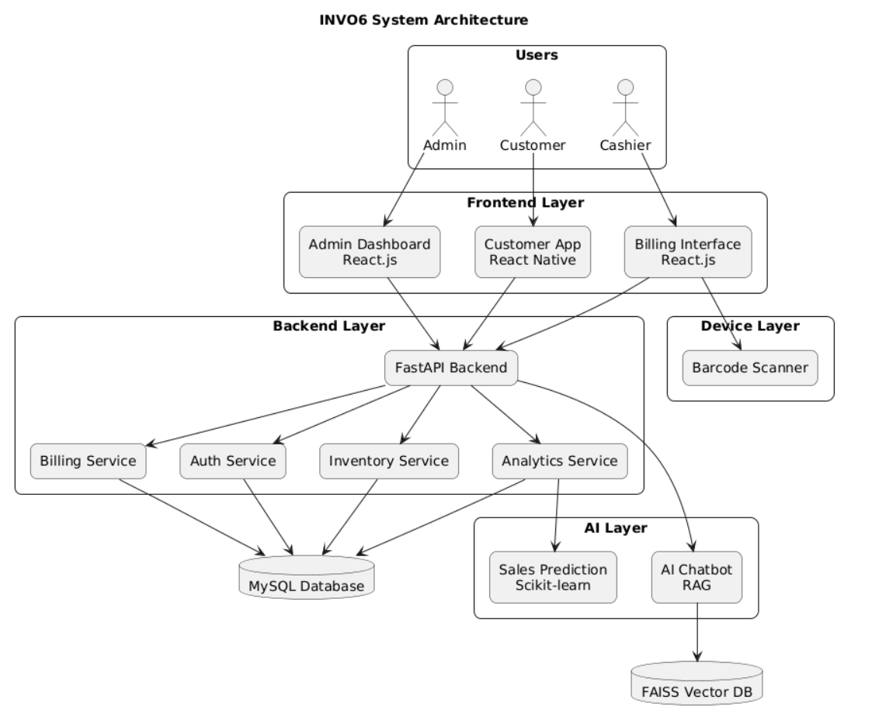
DIAGRAMS
System Architecture Diagram
Modular monolithic architecture — FastAPI central layer connecting IoT, Web, Mobile, AI, and Database services.
[ Insert System Architecture Diagram Here ]

Slide 15
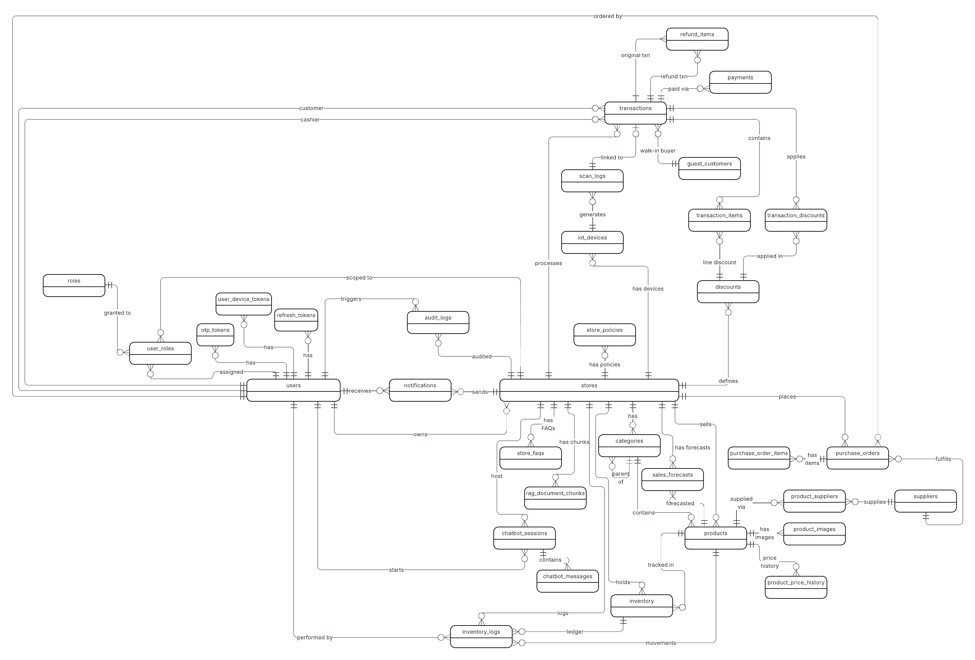
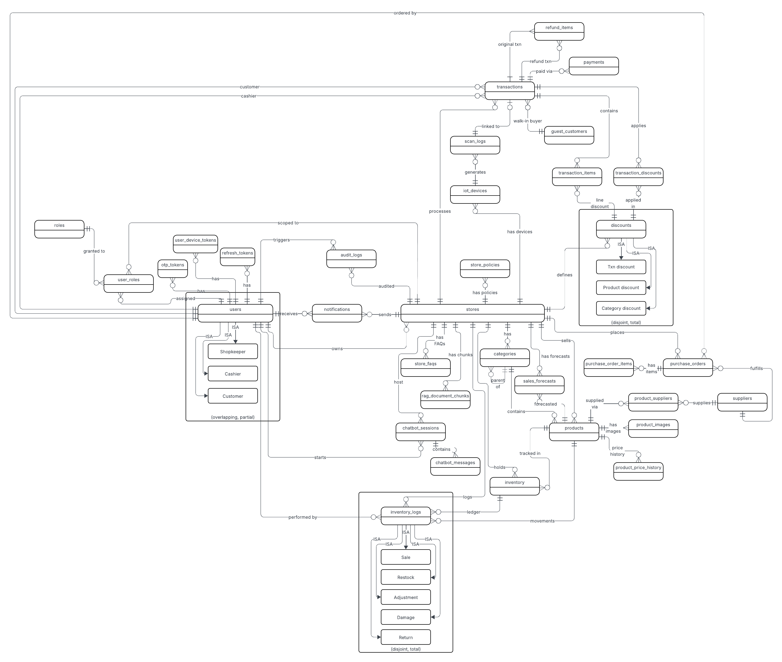
DIAGRAMS
Database Design
Entity Relationship Diagram (ERD)
Enhanced ERD (EERD)
Core tables: Users · Products · Transactions · TransactionItems · Inventory · AuditLogs
Inheritance and specialization layers showing role-based user subtypes and product hierarchy.
[ Insert ERD Here ]
[ Insert EERD Here ]

Slide 16
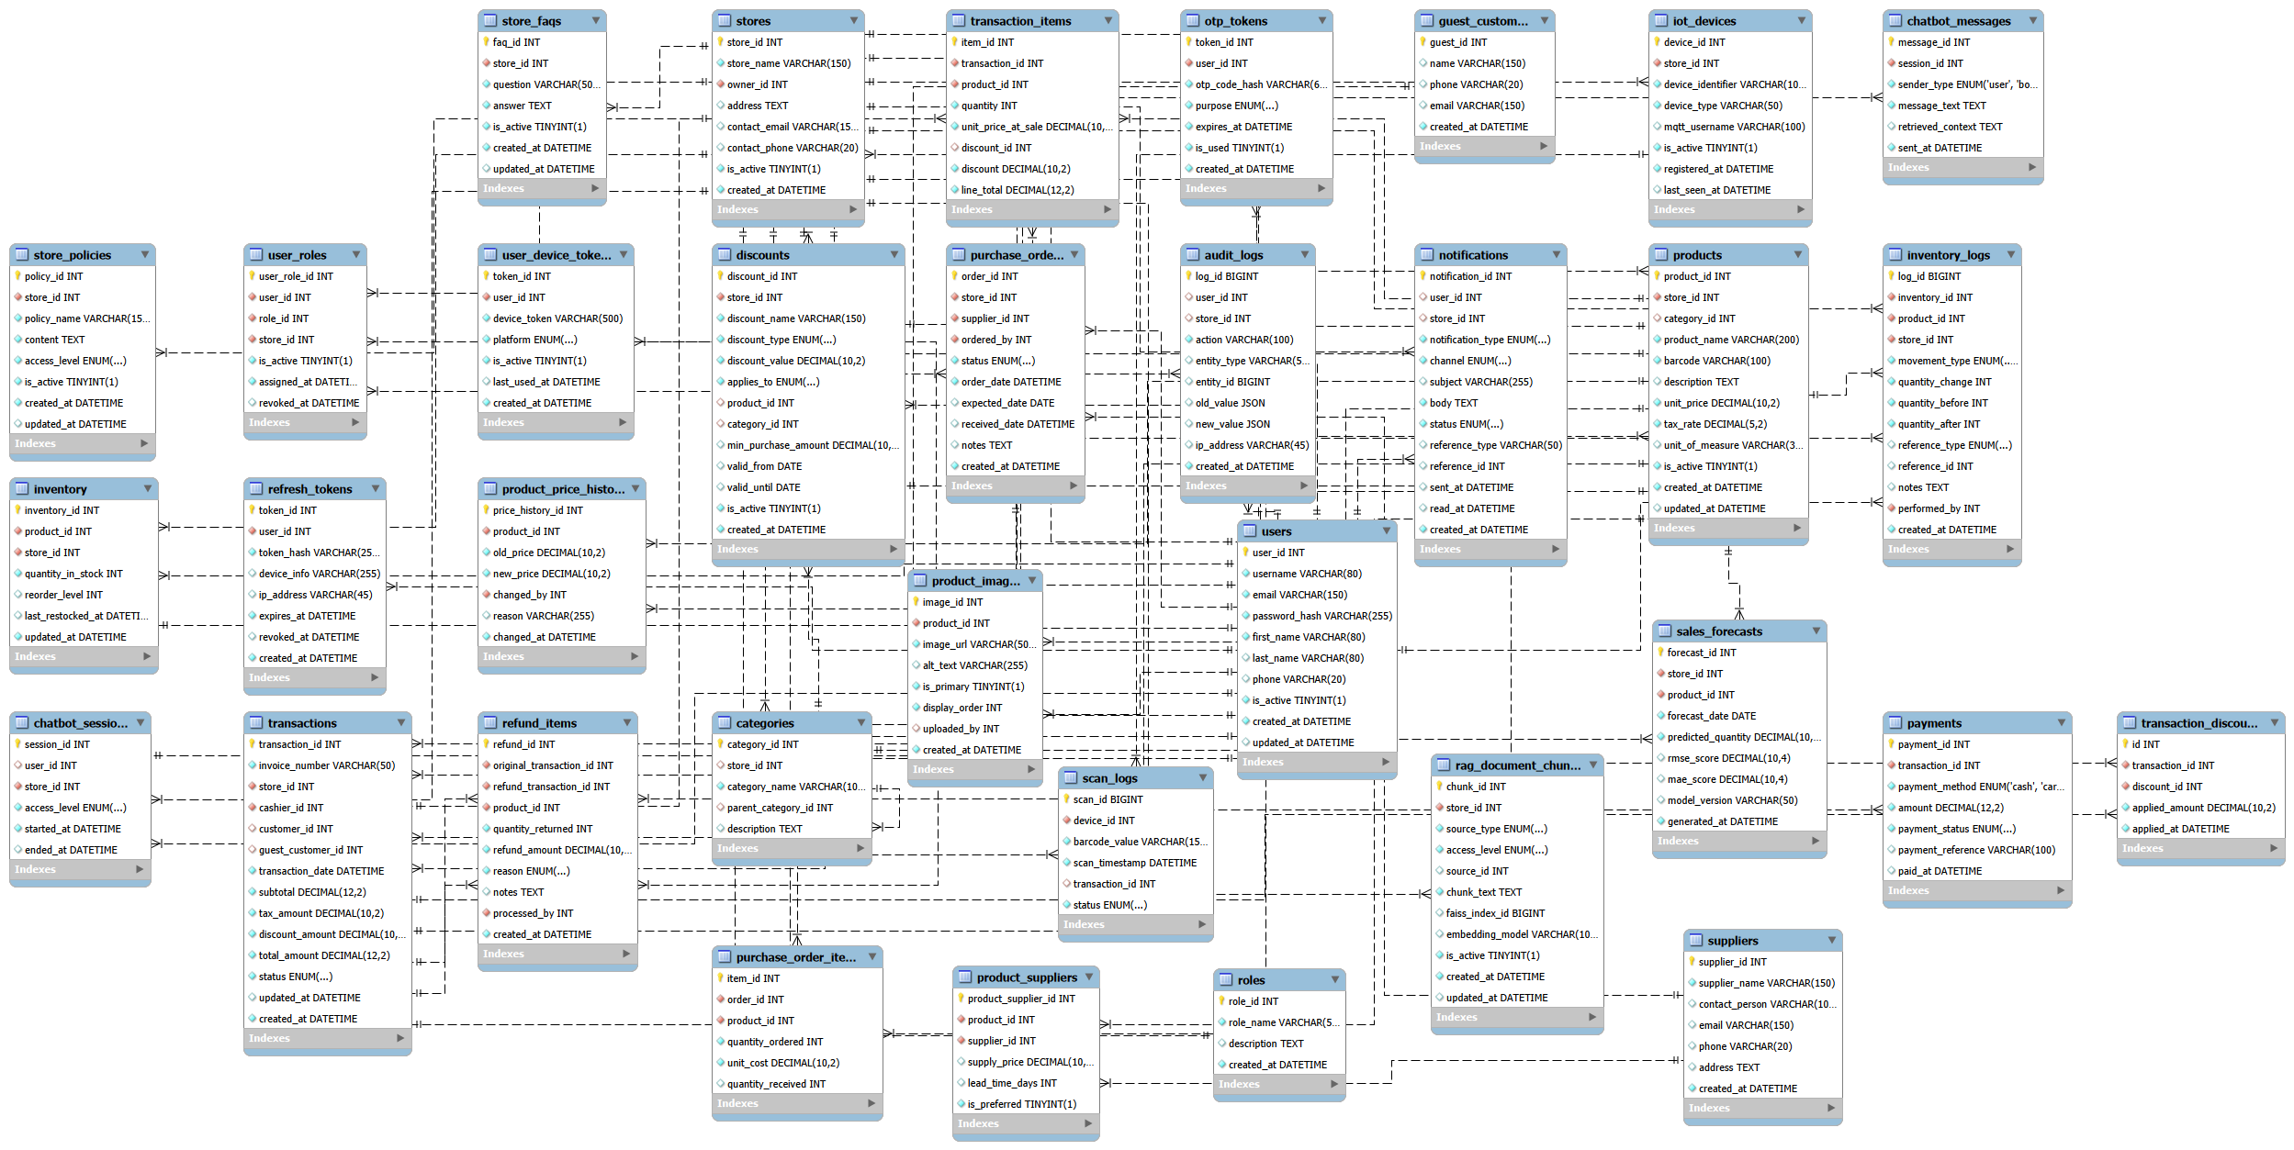
DIAGRAMS
Structural Diagram
Decomposition Diagram
Functional decomposition of INVO6 into Admin, Cashier, Customer, AI, and IoT sub-systems.

Slide 17

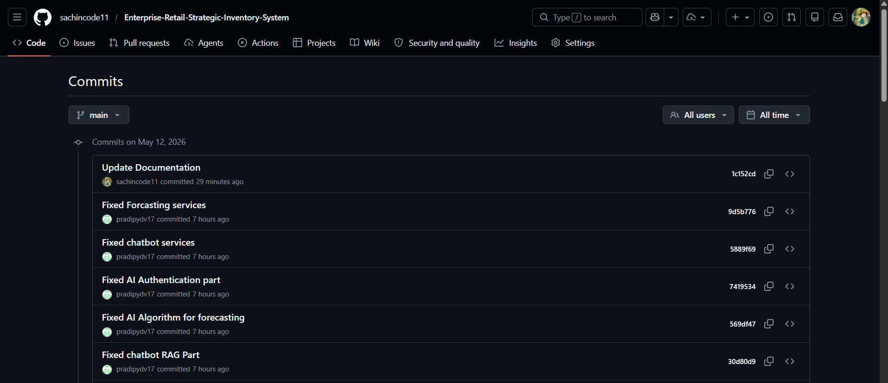
DIAGRAMS
Brand Identity & GitHub
INVO6 Logo & Brand Identity
GitHub Repo
Official logo design representing the enterprise retail identity of INVO6.
GitHub for version Control

Slide 18
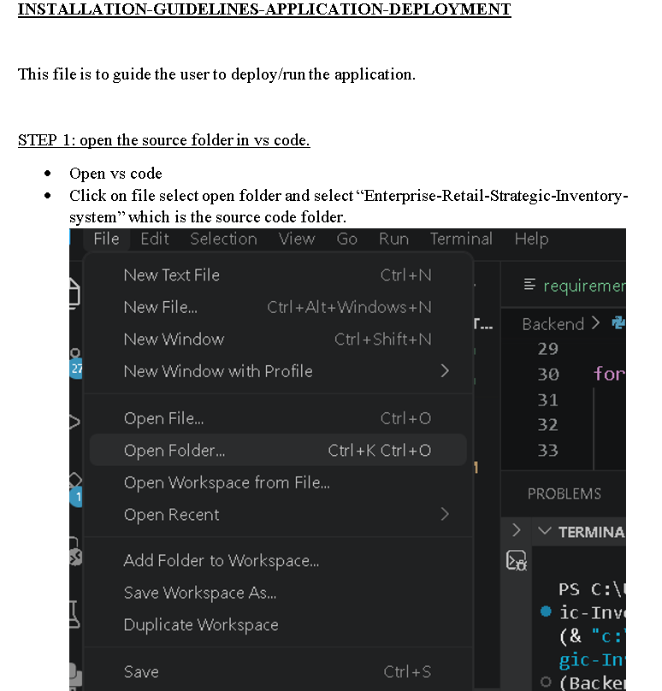
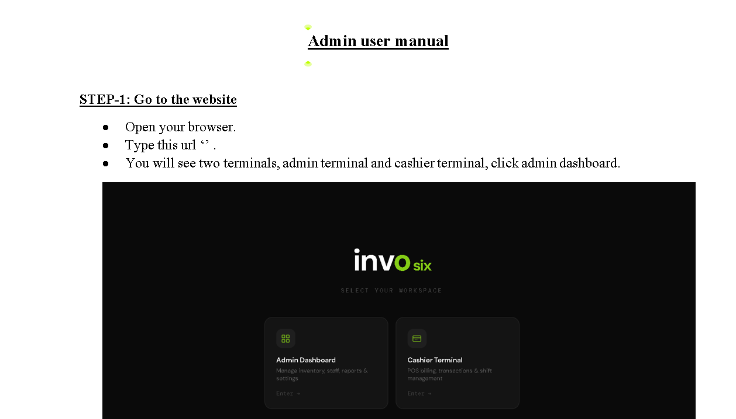
MONITORING And EVALUATION DOCUMENTATION
Installation Guidelines
[ Insert Installation Guide / Docker Setup Screenshot Here ]
[ Insert Final Project Report Cover / Contents Page Here ]

Slide 19
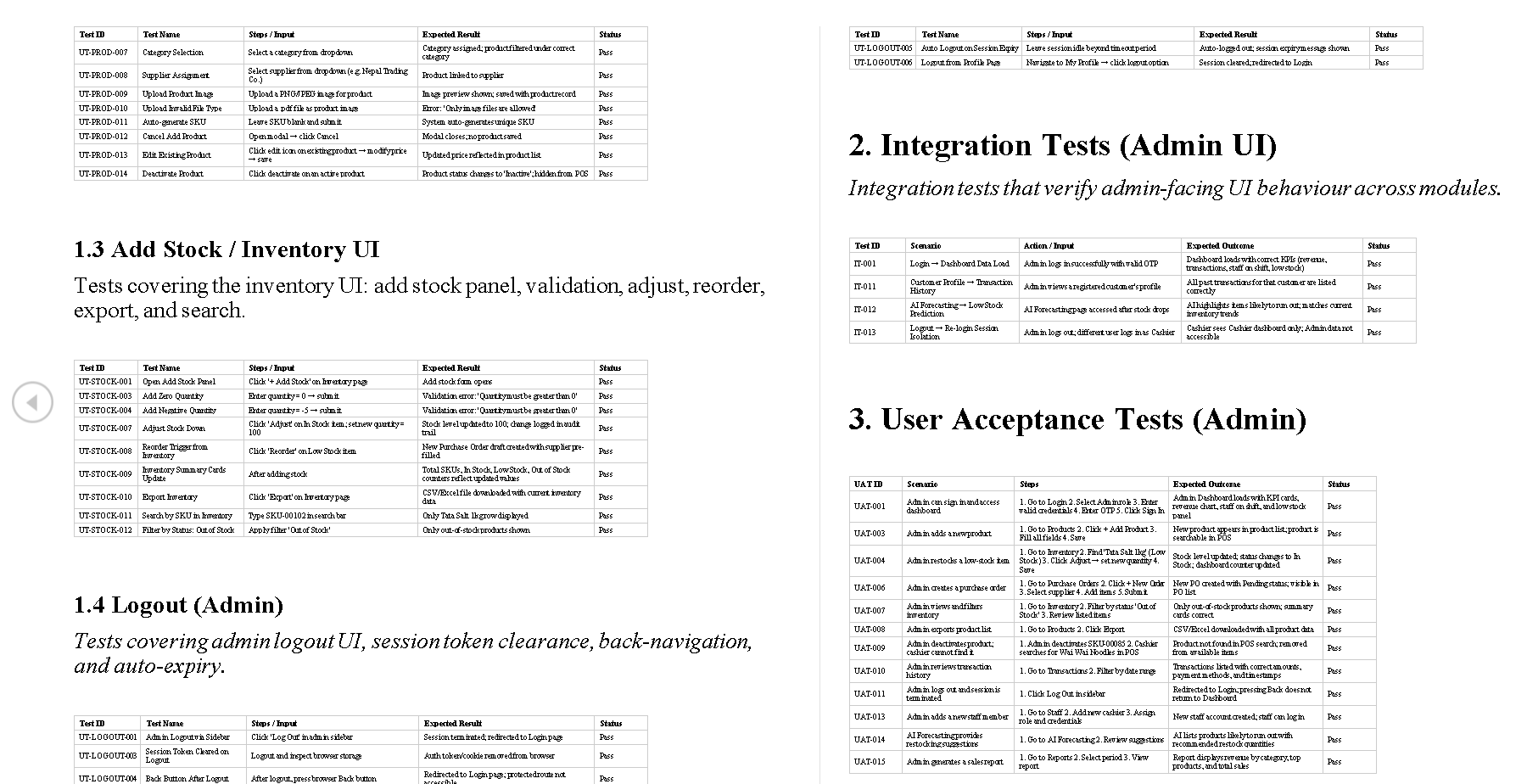
PROJECT MANAGEMENT
Test Cases
Functional and performance test cases.

Slide 20
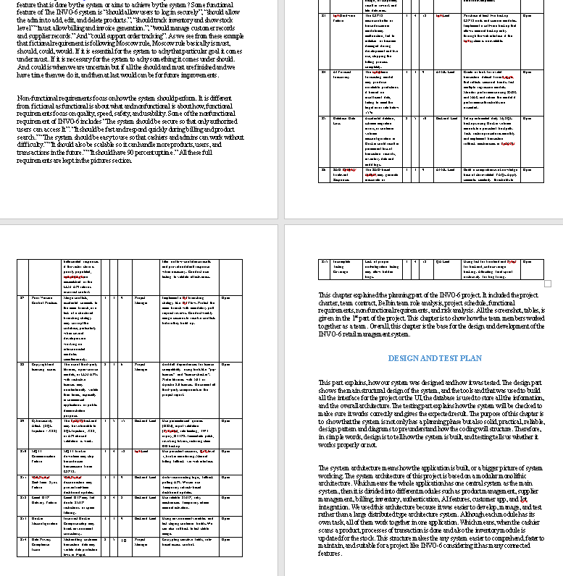
CLOSING DOCUMENTATION
Final Report
[ Insert SRS Document Screenshot Here ]

Slide 21
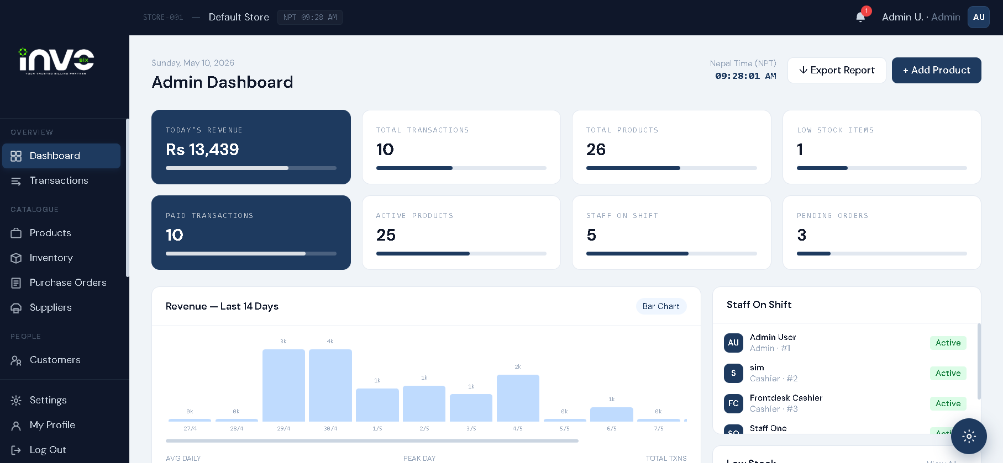
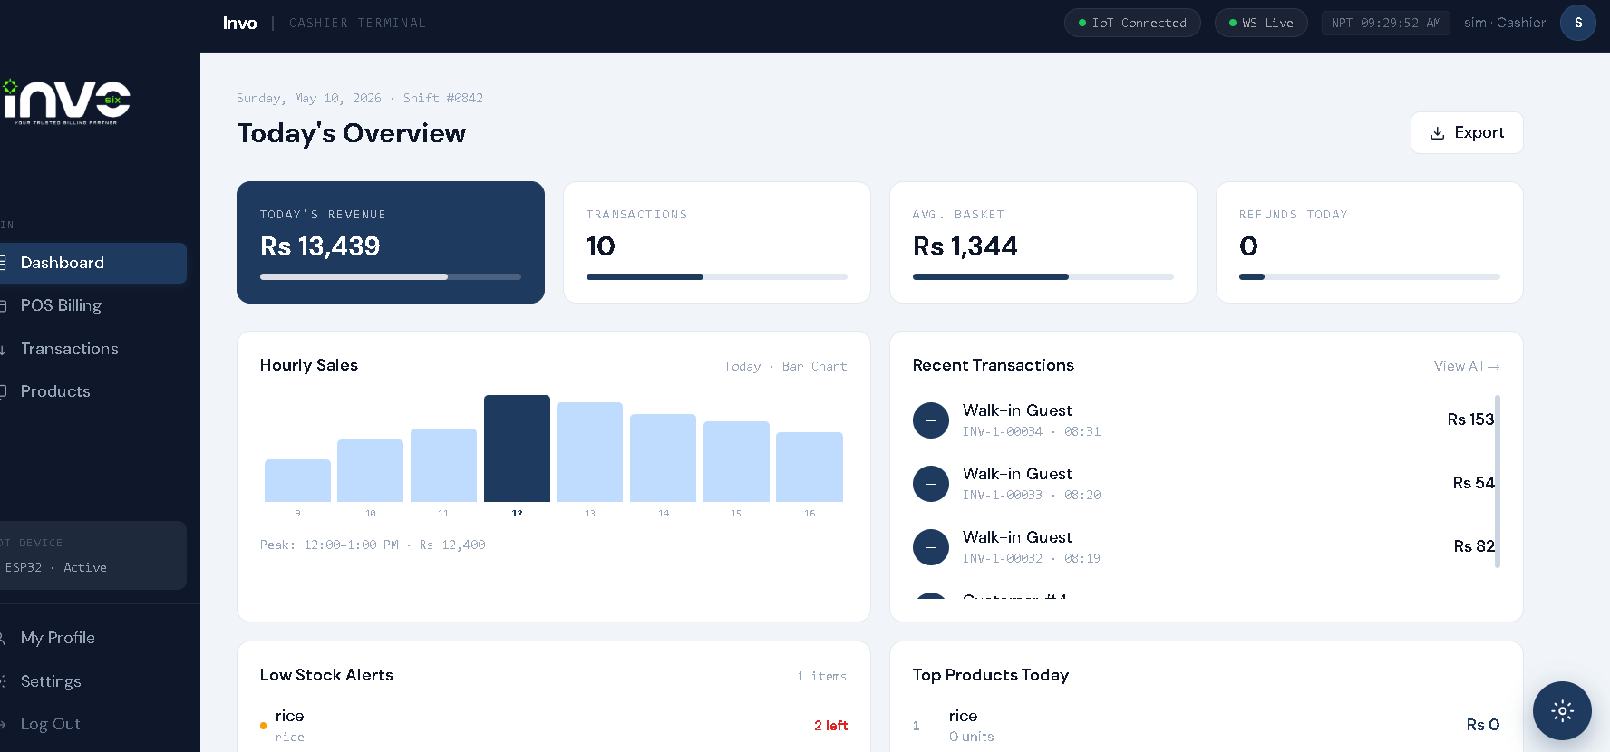
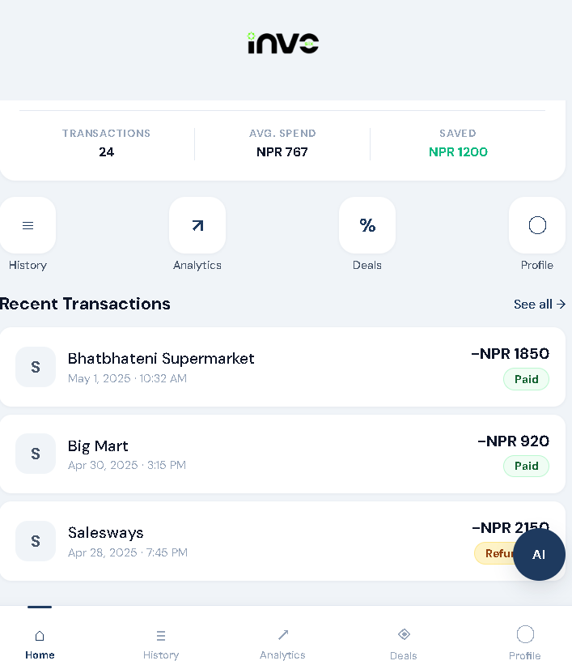
LIVE SYSTEM DEMONSTRATION
System Demo
ADMIN
CASHIER
CUSTOMER
Sachin
Aayushma
Bardan
[ Insert Admin Dashboard Screenshot ]
[ Insert Cashier Billing Screenshot ]
[ Insert Customer Mobile App Screenshot ]

Slide 22
WHAT COMES NEXT
"So… is this the end of INVO6?"
No. This is only the beginning.
Cloud Deployment
Advanced AI Automation
Voice Assistant
Production-grade cloud hosting with high availability and load balancing.
Deeper ML integration buying api for dynamic pricing, demand prediction.
Voice-controlled inventory and billing queries for hands-free operation.
Multi-Branch Support
Expanded IoT
Mobile Enhancements
Centralized management for retail chains with branch-level analytics.
Smart shelf sensors, theft detection.
Push notifications, product browsing , and personalized product recommendations.

Slide 23
Thank You
INVO6 — Enterprise Retail & Strategic Inventory System
Group 5 | BSc (Hons) Artificial Intelligence — Level 5 | The British College
Sachin Maharjan · Simona Kattel · Aayushma Dhakal · Abhinav Sitaula · Bardan Thapa · Pradip Yadav

