Slide 1

Web application testing
www.kfea.ro

Slide 2
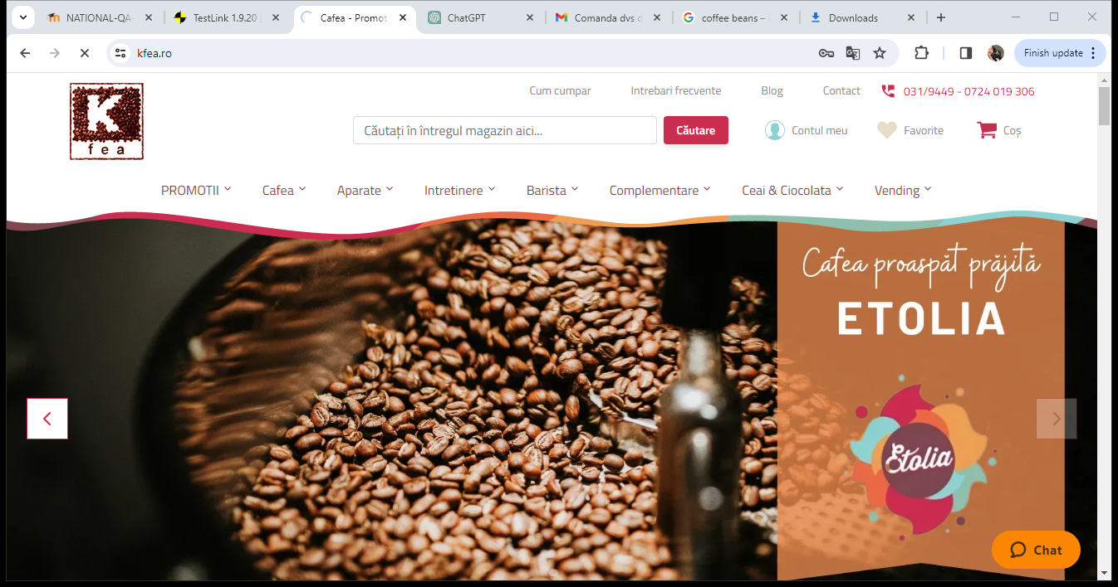
App description: -Web application -Online coffee supplies store

Slide 3

Testing approach
To familiarize with the website,the main testing approach was exploratory testing,along with the smoke tests where I discovered the main functionalities.
Această fotografie de Autor necunoscut este licențiată în condițiile CC BY-SA-NC

Slide 4
The mail tools used
Testlink
Snipping tool
Mantis
Xmind
Online spell checker

Slide 5
Testing types used for Kfea
Exploratory testing
Smoke testing
UI/UX testing
Compatibility testing
Positive testing
Negative testing
Usability testing
End-to-end testing

Slide 6
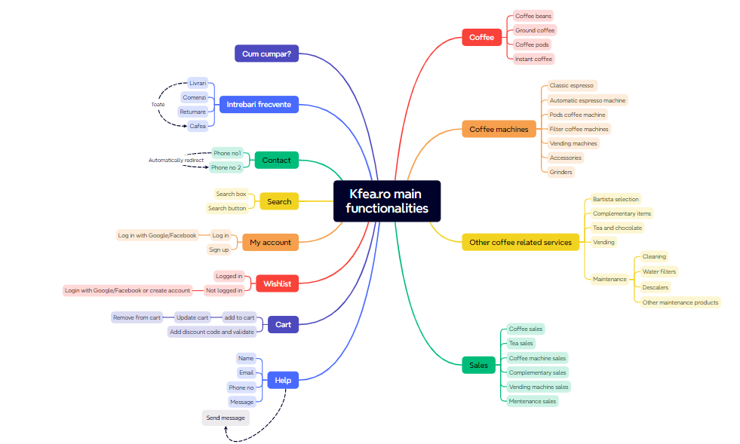

Slide 7
Bugs overview

Slide 8
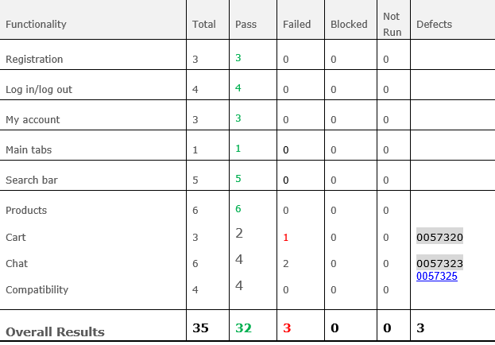
Test cases results

Slide 9
Conclusions
Overall, the chosen website functionalities were very satisfying.
Managing to stay focused on main functionalities, only 35 test cases were created ,which 91% passed and the remaining 9% failed.
The bugs discovered ,only 3, had a normal severity which can get me to the conclusion that they care about their customers ☺

Slide 10
Lessons learnt
Requirements are extremely important as the testers know on what functionalities to focus ,but making a mindmap was helpful too,because I had some starting points to work at.
Exploratory testing remain the most effective method

