Slide 1
Blank Spots, Critical Information Needs and Local Journalism Funding
Author: Simona Bisiani
Examiner: Karl Wennberg
Supervisors: Benjamin Jarvis, Étienne Ollion
Opponent: Jan Sodoge

Slide 2
Two research focuses: 1. Import the Critical Information Needs framework to Sweden
RATIONALE and RESEARCH QUESTION
Local newspapers are disappearing (Abernathy, 2018)
Appearance of news deserts in the US, and blank spots in Sweden (Abernathy, 2018; Nygren & Engelbrecht, 2018)
US launches media ecology assessment, introducing the notion of “Critical Information Needs” (CINs) (Friedland et al, 2012)
There are eight CINs: politics, education, civic information, health, transportation, environment, emergency and economy
Local newspapers are central in fulfilling local communities CINs in the US (Mahone et al, 2019)
Local newspapers are original producers of articles about city halls, court reporting, local corruption, local political and civic life (Mahone et al, 2019; Waldman 2011)
There are empirical differences between blank spots/non-blank spots in Sweden when it comes to amount of news, readership levels, type of news (Nygren & Engelbrecht, 2018; Hellekant Rowe, 2016; Pålsson, 2017; Kekezi & Mellander, 2017)
RQ1: are local newspapers in blank spot municipalities providing articles that fulfill the CINs of their citizenry?

Slide 3
Two research focuses: 2. Measure the effect of state subsidies for local journalism on local journalistic production
RATIONALE
RESEARCH QUESTION and HYPOTHESES
The Swedish government introduces in 2019 lokaljournalistikstödet, a yearly state subsidy to sustain and strengthen local journalism
Obtainable by individual outlets whose application is approved by MPRT
30m SEK distributed in 2019 to 34 publishers across 65 municipalities, increased to 121m SEK and 90 publishers across 181 municipalities in 2020 (Nygren, 2020b)
A survey (Tenor, 2020) shows most municipality officials do not see any changes in the local journalism thanks to the funding, and otherwise we see more noticed positive rather than negative changes
RQ2: how has the newly introduced state funding impacted local journalism’ provision of critical information needs at the publisher and municipality level, and particularly in terms of the type of stories local newspapers have traditionally been associated with, namely civic and political stories?
H1: the allocation of funding will have increased the volume of critical information needs articles in those municipalities within which some publishers have obtained funding, and particularly for those funding-receiving publishers.
H2: the allocation of funding will have increased the overall amount of articles about Civic Information and Politics.

Slide 4
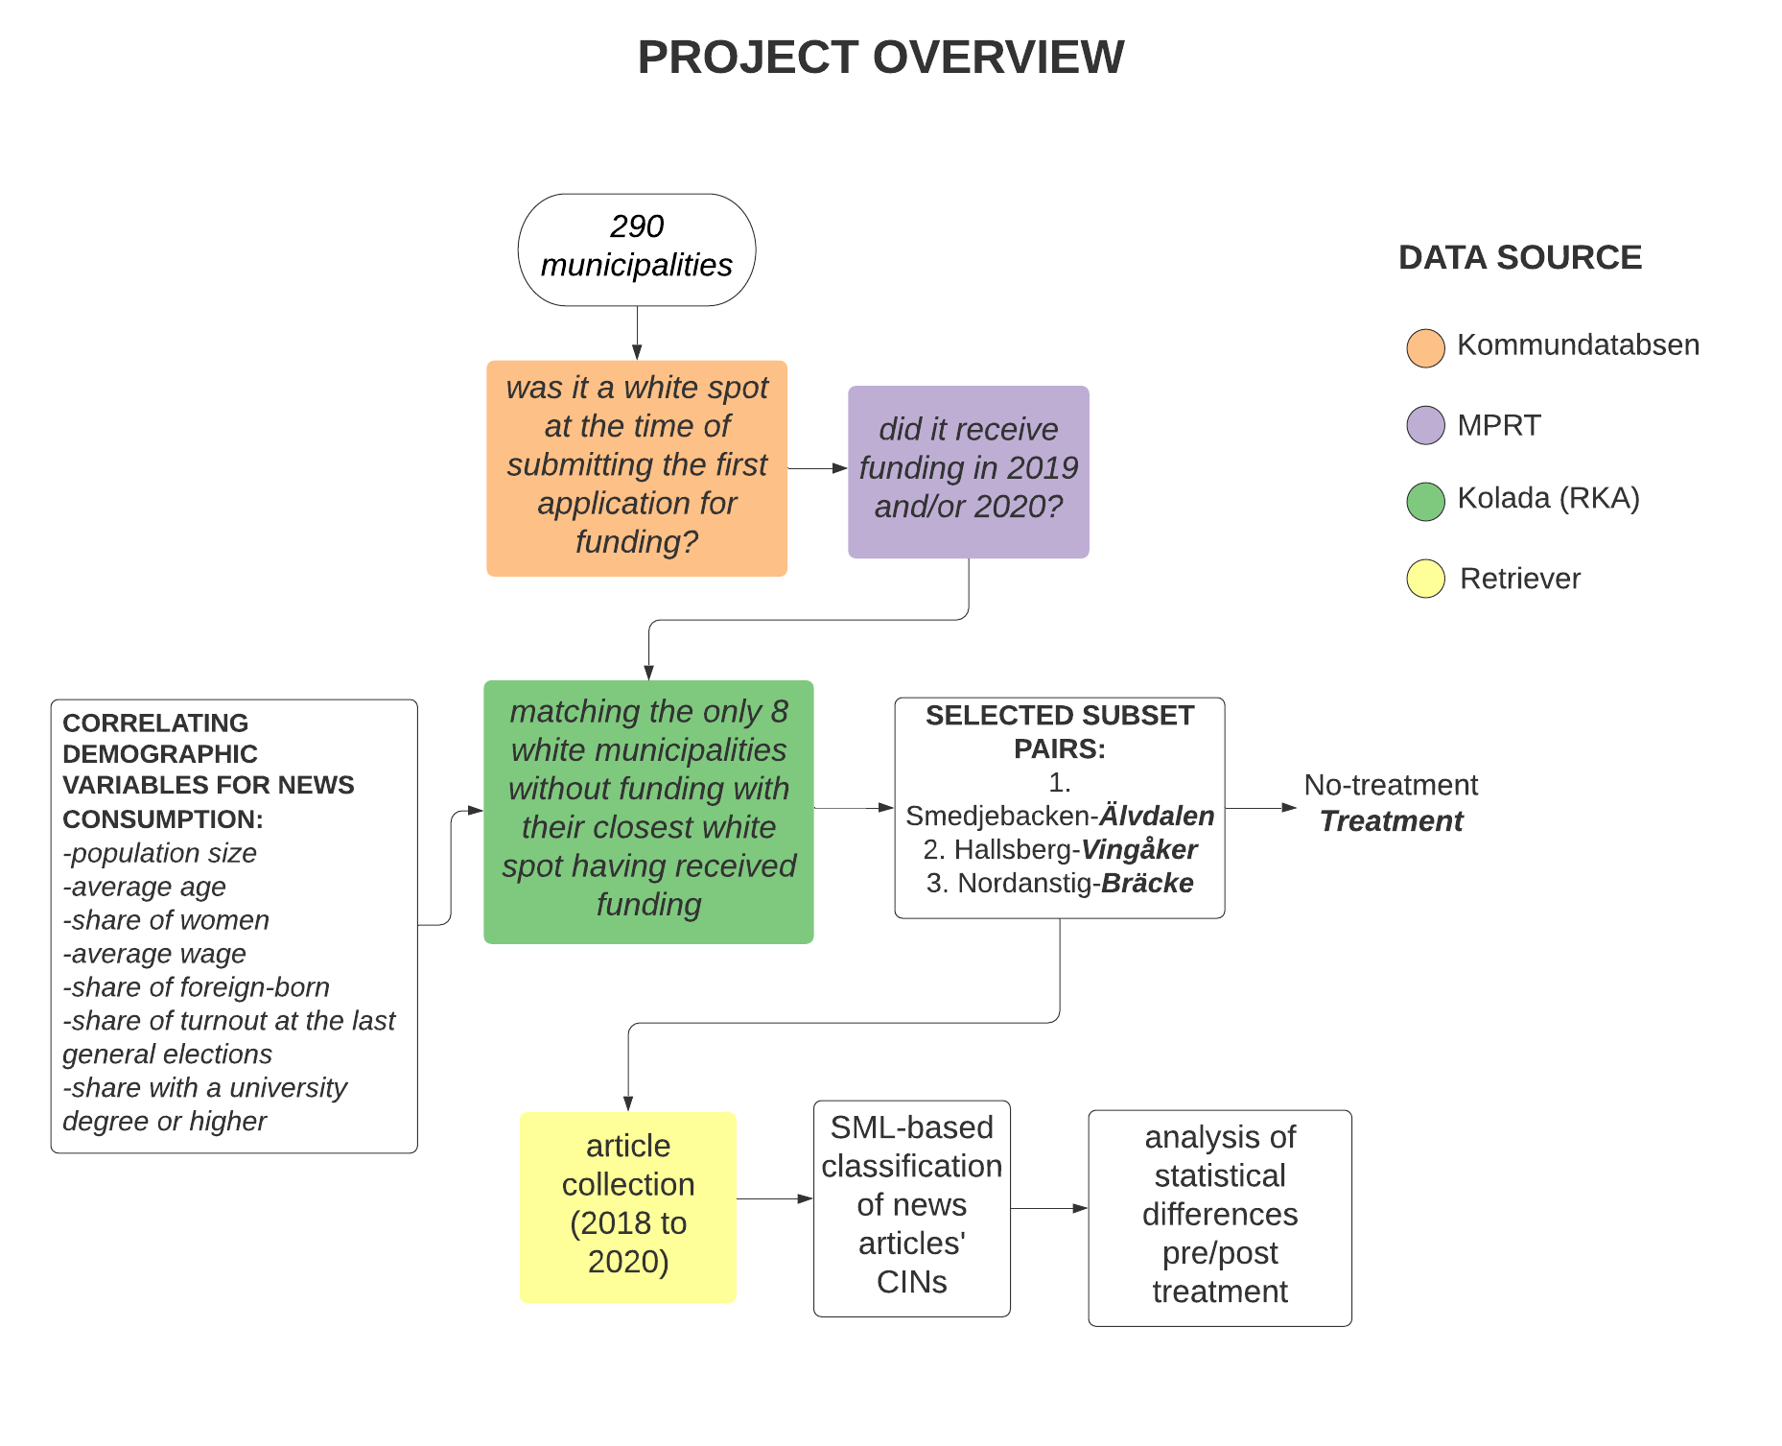
Pre-data collection steps and overview
Find blank spots
Find which blank spots have/have not received funding through the publishers that have received funding to cover them
Create a sample of municipalities for this study

Slide 5
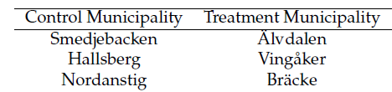

Data
51209 articles about 6 blank spot municipalities collected from the media archive Retriever
Collection used a keyword search of the municipality name
Articles were published between January 2018 and December 2020

Slide 6
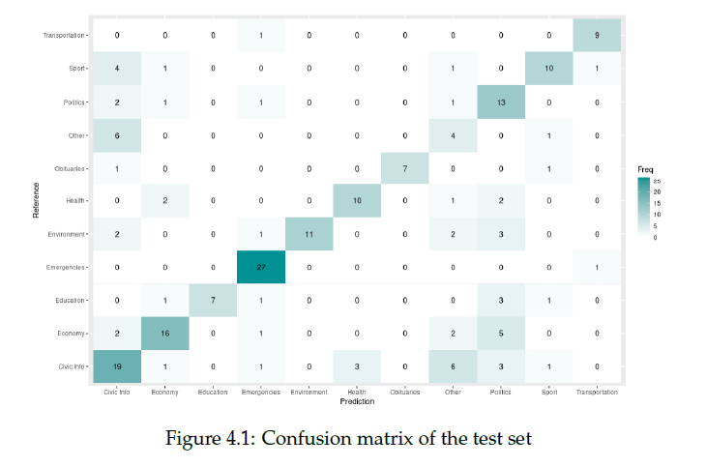
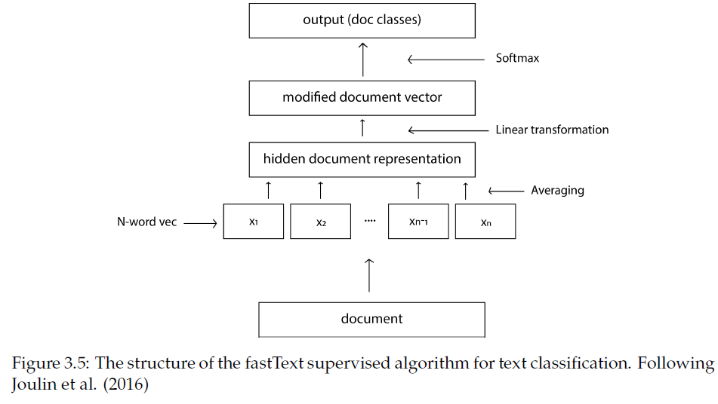
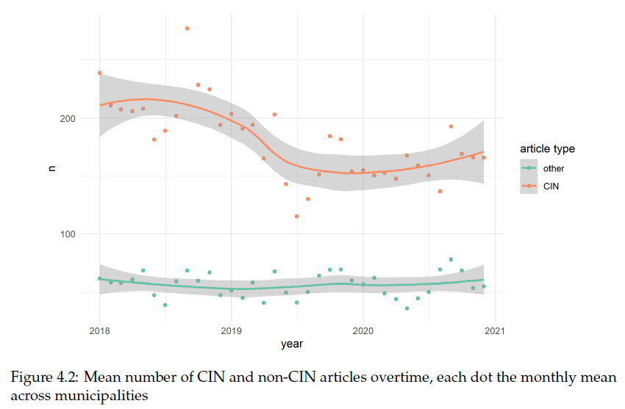
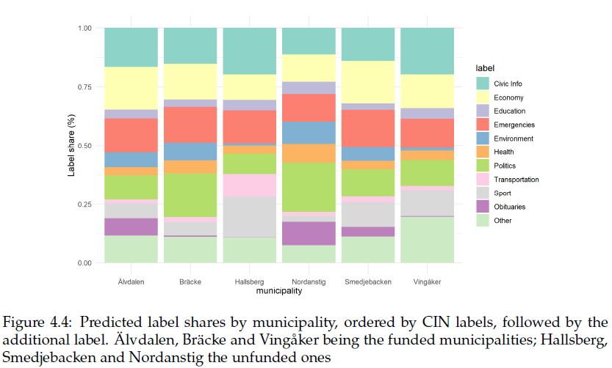
RQ1 Method and Results
Hand annotated 1000 articles and classified the remainder in the 8 CINs category + 3 (obituaries, other, sport) using Facebook’s FastText algorithm
Around .75 of all articles written by local newspapers fulfill a CIN.

Slide 7
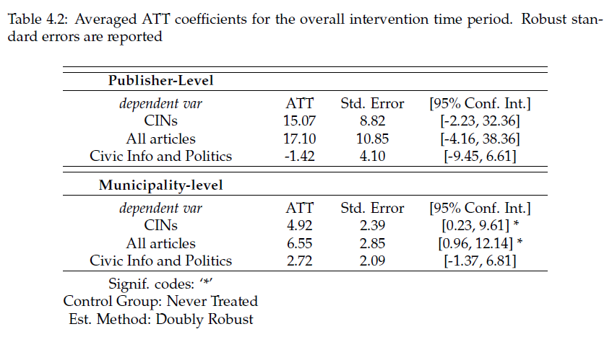
RQ2 Method and Results
Difference-in-differences regression with time fixed effects with data as panel data and time as yearly quarters
Two level of analysis: publisher and municipality
3 models, different outcome variable: the number of CIN articles, the number of overall articles, the number of articles about Civic Information and Politics, published within a yearly quarter by each publisher
H1
H2
H1
H2

Slide 8
Conclusion Limitations Extensions
Despite not being locally present, newspapers covering blank spots produce mostly news that fulfill citizens’ CINs
Results somewhat reflect what we know from the survey (Tenor, 2020)
Publisher level no effect, yet an effect at the municipality level: a crowding out effect?
Results dependent on my choices as the sole hand-coder, the amount of annotated data, and the classification algorithm
Small sample sizes, not many publishers within these municipalities were funded
Too early to see changes?
No changes does not mean no beneficial usage of funds
Test differences in CINs between blank spots and non-blank spots
Compare CINs provision across mediums (e.g. radio, TV, and citizen journalism)
Incorporate more data
Test further the idea of a crowding out effect
Change the analytical setup
RQ1
RQ2

Slide 9
Thank you

