Slide 1


VALORANT
5v5 lövöldözős
Egyszerű
Szórakozás
Háttértörténet

Slide 2
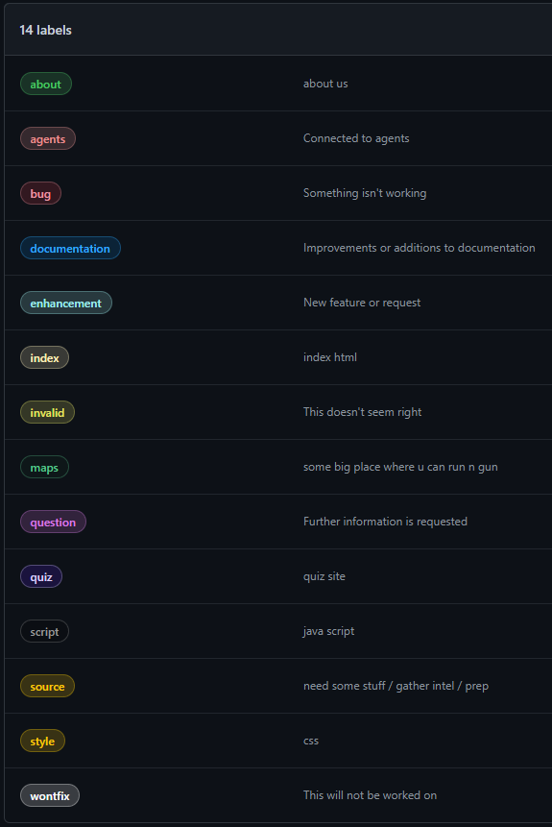

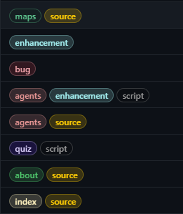
Címkék
Érthető
Rövid

Slide 3
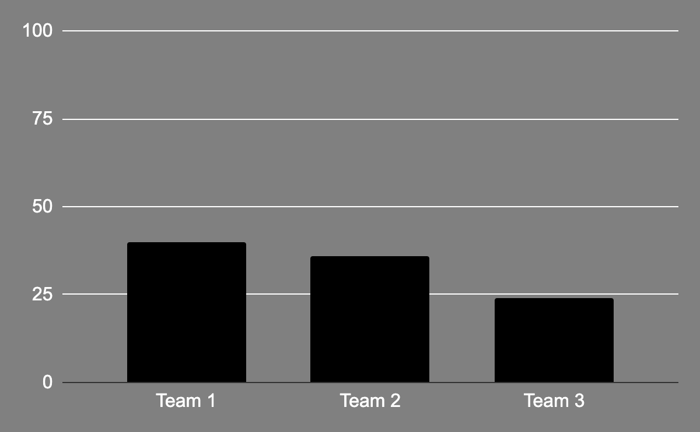
ADMINISTRATION TRENDS
TEAM 1
40%
Mars is actually a cold place
TEAM 2
36%
Mercury is a small planet
TEAM 3
24%
Neptune is very far from the Sun
Follow the link in the graph to modify its data and then paste the new one here. For more info, click here

Slide 4

ANOTHER INFOGRAPHIC
MERCURY
VENUS
JUPITER
SATURN
Mercury is the closest planet to the Sun
Venus is the second planet from the Sun
Jupiter is the biggest planet of them all
It’s composed of hydrogen and helium

Slide 5
TESTIMONIALS
—SOPHIA MCKANE
—RICHARD ROE
—DONALD DOE
—JENNA MCANN
“Mercury is the closest planet to the Sun and the smallest one in the Solar System”
“Venus has a beautiful name and is the second planet from the Sun. It’s terribly hot”
“Despite being red, Mars is actually a cold place. It’s full of iron oxide dust”
“Jupiter is the biggest planet in the Solar System. It's the fourth-brightest object”

