Slide 1
Air Fryer Market
Intelligence Report
Brand-Level Analysis · 2019 – 2023
Demand Estimation · Cost & Margin Analysis · Competitive Positioning

Slide 2
Market at a Glance
10
5
$16
$228+
Top Brands
Years of Data
Lowest Price
Highest Price
Name-brand market
2019 – 2023
Dash (value leader)
Cuisinart (premium)
Market Snapshot
The air fryer market underwent rapid transformation from 2019 to 2023. Early leaders like GoWise USA ceded ground to Ninja and Instant Pot, which now jointly command roughly 40–50% of the name-brand market. Cuisinart anchors the premium segment above $200, while Dash competes aggressively on value below $20. The market shows significant brand churn and pricing volatility, signs of a competitive landscape still reaching equilibrium. At 89.1% model R², a logit demand framework explains nearly all variation in brand share.

Slide 3
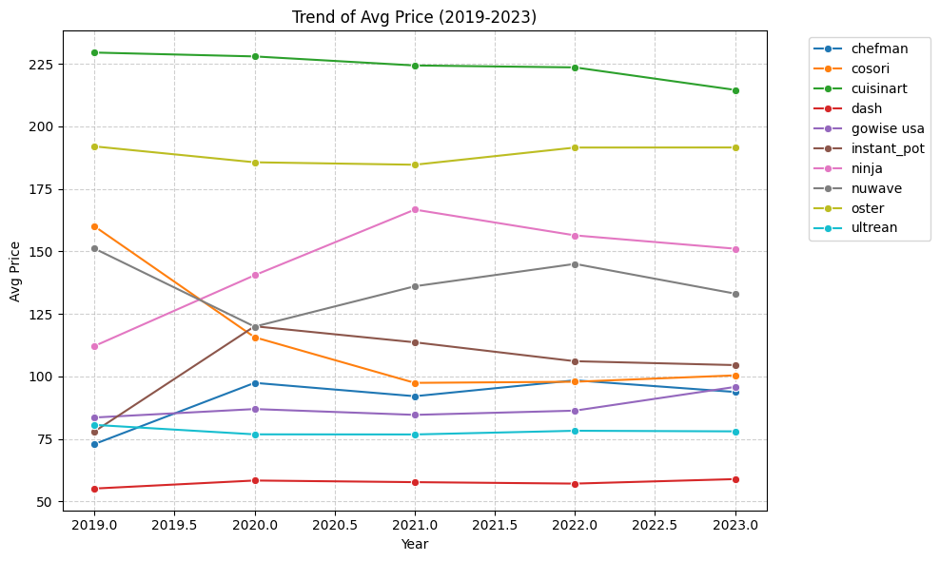
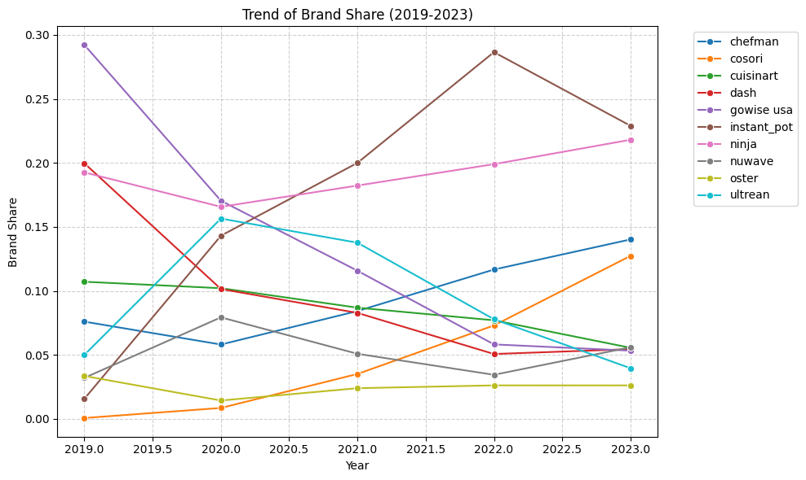
Market Trends: Price & Share (2019–2023)
Average Price by Brand ($)
Brand Market Share (%)
Cuisinart is consistently above $200 — the clear premium anchor
Ninja & Instant Pot surged to ~40% combined share by 2023
GoWise USA fell from market leader to mid-tier between 2019–2022

Slide 4
What Drives Consumer Choice?
A logit demand model explains how price, ratings, and features shape brand market share
1
Log share regression
−0.0267
We regress log(brand market share) on price, ratings, product features, and brand + year fixed effects — a linear approximation of the multinomial logit.
Price Coefficient (β̂price)
Significant at p = 0.002 · Higher price → lost share
2
One price coefficient for all
89.1%
A single β_price is estimated across all brands and years, giving a consistent elasticity measure and enabling cost back-out.
Model R²
Variance in brand share explained by the model
3
Brand & year dummies
2021
Brand dummies capture fixed quality differences; year dummies absorb aggregate demand shifts (e.g., the COVID-era air fryer boom in 2020–2021).
Peak Demand Year
Largest year dummy coefficient — COVID-era air fryer boom
A negative price coefficient is essential. If positive, the model is misspecified and cost inference breaks down. Here, a $1 price increase reduces a brand's log share by 0.027 — confirming standard consumer demand behavior.

Slide 5
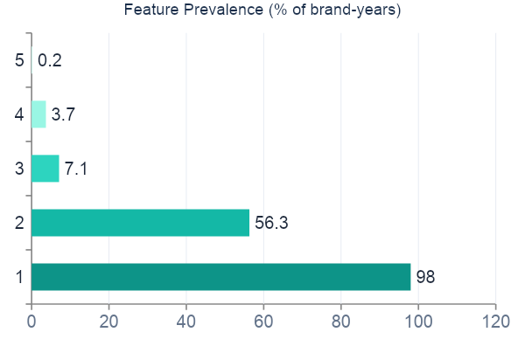
What Features Matter?
Compact = table stakes
98% of products are compact. Being compact doesn't win share — not being compact would lose it.
Oven-style is polarizing
56% prevalence but a slight negative coefficient. Cuisinart, Dash, and Oster specialize here — quality of execution matters more than the feature itself.
Dual basket: hidden gem
Only 0.2% penetration yet the strongest positive demand signal (+12.2). A massive untapped opportunity for any brand willing to invest.
Chefman leads the niches
Demand Coefficients (direction of effect on share)
Highest rotisserie (37%) and window (36%) shares among all brands — carving out an enthusiast segment others ignore.
Dual Basket: +12.2 · Compact: +1.5 · Rotisserie: +1.3 · Oven-Style: −0.4 · Window: −0.6

Slide 6
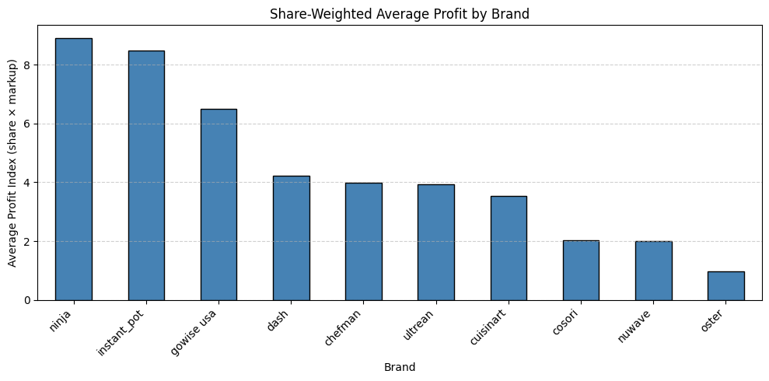
Unit Costs, Markups & Profitability
Brand | Avg Price | Unit Cost | Markup
Cuisinart | ~$228 | ~$183 | ~$45
Oster | ~$196 | ~$151 | ~$45
Ninja | ~$145 | ~$99 | ~$46
Instant Pot | ~$95 | ~$53 | ~$42
GoWise USA | ~$62 | ~$22 | ~$40
Dash | ~$54 | ~$16 | ~$38
Markup range: $38 – $46
Markups are compressed across all brands. Price differences mainly reflect cost differences, not margin strategy.
Ninja and Instant Pot generate the highest share-weighted profit — not through higher margins, but through market volume. Oster sits at the bottom despite its high price, because low market share drags its profit index to just 0.96.

Slide 7
Competitive Landscape & Takeaways
Volume wins
Ninja & Instant Pot lead on profit — not because of wider margins, but because ~40% market share amplifies every dollar of markup. Scale is the clearest competitive moat in this market.
Premium is viable but niche
Cuisinart sustains a $183 unit cost and $228 price point. But its low share limits total profitability. A premium strategy demands a loyal, price-inelastic customer base.
Dual basket: biggest opportunity
With the strongest demand coefficient (+12.2) and only 0.2% market penetration, dual-basket designs are the most underexplored feature. Early movers stand to capture significant share.
Price reflects cost, not strategy
Markups are nearly identical across brands ($38–$46). Brands aren't differentiating on margin — they're competing on cost structure and volume.
Watch Cosori
Grew from near-zero to top-tier share between 2019–2023 in the standard basket segment. Poses the most credible near-term threat to Ninja's dominance.

