Slide 1
Reconstructing Transit Gateway in Landing Zone
A step-by-step demonstration deployed as a series of CloudFormation templates

Slide 2
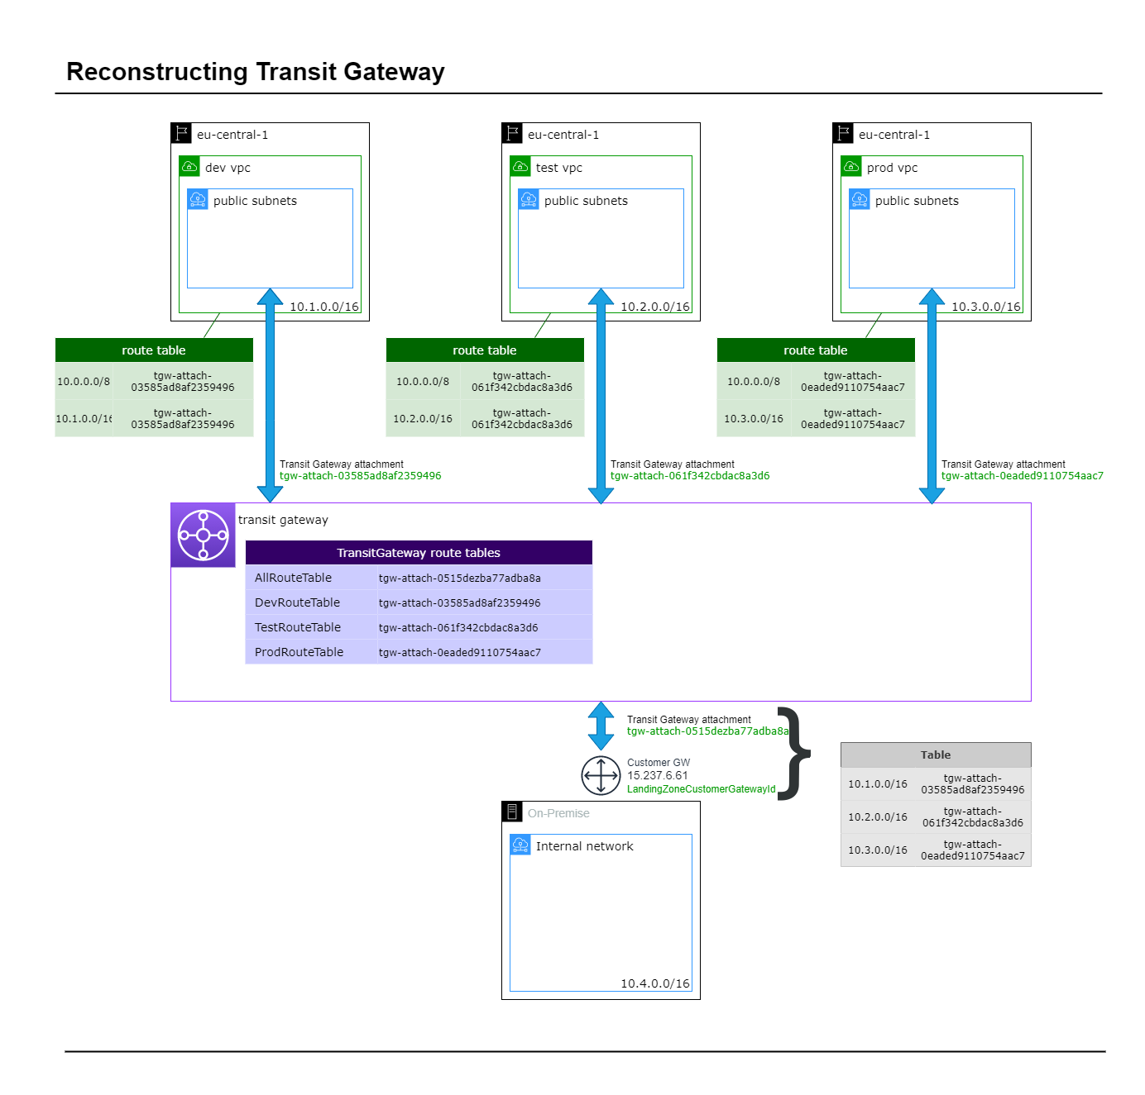
Transit Gateway Infrastructure
This is a short demonstration showing how AWS’ TGW (Transit Gateway) has been deployed at CRUK.
The accompanying bash scripts launch a CloudFormation template that builds each step. Please see the GitHub repo README.md for more info

Slide 3
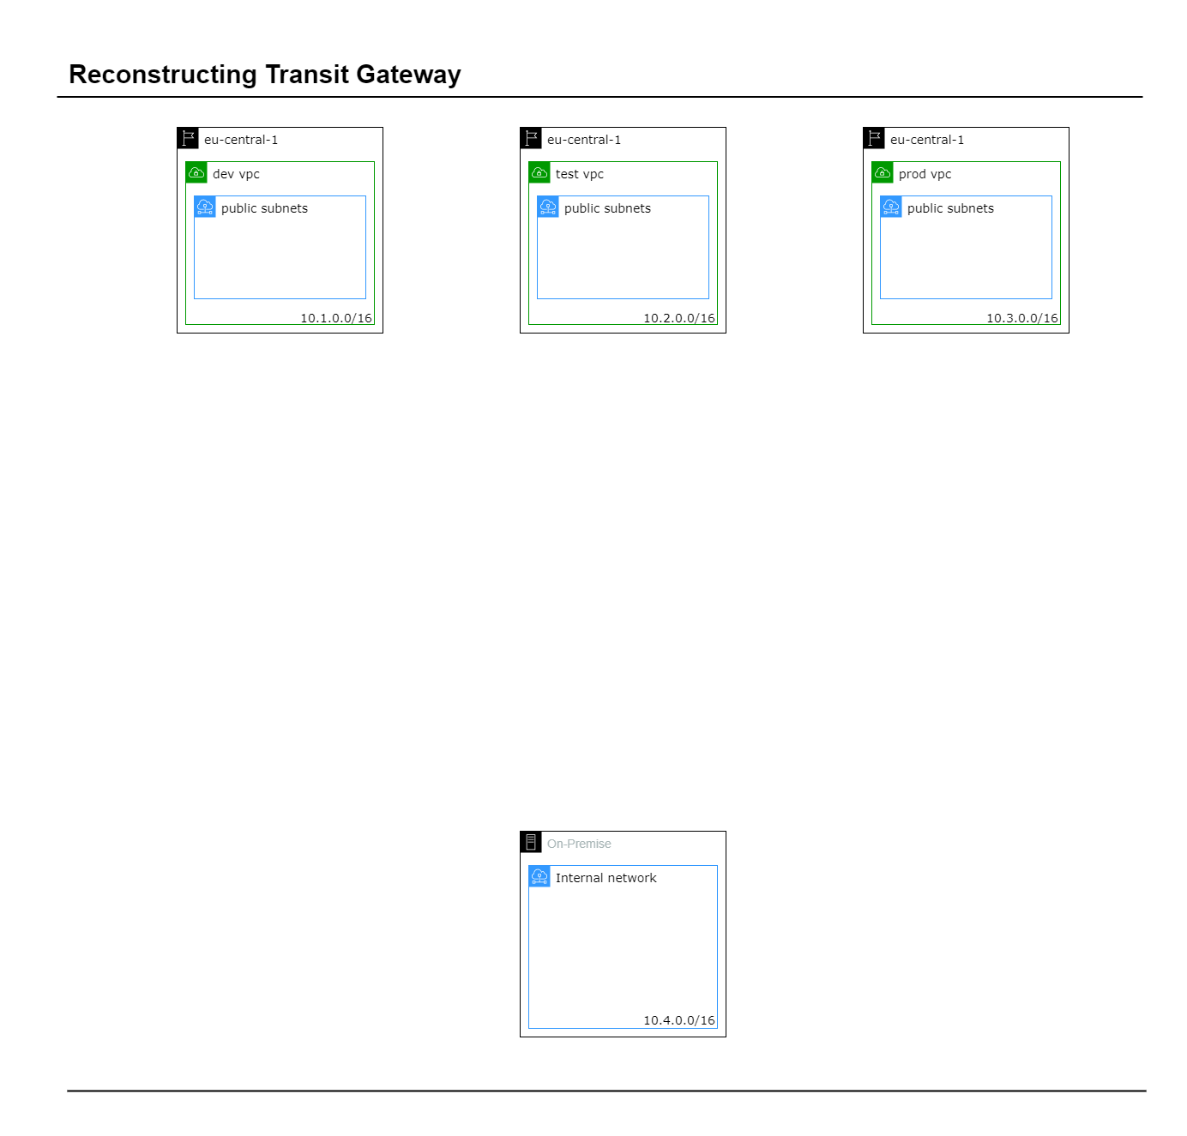
Start: Set up VPCs
Create the VPCs for the sandbox environment. We’ll need a VPC to represent the Datacentre and three to represent the AWS accounts we’re connecting.
tgw-attach-demo/ - create-demo-datacentre.sh
- create-demo-vpc.sh

Slide 4
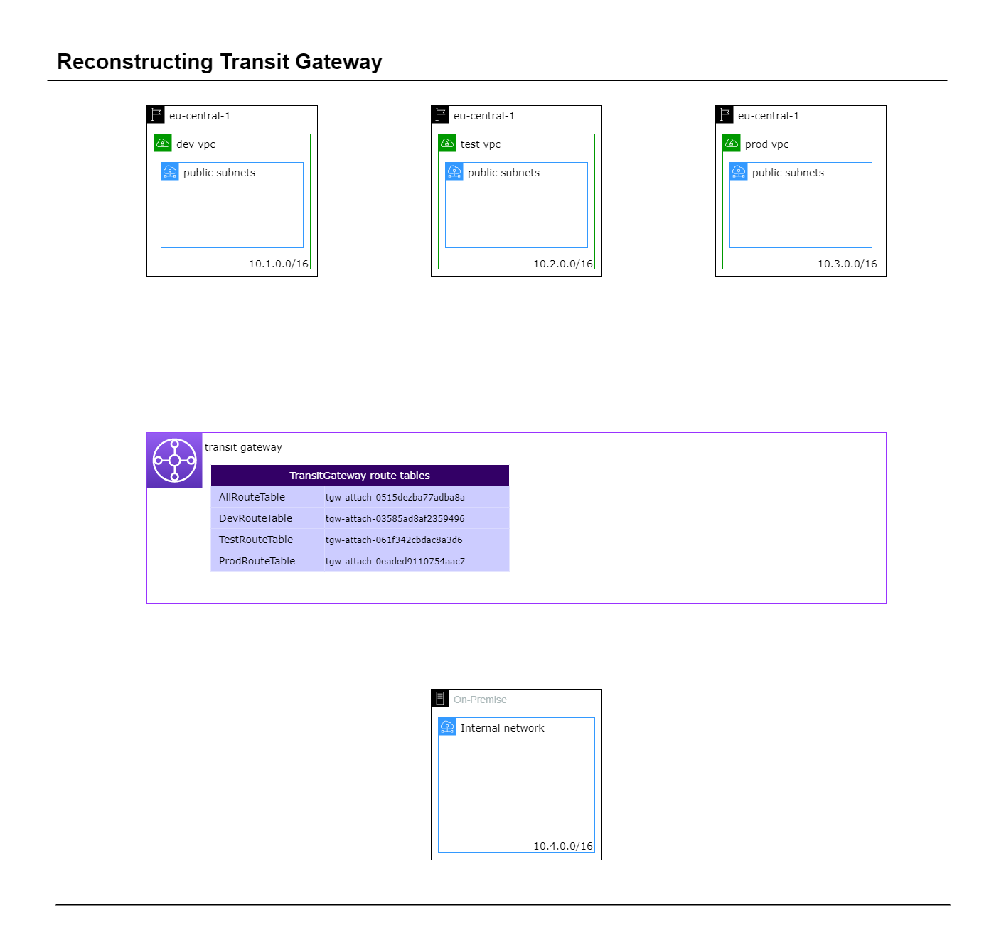
Step 1: Create TGW
Create the VPCs for the sandbox environment. We’ll need a VPC to represent the datacentre and three to represent the AWS accounts we’re connecting to.
tgw-attach-demo/ create-demo-datacentre.sh
create-demo-vpc.sh

Slide 5
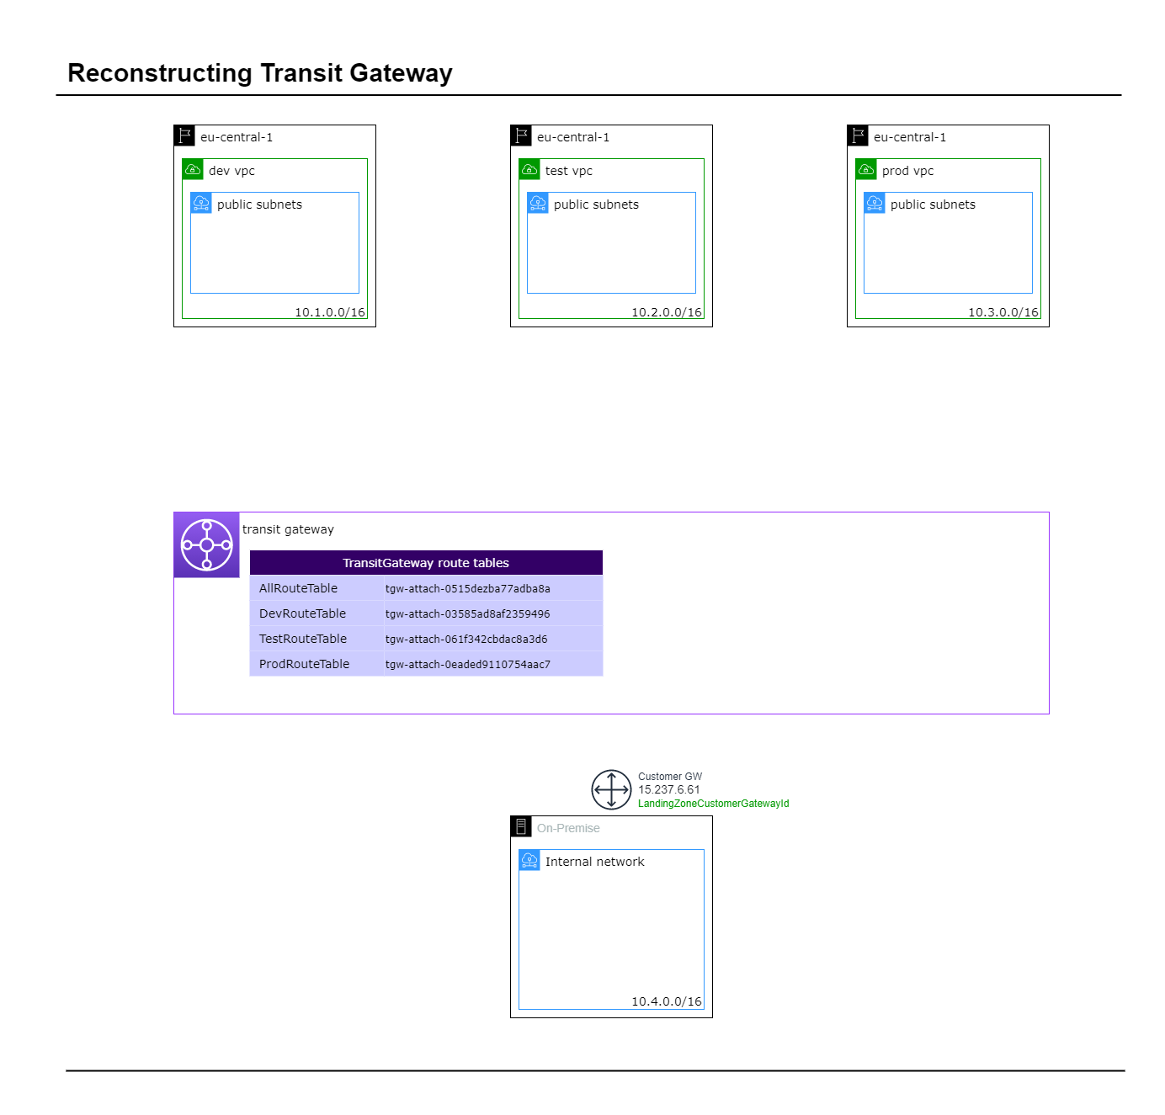
Step 2: Create CGW
tgw-attach-demo/
2-cgw.sh

Slide 6
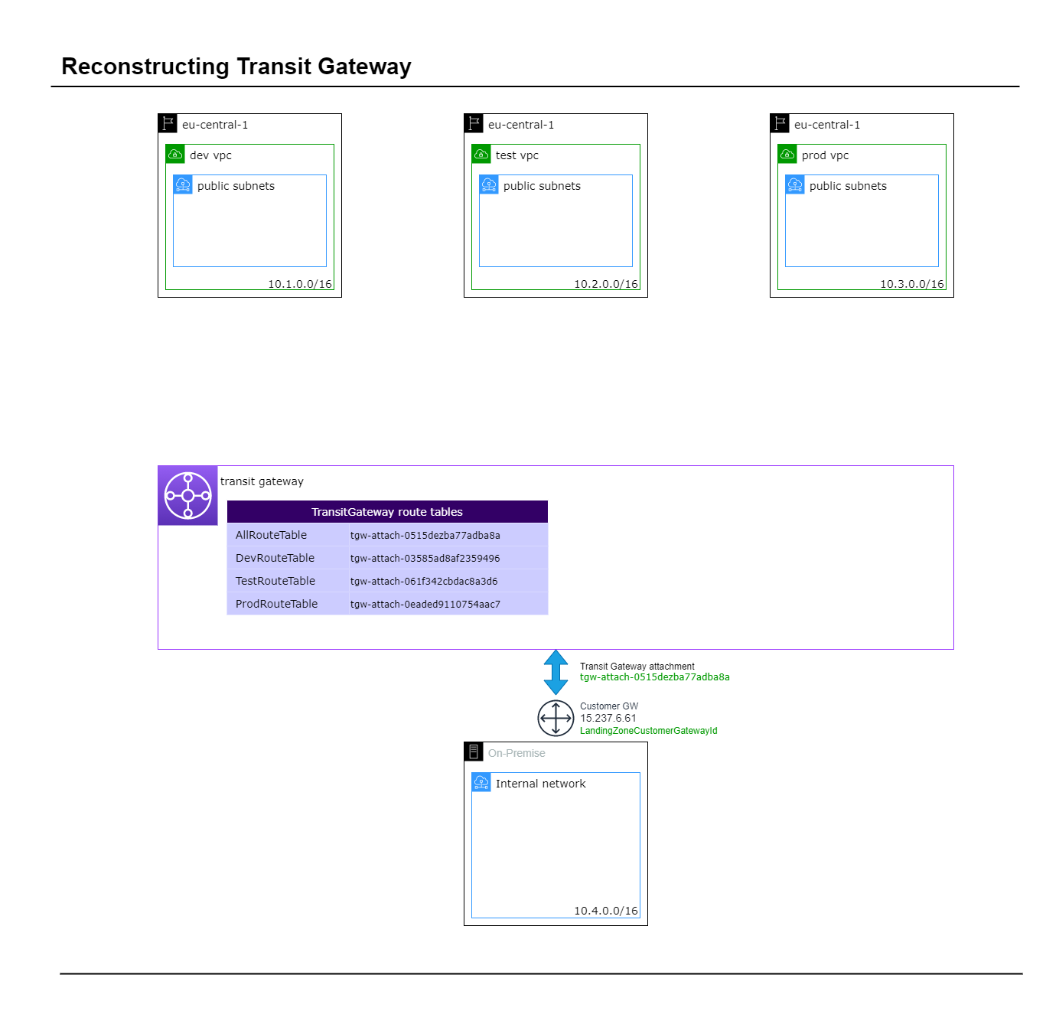
Step 3: Create VPN attachment
tgw-attach-demo/ 3-tgw-vpn-attachment.sh

Slide 7
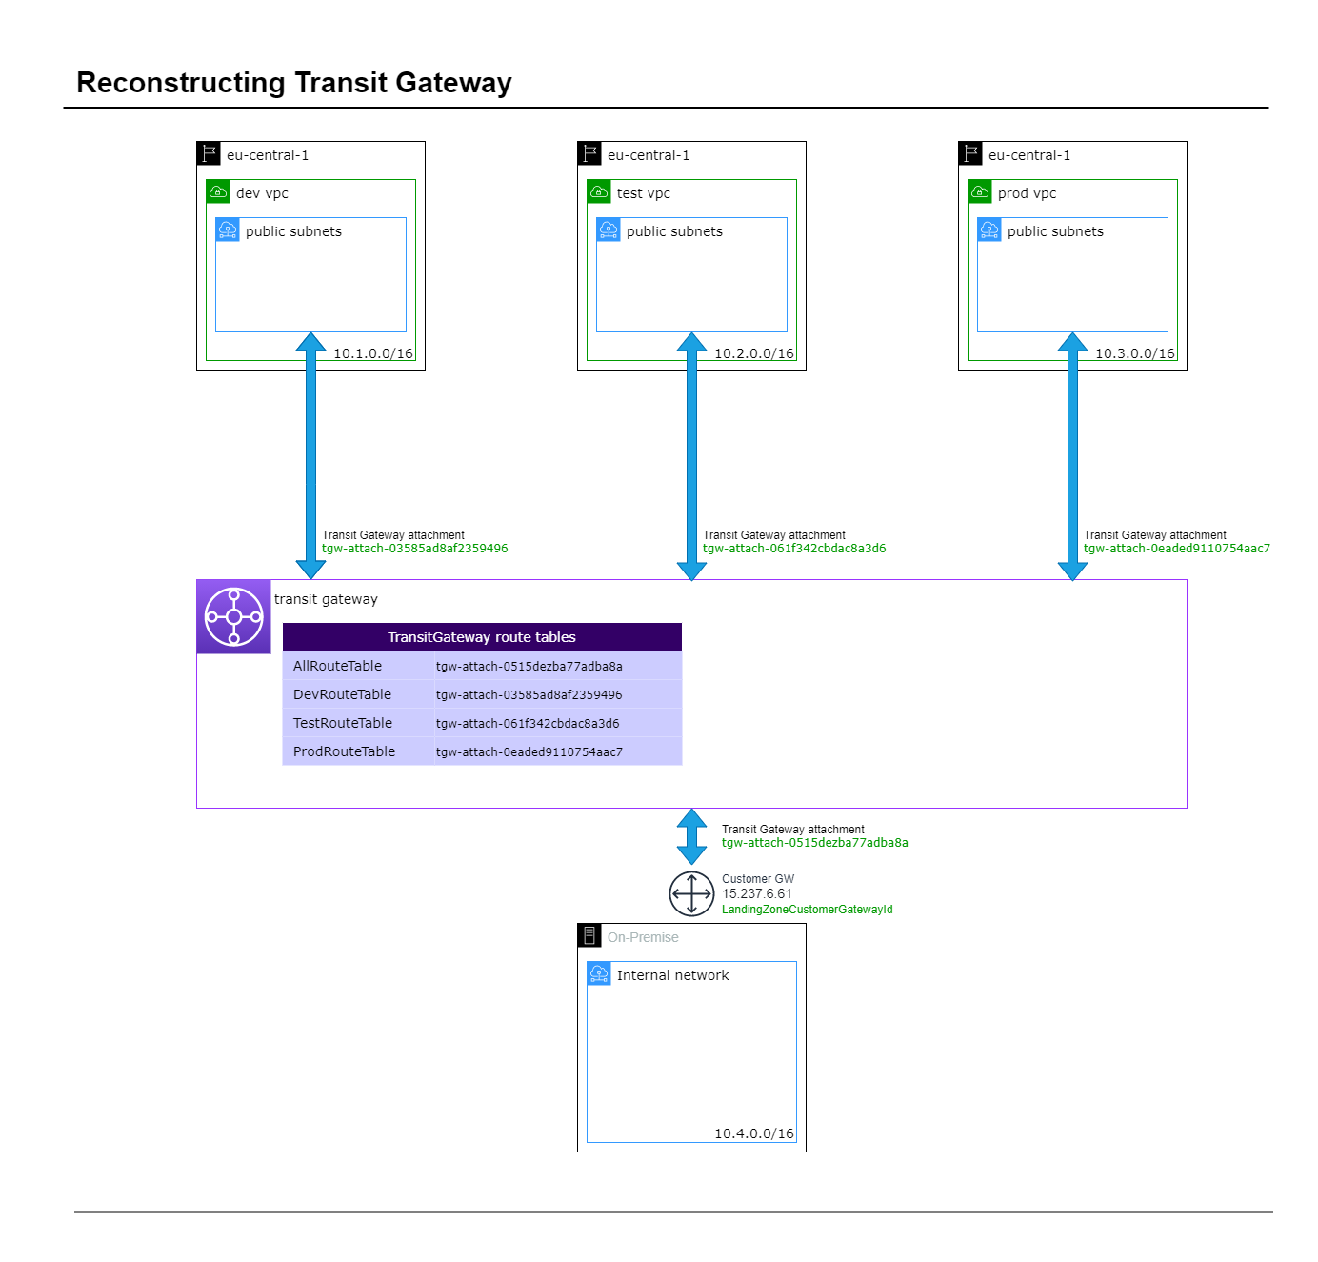
Step 4: VPC Attachments
tgw-attach-demo/
4-tgw-vpc-attachments.sh

Slide 8
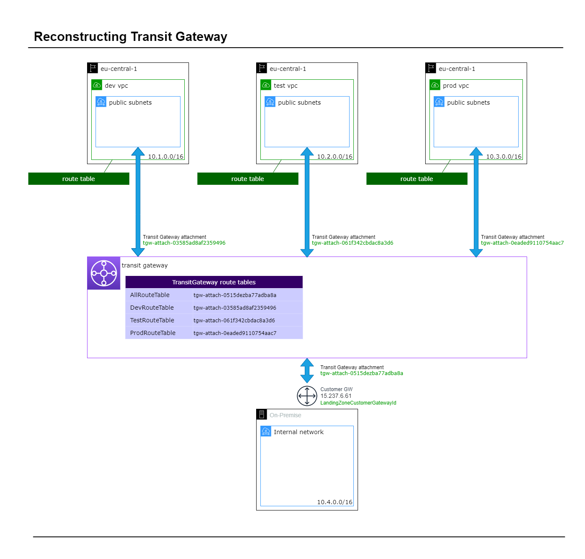
Step 5: TGW VPC Association
tgw-attach-demo/
5-tgw-vpc-association.sh

Slide 9
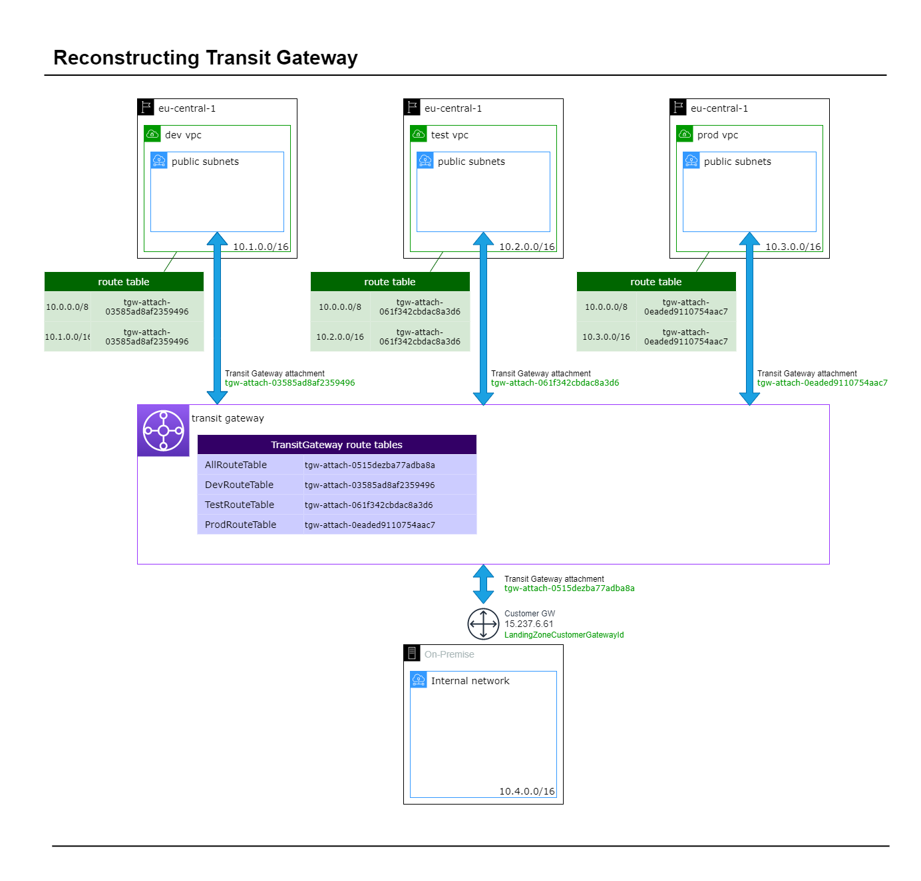
Step 6: Route Association and Propagation
tgw-attach-demo/
6-tg-rt-env-assoc-and-propogation.sh

Slide 10
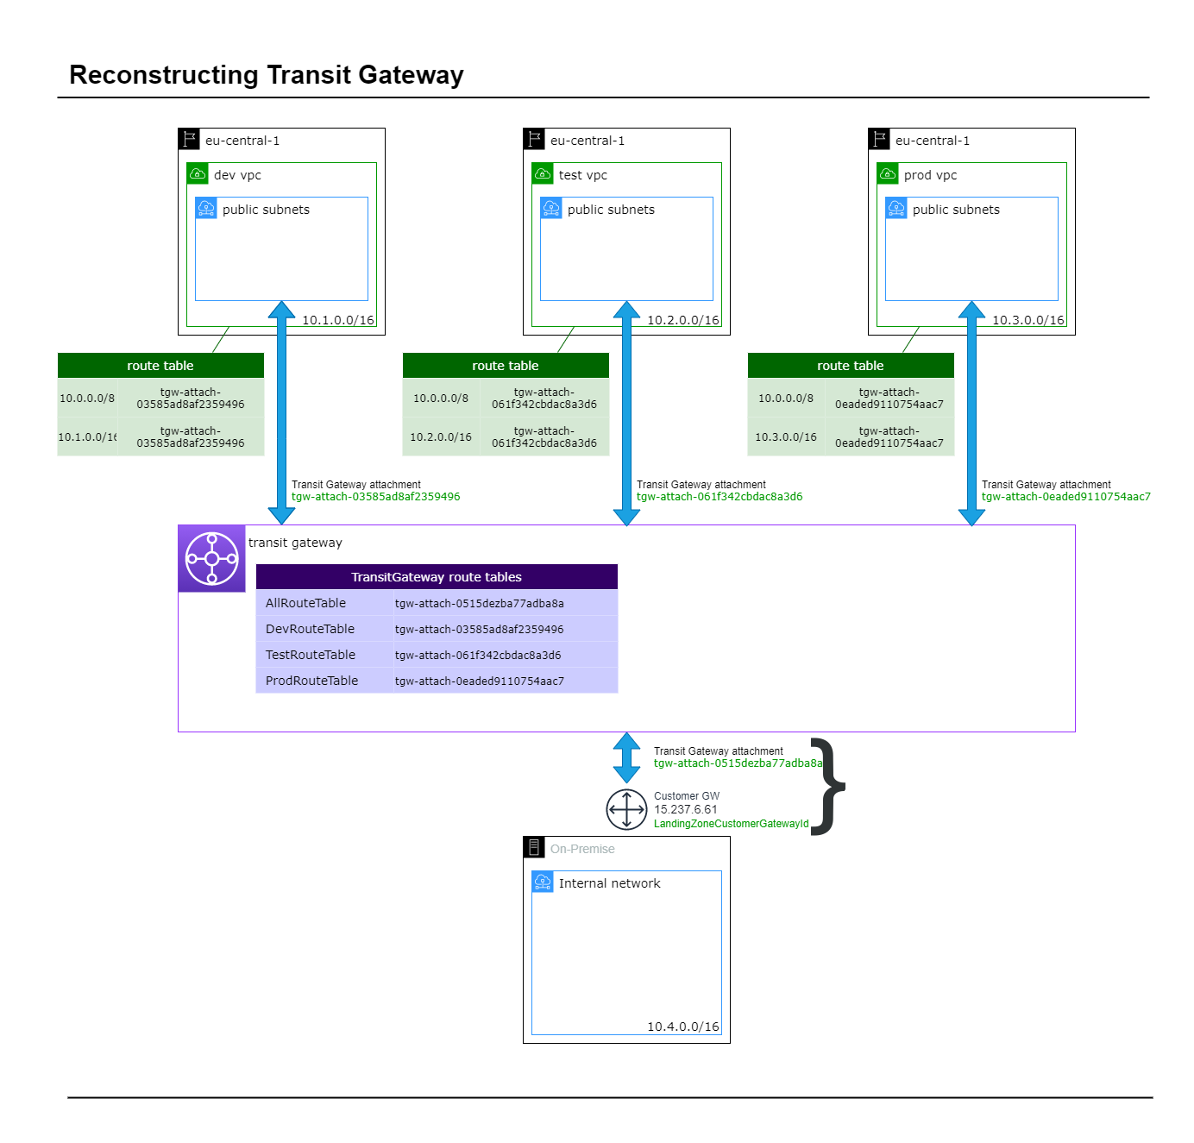
Step 7: VPN Association
tgw-attach-demo/
7-tgw-vpn-association.sh

Slide 11

Step 8: Configure Client Gateway
Download site-to-site VPN configuration file from the AWS VPC console and pass to Network engineers to configure the customer endpoint of the VPN.

Slide 12
Thank you everyone for coming to my talk.
Does anyone have any questions?

