Slide 1
Torino, 20/05/2024
Preserving the Privacy of Personal Data: A Practical Approach with Nerpii
Notes:
Speaker Notes

Slide 2
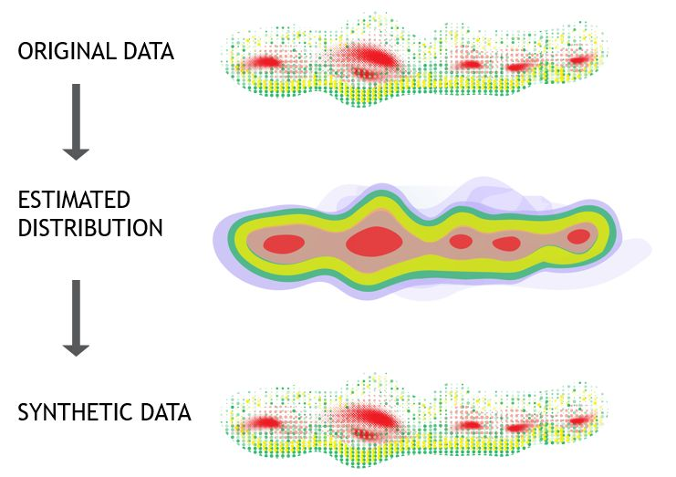
What are Synthetic Data?
Synthetic data is artificially generated using artificial intelligence algorithms on real data samples.
They possess the same statistical properties and predictive capabilities as the real data from which they were generated.

Slide 3
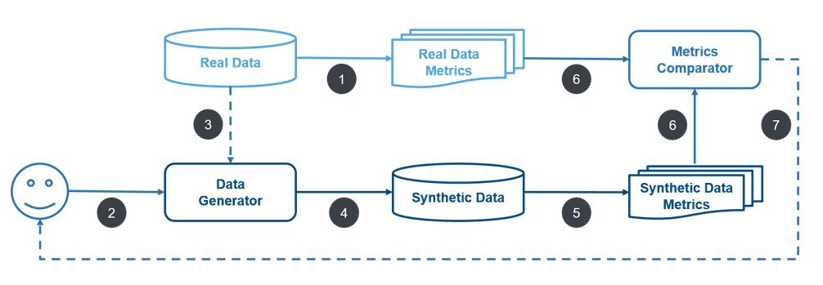
How are synthetic data generated?
Source: J. P. Morgan https://www.jpmorgan.com/technology/artificial-intelligence/initiatives/synthetic-data

Slide 4
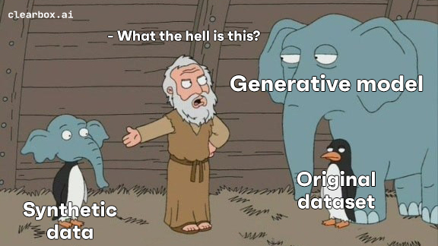
Synthetic Data Generation
Notes:
You just need to know that the generations takes place through a neural network. The generative model of this meme is a neural network, a Variational Auto Encoder to be specific. The model is trained on the original dataset, it leans the statistical properties of the data and it's then able to generate new data.
We are not just asking ChatGPT to generate new data, I swear.

Slide 5
Why Synthetic Data?
Data Augmentation
Utility/Fidelity
Notes:
We can identify at least two main reasons: data augmentation and data sharing.
If the goal is just data augmentation, the only thing that matters is high fidelity. The synthetic data must be as close as possible to the original dataset. They must be useful. And by similarity I obviously mean statistical similarity. The statistical distribution of the synthetic data must be very similar to the original.
Example with Age and Feature Correlation.

Slide 6
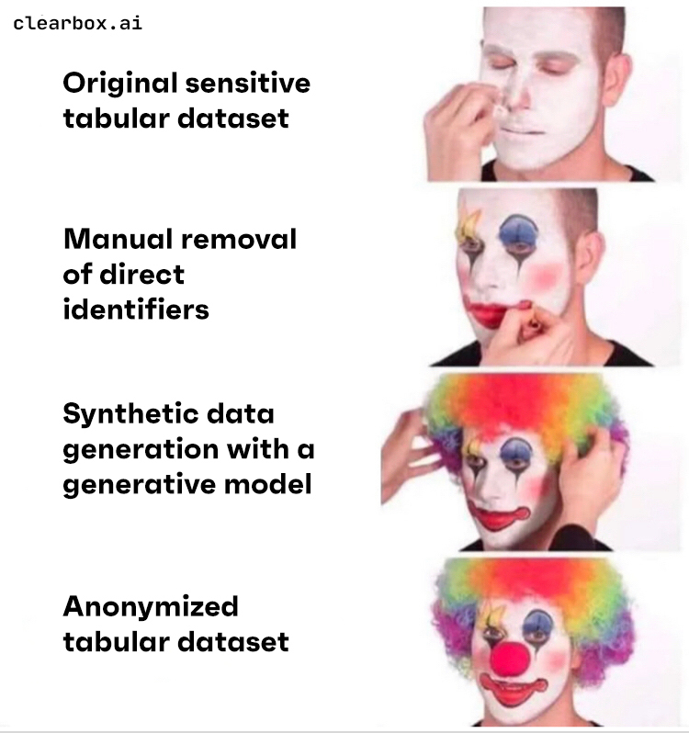
Why Synthetic Data?
Data Sharing
Privacy
Notes:
The other example is Data Sharing. This applies when you have a dataset with personal data of course. Consider for example, a financial institution, a bank for example. They have a huge amount of data about theri customer, right? Names, age, how much they earn, how much money they have, how much they spend, how many times they use their credit card and so on. If the bank wants to use this data for whatever reason, a lot of privacy laws and regulations apply, need to be followed. Even if they want to share their data internally. I don't know, maybe they want to share the data with the data science team to build some models.
Ok so synthetic data generation could be a good solution here. You can get data that are similar to the original ones and, in theory, this new data is not personal anymore cause it's synthetic...

Slide 7
Data Anonymization
All the traditional techniques require a more or less complex transformation of the original sensitive data into anonymised data. This means that there is a 1-to-1 mapping between the original data and the synthetic data, so it might be possible to find an inverse transformation that allows one to get back the original data from the synthetic data, although this might be very difficult.
On the other hand, with a good synthetic data generation, new data records are generated from a distribution learnt by a (ML) model, there is by construction no unique mapping between the synthetic records and the original ones. This is true in general, but we should not underestimate the risks.
Notes:
Traditional techniques: you take one original person and you apply a transformation or some transformation to make some changes, to hide the sensitive features. So from one row you got a transformed row. There’s a 1-to-1 mapping. If you have a transformation, you can find the inverse transformation.
With ML, in our case, new data record are generated by a distribution learnt by a model. There’s no unique mapping, in theory. But you should not underestimate the risks.
What risks are we talking about?

Slide 8
Identity Disclosure
Let’s say s is a record in our private synthetic dataset S. If an attacker is able, with or without any background knowledge, to assign a real identity to that record, we call this an identity disclosure.
Assessing the risk and relevance of an identity disclosure, we must take into account the background knowledge and resulting information gain of the attacker. Did the attacker learn something new about the identified subject?
We should be particularly concerned only with the risks derived from identity disclosures where the information gain is greater than zero. A good synthetic data generation protects from these meaningful identity disclosures.
Notes:
Let’s say s is a record in our private synthetic dataset S. If an attacker is able, with or without any background knowledge, to assign a real identity to that record, we call this an identity disclosure.
Only correct identity assignments matter. If the attacker assigns a wrong identity to a synthetic record or assigns an identity of a real person who was not present in the original training dataset, there is no identity disclosure.
Assessing the risk and relevance of an identity disclosure, we must take into account the background knowledge and resulting information gain of the attacker. Did the attacker learn something new about the identified subject? If it is able to assign a real identity to a synthetic record, but it already knew all the attributes of that individual, it did not learn anything new from this assignment, the information gain is zero. We should be particularly concerned only with the risks derived from identity disclosures where the information gain is greater than zero.
A good synthetic data generation protects from these meaningful identity disclosures.

Slide 9
Utility vs Privacy
Ideally Synthetic Data should be:
globally (statistically) very similar AND
individual record wise very different
with respect to the Original Data.
Notes:
So we would like to have synthetic data that is statistically very similar but at the same time, individual record wise, very different from the original data. Yes, it is a big deal.
There's this big trade off and while, for example, traditional anonymization techniques have been available for decades, techniques such as masking and hashing, synthetic data generation can better deal with this trade-off: synthetic data, if done properly, is private, realistic and retains the original statistical properties. However, we need to be clear about this, it's not possible to have new data with 100% fidelity score and 100% privacy score, it is still a trade-off but synthetic data can help.
To prove this, we need metrics that help us to quantify and manage risks. We're going to assess the privacy risks.

Slide 10
Direct and Indirect Identifiers
Identifiers are personal attributes that can be used to help identify an individual.
Direct identifiers: Identifiers that are unique to a single individual, such as Name, Surname, Social Security numbers (Codice Fiscale), passport numbers, IP addresses and IBANs. These are called Personal Identifiable Information (PII).
Indirect identifiers The remaining kinds of identifiers, personal attributes that are not unique to a specific individual on their own such as height, gender, native country, city of residence, and more. Indirect identifiers can often be used in combination to single out an individual’s records.
Notes:
And with personal data usually you have identifiers: you could have direct identifiers (examples) and you could have indirect identifiers, the remaining ones such as age, gender, occupation
The difference is that with direct identifiers you can directly identify someone. With just one feature you can identify a person: 1 CF means 1 person. If I know CF of one of you, I can directly identify you. And the same is true for Passport, IP. Indirect identifiers don’t work like that. If you just know how old is someone, you can’t identify him/her.
Protect direct identifiers is easy, just remove/replace them. Those features are not so useful in terms of ML models, in terms of statistical models, It’s noise…
It is easier to protect direct identifiers: you can simply delete them or replace them with fake values. For indirect identifiers it is harder: that's where the usefulness of the data lies, we want to preserve them, we want to preserve their statistical properties. This is where synthetic data generation helps us.

Slide 11
Privacy Preserving Techniques on Textual Data
Replace Personally Identifiable Information (PII):
Replace names, addresses, and other identifiable information with generic placeholders (e.g., "John Doe", "123 Main St").
Tokenization:
Break down text into tokens and replace sensitive words or phrases with random identifiers or tokens.
Preserves the structure and context of the text while masking sensitive information.
Hashing or Encryption:
Apply cryptographic techniques like hashing or encryption to obscure sensitive data.
Hash functions convert data into fixed-size strings of characters, making it difficult to reverse-engineer original values.
Encryption algorithms encode data in a way that only authorized parties with access to a decryption key can decipher.
Notes:
And with personal data usually you have identifiers: you could have direct identifiers (examples) and you could have indirect identifiers, the remaining ones such as age, gender, occupation
The difference is that with direct identifiers you can directly identify someone. With just one feature you can identify a person: 1 CF means 1 person. If I know CF of one of you, I can directly identify you. And the same is true for Passport, IP. Indirect identifiers don’t work like that. If you just know how old is someone, you can’t identify him/her.
Protect direct identifiers is easy, just remove/replace them. Those features are not so useful in terms of ML models, in terms of statistical models, It’s noise…
It is easier to protect direct identifiers: you can simply delete them or replace them with fake values. For indirect identifiers it is harder: that's where the usefulness of the data lies, we want to preserve them, we want to preserve their statistical properties. This is where synthetic data generation helps us.

Slide 12
NERPII
NERPII is a Python library to perform Named Entity Recognition and generate Personal Identifiable Information.
When working with banks or healthcare companies, personal information is abundant, necessitating the anonymization of this data.
The idea for NERPII stems from the need to preserve the privacy of personal information contained in structured data, such as Excel or CSV files.

Slide 13
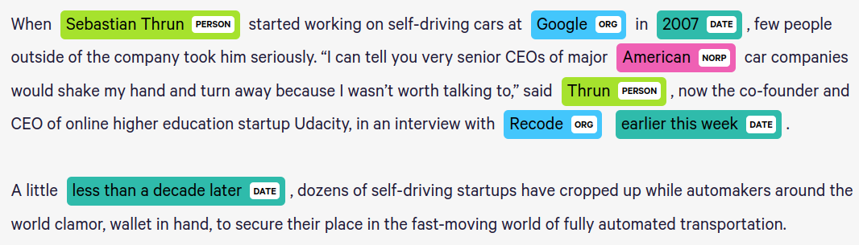
Named Entity Recognition
Named Entity Recognition (NER) is a natural language processing technique that focuses on identifying and classifying specific entities or named entities in data, such as LOCATION, ORGANIZATION or PERSON to words in texts.
Image source: https://demos.explosion.ai/displacy-ent

Slide 14
NERPII Library - Architecture
NERPII contains two classes:
NamedEntityRecognizer
to perform Named Entity Recognition on structured data, typically in the form of a CSV file
FakerGenerator
to generate synthetic Personal Identifiable Information

Slide 15
NamedEntityRecognizer
This class assigns a named entity to the columns of a dataset to obtain information about their contents.
To do this, it uses:
Presidio, an SDK from Microsoft
NLP model (dslim/bert-base-NER for English and osiria/bert-italian-uncased-ner for Italian), available on HuggingFace.
some manual processes based on regex.
These two models, trained to perform NER, check each row in a column and try to assign an entity to each row. The final entity assigned to the column will be the most frequent entity.

Slide 16
NERPII Library - How to use it - 1
pip install nerpii
from nerpii.named_entity_recognizer import NamedEntityRecognizer
recognizer = NamedEntityRecognizer('./csv_path.csv', lang='en')
recognizer.assign_entities_with_presidio()
recognizer.assign_entities_manually() recognizer.assign_organization_entity_with_model()
recognizer.dict_global_entities

Slide 17
Results of the NamedEntityRecognizer
{'name': {'entity': 'PERSON', 'confidence_score': 0.9127725856697819},
'address': {'entity': 'ADDRESS', 'confidence_score': 0.8926174496644296},
'city': {'entity': 'LOCATION', 'confidence_score': 0.8731343283582089},
'zip': {'entity': 'ZIPCODE', 'confidence_score': 1.0},
'phone': {'entity': 'PHONE_NUMBER', 'confidence_score': 0.888},
'email': {'entity': 'EMAIL_ADDRESS', 'confidence_score': 1.0}}

Slide 18
FakerGenerator
After knowing which entity types our columns in the dataset contain, NERPII regenerates data for those columns containing PII, such as names, addresses, phone numbers etc.
For this generation it uses Faker, a Python package that generates fake data to anonymize PII.

Slide 19
NERPII Library - How to use it - 2
from nerpii.faker_generator import FakerGenerator
generator = FakerGenerator(dataset, recognizer.dict_global_entities, lang='en')
generator.get_faker_generation()

Slide 20

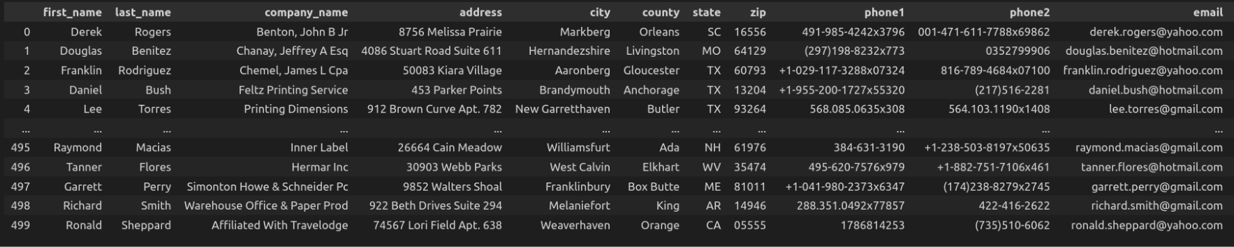
Results of the FakerGenerator
Table 1: Real Data
Table 2: Synthetic Data
Notes:
change these tables

Slide 21
Future Directions and Conclusion for Nerpii
A promising direction for the future development of this library is
to adapt it to other languages in addition to English and Italian
to expand the number of Named Entities recognized by the NamedEntityRecognizer and those regenerated by the FakerGenerator.
to examine the aspect of coherence among different columns.
NERPII combines the remarkable potential of Named Entity Recognition with the power of synthetic data in order to preserve the privacy of the Personal Identifiable Information contained in structured data.

Slide 22

Useful links
NERPII: https://github.com/Clearbox-AI/nerpii
Presidio: https://microsoft.github.io/presidio/
Faker: https://faker.readthedocs.io/en/master/

Slide 23
Thanks!
Feel free to contact us:
www.clearbox.ai
info@clearbox.ai
simona@clearbox.ai
@ClearboxAI

