Slide 1


EC Django Deploy
A project to deploy your Django projects in Minutes

Slide 2

Introduction
Developers with Django skill often face challenges in deploying Django projects on AWS.
Our solution simplifies this process, allowing quick and efficient deployment.

Slide 3

Key Features
One-Click Django Deployment
Deploying Django projects is now as simple as clicking a button.
GitHub Integration
Seamlessly connect your GitHub repository with our platform.
Centralized Domain Access
Elevate your deployment experience with our centralized domain access feature.

Slide 4


How It Works
Prerequisites
A public Github repository.
A Django projects created within a predefined folder structure.

Slide 5
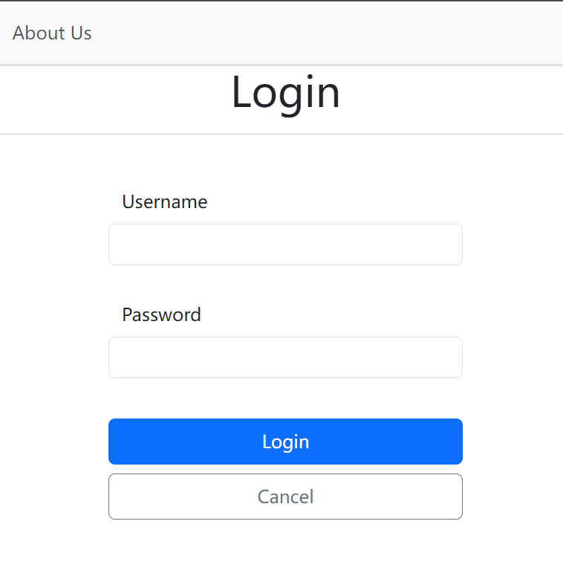
How It Works
Login

Slide 6
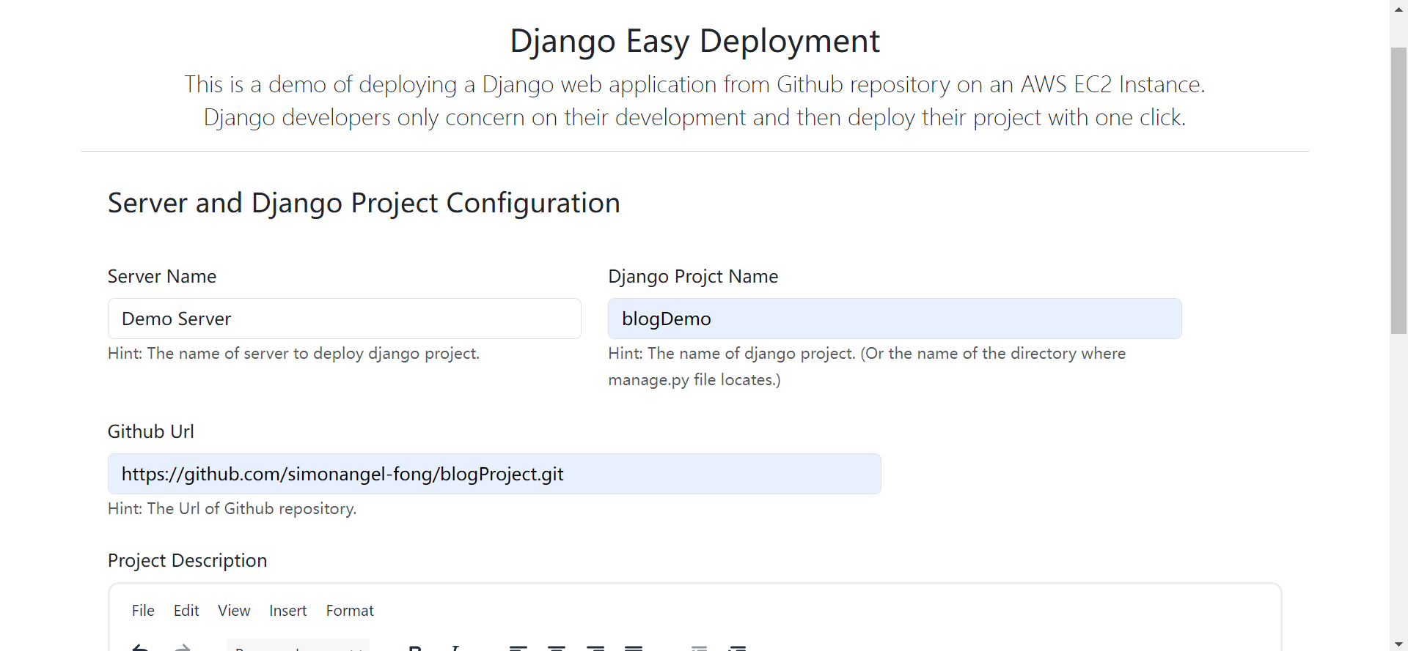
How It Works
Fill in
Project name
Github Url

Slide 7

How It Works
Click “Create button”

Slide 8
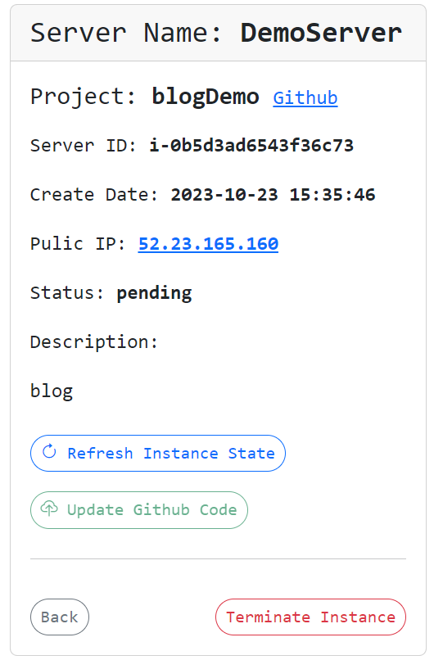
How It Works
Wait a minute.

Slide 9
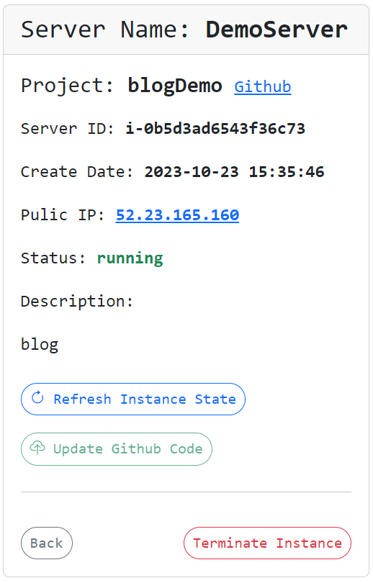
How It Works
Click “Public IP” to visit your webste.

Slide 10
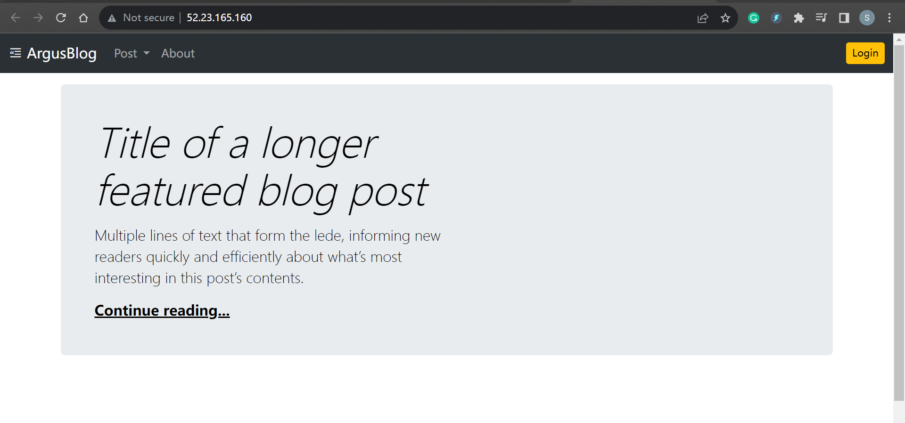
How It Works

Slide 11
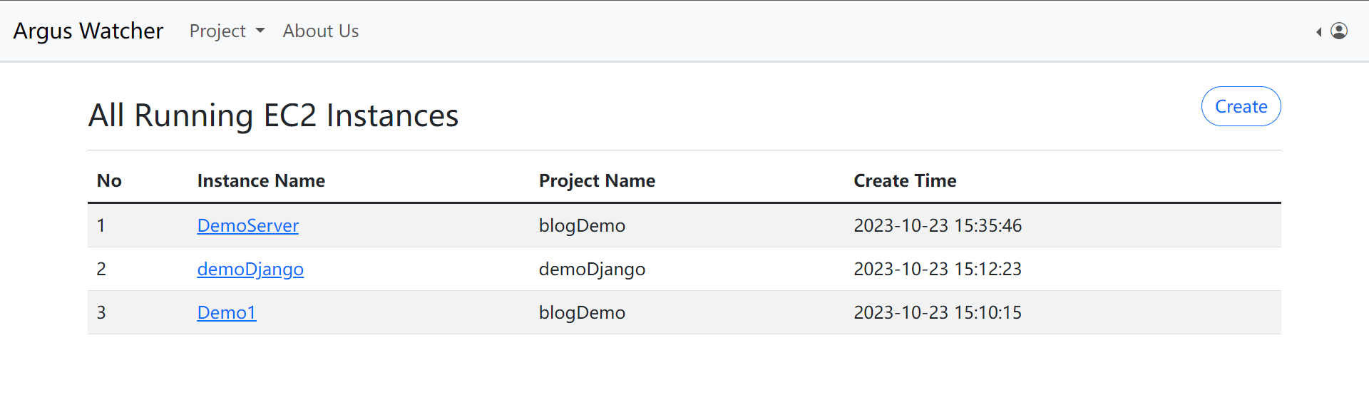
How It Works
View all your projects.

Slide 12
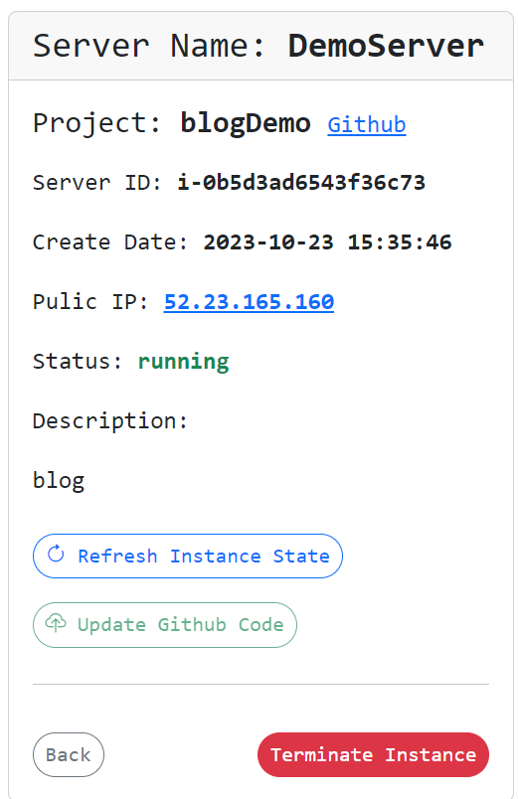
How It Works
Delete the project you don’t need.

Slide 13
Technologies Used
Django:
The core of our web application development.
A Python web framework used to build our project.
Git and GitHub:
Git: a version control system
Github: a cloud-based Git repository to store our codes.
https://github.com/simonangel-fong/EC-Django-Deploy.git

Slide 14








Technologies Used
CICD:
Automation process to continuous deploy our project
AWS CodeBuild, CodeDeploy, Pipline
Deployment:
AWS Cloud: EC2(Server), RDS(Database), Rout53(Domain)
Linux: Nginx + Gunicorn + Supervisor

Slide 15

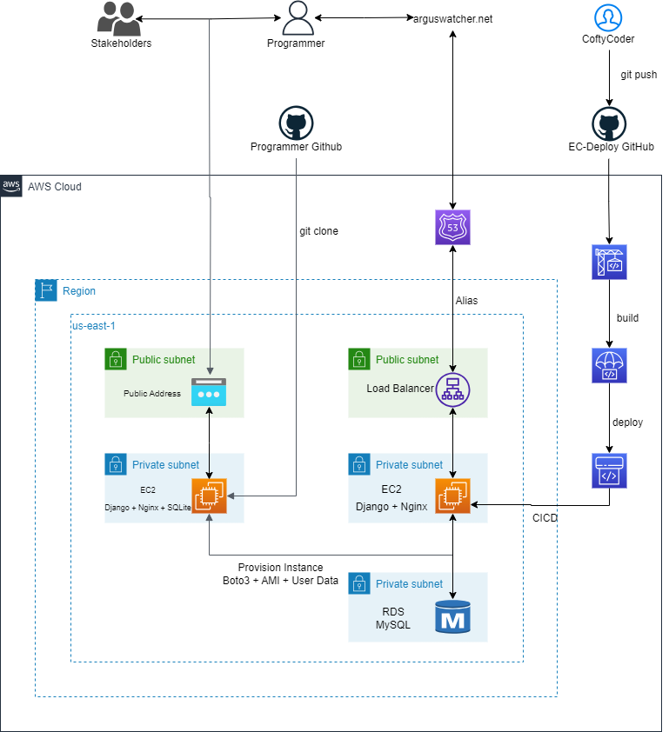



AWS Architecture

Slide 16

Benefits
Save Time:
Our application drastically reduces the time required for deployment.
With automated processes and one-click solutions, developers can allocate more time to coding and innovation, accelerating project timelines.

Slide 17

Benefits
Simplify Deployment:
Say goodbye to the complexities of deployment.
Our intuitive interface and seamless integrations with GitHub and AWS services simplify the entire deployment process, making it accessible even to those with minimal DevOps experience.

Slide 18

Benefits
Maintain Consistency:
Consistency is key in software development.
Our application enforces a standardized deployment structure, ensuring that all projects follow the same best practices. This not only enhances collaboration but also reduces the likelihood of errors.

Slide 19
Future Roadmap
Easy deployment service for other frameworks:
Spring
Node.js
ASP.NET Core
Easy machine learning
Create, train, and deploy machine learning model with one click

