Slide 1
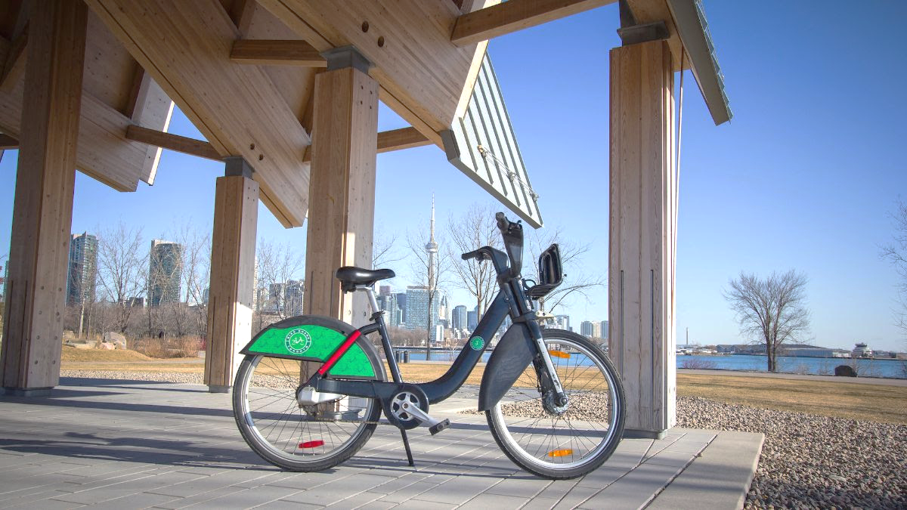
Urban Pedals
Unveiling Toronto's Bike Share Story

Slide 2
Overview
Data Source
Data Processing
Trip Analysis
Duration Analysis
Location Analysis

Slide 3
Data Source
Bike Share Toronto Ridership Data
Features
Authoritative, official data, one of the data sources in the Toronto Open Data Project.
Historical Data, since 2014.
Up-to-date, monthly update, last refreshed 2024-01-14.

Slide 4
Data Processing
Download and import data, 54 csv files.
Data Processing
Combine all datasets into one.
Drop “NA” and “NULL” records.
Convert time dimensional data. Character -> Int
Export processed data for consistency. (data.csv, 2.8G)

Slide 5
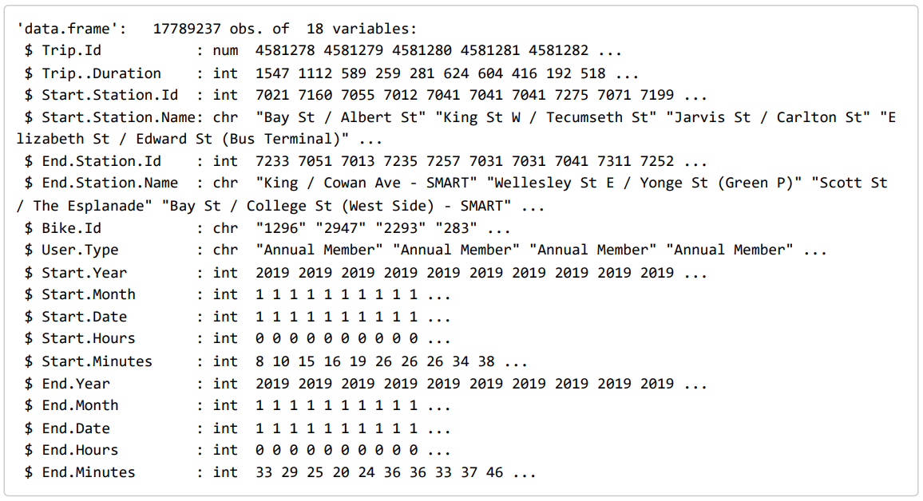
Data Processing - Summary
Rows: 17 million
Columns: 18

Slide 6
Trip Analysis
Trip Yearly Trends
Trip Monthly Pattern
Trip Hourly Pattern

Slide 7
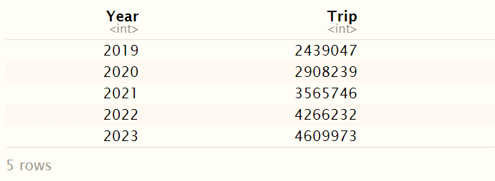
Trip Yearly Trends
Sum up the total trip per year
Plot a Line chart to reveal the pattern

Slide 8
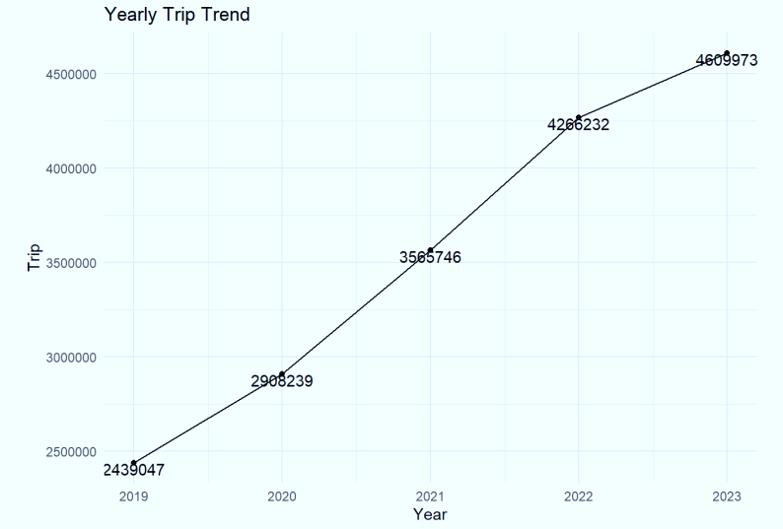
Trip Yearly Trends
From 2.4 million to 4.6 million in 5 yeas.
Doubled the number.
A consistent upward trend.

Slide 9
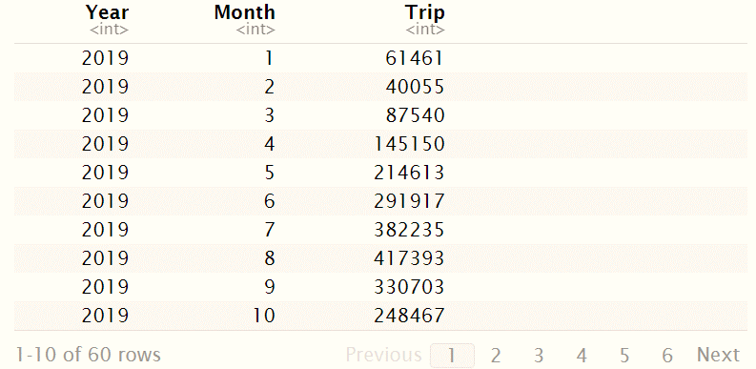
Trip Monthly Pattern
Sum up the total trip per month across 5 years.
Plot a Box plot, with the minimum, first quartile, median, third quartile, and maximum to reveal the pattern

Slide 10
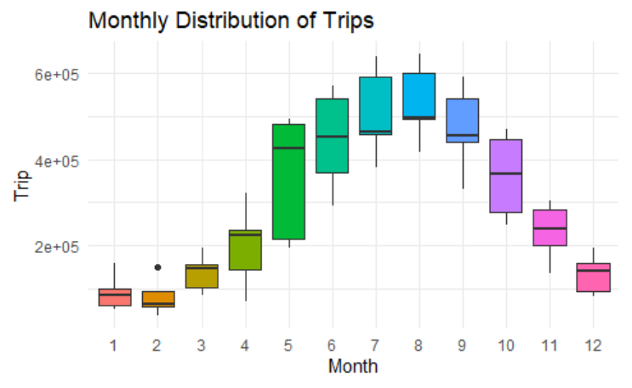
Trip Monthly Pattern
On average, how many people take shared-bike per month?
median
1st quarter: Stay low
2nd quarter: Rise sharply
3rd quarter: Reach the peak
4th quarter: Decline gradually

Slide 11
Trip Monthly Pattern
How does the number change?
Interquartile range
IQR = Q3 – Q1
range of the middle 50%
1st quarter: Remain small
2nd quarter: Expand sharply
Max in MAY
3rd quarter: Keep steady
4th quarter: Narrow gradually

Slide 12
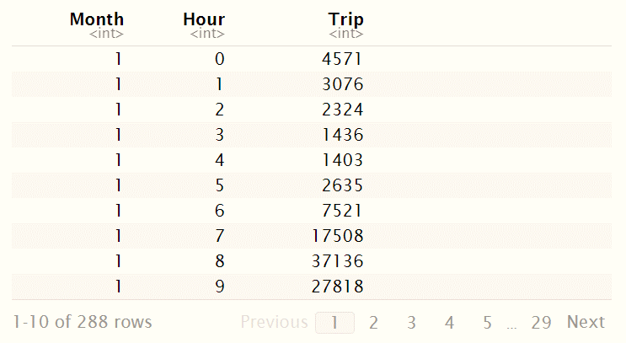
Trip Hourly Pattern
Sum up the total trip per hour across each month.
Plot a Box plot, with the minimum, first quartile, median, third quartile, and maximum to reveal the pattern

Slide 13
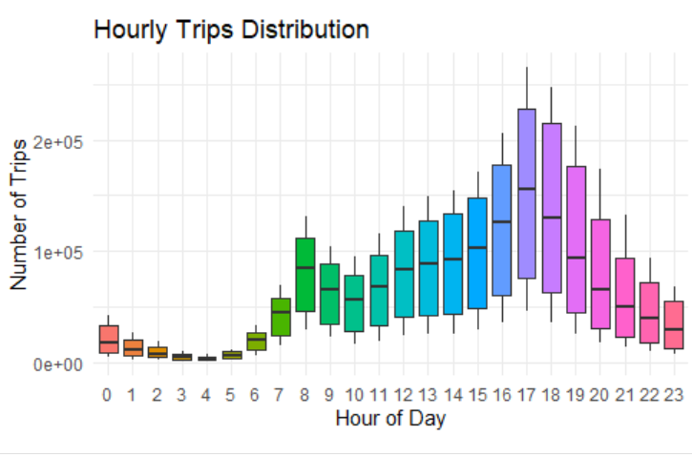
Trip Hourly Pattern
On average, how many people take shared-bike per hour?
median
Early Hours (12 a.m. – 5 a.m.): Low
Morning rush hours (6 a.m. – 9 a.m.): Increase rapidly
Working hours (9 a.m. – 5 p.m.): Increase steady with small fluctuation.
Evening Hours (5 p.m. – 12 a.m.): Decline gradually

Slide 14
Trip Hourly Pattern
How does the number change?
IQR
Early hours: Shrink slowly
Morning rush hours: Expand rapidly
Working hours: Increase steadily
Evening hours: Decline gradually

Slide 15
Duration Analysis
Duration Yearly Trends
Duration Monthly Pattern
Duration Hourly Pattern

Slide 16
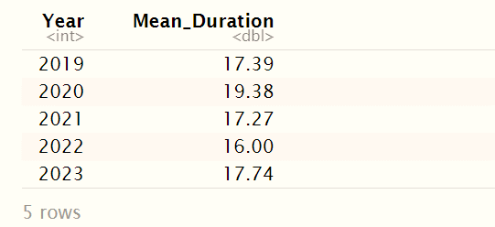
Duration Yearly Trends
Calculate the average duration per year.
Plot a Line chart to reveal the pattern.

Slide 17
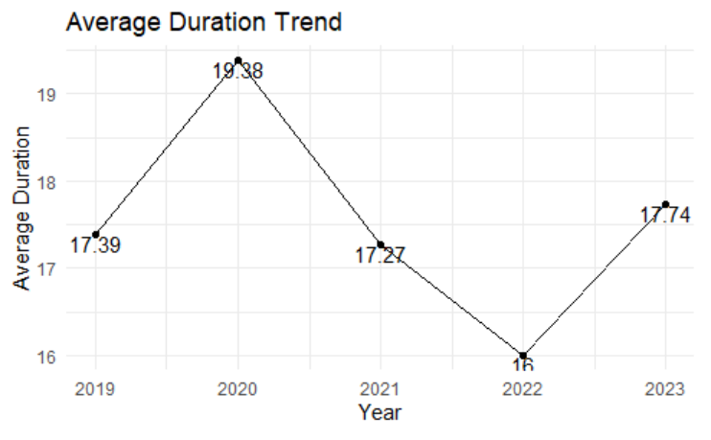
Trip Yearly Trends
Up-and-down
Around 17 minute

Slide 18
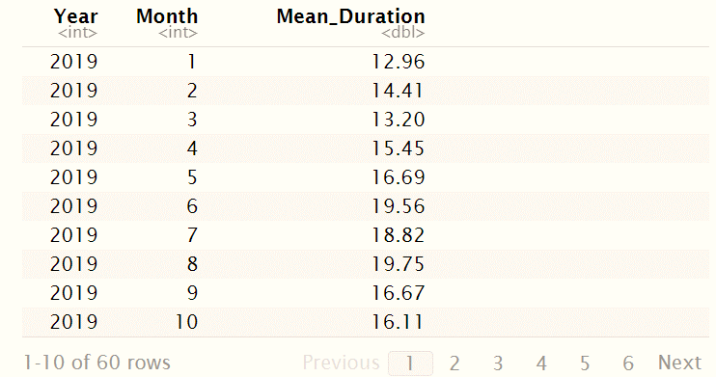
Duration Monthly Pattern
Calculate the mean duration per month across 5 years.
Plot a Box plot, with the minimum, first quartile, median, third quartile, and maximum to reveal the pattern

Slide 19
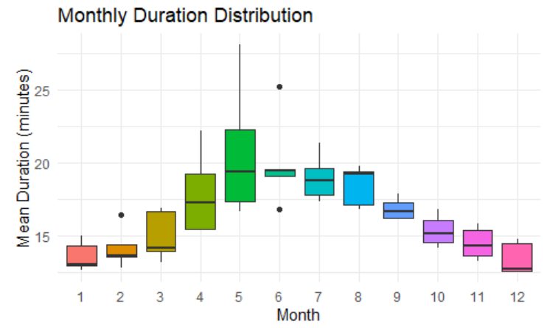
Duration Monthly Pattern
On average, how much time do people spend using shared bikes per month?
median
1st quarter: Steady low
2nd quarter: Rise slowly
3rd quarter: Start declining
4th quarter: Continue decreasing

Slide 20
Duration Monthly Pattern
How does the number change?
IQR
1st quarter: Shrink in Feb but grows swiftly in Mar.
2nd quarter: Remain wide until Jun, which dramatically shrink and has 2 outliers.
3rd quarter and 4th quarter: Keep steady.

Slide 21
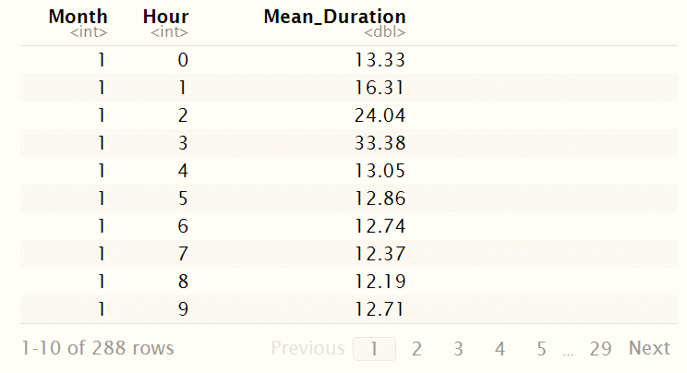
Duration Hourly Pattern
Calculate the mean duration per hour across the year.
Plot a Box plot, with the minimum, first quartile, median, third quartile, and maximum to reveal the pattern

Slide 22
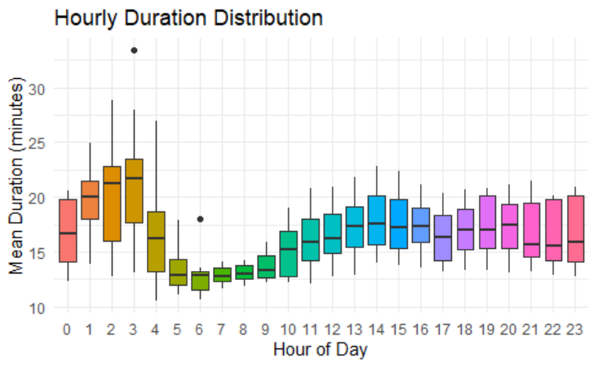
Duration Hourly Pattern
On average, how much time do people spend using shared bikes per hour?
median
Early hours: Increase until 3 am then drop sharply.
Morning rush hours: Stay steady
Working hours: Increase gradually
Evening hours: Keep stable until 8 p.m. then remain at 15 min.

Slide 23
Duration Hourly Pattern
How does the number change?
IQR
Early hours: substantial variation
Morning rush hours: Stay steady
Throughout the rest of the day: gap doesn't show a significant change with small fluctuation.

Slide 24
Insight of Trip and duration - Monthly Pattern
Reach peak value during Summer.
Have minimum value during Winter.
Numbers in May witness the biggest variant.

Slide 25
Insight of Trip and duration - Hourly Pattern
Early hours: Fewer people opt for shared bikes, but the duration of their rides is relatively long and varies significantly.
Morning rush hours : More people are using shared bikes, but the duration of their rides remains quite stable.

Slide 26
Insight of Trip and duration - Hourly Pattern
Working hours: As time passes, an increasing number of people are opting for shared bikes, and the duration of their rides remains stable.
Evening hours: As the night progresses, a decreasing number of individuals opt for shared bikes, yet their riding durations remain relatively consistent.

Slide 27
Location Analysis
Hot Start Locations
Hot End Locations
Hot Trips

Slide 28
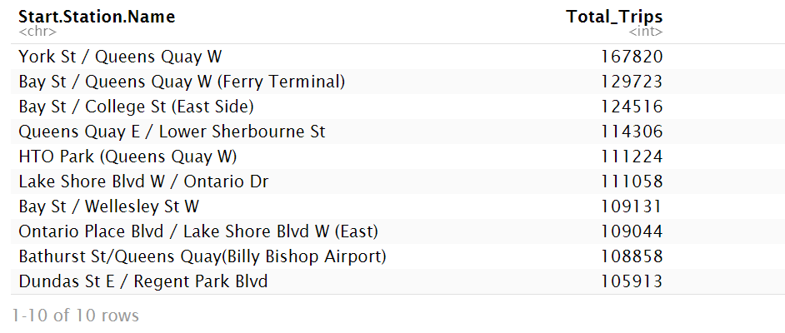
Hot Start Locations - starting station
Calculate the frequency of the starting station.

Slide 29
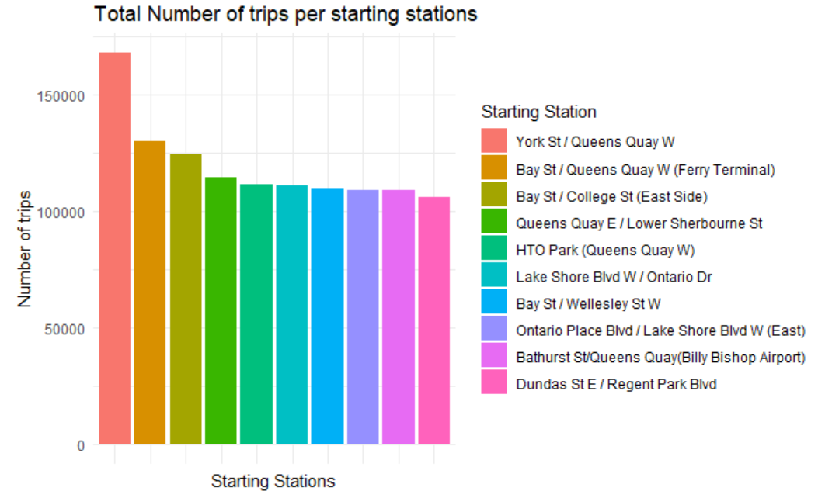
Hot Start Locations - starting station
Most Bike sharing trips start at York St/ Queens Quay West (174897 trips)
The most popular biker spots are located in Downtown, especially in Toronto Harbourfront

Slide 30
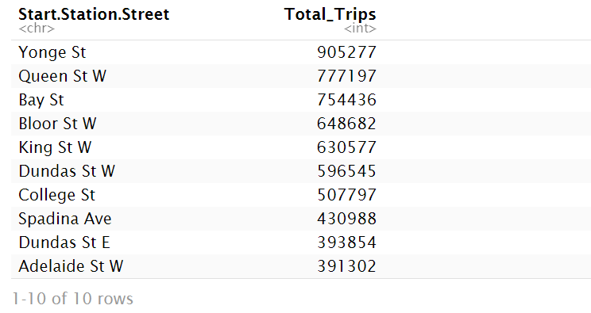
Hot Start Locations - start street
Calculate the frequency of the starting street.

Slide 31
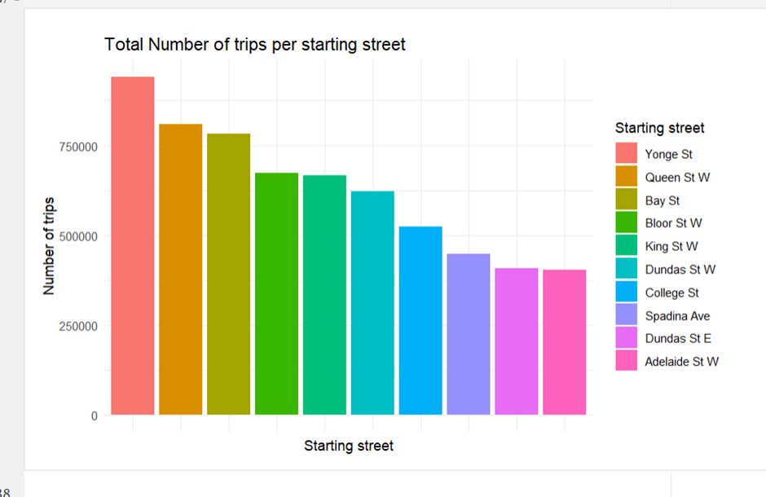
Hot Start Locations - start street
Most Bike sharing trips start at Yonge St (940814 trips)
Queen St W and bay St are notable popular streets for starting bike sharing
Indicates the busy level and bike friendliness of the street

Slide 32
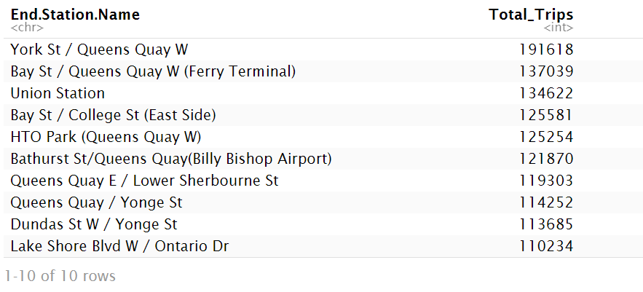
Hot End Locations - End Station
Calculate the frequency of the End Station.

Slide 33
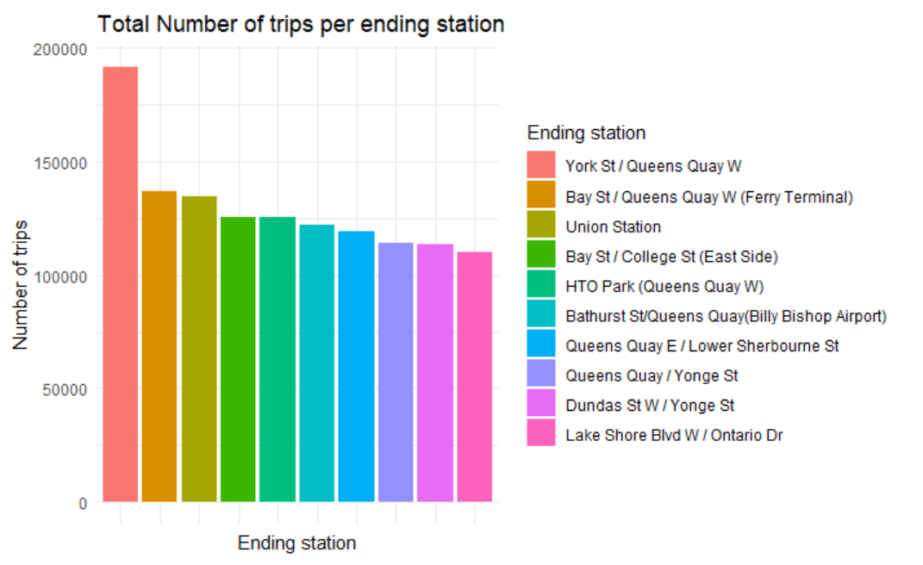
Hot End Locations - End Station
Most Bike sharing trips end at York St / Queens Quay West
The most popular biker spots are located in Downtown, especially in Toronto Harbourfront (top 3 are in harbourfront)

Slide 34
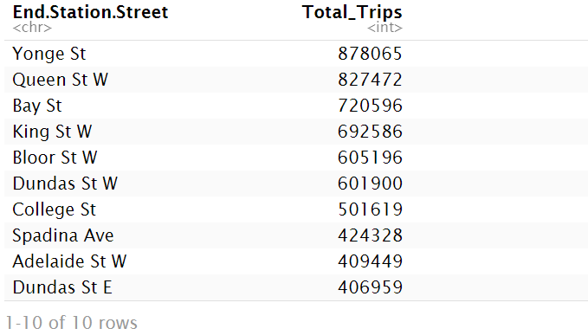
Hot End Locations - End street
Calculate the frequency of the End Street.

Slide 35
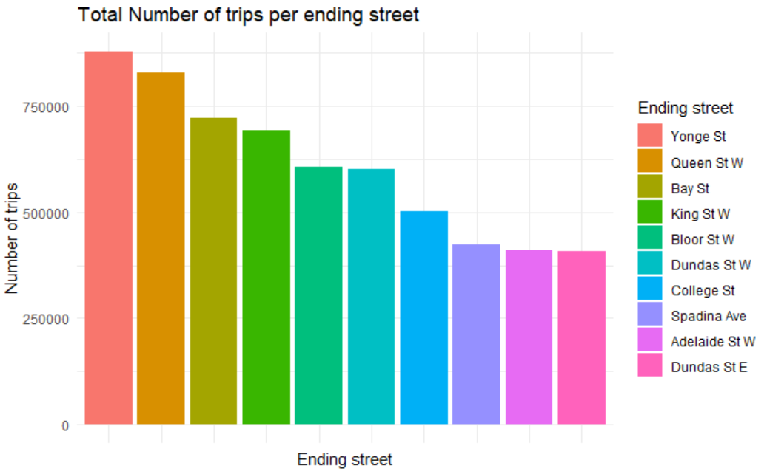
Hot End Locations - End street
Most Bike sharing trips end at Yonge St (910337 trips)
Queen St W and Bay St are notable popular streets for starting bike sharing
Indicates the busy level and bike friendliness of the street
Same result with starting street

Slide 36
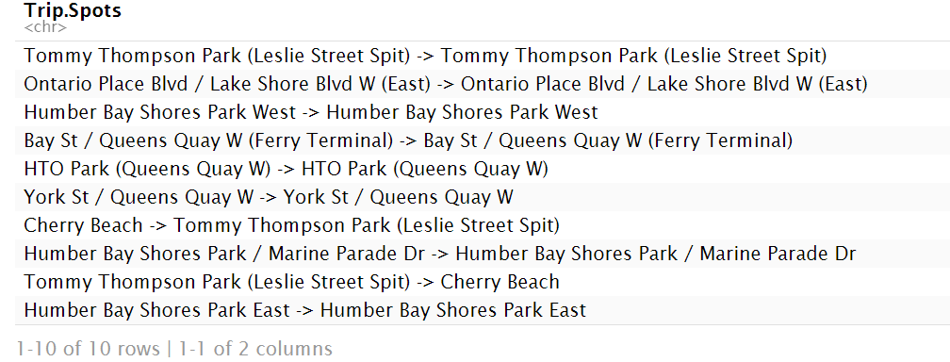
hot ride
Calculate the hot ride, a pair of stating spot and ending spot.

Slide 37
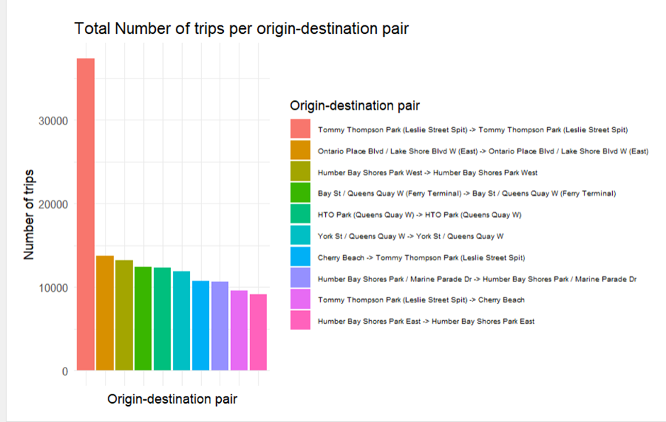
hot ride
Most Bike sharing trips start and end at Tommy Thompson Park (Lesile Street Split)
Other notable trips are between Ontario Place Blvd and Humber Bay Shores Park West

Slide 38
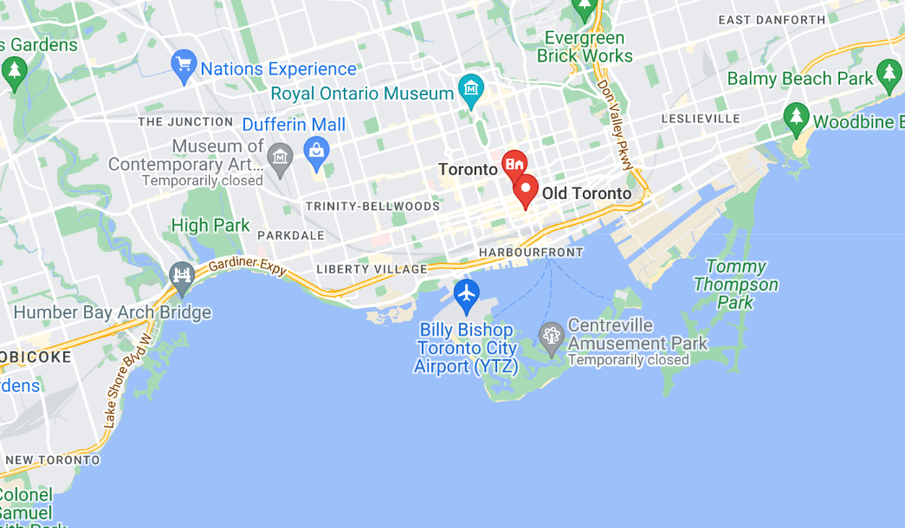
Insight - hot ride
These places are recreational area/ parks
Indicates leisure activities contributes a proportion of bike sharing in Toronto

Slide 39
Summary
In this project, we analyzed and examined the official shared-bike dataset for Toronto. Our findings reveal that:
During the summer, a greater number of individuals opt for shared bikes, while in the winter, the usage decreases, and a similar trend is observed in terms of the duration of rides.
Throughout the day, distinct patterns emerge in people's usage of shared bikes for early hours, morning rush hours, working hours, and evening hours.
In recreational areas with limited access to public transportation, there is a preference for shared bikes, leading to increased usage in these areas.

Slide 40
Source
O’Rourke, P. (2020). Toronto launches e-bike pilot program and expands bikeshare network. MobileSyrup. https://mobilesyrup.com/2020/06/09/toronto-launches-e-bike-pilot-program-expands-bikeshare-network/
City of Toronto. About Bike Share Toronto Ridership Data. https://open.toronto.ca/dataset/bike-share-toronto-ridership-data/

