Slide 1
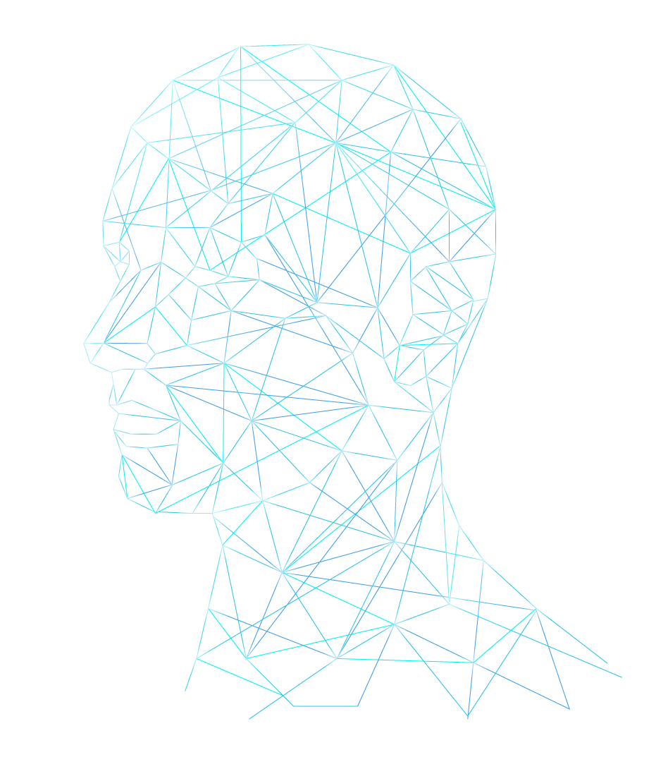
FACIAL EXPRESSION DETECTION
PREPARED BY:
DHVANI SONI
JASKIRAN KAUR SAINI

Slide 2

ABOUT THE DATASET
The FER-2013 dataset is sourced from the Kaggle Facial Expression Recognition Challenge
The dataset captures a wide spectrum of age ranges and orientations, contributing to its inclusivity and real-world relevance
Comprises 35,887 grayscale facial images, each sized at 48x48 pixels
Images labeled with one of seven emotion categories: Angry, Disgust, Fear, Happy, Sad, Surprise, Neutral
For our study, focus on 'happy,' 'sad,' and 'neutral' emotions.
Equal numbers of images were carefully chosen for each label, ensuring a balanced and representative dataset
Training: 9,080 images.
Testing: 2,280 images.
Happy
Neutral
Sad

Slide 3
MODELS FOR FER CLASSIFICATION
1
Convolution Neural Network
2
Transfer Learning with ResNet18
3
Transfer Learning with VGG16
4
Convolution Neural Network
with Batch Normalization

Slide 4
CNN WITH BATCH NORMALIZATION
Model comprises three convolutional blocks with specific filters and 3x3 kernel size.
Data augmentation applied to training and validation datasets using ImageDataGenerator for enhanced generalization.
Batch normalization and ReLU activation applied after each convolutional layer.
Max pooling (2x2) reduces spatial dimensions, followed by dropout (0.25) to prevent overfitting.
Flattened output from convolutional layers fed into two fully connected blocks:
Dense layers with units, batch normalization, ReLU activation, and dropout (0.25).
Last layer: Dense layer with 3 units for facial expression classes.
Softmax activation yields class probability distributions.
Optimized for data preprocessing and model training, key parameters such as image size batch size, number of epochs, learning rate, min learning rate, and optimizer are carefully tuned.

Slide 5
TRANSFER LEARNING WITH VGG16
Pre-trained VGG-16 model, trained on ImageNet, as a feature extractor.
Freezed all convolutional layers, ensuring that they remain unchanged during our training process and modify the final layer to our specific facial expression classification task.
The first layer captures more abstract representations from the convolutional layers, while the last layer has 3 nodes to correspond to our three facial expression classes: "happy," "sad," and "neutral."
Fine-tuning the model's output layer to facial expression classification.
Employed SGD optimizer with a learning rate of 0.001 and momentum of 0.9 for training the model. The model is trained for different number of epochs 10, 15, 25 using a batch size of 64,128,256.
Used categorical cross-entropy loss function as it is appropriate for multi-class classification tasks.

Slide 6
TRANSFER LEARNING WITH RESNET18
Pre-trained ResNet-18 model adopted for transfer learning in image classification.
Model comprises convolutional layers, batch normalization, ReLU activation, and residual blocks.
Initial convolutional layer followed by batch normalization and ReLU and max-pooling layer.
Four sequential blocks with two BasicBlock modules each includes 3x3 convolutions preserving or downsampling spatial dimensions.
AdaptiveAvgPool2d for spatial averaging, followed by a custom fully connected layer adapted from ResNet-18 for FER classification.
Convolutional layers frozen and used as feature extractors, complemented by a custom classifier featuring two fc layers (4096 and 3 nodes) designed for abstract feature extraction and final classification
Employed SGD optimizer with a learning rate of 0.001 and momentum of 0.9 for training the model. The model is trained for different number of epochs 10, 15, 25 using a batch size of 64,128,256.
Categorical cross-entropy loss employed for multi-class classification.

Slide 7
RESULT COMPARISON OF MODEL
 | CNN | RESNET | VGG | CNN+BN
Train Accuracy | 59.2 | 49.56 | 46.53 | 79.41
Test Accuracy | 58.9 | 48.34 | 51.05 | 71.23

Slide 8
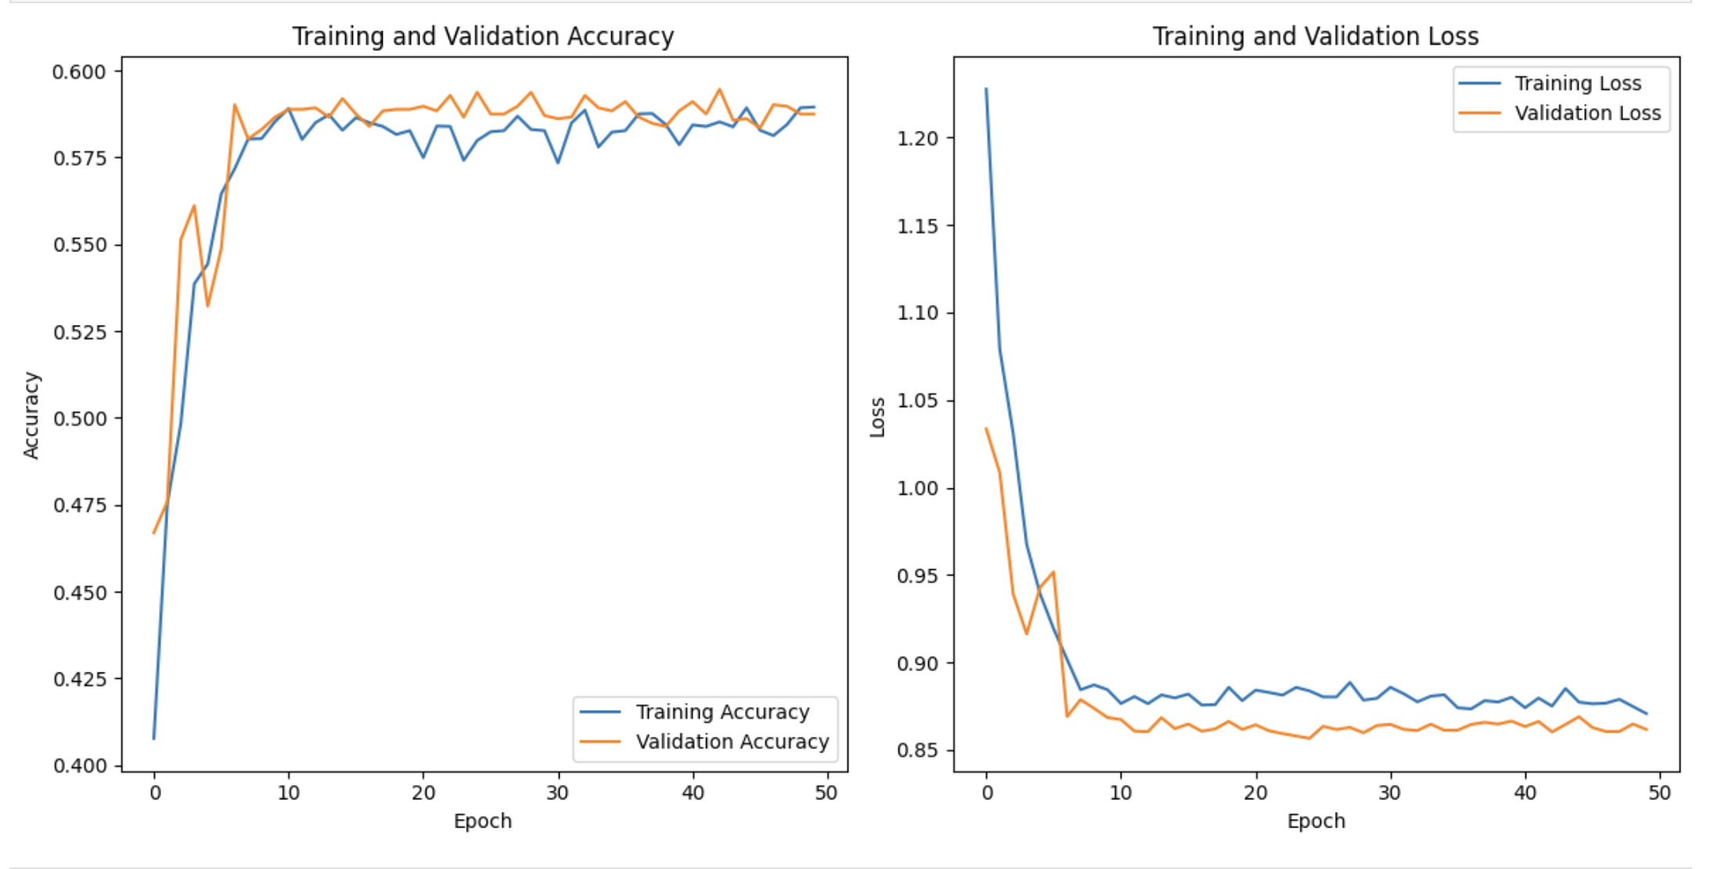
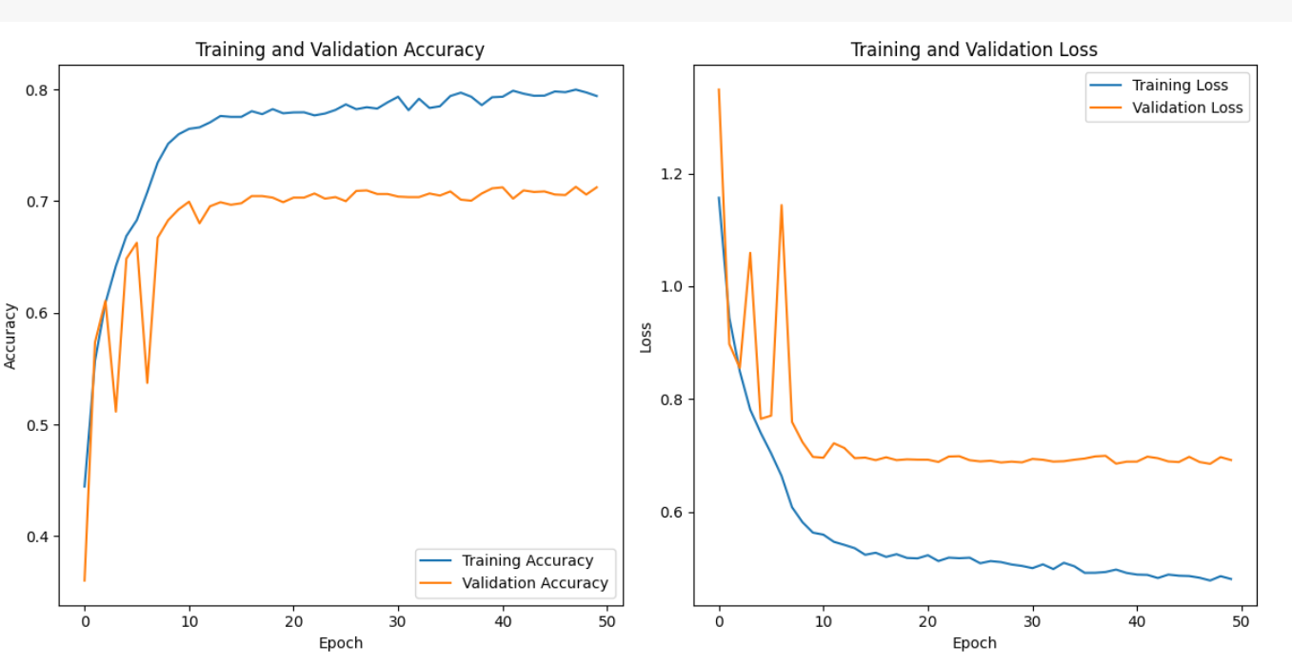
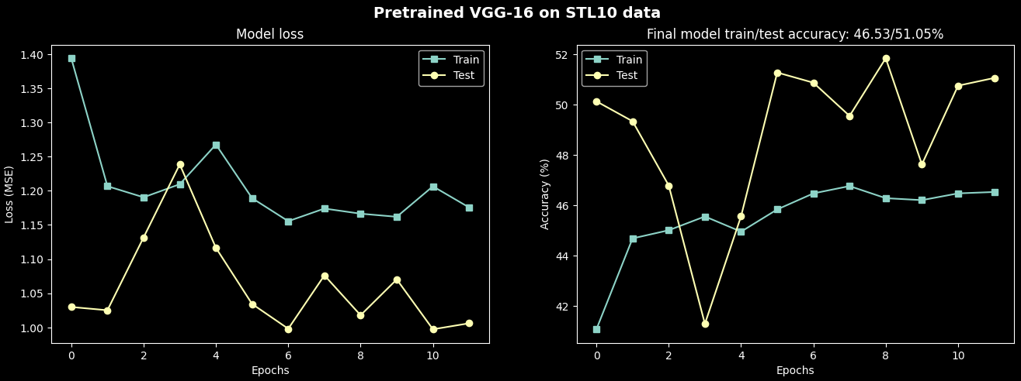
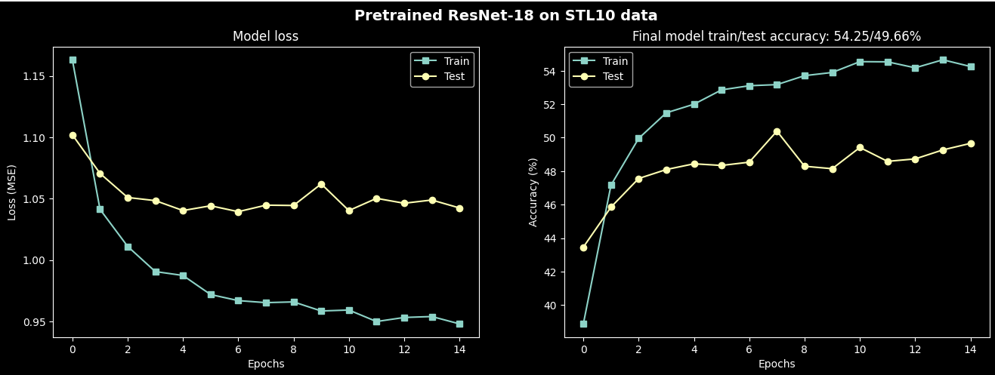
MODEL ACCURACY AND LOSS
CNN
CNN+BN
VGG16
RESNET18

Slide 9
MODEL ACCURACY AND LOSS
CNN

Slide 10
MODEL ACCURACY AND LOSS
CNN+BN

Slide 11
MODEL ACCURACY AND LOSS
VGG16

Slide 12
MODEL ACCURACY AND LOSS
RESNET18

Slide 13
RESULT COMPARISON OF MODEL
CNN+BN model achieved the highest accuracy on both the training and testing datasets, outperforming the other models.
The CNN+BN model demonstrated remarkable training accuracy, reaching 79.41% and achieving a testing accuracy of 71.23%. This indicates that the model effectively learned the underlying patterns in the data and successfully generalized to unseen samples.
The VGGNet and ResNet models showed lower training and testing accuracies compared to the CNN+BN model.
VGGNet achieved a training accuracy of 46.53% and a testing accuracy of 51.05%, while ResNet performed slightly worse with a training accuracy of 49.56% and a testing accuracy of 48.34%.

Slide 14
CLASSIFICATION REPORT FOR CNN+BN
 | Precision | Recall | F1-score | Support
happy | 0.85 | 0.77 | 0.81 | 750
neutral | 0.63 | 0.71 | 0.67 | 750
sad | 0.67 | 0.65 | 0.66 | 750
accuracy |  |  | 0.71 | 2250
macro avg | 0.72 | 0.71 | 0.71 | 2250
weighted avg | 0.72 | 0.71 | 0.71 | 2250

Slide 15
COMPARISON OF HYPERPARAMETRS
 | Batch Size | Optimizer | Learning Rate | Min Learning Rate | Epochs | Test Accuracy | Train Accuracy
1. | 64 | SGD | 0.0005 | 0.00001 | 50 | 59.24% | 58.95%
2. | 64 | Adam | 0.0005 | 0.00001 | 50 | 72.27% | 84.88%
3. | 128 | Adam | 0.0005 | 0.00001 | 50 | 71.23% | 79.41%
4. | 128 | Adam | 0.001 | 0.001 | 50 | 66.49% | 95.90%
5. | 128 | Adam | 0.001 | 0.00001 | 25 | 71.38% | 79.21%
6. | 256 | Adam | 0.01 | 0.005 | 25 | 56.13% | 67.34%

Slide 16
RESULTS AND OBSERVATION
SGD optimizer demonstrated slightly lower test accuracy (59.24%) compared to Adam (72.27%) with a batch size of 64.
The model with batch size 64 and Adam optimizer achieved the highest test accuracy of 72.27%.
Larger batch sizes (128 and 256) showed slightly lower test accuracies, suggesting the benefits of smaller batch sizes in this context.
The models consistently demonstrated higher training accuracy compared to test accuracy, indicating potential overfitting.
Elevating the learning rate to 0.001 boosted training accuracy (95.90%) but yielded only a marginal improvement in test accuracy (66.49%), emphasizing the delicate balance required for optimizing both training and generalization
Lower learning rates and min learning rates helped in optimizing the model's performance and thus yielded better results.

Slide 17
CONCLUSION
In conclusion, the CNN with batch normalization (CNN+BN) was the most successful model for facial expression recognition on FER dataset, achieving the highest accuracy on both training and testing datasets. The integration of batch normalization significantly improved training stability, resulting in faster convergence and better generalization. The CNN+BN model provides a promising approach for facial expression recognition tasks, along with hyperparameter tuning and thus can be further explored and optimized for real-world applications.

