Slide 1

GPU-Enabled MLOps Platform
One platform.
3 engineerings.
End-to-end MLOps practice.

Slide 2
Business Challenge
Training a Model Is Only the Beginning.
A model creates business value only when it works reliably in production.
How do teams close the GAP between experimentation and production?

Slide 3
Project Overview
This project addresses the challenge by dividing it into 3 perspectives:
ML engineering
Platform engineering
DevOps engineering
Present the solution with a car plate detection application

Slide 4
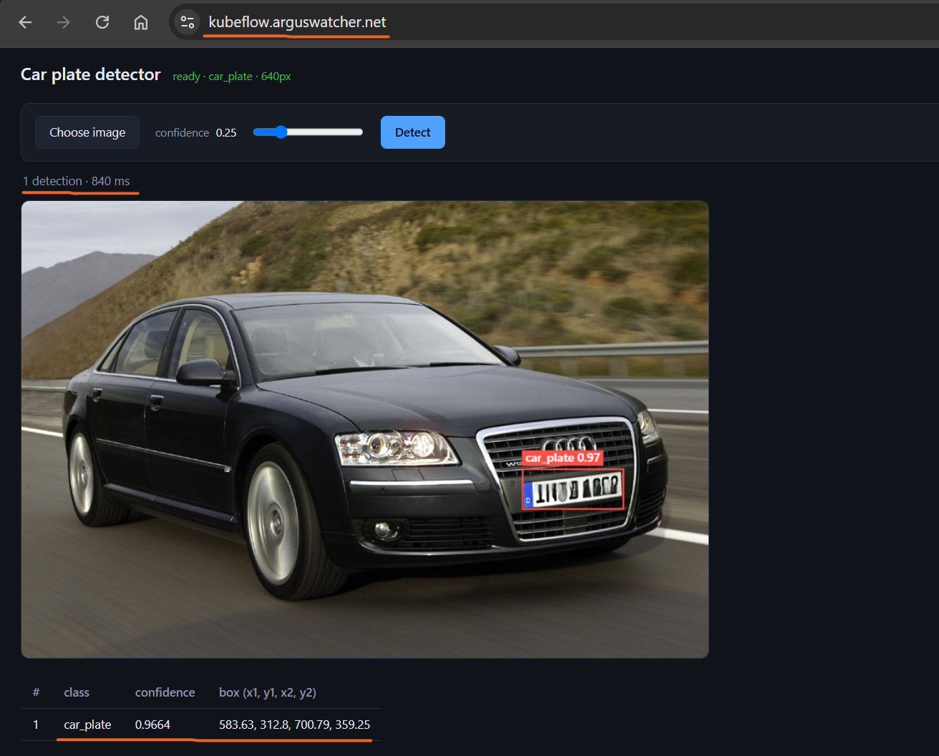
Demo
Live application demo:
car plate detection

Slide 5
ML engineering
Construct a machine learning platform with Kubeflow features.

Slide 6
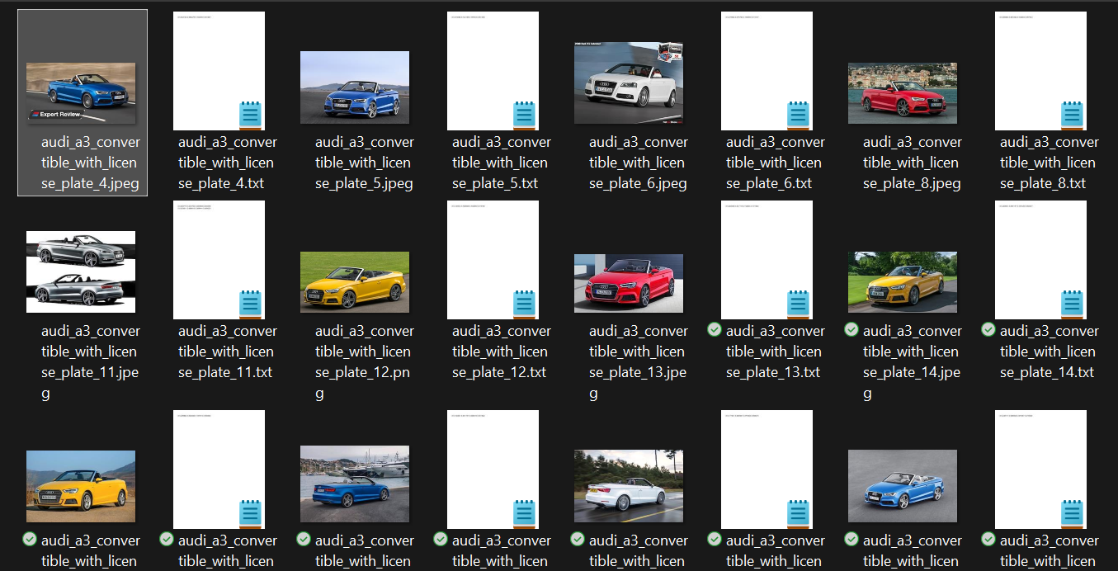
ML engineering - 1. Data preparation
S3 stores images and labels
DVC tracks versioning

Slide 7
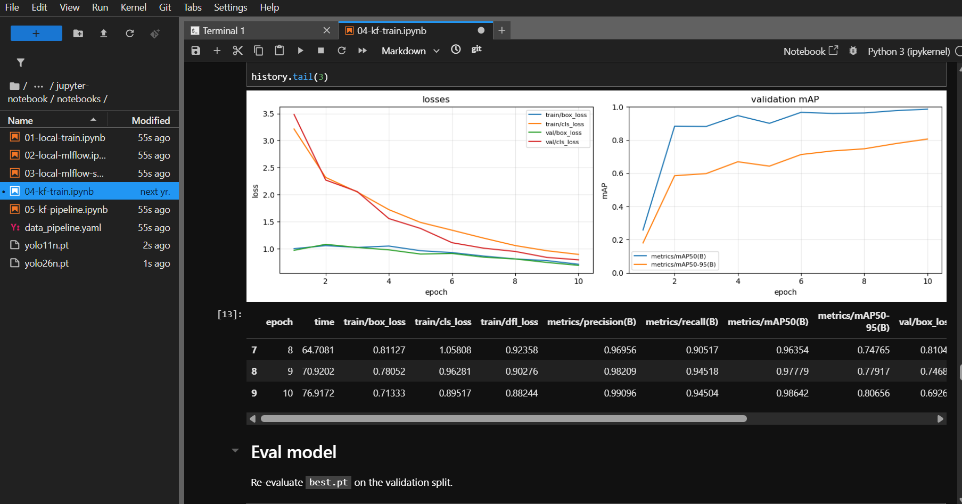
ML engineering - 2. Model development
Jupyter Notebook

Slide 8
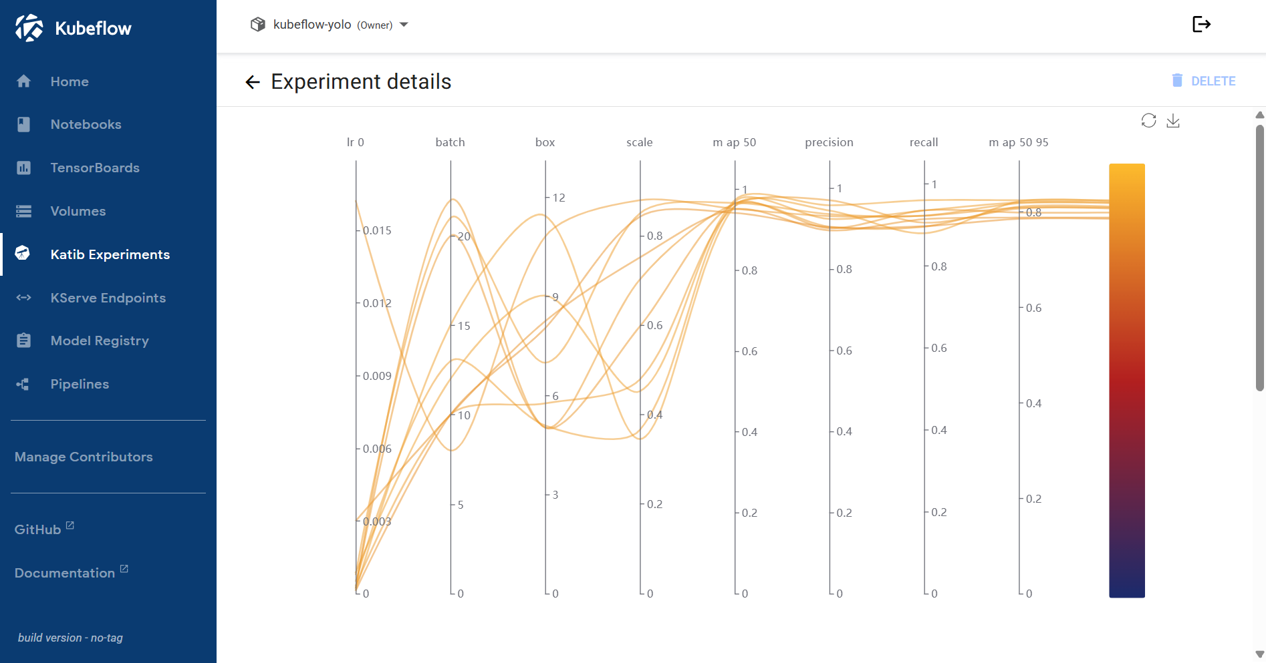
ML engineering - 3. Experimentation
Katib runs hyperparameter trials

Slide 9
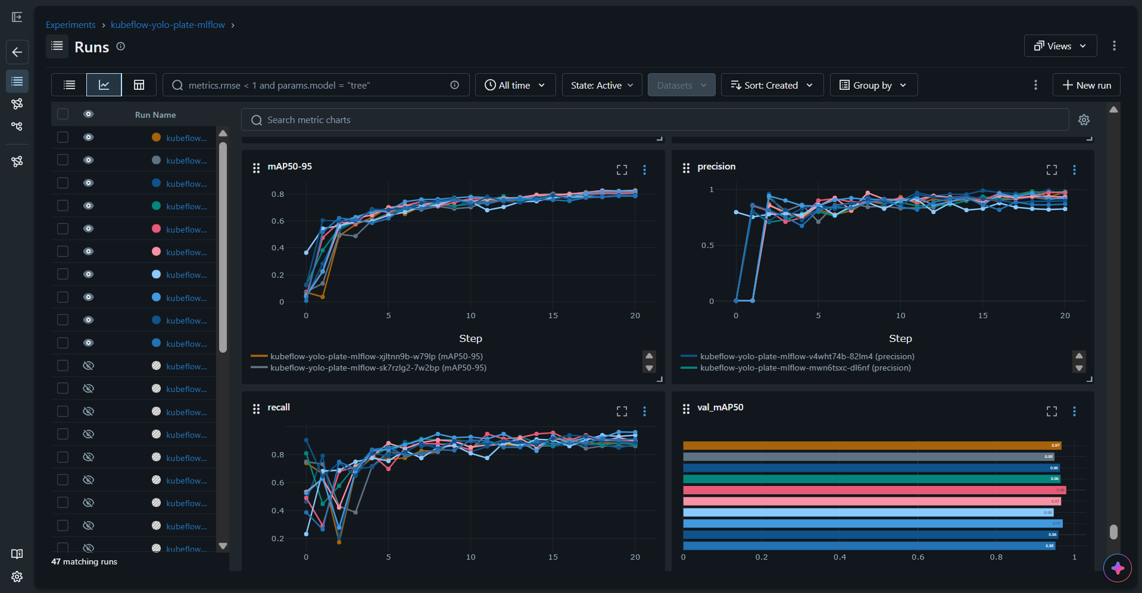
ML engineering - 3. Experimentation
MLflow tracks metrics

Slide 10
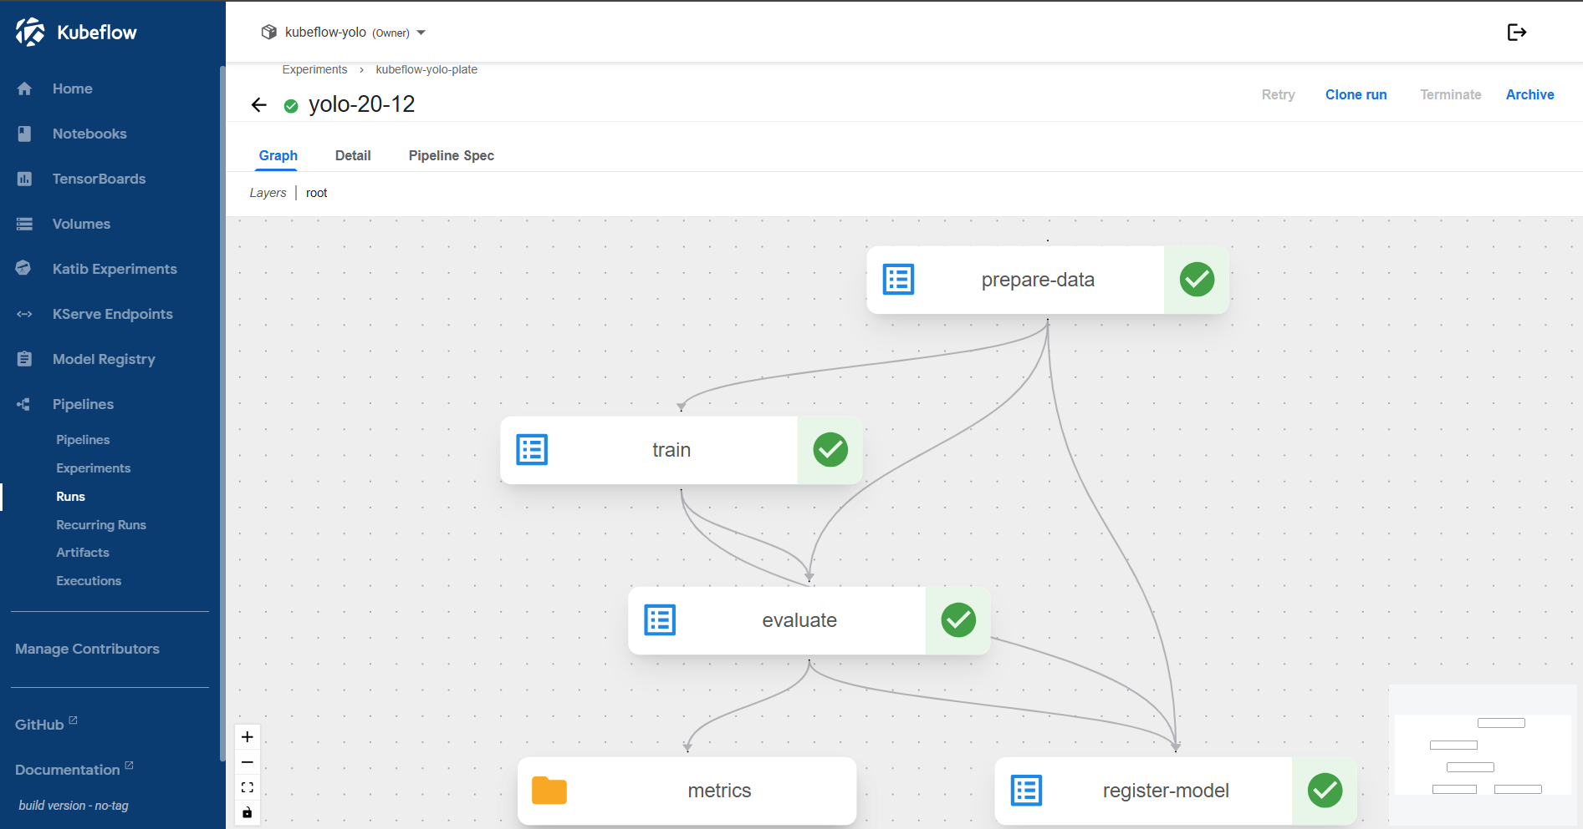
ML engineering - 4. Training pipeline
Kubeflow Pipeline for orchestration

Slide 11
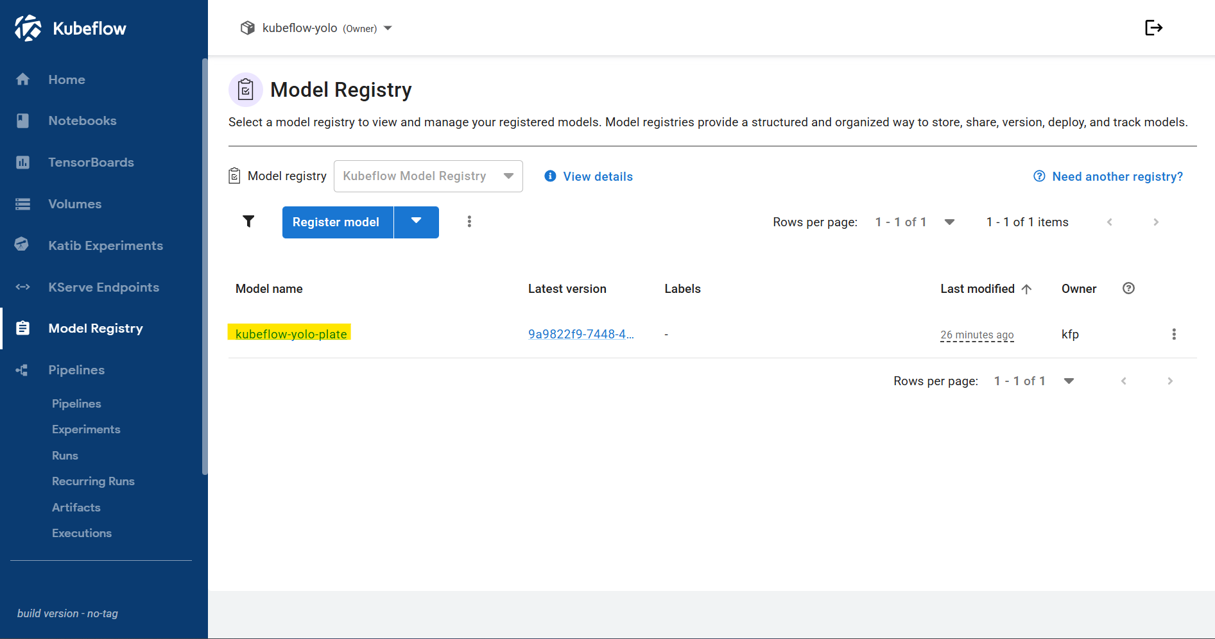
ML engineering - 4. Training pipeline
model registered and versioned after training

Slide 12
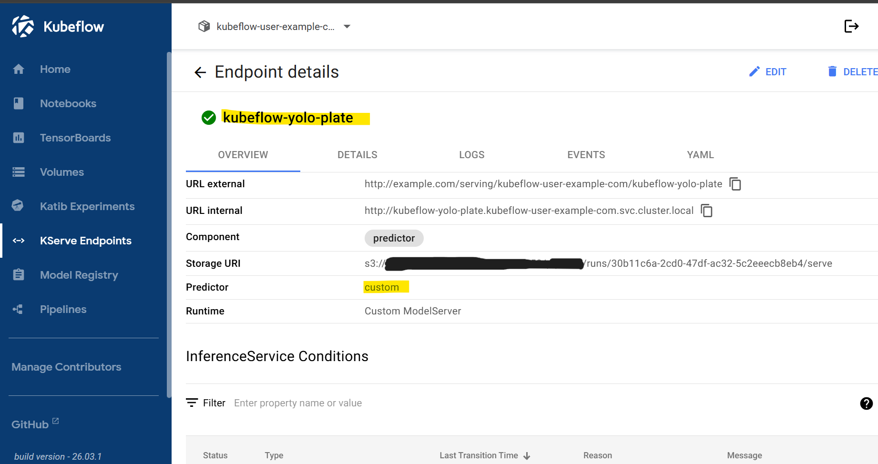
ML engineering - 5. Model serving
KServe for online inference

Slide 13
Platform Engineering - Infrastructure as Code
managed by Terraform with an S3 remote backend

Slide 14
Platform Engineering - Capabilities
Compute
Autoscaling and GPU node provisioning with Karpenter
Storage
Persistent and shared storage for ML workloads with S3, EBS, EFS, StorageClass, PVC
Networking
North-south/east-west traffic and automated DNS with ALBC, Istio, Gateway API, External DNS

Slide 15
Platform Engineering - Capabilities
Security
Secrets, encryption, certificates, and isolation with AWS Secrets Manager, KMS, ESO, cert-manager, NetworkPolicy
Monitoring
Logs and visualize platform metrics with Prometheus and Grafana

Slide 16
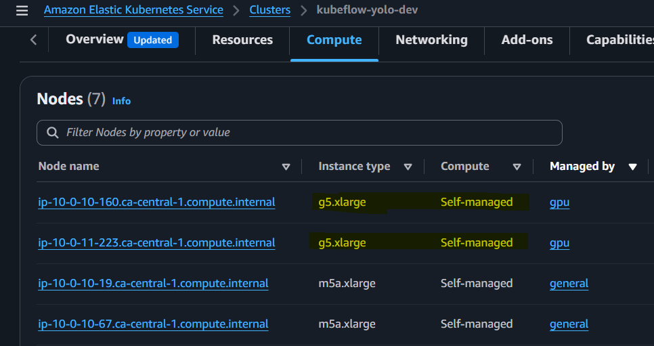
Platform Engineering
Autoscale GPU node provisioning with Karpenter

Slide 17
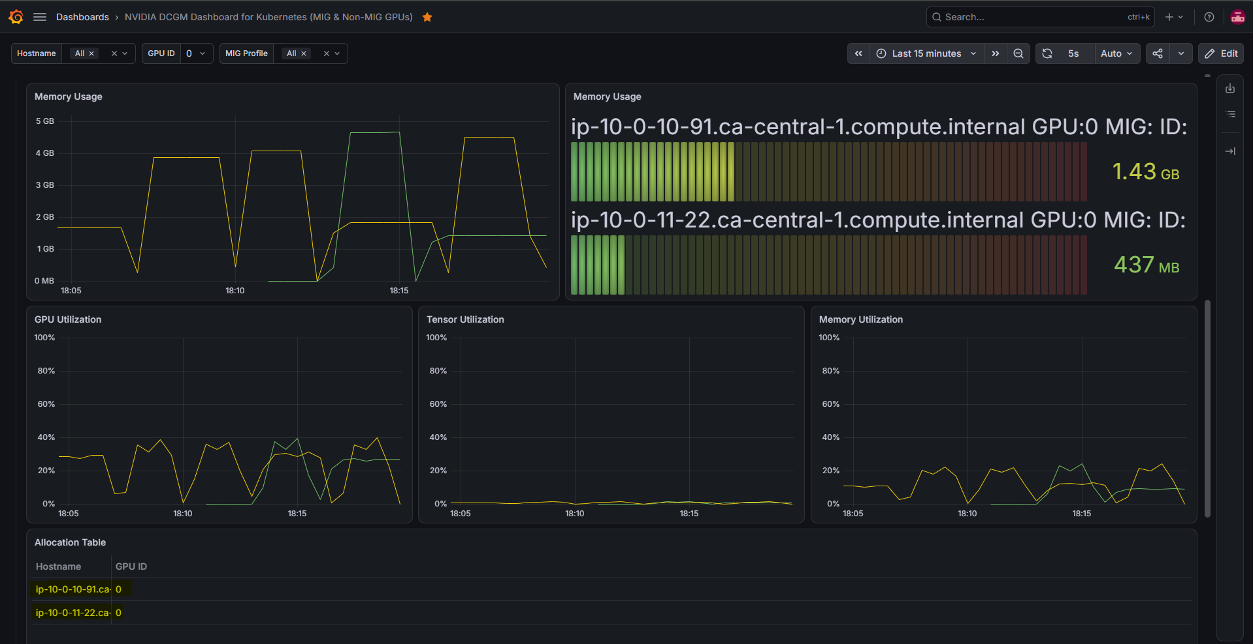
Platform Engineering
Monitor GPU usage in Grafana dashboard

Slide 18
DevOps Engineering
Create CI/CD pipelines with GitHub Actions
Deploy infrastructure with Terraform:
terraform-apply
Build and publish images to ECR:
build-image-train
build-image-inference
build-image-frontend

Slide 19
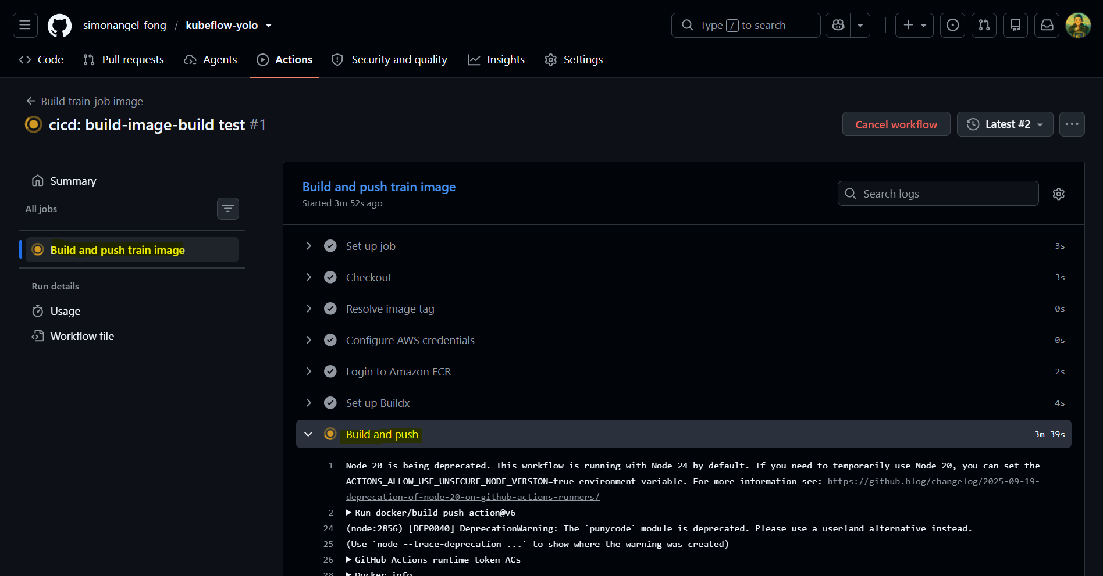
DevOps Engineering
CI pipeline demo: build-image-train

Slide 20
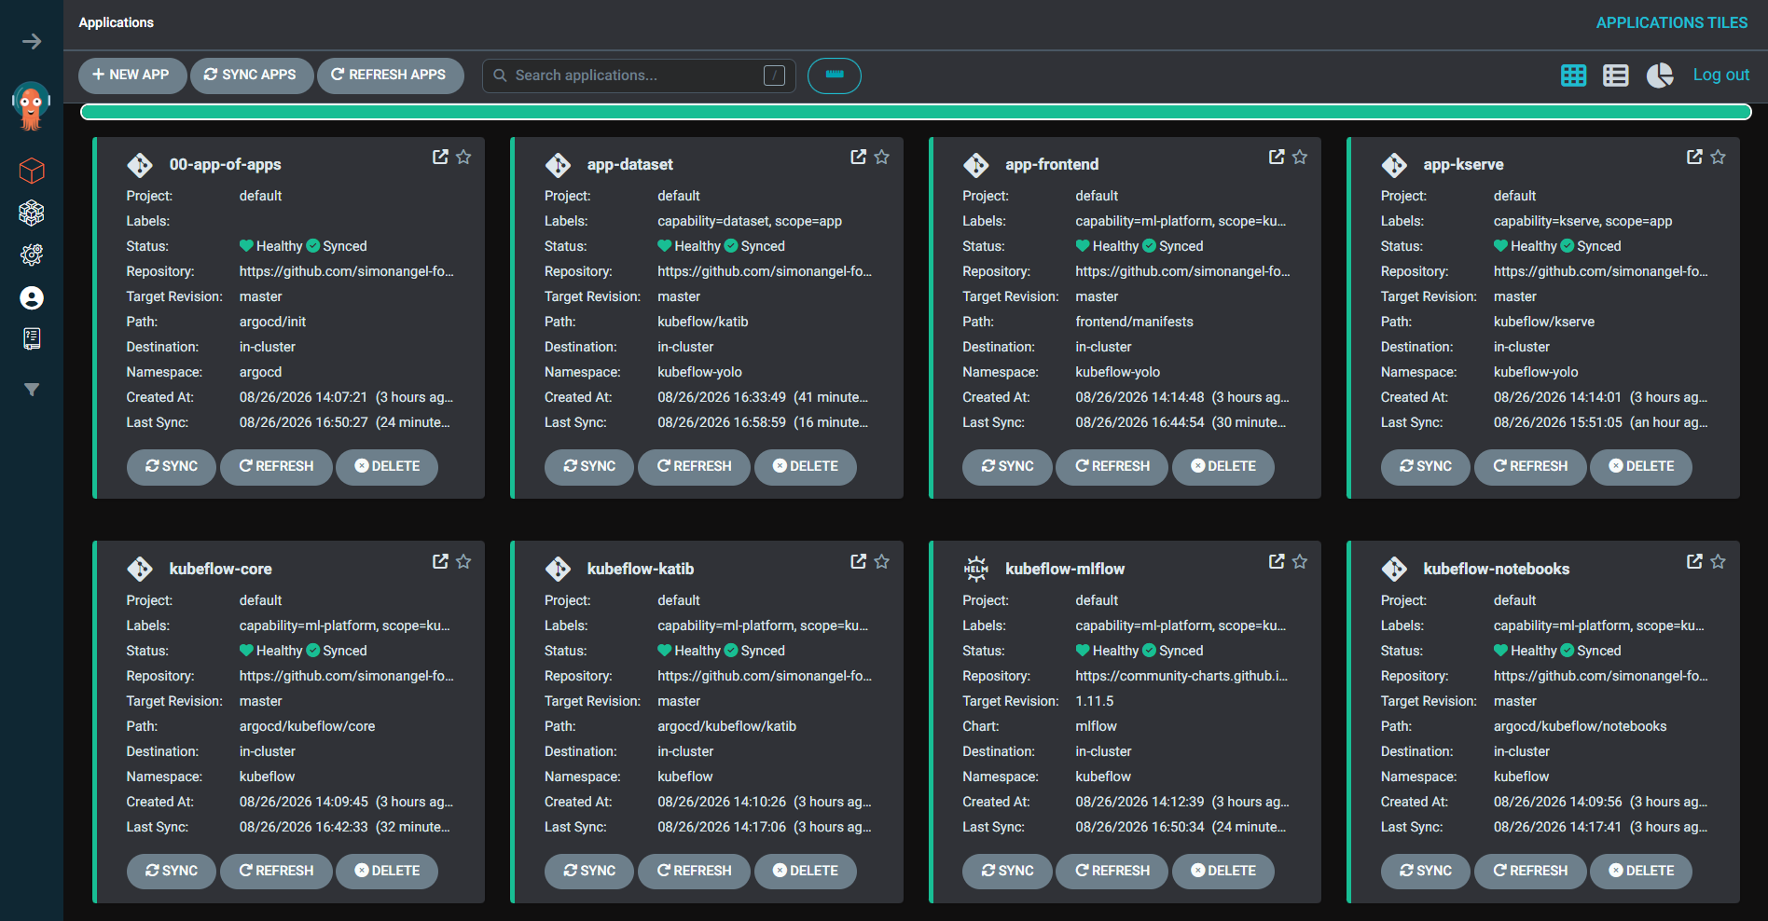
DevOps Engineering
Manage deployment with GitOps practices via Argo CD

Slide 21
Project Summary
Bridging the GAP between experimentation and production needs 3 pillars:
ML engineering: how to orchestrate model training?
Platform engineering: how to manage underlying infrastructure?
DevOps engineering: how to integrate and deploy ML application?

Slide 22
Project Architecture

Slide 23
LET'S TALK
Open to Cloud / DevOps / SRE / Platform / MLOps Engineering roles
Links:
▸ 🔗 Project website: kubeflow-yolo.arguswatcher.net
▸ 💻 GitHub: github.com/simonangel-fong/kubeflow-yolo
▸ 👤 LinkedIn: linkedin.com/in/simonangelfong/

