Slide 1
PART 2 / PLATFORM ADMINISTRATOR
Incident Response on Amazon EKS
The secrets are exposed. What happens next?
React2Shell lab / Part 2
The attacker has reached the cloud secret. Now the platform administrator investigates the evidence and contains the compromised pod.
01 / 18
Notes:
CAPTION
The attacker has reached the cloud secret. Now the platform administrator investigates the evidence and contains the compromised pod.
PRIMARY SOURCE
C:/Users/simon/OneDrive/Tech/Github/react2shell-eks/docs/post02_incident_response.md
SLIDE COPY
C:/Users/simon/OneDrive/Tech/Github/react2shell-eks/docs/post02_incident_response_slide.md
All activity and screenshots refer to the supplied controlled lab. No cloud or cluster commands were executed while creating this presentation.

Slide 2
The Administrator's Starting Point
Routine CloudTrail review reveals unexpected role activity.
Which workload made the calls?
What did it access?
The investigation starts with a routine CloudTrail review. Unexpected role activity gives the administrator a lead to investigate.
02 / 18
Notes:
CAPTION
The investigation starts with a routine CloudTrail review. Unexpected role activity gives the administrator a lead to investigate.
**Presenter note:** This episode demonstrates manual investigation. It does not demonstrate an automated alert. Role assumption is a normal IRSA operation and requires context before classifying it as malicious.
PRIMARY SOURCE
C:/Users/simon/OneDrive/Tech/Github/react2shell-eks/docs/post02_incident_response.md
SLIDE COPY
C:/Users/simon/OneDrive/Tech/Github/react2shell-eks/docs/post02_incident_response_slide.md
All activity and screenshots refer to the supplied controlled lab. No cloud or cluster commands were executed while creating this presentation.

Slide 3
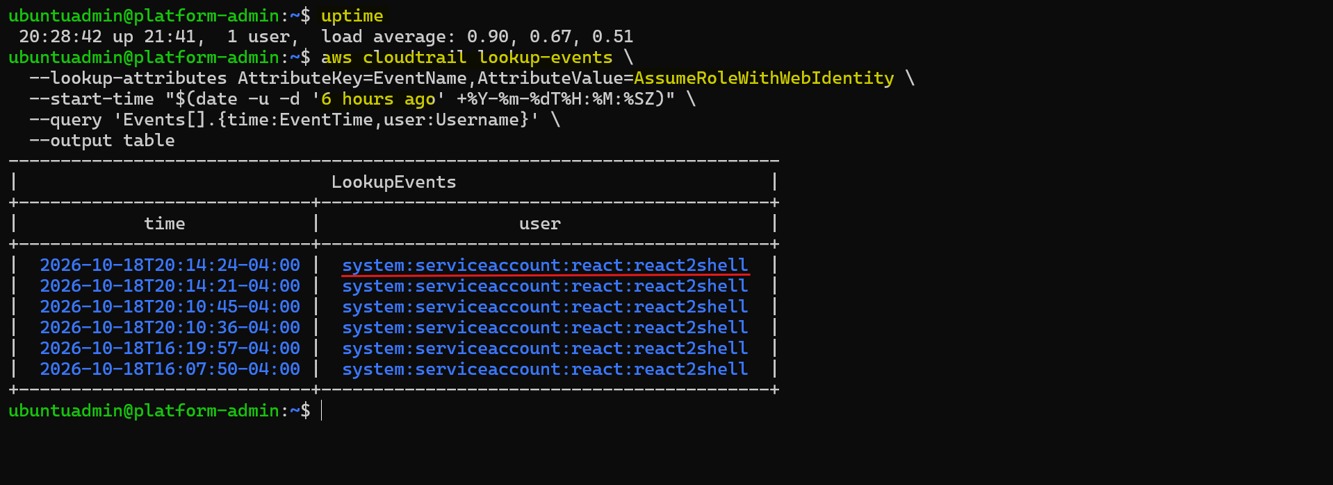
Four Recent Role Sessions
Event: AssumeRoleWithWebIdentity
Four sessions within four minutes.
Same workload identity.
Four recent sessions use the same workload identity. The administrator checks whether their activity fits the application's expected behavior.
03 / 18
Notes:
CAPTION
Four recent sessions use the same workload identity. The administrator checks whether their activity fits the application's expected behavior.
EVIDENCE
[CloudTrail event list](img/platform_admin/webid_event.png)
**Presenter note:** The screenshot also includes two earlier sessions. The investigation focuses on the four calls between 00:10:36 and 00:14:24 UTC on October 19. Frequency alone does not confirm compromise.
PRIMARY SOURCE
C:/Users/simon/OneDrive/Tech/Github/react2shell-eks/docs/post02_incident_response.md
SLIDE COPY
C:/Users/simon/OneDrive/Tech/Github/react2shell-eks/docs/post02_incident_response_slide.md
All activity and screenshots refer to the supplied controlled lab. No cloud or cluster commands were executed while creating this presentation.

Slide 4
The Workload Identity
Namespace
react
Service account
react2shell
IAM role
react2shell-eks-insecure-pod-irsa
The CloudTrail identity points to the react2shell service account in the react namespace and its associated IAM role.
04 / 18
Notes:
CAPTION
The CloudTrail identity points to the react2shell service account in the react namespace and its associated IAM role.
**Evidence:** Readable identity excerpt from the source guide's full event summary. No raw token or session credentials appear on the slide.
PRIMARY SOURCE
C:/Users/simon/OneDrive/Tech/Github/react2shell-eks/docs/post02_incident_response.md
SLIDE COPY
C:/Users/simon/OneDrive/Tech/Github/react2shell-eks/docs/post02_incident_response_slide.md
All activity and screenshots refer to the supplied controlled lab. No cloud or cluster commands were executed while creating this presentation.

Slide 5
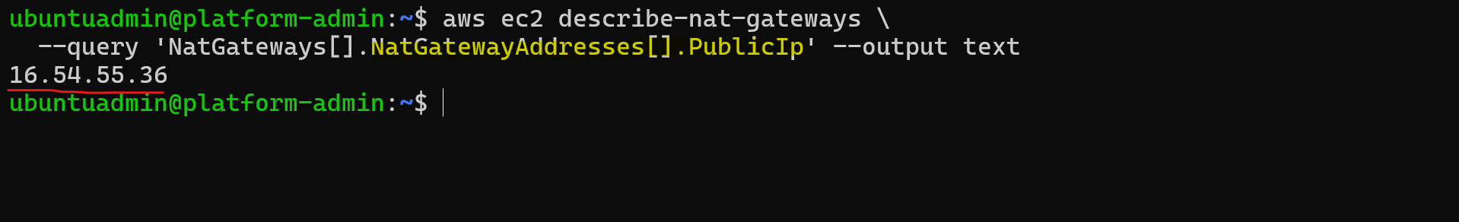
The Source IP Matches Cluster Egress
Source IP: 16.54.55.36
Matches the EKS environment's NAT gateway.
The shared IP alone cannot identify a pod.
The source IP matches the cluster's NAT gateway. The administrator still needs workload and log evidence to identify the pod.
05 / 18
Notes:
CAPTION
The source IP matches the cluster's NAT gateway. The administrator still needs workload and log evidence to identify the pod.
EVIDENCE
[NAT gateway lookup](img/platform_admin/webid_ip_check.png)
PRIMARY SOURCE
C:/Users/simon/OneDrive/Tech/Github/react2shell-eks/docs/post02_incident_response.md
SLIDE COPY
C:/Users/simon/OneDrive/Tech/Github/react2shell-eks/docs/post02_incident_response_slide.md
All activity and screenshots refer to the supplied controlled lab. No cloud or cluster commands were executed while creating this presentation.

Slide 6
What the Sessions Accessed
2026-10-19 / UTC
Time | Action | Result
00:10:36 | ListSecrets | Secret discovery
00:10:45 | GetSecretValue | Lab RDS credential
00:14:21 | GetSecretValue | Same credential
00:14:25 | ListSecrets | Secret discovery
Two reads of the same cloud secret.
Session-key lookups reveal secret discovery and two reads of the same lab credential, within a three-minute, forty-nine-second window.
06 / 18
Notes:
CAPTION
Session-key lookups reveal secret discovery and two reads of the same lab credential, within a three-minute, forty-nine-second window.
**Evidence:** Readable table from the source guide's session lookups. The final ListSecrets call occurs at 00:14:25 UTC; its role session starts at 00:14:24.
PRIMARY SOURCE
C:/Users/simon/OneDrive/Tech/Github/react2shell-eks/docs/post02_incident_response.md
SLIDE COPY
C:/Users/simon/OneDrive/Tech/Github/react2shell-eks/docs/post02_incident_response_slide.md
All activity and screenshots refer to the supplied controlled lab. No cloud or cluster commands were executed while creating this presentation.

Slide 7
The Identity Leads to a Pod
Match .spec.serviceAccountName to react2shell.
Pod: react2shell-6d4d4db59d-xwtxq
Compare its logs with the CloudTrail sessions.
The administrator finds the pod using this service account, then compares its timestamped logs with the AWS activity.
07 / 18
Notes:
CAPTION
The administrator finds the pod using this service account, then compares its timestamped logs with the AWS activity.
**Evidence:** Readable excerpt from the source guide's pod lookup.
PRIMARY SOURCE
C:/Users/simon/OneDrive/Tech/Github/react2shell-eks/docs/post02_incident_response.md
SLIDE COPY
C:/Users/simon/OneDrive/Tech/Github/react2shell-eks/docs/post02_incident_response_slide.md
All activity and screenshots refer to the supplied controlled lab. No cloud or cluster commands were executed while creating this presentation.

Slide 8
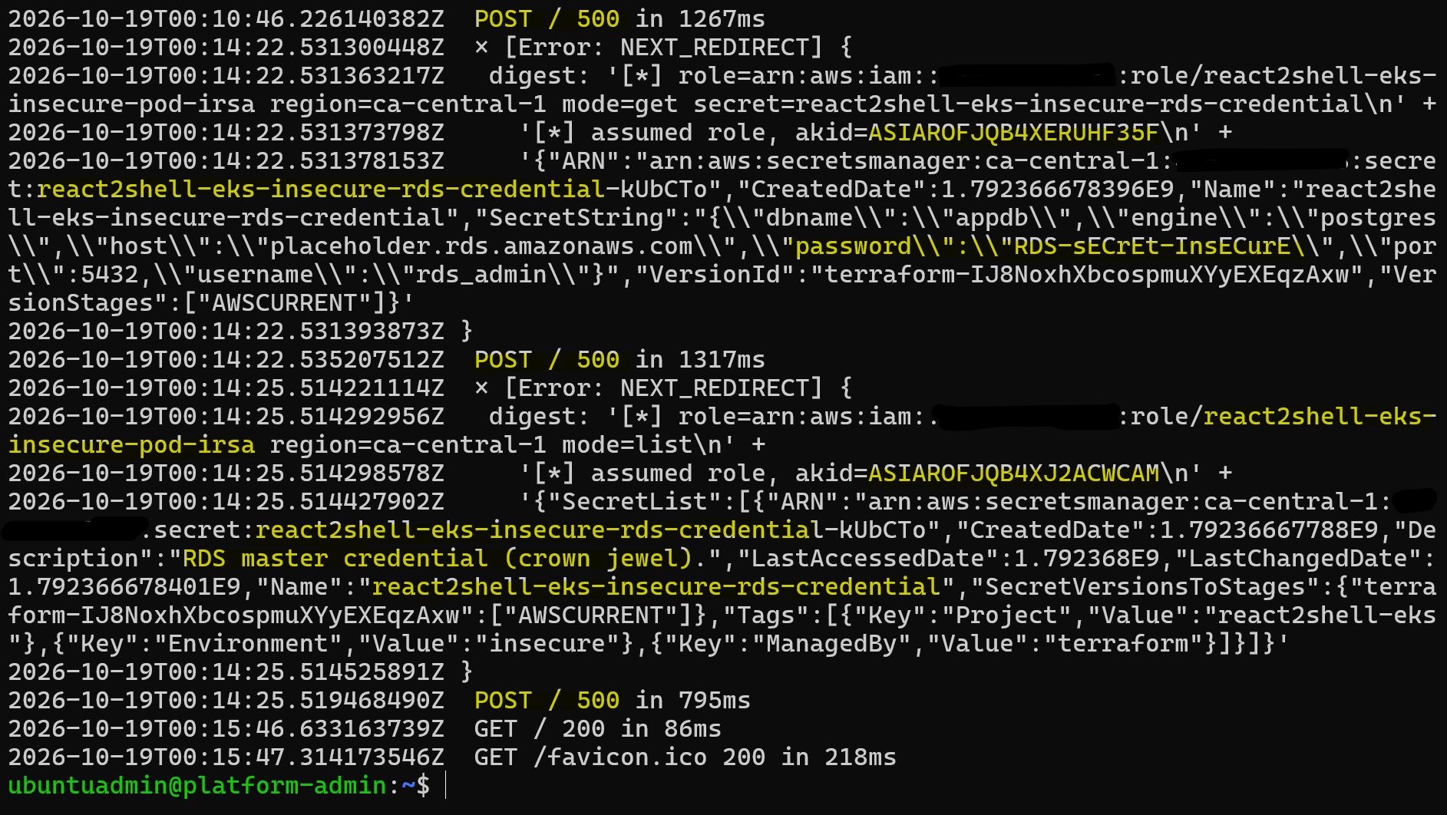
Pod Logs Confirm Secret Exposure
Session key matches CloudTrail.
Error digest contains the lab secret value.
Timestamps align with GetSecretValue.
Matching session keys and timestamps connect the cloud calls to the pod. Its error output also contains the lab secret value.
08 / 18
Notes:
CAPTION
Matching session keys and timestamps connect the cloud calls to the pod. Its error output also contains the lab secret value.
EVIDENCE
[Timestamped pod logs](img/platform_admin/react_pod_logs02.png)
**Presenter note:** HTTP 500 responses alone do not prove exploitation. In this lab, the correlated command output and secret value establish the link. The RDS credential is synthetic. A database login is not demonstrated.
PRIMARY SOURCE
C:/Users/simon/OneDrive/Tech/Github/react2shell-eks/docs/post02_incident_response.md
SLIDE COPY
C:/Users/simon/OneDrive/Tech/Github/react2shell-eks/docs/post02_incident_response_slide.md
All activity and screenshots refer to the supplied controlled lab. No cloud or cluster commands were executed while creating this presentation.

Slide 9
Evidence Supports a Confirmed Breach
CloudTrail records successful secret access.
Pod logs show the same session and secret output.
Preserve the evidence and begin containment.
CloudTrail and pod logs corroborate the breach. The administrator now limits the pod's access while preserving evidence.
09 / 18
Notes:
CAPTION
CloudTrail and pod logs corroborate the breach. The administrator now limits the pod's access while preserving evidence.
PRIMARY SOURCE
C:/Users/simon/OneDrive/Tech/Github/react2shell-eks/docs/post02_incident_response.md
SLIDE COPY
C:/Users/simon/OneDrive/Tech/Github/react2shell-eks/docs/post02_incident_response_slide.md
All activity and screenshots refer to the supplied controlled lab. No cloud or cluster commands were executed while creating this presentation.

Slide 10
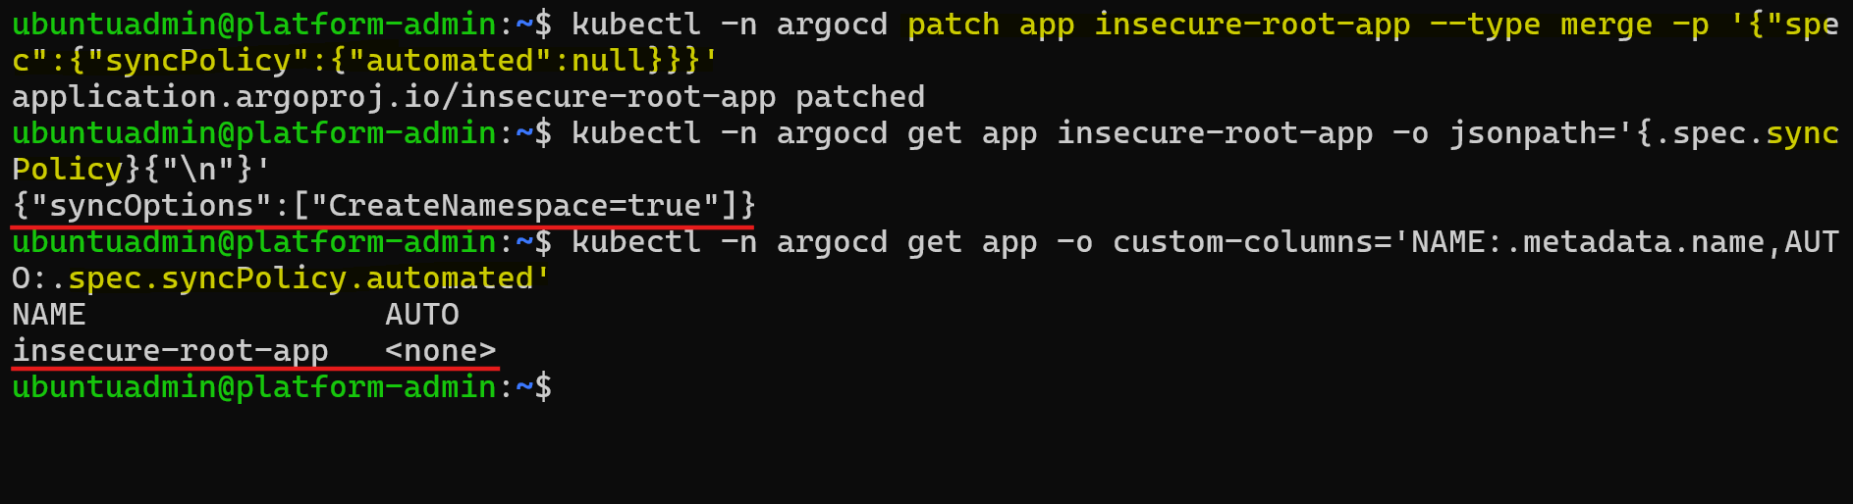
GitOps Reconciliation Paused
Disable Argo CD auto-sync.
Check parent and child Applications.
Keep emergency changes from reverting.
The administrator pauses automatic sync and checks the Application hierarchy so GitOps does not undo the containment changes.
10 / 18
Notes:
CAPTION
The administrator pauses automatic sync and checks the Application hierarchy so GitOps does not undo the containment changes.
EVIDENCE
[Argo CD containment step](img/platform_admin/containment_disable_argocd.png)
**Presenter note:** The screenshot records the root Application setting. The guide also includes a parent-and-child check. This step pauses automated sync; it does not prevent every manual or external change.
PRIMARY SOURCE
C:/Users/simon/OneDrive/Tech/Github/react2shell-eks/docs/post02_incident_response.md
SLIDE COPY
C:/Users/simon/OneDrive/Tech/Github/react2shell-eks/docs/post02_incident_response_slide.md
All activity and screenshots refer to the supplied controlled lab. No cloud or cluster commands were executed while creating this presentation.

Slide 11
Evidence Captured Before Disruption
Timestamped pod logs.
Pod specification and Kubernetes events.
Decoded token claims for identity correlation.
Keep the original pod available for investigation.
The administrator saves logs, workload details, events, and token claims before making changes that could disrupt the evidence.
11 / 18
Notes:
CAPTION
The administrator saves logs, workload details, events, and token claims before making changes that could disrupt the evidence.
**Presenter note:** Token claims provide identity metadata. Keep evidence access restricted because logs contain the disclosed lab credential. Live collection changes some system state and is not a complete forensic image.
PRIMARY SOURCE
C:/Users/simon/OneDrive/Tech/Github/react2shell-eks/docs/post02_incident_response.md
SLIDE COPY
C:/Users/simon/OneDrive/Tech/Github/react2shell-eks/docs/post02_incident_response_slide.md
All activity and screenshots refer to the supplied controlled lab. No cloud or cluster commands were executed while creating this presentation.

Slide 12
The Compromised Pod Leaves the Service
Change its label to app=quarantined.
The Service selector no longer matches.
A replacement pod appears in the lab.
Relabeling removes the original pod from the Service's selected backends. The lab shows a replacement while retaining the original pod.
12 / 18
Notes:
CAPTION
Relabeling removes the original pod from the Service's selected backends. The lab shows a replacement while retaining the original pod.
EVIDENCE
Readable pod-list excerpt: original pod is Running with app=quarantined; replacement is Running with app=react2shell.
**Presenter note:** Confirm Service EndpointSlices and replacement readiness during a real response. A replacement running the same vulnerable image still needs remediation. Removing a Service selector match does not block direct pod access or guarantee immediate termination of existing connections.
PRIMARY SOURCE
C:/Users/simon/OneDrive/Tech/Github/react2shell-eks/docs/post02_incident_response.md
SLIDE COPY
C:/Users/simon/OneDrive/Tech/Github/react2shell-eks/docs/post02_incident_response_slide.md
All activity and screenshots refer to the supplied controlled lab. No cloud or cluster commands were executed while creating this presentation.

Slide 13
Network Quarantine and Verification
Select app=quarantined with a NetworkPolicy.
Allow no ingress or egress in that policy.
STS egress test times out with exit code 124.
The administrator applies the quarantine policy and tests connectivity. The recorded request to regional STS times out.
13 / 18
Notes:
CAPTION
The administrator applies the quarantine policy and tests connectivity. The recorded request to regional STS times out.
EVIDENCE
Readable NetworkPolicy and test-result excerpts from the source guide.
**Presenter note:** NetworkPolicies are additive and require a supporting network plugin. Check all policies selecting the pod. The source records an STS egress test, not exhaustive ingress, Secrets Manager, or existing-connection verification. Source: https://kubernetes.io/docs/concepts/services-networking/network-policies/
PRIMARY SOURCE
C:/Users/simon/OneDrive/Tech/Github/react2shell-eks/docs/post02_incident_response.md
SLIDE COPY
C:/Users/simon/OneDrive/Tech/Github/react2shell-eks/docs/post02_incident_response_slide.md
All activity and screenshots refer to the supplied controlled lab. No cloud or cluster commands were executed while creating this presentation.

Slide 14
The Hosting Node Is Cordoned
Mark the node unschedulable.
Keep existing pods running.
Add the autoscaler scale-down exclusion.
Node status: Ready,SchedulingDisabled
The administrator prevents ordinary new scheduling on the hosting node and requests an autoscaler exclusion while investigation continues.
14 / 18
Notes:
CAPTION
The administrator prevents ordinary new scheduling on the hosting node and requests an autoscaler exclusion while investigation continues.
**Presenter note:** Cordon does not prove the node is compromised, isolate its network, or guarantee protection from all eviction and termination paths. It leaves existing pods running. Source: https://kubernetes.io/docs/concepts/architecture/nodes/
PRIMARY SOURCE
C:/Users/simon/OneDrive/Tech/Github/react2shell-eks/docs/post02_incident_response.md
SLIDE COPY
C:/Users/simon/OneDrive/Tech/Github/react2shell-eks/docs/post02_incident_response_slide.md
All activity and screenshots refer to the supplied controlled lab. No cloud or cluster commands were executed while creating this presentation.

Slide 15
Cloud Credential Cleanup Still Requires Action
Rotate the disclosed lab credential.
Review and revoke any still-active compromised sessions.
Restrict the workload's IAM access.
Pod quarantine alone does not invalidate copied credentials.
Quarantining the pod limits that access path. Cloud owners must separately address the disclosed secret and any remaining credential access.
15 / 18
Notes:
CAPTION
Quarantining the pod limits that access path. Cloud owners must separately address the disclosed secret and any remaining credential access.
**Presenter note:** The guide marks these actions as requiring elevated permissions. Their completion is not demonstrated. Check session expiry at response time rather than assuming the original sessions remain active. Source: https://docs.aws.amazon.com/IAM/latest/UserGuide/id_roles_use_revoke-sessions.html
PRIMARY SOURCE
C:/Users/simon/OneDrive/Tech/Github/react2shell-eks/docs/post02_incident_response.md
SLIDE COPY
C:/Users/simon/OneDrive/Tech/Github/react2shell-eks/docs/post02_incident_response_slide.md
All activity and screenshots refer to the supplied controlled lab. No cloud or cluster commands were executed while creating this presentation.

Slide 16
Incident Report and Escalation
Incident: 2026-1019-01
Severity: High / credential disclosure.
Pod quarantined, evidence captured.
Cloud credential cleanup pending.
The report separates confirmed findings, completed containment, and pending cloud actions so the next owner can act on the evidence.
16 / 18
Notes:
CAPTION
The report separates confirmed findings, completed containment, and pending cloud actions so the next owner can act on the evidence.
**Presenter note:** Keep exact attack timestamps in UTC. The guide mixes local-time screenshots and differing detection/containment timestamps, so this draft does not assert a precise detection or containment time.
PRIMARY SOURCE
C:/Users/simon/OneDrive/Tech/Github/react2shell-eks/docs/post02_incident_response.md
SLIDE COPY
C:/Users/simon/OneDrive/Tech/Github/react2shell-eks/docs/post02_incident_response_slide.md
All activity and screenshots refer to the supplied controlled lab. No cloud or cluster commands were executed while creating this presentation.

Slide 17
Response Summary
CloudTrail identifies the workload and secret access.
Pod logs connect the activity to the application.
Evidence collection and quarantine limit further pod access.
Credential cleanup remains an explicit handoff.
The investigation connects cloud activity to the application, preserves evidence, and quarantines the pod. Credential cleanup remains a separate responsibility.
17 / 18
Notes:
CAPTION
The investigation connects cloud activity to the application, preserves evidence, and quarantines the pod. Credential cleanup remains a separate responsibility.
PRIMARY SOURCE
C:/Users/simon/OneDrive/Tech/Github/react2shell-eks/docs/post02_incident_response.md
SLIDE COPY
C:/Users/simon/OneDrive/Tech/Github/react2shell-eks/docs/post02_incident_response_slide.md
All activity and screenshots refer to the supplied controlled lab. No cloud or cluster commands were executed while creating this presentation.

Slide 18
The Pod Is Quarantined. What Comes Next?
How do we prevent the next breach?
Next: Defense in Depth on EKS
Next, we harden the cloud, cluster, container, and code layers, then replay the attack to test the controls.
18 / 18
Notes:
CAPTION
Next, we harden the cloud, cluster, container, and code layers, then replay the attack to test the controls.
PRIMARY SOURCE
C:/Users/simon/OneDrive/Tech/Github/react2shell-eks/docs/post02_incident_response.md
SLIDE COPY
C:/Users/simon/OneDrive/Tech/Github/react2shell-eks/docs/post02_incident_response_slide.md
All activity and screenshots refer to the supplied controlled lab. No cloud or cluster commands were executed while creating this presentation.

