Slide 1

React2Shell on Amazon EKS
One vulnerability. Four layers.
Attack. Detect. Harden.

Slide 2
An Administrator's Story
Scenario: hours after a React2Shell breach in an EKS cluster.
The platform administrator starts the scheduled routine review …
Notes:
Hours after the attack, The platform administrator starts the scheduled routine review.

Slide 3

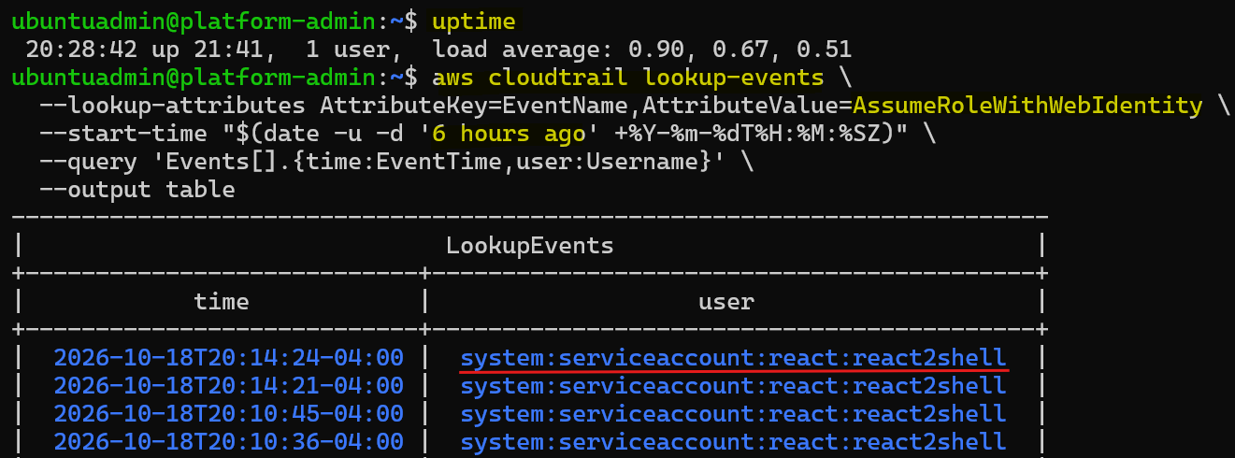
Routine Review: CloudTrail Sessions
Four recent sessions warrant investigation.
- Same workload identity.
- Event: AssumeRoleWithWebIdentity.
- Four sessions within four minutes
Notes:
Four recent sessions share the same workload identity. The administrator checks whether this activity matches the application's expected behavior.

Slide 4
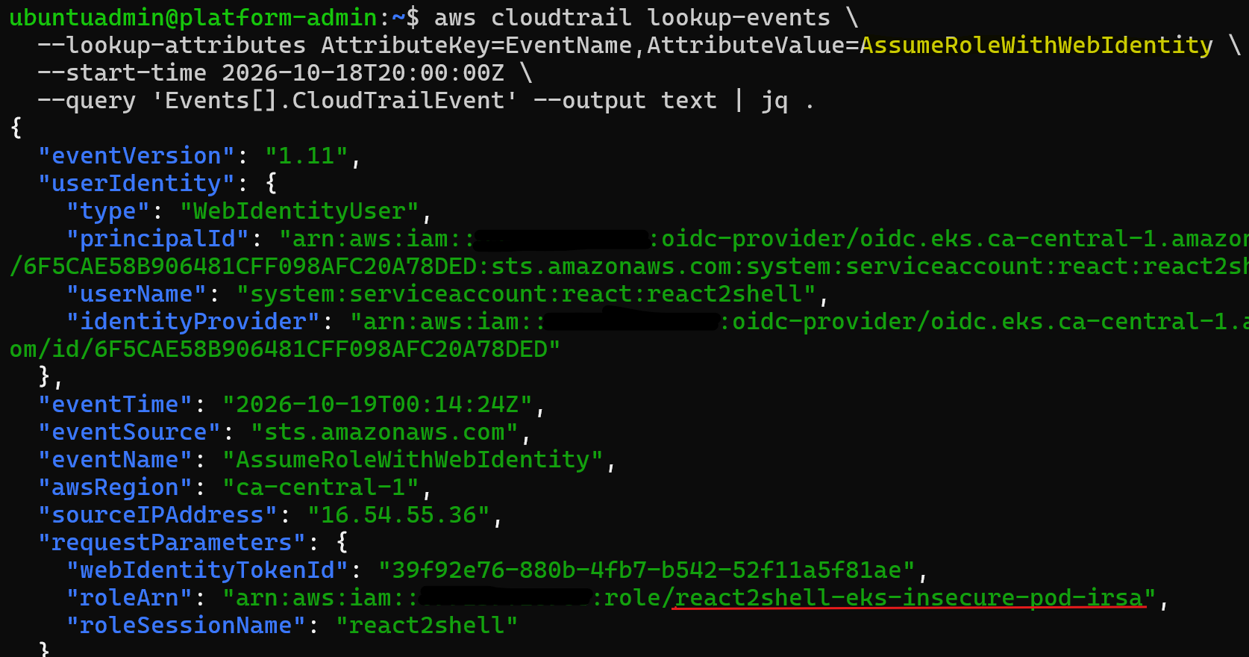
Routine Review: Workload Identity
The full event identifies the workload.
- IAM role: react2shell-eks-insecure-pod-irsa.
- Namespace: react, service account: react2shell.
Notes:
The event identifies the service account, its namespace, and the IAM role it assumed.

Slide 5
Routine Review: Summary
Unexpected AWS activity uses the react2shell service account identity.
The source and accessed resources need investigation.
Next: trace the activity.
Notes:
Routine review reveals an unexpected activity that requires investigation. Next, the administrator traces the source and checks what each session accessed.

Slide 6
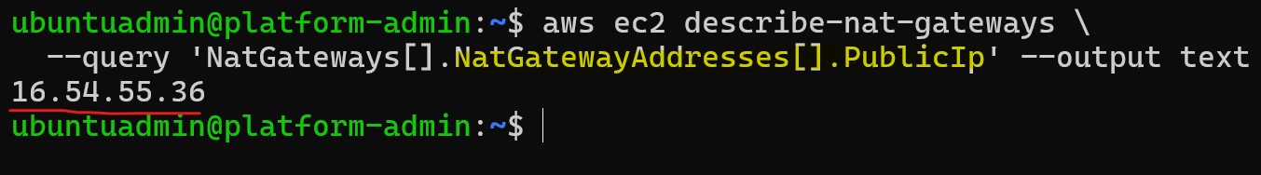
Investigation: Source IP
The source IP matches cluster egress.
- Source IP: 16.54.55.36.
- Matches the EKS environment's NAT gateway.
Notes:
The source IP matches the cluster's NAT gateway. This points to shared cluster egress, but does not identify a specific pod.

Slide 7
Investigation: Accessed Resources
Two reads of the same cloud secret.
Time | Action | Result
00:10:36 | ListSecrets | Secret discovery
00:10:45 | GetSecretValue | RDS credential
00:14:21 | GetSecretValue | Same credential
00:14:25 | ListSecrets | Secret discovery
Notes:
Session lookups reveal secret discovery and two reads of the same lab RDS credential within four minutes.

Slide 8
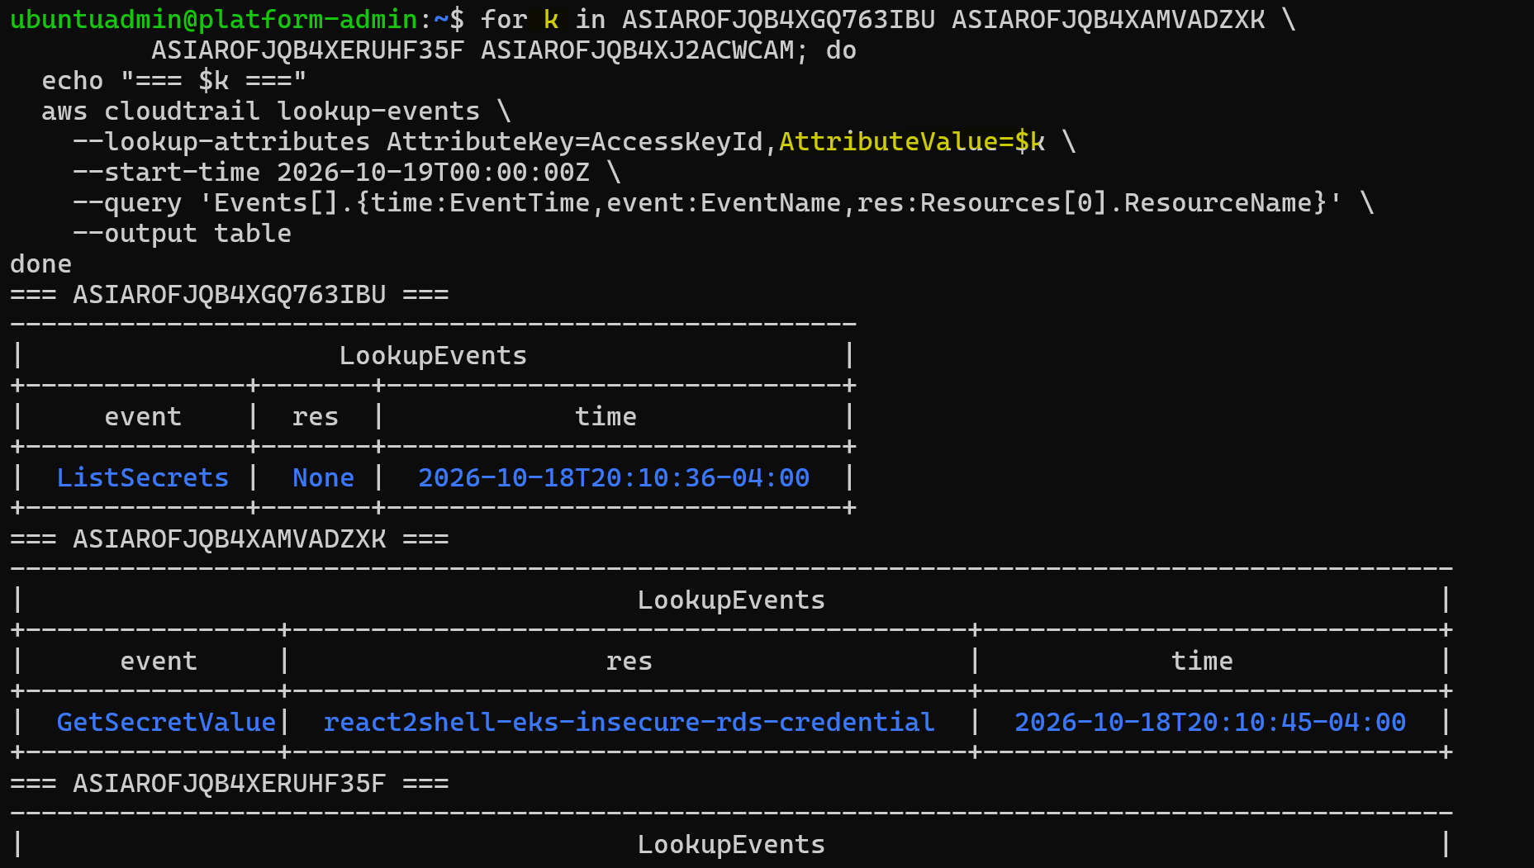
Investigation: Accessed Resources
Event lookup
Notes:
The source IP matches the cluster's NAT gateway. This points to shared cluster egress, but does not identify a specific pod.

Slide 9
Investigation: Locate the Pod
Find pods using service account react2shell.
- Matching pod: react2shell-6d4d4db59d-xwtxq.
- Compare its logs with the CloudTrail sessions.
Notes:
The administrator locates the pod using this service account, then checks its logs against the AWS activity.

Slide 10
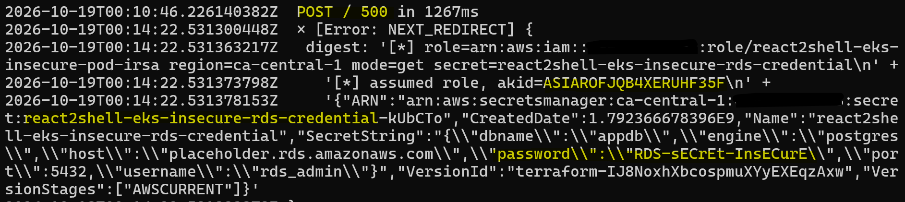
Investigation: Pod Logs
Pod logs confirm secret exposure.
- Timestamps align with GetSecretValue.
- Error digest contains the secret value.
Notes:
Matching session keys and timestamps connect the AWS activity to the pod. Its error output contains the secret value.

Slide 11
Investigation: Summary
The evidence confirms a breach.
- CloudTrail records successful secret access.
- Pod logs contain the matching session and secret output.
Next: preserve evidence and contain the pod.
Notes:
CloudTrail and pod logs confirm the breach. The administrator now preserves evidence and limits the compromised pod's access.

Slide 12
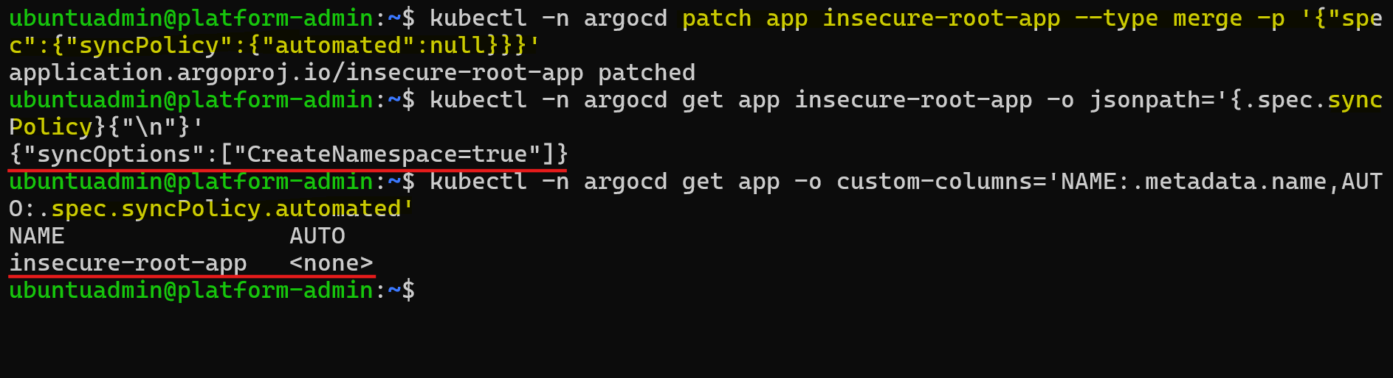
Containment: Pause GitOps Reconciliation
Disable Argo CD auto-sync.
Notes:
The administrator pauses automatic sync. so GitOps does not undo the containment changes.

Slide 13
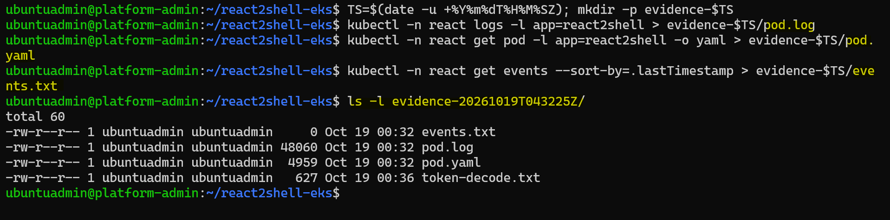
Containment: Preserve Evidence
Capture evidence before disruptive changes.
- Timestamped pod logs.
- Pod specification and Kubernetes events.
- Decoded token claims for identity correlation.
Notes:
The administrator saves logs, workload details, events, and token claims while keeping the original pod available for investigation.

Slide 14
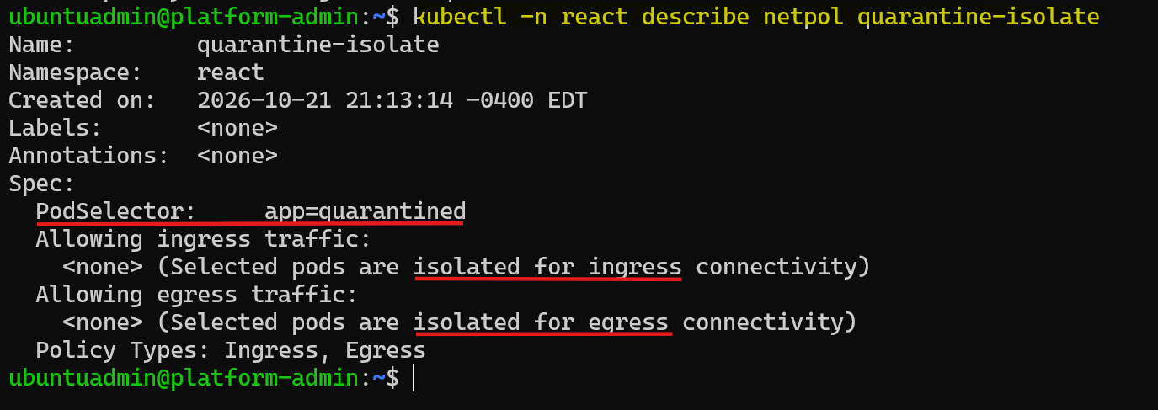
Containment: Network Quarantine
Keep the compromised pod running while limiting its access.
- Relabel it app=quarantined to remove the Service selector match.
- Apply a quarantine NetworkPolicy with no ingress or egress rules.
Notes:
Relabeling removes the Service selector match. The administrator applies the quarantine policy.

Slide 15
Containment: Cordon the Hosting Node
Mark the node unschedulable.
Leave existing pods running for investigation.
Notes:
Cordoning prevents ordinary new scheduling on the hosting node.

Slide 16
Report and Escalation
Report the findings and escalate cloud credential rotation.
- Rotate the disclosed credential.
- Revoke any still-active compromised sessions.
- Restrict the workload's IAM access.
Notes:
The report records the breach and containment actions. Cloud owners must address the exposed credential and any remaining session access.

Slide 17
Incident Response Summary
CloudTrail identifies the workload and secret access.
Pod logs confirm the activity to the application.
Evidence collection and quarantine support investigation and containment.
Escalation assigns the remaining credential cleanup.
Notes:
The administrator connects the evidence, quarantines the pod, and escalates credential cleanup. Permanent remediation still requires further work.

Slide 18
What Comes Next?
The pod is quarantined.
How does EKS cluster prevent the next breach?
To be continued: Hardening EKS
Notes:
The administrator has contained the compromised pod and report the incident. Next, we switch to the security specialist’s perspective to harden the EKS.

