Slide 1

React2Shell on Amazon EKS
One vulnerability. Four layers.
Attack. Detect. Harden.

Slide 2
A Security Specialist's Story
Scenario:
Containment limits the current incident.
The underlying weaknesses still need remediation.
A security specialist begins hardening the environment...
Notes:
The pod is quarantined, but the weaknesses remain. The security specialist now hardens each layer and tests the controls.

Slide 3



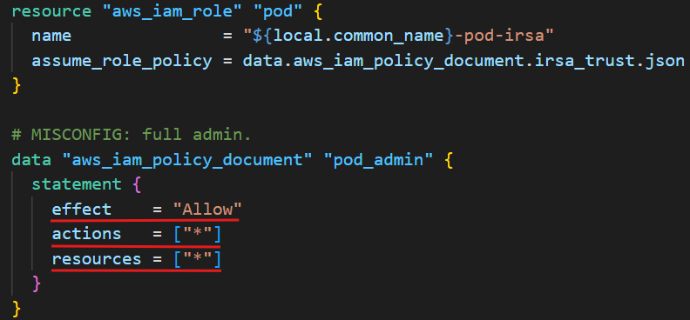
Attacker code container cluster cloud
          cloud cluster container code Security Specialist
Layer: Cloud.
- Issue: The pod can read the RDS credential.
- Cause: An overly permissive pod IAM role.
- Fix: Remove the unnecessary role.
Notes:
The application does not need this cloud access. The specialist removes the broad IAM role used in the attack.

Slide 4
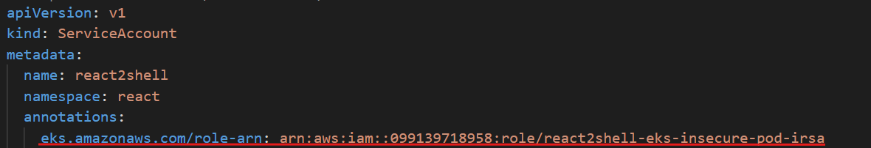
Attacker code container cluster cloud
          cloud cluster container code Security Specialist
Layer: Cloud.
- Issue: The pod receives an unnecessary AWS identity.
- Cause: The service account's IRSA role annotation.
- Fix: Remove the annotation.
Notes:
Removing the annotation stops new application pods from receiving the previous IRSA identity configuration.

Slide 5
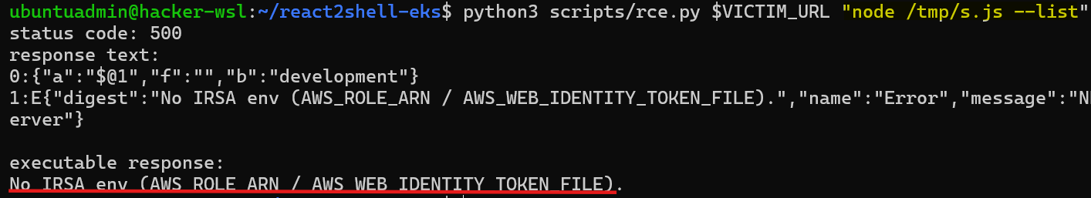
Attacker code container cluster cloud
          cloud cluster container code Security Specialist
Attack replay: read cloud-wide secret
- IRSA environment variables are absent.
- The replay script cannot use the previous role-assumption path.
Notes:
The app remains exploitable, but the replay script cannot find the IRSA identity it previously used to access cloud secrets.

Slide 6


Attacker code container cluster cloud
          cloud cluster container code Security Specialist
Cloud layer
- Remove unnecessary IAM permissions.
- Stop projecting the previous IRSA identity.
- Block the demonstrated cloud-secret access path.
Next: restrict access inside the cluster…
Notes:
Cloud hardening blocks the demonstrated IRSA path.
Next, the specialist restricts the workload's access inside the cluster.

Slide 7
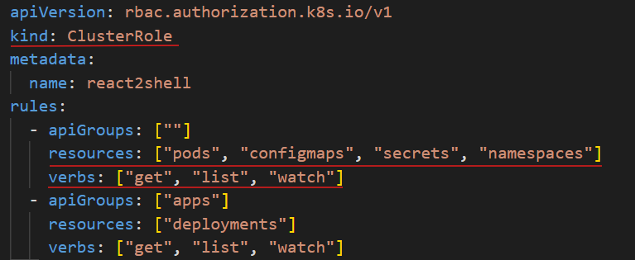
Attacker code container cluster cloud
          cloud cluster container code Security Specialist
Layer: Cluster.
- Issue: The workload can read secrets in the internal namespace.
- Cause: Overly broad RBAC permissions.
- Fix: Grant only the permissions the workload needs.
Notes:
The specialist removes broad secret-read permissions, limiting the Kubernetes service account to the access this workload needs.

Slide 8
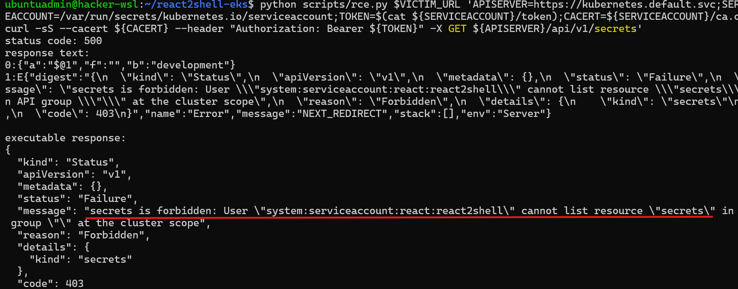
Attacker code container cluster cloud
          cloud cluster container code Security Specialist
Attack replay: read cluster-wide secret
- The cluster-wide secret request returns 403 Forbidden.
- RBAC checks deny cluster-wide secret reads.
Notes:
Replaying the secret request now returns Forbidden. The service account no longer has broad access to cluster secrets.

Slide 9
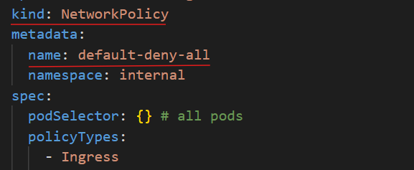
Attacker code container cluster cloud
          cloud cluster container code Security Specialist
Layer: Cluster.
- Issue: The compromised app can read internal API data.
- Cause: Missing network isolation.
- Fix: Use NetworkPolicies to allow only intended callers.
Notes:
The specialist adds default-deny isolation and explicit access rules for the internal service.

Slide 10
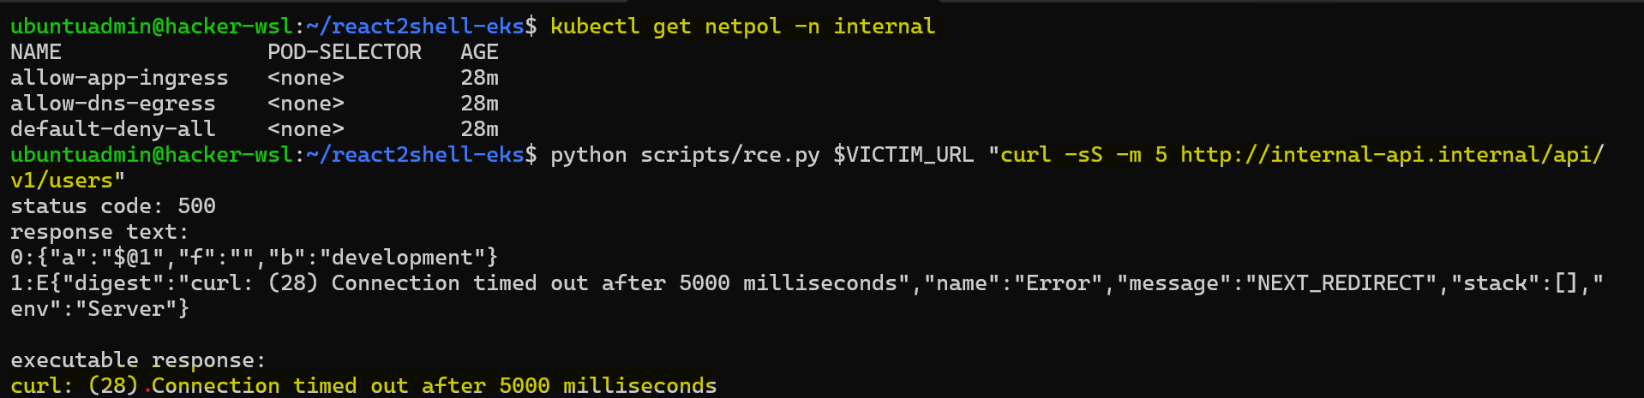
Attacker code container cluster cloud
          cloud cluster container code Security Specialist
Attack replay: read Internal API
- The compromised app's request to the internal API times out.
Notes:
After network isolation, the recorded request from the compromised application to the internal API times out.

Slide 11
Attacker code container cluster cloud
          cloud cluster container code Security Specialist
Cluster layer
- Cluster-wide secret listing is forbidden.
- The internal API request times out.
Next: harden the container itself…
Notes:
Authorization rejects secret access, and the internal API request times out. Next, the specialist hardens the container itself.

Slide 12
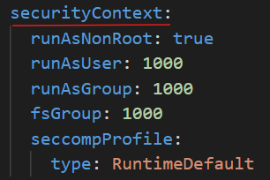
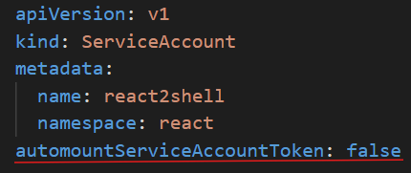
Attacker code container cluster cloud
          cloud cluster container code Security Specialist
Layer: Container.
- Issue: Root execution, unrestricted privilege escalation, and a readable
Kubernetes token.
- Cause: Missing runtime security controls.
- Fix: Apply a restrictive security context and disable automatic token mounting.
Notes:
The specialist limits process privileges, makes the root filesystem read-only, and disables automatic Kubernetes token mounting.

Slide 13
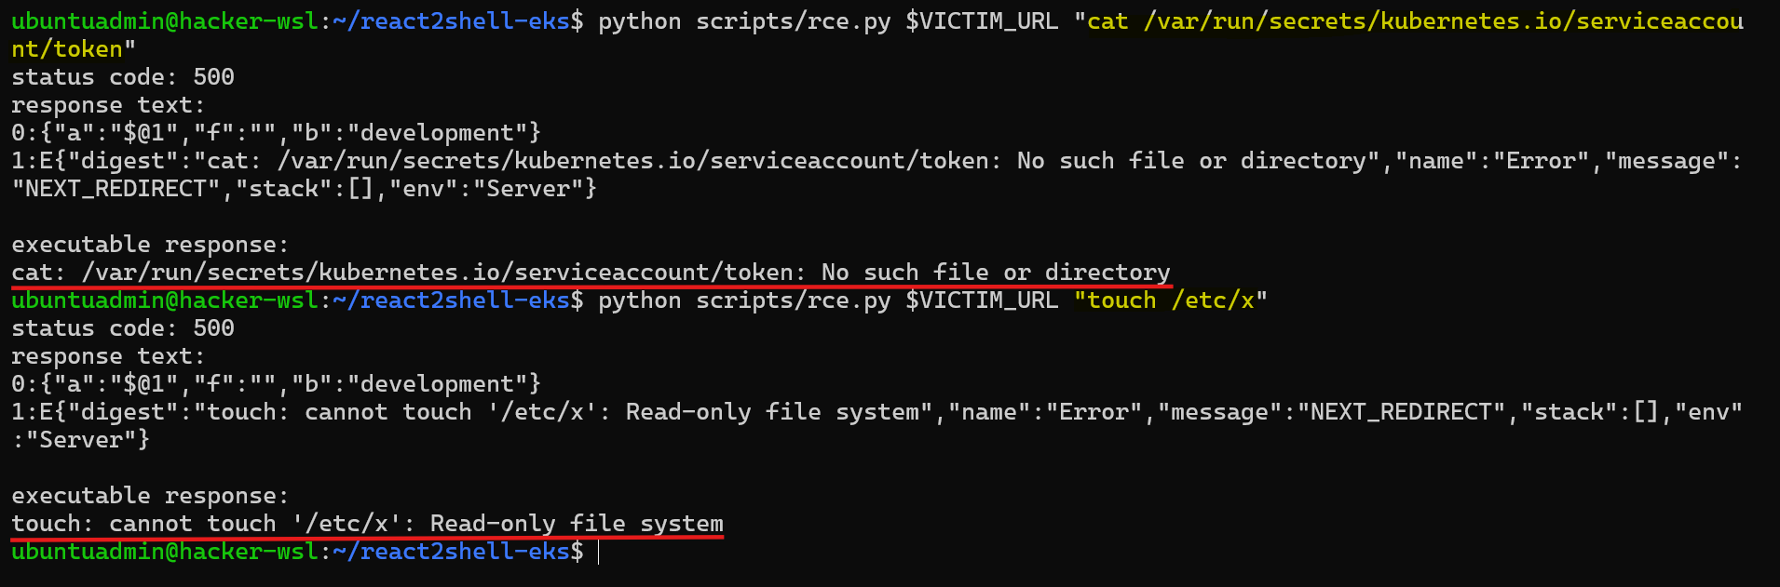
Attacker code container cluster cloud
          cloud cluster container code Security Specialist
Attack Replay: security context
- The standard Kubernetes service account token is absent.
- Commands run as a non-root user.
- Writes to the root filesystem fail.
Notes:
The replay confirms the runtime restrictions.

Slide 14
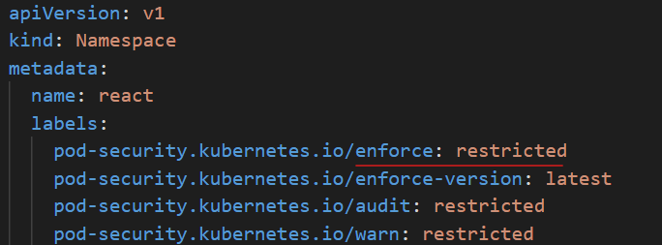
Attacker code container cluster cloud
          cloud cluster container code Security Specialist
Layer: Container.
- Issue: Noncompliant pods can still be created.
- Cause: Missing admission enforcement.
- Fix: Enforce the Restricted Pod Security Standard.
Notes:
Namespace admission controls reject the test pod because it fails the Restricted standard.

Slide 15
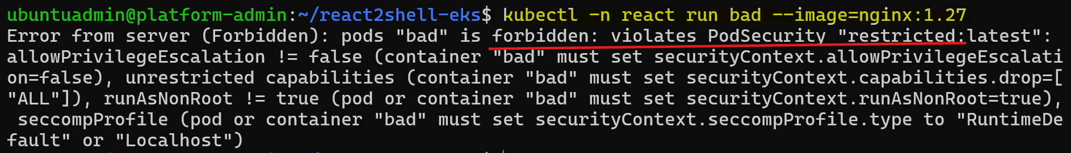
Attacker code container cluster cloud
          cloud cluster container code Security Specialist
Test: Pod Security Standard
- Namespace admission controls reject the noncompliant pod.
Notes:
The replay confirms the runtime restrictions.

Slide 16
Attacker code container cluster cloud
          cloud cluster container code Security Specialist
Container layer
- No automatically mounted Kubernetes token.
- Restrictive security context.
- Admission rejects noncompliant pods.
Next: patch the vulnerable application…
Notes:
Container controls reduce privileges and exposed identity.
The specialist now patches the application vulnerability that enabled the initial attack.

Slide 17
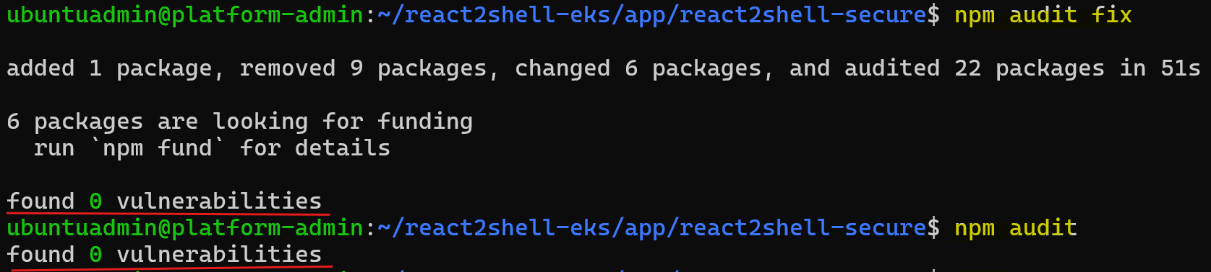
Attacker code container cluster cloud
          cloud cluster container code Security Specialist
Layer: Code.
- Issue: The application permits remote code execution.
- Cause: Framework dependencies affected by React2Shell.
- Fix: Update the vulnerable framework and dependencies.
Notes:
The specialist updates the vulnerable dependencies. The recorded audit reports no known vulnerabilities in that dependency snapshot.

Slide 18
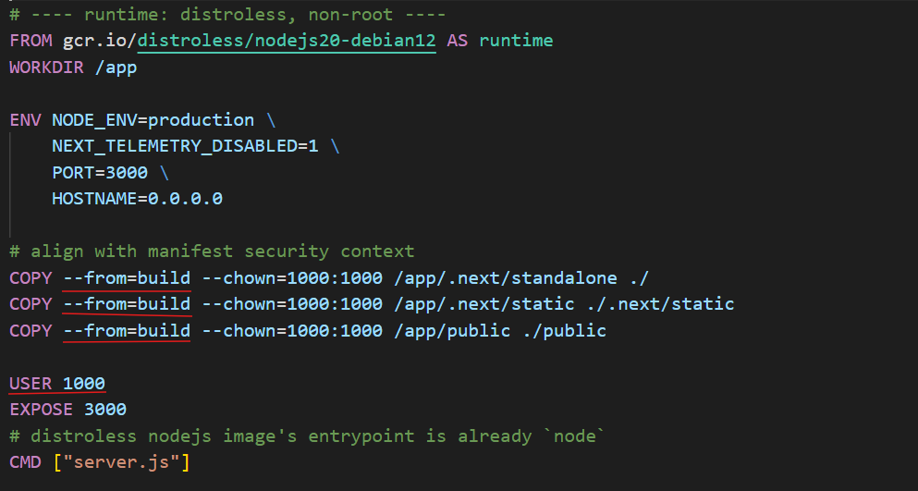
Attacker code container cluster cloud
          cloud cluster container code Security Specialist
Layer: Code.
- Issue: The image runs as root and includes unnecessary tooling.
- Cause: Build tools and runtime share the same image.
- Fix: Use a multistage build and a minimal distroless runtime with a non-root user.
Notes:
A multistage build separates build tooling from the runtime.
The production server runs in a minimal image as a non-root user.

Slide 19
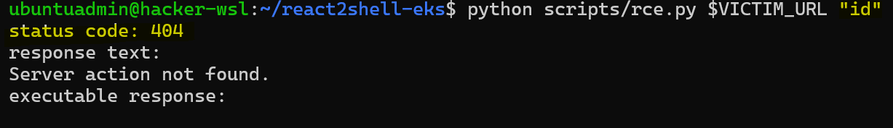
Attacker code container cluster cloud
          cloud cluster container code Security Specialist
Attack Replay: remote code execution
- The exploit request returns HTTP 404.
Notes:
The application remains reachable, while the recorded React2Shell replay returns no command output.

Slide 20
Attacker code container cluster cloud
          cloud cluster container code Security Specialist
Code layer
- Patch the vulnerable application dependencies.
- Harden the production image.
Notes:
The final stage addresses the application entry point and reduces the runtime image's attack surface.

Slide 21
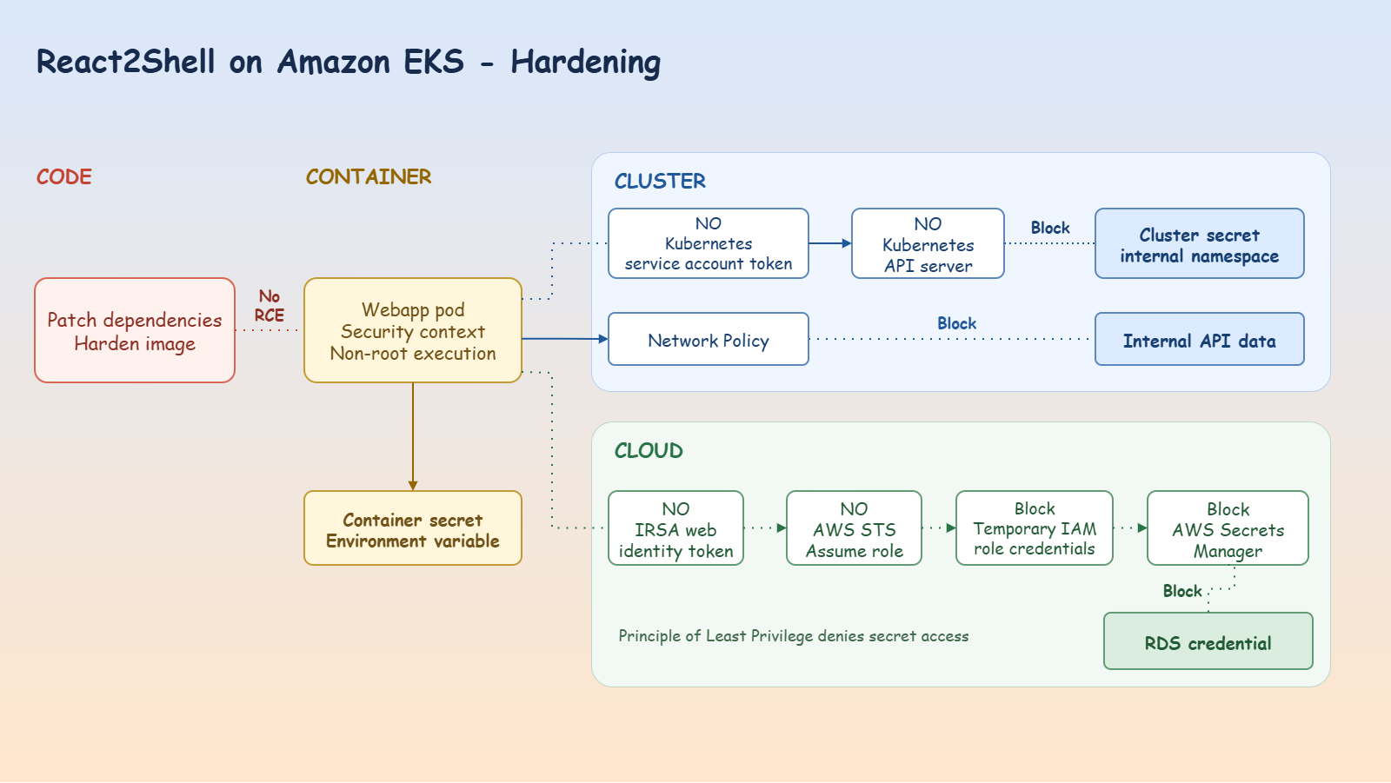
Hardening - Cloud Layer
Notes:
At the cloud layer, remove unnecessary IRSA access and correct the IAM role to secure the RDS credentials.

Slide 22
Hardening - Cluster Layer
Notes:
At the cluster layer, correct role-based access control, enable network isolation, and secure the cluster secret and internal API.

Slide 23
Hardening - Container Layer
Notes:
At the container layer, secure context and Pod Security Standard admission prevent privileged execution.

Slide 24
Hardening - Code Layer
Notes:
At the code layer, patched dependencies and hardened image prevent remote code execution.

Slide 25
Hardening Summary
Layer | Control | Recorded result
Cloud | Remove unnecessary IRSA access | Previous script cannot assume the role
Cluster | RBAC and network isolation | Secret request forbidden; internal API times out
Container | Runtime and admission controls | Non-root execution; token absent; root filesystem read-only
Code | Dependency patch and hardened image | Recorded exploit returns no command output

Slide 26
What Comes Next?
The controls are in place.
How do we keep future changes secure?
To be continued: Integrate security practice in CI/CD and Runtime Monitoring
Notes:
Next, we switch to the DevSecOps perspective and integrate security checks into delivery workflows and runtime monitoring.

