Slide 1

React2Shell on Amazon EKS
One vulnerability. Four layers.
Attack. Detect. Harden. Integrate

Slide 2
A DevSecOps engineer's Story
Scenario:
The environment is hardened. Changes keep coming.
How do we make security part of everyday delivery?
Check changes early.
Monitor workloads after deployment.
A DevSecOps engineer integrates security into delivery and operations…
Notes:
The pod is quarantined, but the weaknesses remain. The security specialist now hardens each layer and tests the controls.

Slide 3
Shift Left: Security Checks in CI
GitHub Actions workflows:
Workflow | Checks
ci-code.yml | Dependencies, exposed secrets, and configuration
ci-image.yml | Dockerfile, image vulnerabilities, and SBOM
ci-manifest.yml | Kubernetes manifest configuration
ci-iac.yml | Terraform validation, configuration, and secrets
Notes:
The pod is quarantined, but the weaknesses remain. The security specialist now hardens each layer and tests the controls.

Slide 4
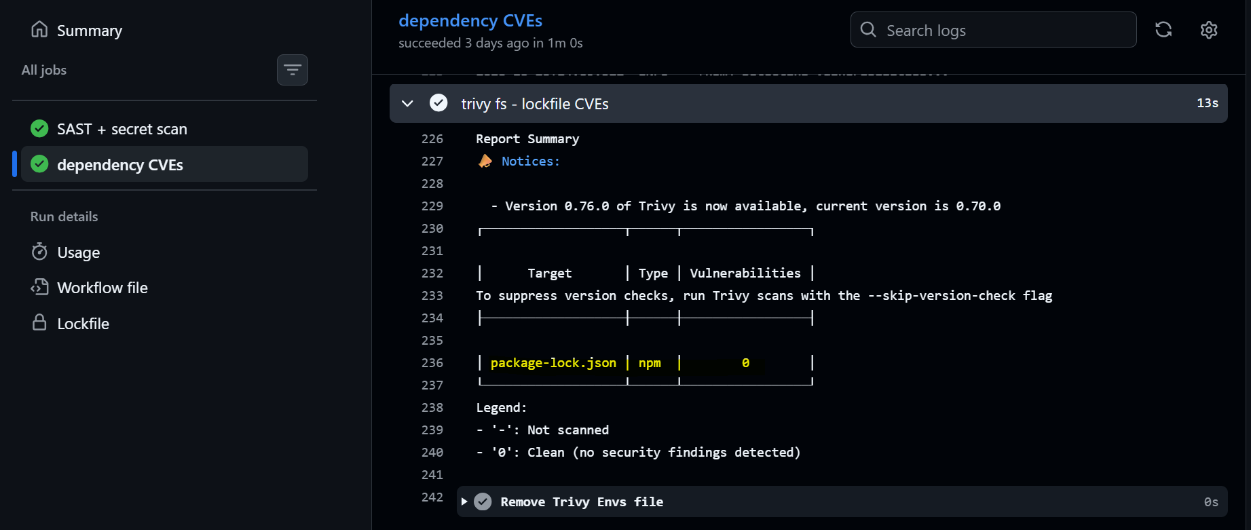
Shift Left: Code Layer
Check dependencies, secrets, and configuration(GitHub Actions ci-code.yml).
- Scan dependencies for known vulnerabilities.
- Scan for exposed secrets and supported misconfigurations.
Notes:
The pod is quarantined, but the weaknesses remain. The security specialist now hardens each layer and tests the controls.

Slide 5
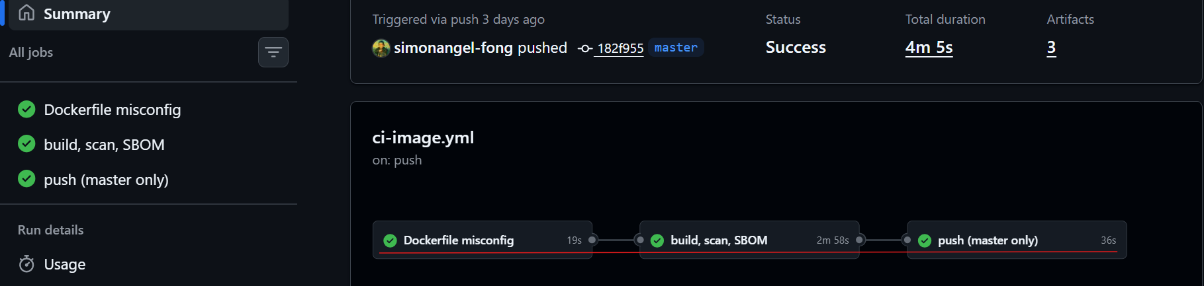
Shift Left: Code Layer
Build and scan the image before the publish stage (GitHub Actions ci-image.yml).
- Check the Dockerfile for misconfigurations.
- Build and scan the image.
- Generate a CycloneDX software bill of materials (SBOM).
- Publish only after prior jobs pass, on pushes to master.
Notes:
The pod is quarantined, but the weaknesses remain. The security specialist now hardens each layer and tests the controls.

Slide 6
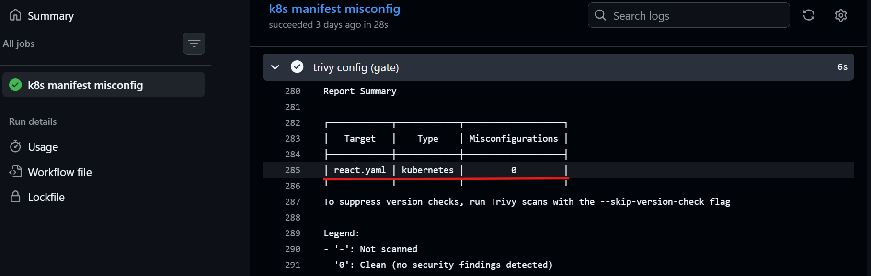
Shift Left: Cluster and Container Layers
Check Kubernetes manifests (GitHub Actions ci-ci-manifest.yml).
- Scan for misconfigurations.
- Upload a SARIF report for review.
- Gate react.yaml on HIGH or CRITICAL findings.
Notes:
The pod is quarantined, but the weaknesses remain. The security specialist now hardens each layer and tests the controls.

Slide 7
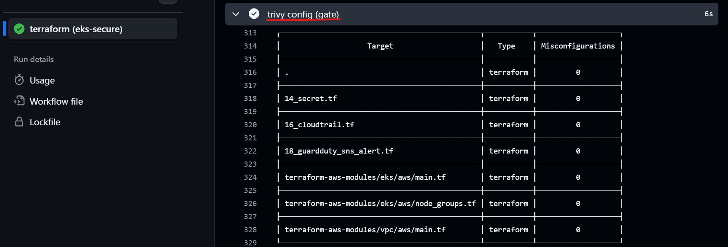
Shift Left: Cloud Layer
Check Terraform configuration (GitHub Actions ci-iac.yml).
- Check formatting and validate Terraform codes.
- Scan infrastructure configuration and exposed secrets.
- Apply HIGH and CRITICAL gates with configured exceptions.
Notes:
The pod is quarantined, but the weaknesses remain. The security specialist now hardens each layer and tests the controls.

Slide 8
Monitoring: Visibility After Deployment
AWS Monitoring Services
AWS Service | Focus
CloudWatch | What is failing or degrading?
CloudTrail | Who called which AWS API, when, and from where?
GuardDuty | What potential threats or unusual activity need investigation?
Notes:
The pod is quarantined, but the weaknesses remain. The security specialist now hardens each layer and tests the controls.

Slide 9
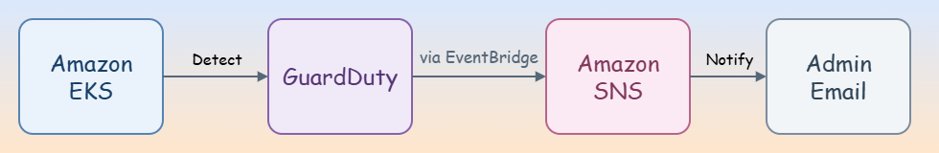
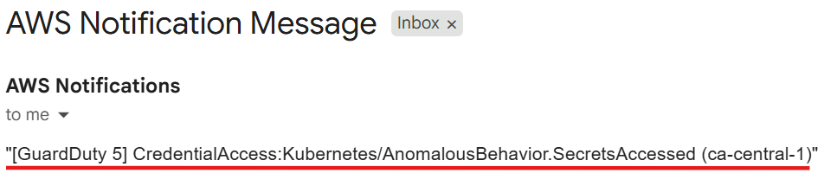
Monitoring: Sample GuardDuty Alert
Test the notification path with a sample finding.
- Generate a GuardDuty sample finding.
- Type: CredentialAccess:Kubernetes/AnomalousBehavior.SecretsAccesseds.
- Recorded severity: 5.0.
- The administrator receives an email notification.
Notes:
The pod is quarantined, but the weaknesses remain. The security specialist now hardens each layer and tests the controls.

Slide 10
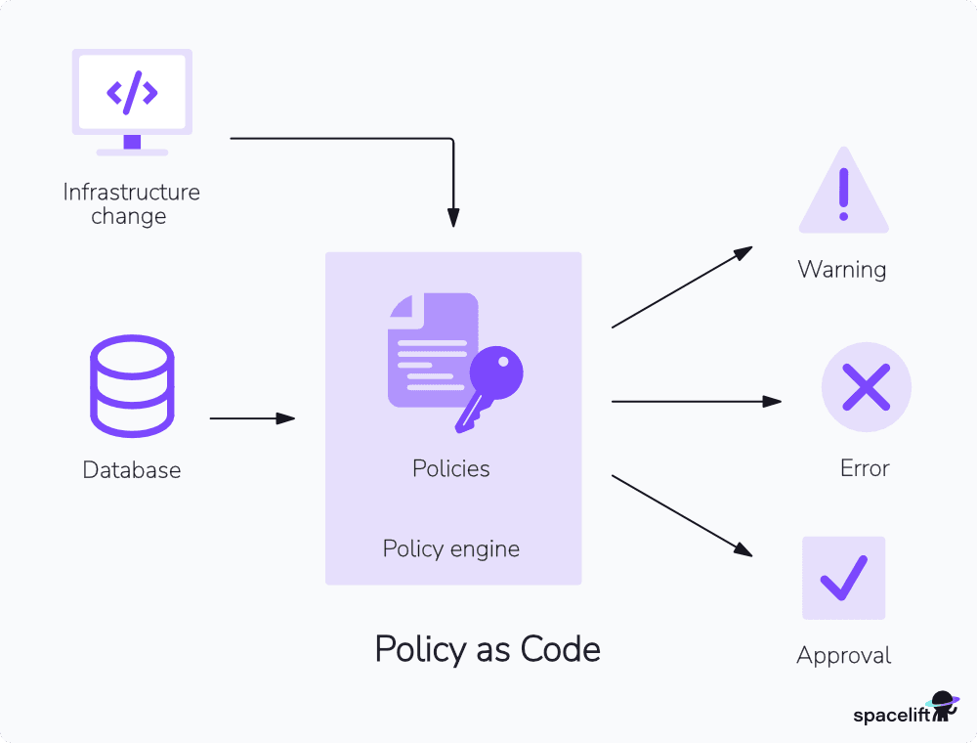
Future Option: Policy as Code
Extend enforcement with Kyverno or OPA Gatekeeper.
- Reject privileged workloads.
- Restrict image registries.
- Require ownership labels.
ref: https://spacelift.io/blog/policy-as-code-tools
Notes:
The pod is quarantined, but the weaknesses remain. The security specialist now hardens each layer and tests the controls.

Slide 11
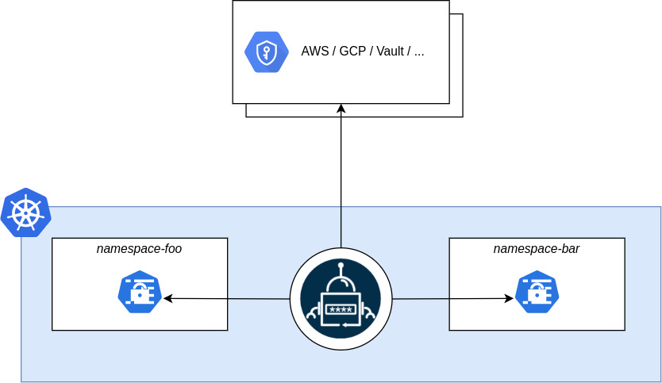
Future Option: Centralized Secret Management
AWS Secrets Manager and External Secrets Operator (ESO)
- Keep secret values out of Git manifests.
- Synchronize selected values into Kubernetes Secrets.
- Retain least-privilege access to those Secrets.
https://external-secrets.io/latest/introduction/overview/
Notes:
The pod is quarantined, but the weaknesses remain. The security specialist now hardens each layer and tests the controls.

Slide 12
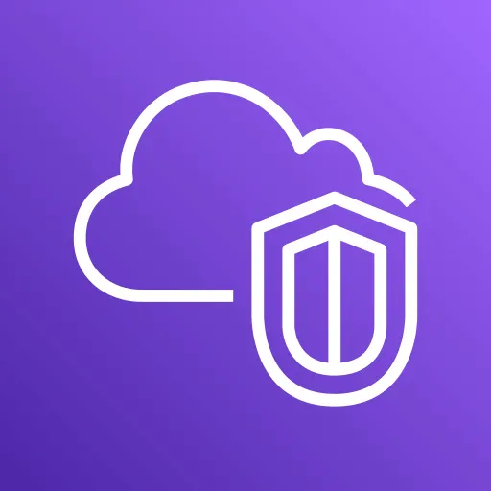
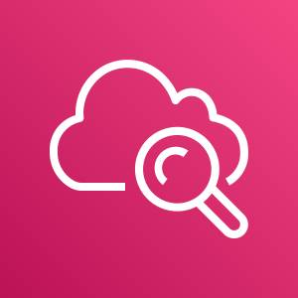




Future Options: Deeper Observability
VPC Flow Logs: network traffic metadata.
CloudWatch Logs Insights: queries over collected logs.
Falco: runtime security detection.
LGTM: logs, dashboards, traces, and metrics.
VPC Flow Logs
CloudWatch Logs
Insights
Falco
Loki
Grafana
Tempo
Mimir
Notes:
The pod is quarantined, but the weaknesses remain. The security specialist now hardens each layer and tests the controls.

Slide 13
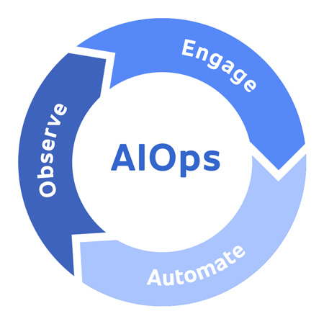
Future Option: AIOps
Potential uses for AI in operations:
- Analyze security signals at scale.
- Correlate alerts and reduce noise.
- Support incident investigation and response automation.
https://en.wikipedia.org/wiki/AIOps
Notes:
The pod is quarantined, but the weaknesses remain. The security specialist now hardens each layer and tests the controls.

Slide 14
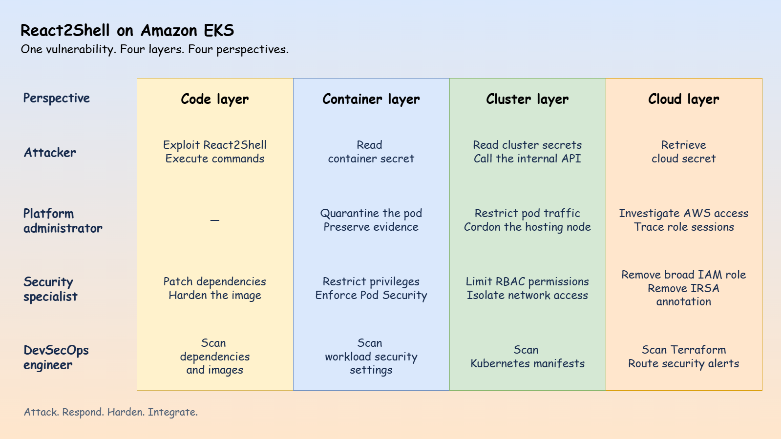
One Vulnerability. Four Layers. Four Perspectives.
Notes:
The attacker exploits React2Shell, reads container and cluster secrets, accesses the internal API, and retrieves a cloud secret.

Slide 15
One Vulnerability. Four Layers. Four Perspectives.
Notes:
The administrator traces AWS activity to the pod, preserves evidence, and quarantines the compromised workload.

Slide 16
One Vulnerability. Four Layers. Four Perspectives.
Notes:
The specialist patches the app and restricts container privileges, Kubernetes access, network traffic, and AWS permissions.

Slide 17
One Vulnerability. Four Layers. Four Perspectives.
Notes:
The DevSecOps engineer automates checks across all four layers and routes runtime security findings to the administrator.

Slide 18
LET'S TALK
Links:
▸ 🔗 Project website: react2shell-eks.arguswatcher.net
▸ 💻 GitHub: github.com/simonangel-fong/react2shell-eks
▸ 👤 LinkedIn: linkedin.com/in/simonangelfong/

