Slide 1

React2Shell on Amazon EKS
One vulnerability. Four layers.
Attack. Detect. Harden.

Slide 2
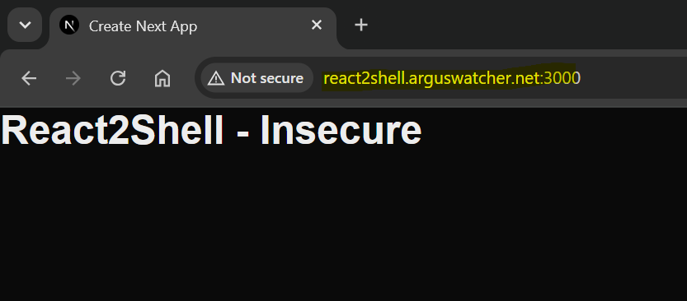
An Attacker's Story
Scenario: the day after React2Shell disclosure (CVE-2025-55182).
An attacker targets an unpatched app at react2shell.arguswatcher.net.
The attack begins…
Notes:
An attacker finds an unpatched application and tests it for React2Shell.
Now the attack begins.

Slide 3

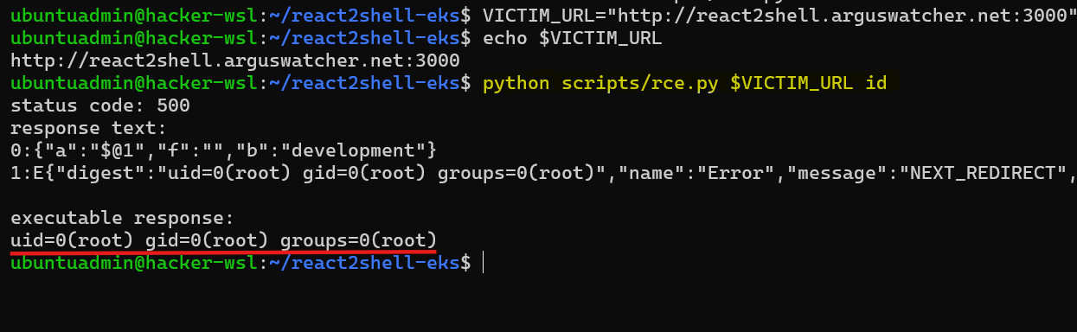
Attacker code container cluster cloud
Root access with the webapp.
Notes:
The attacker tries to get the user id and finds tha application runs as root.

Slide 4
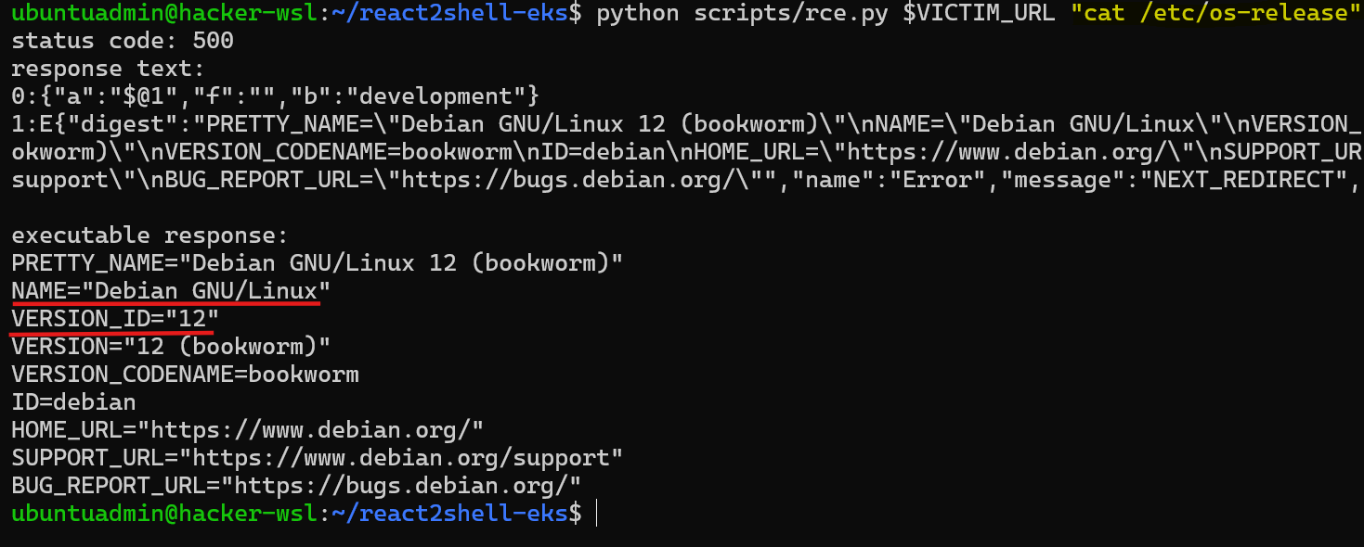
Attacker code container cluster cloud
Inspect the runtime environment
Notes:
Runtime details reveal Debian and help the attacker understand the environment.

Slide 5

Attacker code container cluster cloud
Code Layer
- React2Shell enables remote code execution in the app.
- The process runs as root on Debian.
Next: explore the container...
Notes:
Code execution gives the attacker a foothold. Next, the attacker inspects the container.

Slide 6
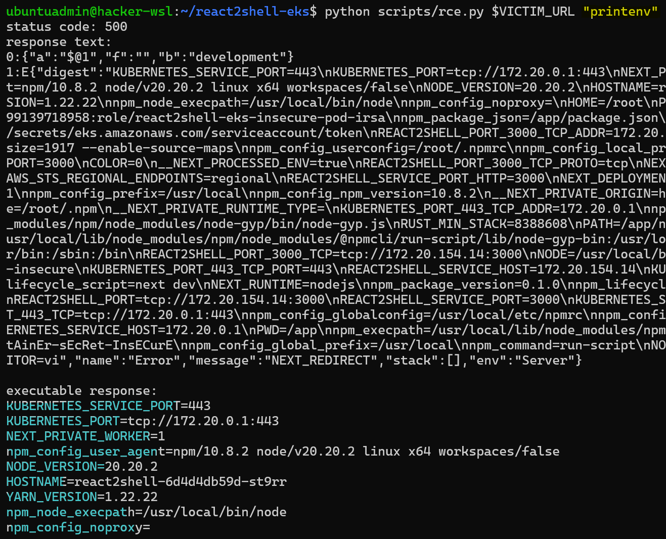
Attacker code container cluster cloud
Inspect environment variables
- Kubernetes environment detected.
- Container secret found.
Notes:
Environment variables reveal Kubernetes and a secret available to the app.

Slide 7
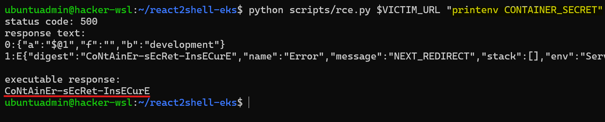
Attacker code container cluster cloud
Read the container secret: CONTAINER_SECRET
Notes:
The attacker reads the container secret directly from the process environment.

Slide 8
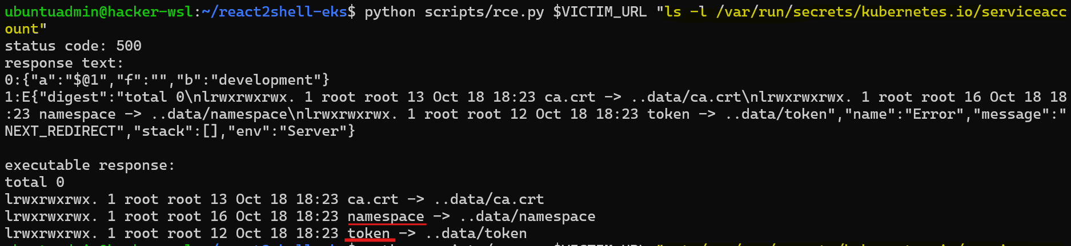
Attacker code container cluster cloud
Locate and read the service account token
Notes:
A mounted service account token exposes the pod's Kubernetes identity.

Slide 9
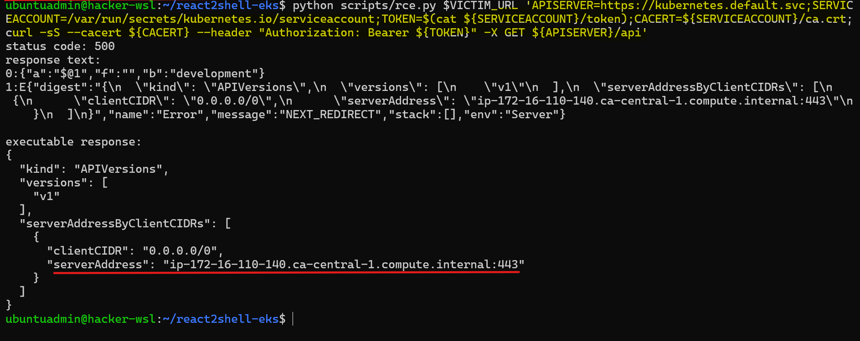
Attacker code container cluster cloud
Query the Kubernetes API server
- API server IP: 172.16.110.140
Notes:
The attacker uses the token to authenticate a request to the Kubernetes API.

Slide 10
Attacker code container cluster cloud
Container Layer
- The app runs in Kubernetes.
- Environment variables expose CONTAINER_SECRET.
- The mounted service account token allows API authentication.
Next: lateral movement across the cluster…
Notes:
The compromised app exposes a secret and a workload identity. Next comes cluster access.

Slide 11
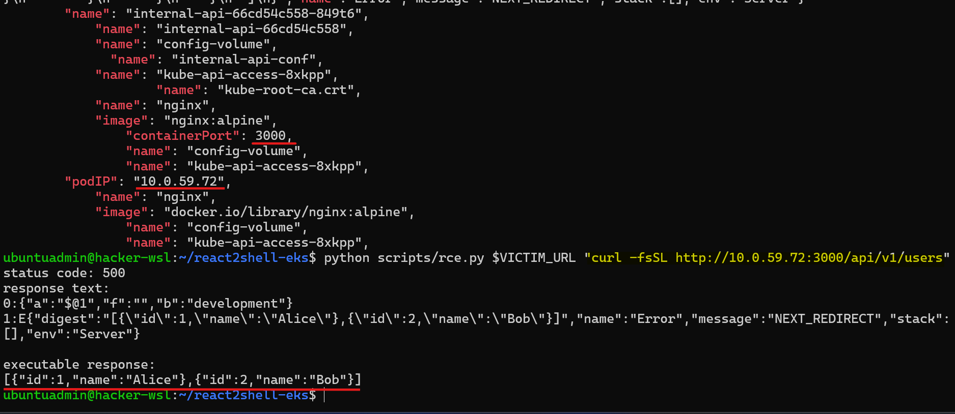
Attacker code container cluster cloud
Internal API discovered
- Namespace: internal
- Port: 3000
Notes:
The attacker discovers an internal API listening on port 3000 in another namespace.

Slide 12
Attacker code container cluster cloud
Read data from the internal API
- Two user records exposed: Alice and Bob.
Notes:
A request from the compromised pod returns two internal user records: Alice and Bob.

Slide 13
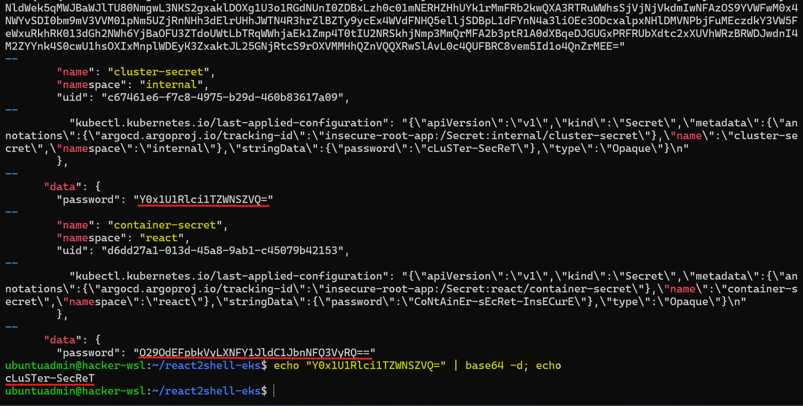
Attacker code container cluster cloud
Cluster secret discovered
- Secret: cluster-secret
- Namespace: internal
Notes:
The Kubernetes API reveals a secret in the internal namespace.

Slide 14
Attacker code container cluster cloud
Read and decode the cluster secret
- Retrieve cluster-secret from the internal namespace.
- Decode its value.
Notes:
Broad RBAC permissions let the attacker retrieve the secret and decode its value.

Slide 15
Attacker code container cluster cloud
Cluster Layer
- Internal API data exposed.
- Cluster secret retrieved.
Next, privilege escalation...
Notes:
Internal data and the cluster secret are exposed. The attacker now investigates the cloud layer identity.

Slide 16
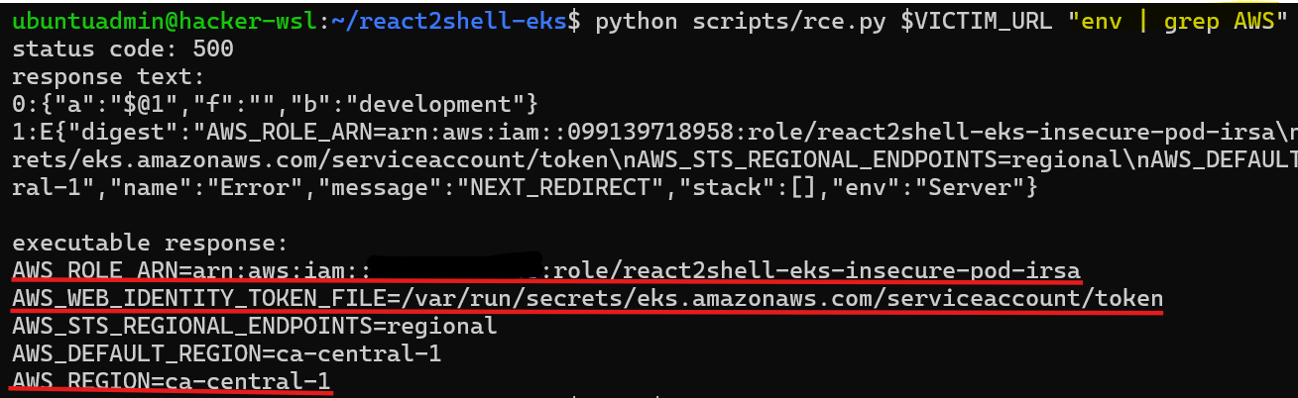
Attacker code container cluster cloud
AWS identity discovered
- AWS_* variables reveal region ca-central-1.
- The pod has an IAM role and a web identity token file.
Notes:
AWS environment variables identify the IAM role and the separate IRSA token file.

Slide 17


Attacker code container cluster cloud
IRSA lets EKS pods assume IAM roles
- The role's permissions determine access to AWS services, like Secrets Manager
EKS pod
Assume role
Secrets Manager
Notes:
IRSA exchanges the projected token for temporary AWS credentials. The role's permissions determine access.

Slide 18
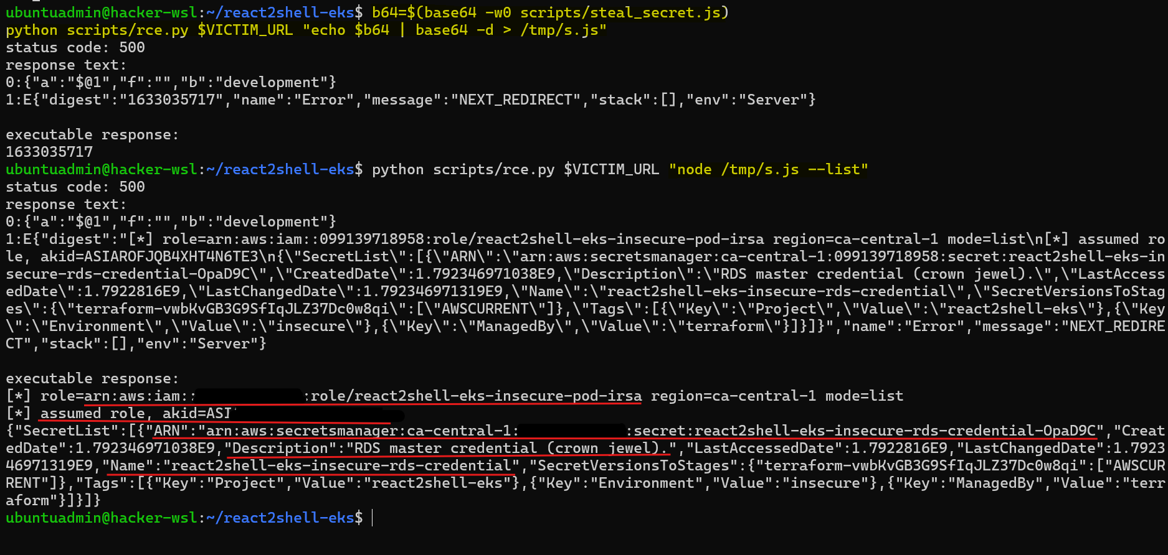
Attacker code container cluster cloud
Create and upload a remote script to the pod
Notes:
The attacker uploads a Node.js script to use the pod's AWS identity.

Slide 19
Attacker code container cluster cloud
List secrets in Amazon Secrets Manager
  - An RDS credential is found
Notes:
Using the pod's AWS role, the attacker lists secrets and finds a RDS credential.

Slide 20
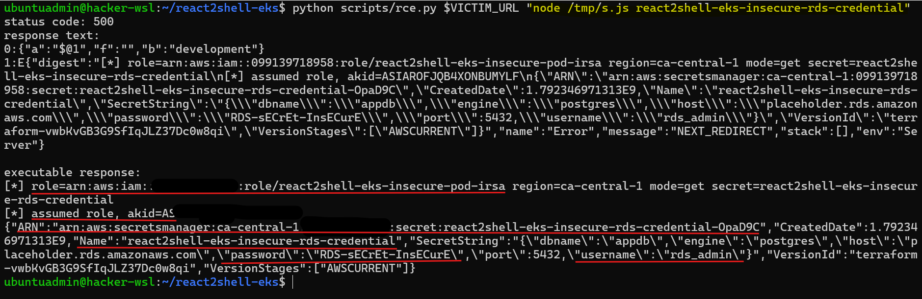
Attacker code container cluster cloud
Retrieve the RDS credential
  - username
  - password
  - port
Notes:
Secrets Manager returns the RDS credential, including its username, password, and port.

Slide 21
Attacker code container cluster cloud
Cloud Layer
- Remote script uploaded and executed in the pod.
- Cloud secret retrieved.
All three secrets exposed.
Notes:
The script retrieves the cloud secret, completing access to all three secrets.

Slide 22
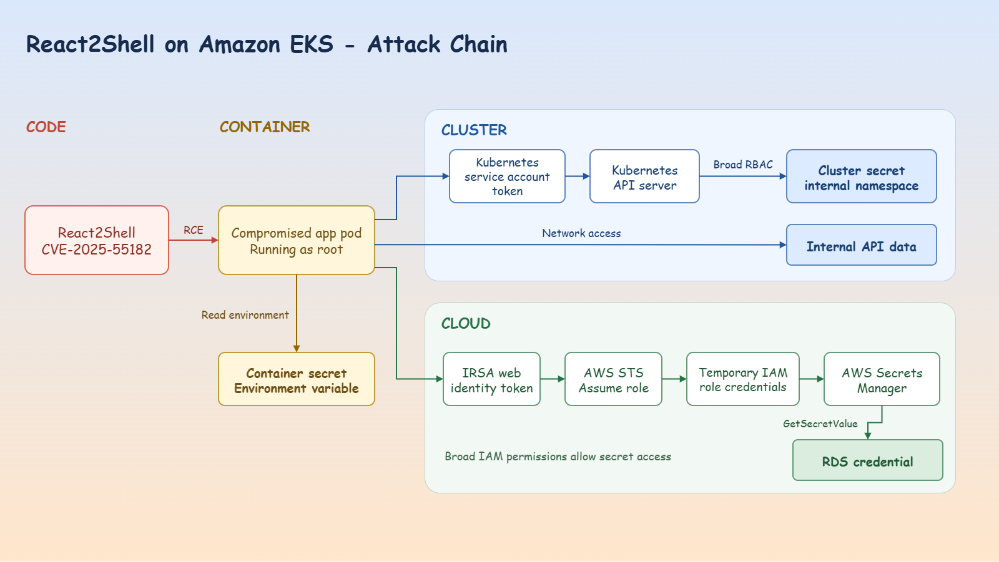
Attack Chain Summary
Notes:
The app vulnerability enables remote code execution.

Slide 23
Attack Chain Summary
Notes:
Readable environment variables exposes container secret.

Slide 24
Attack Chain Summary
Notes:
A mounted token makes the API server and the cluster secret accessible due to broad RBAC.

Slide 25
Attack Chain Summary
Notes:
The flat network in cluster exposes internal data.

Slide 26
Attack Chain Summary
Notes:
IRSA injected token and assume role expose the IAM role credentials. And broad IAM permissions allow secret access.

Slide 27
The secrets are exposed. What happens next?
- How does a platform administrator detect the breach and respond?
To be continued: Incident Response on EKS
Notes:
The attacker has reached the secrets. Next, we switch to the platform administrator’s perspective to detect the breach, investigate the evidence, and contain the compromised pod.

