Slide 1

Handwritten Letter Classification The Arabic Alphabet
by Simona Rahi

Slide 2
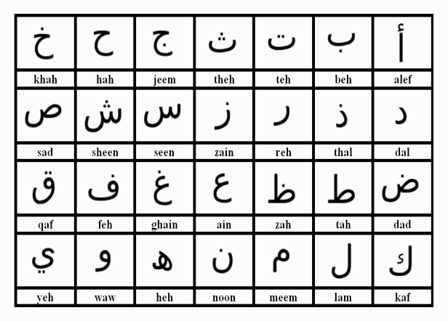
28 letters/characters → 28 classes

Slide 3
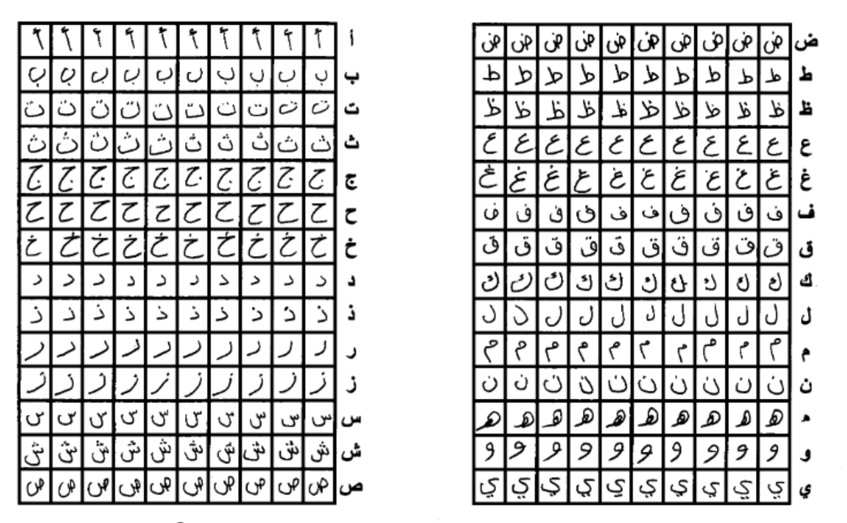
Data at Hand
Contains 16,800 characters
Training set: 13,440 characters → 480 images per class
Test set: 3360 characters → 120 images per class

Slide 4
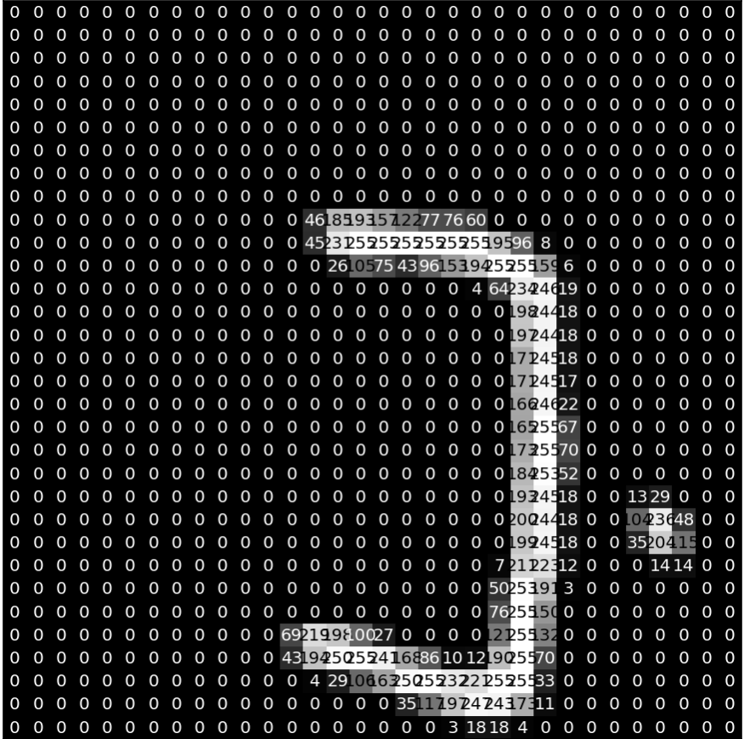
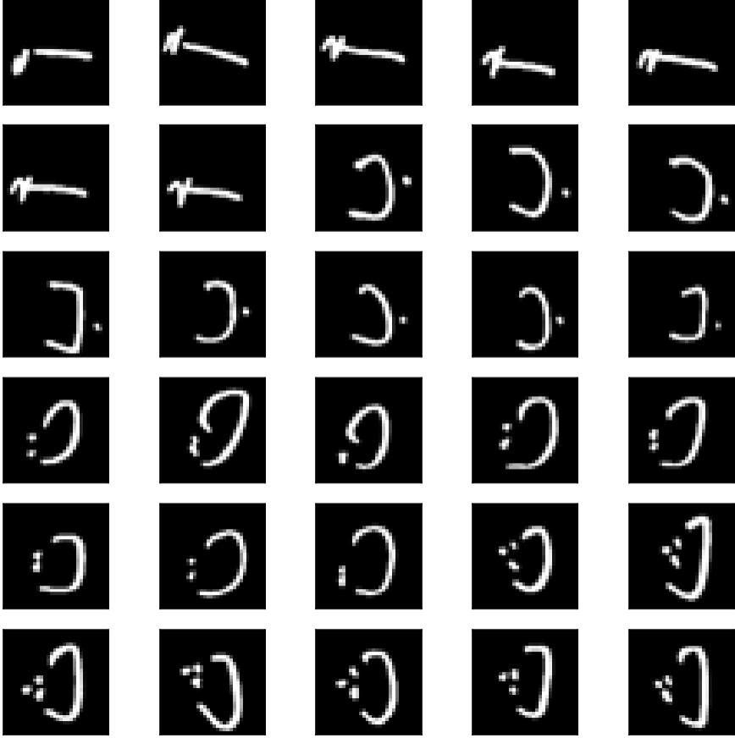
Closer look at images

Slide 5
Model 1: Convolutional Neural Network
Relevant to the type of problem: character classification
Automatically extracts the features
Data Reshaping
Train data shape: (13440, 32, 32, 1)
Train label shape: (13440, 28)
Data Preprocessing
Rescale pixels
Rotate images

Slide 6
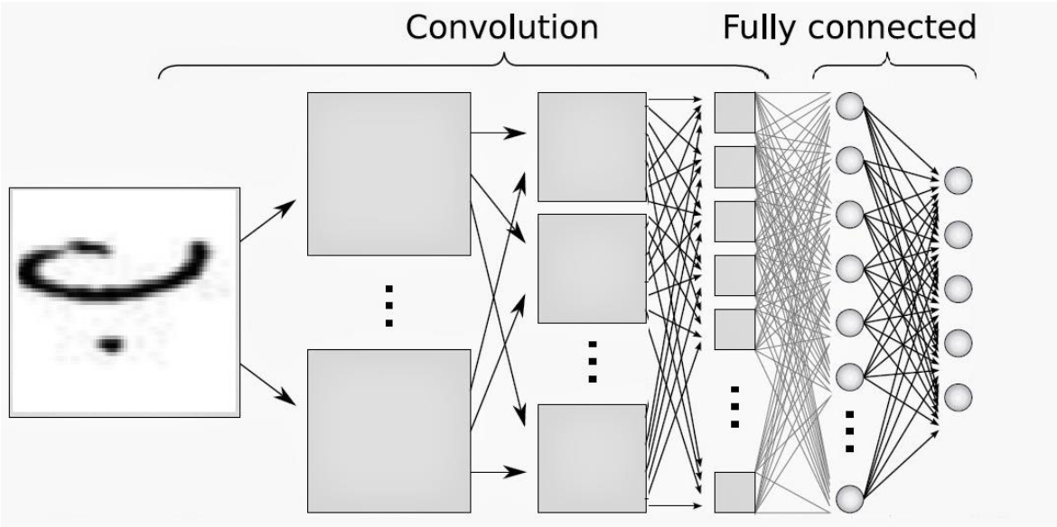
Model Architecture
Input 32x32
Convolution Layers: 4
First 2 have 32 filters of size 5x5
Second 2 have 64 filters of size 3x3
Output layer 28

Slide 7
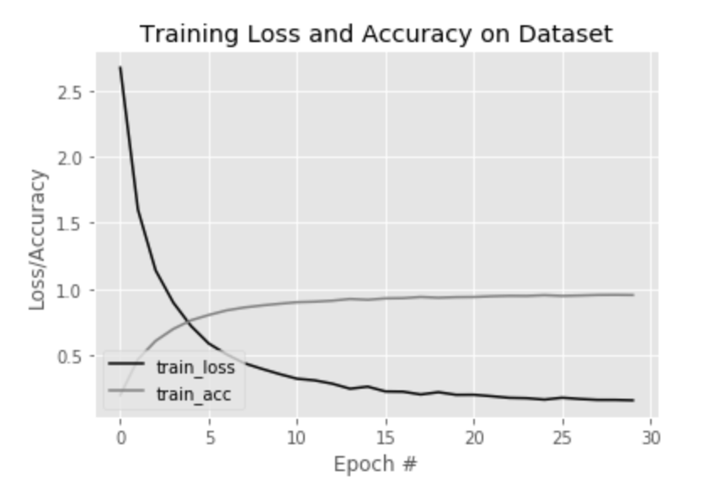
Performance
Trained model on 30 epochs
95.33% test accuracy

Slide 8
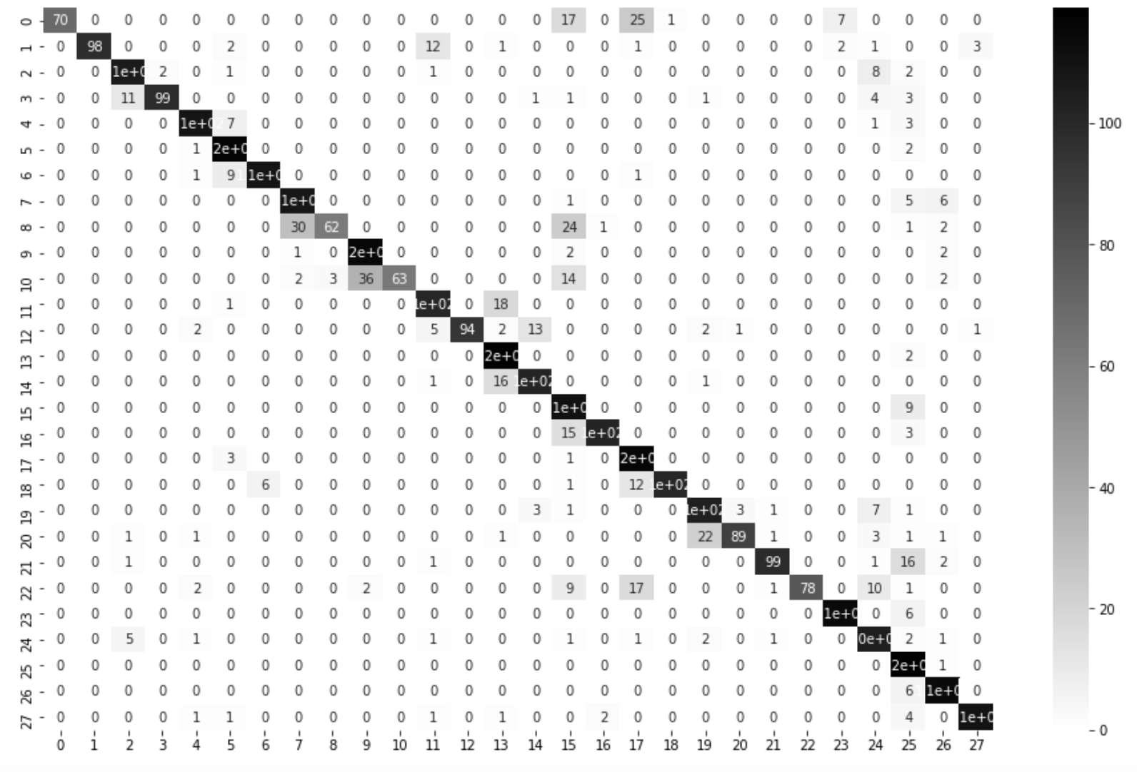
Misclassifications
Confusion Matrix
ا
ب
ت
ث
ج
ح
خ
د
ذ
ر
ز
س
ش
ص
ض
ط
ظ
ع
غ
ف
ق
ك
ل
م
ن
ه
و
ي
ا
ب
ت
ث
ج
ح
خ
د
ذ
ر
ز
س
ش
ص
ض
ط
ظ
ع
غ
ف
ق
ك
ل
م
ن
ه
و
ي

Slide 9
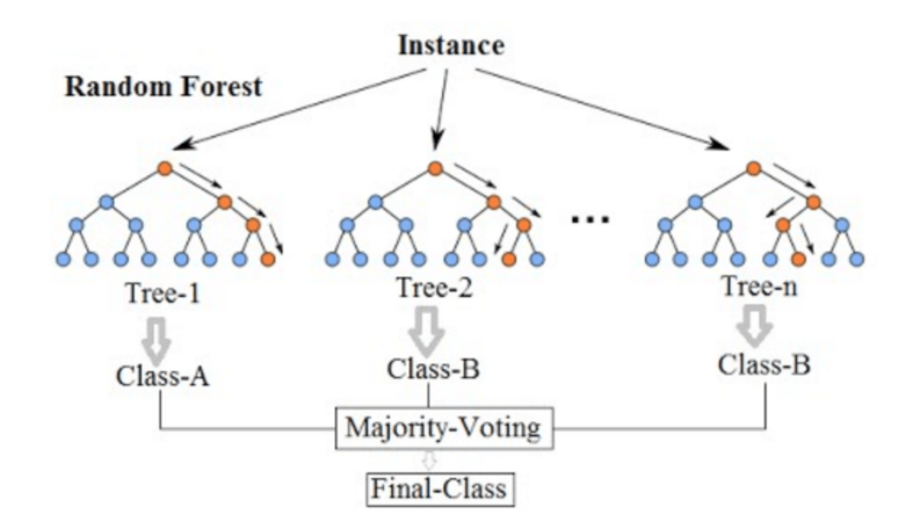
Model 2: Decision Tree – Random Forest Algorithm
Structure of random forest classification

Slide 10
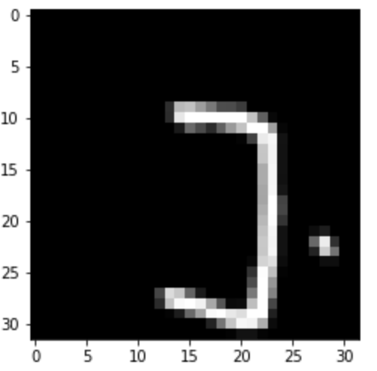
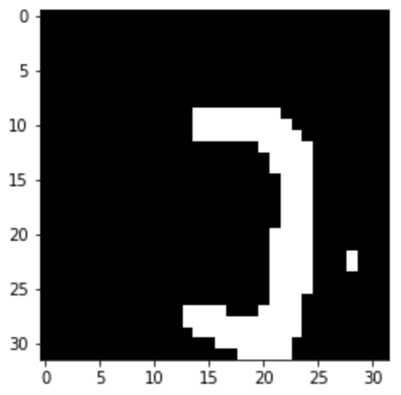
Data Processing
Binary Thresholding (0, 255)

Slide 11
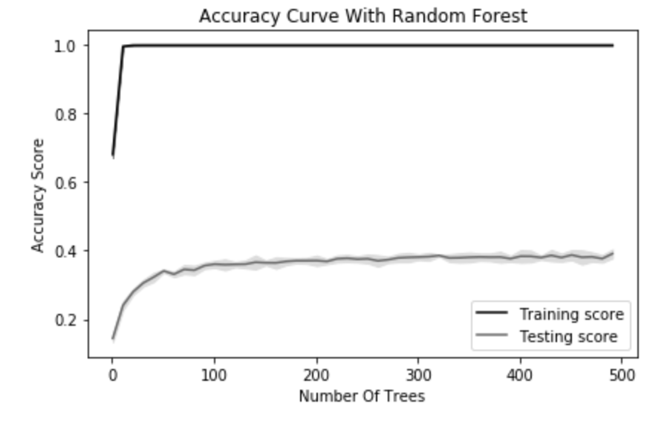
Performance
Test Accuracy score: 40.9%

Slide 12
Which Model Performed Better?
Random Forest: simpler application, computationally less expensive
CNN: automatic feature extraction
CNN performed much better. This is usually the case with image reocgnition

Slide 13
Future Work and Resources
Resources and Inspiration
A. El-Sawy, M. Loey, and H. El-Bakry. “Arabic Handwritten Character Recognition Using Convolutional Neural Network”. WSEAS Transactions on Computer Research, December 2016.
Younis, Khaled. “Arabic Handwritten Character Recognition Based on Deep Convolutional Neural Networks”. Jordanian Journal of Computers and Informations Technology, Vol 3, No.3, December 2017.
Github repository: Arabic-handwriting-recognition, by yogeshjadhav7
Future Work
Improving random forest with more preprocessing, some feature engineering on the images
Using the CNN to recognize the different forms of the letters since they change when in different positions in the word

Slide 14
Thank You شكراً

