Slide 1
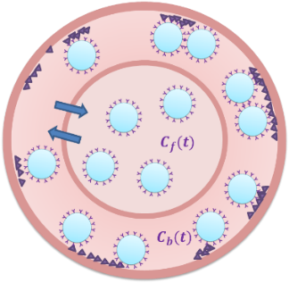
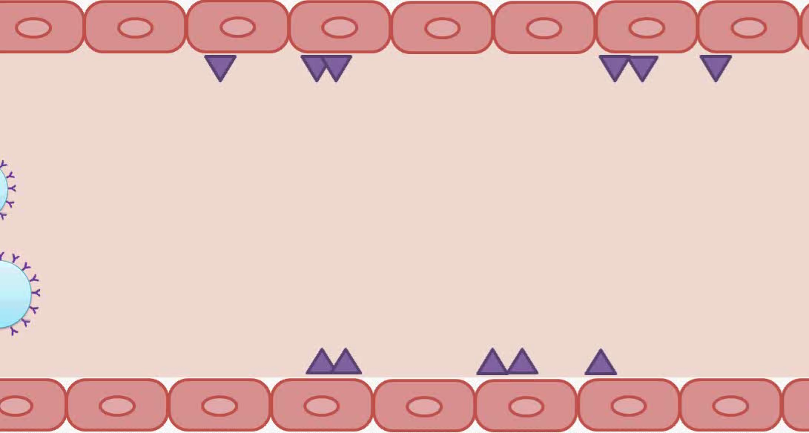



$$C_{f}(t)$$
$$C_{b}(t)$$
$$C_{t}(t)$$

