Slide 1
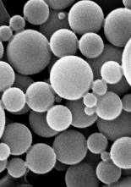
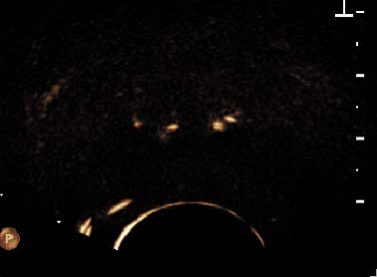
Dynamic Contrast Enhanced US (DCE-US)
Injection of Ultrasound Contrast Agents (UCA)
Time-intensity curve (TIC)

