Slide 1
Automating the rainwater regulation
Simon Baecke
02/03/2023

Slide 2
Rainwater regulation
2 parallel regulations
Building scale
Plot scale
Data from 3 data sources
BIM
GIS
Conceptual idea

Slide 3
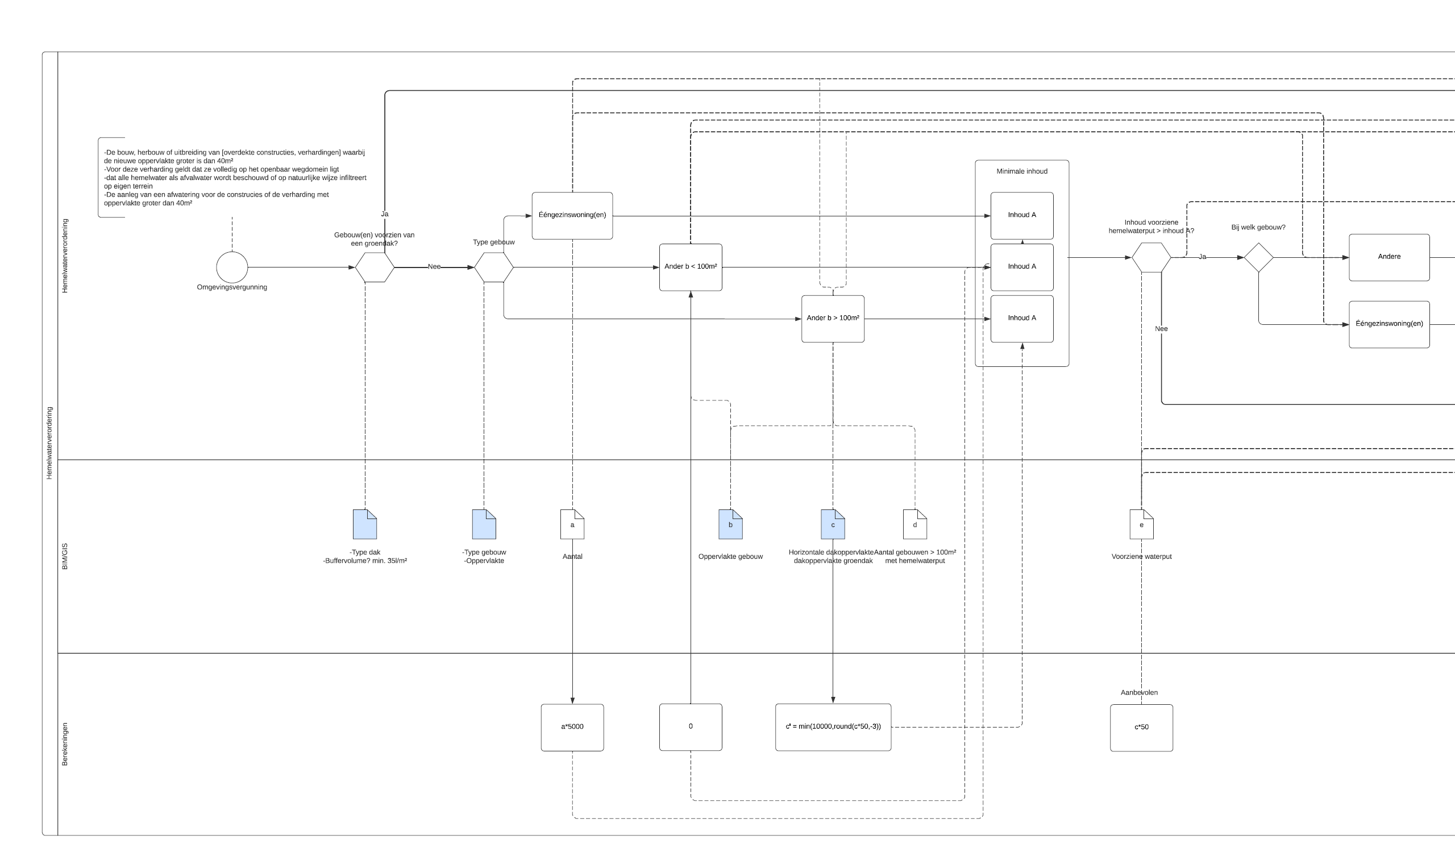

Slide 4
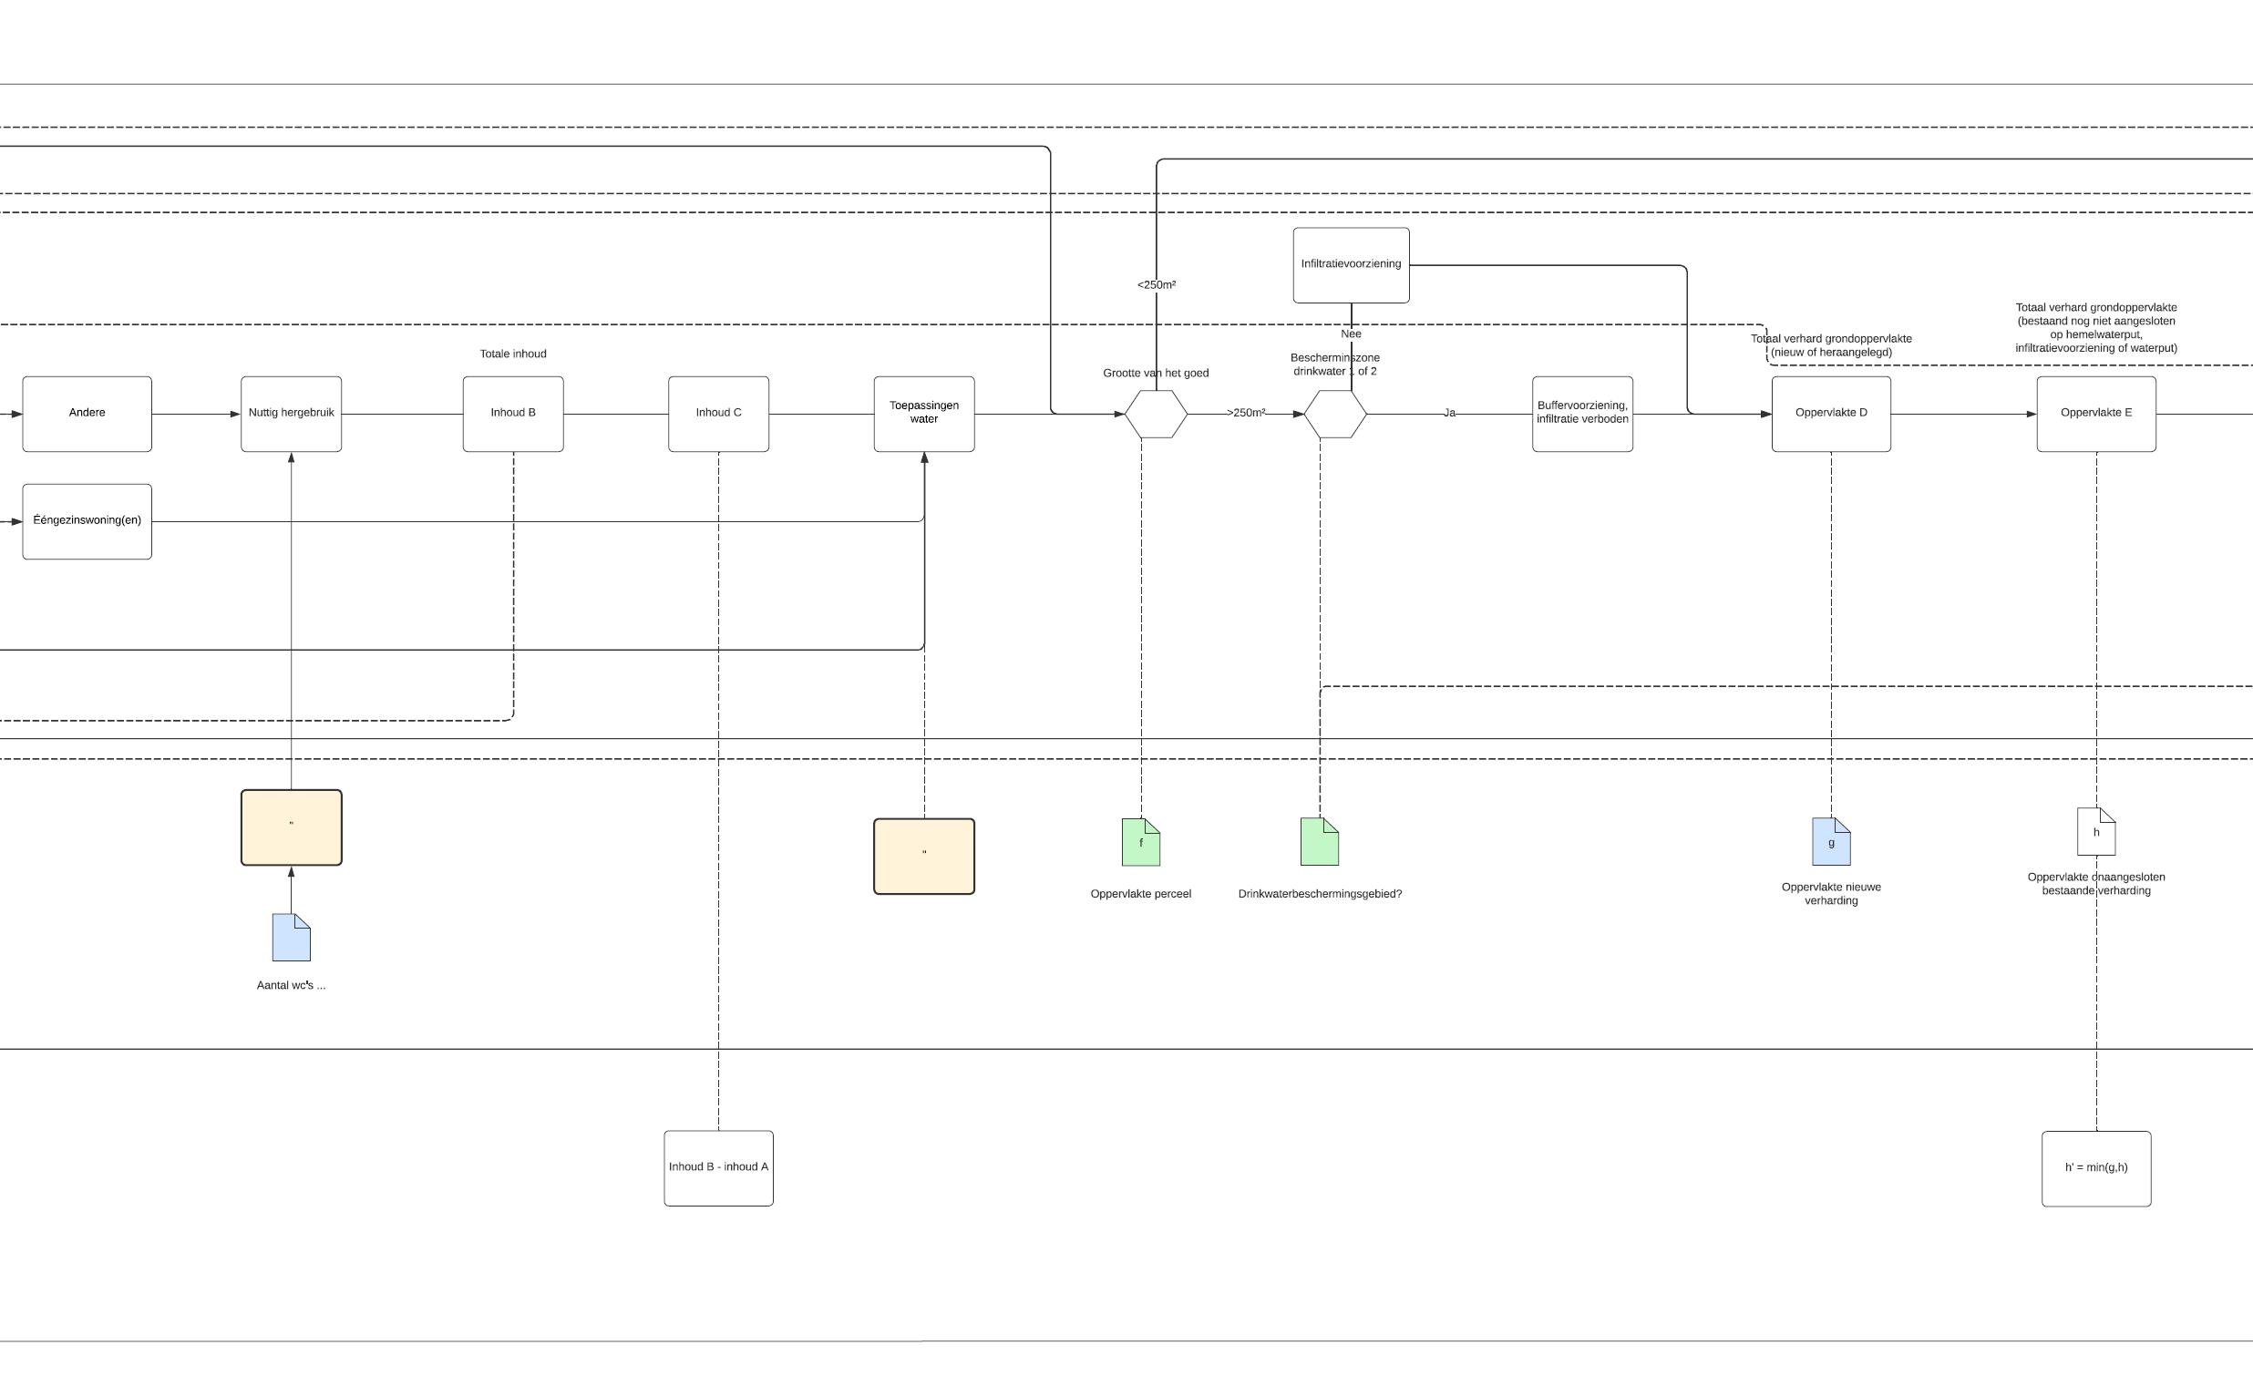

Slide 5
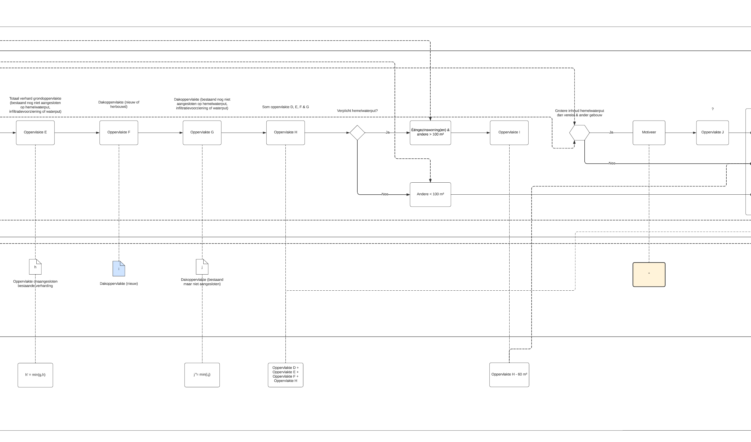

Slide 6
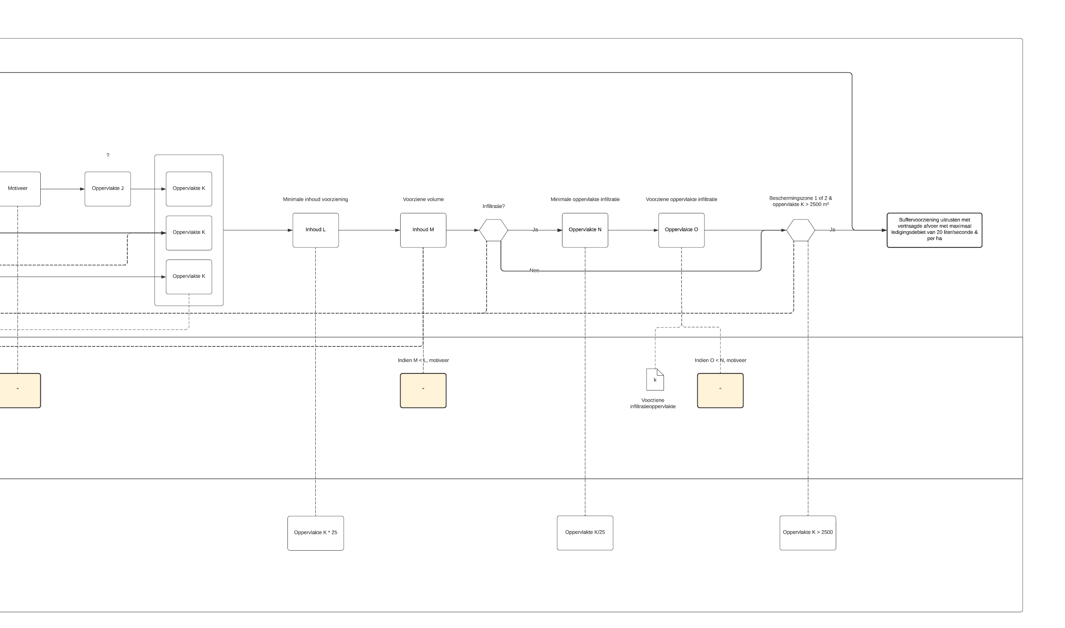

Slide 7
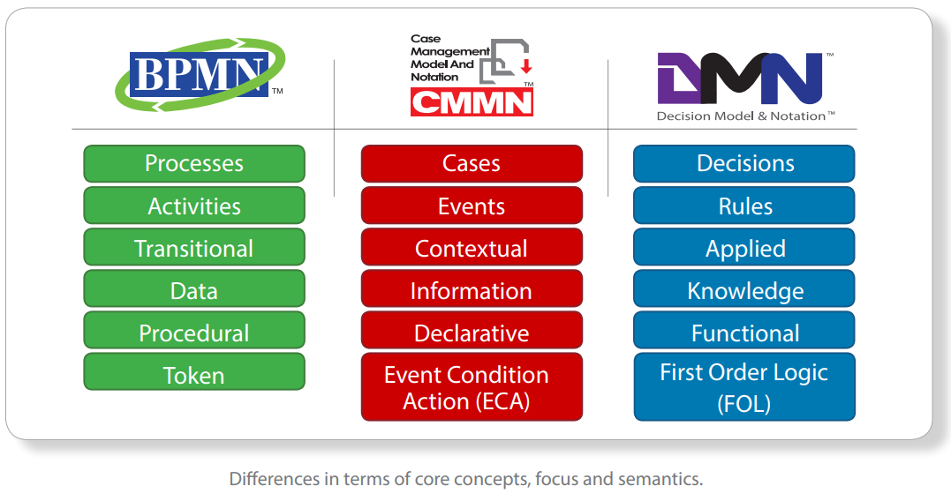
BPMN,DMN & CMMN
Source: Object Management Group

Slide 8
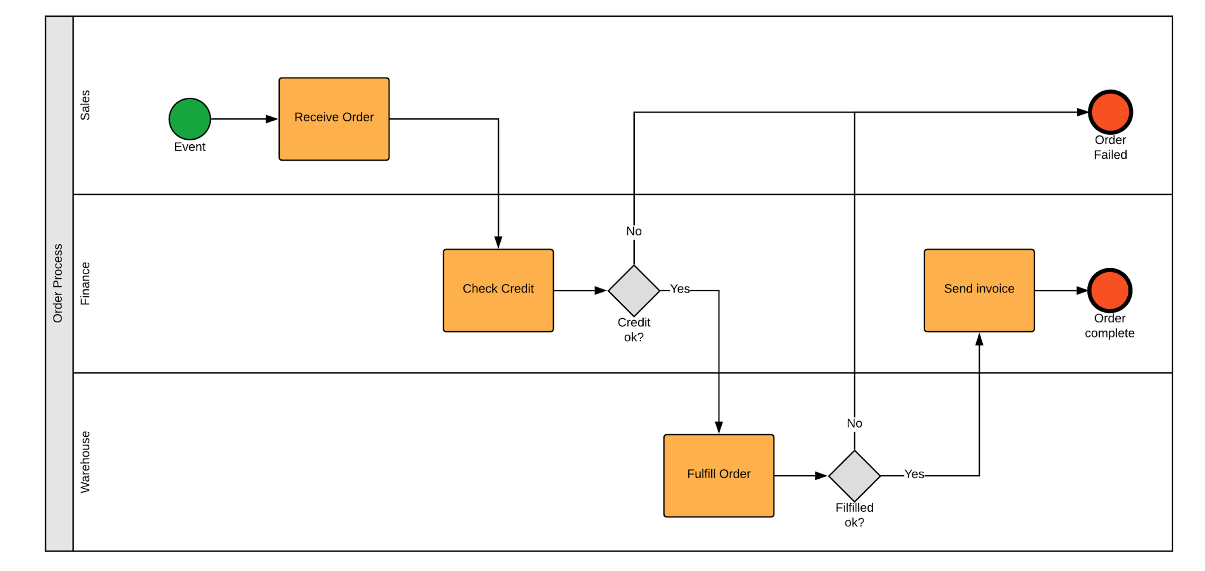
BPMN

Slide 9
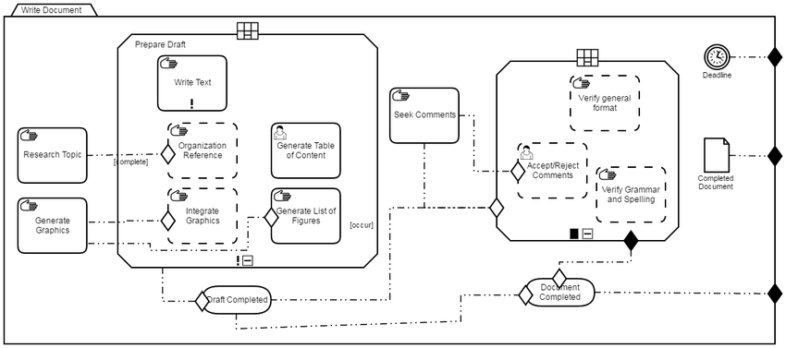
CMMN

Slide 10
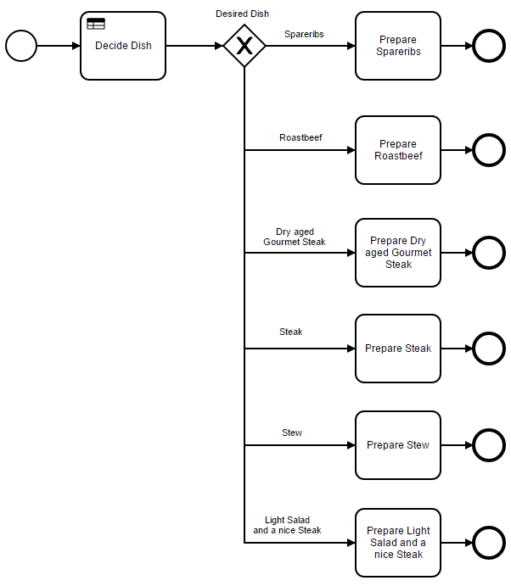
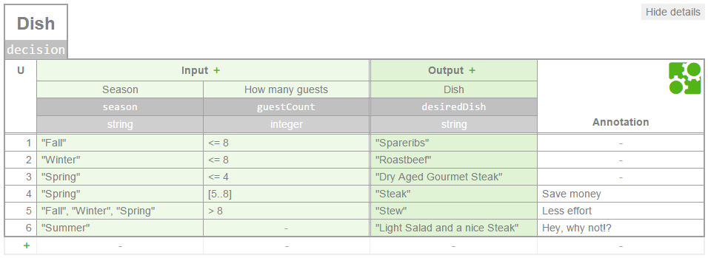
DMN

Slide 11
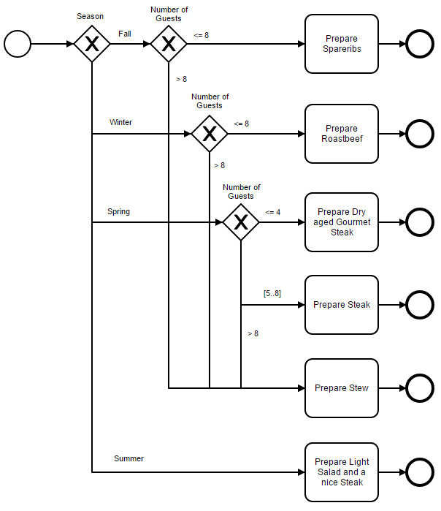

Slide 12
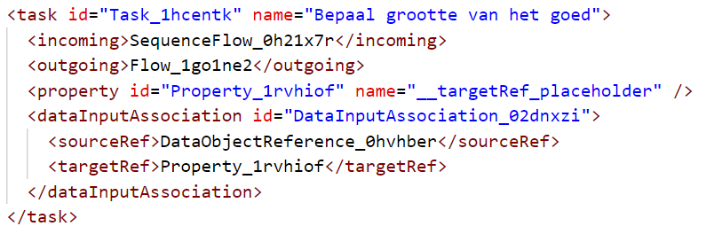
BPMN2.0 XML
BPMN is based on the XML schema
5 types of objects
Events
Tasks

Slide 13
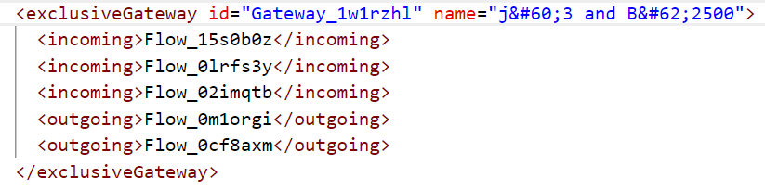
BPMN2.0 XML
Gateways
Artifacts
Connections

Slide 14
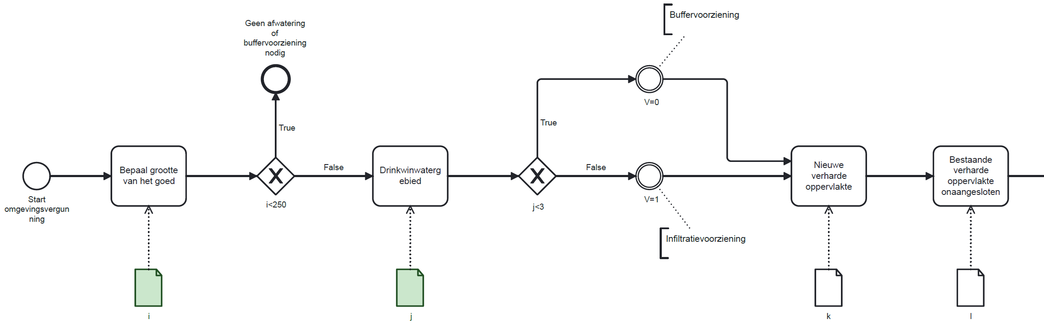

Slide 15
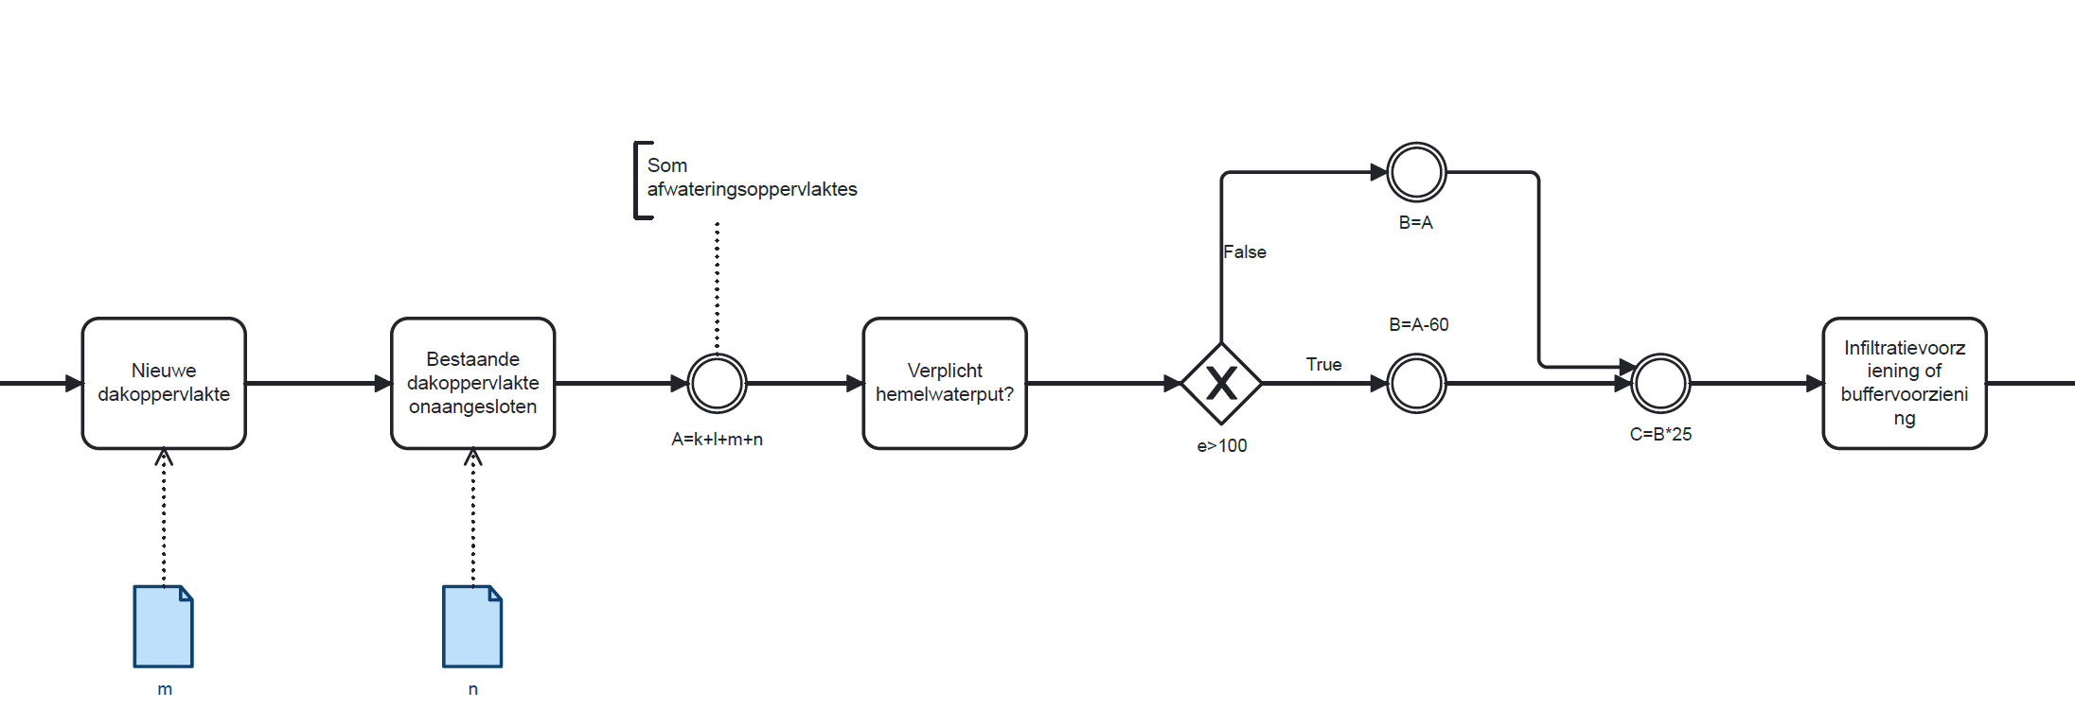

Slide 16
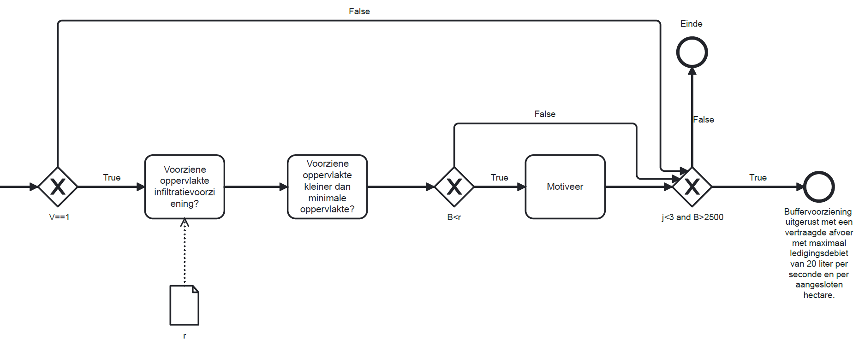

Slide 17
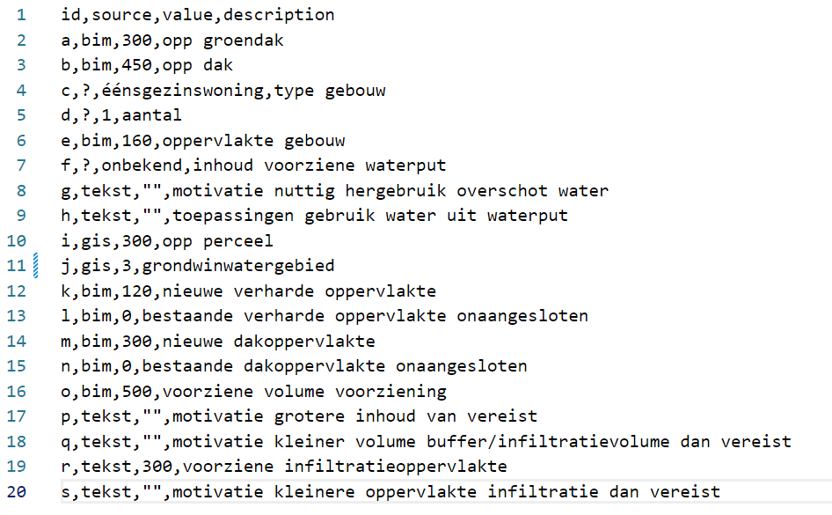
Proof of concept
Data in .csv file
Plot area > 250m²
Not in water extraction area so infiltration

Slide 18
Reflection
Include part 1 of rainwater regulation
Extract data from sources (when needed)
Implement in BIM software to send warnings
Web page with file upload
Output format

Slide 19
GIS data
Extract coordinates from address (and vice versa)
Geolocation Service API by Digitaal Vlaanderen
Data van CRAB, Urb-IS & POI
Extract area of plot and location of water extraction areas
WFS open data

Slide 20
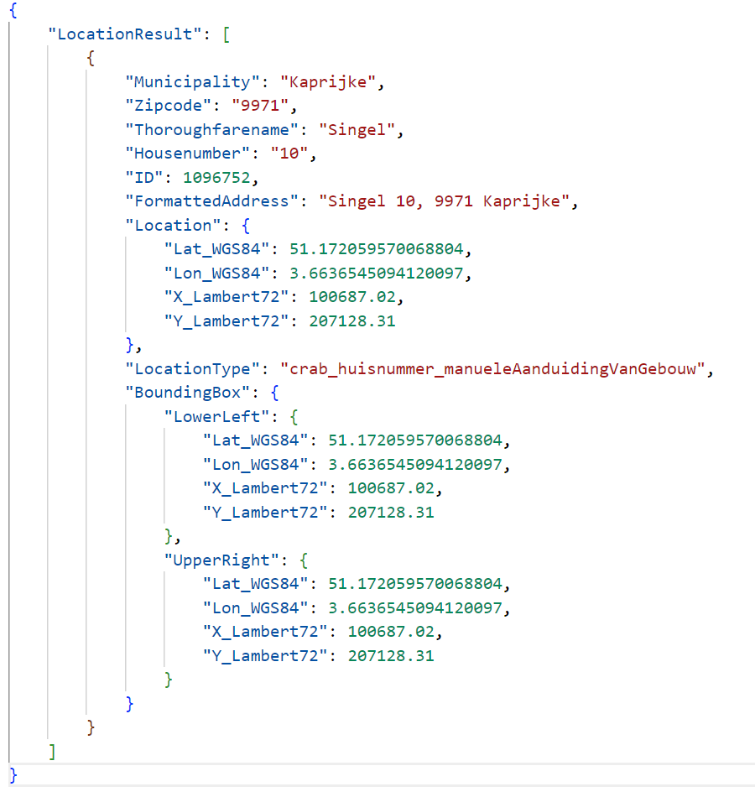



Slide 21
WFS
Grootschalig Referentiebestand (GRB)
Hosted by Digitaal Vlaanderen
Grondwaterwingebieden en beschermingszones (2016)
Hosted by Databank Ondergrond Vlaanderen

Slide 22
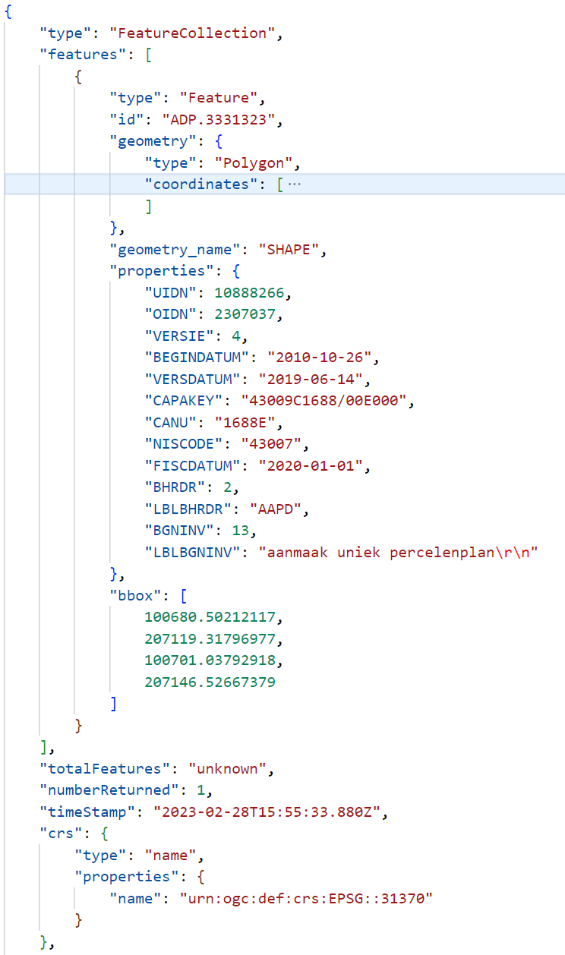
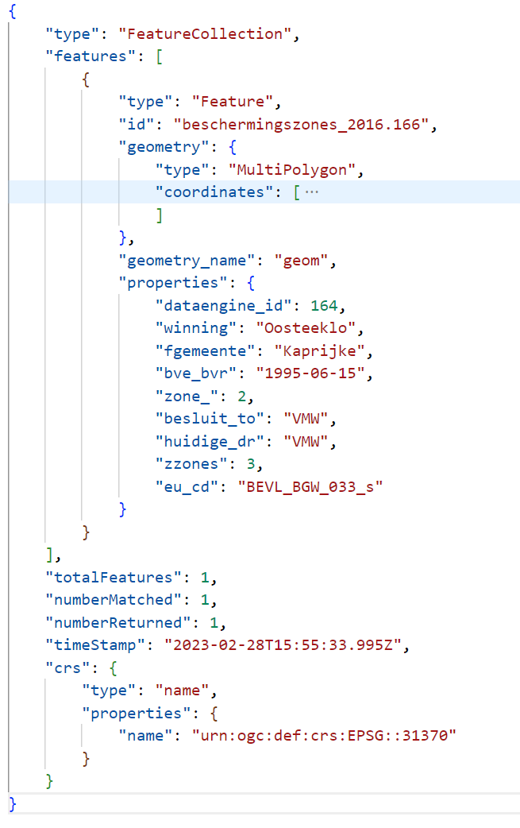



Slide 23
BIM data
Roof type
Building type
Building area
Horizontal projected roof area (old & new)
Pavement area (old & new)
Foreseen infiltration area

Slide 24
BIM data hurdles
No general way to indicate if building type is a single-family dwelling
Sites are not always modelled in BIM environment
Projected horizontal area of site can be complex
Modeling differences:
Area of the roof
Site

