Slide 1
Comparison of state-of-the-art Clustering algorithms
Research Thesis Simon Kamm

Slide 2
Content of Presentation
State-of-the-art Clustering
Programmed Framework
Model Architectures
Experimental Setup
Experiments & Results
Kamm, Simon – 25.04.2019

Slide 3
Content of Presentation
State-of-the-art Clustering
Programmed Framework
Model Architectures
Experimental Setup
Experiments & Results
Kamm, Simon – 25.04.2019

Slide 4

State-of-the-art Clustering
Autoencoder Based Clustering
Latent representation z input for Clustering algorithm
Feature-reduction Model
z
Decoder
Clustering (e.g. K-means)
Kamm, Simon – 25.04.2019

Slide 5
Content of Presentation
State-of-the-art Clustering
Programmed Framework
Model Architectures
Experimental Setup
Experiments & Results
Kamm, Simon – 25.04.2019

Slide 6
Programmed Framework
Implementation in TensorFlow (v1.13)
Main-Function
TensorBoard Summaries:
- Training/Test loss
- Clustering Metrics
- Latent Space Visualization (t-SNE, PCA, UMAP)
Arguments (e.g. Model, Dataset, Save/Data-Directory)
Create Data-Iterator (out of .tfrecord)
_{Training}
Create Feature-extraction Model
Parameter File
_{Evaluation}
_{Create Clustering Model}
Metric Values (metrics.json)
Kamm, Simon – 25.04.2019

Slide 7
Content of Presentation
State-of-the-art Clustering
Programmed Framework
Model Architectures
Experimental Setup
Experiments & Results
Kamm, Simon – 25.04.2019

Slide 8




Model Architectures
Base Model Architecture using:
    Convolutional Layer
    Batch Normalization
    ReLU Activation Function
    2x2 Max-Pooling
32x32x1
16x16x16
8x8x32
4x4x64
2x2x128
512
512
2x2x128
4x4x64
8x8x32
16x16x16
32x32x1
10
X
X‘
z
encoder
decoder
Kamm, Simon – 25.04.2019

Slide 9
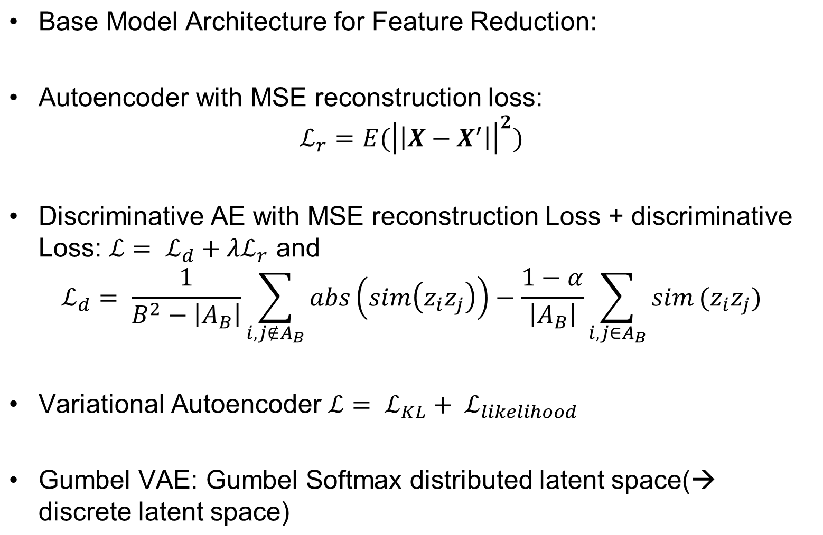
Model Architectures
Kamm, Simon – 25.04.2019

Slide 10
Content of Presentation
State-of-the-art Clustering
Programmed Framework
Model Architectures
Experimental Setup
Experiments & Results
Kamm, Simon – 25.04.2019

Slide 11
Experimental Setup
Large-Scale Evaluation on six datasets
Split into training and test dataset → Clustering performance measured on unseen test data
Used Clustering Metrics:
      Cluster Accuracy (ACC)
      Normalized Mutual Information (NMI)
      Adjusted Rand Index (ARI)
Clustering performed with K-Means
Dataset | # Training images | # Test images | Image Size | # classes
MNIST | 55000 | 10000 | 32x32x1 | 10
F-MNIST | 50000 | 10000 | 32x32x1 | 10
CIFAR-10 | 50000 | 10000 | 32x32x3 | 10
CIFAR-100 | 50000 | 10000 | 32x32x3 | 20
Imagenet-Dog | 19472 | 750 | 64x64x3 | 15
Imagenet-10 | 13000 | 500 | 64x64x3 | 10
Kamm, Simon – 25.04.2019

Slide 12
Content of Presentation
State-of-the-art Clustering
Programmed Framework
Model Architectures
Experimental Setup
Experiments & Results
Kamm, Simon – 25.04.2019

Slide 13
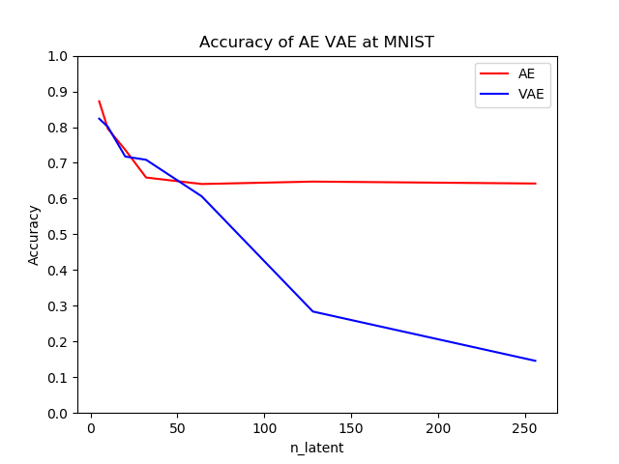
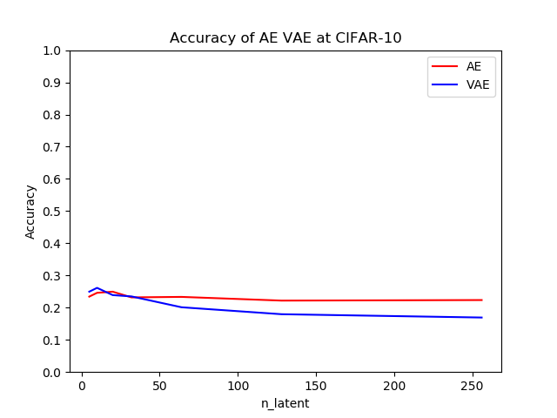
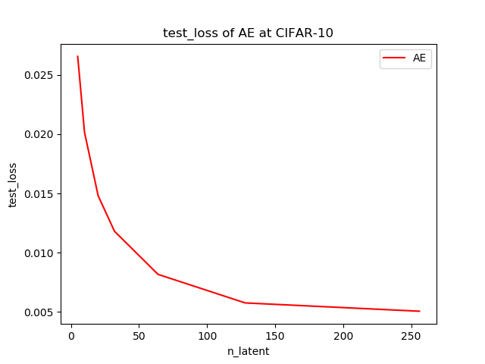




Experiments & Results
1st: Model-related Hyperparameter Optimization
Size of latent space:
Original Image | n_latent = 5 | n_latent=32 | n_latent=256
Kamm, Simon – 25.04.2019

Slide 14
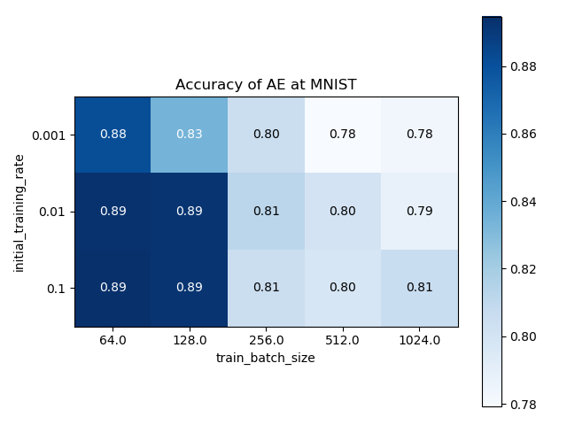
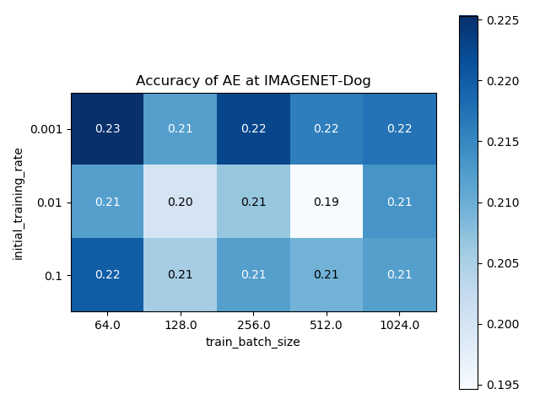
Experiments & Results
2nd: Training-related Hyperparameter Optimization
Batch Size & (Constant) Learning Rate:
Choice of these Hyperparameters depends on the Dataset
Smaller Batch Sizes increase performance for MNIST
Kamm, Simon – 25.04.2019

Slide 15
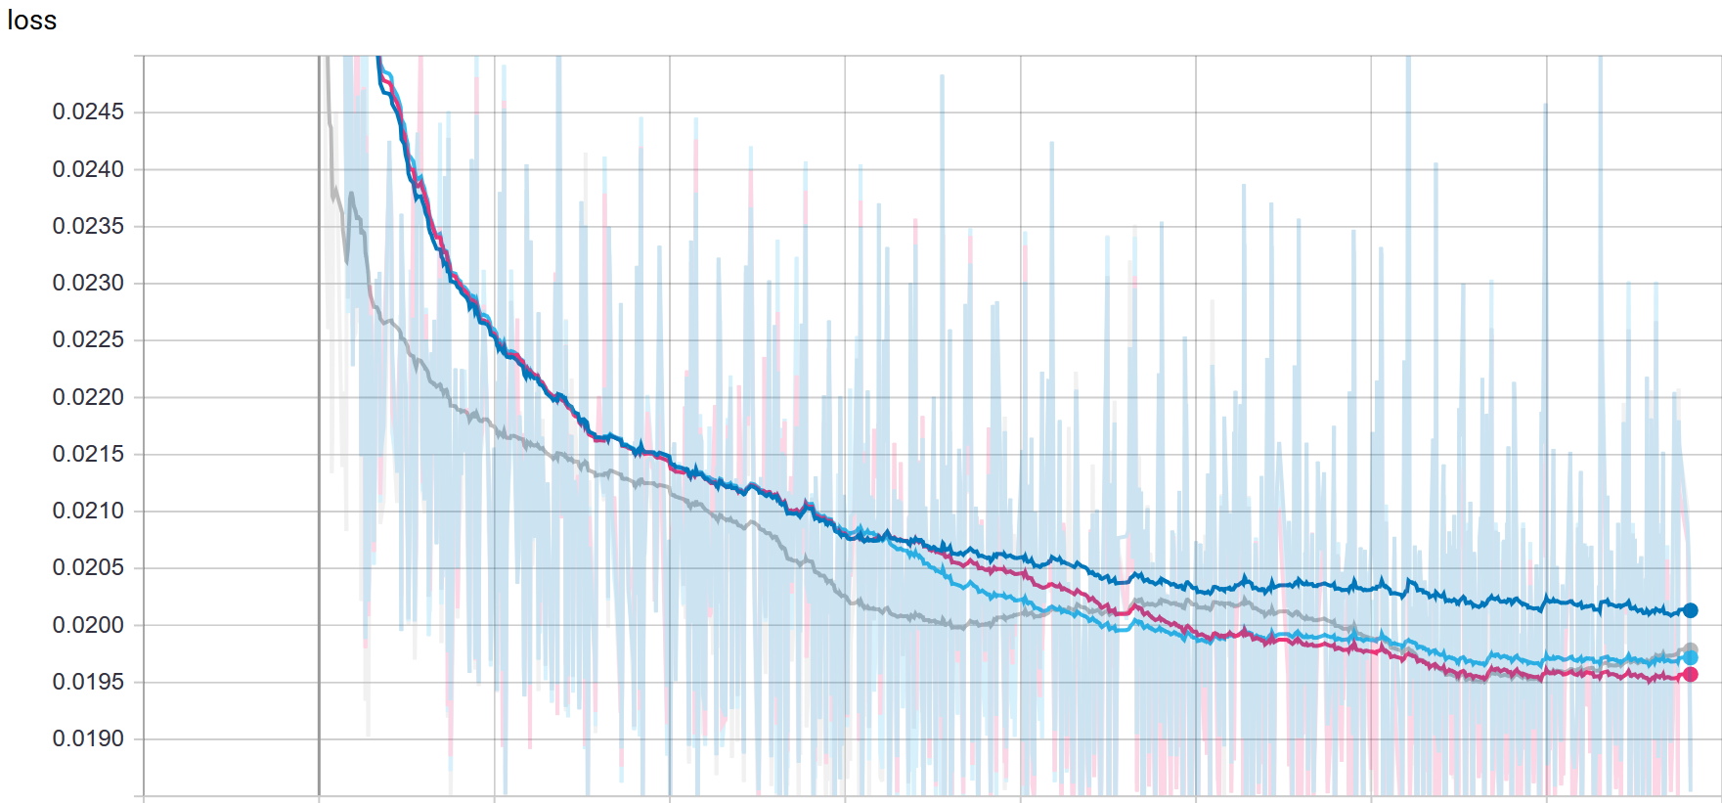
Experiments & Results
2nd: Training-related Hyperparameter Optimization
Learning Rate Scheduling:
    Exponential Decay
    Step Decay
    Triangular Learning Rate
Effect on Training Loss (CIFAR-10):
Step Decay
Constant Lr
Exponential Decay
Triangular Lr
Kamm, Simon – 25.04.2019

Slide 16
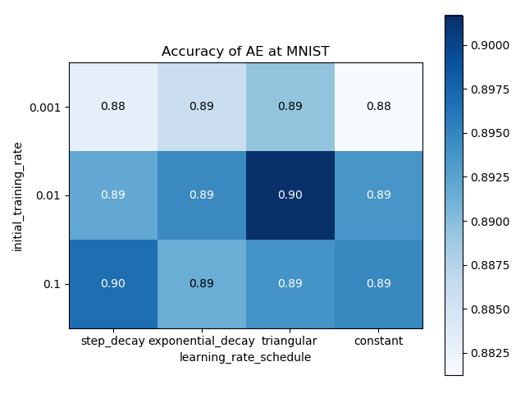
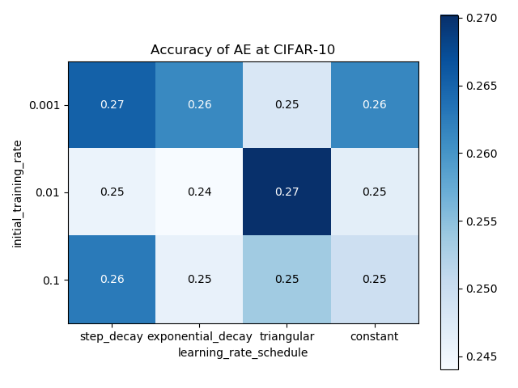
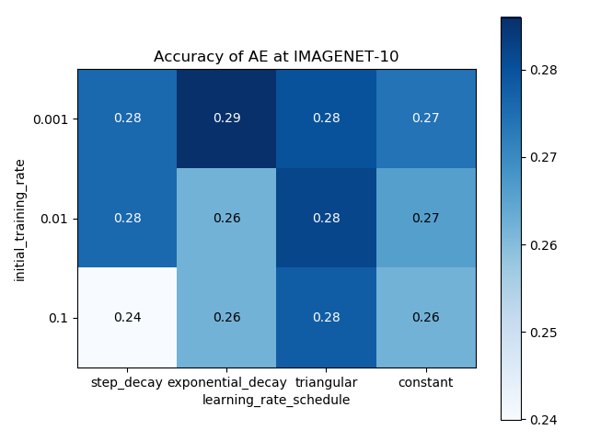
Experiments & Results
2nd: Training-related Hyperparameter Optimization
Learning Rate Scheduling – effect on Clustering
→ Not one optimum scheduling
→ But: Clustering Performance can be increased slightly by good choice of scheduling
Kamm, Simon – 25.04.2019

Slide 17
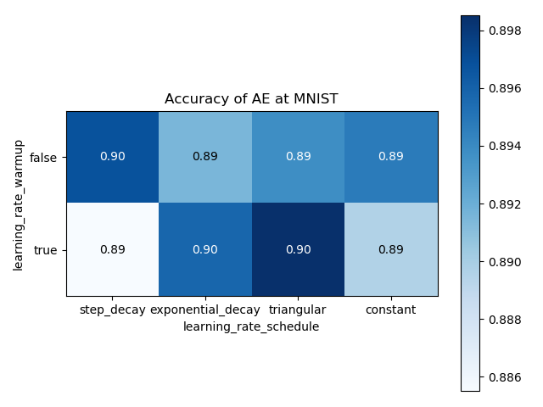
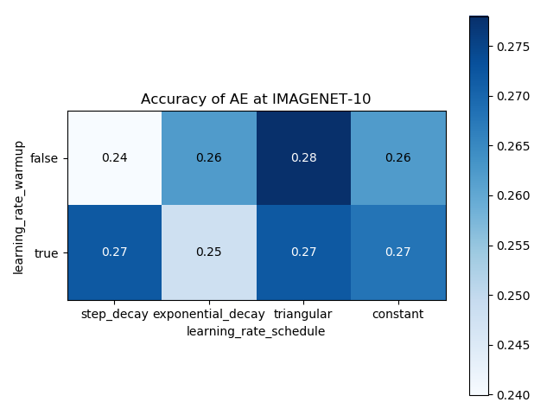
Experiments & Results
2nd: Training-related Hyperparameter Optimization
Linear Learning Rate Warmup – effect on Clustering
In some combinations improvement of clustering
In some combinations worse clustering performance
Kamm, Simon – 25.04.2019

Slide 18
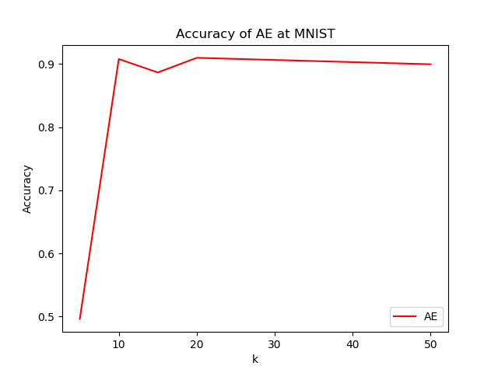
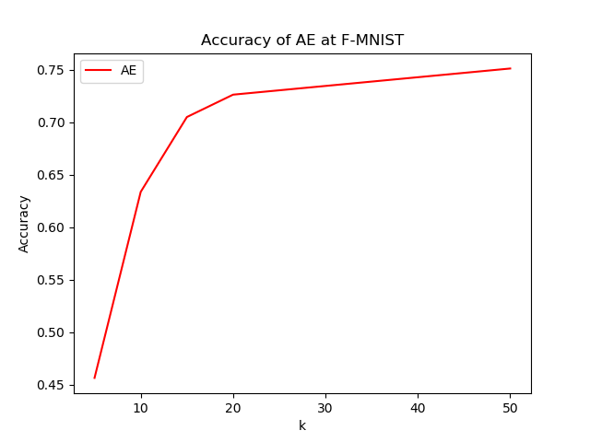
Experiments & Results
3rd: Clustering Robustness
Effect of k (# clusters) on Clustering Performance
For MNIST: Highest ACC (Purity) of Clusters already at k=10
For F-MNIST: Purity increases with number of k (usual behavior)
Kamm, Simon – 25.04.2019

Slide 19
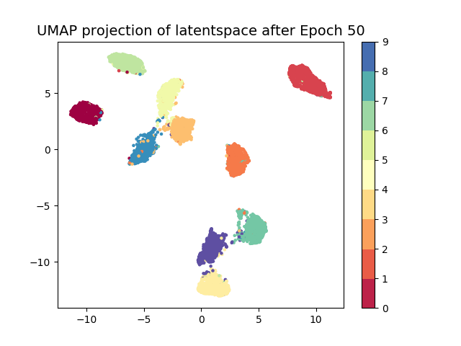
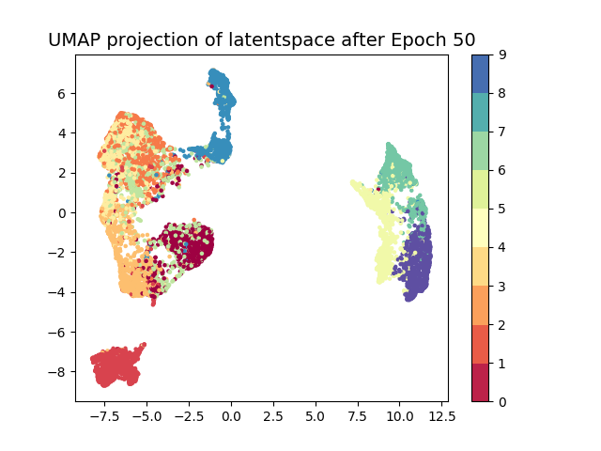
Experiments & Results
3rd: Clustering Robustness
Effect of k (# clusters) on Clustering Performance
For MNIST (left): 10 separated Clusters Visible
For F-MNIST: Mixed Clusters, larger k will increase purity
Kamm, Simon – 25.04.2019

Slide 20
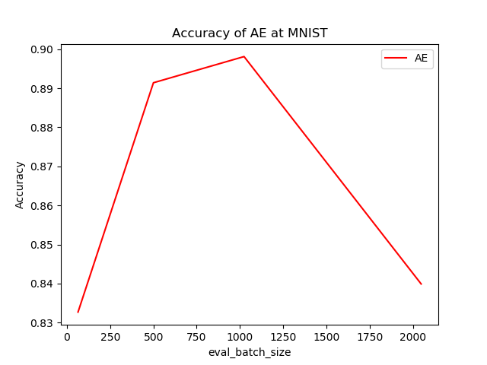
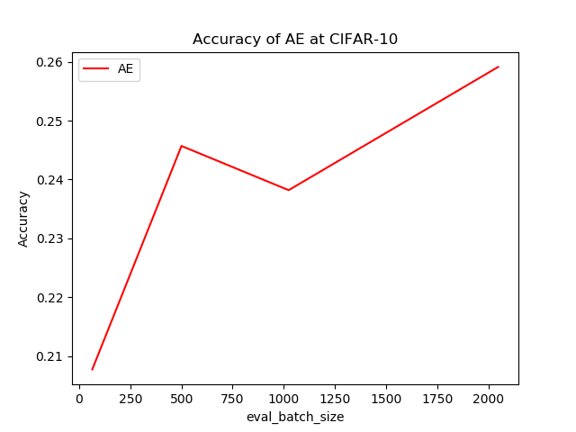
Experiments & Results
3rd: Clustering Robustness
Effect of cluster batch size on Clustering Performance
For MNIST: For higher batch size accuracy decreases (perhaps due to less training-steps)
For CIFAR-10 and other: Accuracy increases with batch size and becomes more stable (expected behavior)
Kamm, Simon – 25.04.2019

Slide 21
Experiments & Results
Final Results (with observed best Parameter choice) – Cluster Accuracy
Improvement of feature reduction model training improves clustering results tremendously
Final Model Evaluation/Framework Test on Imagenet-Full (~1M training images)
 | MNIST | F-MNIST | CIFAR- 10 | CIFAR- 100 | Imagenet- Dog | Imagenet- 10 | Imagenet-Full
AE + K-Means | 0.889 (0.043) | 0.654 (0.023) | 0.270 (0.005) | 0.164 (0.003) | 0.216 (0.005) | 0.260 (0.008) | 0.018
AE + IDEC | 0.872 | 0.589 | x | x | x | x | x
Discr. AE + K-Means | 0.780 (0.021) | 0.621 (0.044) | 0.256 (0.008) | 0.097 (0.005) | 0.219 (0.006) | 0.235 (0.001) | x
VAE + K-Means | 0.859 (0.003) | 0.604 (0.014) | 0.267 (0.005) | 0.150 (0.002) | 0.199 (0.009) | 0.274 (0.000) | x
Gumbel VAE + K-Means | 0.60 | 0.47 | 0.21 | 0.14 | 0.20 | 0.25
K-Means | 0.626 | 0.612 | 0.245 | 0.145 | 0.156 | 0.256 | X
Kamm, Simon – 25.04.2019

Slide 22
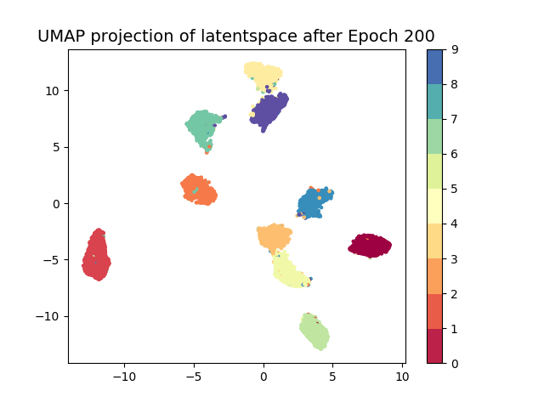
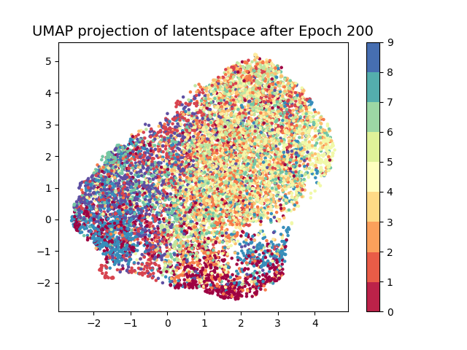
Experiments & Results
Final Results
Latent Space of MNIST (left) and Cifar-10 (right)
AE has the fast and stable training and enables good feature spaces for clustering (so far mainly for MNIST and F-MNIST)
Model not capable to learn representations for complex datasets (e.g. CIFAR-10) → Model capacity too low?!
Kamm, Simon – 25.04.2019

Slide 23
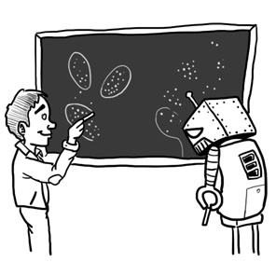
Research Thesis Simon Kamm
Thanks for your attention
(Reference: Roberto Battiti and Mauro Brunato - Reactive Business Intelligence: From Data to Models to Insight, P.42)
Name, Vorname - Datum

