Slide 1
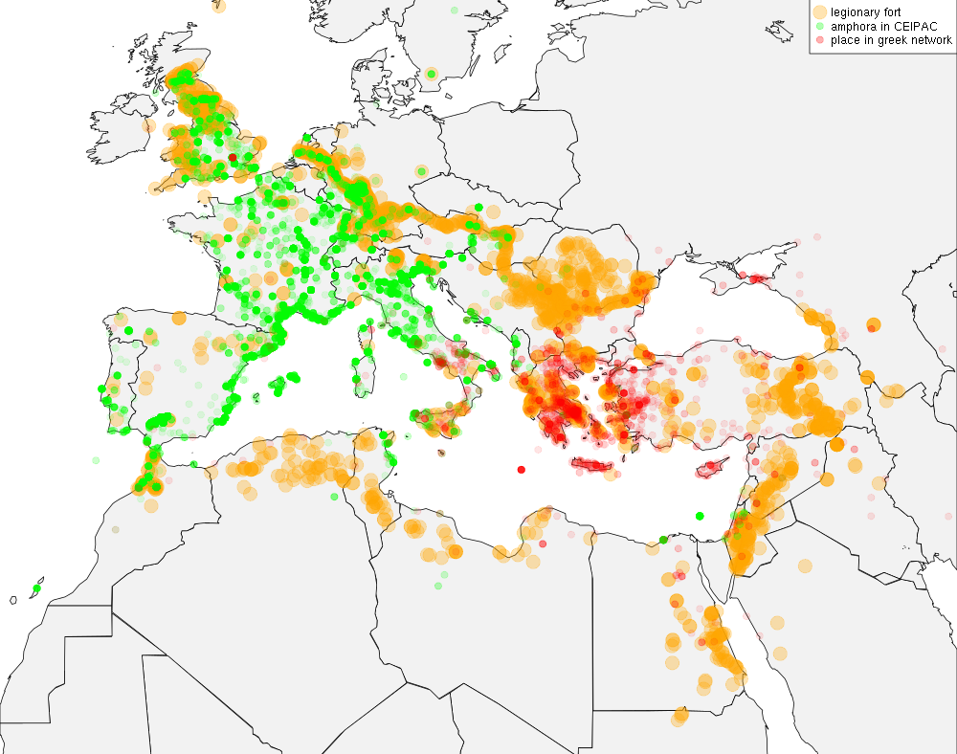

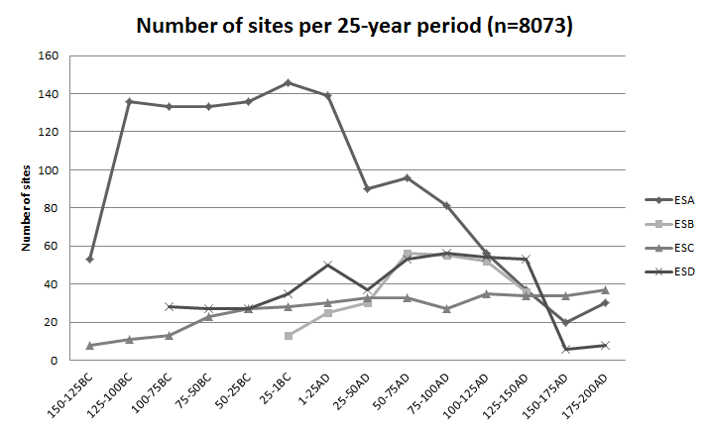



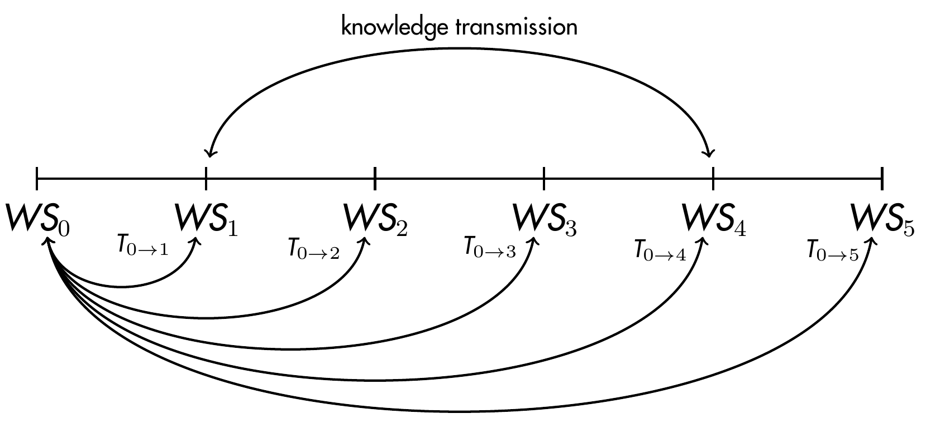

DATA
PATTERN
PROCESS

Slide 2
DATA
PATTERN
PROCESS

Slide 3
DATA
PATTERN
PROCESS

Slide 4
DATA
PATTERN
PROCESS

Slide 5
DATA
PATTERN
PROCESS

Slide 6
DATA
PATTERN
PROCESS

Slide 7
DATA
PATTERN
PROCESS

